Slide 1
FMU Library Catalogue
Serhat Kahraman
18.06.2025
v0.3

Slide 2
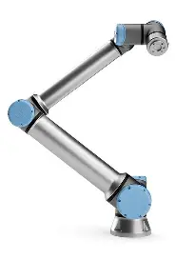
Model Name: UR10e Cobot
FMU Name: UR10e.fmu
FMI Standard: v2.0.2
FMU Types - UR10e Cobot:
Forward Kinematics
Inverse Kinematics
Dynamics
Source:UR10e

Slide 3




Model Name: UR10e Robot Forward Kinematics Model Block Diagram
UR10eRobotManipulatorFKinematics.fmu
Forward
Kinematics
Function – Homogenous Transformation
(UR10e)
$$p=\{x,y,z\}$$
$$q = \{q_{1},q_{2}..q_{6}\}$$
$$R_{euler}$$
$$R_{Quaternion}$$

Slide 4
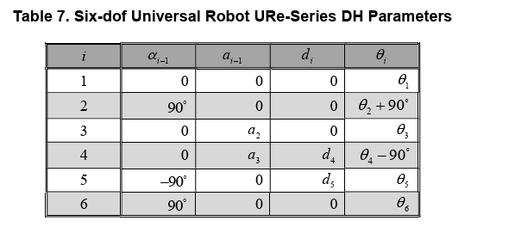
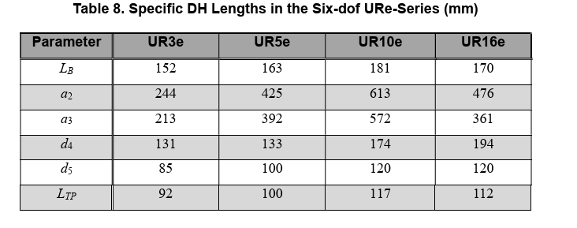
Model Name: UR10e Robot Forward Kinematics (FK) UR10e FK Model
Source:
R.L. Williams II, “Universal Robot URe-Series Kinematics”, Internet Publication, https://www.ohio.edu/mechanical-faculty/williams/html/pdf/UniversalKinematics.pdf, January 2024.

Slide 5
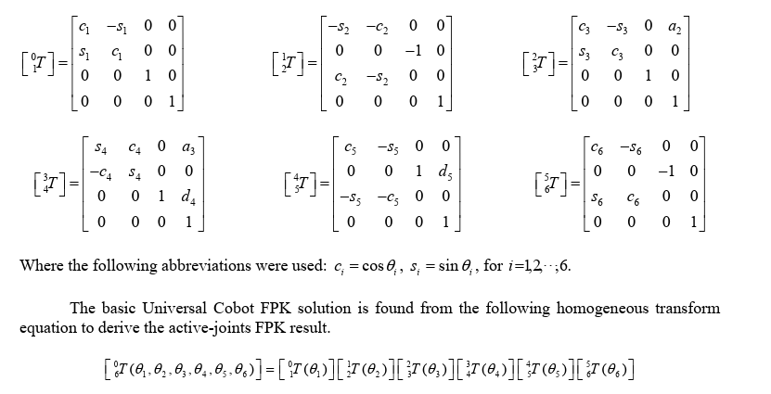
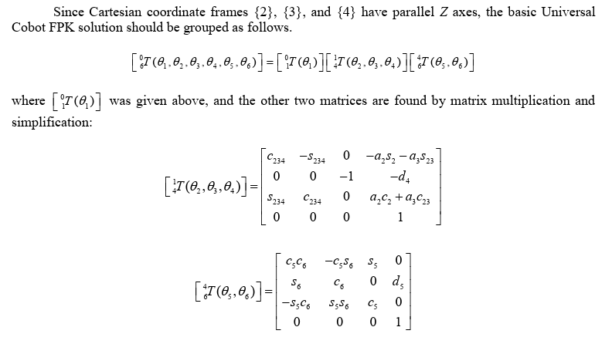
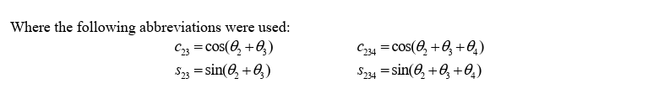
Model Name: UR10e Robot Forward Kinematics (FK) UR10e FK Model
Source:
R.L. Williams II, “Universal Robot URe-Series Kinematics”, Internet Publication, https://www.ohio.edu/mechanical-faculty/williams/html/pdf/UniversalKinematics.pdf, January 2024.

Slide 6
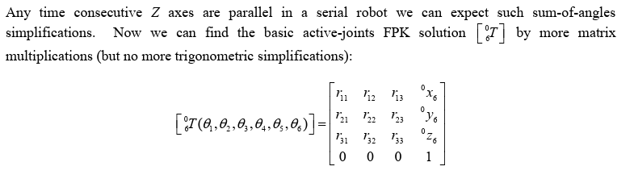
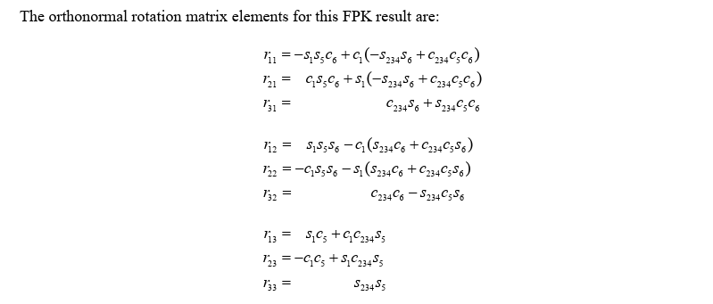
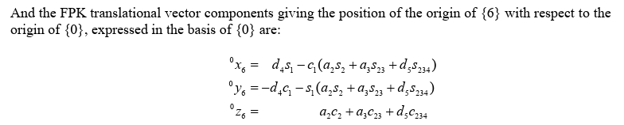
Model Name: UR10e Robot Forward Kinematics (FK) UR10e FK Model
Source:
R.L. Williams II, “Universal Robot URe-Series Kinematics”, Internet Publication, https://www.ohio.edu/mechanical-faculty/williams/html/pdf/UniversalKinematics.pdf, January 2024.

Slide 7
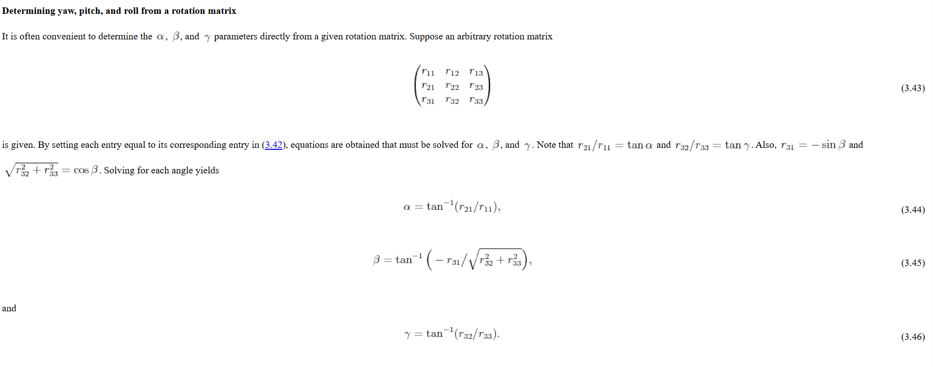
Model Name: UR10e Robot Forward Kinematics (FK) UR10e FK Model
Source:Determining yaw, pitch, and roll from a rotation matrix

Slide 8
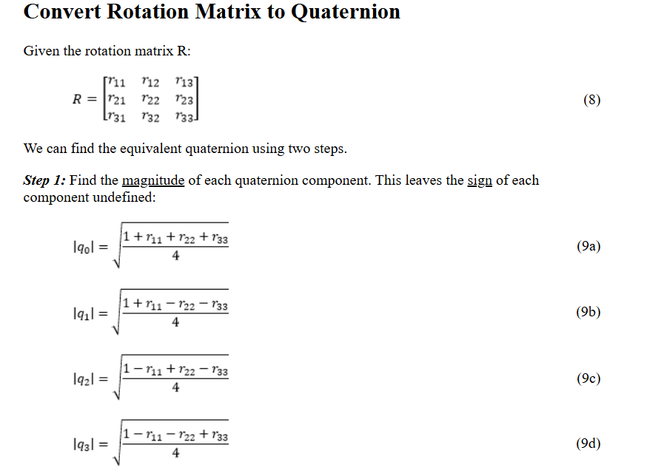
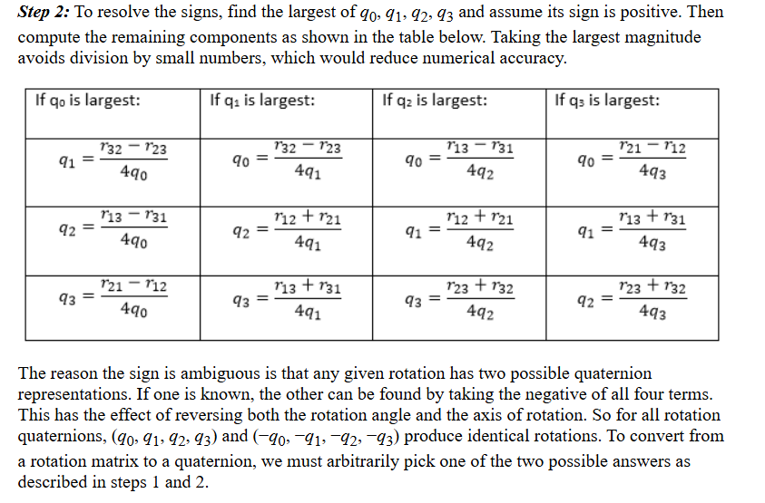
Model Name: UR10e Robot Forward Kinematics (FK) UR10e FK Model
Source:Quaternions

Slide 9
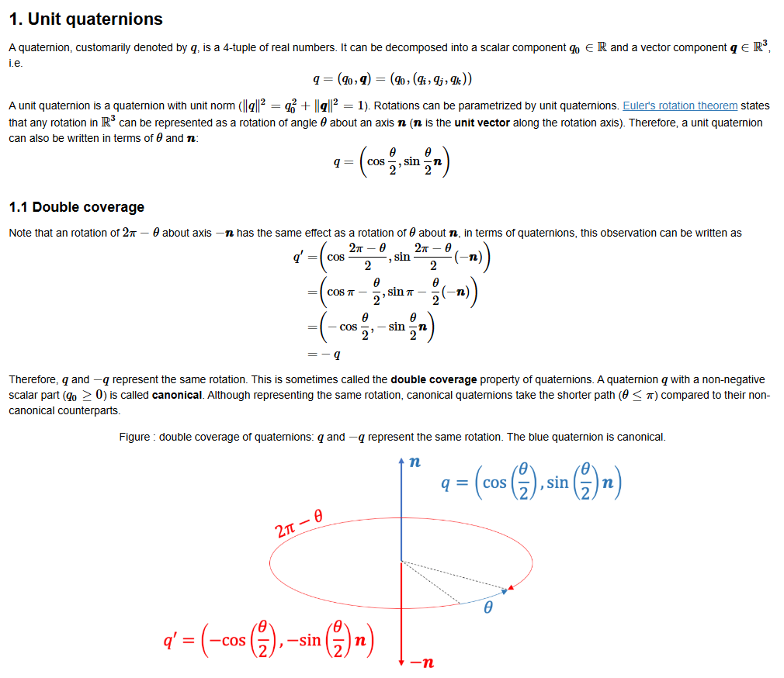
Model Name: UR10e Robot Forward Kinematics (FK) UR10e FK Model
Source:pset5_rotation

Slide 10
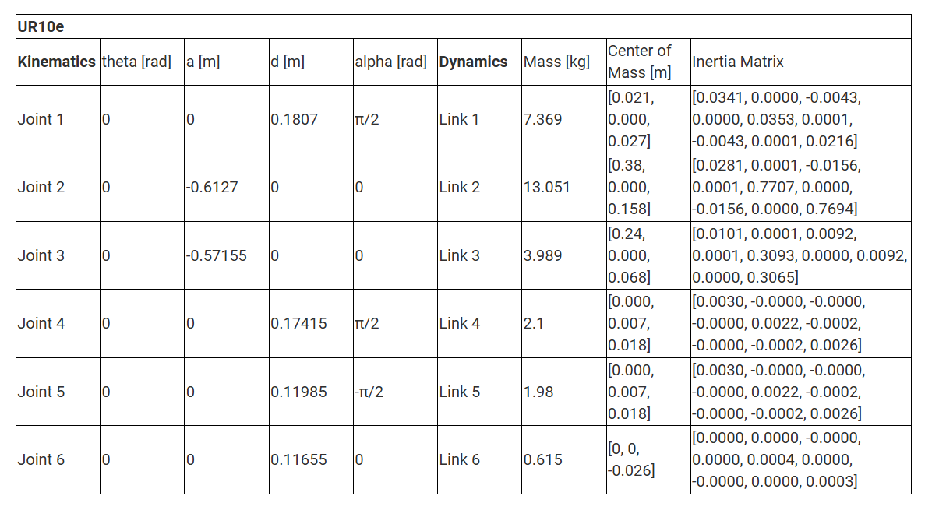
Link: https://www.universal-robots.com/articles/ur/application-installation/dh-parameters-for-calculations-of-kinematics-and-dynamics/?ysclid=m9jvxr13yl422421043

Slide 11
REFERANSLAR
Kaynak: https://github.com/ESOGU-SRLAB

