Slide 1
Modelling inter-zone airflow in ESP-r

Slide 2
Objectives
What is inter-zone air flow?
What modelling methodologies
does ESP-r use?
How do I model inter-zone airflow?
How do I impose control?

Slide 3
Outline
Introduction
  Flow modelling strategies
  Inter-zone air flow
  ESP-r methodologies
Demonstration and hands-on exercises
  Creating an air-flow network
  Running simulations and analyzing results
  Imposing control

Slide 4
Integrated thermal and flow modelling
Building thermal
domain
to zones
air flow connection
from zones
Flow
domain
fluid flow node
hot water flow path
Air
Water
from supply fan
air flow connection
Plant
domain
to extract fan

Slide 5
Where does fluid flow occur?
Openings and cracks and other opening in the envelope and interior partitions
  Inter-zone infiltration and ventilation
Mechanical air distribution systems
Hydronic heating/cooling equipment
Interior spaces (intra-zone convective flow)

Slide 6
Why does fluid-flow matter?
Infiltration and ventilation affect:
  load and energy calculations
  thermal comfort assessment
  contaminant and moisture dispersal
Hydronic flows affect plant control.

Slide 7
Levels of resolution
Scheduled
air flow
Pressure-driven
network
Intra-zone
CFD
Easy-to-use
Hard-to-use

Slide 8
Integrated CFD
Solution of conservation equations for mass, energy, and momentum for all grid points
Limitation is large amount of computing resources needed
Used mainly to predict temperature and velocity fields inside large and complex enclosures such as atria

Slide 9
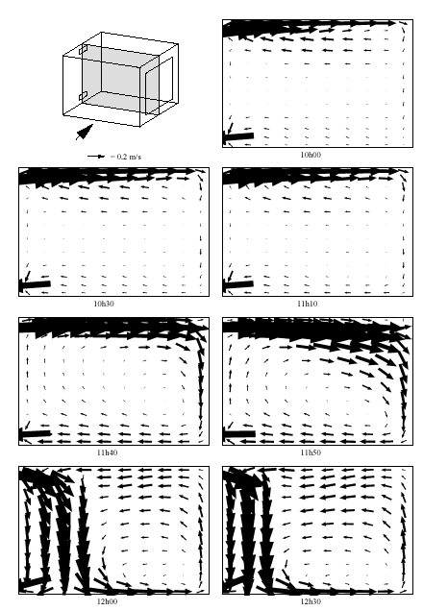
Integrated CFD
Couples to building thermal domain
Couples to air-flow network
Resolves flow patterns within zones

Slide 10
Inter-zone air flow
Flow modelling is used extensively in ESP-r for:
  natural ventilation in offices
  solar ventilation pre-heat
  mixed mode ventilation
  displacement ventilation, etc.
Examples can be seen in the realistic models section of the exemplars
Scheduled airflow is ignored when an air flow network is defined!

Slide 11
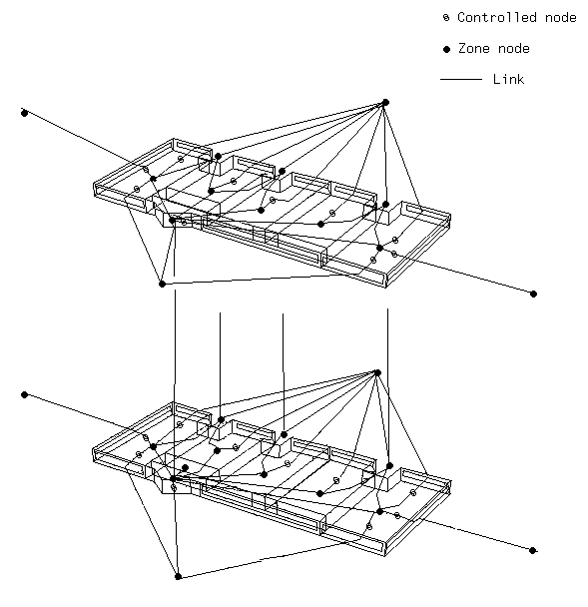
Air flow network constituents
Nodes
Connecting components
Inter-nodal connections

Slide 12
Nodes (1)
Points in the network where the pressure is calculated or known
Node pressures are network state variables
internal fixed pressure
wind-induced pressure
internal unknown pressure

Slide 13
Nodes (2)
Internal, or boundary nodes
Pressure may be fixed, wind-induced, or unknown.
internal fixed pressure
wind-induced pressure
internal unknown pressure

Slide 14
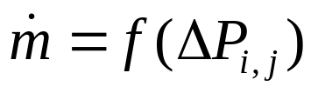
Components and connections (1)
Components
  describe the flow characteristics of the nodal connections
Connections
  flows through connections are usually a non-linear function of the pressure difference
P_{i}
P_{j}

Slide 15
Components and connections (2)
Flow connections may or may not be represented in the thermal model
  for example: two zones may be connected by a door in the air flow model, but that door may be omitted in the building model
The height of the connection inlet and outlet is required to compute stack effect
Multiple connections can use the same component

Slide 16
Stack effect
The pressure difference across the connection may not equal the pressure difference between the two nodes.
connection
1
2
n
h₂
m
h₁
h_{n}
h_{m}

Slide 17
Solution
The flows are a function of nodal pressures and the component characteristics
  conservation of mass for each node
All the internal nodes are directly or indirectly linked to at least one boundary node
Pressure and mass flow computed for each node
Iteration may be required

Slide 18
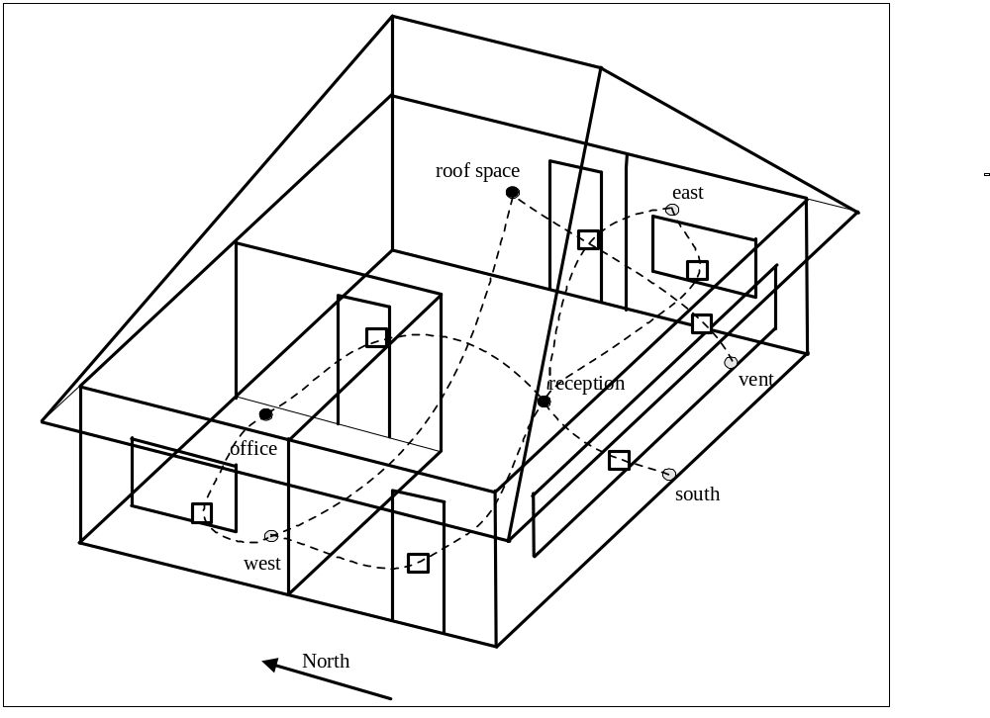
Defining airflow networks in ESP-r
Demonstration and exercise
Nodes
Components
Connections

Slide 19
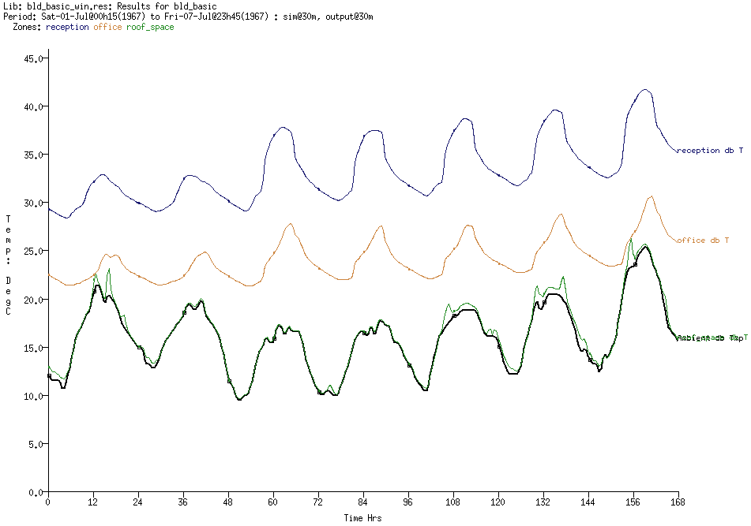
Unventilated performance

Slide 20
Imposing control
Controls manipulate network characteristics in response to climate and building conditions
actuator
T
sensor

Slide 21
Network controls
Comprise:
  Sensors
  Actuators
  Control laws
On/off and proportional laws control available
All connections using a given component can be actuated at once

Slide 22
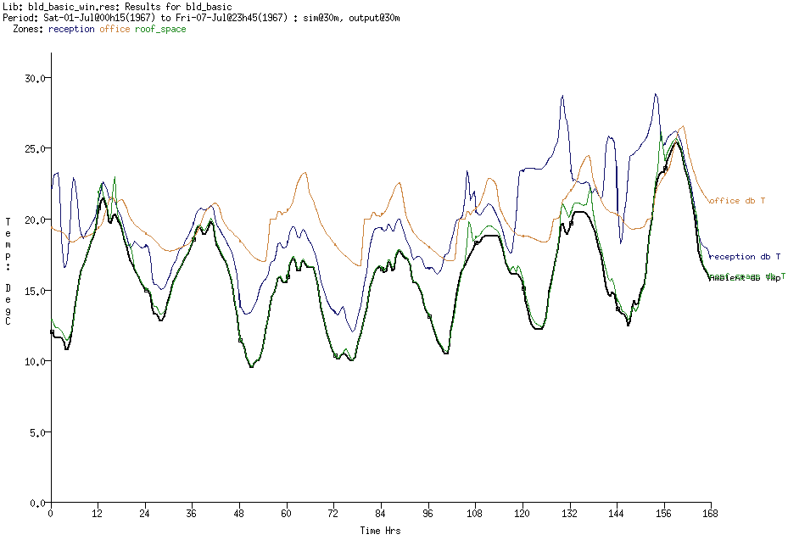
Effect of ventilation

