Slide 1
An Introduction to ESP-r

Slide 2
Objectives
How does ESP-r model buildings?
What is ESP-r capable of?
How do I model buildings in ESP-r?

Slide 3
Outline
Introduction
  What is Building simulation
  ESP-r methodologies
  ESP-r structure
Demonstration and hands-on exercises
  Building thermal domain
  Network air flow modelling

Slide 4
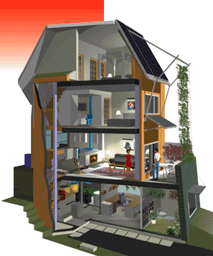
What is building simulation?
Building Performance
  Equipment sizing
  Energy use & emissions
  Occupant comfort
  Air quality
  Daylighting
  Water management
  Acoustics
Supports integrated design and optimization
CMHC “Healthy House”, Toronto

Slide 5
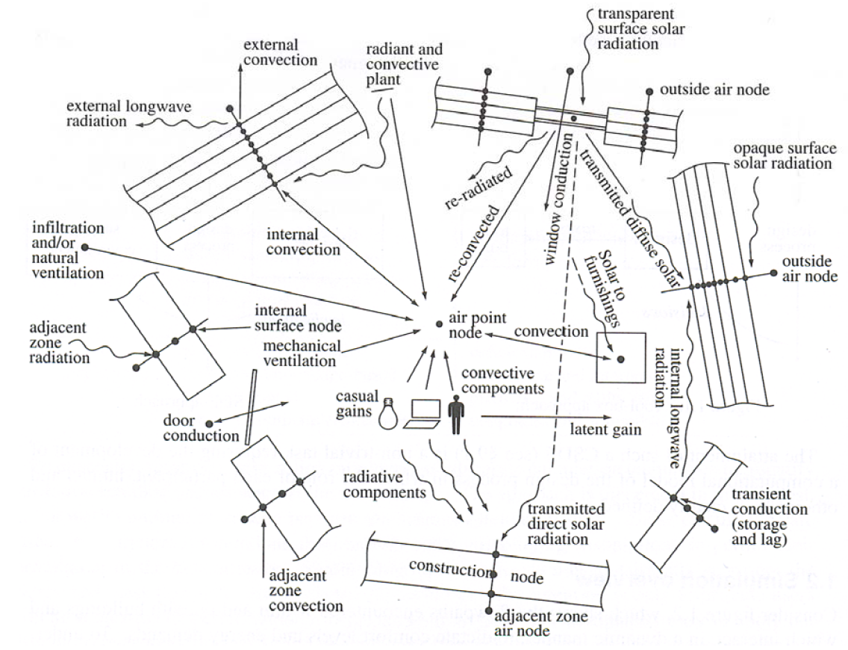
Image: Clarke, J.A. (2001) Energy Simulation in Building Design, 2nd Edition

Slide 6
Levels of resolution
Feasibility
analysis
Residential
Commercial
Research
Hot 2000
Hot 3000
eQuest
(DOE 2.1)
TRNSYS,
ESP-r
RETScreen
EnergyPlus
(Easy-to-use)
(Hard-to-use)
US DOE Software tools directory:
http://www.eere.energy.gov/buildings/tools_directory/

Slide 7


ESP-r: Open source software
ESP-r is free software:
  Licensed under the GPL
  “Share-and-share-alike”
Used around the world
Contributions from:
  U.Eidenhoven, U.London, NRC,
  Concordia, U. Calgary, Dalhousie,
  U. Toronto, Carleton, Laval,
  Ecole Polytechnique …

Slide 8
ESP-r: Research focused
ESP-r is a research tool:
  Developed by graduate students and professors
  30-years of development
  “First-principles” philosophy
Ease-of-Use is not a priority:
  Developers are research-focused
  Limited resources for general improvements
  X11 interface circa 1989
  Full of surprises (bugs)
Expect to be frustrated!

Slide 9
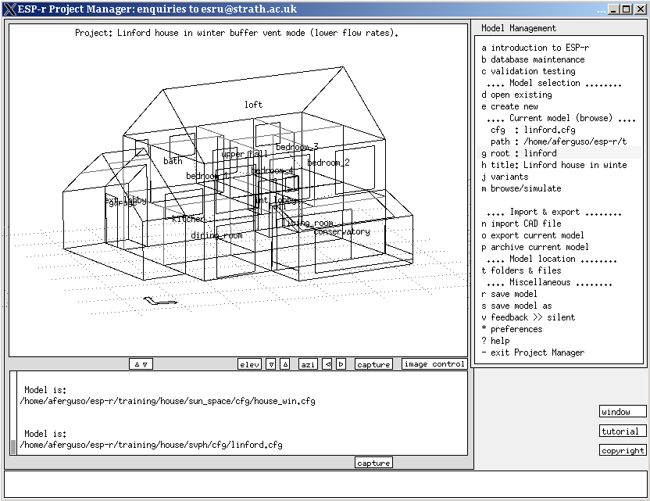
ESP-r: X11 interface

Slide 10
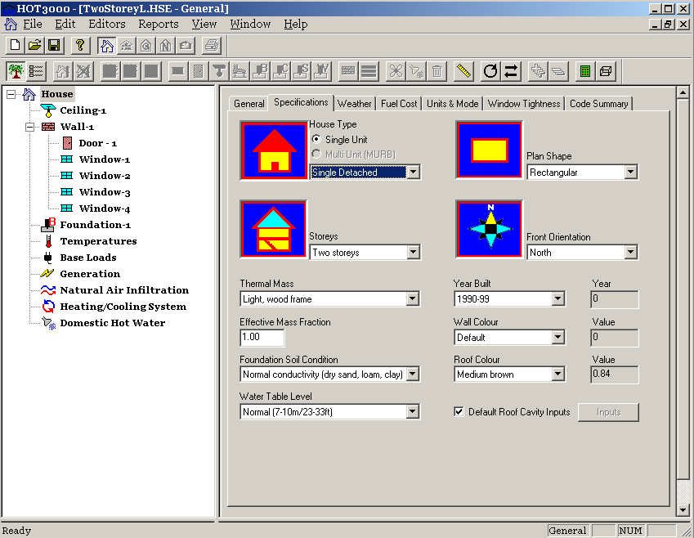
ESP-r: HOT3000

Slide 11
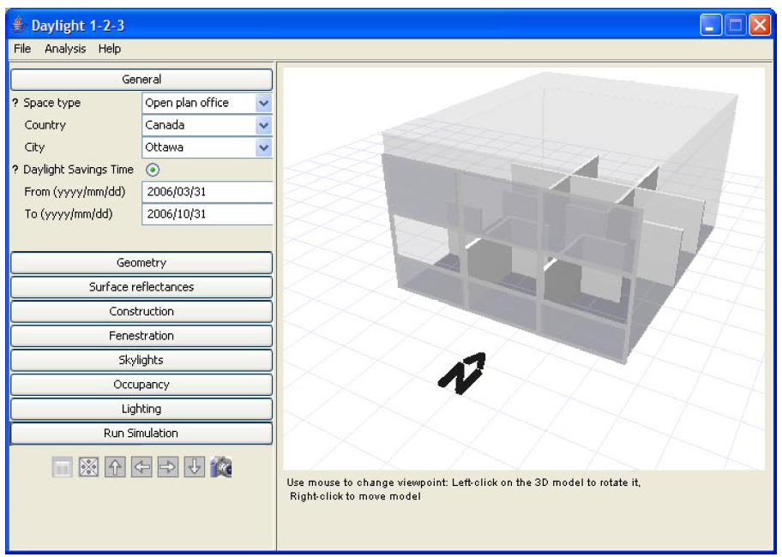
ESP-r: Daylight 1-2-3

Slide 12
ESP-r: Capabilities
ESP-r
Indoor Air quality
Insolation &
obstructions
Radiance (daylighting)
Acoustics
Building
envelope
Mold
growth
TRNSYS
Models
(HVAC)
Electrical
systems
Intra-zone
air flow
(CFD)
HVAC
Systems
Matlab (controls)
Renewable
Energy
Inter-zone
air flow

Slide 13
ESP-r: Maturity
ESP-r
Indoor Air quality
Insolation &
obstructions
Radiance (daylighting)
Acoustics
Building
envelope
Mold
growth
TRNSYS
Models
(HVAC)
Electrical
systems
Intra-zone
air flow
(CFD)
HVAC
Systems
Matlab (controls)
Renewable
Energy
Inter-zone
air flow

Slide 14
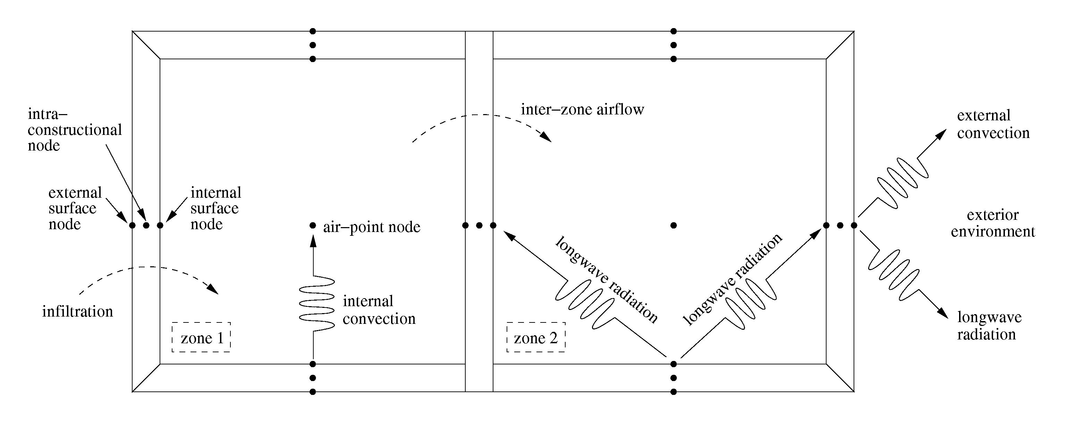
ESP-r: Building domain
ESP-r’s heat-balance method:
  Discretize in space by representing building fabric and internal zones with control volumes (CV).
  Form heat balances for each CV.
  Simultaneously solve matrix of heat balances.

Slide 15
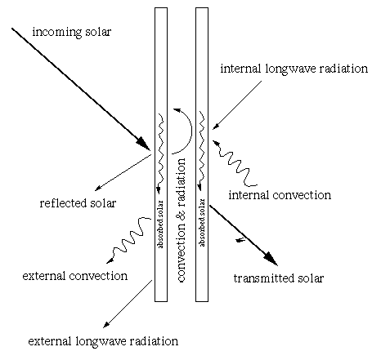
ESP-r: Windows

Slide 16
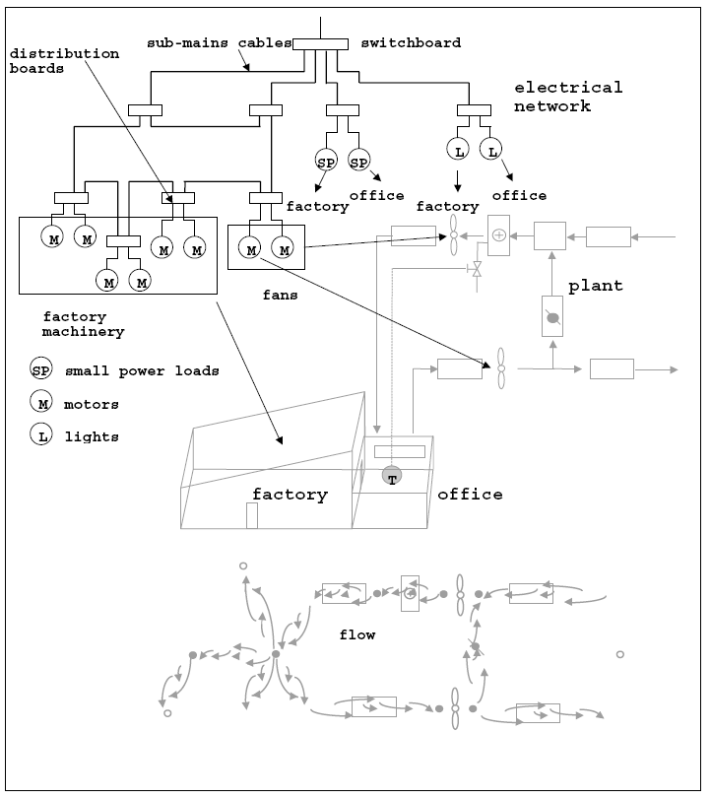
ESP-r: Integrating other domains
Plant (HVAC)
Air Flow
Power flow

Slide 17
ESP-r: Additional capabilities
  Solar shading.
  Solar insolation.
  Internal surface convection.
  View factor calculation.
  Casual gains control (daylight control).
  Temperature-dependent material properties.
  Image rendering.
  Controls: network air flow, setbacks, etc.
  Plant injections: radiant-slabs, convective heating, convective-radiative, etc...
  Control of optical properties.
  TRNSYS coupling

Slide 18
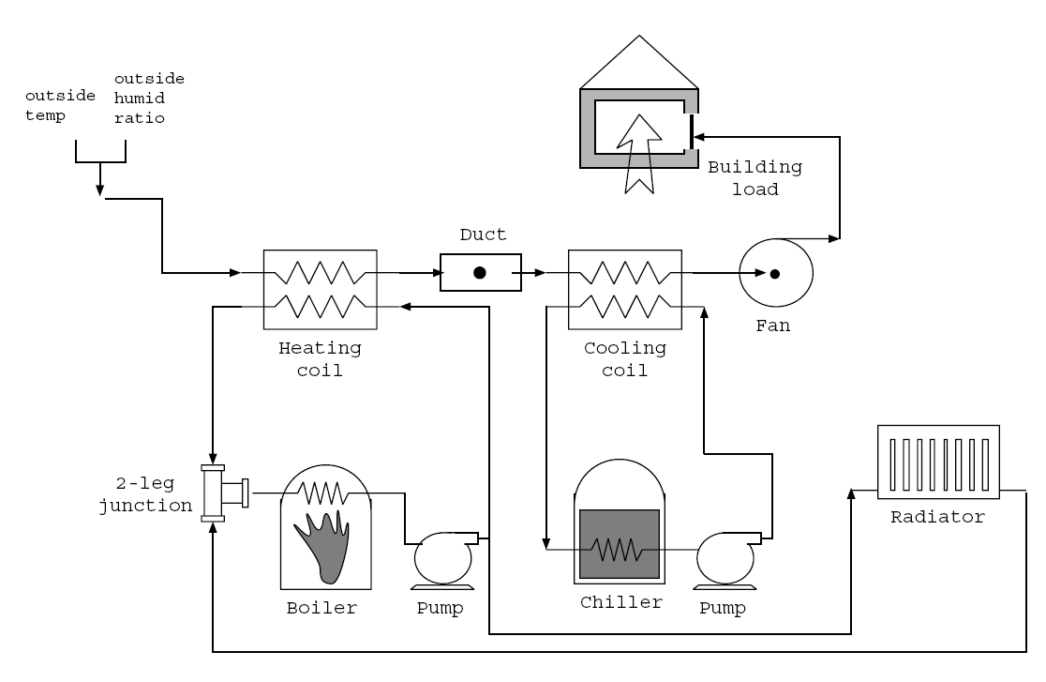
ESP-r: Explicit plant model

Slide 19
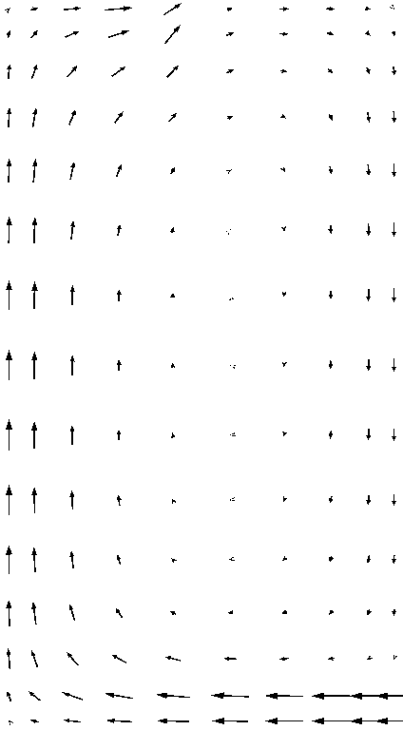
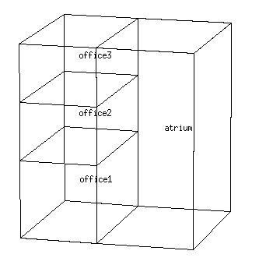
ESP-r: Integraded CFD

Slide 20
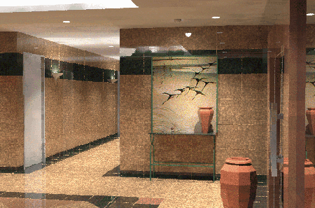
ESP-r: Lighting simulation with Radiance

Slide 21
ESP-r: Structure
Project management facility
3rd party CAD
Problem
description
Simulation engine
Results database
Plant component db
Plant component db management
Results recovery & analysis
Event profiles db
Event profile db management
Export
Climatic time-series db
Climate db analysis & management
3rd party graphing &
analysis package
Temporal definitions db
Temporal def’ns db management
External shading and internal
insolation prediction
Shading/insolation db
Mass flow
results
Stand-alone mass flow solver
& results recovery

Slide 22
ESP-r: Availability
Binary versions can be downloaded from:
http://esru.strath.ac.uk
Source code available through versioning control:
http://www.esru.strath.ac.uk/Programs/ESP-r_central.htm

Slide 23
ESP-r: Resources
Documentation:
http://www.esru.strath.ac.uk/
Support mailing list:
http://www.esru.strath.ac.uk/Programs/user_club.htm

Slide 24
Demonstration and exercises
Building domain exercise:
  Defining constructions
  Defining geometry
  Attributing surfaces
  Adding windows
  Applying boundary conditions
  Imposing air flow and internal gains
  Modeling plant and controls ideally
  Adding obstructions
  Performing simulations
  Analyzing results

Slide 25
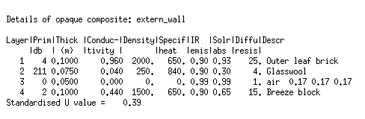
Constructions databases
Database of construction elements:
  conductivity, density, and specific heat;
  infrared emissivity and solar absorptivity;
  contains many standard materials;
  easily modified.
Database of multilayer constructions:
  layer-by-layer description;
  references materials from elements database;
  specify thickness of each layer.

Slide 26
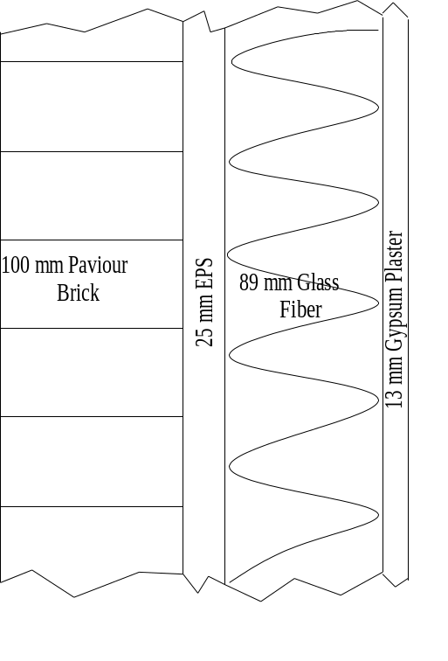
Opaque envelope
Demonstration and exercise

Slide 27
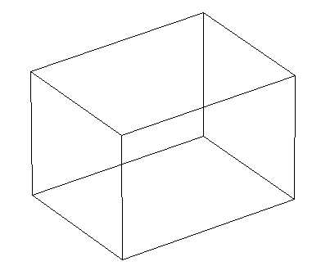
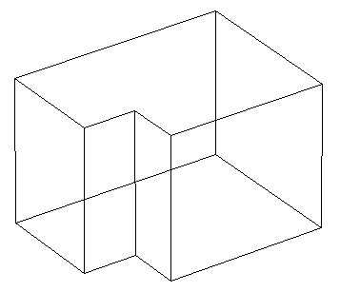
Defining geometry
Explicit geometrical model required for:
  Inter-surface radiation exchange.
  Internal surface convection.
  Forced external convection.
  Solar shading and insolation patterns.
≠

Slide 28
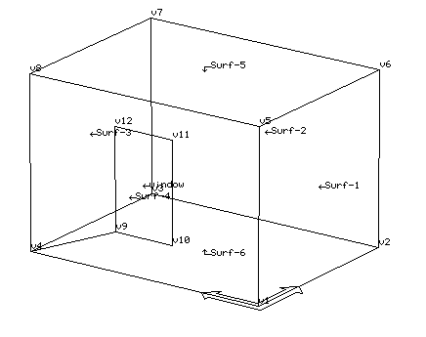
Defining geometry: creating a zone
Define coordinates of vertex points.
Join vertices to form surfaces.
Zone must be completely enclosed.
Lots of handy tools to assist data input.
Simpler models are better!

Slide 29
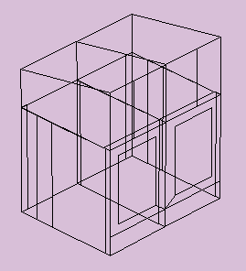
Defining geometry: Creating a building
Building defined zone-by-zone.
Zones can be moved, copied, deleted, and merged.
Plan the model (make a sketch) before attempting data input.
CAD input possible, but generally easier to use project manager.
Avoid unnecessary complexity.

Slide 30
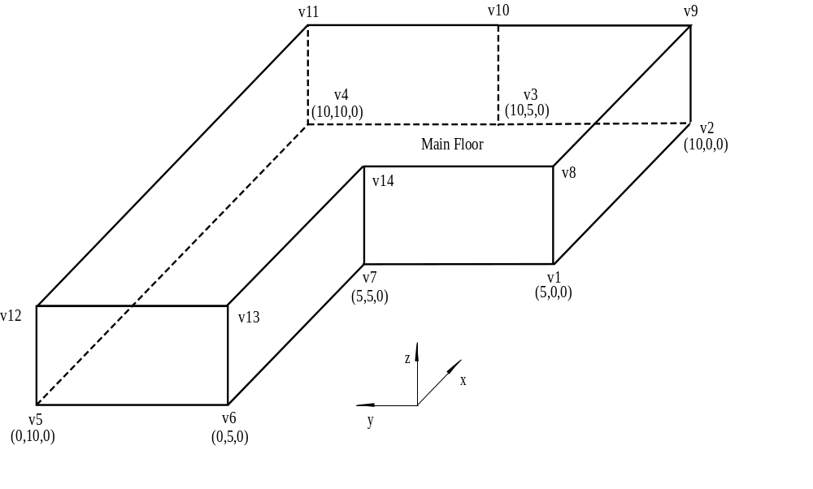
Defining Geometry
Demonstration and exercise

Slide 31
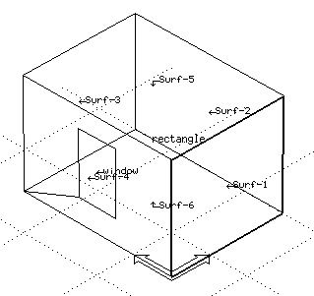
Opaque envelope: Attribute surfaces
Surfaces attributed by assigning multilayer constructions from database.

Slide 32
Catch-up
If you did not complete the geometrical input, then do the following:
  Exit ESP-r.
  Enter “skipto intro2” in your terminal.

Slide 33
Windows
Called transparent multilayer constructions.
Created in similar fashion as opaque mlc’s, but:
  optical properties also required;
  gas fill characterized by a thermal resistance.
Can import optical properties from Window.
Create wall geometry first, then insert windows.
Frame: declare separately as opaque MLC or include effect on window U-value and optical properties of window

Slide 34
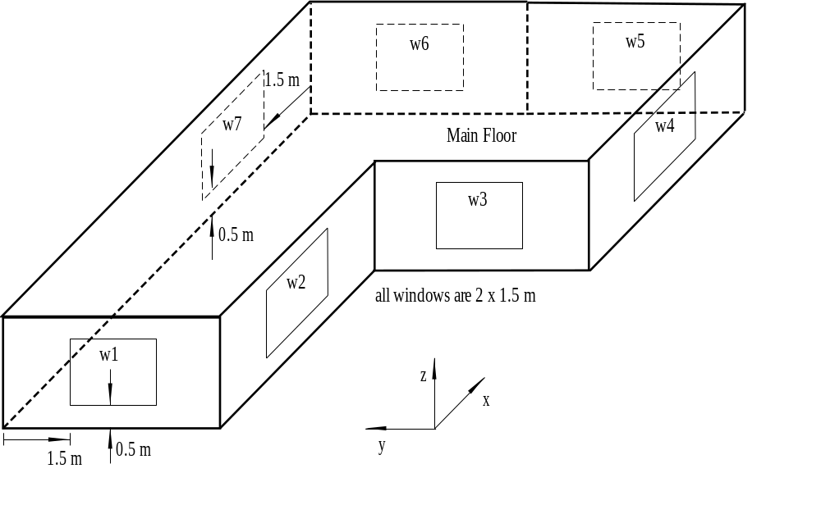
Windows
Demonstration and exercise
    Insert window w1.
    Attribute the window with the layered construction called d_glz.

Slide 35
Catch-up
If you did not complete the windows input, then do the following:
  Exit ESP-r.
  Enter “skipto intro3” in your terminal.

Slide 36
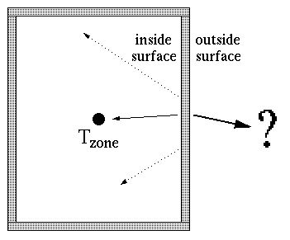
Applying boundary conditions
Multilayer constructions have inside and outside surfaces.

Slide 37
Types of boundary conditions
The inside surface
  faces the zone’s air-point;
  is handled automatically.
Must define boundary condition for outside surface
  exposed to outdoors;
  faces another zone;
  exposed to fixed temperature and radiation source;
  connected to ground (user-defined monthly temperature profile);
  exposed to same conditions as inside;
  adiabatic;
  BASESIMP foundation.

Slide 38
Applying boundary conditions: Tools
Two approaches:
  Manual method
    Assign boundary condition to each surface the same way it is attributed with a multilayer construction.
  Automatic method
    Use topology checker program to automatically match common surfaces between adjoining zones and prompt for other boundary condition types.

Slide 39
Applying boundary conditions
Demonstration and exercise
  Connect windows, walls and ceiling to exterior.
  Connect floor to BASESIMP, and use configuration 42.

Slide 40
Catch-up
If you did not complete the boundary condition input, then do the following:
  Exit ESP-r.
  Enter “skipto intro4” in your terminal.

Slide 41
Imposing internal gains
Internal gains can be set for:
  occupants;
  lights;
  equipment.
Setting internal gains:
  loads in W or W/ m2;
  radiant and convective portions;
  sensible and latent portions.
Gains are scheduled:
  possible to import fractional profiles from previously created database.

Slide 42
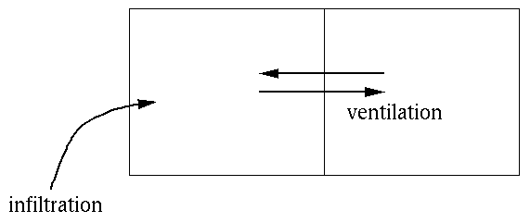
Imposing air flows
Two methods for handling air flow:
  explicitly calculated with a network air-flow model (coming later);
  thermal impact of imposed flows calculated.
Infiltration is air flow from the outdoors to the zone.
Ventilation is air flow from another zone (or at a set temperature).

Slide 43
Imposing air flows
Setting infiltration and ventilation rates:
  on zone-by-zone basis;
  in ac/h (receiving zone);
  scheduled;
  + source zone (or temperature) for ventilation.
Flow rates can be controlled (3-stage) as a
function of:
  zone temperature;
  adjacent zone temperature;
  outdoor temperature;
  wind speed.

Slide 44
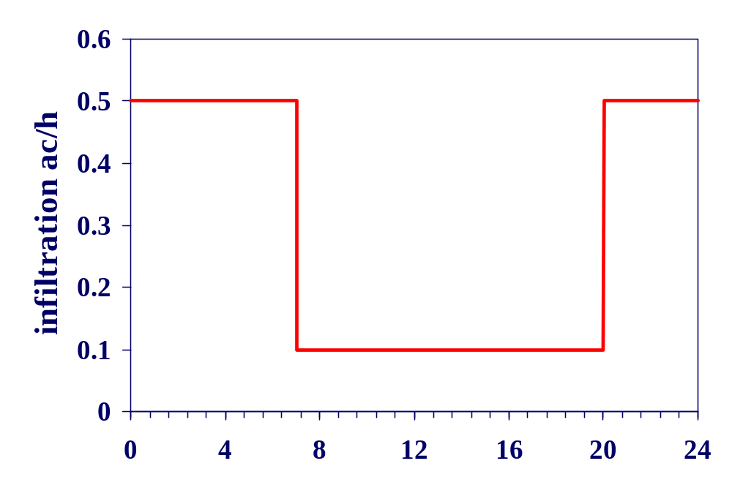
Imposing air flows and internal gains
Demonstration and exercise

Slide 45
Catch-up
If you did not complete the operations input, then do the following:
  Exit ESP-r.
  Enter “skipto intro5” in your terminal.

Slide 46
Modelling plant and controls Ideally
Two methods for plant modelling:
  explicitly with a component model;
  ideally.
Ideal plant modelling:
  control behavior of HVAC system modeled, but not components;
  usual approach employed by ESP-r users.

Slide 47
Ideal control: Sensor and actuator
Locate sensor:
  current zone temperature;
  air temperature in another zone;
  mix of zone temperature and MRT;
  outdoor condition: temperature, wind, solar.
Locate actuator:
  air point of current zone (convective heater)
  at a surface
  within a layered construction (radiant slab)
  convective/radiative heater

Slide 48
Ideal control: Control law
Specify control period
Select control law:
  ideal heat injection/extraction with fixed capacities;
  free-floating;
  on/off and 3-position;
  constant volume, variable temperature;
  PID, fuzzy-logic PI-PD, etc.
Specify set points and heating & cooling capacities.

Slide 49
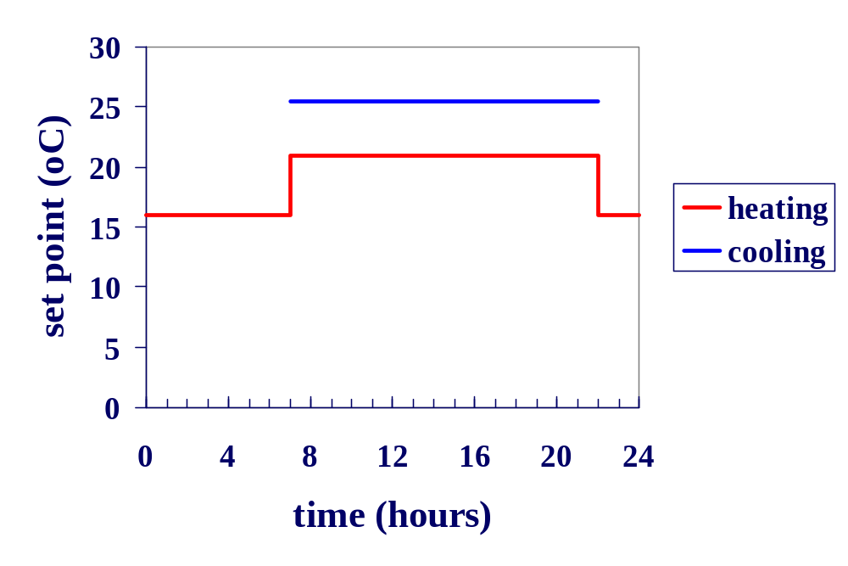
Applying ideal control
Demonstration and exercise
free floating

Slide 50
Catch-up
If you did not complete the inputs for zone controls, then do the following:
  Exit ESP-r.
  Enter “skipto intro6” in your terminal.

Slide 51
Shading and Insolation
Two methods for insolation:
  Specified insolation within zone geometry
    Diffuse treatment
    Insolation to 1 or 2 surfaces
  Shading and insolation module: ish
Shading and insolation module:
  Add obstruction blocks, window reveals, overhangs
  Detailed internal insolation distribution
  Limitations:
    Does not account for self shading
    Crude obstruction geometry

Slide 52
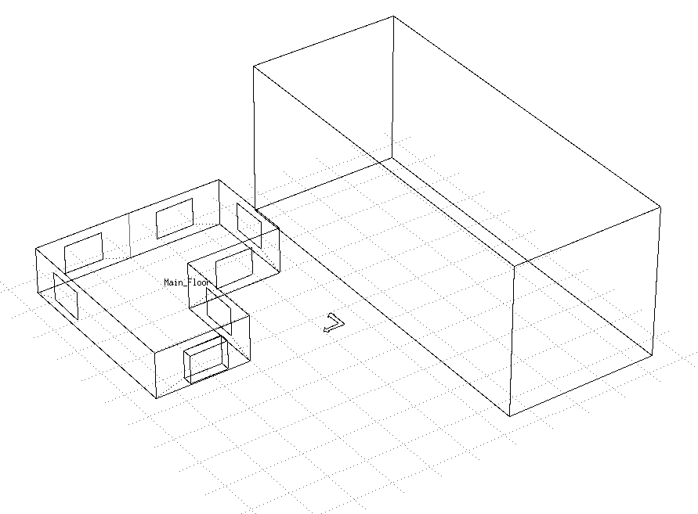
Adding obstructions

Slide 53
Catch-up
If you did not complete the inputs for zone shading and insolation, then do the following:
  Exit ESP-r.
  Enter “skipto intro7” in your terminal.

Slide 54
Performing simulations
Select weather file.
Set period of simulation.
Choose time step.
Simulation toggles:
  sky model, surface convection model, solver data, etc.
Trace detailed output:
  convection coefficients, air flows, etc.
Monitor zone temperatures and plant injections as simulation progresses.

Slide 55
Performing simulations
Demonstration and exercise
  Simulate house with constant set-point temperature.
  Repeat simulation, but use set-back thermostat.
  Simulate from Jan 9-15, 1 hour time step.
  User /usr/esru/esp-r/climate/ottawa.cwec for the weather file.

Slide 56
Analyzing Results
Plot solution variables against time:
  zone, surface, and interstitial temperatures;
  plant injections or extractions;
  infiltration & ventilation loads;
  internal loads; etc.
Create plots of cross-sectional temperatures.
Graph frequency distributions:
  temperatures;
  heat fluxes; etc.
Text output of instantaneous and integrated quantities

Slide 57
Analyzing Results
Demonstration and exercise
  Plot zone temperature and heat injection for constant set-point temperature simulation.
  Repeat for set-back thermostat simulation.

