Slide 1
Heat transfer correlations for BIPV/T systems
Luis Candanedo
Concordia University
Montreal, November 23th, 2009

Slide 2
Overview
Introduction
Complexity
Numerical modeling
Experimental setup - Smooth cavity
Data Reduction / Correlations
Grashof number
Comparison with previous correlations
Papers (Journal Publications (ASHRAE&ASME)
In development: framing effects and tilt angle

Slide 3
Introduction
Literature review showed that typical correlations for pipes and ducts underestimated the convective heat transfer coefficients in BIPV/T systems (Eicker et al, 1999, Bazilian and Prasad 2002, Bloem, 2004 and Charron and Athienitis 2006)
Experimental measurement of convective heat transfer coefficients has been carried out @ Concordia using a BIPV/T channel setup. The approach consists to study first a smooth configuration and then framing effects to have Nusselt number limits.

Slide 4

Intro… cont
.
Researchers recommend to use a combination of natural convection Nusselt number correlation (or laminar flow) with forced flow correlations. (See details in Paper)
E.g. Eicker, 2003 recommends for a ventilated PV vertical façade

Slide 5
Complexity
-Non uniform heat fluxes or temperatures across boundaries.
-Natural convection effects.
-Framing effects.
-Developed Vs Non developed flow conditions.

Slide 6
Numerical Modeling
See papers SBRN conference in Toronto (Candanedo et al, 2009) and ASHRAE (Candanedo et al, 2010).

Slide 7
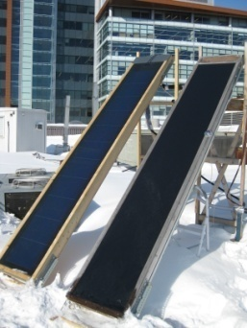
Experimental Setups
Amorphous PV module 6% η_{e}

Slide 8
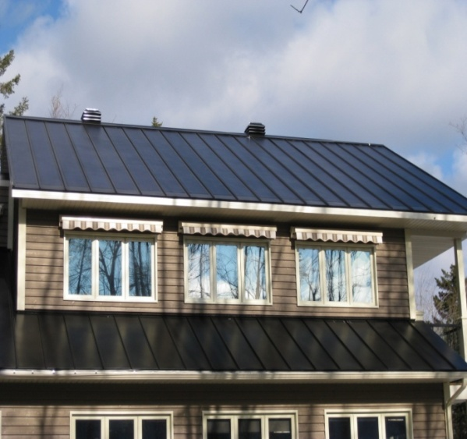
Ecoterra House

Slide 9
Measured variables
Temperature distributions along PV interior surface and insulation.
Temperature rise of the air.
Accurate measurement of the airflow inside the channel (CFM).
Surfaces long-wave emissivities.
Electrical power output.
Ambient air temperature and inlet air temperature, relative humidity and exterior wind speed.

Slide 10
Features
No thermal gradients across the width were observed.
Major emphasis of temperature variation along the length.
Negligible heat loss through the bottom surface (combined R ≈ 1.96 RSI
Aspect ratio, Width/Height of 10 in order to represent a roof BIPV/T installation.
Length/Hydraulic Diameter of 38.
Tilt angles tested (45 & 30 degrees from horizontal)

Slide 11
Data Reduction
Non dimensional numbers employed, Nusselt & Reynolds numbers, x/Dh, Grashoft numbers
Dh = 4A_{c}/U, where U is the wetted perimeter

Slide 12
Eliminating transient effects.
Due to thermal mass of PV modules
and air flow rate.

Slide 13
Air temperature distribution inside the channel (Time Response)

Slide 14
Air Temperature distribution
where A, B, and C are fitted parameters. The correlation coefficients (R²) of the regressions shown in Figure 6 are high (R²≈ 0.99).

Slide 15


Computation of CHTC’s
Since there is negligble heat loss through the bottom surface, it follows that:

Slide 16

Nusselt numbers

Slide 17
Nusselt number distribution

Slide 18
Nusselt number at the PV surface

Slide 19
Nusselt number at the bottom surface

Slide 20
Comparison with other correlations

Slide 21
Grashof number

Slide 22
Most of the experimental data falls in the mixed regime of turbulent heat transfer (2×10¹⁰<Ra<5×10¹⁰).
The experimental data is also in agreement with the results obtained by Sudo et al. [51]

Slide 23
Papers
Candanedo, L.M., A.K. Athienitis, J. Candanedo, W. O'Brien, and Y.-X. Chen, Transient and steady state models for open-loop air-based BIPV/T systems. ASHRAE transactions, 2010. (accepted)
Candanedo, L.M, A.K. Athienitis. Convective Heat Transfer Coefficients in a Building-Integrated Photovoltaic/Thermal System. Submitted to ASME Journal of Solar Energy Engineering, October 14th, 2009.

Slide 24
New Correlations under development
Correlations at 30 degree tilt angle (Top and bottom surfaces)
Results show a negligible reduction of Nusselt number due to the tilt angle.
Correlation including wood framing effects. Soon to be finished. This week. Results show increased Nusselt number by around 30% compared to the 45 degree tilt angle correlation .

Slide 25
Questions / Comments Thank you

