Slide 1
SBRN Sub-Project 4.2 a/b a – Comprehensive modelling of the energy end-uses and GHG emissions of the Canadian housing stock B – Assessing the impact of solar technologies and integration strategies
Lukas Swan – Dalhousie Univ.

Slide 2
CHREM Model
CSDDRD (17,000 houses)
Neural Network
ESP-r
GHG emission factors

Slide 3
CHREM Status
Complete
Database
NN
Integration of A&L and DHW into ESP-r
Generation of houses into ESP-r models
Recent effort was multilayer constructions
GHG factors (Amal Farhat, 2009)

Slide 4
CHREM Status
Incomplete
Final results collation
Verification (have acquired data)
Demonstrate solar technology

Slide 5
CHREM Intent
Detailed model
Simulating solar technologies
Capture variety of housing stock
Technology models enter through ESP-r
Unfortunately, few technologies added
CFC
BIPV/T with HP
Phase change?

Slide 6
CHREM and ESP-r
ESP-r requires a house model (set of files)
CHREM generates the files using Perl
Configuration – climate
AIM2 - infiltration
Mechanical ventilation
Control
HVAC
DHW
Obstructions and shading (Sara)

Slide 7
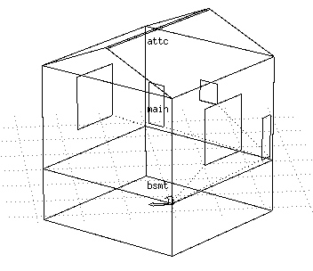
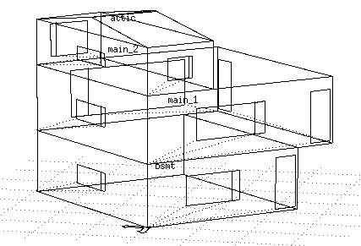
CHREM and ESP-r
CHREM generates the files using Perl
Determine zones (bsmt, crawl, main(s), attic/roof)
2 to 5 zones

Slide 8
CHREM and ESP-r
CHREM generates the files using Perl
Geometry
Rectangular
Independent zone size (exterior)
Windows & frames
Doors
Construction and connections
Determine facing condition
Build layer by layer from code (e.g. 11A59G4L)
Siding, sheathing, insulation_2, insulation_1 (modified), interior

Slide 9
CHREM and ESP-r
CHREM generates the files using Perl
Operations
Occupants
Fixed air flows
Infiltration (attic/roof or crawl space)
Zone to Zone
BCD file
Links Stove, Dryer, AL-Other (heat or not?)
Select appropriate profile
Electrical Network
1 – AC node
Power only loads

Slide 10
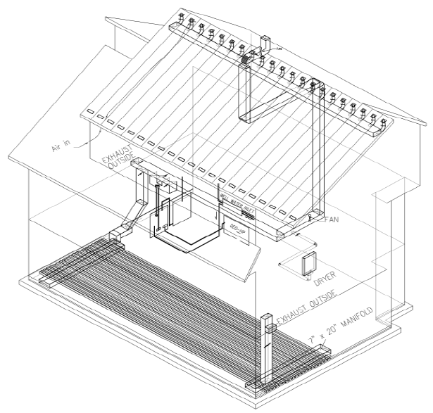
How to implement new technology into CHREM?
Your expertise
Understand the technology
Simplification for modeling
Example in ESP-r
Determine sizing calculations
What makes a house applicable
Alouette Homes, 2007

Slide 11
How to implement new technology into CHREM?
Our expertise
Use characteristics (data) to determine applicable houses
Make templates for technology changes
Size system (calculation)
Generate the ESP-r model file
Simulate

Slide 12
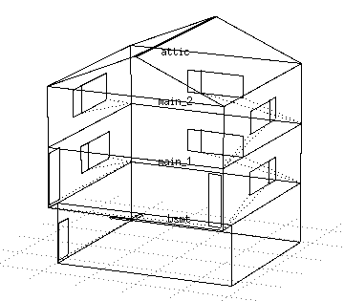
Potential Difficulties
We are multi-zone for main levels
Inject based on volumetric proportion?
Inject in one zone and use zone-zone ventilation?
Roof area – perhaps very different from level 1

Slide 13
Key questions
Do you have a:
Change in ESP-r source code to facilitate?
Working ESP-r example?
Application determination method?
Sizing methodology using available characteristics?
This is what I hope to learn here about the BIPV/T

