Slide 1
NRCan modules for ESP-r ”Hot” Modules added to support the Canadian housing stock
Lukas Swan – Dalhousie Univ.

Slide 2
HOT Modules for ESP-r
Per Building (1 for all zones)
*aim – AIM2 Alberta Infiltration Model (leaks)
*mvnt – Mechanical ventilation model (air exchange systems)
*bcd – Boundary condition file (timestep information of draws, electrical loads, etc.)
*pnt – Electrical network file for type 18 (A&L loads)
*hvac – HVAC equipment calcs model (primary energy consumption)
*dhw – Simple DHW model for primary energy consumption
Per Zone
*bsm – BASESIMP foundation heat loss model

Slide 3
Ways to find info
Use HOT3000 and examine the your_hot3000_dir\user\wizardhouse
Read some of NRCan’s internal documents (request)
Read the ESP-r source code
src/cetc
src/esrubld
src/esrucom
Examine exemplars
tester/
NOTE: find most options through HOT program suite (I like HOT2XP as HOT3000 does not have all options)

Slide 4
Unfortunate things
Not tagged format
Data lines change with system type
Order is important
Some files require others
Most are rudimentarily hacked in
Problem areas: multi-zone, overrides, etc.

Slide 5
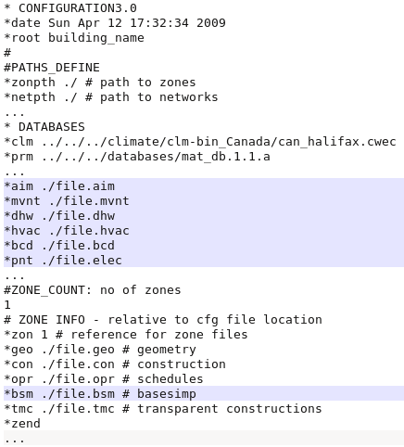
*.cfg – declare the files
Building
*aim
*mvnt
*dhw
*hvac
*bcd
*pnt
Zone
*bsm
Order is not important
Requirements:
HVAC->AIM
AIM->MVNT
I forgot *selr

Slide 6
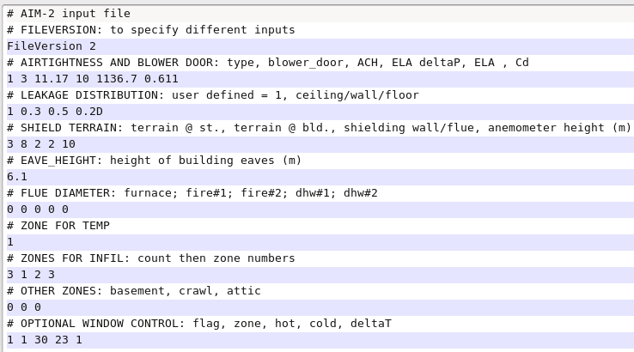
*aim – zone air infiltration
Wind and Stack effect
Leakage
Terrain
Height
Flues
Zones
Apportions infiltration to zones
NOTE: overrides all *.opr infiltration
Applies constant infiltration to crawl and attic (0.5 AC/h)
Supplies temperature data for window opening
NOTES:
Requires cooling
Requires AFN
Affects the infiltration variables in src/esrubld/subsys.F – look up
See: src/cetc/aim2_*timestep.F

Slide 7
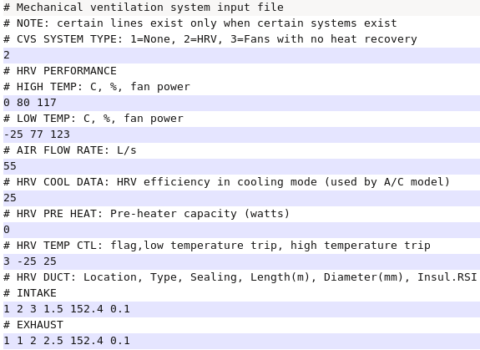
*mvnt – mechanical ventilation
Mech. Ventilation characteristics
HRV
CVS
Exhaust fans
Adds air change to AIM2
Requires *.aim file so that this is executed
Affects the infiltration variables in src/esrubld/subsys.F
See: src/cetc/CentralVentSys.F

Slide 8
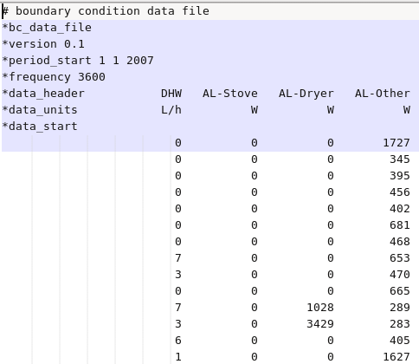
*bcd – boundary condition data
Supplies timestep data
Use: fGet_BC_Data to access
Examples
Plug loads
DHW draw
NOTE: Does not interpolate so data must be same/finer than timestep
See: src/esrubps/BC_data.F

Slide 9
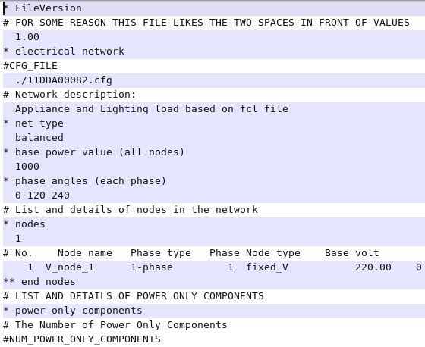
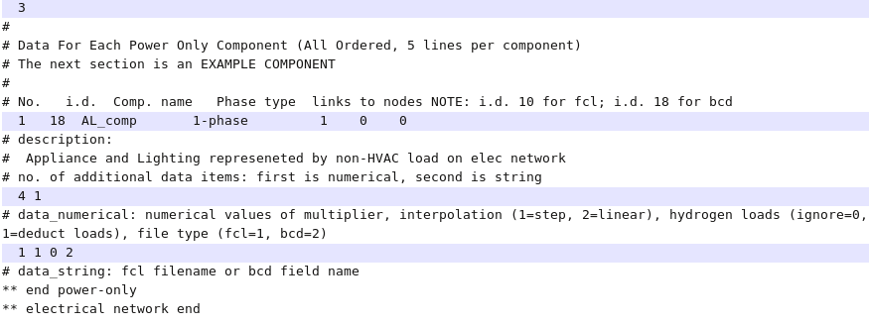
*pnt – electrical network file
Connect Plug loads to electrical from BCD
Type 11/18 to manifest as heat in /src/esrubld/casual.F
Define
1 node
Type 18 – Power only component resulting in heat
NOTES:
Somewhat columnar format
Provide elec results file *selr
See: src/esrupfs/powoc_calc.F

Slide 10
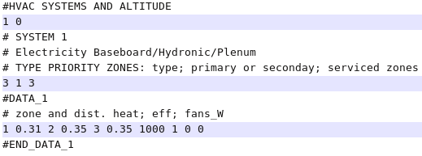
*hvac – heating and cooling only!
Systems
Furnace
Boiler
Baseboard
ASHP
GSHP
Energy source
Electricity
Natural gas/propane
Oil
Wood
Old/New version
NOTE: requires simple controller with heating specified
Systems must be in order
Furnace/boiler/baseboard – including backup
HP heating
HP cooling
Resets your simple controller capacity (*.ctl)
Postprocesses to determine primary energy consumption
See: src/cetc/hvacsim.F
Furnace.F, GCEP.F, ashp.F, baseboard.F

Slide 11
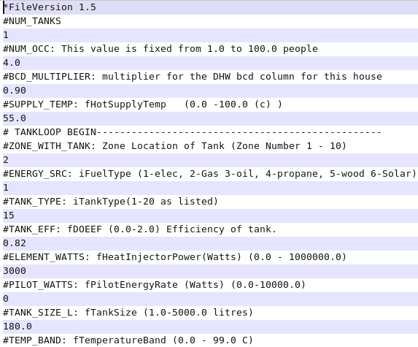

*dhw – simply to include in consumption
Occupants controls the draw
Single hardcoded profile
Basic tank info
Type
Energy source
Postprocesses energy consumption
NOTE: if you open model in prj, it will forget dhw link
See: src/cert/DHW_module.F

Slide 12
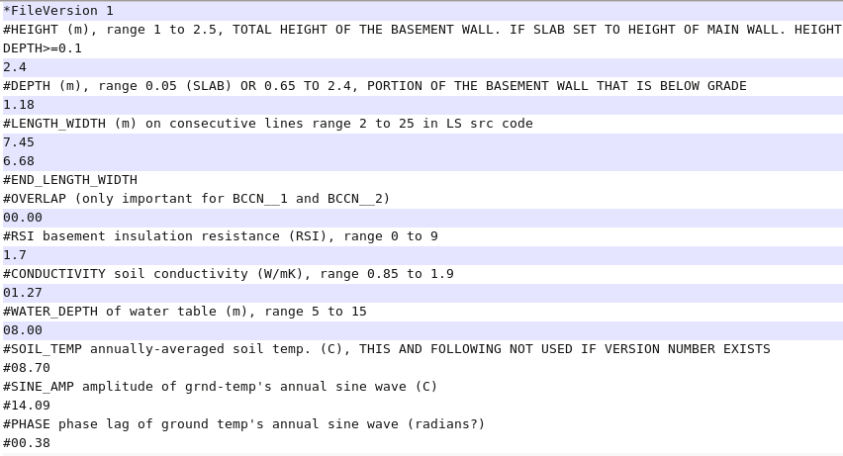
*bsm – foundation heat loss
Dimension and RSI
Moore model (DHW too)
Adjust other files
Geo: BASESIMP
Con
Facing 6
Type of found.
% allocation
Walkouts
NOTE: overrides typical heat trans calc
See: src/esrubld/basesimp.F

