Slide 1

Working with PV and SDHW modules in ESP-r
Bart Lomanowski
November 23, 2009

Slide 2
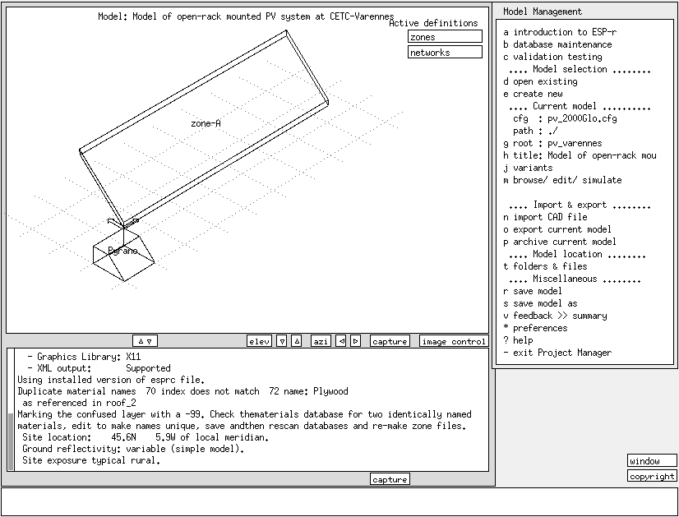
PV
In ESP-r, a PV module is situated on an existing zone surface
  PV construction is physically linked to the thermal solution domain since it is a surface in a zone
  For a PV rack on a flat roof, must build dummy zone to represent the array
General Procedure for specifying PV in ESP-r
  Create transparent construction to represent PV composition
  Create a special material component to link the TMC zone surface to the PV calculation module
  Create a DC node in an electrical network and connect the PV array to the DC node
  See /tester/test_suite/pv_example or /tester/test_suite/bld_PV

Slide 3
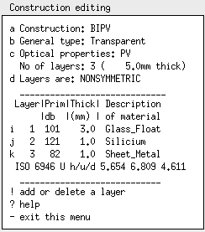
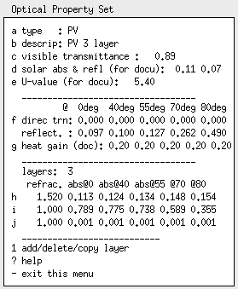
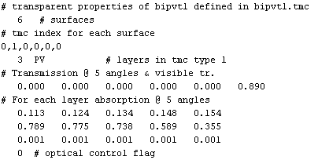
PV transparent construction
Optical property set:
Direct transmission is 0
Solar absorptivities of Silicium layer drive PV generation
Thermal domain solver assumes solar absorbed is turned entirely into heat
*.tmc file holds PV solar optical properties just like for windows

Slide 4
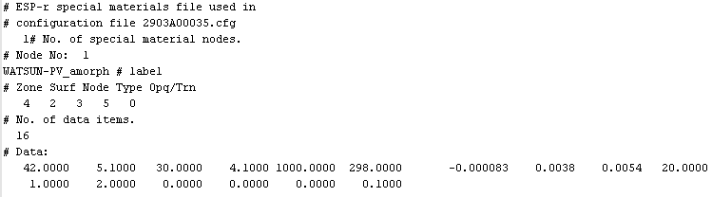
Special materials component
Create PV special materials component in prj:
  zone composition menu -> integrated renewables
HOT3000 uses WATSUN-PV model (special material type 5)
Refer to [1] or source code for WATSUN-PV model description and input parameter definition
Look for subroutine SPMCMP5 in esrubld/spmatl.F
A special materials file is created:
The special materials file tag in the model configuration (cfg) file is *spf

Slide 5
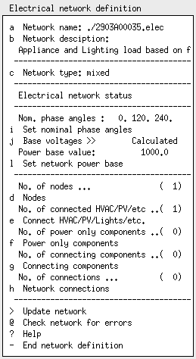
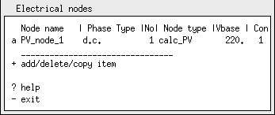
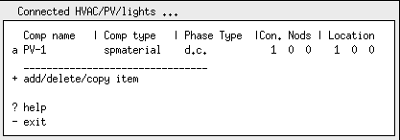
Electrical network
Simplest network: 1 DC node and one PV connected component

Slide 6
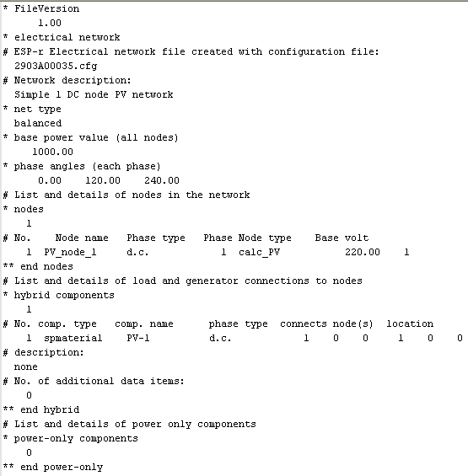
Electrical network – sample file
Electrical network file tag in model configuration file is *pnt

Slide 7
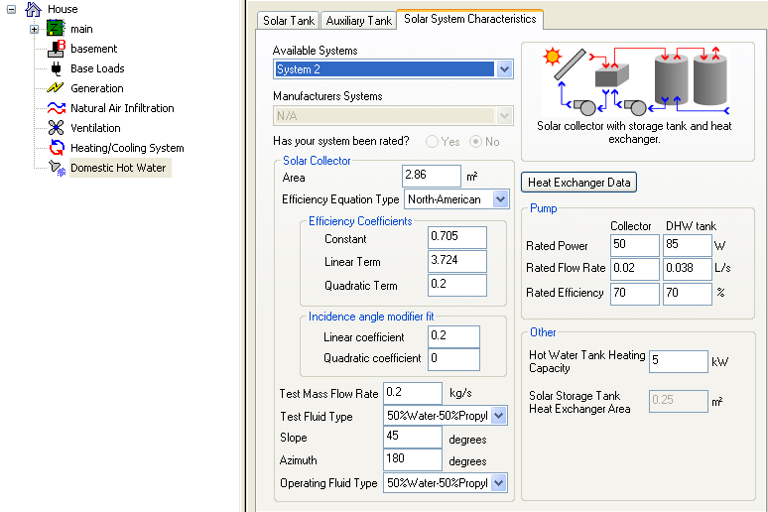
SDHW
Refer to [2] for a description of the SDHW model and see example: /tester/test_suite/plt_SDHW
Unlike the DHW model, SDHW is modeled as an explicit plant network in ESP-r
  See ESP-r cook-book for a good tutorial on plant networks
Plant control functions actuate the pumps in the system based on sensed tank and collector properties
The DHW draw profile is modeled as a dummy plant component. The draw profile can be changed by editing the plant component.
  HOT3000 input screen for SDHW

Slide 8
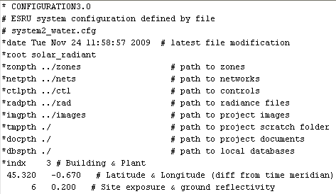
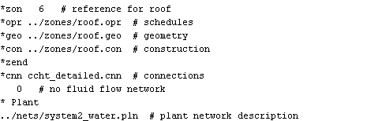
SDHW - files
Model files required for SDHW system:
  *.pln – plant network file holds component description and data, component connections and component containments (if plant components are situated in a thermal zone then the UA heat losses are represented as zone casual gains)
  *.ctl – contains all control functions for building, plant, etc.
Configuration model (*.cfg) changes:

Slide 9
References
[1] Mottillo, M., Beausoleil-Morrison, I., Couture, L., Poissant, Y., “ A Comparison and Validation of Two Photovoltaic Models”, eSim 20?? presumably
[2] Haddad, K., Purdy, J., Sibbitt, B., “Simulation of Residential Solar DHW Systems in HOT3000 Software”, eSim 20?? presumably

