Slide 1
Coupling TRNSYS Components to ESP-r
Alex Ferguson & Weimin Wang
November 23, 2007

Slide 2
Objective
To learn the use of a wrapper to couple TRNSYS components to ESP-r

Slide 3
When and Why
The model for a required component does not exist in the base program (ESP-r).
The existing model is not adequate for a specific study.
To save time and financial resources.

Slide 4
Coupling Strategies
External coupling
  Separate and executable simulation programs coexist.
  They communicate with each other at run time.
  Called distributed simulation in literature.
Internal coupling
  One simulation program exists.
  This program contains component models from other simulation programs.
Reuse at different levels

Slide 5
Internal Coupling
Convert the component model to be coupled into a subroutine of the host simulation program.
Source code needs to be available.
A wrapper is designed to ease the coupling process.
However, you still have to work on the source code.

Slide 6
Why TRNSYS ?
Open, modular structure
Source code available for end-users
Includes many components commonly found in thermal and electrical energy systems
Strong in modelling solar energy systems

Slide 7
Review of ESP-r Plant Modelling
Simultaneous modelling technique.
Plant matrix structure depends on:
  The matrix structure for each plant component
  The connections among plant components
Plant matrix structure is known prior to simulation for a well-defined network.
During run time, the simulation fills the matrix with coefficients and solve the state variables.

Slide 8
Review of ESP-r Plant Modelling
Introducing a new plant component requires:
An entry in the plant database.
(a type in TRNSYS library)
A subroutine to check the validity of its definition in the plant network.
(Initialization call and TIME=TIME0 manipulations)
A subroutine to generate the required coefficients.
(Every time step manipulations)

Slide 9
ESP-r Plant Component
Component Description
Generic type : gas-fired water tank with 2 connections
Description : 3-node tank for charging by residential fuel cell
Insertion date : 19 Oct 01 11:37
Type: Single component Component code : 810
Nodal Scheme Description
Number of nodes : 3 No of nonzero matrix elements : 4
Matrix positions : 1, 5, 8, 9,
Node connections : 2, 0, 0,
Variable type : 20, 21, 21,
Miscellaneous Data
Adata items : 14 Bdata items : 0 Cdata items : 1

Slide 10
ESP-r Plant Component
ADATA variables:
1 Component total mass (kg)
Value = 300.00 Range (Min Max): 1.0000 1000.0
……
CDATA variables:
1 Firing signal (on/off)
Number of additional output parameters: 8
Additional output variables:
1 burner output (W) Type : 1
……

Slide 11
The TRNSYS Wrapper in Plant DB
  The wrapper aims to be generic.
  The nodes, connections, and parameters cannot be fixed beforehand.
  No fun to work with the plant database.
Our approach is to establish ONE dummy ESP-r component in the database file for TRNSYS wrapper.
  Fields of node scheme description, miscellaneous data, ADATA, CDATA, and additional outputs have dummy values in the database file.
  Actual, meaningful values are provided in a text file.

Slide 12
The TRNSYS Wrapper in Plant DB
  Plant component no 85
  Open and have a look
  Warning: out of prj control !

Slide 13
ESP-r Coefficients Matrix
Self coefficients
Cross coefficients
RHS coefficients
X
=
State variables

Slide 14
Coefficient Generator
Given inputs:
  ADATA
  CDATA
The purpose of coefficient generator aims at producing the following outputs:
  Coefficients COUT
  Additional outputs PCAOUT

Slide 15
Different Modelling Approach of TRNSYS
Sequential Modelling Technique
Given inputs, a TRNSYS components will produce the outputs for state variables.

Slide 16
TRNSYS Wrapper’s Coefficients Matrix
Self coefficients
State variables
RHS coefficients
1
1
X
=
1
Self coefficients are entity matrix.
No cross coefficients exist even if the component has external connections.
RHS coefficients are TRNSYS outputs.

Slide 17
Coefficient Generator
Therefore, we can see that:
  The coefficients (COUT) will be known once the TRNSYS component generates its outputs.
  Additional ESP-r outputs (PCAOUT) will be selected from the TRNSYS outputs.
  The wrapper’s task includes:
  Prepare the input for the coupled TRNSYS component
  Call this TRNSYS subroutine
  Map TRNSYS outputs to COUT and PCAOUT

Slide 18
TRNSYS Type
TYPEn(TIME,XIN,OUT,T,DTDT,PAR,INFO,ICNTRL,*)
TIME simulation time
XIN inputs
OUT outputs
T
DTDT derivatives
PAR parameters
INFO
ICNTRL
* alternate return

Slide 19
TRNSYS Inputs
Inputs are those parameters that might change with simulation time. Potential inputs include:
  States variables (temperature, 1st and 2nd phase flow rate) associated with the connected inflow fluids
  Control variables
  Climate data
  The environment temperature
  Additional outputs of other plant components
  User defined values

Slide 20
TRNSYS Parameters
Parameters do not change with simulation time.
  User defined values
  Thermal physical properties (e.g., density and specific heat) that vary with temperature
  The environment temperature

Slide 21
TRNSYS Outputs
There are normally many outputs for a TRNSYS components. What we are interested most is to map these TRNSYS outputs to ESP-r’s coefficient generator outputs:
  COUT, states variables for leaving connections
  Selected additional outputs

Slide 22
Unit Issues
Different units may be employed by ESP-r and TRNSYS in their inputs and outputs. For example, flow rate has the unit of kg/s in ESP-r while it is usually kg/hr in TRNSYS.
ESP-r
TRNSYS

Slide 23
Unit Conversion
Approach 1
objectiveUnit = sourceUnit * A + B
A: multiplication factor
B: addition factor
Approach 2
Unit codes
Example: TE1 ºC
TE2 F
TE3 K

Slide 24
Input File: General
The text file is named as trnsysInput?.txt, where ? Indicates the serial number of that TRNSYS component in the plant network.
The text file must be located at ../trnsys/
The file has the same formats as other ESP-r input text files.
Keywords are case sensitive.
Five major sections including component configuration, parameters, inputs, derivatives and outputs.

Slide 25
Component Configuration
TRNSYS-Type, ?[I]
Component-Type, 0
Nodes-Number, ?[I]
Node-Connection, ?[I],?[I],...,?[I]
# Nodes-Number integers
Variable-Type, ?[I],?[I],...,?[I]
# Nodes-Number integers

Slide 26
Node Connections
>0 : expected number of receiving connections
=0 : no entering or leaving external connections allowed
-1 : only leaving connections allowed
Node 1: water in heat exchanger
(node connection = 1)
Node 2: outlet water for supply
(node connection = 1)
supply
Other schemes are workable but may be not reasonable !

Slide 27
Variable Type
An ISV value that defines nodal fluid type & coefficient generator model capabilities:
ISV=0,10,20 node represents water
ISV=1,11,21 node represents dry air + water vapour
ISV=9,19,29 node represents some solid material only
0 <=ISV<10 model suitable for energy balance only
10<=ISV<20 model suitable for energy + single phase mass balance
20<=ISV<30 model suitable for energy + two phase mass balances

Slide 28
Parameter Section
Parameters, ?[I]
ID, description, type(=Y or N), type-dependent-fields
ID, description, Y, ?[R]
2, tank volume, Y, 0.35

Slide 29
Parameter Section
ID, description, N, ?[I], ?[I], ?[C*3]
=0: environment temperature
>0: properties that change due to the receiving temp.
<0: properties that change not due to the receiving temp.
1 : specific heat of dry air
2 : specific heat of water vapour
3 : specific heat of water
4 : density of dry air
5 : density of water vapour
6 : density of water
7 : environment temperature
Example:
10, fluid density, N, -2, 6, DN1

Slide 30
Input Section
Inputs, ?[I]
ID, description, type, type-dependent-fields
Supporting Types
-3 :outdoor temperature
1, 1st input description, -3, TE1
-2 :control variable
1, 1st input description, -2, 2, DM1
-1 :environment temperature
1, 1st input description, -1, TE1
0 :user fixed value
1, 1st input description, 0, 35.8

Slide 31
Input Section
Supporting Types
1 :temperature of a receiving connection
1, 1st input description, 1, 2, 1, TE1
linked node
coupling
2 :first phase mass flow rate of a receiving connection
1, 1st input description, 2, 2, 1, MF1
3 :second phase mass flow rate of a receiving connection
1, 1st input description, 3, 2, 1, MF1
4 :additional output of a plant component
1, 1st input description, 4, 3, 2, EN1

Slide 32
Derivative Section
Derivatives, ?[I], ?[I]
Number of derivatives
Initialization method:
0 : set by ESP-r
1 : set by user
ID, ?[R]
In the current stage, the derivatives are assumed to represent temperature in oC only.

Slide 33
Output Section
Outputs, ?[I]
ID, description, ?[I], ?[C*3], ?[I], ?[C*3], ?[I], C*3]
temperature
1st phase mass
2nd phase mass
Integer:
position > 0, map to TRNSYS outputs
position < 0, map to TRNSYS inputs
position = 0, map to zero
Example:
2, 2nd node, 5, TE1, -10, MF1, 0, MF1

Slide 34
Output Section
Additional-Outputs, ?[I]
ID, description, ?[I], ?[C*3]
TRNSYS output position
Example:
2, 2nd additional output description, 15, PW1

Slide 35
Related Source Files
esrucom/readTrnsys.F
cetc/trnsys_wrapper.F
cetc/trnsys_lib.F
esruplt/trstyp.F
include/trnsys.h

Slide 36
walk through code
Necessary ??

Slide 37
Example
m₀, T_{0,in}
m₁, T_{1,out}
m₀, T_{0,out}
m₁, T_{1,in}

Slide 38
Tank Parameters
Volume: 324 L
Height: 1.8 m
Form: cylindrical
Heat loss factor: 0.1 W/m2/°C
Heat capacitance of fluid: 4200 J/kg/°C
Thermal conductivity of fluid: 0.58 W/m/K
Additional thermal conductivity: 0 W/m/K
Density of fluid: 1000 kg/m3
Environment temperature: 5 °C

Slide 39
Given Conditions
Initial tank temperature: 30 °C
m₀ = m₁ = 36 L/h
T_{0,in} = 50 °C
T_{1,in} = 10 °C

Slide 40
Possible Bugs
Incompatible compilers
  Syntax error
  Unsupported features such as modules and array operation as a whole
  Unsupported functions
The ripple effects
  global variables (trnsys.h)
  utility functions (trnsys_lib.F)
  subroutines (depends)

Slide 41
Suggestions
Try gfortran compiler
Divide and conquer
Be patient !

Slide 42
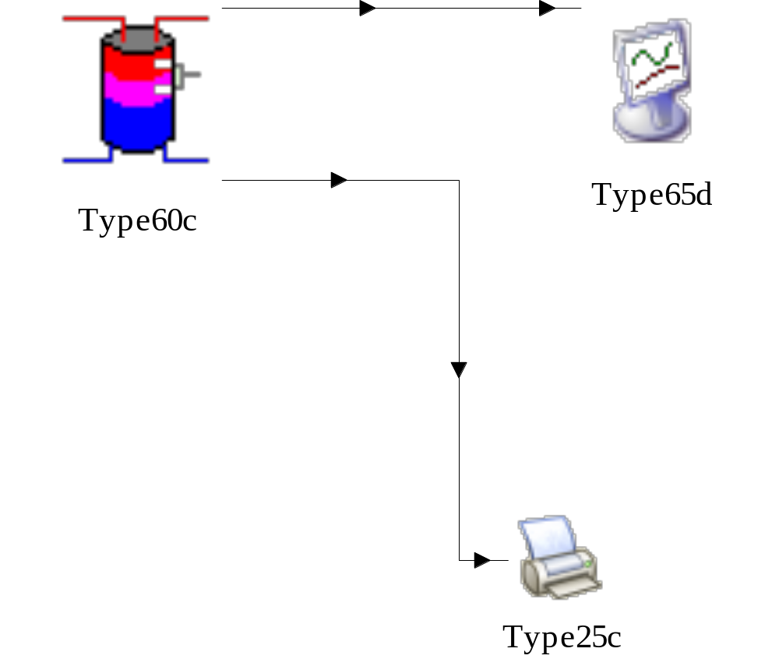
TRNSYS Simulation

Slide 43
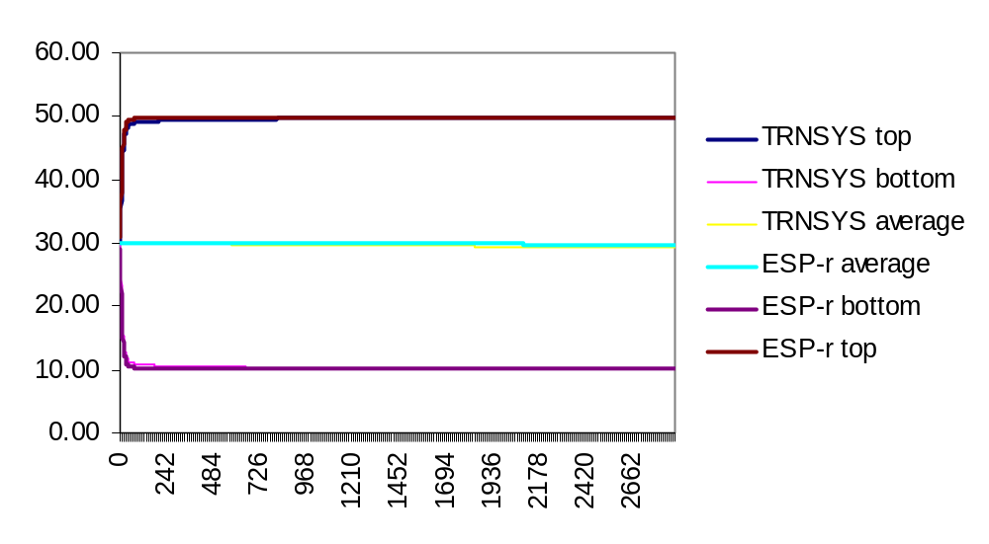
Results Comparison

Slide 44
Comments & Questions

Slide 45
Your Help
Use and test the wrapper
Identify and correct the bugs
Expand the scope from plant to electrical network
A test case without copyright issues
Email: weiwang@nrcan.gc.ca

