Slide 1
Electrical networks in ESP-r

Slide 2
Objectives
How does ESP-r model buildings?
What is ESP-r capable of?
How do I model buildings in ESP-r?

Slide 3
Outline
Introduction
  What is Building simulation
  ESP-r methodologies
  ESP-r structure
Demonstration and hands-on exercises
  Building thermal domain
  Network air flow modelling

Slide 4



Electrical network with PV
PV-bus (floating voltage)
PV-array
DC-AC converter
AC-bus (120V)
Occupant-driven loads
Grid import/
export
HVAC Pumps

Slide 5
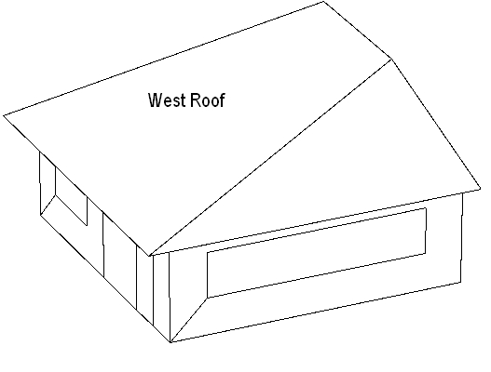
PV located on west-roof

