Slide 1
Electrical networks in ESP-r

Slide 2
Objectives
How does ESP-r model
electrical networks?
How can electrical networks
be coupled to other domains?
How can I model electrical networks?

Slide 3
Outline
Introduction
  Electrical network methodology
  Special materials & Hybrid components
  Power-only components and occupant-driven loads
  Connectors
  Grid interaction
Demonstration and hands-on exercises
  Special materials --- renewables
  Coupling plant components
  Power-only components
  Simulations and results analysis

Slide 4
Electric networks
Connection to
other domains
Connection to
other domains
Node 1
Component A
Component B
Connector 1
Node 2
Grid import
export
Connector 2
Node 3

Slide 5
Nodes
Describe portions of network with common voltages
Node 1
Component A
Calculated:
Voltage computed
by coupled
component
Node 2
Grid import
export
Balanced:
Voltage dependant
on other nodes
Fixed:
Voltage maintained
by grid import/export
Node 3

Slide 6
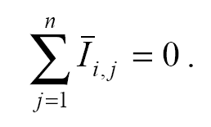
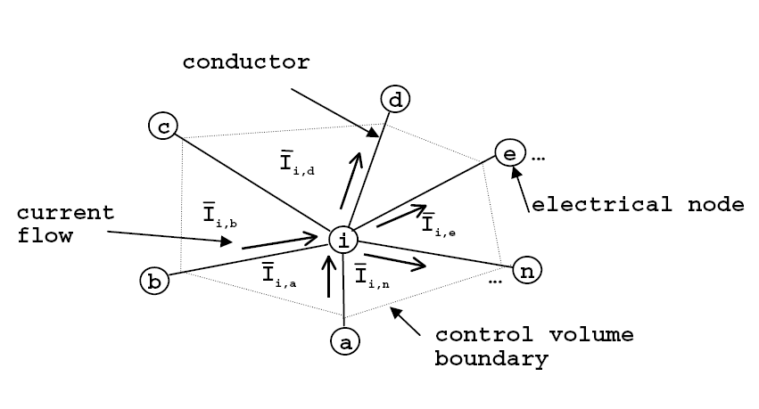
Node control volumes
Flow (current) and energy balances

Slide 7
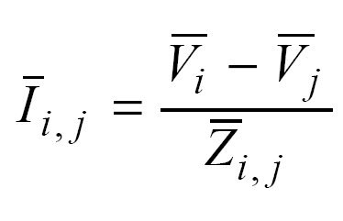
Conductors
Describe constant, linear impedance between nodes

Slide 8
Components
Connection to
other domains
Connection to
other domains
Component A
Component B
Components couple network to other domains (plant/building envelope)
Provide network BC’s
Can also stand-in for conductors with non-linear impedance.

Slide 9
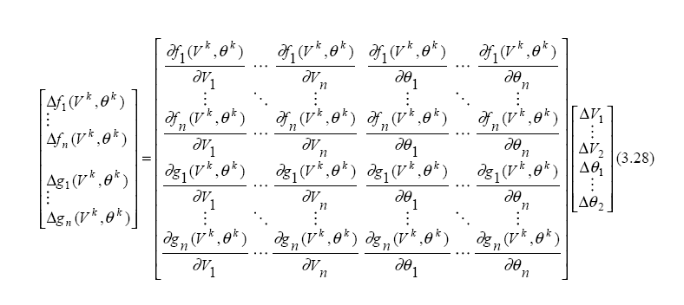
Network solution

Slide 10
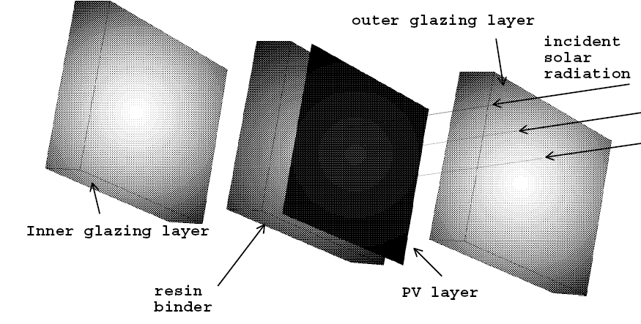
Special materials (PV)
Fully integrated into building fabric
  performance temperature dependent
  Transmittance computed like windows

Slide 11
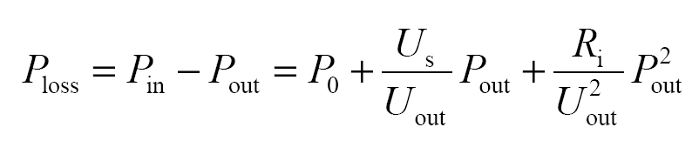
Power conditioning (DC-DC, AC-DC)
PCU

Slide 12
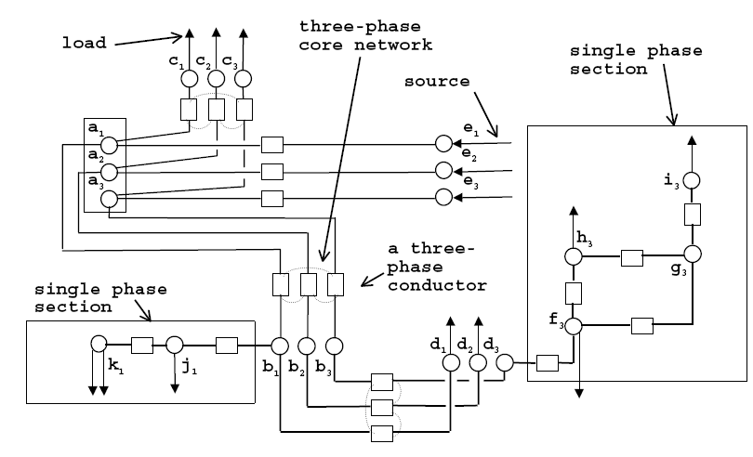
ESP-r Electrical network

Slide 13



Electrical network with PV
PV-bus (floating voltage)
PV-array
DC-AC converter
AC-bus (120V)
Occupant-driven loads
Grid import/
export
HVAC Pumps

Slide 14
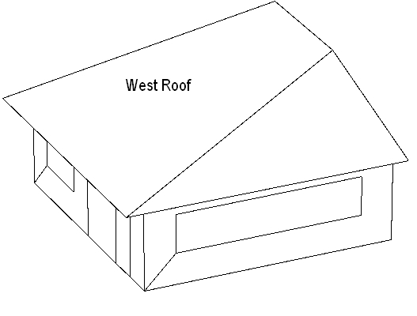
PV located on west-roof

