Slide 1
Plant networks in ESP-r

Slide 2
Objectives
How does ESP-r model buildings?
What is ESP-r capable of?
How do I model buildings in ESP-r?

Slide 3
Outline
Introduction
  What is Building simulation
  ESP-r methodologies
  ESP-r structure
Demonstration and hands-on exercises
  Building thermal domain
  Network air flow modelling

Slide 4
Solar heating system
Solar
Collector
Radiators
Gas-fired
tank
Buffer
tank

Slide 5
Plant-networks: Components
Solar
Collector
Radiators
Gas-fired
tank
Buffer
tank

Slide 6
Plant-components: Control-volumes
Solar
Collector
Radiators
Gas-fired
tank
Buffer
tank

Slide 7
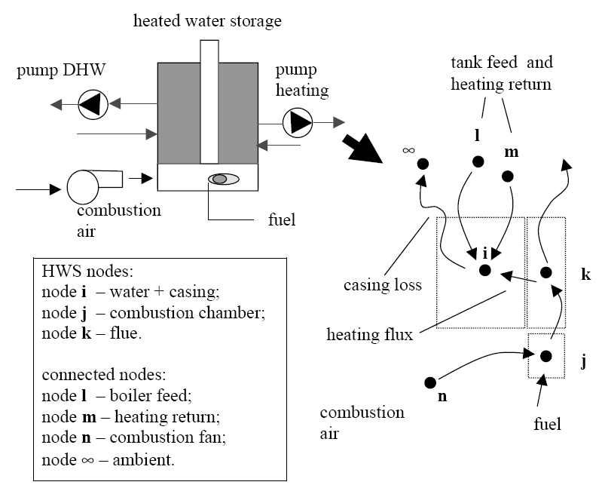
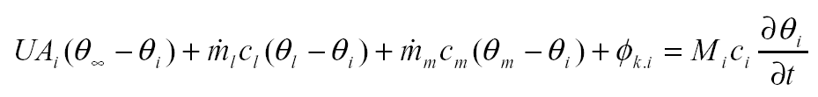
Component models: control volumes

Slide 8
Building coupling
Sequential solution
B
B
B
B
B
B
B
P
P
P
P
P
P
P
Integrated solution
B
B
B
B
B
B
B
P
P
P
P
P
P
P

Slide 9
Plant network constituents
Components
T
Connections
T
Containments
Solar
Collector
Controls
T
Buffer
tank

Slide 10
Components
Selected from database
Linked to algorithms in ESP-r sourse code
Scope and resolution varies
Solar
Collector

Slide 11
Connections
Describe two-phase fluid flow paths
Diversion ratios:
Must add to 1 for
each node
Are ignored for
imposed flows.
Radiators
Gas-fired
tank

Slide 12
Containments
Describe a component’s surroundings
Can be:
  Fixed value
  Ambient (outdoor)
  Zone / surface / layer
  Node within another plant component
  Fixed temperature
T
Solar
Collector
T

Slide 13
Solar heating system
Solar
Collector
Radiators
Gas-fired
tank
Buffer
tank

Slide 14
Controls
Solar
Collector
Radiators
Gas-fired
tank
Buffer
tank

Slide 15
Controls: Buffer tank pump
Irradiance
200 W - on
Solar
Collector
100 W - off
P
Time
Buffer
tank

Slide 16
Controls: Gas burner
Temperature
60 °C - off
55 °C - off
Time
Gas-fired
tank
T
Buffer
tank

Slide 17
Controls: Gas-fired-tank pump
Temperature
60 °C - on
55 °C - off
Time
Gas-fired
tank
T
Buffer
tank

Slide 18
Controls: Radiator pump
Radiators
Gas-fired
tank
Temperature
21 °C - off
19 °C - on
Time

