Slide 1
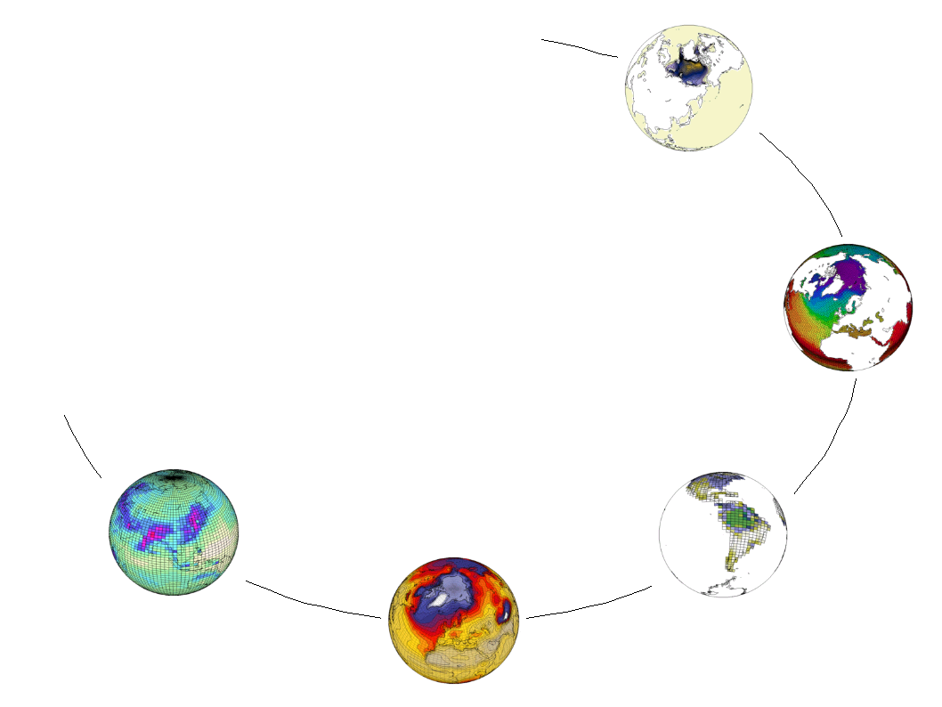
PRODIGUER
French Climate Modelling
Information Services Platform

Slide 2
Core Partners
IPSL – (Paris)
CERFACS – (Toulouse)
Meteo-France (Toulouse)

Slide 3
Core Team
Sebastien Denvil (IPSL)
Ashish Bhardwaj (IPSL)
Mark Morgan (IPSL)

Slide 4
Core Objectives
Collaborative eScience
Accessible Data
Real-time simulation monitoring
Meta-data publishing

Slide 5
PART 1
The Big Picture

Slide 6
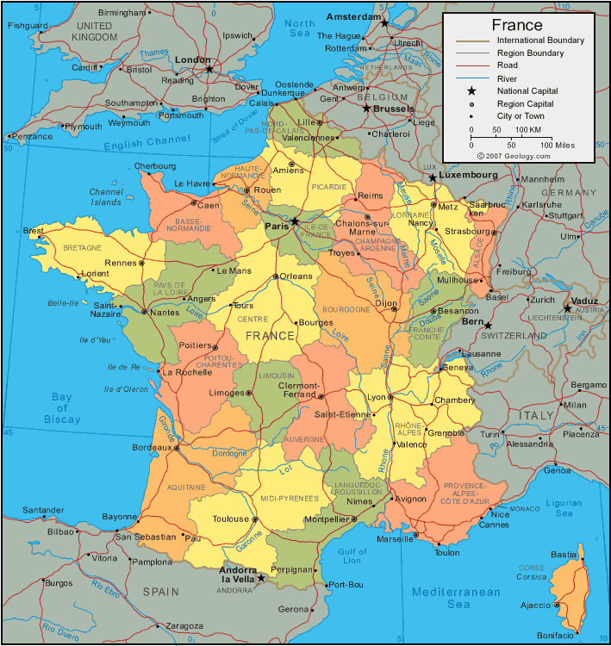
Core Computational Centres
CCRT
IDRIS
CERFACS
Meteo
France

Slide 7
SCIENTIFIC COMPUTING CENTRES (DN = DATA NODE)
DN-1
(CCRT)
DN-2
(IDRIS)
DN-3
(CERFACS)
...
DN-N
(Meteo-France)
CORE (CMIP5+)
OPERATIONAL (R&D)
HTTPS / X509
HTTPS / X509
HTTPS / X509
PRODIGUER WEB SERVERS
(IPSL)
HTTPS / X509
HTTPS / X509
HTTPS / OpenID
ESG GATEWAY
(PCMDI)
METAFOR
(BADC)
IS-ENES
(DKRZ)
HTTPS / OpenID
HTTPS / OpenID
HTTPS / OpenID
PRODIGUER COMMUNITY
(Scientists, Researchers, Students)

Slide 8
3 Step Transition
1- Data Nodes
2 – Web Services
3 – Web Portals

Slide 9
STEP 1
DATA NODES
CCRT, IDRIS, CERFACS, Meteo-France

Slide 10
Computational Centre
COMPUTATION CLUSTER
STORAGE CLUSTER
SM 1
SM 2
SM N
...
DISK
TAPE

Slide 11
Computational Centre
COMPUTATION CLUSTER
STORAGE CLUSTER
SM 1
SM 2
SM N
...
DISK
TAPE
PRODIGUER DATA-NODE

Slide 12
Computational Centre
COMPUTATION CLUSTER
STORAGE CLUSTER
SM 1
SM 2
SM N
...
DISK
TAPE
PRODIGUER DATA-NODE
ESG
Data Publishing

Slide 13
Computational Centre
COMPUTATION CLUSTER
STORAGE CLUSTER
SM 1
SM 2
SM N
...
DISK
TAPE
PDG
PDG
PDG
PRODIGUER DATA-NODE
Prodiguer
Messaging
ESG
Data Publishing

Slide 14
Computational Centre
COMPUTATION CLUSTER
STORAGE CLUSTER
SM 1
SM 2
SM N
...
DISK
TAPE
PDG
PDG
PDG
PRODIGUER DATA-NODE
Prodiguer
Messaging
ESG
Data Publishing

Slide 15
Computational Centre
COMPUTATION CLUSTER
STORAGE CLUSTER
SM 1
SM 2
SM N
...
DISK
TAPE
PDG
PDG
PDG
FIREWALL
PRODIGUER DATA-NODE
Prodiguer
Messaging
ESG
Data Publishing

Slide 16
Computational Centre
COMPUTATION CLUSTER
STORAGE CLUSTER
SIM 1
SIM 2
SIM N
...
DISK
TAPE
PDG
PDG
PDG
FIREWALL
PRODIGUER DATA-NODE
Prodiguer
Messaging
ESG
Publishing
HTTPS
HTTP
HTTPS
GRID-FTP
WEB SERVICES

Slide 17
STEP 2
WEB SERVICES
ESG , Prodiguer, Metafor, IS-ENES
Meta-Data Publication

Slide 18
Meta-Data Publication
FRENCH SCIENTIFIC COMPUTING CENTRES (DN = DATA NODE)
DN-1
(CCRT)
DN-2
(IDRIS)
DN-3
(CERFACS)
...
DN-N
(Meteo-France)

Slide 19
Meta-Data Publication
FRENCH SCIENTIFIC COMPUTING CENTRES (DN = DATA NODE)
DN-1
(CCRT)
DN-2
(IDRIS)
DN-3
(CERFACS)
...
DN-N
(Meteo-France)
CORE (CIMP5)

Slide 20
Meta-Data Publication
FRENCH SCIENTIFIC COMPUTING CENTRES (DN = DATA NODE)
DN-1
(CCRT)
DN-2
(IDRIS)
DN-3
(CERFACS)
...
DN-N
(Meteo-France)
CORE (CIMP5)
OPERATIONAL

Slide 21
Meta-Data Publication
FRENCH SCIENTIFIC COMPUTING CENTRES (DN = DATA NODE)
DN-1
(CCRT)
DN-2
(IDRIS)
DN-3
(CERFACS)
...
DN-N
(Meteo-France)
CORE (CIMP5)
OPERATIONAL
WEB SERVICES (RESTful, AtomPub)

Slide 22
Meta-Data Publication
FRENCH SCIENTIFIC COMPUTING CENTRES (DN = DATA NODE)
DN-1
(CCRT)
DN-2
(IDRIS)
DN-3
(CERFACS)
...
DN-N
(Meteo-France)
CORE (CIMP5)
OPERATIONAL
WEB SERVICES (RESTful, AtomPub)
ESG – GATEWAY
ESG – GATEWAY
DATABASE(S)
PostGres, RDF-Triple

Slide 23
Meta-Data Publication
FRENCH SCIENTIFIC COMPUTING CENTRES (DN = DATA NODE)
DN-1
(CCRT)
DN-2
(IDRIS)
DN-3
(CERFACS)
...
DN-N
(Meteo-France)
CORE (CIMP5)
OPERATIONAL
WEB SERVICES (RESTful, AtomPub)
ESG – GATEWAY
ESG – GATEWAY
PRODIGUER
DATABASE(S)
PostGres, RDF-Triple
DATABASE(S)
PostGres

Slide 24
Meta-Data Publication
FRENCH SCIENTIFIC COMPUTING CENTRES (DN = DATA NODE)
DN-1
(CCRT)
DN-2
(IDRIS)
DN-3
(CERFACS)
...
DN-N
(Meteo-France)
CORE (CIMP5)
OPERATIONAL
WEB SERVICES (RESTful, AtomPub)
ESG – GATEWAY
METAFOR / IS-ENES
ESG – GATEWAY
PRODIGUER
DATABASE(S)
PostGres, RDF-Triple
DATABASE(S)
eXist, PostGres
DATABASE(S)
PostGres

Slide 25
Meta-Data Publication
FRENCH SCIENTIFIC COMPUTING CENTRES (DN = DATA NODE)
DN-1
(CCRT)
DN-2
(IDRIS)
DN-3
(CERFACS)
...
DN-N
(Meteo-France)
CORE (CIMP5)
OPERATIONAL
XML
Base64
WEB SERVICES (RESTful, AtomPub)
ESG – GATEWAY
METAFOR / IS-ENES
ESG – GATEWAY
PRODIGUER
DATABASE(S)
PostGres, RDF-Triple
DATABASE(S)
eXist, PostGres
DATABASE(S)
PostGres
XML
XML

Slide 26
Meta-Data Publication
FRENCH SCIENTIFIC COMPUTING CENTRES (DN = DATA NODE)
DN-1
(CCRT)
DN-2
(IDRIS)
DN-3
(CERFACS)
...
DN-N
(Meteo-France)
CORE (CIMP5)
OPERATIONAL
XML
Base64
HTTPS / X509
WEB SERVICES (RESTful, AtomPub)
ESG – GATEWAY
METAFOR / IS-ENES
ESG – GATEWAY
PRODIGUER
DATABASE(S)
PostGres, RDF-Triple
HTTPS / X509
DATABASE(S)
eXist, PostGres
HTTPS / X509
DATABASE(S)
PostGres
XML
XML

Slide 27
Prodiguer Web Services
Apache
X509
Python
Pylons

Slide 28
STEP 3
WEB PORTALS
ESG , Prodiguer, Metafor, IS-ENES
Meta-Data Analysis

Slide 29
Meta-Data Analysis
WEB SERVICES (RESTful, AtomPub)
ESG – GATEWAY
METAFOR / IS-ENES
ESG – GATEWAY
PRODIGUER
DATABASE(S)
PostGres, RDF-Triple
DATABASE(S)
eXist, PostGres
DATABASE(S)
PostGres

Slide 30
Meta-Data Analysis
WEB SERVICES (RESTful, AtomPub)
ESG – GATEWAY
METAFOR / IS-ENES
ESG – GATEWAY
PRODIGUER
DATABASE(S)
PostGres, RDF-Triple
DATABASE(S)
eXist, PostGres
DATABASE(S)
PostGres
WEB PORTALS (HTML / Javascript)

Slide 31
Meta-Data Analysis
WEB SERVICES (RESTful, AtomPub)
ESG – GATEWAY
METAFOR / IS-ENES
ESG – GATEWAY
PRODIGUER
DATABASE(S)
PostGres, RDF-Triple
DATABASE(S)
eXist, PostGres
DATABASE(S)
PostGres
ESG CURATOR
WEB PORTALS (HTML / Javascript)

Slide 32
Meta-Data Analysis
WEB SERVICES (RESTful, AtomPub)
ESG – GATEWAY
METAFOR / IS-ENES
ESG – GATEWAY
PRODIGUER
DATABASE(S)
PostGres, RDF-Triple
DATABASE(S)
eXist, PostGres
DATABASE(S)
PostGres
ESG CURATOR
METAFOR /
IS-ENES
WEB PORTALS (HTML / Javascript)

Slide 33
Meta-Data Analysis
WEB SERVICES (RESTful, AtomPub)
ESG – GATEWAY
METAFOR / IS-ENES
ESG – GATEWAY
PRODIGUER
DATABASE(S)
PostGres, RDF-Triple
DATABASE(S)
eXist, PostGres
DATABASE(S)
PostGres
ESG CURATOR
METAFOR /
IS-ENES
PRODIGUER
WEB PORTALS (HTML / Javascript)

Slide 34
Meta-Data Analysis
WEB SERVICES (RESTful, AtomPub)
ESG – GATEWAY
METAFOR / IS-ENES
ESG – GATEWAY
PRODIGUER
DATABASE(S)
PostGres, RDF-Triple
DATABASE(S)
eXist, PostGres
DATABASE(S)
PostGres
ESG CURATOR
METAFOR /
IS-ENES
PRODIGUER
WEB PORTALS (HTML / Javascript)

Slide 35
Meta-Data Analysis
WEB SERVICES (RESTful, AtomPub)
ESG – GATEWAY
METAFOR / IS-ENES
ESG – GATEWAY
PRODIGUER
DATABASE(S)
PostGres, RDF-Triple
DATABASE(S)
eXist, PostGres
DATABASE(S)
PostGres
XML
JSON / XML
JSON
ESG CURATOR
METAFOR /
IS-ENES
PRODIGUER
WEB PORTALS (HTML / Javascript)

Slide 36
Meta-Data Analysis
WEB SERVICES (RESTful, AtomPub)
ESG – GATEWAY
METAFOR / IS-ENES
ESG – GATEWAY
PRODIGUER
DATABASE(S)
PostGres, RDF-Triple
DATABASE(S)
eXist, PostGres
DATABASE(S)
PostGres
XML
JSON / XML
JSON
HTTPS / OpenID
ESG CURATOR
METAFOR /
IS-ENES
PRODIGUER
WEB PORTALS (HTML / Javascript)

Slide 37
Meta-Data Analysis
WEB SERVICES (RESTful, AtomPub)
ESG – GATEWAY
METAFOR / IS-ENES
ESG – GATEWAY
PRODIGUER
DATABASE(S)
PostGres, RDF-Triple
DATABASE(S)
eXist, PostGres
DATABASE(S)
PostGres
XML
JSON / XML
JSON
HTTPS / OpenID
Max Planck Institute
University of
Cantabria
Meteo-France
WEB PORTALS (HTML / Javascript)

Slide 38
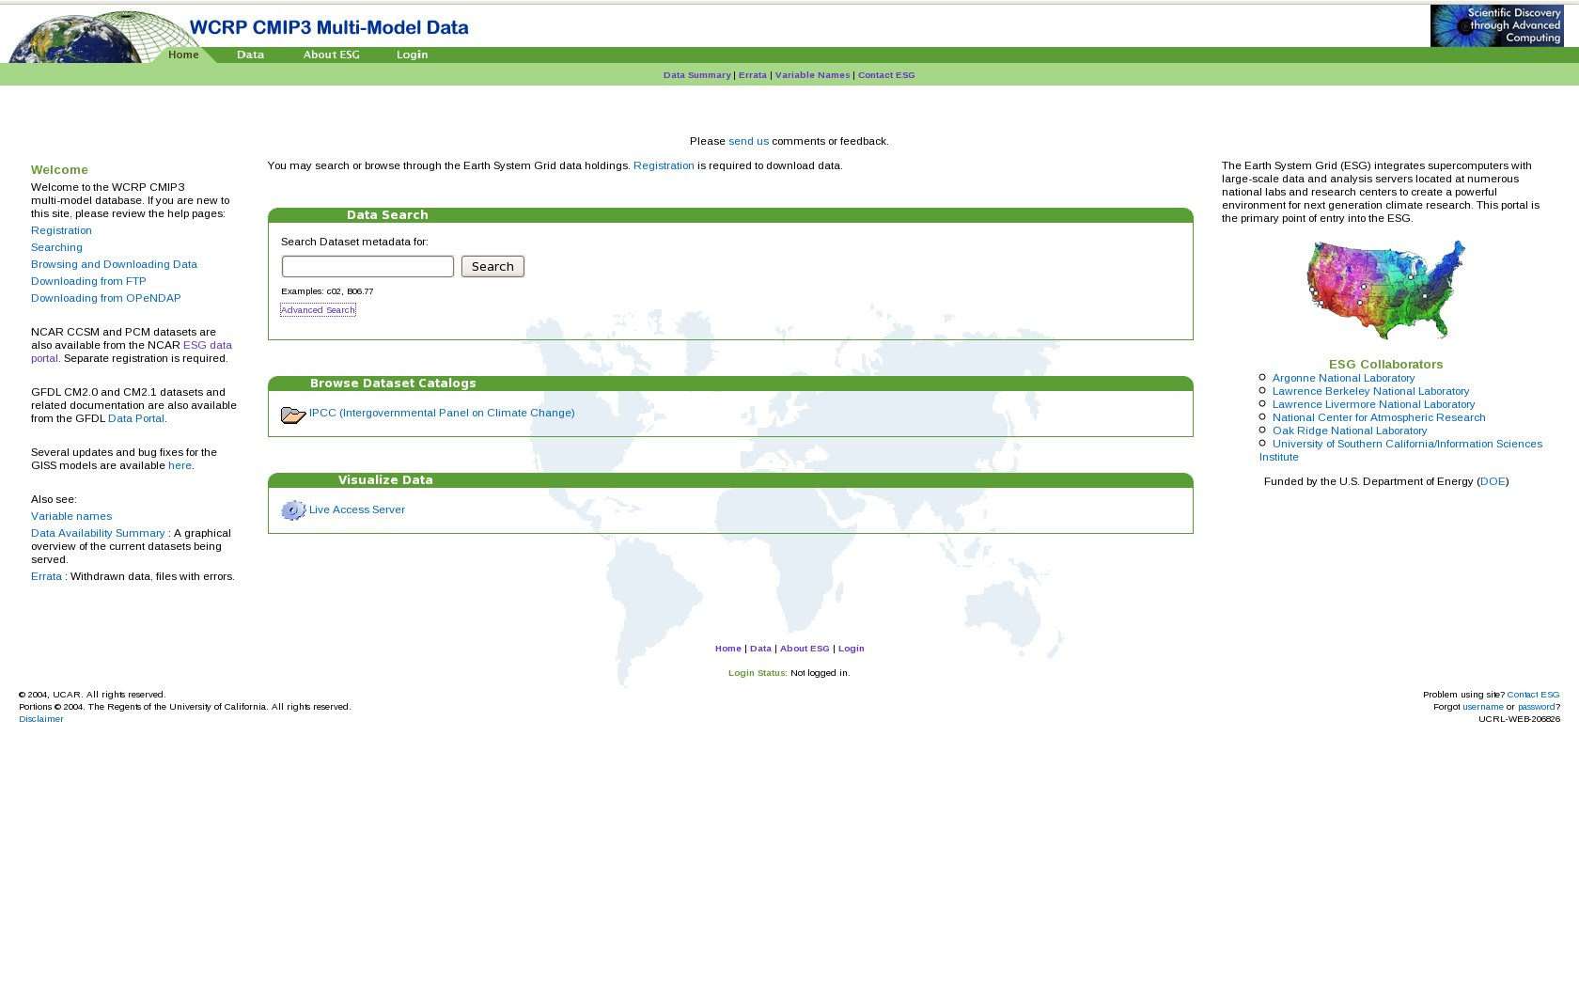
ESG Web Portal

Slide 39
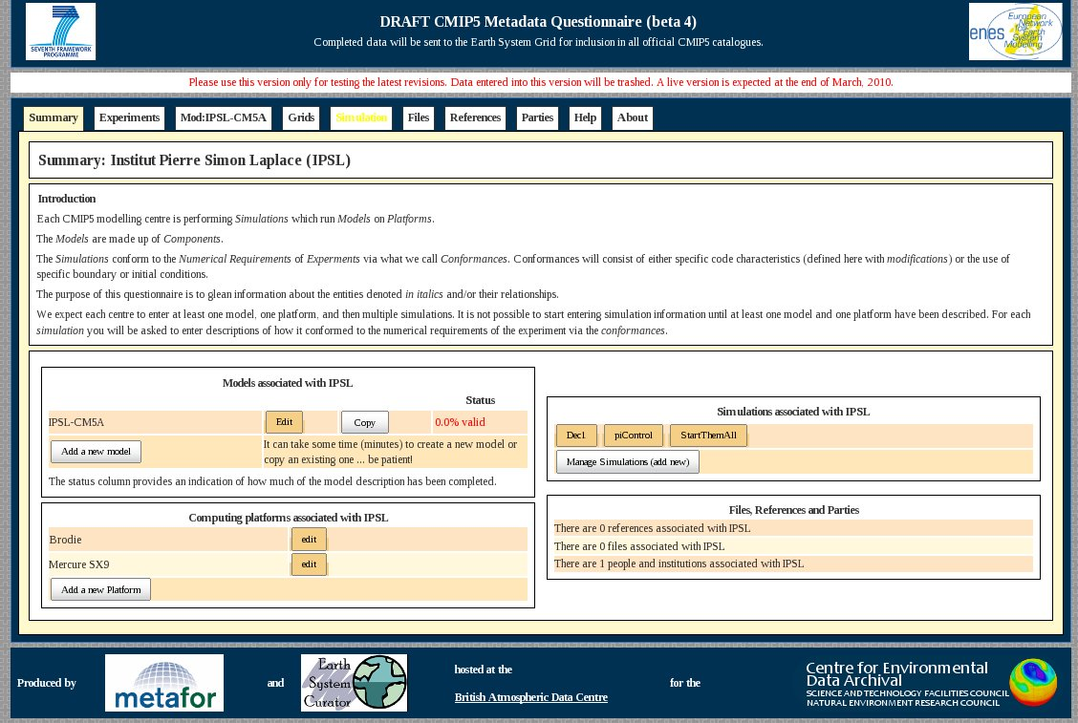
Metafor Web Portal

Slide 40
Prodiguer Web Portal
Apache
OpenID
Python
Pylons
HTML
Javascript
Jquery
JSON
In Progress
Version 1.0: July 2010

Slide 41
PART 2
Bottom-Up View

Slide 42
PRODIGUER Messaging Infrastructure
Python, Message Queues, Databases

Slide 43
Computational Centre
COMPUTATION CLUSTER
STORAGE CLUSTER
SIM 1
SIM 2
SIM N
...
DISK
TAPE
PDG
PDG
PDG
FIREWALL
PRODIGUER DATA-NODE
Prodiguer
Messaging
ESG
Publishing
HTTPS
HTTP
HTTPS
GRID-FTP
WEB SERVICES

Slide 44
Computational Centre
COMPUTATION CLUSTER
STORAGE CLUSTER
SIM 1
SIM 2
SIM N
...
DISK
TAPE
PDG
PDG
PDG
FIREWALL
PRODIGUER DATA-NODE
Prodiguer
Messaging
HTTPS
WEB SERVICES

Slide 45
OBJECTIVE
Real time simulation monitoring across Prodiguer enabled computation centres

Slide 46
USE CASES
View simulations by centre
View simulations by time-period
View Simulations by user
View simulations by failure
View simulations by coupling
View simulations by coupling and failure
View simulation configuration files
Display results in tabular and graphical (Atlas) modes.

Slide 47
SIMULATION MACHINE
Simulation Execution Environment (e.g. IGCM)
S 1
S 2
S 3
...
S N
Input
.ini
.netCDF
.make
Events
100=Start
101=Stop
Output
.ini
.netCDF

Slide 48
SIMULATION MACHINE
Simulation Execution Environment (e.g. IGCM)
S 1
S 2
S 3
...
S N
Input
.ini
.netCDF
.make
Events
100=Start
101=Stop
Output
.ini
.netCDF
Prodiguer Simulation Monitor

Slide 49
SIMULATION MACHINE
Simulation Execution Environment (e.g. IGCM)
S 1
S 2
S 3
...
S N
Input
.ini
.netCDF
.make
Events
100=Start
101=Stop
Output
.ini
.netCDF
Prodiguer Simulation Monitor
FIREWALL
Prodiguer Data Node

Slide 50
SIMULATION MACHINE
Simulation Execution Environment (e.g. IGCM)
S 1
S 2
S 3
...
S N
Input
.ini
.netCDF
.make
Events
100=Start
101=Stop
Output
.ini
.netCDF
Prodiguer Simulation Monitor
FIREWALL
Prodiguer Data Node
HTTPS / X509
Prodiguer Web Services

Slide 51
System Constraints
Secure
Fault Tolerant
Distributed
Reliable
Extensible
Loosely Coupled
Python Implemented

Slide 52
What If ....

Slide 53
SIMULATION MACHINE
Simulation Execution Environment (e.g. IGCM)
S 1
S 2
S 3
...
S N
Input
.ini
.netCDF
.make
Events
100=Start
101=Stop
Output
.ini
.netCDF
Prodiguer Simulation Monitor
FIREWALL
Prodiguer Data Node
HTTPS / X509
Prodiguer Web Services

Slide 54
SIMULATION MACHINE
Simulation Execution Environment (e.g. IGCM)
S 1
S 2
S 3
...
S N
Input
.ini
.netCDF
.make
Events
100=Start
101=Stop
Output
.ini
.netCDF
Prodiguer Simulation Monitor
FIREWALL
Prodiguer Data Node
HTTPS / X509
Prodiguer Web Services

Slide 55
Solution =
Durable Message Queues

Slide 56
AMPQ
Advanced Message Queue Protocol
1. A standard ala HTTP
2. Supported Message Patterns:
Reliable Fire & Forget;
Broadcast;
File Transfer;
3. Supported by industry players

Slide 57
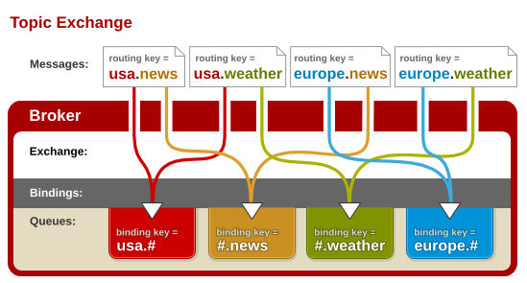

Slide 58
RabbitMQ
AMQP Implementation
1. Erlang – i.e. parallel & scalable;
2. Persistence – i.e. durable;
3. Multi-OS – i.e. ubiquitous;
4. Python – py-amqlib / txAMPQ

Slide 59
RabbitMQ
Python Libraries (py-amqlib / txAMPQ)
# Importing client package from amqplib import client_0_8 as amqp
# Opening comms channel to RabbitMQ server conn = amqp.Connection(host="localhost:5672 ", userid="guest", password="guest", virtual_host="/", insist=False) chan = conn.channel()
# Declaring queue chan.queue_declare(queue="po_box", durable=True, auto_delete=False)
# Writing to queue msg = amqp.Message("Test message!") chan.basic_publish(msg,exchange="sorting_room",routing_key="jason")
# Reading from queue chan.queue_bind(queue="po_box", exchange="sorting_room", routing_key="EGU") msg = chan.basic_get("po_box")

Slide 60
SIMULATION MACHINE
Simulation Execution Environment (e.g. IGCM)
S 1
S 2
S 3
...
S N
Input
.ini
.netCDF
.make
Events
100=Start
101=Stop
Output
.ini
.netCDF
Prodiguer Simulation Monitor
FIREWALL
Prodiguer Data Node
HTTPS / X509
Prodiguer Web Services

Slide 61
MessageInfo Python Base Classe
* = derived
MessageInfo
IdInfo
(GUID, Timestamp, TypeCode)
QueueInfo
MachineInfo*
UserInfo*
ProcessInfo*

Slide 62
Message Handling Python Classes
MessageQueueManager
  Manages all message queue access
MessageQueue
  Message queue wrapper (RabbitMQ)
  Exposes methods: queue(), dequeue(), requeue()
MessageDispatcherManager
  Manages a private collection of message dispatchers
  Manages interaction with event queues
MessageDispatcher
  Dispatches messages to next comms node

Slide 63
SIMULATION MACHINE
Simulation Execution Environment (e.g. IGCM)
S 1
S 2
S 3
...
S N
Input
.ini
.netCDF
.make
Events
100=Start
101=Stop
Output
.ini
.netCDF
Prodiguer Simulation Monitor
Event Monitor
Event Queue(s)
(RabbitMQ)
Event Publisher
Prodiguer Data Node

Slide 64
Event Info Python Classes
* = derived
EventInfo : MessageInfo
SimulationInfo
(Status, ID)

Slide 65
Event Handling Python Classes
EventMonitorManager
  Manages collection of event monitors
  Exposes methods for invoking event listeners
EventMonitor
  Handles events raised from simulation environment
EventPublisherManager
  Manages a private collection of event publishers
  Manages interaction with event queues
EventPublisher
  Publishes event information to Prodiguer data node

Slide 66
Prodiguer Data Node
Prodiguer Simulation Monitor
Event Monitor
Event Queue(s)
(RabbitMQ)
Event Publisher
Prodiguer Web Services

Slide 67
Event Info Python Classes
* = derived
EventInfo : MessageInfo
SimulationInfo
(Status, ID)
SimulationInfo
ComputingCentreInfo*
(Code, Timestamp)

Slide 68
Event Handling Python Classes
EventMonitorManager
  Manages collection of event monitors
  Exposes methods for invoking event listeners
EventMonitor
  Handles events raised from simulation environment
EventPublisherManager
  Manages a private collection of event publishers
  Manages interaction with event queues
EventPublisher
  Publishes event information to Prodiguer data node

Slide 69
Prodiguer Web Services
Prodiguer Simulation Monitor
Event Monitor
Event Queue(s)
(RabbitMQ)
Event Processors

Slide 70
Prodiguer Web Services
Prodiguer Simulation Monitor
Event Monitor
Event Queue(s)
(RabbitMQ)
Event Processors
SqlAlchemy
PRODIGUER DATABASE(S)

Slide 71
Event Handling Python Classes
EventMonitorManager
  Manages collection of event monitors
  Exposes methods for invoking event listeners
EventMonitor
  Handles events raised from simulation environment
EventProcessorManager
  Manages a private collection of event processors
  Manages interaction with event queues
EventProcessor
  Processes event information, e.g. persist to database

Slide 72
Prodiguer Web Portal
PRODIGUER DATABASE(S)
SqlAlchemy
Simulation Monitor Web Application
JSON
HTTPS / OpenID
PRODIGUER COMMUNITY
Researchers, Scientists, Students,
Impacts, Private Sector,
Politicians, Journalists, Public

Slide 73
System Constraints
Secure
Fault Tolerant
Distributed
Reliable
Extensible
Loosely Coupled
Python Implemented

Slide 74
FUTURE
Intra-Cluster Messaging ???

Slide 75
SUMMARY

Slide 76
PRODIGUER
French Climate Modelling
Information Services Platform

Slide 77
Core Partners
IPSL – (Paris)
CERFACS – (Toulouse)
Meteo-France (Toulouse)

Slide 78
Core Team
Sebastien Denvil (IPSL)
Ashish Bhardwaj (IPSL)
Mark Morgan (IPSL)

Slide 79
Core Objectives
Collaborative eScience
Accessible Data
Real-time simulation monitoring
Meta-data publishing

Slide 80
SCIENTIFIC COMPUTING CENTRES (DN = DATA NODE)
DN-1
(CCRT)
DN-2
(IDRIS)
DN-3
(CERFACS)
...
DN-N
(Meteo-France)
CORE (CMIP5+)
OPERATIONAL (R&D)
HTTPS / X509
HTTPS / X509
HTTPS / X509
PRODIGUER WEB SERVERS
(IPSL)
HTTPS / X509
HTTPS / X509
HTTPS / OpenID
ESG GATEWAY
(PCMDI)
METAFOR
(BADC)
IS-ENES
(DKRZ)
HTTPS / OpenID
HTTPS / OpenID
HTTPS / OpenID
PRODIGUER COMMUNITY
(Scientists, Researchers, Students)

Slide 81
Computational Centre
COMPUTATION CLUSTER
STORAGE CLUSTER
SIM 1
SIM 2
SIM N
...
DISK
TAPE
PDG
PDG
PDG
FIREWALL
PRODIGUER DATA-NODE
Prodiguer
Messaging
ESG
Publishing
HTTPS
HTTP
HTTPS
GRID-FTP
WEB SERVICES

Slide 82
Meta-Data Publication
FRENCH SCIENTIFIC COMPUTING CENTRES (DN = DATA NODE)
DN-1
(CCRT)
DN-2
(IDRIS)
DN-3
(CERFACS)
...
DN-N
(Meteo-France)
CORE (CIMP5)
OPERATIONAL
XML
Base64
HTTPS / X509
WEB SERVICES (RESTful, AtomPub)
ESG – GATEWAY
METAFOR / IS-ENES
ESG – GATEWAY
PRODIGUER
DATABASE(S)
PostGres, RDF-Triple
HTTPS / X509
DATABASE(S)
eXist, PostGres
HTTPS / X509
DATABASE(S)
PostGres
XML
XML

Slide 83
Meta-Data Analysis
WEB SERVICES (RESTful, AtomPub)
ESG – GATEWAY
METAFOR / IS-ENES
ESG – GATEWAY
PRODIGUER
DATABASE(S)
PostGres, RDF-Triple
DATABASE(S)
eXist, PostGres
DATABASE(S)
PostGres
XML
JSON / XML
JSON
HTTPS / OpenID
ESG CURATOR
METAFOR /
IS-ENES
PRODIGUER
WEB PORTALS (HTML / Javascript)

Slide 84
SIMULATION MACHINE
Simulation Execution Environment (e.g. IGCM)
S 1
S 2
S 3
...
S N
Input
.ini
.netCDF
.make
Events
100=Start
101=Stop
Output
.ini
.netCDF
Prodiguer Simulation Monitor
FIREWALL
Prodiguer Data Node
HTTPS / X509
Prodiguer Web Services

Slide 85
Durable Message Queues
AMPQ
RabbitMQ

