Slide 1
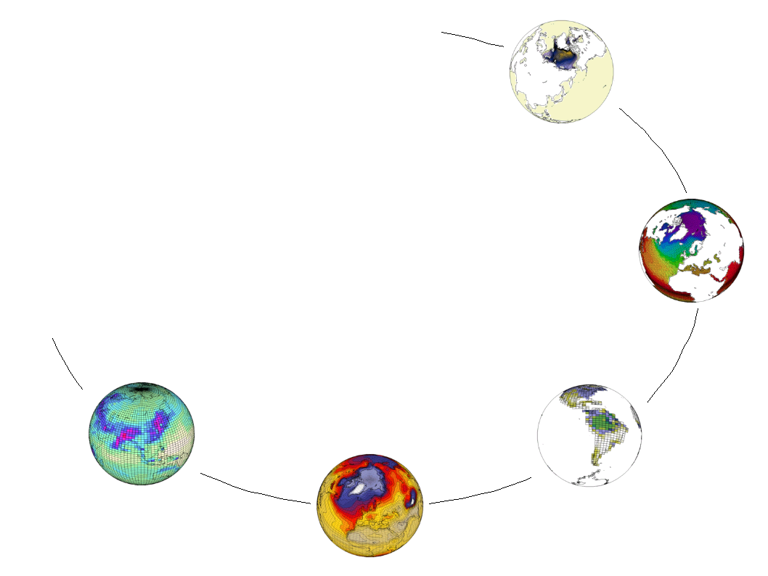



Building on the CMIP5 effort to prepare next steps : integrate community related effort in the every day workflow to lower the data distribution and data management burden
Sébastien Denvil, Mark Morgan, Ashish Bhardwaj, Martial Mancip, and Patrick Brockmann
Climate Modeling Group, IPSL

Slide 2
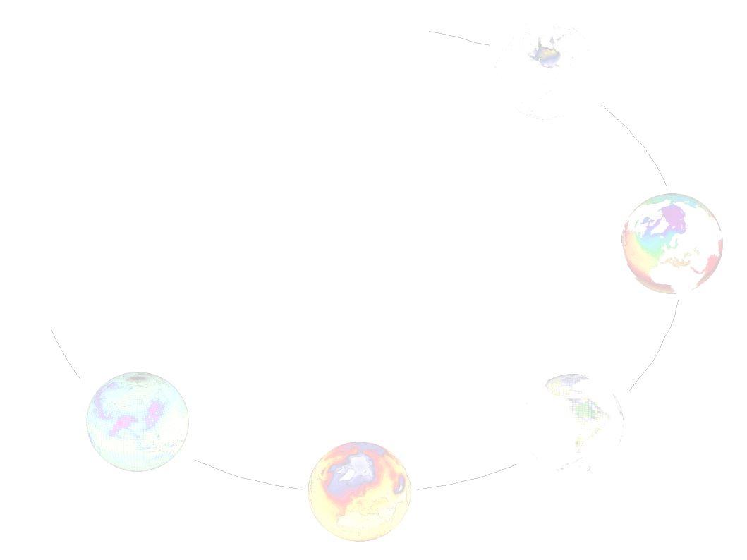
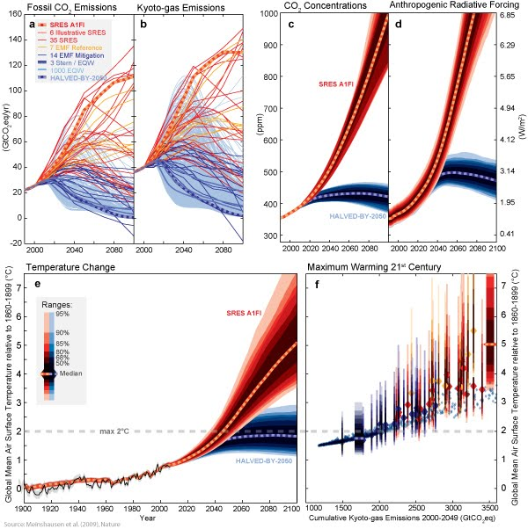
Context : coutdown of the IPCC report
2010 → Mid 2011 : Climate simulations
End of 2010 → ? : Data distribution
End of 2010 → July 2012 : articles submission
September 2013 : IPCC AR5 WG1 plenary session
October 2014 : Nobel Prize?

Slide 3
Management of data since years in many climate modeling groups
Mainly centralized, store on a SAN
OpenDap access on Supercomputing Centre
Basic system of data retrieval
Access to raw data
Security/Authentication/Restriction to data access : not an issue
No on demand post-processing
No metadata integration
No support for high level database query

Slide 4
Emerging requirements for Data management
Move the data a minimum, keep them close to supercomputing centres if possible
  Data access protocol, strong links with computing centres
When data needs to be moved do it quickly and with a minimum amount of human intervention
  Management of storage resources, fast network
Keep a track of what we got, particularly what is on deep storage
  Metadata et data catalogues
Exploiting a federation of sites
  EarthSystemGrid software stack

Slide 5
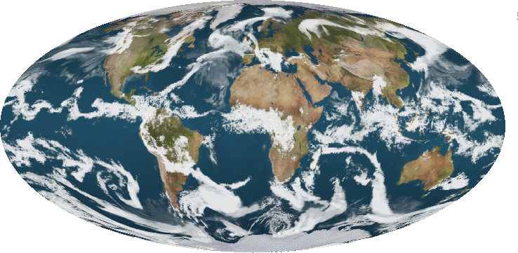
CMIP5 global data amount
Raw Data amount lower bound ➔ 565 TB
Raw Data amount higher bound ➔ 1000 TB
CMIP5 Distribution (50%) ➔ 280-500 TB
Global Storage (Raw+Distributed) ➔ 800-1500 TB
LMDz 0.5° (50 Km)

Slide 6
IPSL Earth System Model (ESM)
Emissions
Tropospheric chemistry
& aerosols (INCA)
Physic – Transport
Atmosphere (LMDZ)
Surface (ORCHIDEE)
Ocean (NEMO/OPA)
Sea ice (NEMO/LIM2)
Coupler (OASIS)
Land use
Carbon / CO₂
(ORCHIDEE, NEMO/PISCES)
Global climate
Volcanoes
Solar irradiance
Stratospheric chemistry / ozone (REPROBUS)
Various kind of Model
Impacts studies
Dynamical Downscaling (RCM)
Regional
climate
Statistical Downscaling

Slide 7
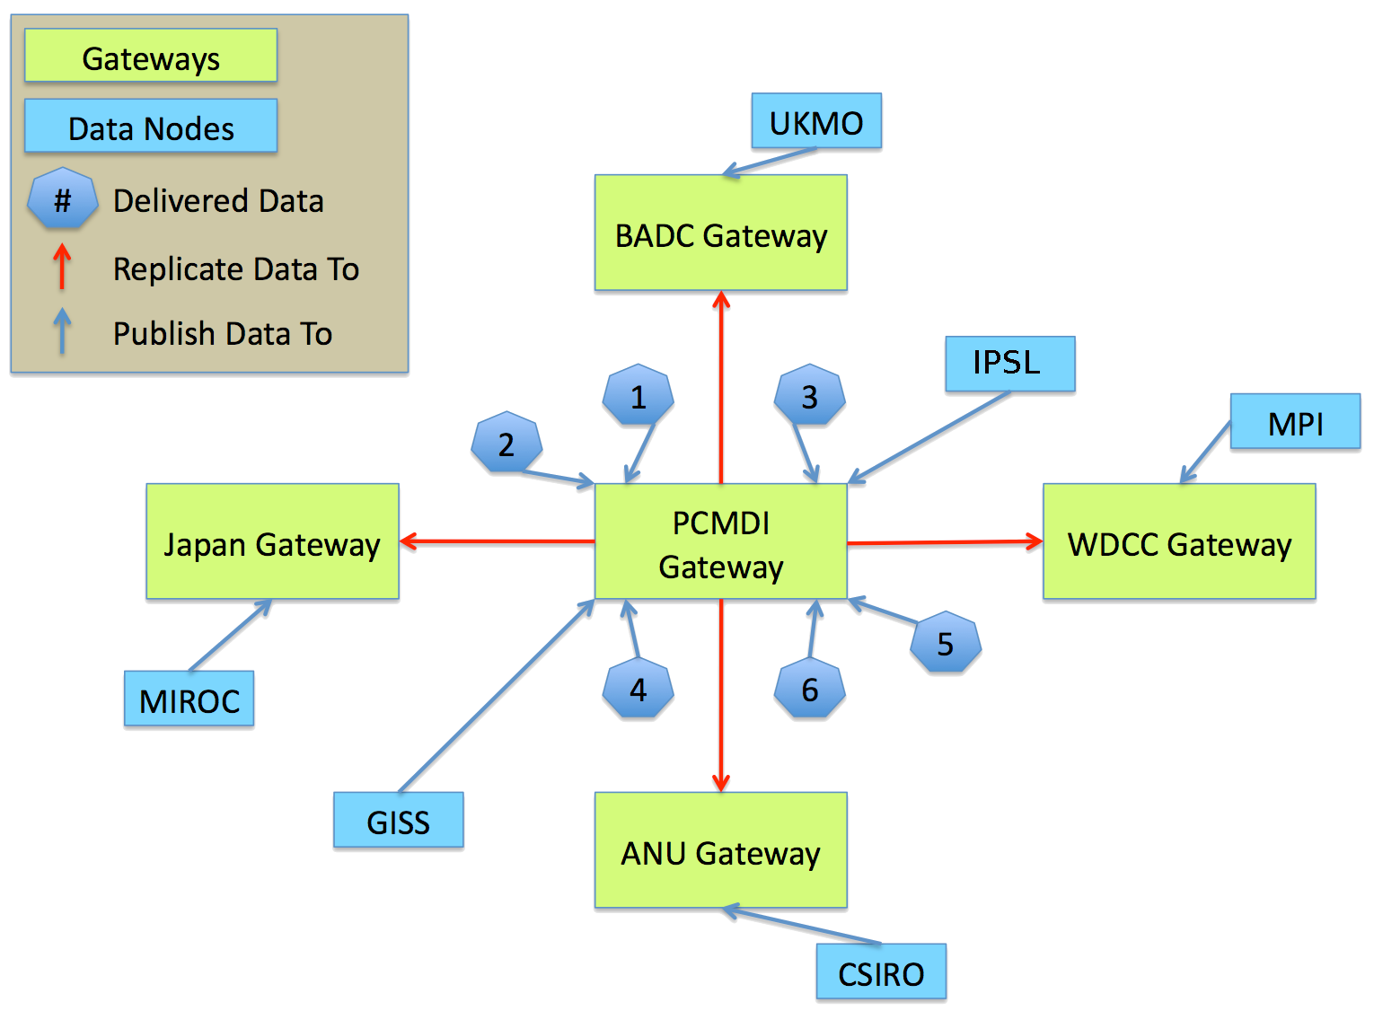
Earth System Grid Federation to support CMIP5

Slide 8
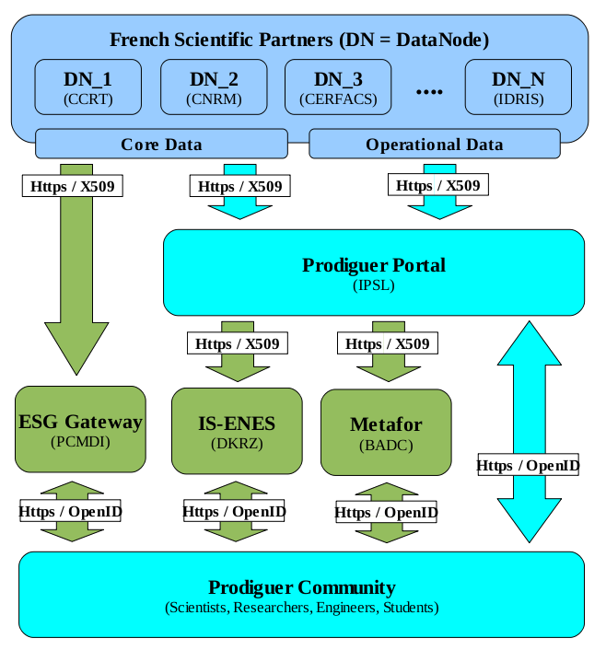
National Level: many partners International Level: many partners

Slide 9
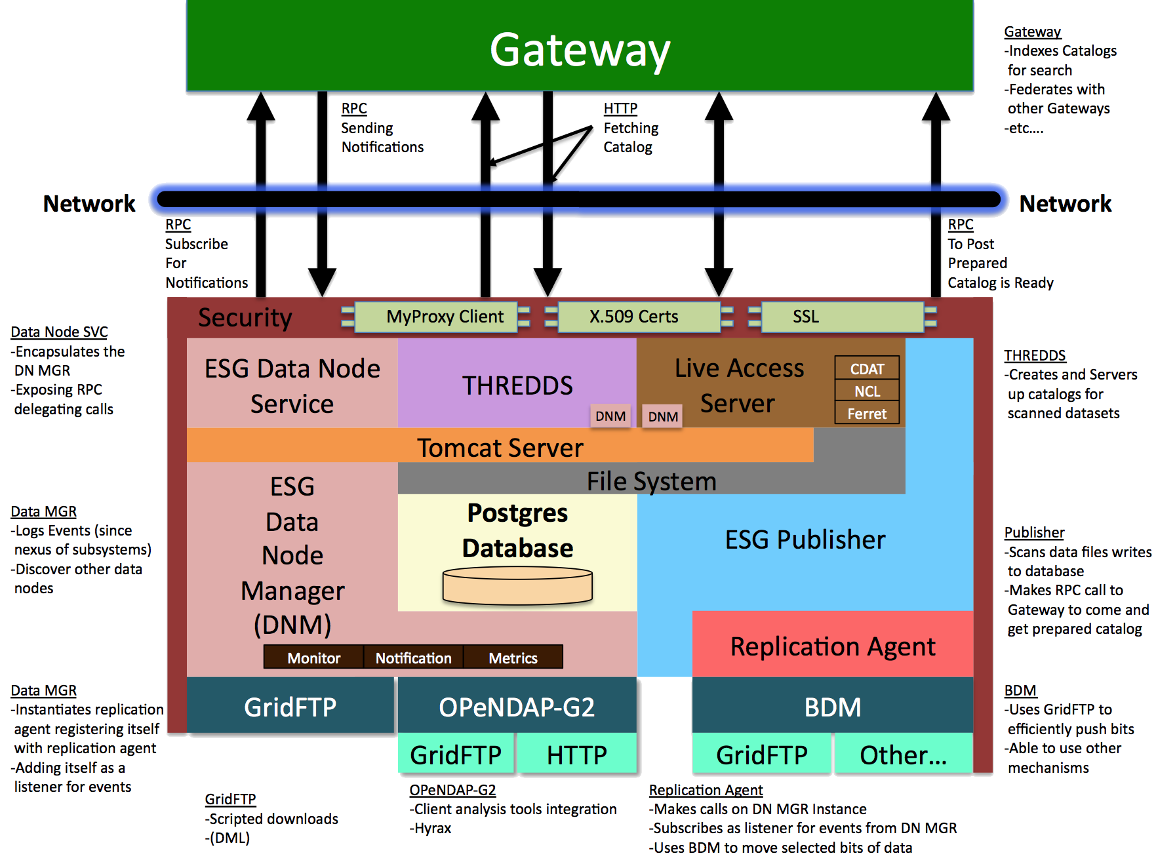
Data Node Architecture

Slide 10
SIMULATION MACHINE
Simulation Execution Environment
S 1
S 2
S 3
...
S N
Input
.ini
.netCDF
.make
Events
100=Start
101=Stop
Output
.ini
.netCDF

Slide 11
SIMULATION MACHINE
Simulation Execution Environment
S 1
S 2
S 3
...
S N
Input
.ini
.netCDF
.make
Events
100=Start
101=Stop
Output
.ini
.netCDF
Python
(Async)
Prodiguer Simulation Services
Event
Monitor
Message
Queues
(RabbitMQ)
Event
Publisher

Slide 12
SIMULATION MACHINE
Simulation Execution Environment
S 1
S 2
S 3
...
S N
Input
.ini
.netCDF
.make
Events
100=Start
101=Stop
Output
.ini
.netCDF
Python
(Async)
Prodiguer Simulation Services
Event
Monitor
Message
Queues
(RabbitMQ)
Event
Publisher
Base64
FIREWALL
PRODIGUER AGGREGATING DATA NODE

Slide 13
Meta-Data Publication
FRENCH SCIENTIFIC PARTNER/COMPUTING CENTRES
DN-1
(CCRT)
DN-2
(IDRIS)
DN-3
(CERFACS)
...
DN-N
(Meteo-France)
(DN=Data Node)

Slide 14
Meta-Data Publication
FRENCH SCIENTIFIC PARTNER/COMPUTING CENTRES
DN-1
(CCRT)
DN-2
(IDRIS)
DN-3
(CERFACS)
...
DN-N
(Meteo-France)
CORE (CMIP5)

Slide 15
Meta-Data Publication
FRENCH SCIENTIFIC PARTNER/COMPUTING CENTRES
DN-1
(CCRT)
DN-2
(IDRIS)
DN-3
(CERFACS)
...
DN-N
(Meteo-France)
CORE (CMIP5)
OPERATIONAL

Slide 16
Meta-Data Publication
FRENCH SCIENTIFIC PARTNER/COMPUTING CENTRES
DN-1
(CCRT)
DN-2
(IDRIS)
DN-3
(CERFACS)
...
DN-N
(Meteo-France)
CORE (CMIP5)
OPERATIONAL
WEB SERVICES (RESTful, AtomPub)

Slide 17
Meta-Data Publication
FRENCH SCIENTIFIC PARTNER/COMPUTING CENTRES
DN-1
(CCRT)
DN-2
(IDRIS)
DN-3
(CERFACS)
...
DN-N
(Meteo-France)
CORE (CMIP5)
OPERATIONAL
WEB SERVICES (RESTful, AtomPub)
ESG – GATEWAY
ESG – GATEWAY
DATABASE(S)
PostGres, RDF-Triple

Slide 18
Meta-Data Publication
FRENCH SCIENTIFIC PARTNER/COMPUTING CENTRES
DN-1
(CCRT)
DN-2
(IDRIS)
DN-3
(CERFACS)
...
DN-N
(Meteo-France)
CORE (CMIP5)
OPERATIONAL
WEB SERVICES (RESTful, AtomPub)
ESG – GATEWAY
ESG – GATEWAY
PRODIGUER
DATABASE(S)
PostGres, RDF-Triple
DATABASE(S)
PostGres

Slide 19
Meta-Data Publication
FRENCH SCIENTIFIC PARTNER/COMPUTING CENTRES
DN-1
(CCRT)
DN-2
(IDRIS)
DN-3
(CERFACS)
...
DN-N
(Meteo-France)
CORE (CMIP5)
OPERATIONAL
WEB SERVICES (RESTful, AtomPub)
ESG – GATEWAY
METAFOR / IS-ENES
ESG – GATEWAY
PRODIGUER
DATABASE(S)
PostGres, RDF-Triple
DATABASE(S)
eXist, PostGres, RDF
DATABASE(S)
PostGres

Slide 20
Meta-Data Publication
FRENCH SCIENTIFIC PARTNER/COMPUTING CENTRES
DN-1
(CCRT)
DN-2
(IDRIS)
DN-3
(CERFACS)
...
DN-N
(Meteo-France)
CORE (CMIP5)
OPERATIONAL
XML
Base64
WEB SERVICES (RESTful, AtomPub)
ESG – GATEWAY
METAFOR / IS-ENES
ESG – GATEWAY
PRODIGUER
DATABASE(S)
PostGres, RDF-Triple
DATABASE(S)
eXist, PostGres, RDF
DATABASE(S)
PostGres
XML
XML

Slide 21
Meta-Data Publication
FRENCH SCIENTIFIC PARTNER/COMPUTING CENTRES
DN-1
(CCRT)
DN-2
(IDRIS)
DN-3
(CERFACS)
...
DN-N
(Meteo-France)
CORE (CMIP5)
OPERATIONAL
XML
Base64
HTTPS / X509
WEB SERVICES (RESTful, AtomPub)
ESG – GATEWAY
METAFOR / IS-ENES
ESG – GATEWAY
PRODIGUER
DATABASE(S)
PostGres, RDF-Triple
HTTPS / X509
DATABASE(S)
eXist, PostGres, RDF
HTTPS / X509
DATABASE(S)
PostGres
XML
XML

Slide 22
Conclusions
« CMIP5 like » Data
Operational Data
European response to climate simulation proliferation has been built in close collaboration with the ESG-CET American consortium.
To come in support to CMIP5 require a work on software environment, data storage, their handling, distribution to users AND a work to describe simulations, their contexts, and their results.
ESGF, IS-ENES and METAFOR has been built to support this.
The every day workflow and then the every day simulation must benefit from the work done to achieve “CMIP5 like” exercise.
The aggregating data node approach is the one we choose.
It’s an integration activity, leveraging what’s been done to support CMIP5 like activity.

