Slide 1
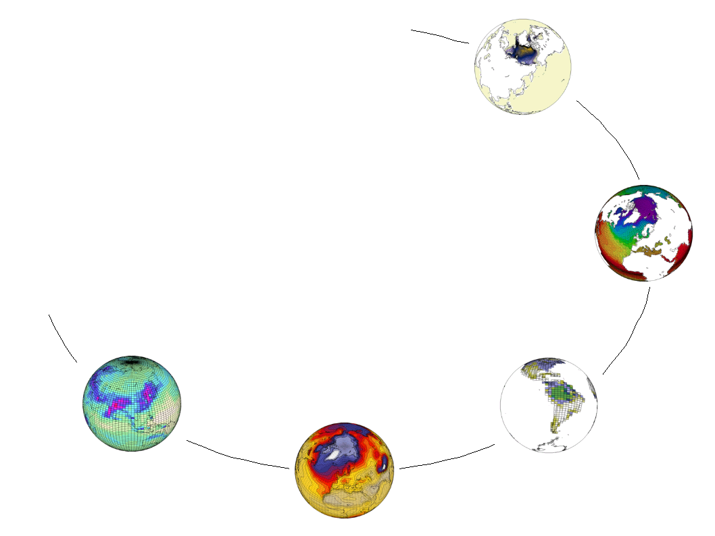
IS-ENES SA2/JRA4
IPSL Status/Questions
Sébastien Denvil, Ashish Bhardwaj, Mark Morgan
IPSL, Global Climate Modeling Group

Slide 2

Context : countdown of the GIEC/IPCC report
End of 2009 → End 2010 : Climate simulations
Mid 2010 → ? : Data Distribution
End of 2010 → July 2012 : articles submission last call
September 2013 : IPCC AR5 WG1 plenary session
October 2014 : Nobel price

Slide 3
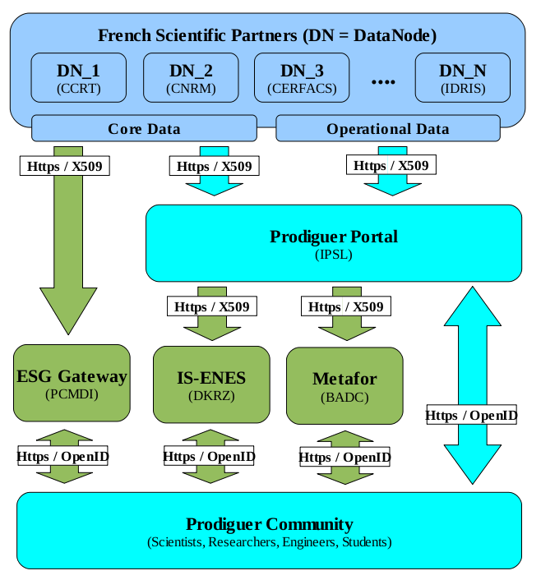
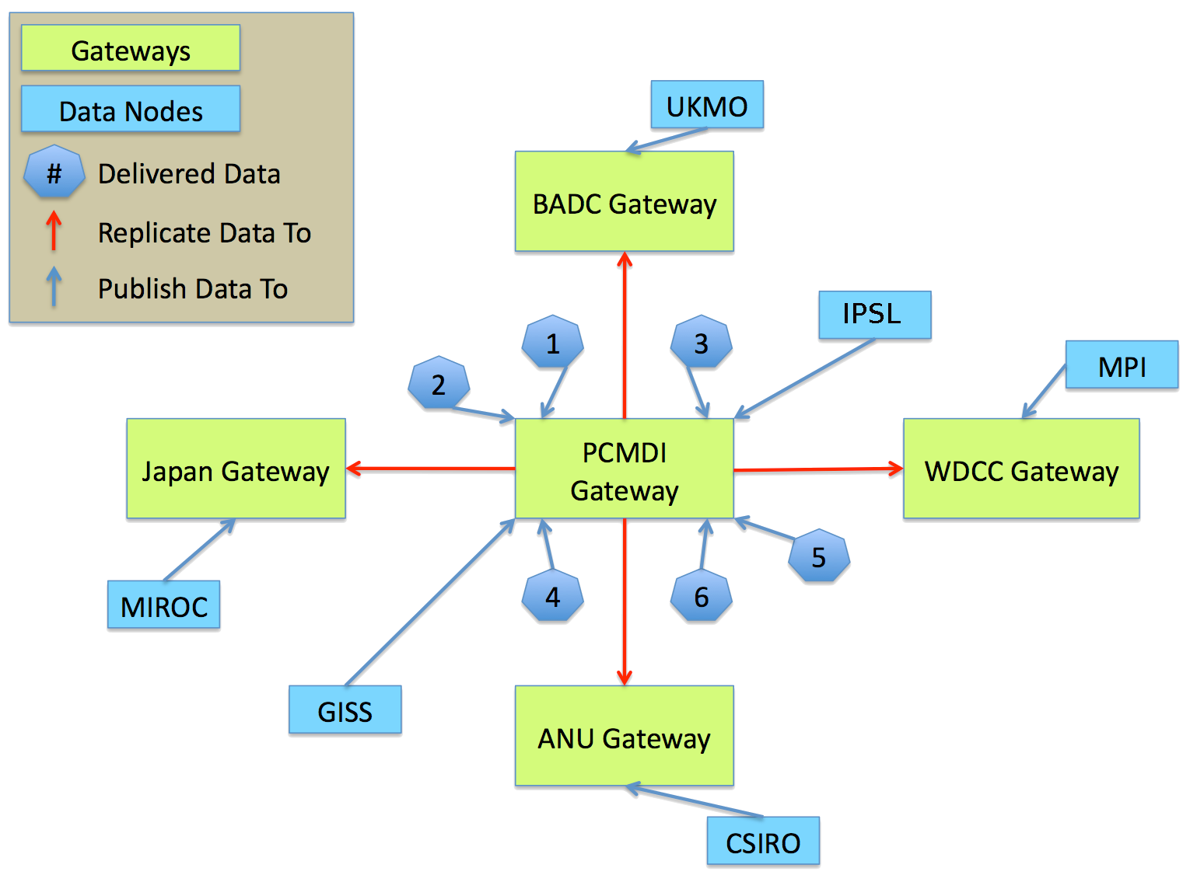
At the national level : Multiple partner
At the international level : Multiple partner

Slide 4

Global storage for simulations data
Raw data lower range ➔ 565 TB
Raw data higher range ➔ 1000 TB
CMIP5 data (25-50%) ➔ (140-280) (250-500) TB
Global storage ➔ 700-1500 TB
LMDz 0.5° (50 Km)

Slide 5

Network, Data Node and Hardware
Dedicated bandwidth IPSL/BADC/DKRZ/PCMDI/others
  2TB / day
IPSL (Data Node OK, testing purpose/back up)
  Lustre file system : 60TB extensible to (600 TB)
  Dedicated to IPSL/CMIP5 analysis/articles
  Sample to define (10% of core data : 600 TB)
CCRT (Data Node install : 9th of March)
  Bi octo-core nehalem 32GB ram
  1 PB cache, 5 PB tape
Météo-France (Data Node install : 5th of March)
  Bi quad-code 32GB ram
  Lustre file system 100 TB

Slide 6
Important points/Questions
Data Node :
  Data node publishing to multiple portals
  Tertiary Storage management
  Data Node manager
Network
  Dedicated bandwidth to support applications
…

