Slide 1
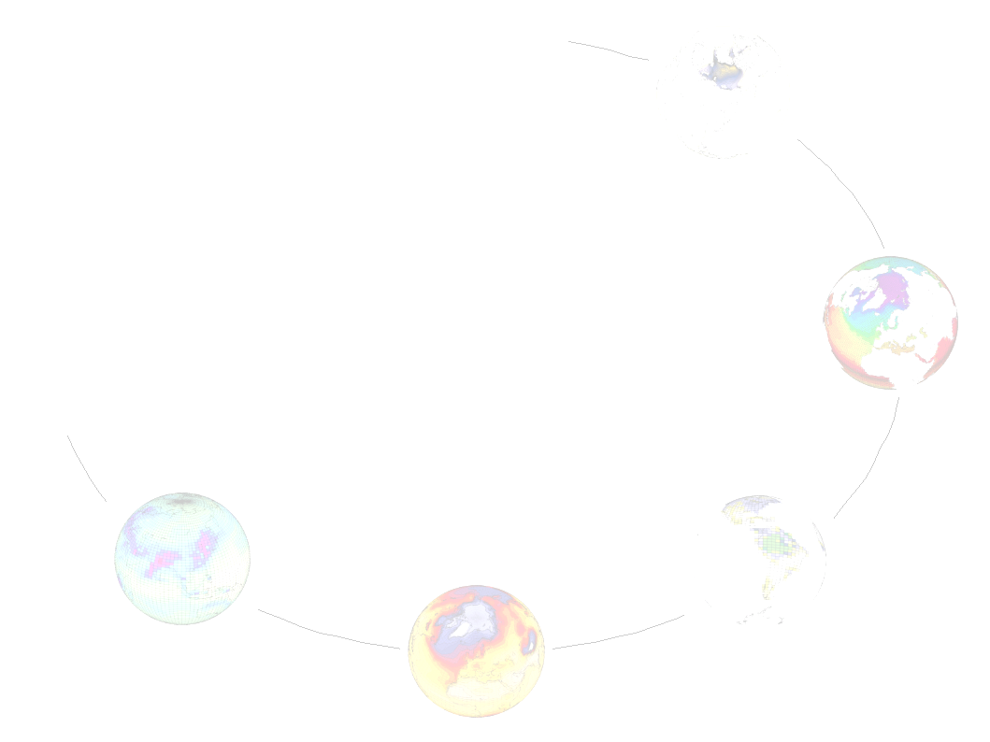
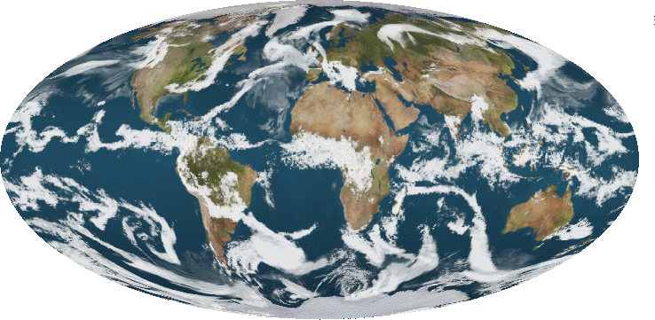
Stockage global des simulations
Stockage brute borne basse ➔ 565 TB
Stockage brute borne haute ➔ 1000 TB
Distribution CMIP5 (25-50%) ➔ (140-280) (250-500) TB
Stockage global ➔ 700-1500 TB
LMDz 0.5° (50 Km)

Slide 2
30Go/y 96x95x39 66Go/y 144x142x39 | Long term | ESM | Decanal-Time Slice
96x95x39 Core 96x95x39 Tiers1 96x95x39 Tiers2 | 1226y (35 To) 1592y (46 To) 1898y (55 To) | 492y (14 To) 251y (7 To) 251y (7 To)
144x142x39 Core 144x142x39 Tiers1 144x142x39 Tiers2 | 1226y (77 To) 1592y (101 To) 1898y (121 To) |  | 480y (31 To) 1925y (125 To)
144x142x39N Core 144x142x39N Tiers1 144x142x39N Tiers2 | 1226y (77 To) 1592y (101 To) 1898y (121 To)
Total Brut | 734 To | 28 To | 156 To
Total Distribué | 367 To | 14 To | 78 To
Total | 1101 To | 42 To | 234 To

