Slide 1
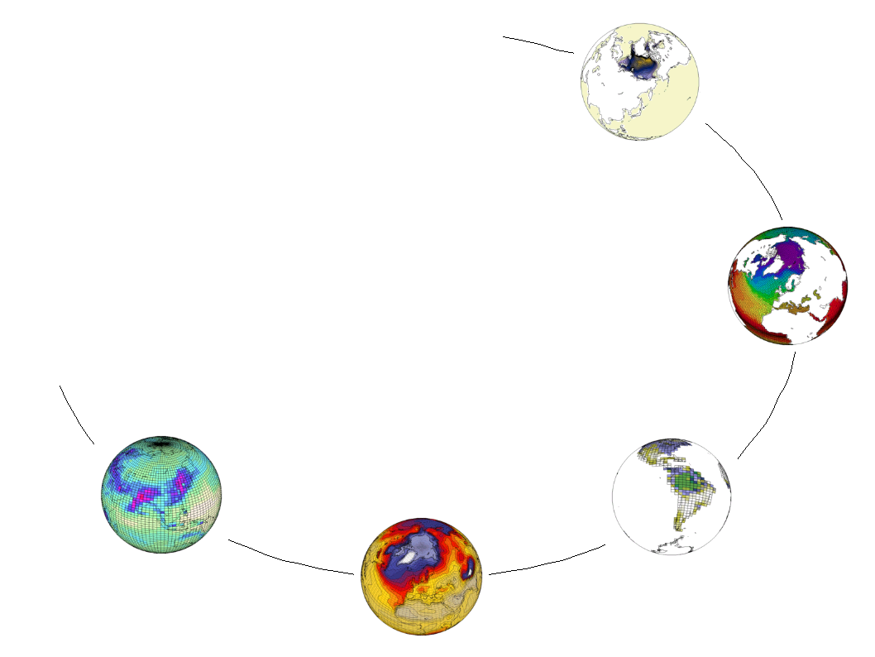
PRODIGUER
French Climate Modelling
Information Services Platform

Slide 2
COMMUNITY
French, European, Global

Slide 3
Community - Problem Space
E-science collaboration is difficult

Slide 4
Community - Problem Space
E-science collaboration is difficult
Political debate is intense

Slide 5
Community - Problem Space
E-science collaboration is difficult
Political debate is intense
Many different actors

Slide 6
Community - Problem Space
E-science collaboration is difficult
Political debate is intense
Many different actors
  Scientists / researchers / students

Slide 7
Community - Problem Space
E-science collaboration is difficult
Political debate is intense
Many different actors
  Scientists / researchers / students
  Impacts community / private sector

Slide 8
Community - Problem Space
E-science collaboration is difficult
Political debate is intense
Many different actors
  Scientists / researchers / students
  Impacts community / private sector
  Politicians / journalists / public

Slide 9
Community - Problem Space
E-science collaboration is difficult
Political debate is intense
Many different actors
  Scientists / researchers / students
  Impacts community / private sector
  Politicians / journalists / public
Data consumers & producers

Slide 10
Community - Problem Space
E-science collaboration is difficult
Political debate is intense
Many different actors
  Scientists / researchers / students
  Impacts community / private sector
  Politicians / journalists / public
Data consumers & producers
Freedom of information

Slide 11
Community - Problem Space
E-science collaboration is difficult
Political debate is intense
Many different actors
  Scientists / researchers / students
  Impacts community / private sector
  Politicians / journalists / public
Data consumers & producers
Freedom of information
Demand for analytical tools

Slide 12
DATA
NetCDF, PetaByte, Distributed

Slide 13
Data - Problem Space
Massive volumes (peta-scale)

Slide 14
Data - Problem Space
Massive volumes (peta-scale)
Ever increasing

Slide 15
Data - Problem Space
Massive volumes (peta-scale)
Ever increasing
Widely distributed

Slide 16
Data - Problem Space
Massive volumes (peta-scale)
Ever increasing
Widely distributed
Difficult to move

Slide 17
Data - Problem Space
Massive volumes (peta-scale)
Ever increasing
Widely distributed
Difficult to move
Meta-data publication

Slide 18
META-DATA
Publishing & Analysis

Slide 19
Meta-Data - Problem Space
The black-box problem

Slide 20
Meta-Data - Problem Space
The black-box problem
Standards (CF / Metafor)

Slide 21
Meta-Data - Problem Space
The black-box problem
Standards (CF / Metafor)
Extraction tools

Slide 22
Meta-Data - Problem Space
The black-box problem
Standards (CF / Metafor)
Extraction tools
Publication workflow

Slide 23
Meta-Data - Problem Space
The black-box problem
Standards (CF / Metafor)
Extraction tools
Publication workflow
Governance

Slide 24
SOLUTION
Data Nodes
Web Services
Web Portals

Slide 25
DATA NODES
CCRT, IDRIS,
CERFACS, Meteo-France

Slide 26
Data Node
COMPUTATION CLUSTER
STORAGE CLUSTER
SM 1
SM 2
SM N
...
DISK
TAPE

Slide 27
Data Node
COMPUTATION CLUSTER
STORAGE CLUSTER
SM 1
SM 2
SM N
...
DISK
TAPE
PRODIGUER SERVER

Slide 28
Data Node
COMPUTATION CLUSTER
STORAGE CLUSTER
SM 1
SM 2
SM N
...
DISK
TAPE
PRODIGUER SERVER
ESG
Data Publishing

Slide 29
Data Node
COMPUTATION CLUSTER
STORAGE CLUSTER
SM 1
SM 2
SM N
...
DISK
TAPE
PDG
PDG
PDG
PRODIGUER SERVER
Prodiguer
Simulation Monitoring
ESG
Data Publishing

Slide 30
Data Node
COMPUTATION CLUSTER
STORAGE CLUSTER
SM 1
SM 2
SM N
...
DISK
TAPE
PDG
PDG
PDG
PRODIGUER SERVER
Prodiguer
Simulation Monitoring
ESG
Data Publishing

Slide 31
Data Node
COMPUTATION CLUSTER
STORAGE CLUSTER
SM 1
SM 2
SM N
...
DISK
TAPE
PDG
PDG
PDG
FIREWALL
PRODIGUER SERVER
Prodiguer
Simulation Monitoring
ESG
Data Publishing

Slide 32
Data Node
COMPUTATION CLUSTER
STORAGE CLUSTER
SIM 1
SIM 2
SIM N
...
DISK
TAPE
PDG
PDG
PDG
FIREWALL
PRODIGUER SERVER
Prodiguer
Simulation Monitoring
ESG
Data Publishing
HTTPS
HTTP
HTTPS
GRID-FTP
WEB SERVICES

Slide 33
WEB SERVICES
ESG , Prodiguer, Metafor, IS-ENES
Meta-Data Publication

Slide 34
Meta-Data Publication
FRENCH SCIENTIFIC COMPUTING CENTRES (DN = DATA NODE)
DN-1
(CCRT)
DN-2
(IDRIS)
DN-3
(CERFACS)
...
DN-N
(Meteo-France)

Slide 35
Meta-Data Publication
FRENCH SCIENTIFIC COMPUTING CENTRES (DN = DATA NODE)
DN-1
(CCRT)
DN-2
(IDRIS)
DN-3
(CERFACS)
...
DN-N
(Meteo-France)
CORE (CIMP5)

Slide 36
Meta-Data Publication
FRENCH SCIENTIFIC COMPUTING CENTRES (DN = DATA NODE)
DN-1
(CCRT)
DN-2
(IDRIS)
DN-3
(CERFACS)
...
DN-N
(Meteo-France)
CORE (CIMP5)
OPERATIONAL

Slide 37
Meta-Data Publication
FRENCH SCIENTIFIC COMPUTING CENTRES (DN = DATA NODE)
DN-1
(CCRT)
DN-2
(IDRIS)
DN-3
(CERFACS)
...
DN-N
(Meteo-France)
CORE (CIMP5)
OPERATIONAL
WEB SERVICES (RESTful, AtomPub)

Slide 38
Meta-Data Publication
FRENCH SCIENTIFIC COMPUTING CENTRES (DN = DATA NODE)
DN-1
(CCRT)
DN-2
(IDRIS)
DN-3
(CERFACS)
...
DN-N
(Meteo-France)
CORE (CIMP5)
OPERATIONAL
WEB SERVICES (RESTful, AtomPub)
ESG – GATEWAY
ESG – GATEWAY
DATABASE(S)
PostGres, RDF-Triple

Slide 39
Meta-Data Publication
FRENCH SCIENTIFIC COMPUTING CENTRES (DN = DATA NODE)
DN-1
(CCRT)
DN-2
(IDRIS)
DN-3
(CERFACS)
...
DN-N
(Meteo-France)
CORE (CIMP5)
OPERATIONAL
WEB SERVICES (RESTful, AtomPub)
ESG – GATEWAY
ESG – GATEWAY
PRODIGUER
DATABASE(S)
PostGres, RDF-Triple
DATABASE(S)
PostGres

Slide 40
Meta-Data Publication
FRENCH SCIENTIFIC COMPUTING CENTRES (DN = DATA NODE)
DN-1
(CCRT)
DN-2
(IDRIS)
DN-3
(CERFACS)
...
DN-N
(Meteo-France)
CORE (CIMP5)
OPERATIONAL
WEB SERVICES (RESTful, AtomPub)
ESG – GATEWAY
METAFOR / IS-ENES
ESG – GATEWAY
PRODIGUER
DATABASE(S)
PostGres, RDF-Triple
DATABASE(S)
eXist, PostGres
DATABASE(S)
PostGres

Slide 41
Meta-Data Publication
FRENCH SCIENTIFIC COMPUTING CENTRES (DN = DATA NODE)
DN-1
(CCRT)
DN-2
(IDRIS)
DN-3
(CERFACS)
...
DN-N
(Meteo-France)
CORE (CIMP5)
OPERATIONAL
XML
Base64
WEB SERVICES (RESTful, AtomPub)
ESG – GATEWAY
METAFOR / IS-ENES
ESG – GATEWAY
PRODIGUER
DATABASE(S)
PostGres, RDF-Triple
DATABASE(S)
eXist, PostGres
DATABASE(S)
PostGres
XML
XML

Slide 42
Meta-Data Publication
FRENCH SCIENTIFIC COMPUTING CENTRES (DN = DATA NODE)
DN-1
(CCRT)
DN-2
(IDRIS)
DN-3
(CERFACS)
...
DN-N
(Meteo-France)
CORE (CIMP5)
OPERATIONAL
XML
Base64
HTTPS / X509
WEB SERVICES (RESTful, AtomPub)
ESG – GATEWAY
METAFOR / IS-ENES
ESG – GATEWAY
PRODIGUER
DATABASE(S)
PostGres, RDF-Triple
HTTPS / X509
DATABASE(S)
eXist, PostGres
HTTPS / X509
DATABASE(S)
PostGres
XML
XML

Slide 43
WEB PORTALS
ESG , Prodiguer, Metafor, IS-ENES
Meta-Data Analysis

Slide 44
Meta-Data Analysis
WEB SERVICES (RESTful, AtomPub)
ESG – GATEWAY
METAFOR / IS-ENES
ESG – GATEWAY
PRODIGUER
DATABASE(S)
PostGres, RDF-Triple
DATABASE(S)
eXist, PostGres
DATABASE(S)
PostGres

Slide 45
Meta-Data Analysis
WEB SERVICES (RESTful, AtomPub)
ESG – GATEWAY
METAFOR / IS-ENES
ESG – GATEWAY
PRODIGUER
DATABASE(S)
PostGres, RDF-Triple
DATABASE(S)
eXist, PostGres
DATABASE(S)
PostGres
WEB PORTALS (HTML / Javascript)

Slide 46
Meta-Data Analysis
WEB SERVICES (RESTful, AtomPub)
ESG – GATEWAY
METAFOR / IS-ENES
ESG – GATEWAY
PRODIGUER
DATABASE(S)
PostGres, RDF-Triple
DATABASE(S)
eXist, PostGres
DATABASE(S)
PostGres
ESG CURATOR
WEB PORTALS (HTML / Javascript)

Slide 47
Meta-Data Analysis
WEB SERVICES (RESTful, AtomPub)
ESG – GATEWAY
METAFOR / IS-ENES
ESG – GATEWAY
PRODIGUER
DATABASE(S)
PostGres, RDF-Triple
DATABASE(S)
eXist, PostGres
DATABASE(S)
PostGres
ESG CURATOR
METAFOR /
IS-ENES
WEB PORTALS (HTML / Javascript)

Slide 48
Meta-Data Analysis
WEB SERVICES (RESTful, AtomPub)
ESG – GATEWAY
METAFOR / IS-ENES
ESG – GATEWAY
PRODIGUER
DATABASE(S)
PostGres, RDF-Triple
DATABASE(S)
eXist, PostGres
DATABASE(S)
PostGres
ESG CURATOR
METAFOR /
IS-ENES
PRODIGUER
WEB PORTALS (HTML / Javascript)

Slide 49
Meta-Data Analysis
WEB SERVICES (RESTful, AtomPub)
ESG – GATEWAY
METAFOR / IS-ENES
ESG – GATEWAY
PRODIGUER
DATABASE(S)
PostGres, RDF-Triple
DATABASE(S)
eXist, PostGres
DATABASE(S)
PostGres
ESG CURATOR
METAFOR /
IS-ENES
PRODIGUER
WEB PORTALS (HTML / Javascript)

Slide 50
Meta-Data Analysis
WEB SERVICES (RESTful, AtomPub)
ESG – GATEWAY
METAFOR / IS-ENES
ESG – GATEWAY
PRODIGUER
DATABASE(S)
PostGres, RDF-Triple
DATABASE(S)
eXist, PostGres
DATABASE(S)
PostGres
XML
JSON / XML
JSON
ESG CURATOR
METAFOR /
IS-ENES
PRODIGUER
WEB PORTALS (HTML / Javascript)

Slide 51
Meta-Data Analysis
WEB SERVICES (RESTful, AtomPub)
ESG – GATEWAY
METAFOR / IS-ENES
ESG – GATEWAY
PRODIGUER
DATABASE(S)
PostGres, RDF-Triple
DATABASE(S)
eXist, PostGres
DATABASE(S)
PostGres
XML
JSON / XML
JSON
HTTPS / OpenID
ESG CURATOR
METAFOR /
IS-ENES
PRODIGUER
WEB PORTALS (HTML / Javascript)

Slide 52
Meta-Data Analysis
WEB SERVICES (RESTful, AtomPub)
ESG – GATEWAY
METAFOR / IS-ENES
ESG – GATEWAY
PRODIGUER
DATABASE(S)
PostGres, RDF-Triple
DATABASE(S)
eXist, PostGres
DATABASE(S)
PostGres
XML
JSON / XML
JSON
HTTPS / OpenID
Max Planck Institute
University of
Cantabria
Meteo-France
WEB PORTALS (HTML / Javascript)

Slide 53
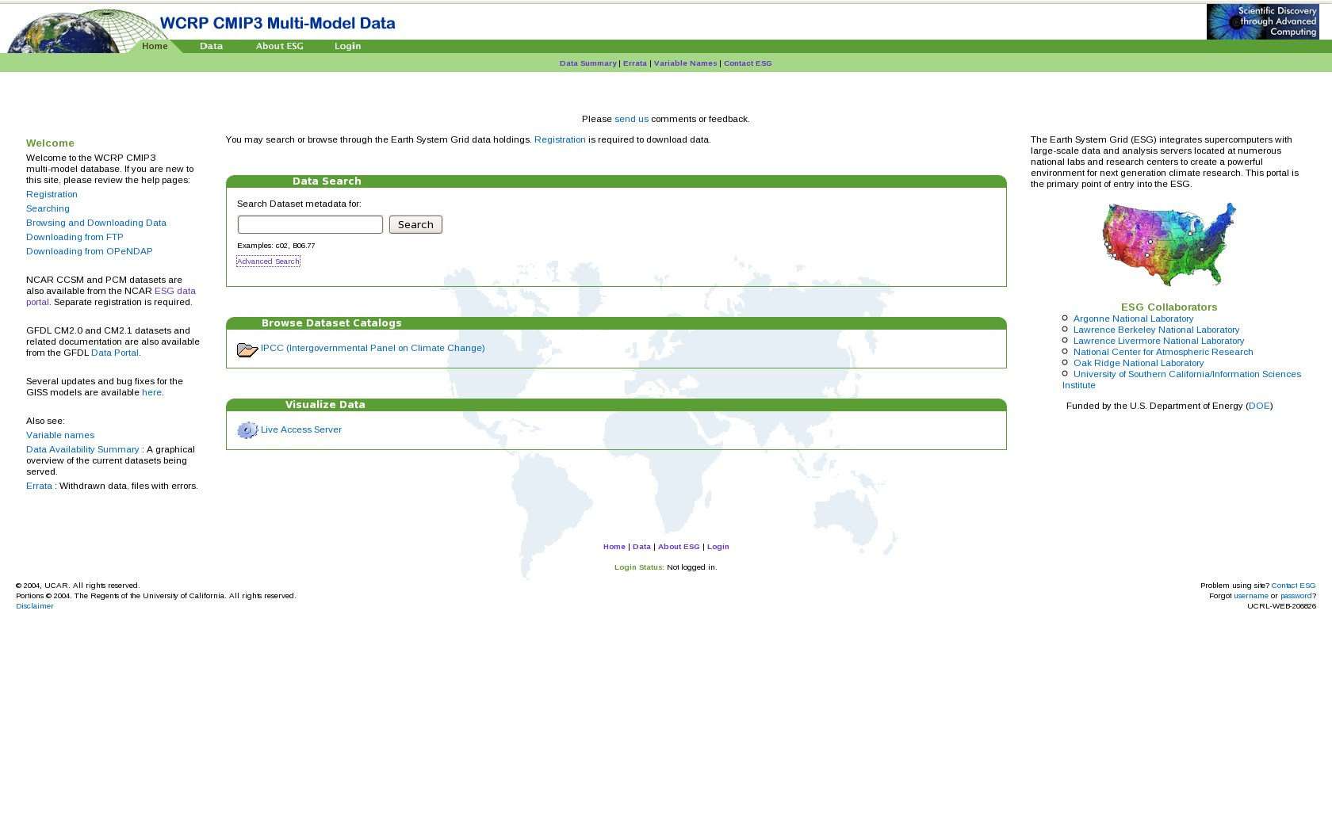
ESG Portal

Slide 54
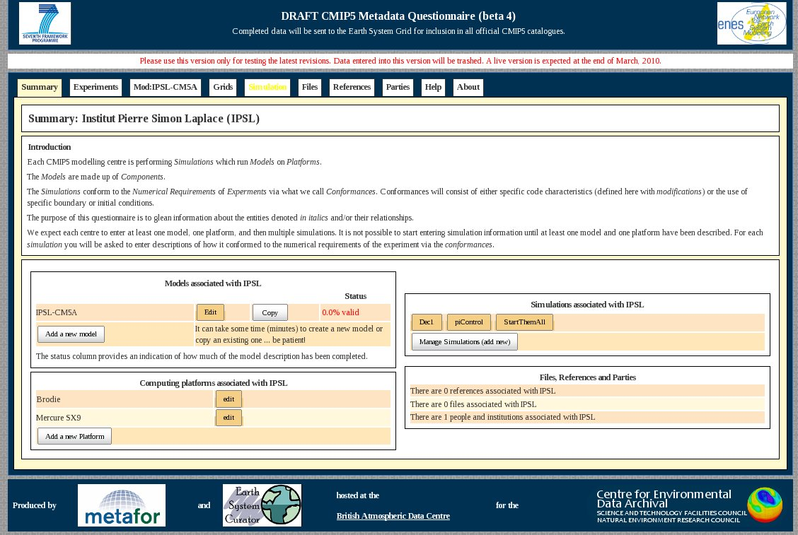
Metafor Portal

Slide 55
Prodiguer Portal
A VENIR
Premier prototype: Fin Mai 2010

Slide 56
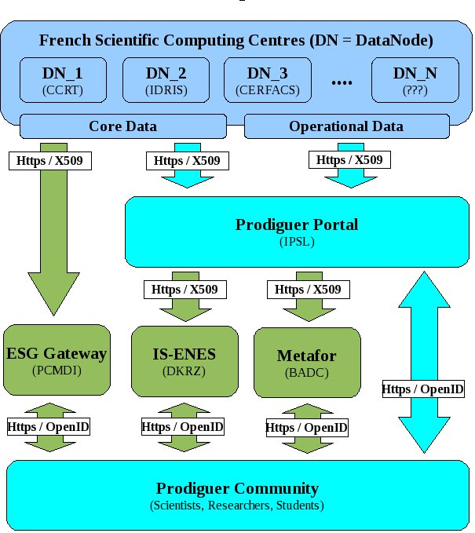

Slide 57
PRODIGUER SIMULATION MONITOR
Python, Message Queues, Databases

Slide 58
Data Node
COMPUTATION CLUSTER
STORAGE CLUSTER
SIM 1
SIM 2
SIM N
...
DISK
TAPE
PDG
PDG
PDG
FIREWALL
PRODIGUER SERVER
Prodiguer
Simulation Monitoring
ESG
Data Publishing
HTTPS
HTTP
HTTPS
GRID-FTP
WEB SERVICES

Slide 59
Data Node
COMPUTATION CLUSTER
SIM 1
SIM 2
SIM N
...
PDG
PDG
PDG
FIREWALL
PRODIGUER SERVER
Prodiguer
Simulation Monitoring
HTTPS
WEB SERVICES

Slide 60
OBJECTIVE
Real time monitoring of all simulations executing within Prodiguer computing centres

Slide 61
USE CASES
View simulations by centre;
View simulations by month
View simulations by failure
View simulations by coupling
View simulations by coupling and failure
View simulation configuration files
Display results in tabular and graphical (Atlas) modes.

Slide 62
SIMULATION MACHINE
Simulation Execution Environment
S 1
S 2
S 3
...
S N
Input
.ini
.netCDF
.make
Events
100=Start
101=Stop
Output
.ini
.netCDF

Slide 63
SIMULATION MACHINE
Simulation Execution Environment
S 1
S 2
S 3
...
S N
Input
.ini
.netCDF
.make
Events
100=Start
101=Stop
Output
.ini
.netCDF
Python
(Async)
Prodiguer Simulation Services
Event
Monitor
Message
Queues
(RabbitMQ)
Event
Publisher

Slide 64
SIMULATION MACHINE
Simulation Execution Environment
S 1
S 2
S 3
...
S N
Input
.ini
.netCDF
.make
Events
100=Start
101=Stop
Output
.ini
.netCDF
Python
(Async)
Prodiguer Simulation Services
Event
Monitor
Message
Queues
(RabbitMQ)
Event
Publisher
Base64
FIREWALL
PRODIGUER DATA NODE

Slide 65
Event Info Python Classes
EventInfo
  Encapsulates event information (IMPORTANT!)
SimulationInfo
  Encapsulates information regarding the simulation
MachineInfo*
  Encapsulates information regarding the machine
UserInfo*
  Encapsulates information regarding the user
CoreInfo*
  Encapsulates information regarding the cpu

Slide 66
Python Classes
EventMonitorManager
  Manages collection of event monitors
  Exposes methods for invoking event monitors
EventMonitor
  Handles events raised from simulation environment
EventQueueManager
  Manages event queue access
EventQueue
  Event queue wrapper (RabbitMQ)
  Exposes methods: queue(), dequeue(), requeue()
EventPublisherManager
  Manages a private collection of event publishers
  Manages interaction with event queues
EventPublisher
  Publishes event information to Prodiguer data node

Slide 67
PRODIGUER SIMULATION SERVICE
Base64
FIREWALL

Slide 68
PRODIGUER SIMULATION SERVICE
Base64
FIREWALL
DATA NODE MACHINE
Prodiguer Data Node Services
Event
Monitor
Message
Queues
(RabbitMQ)
Event
Publisher

Slide 69
PRODIGUER SIMULATION SERVICE
Base64
FIREWALL
DATA NODE MACHINE
Prodiguer Data Node Services
Event
Monitor
Message
Queues
(RabbitMQ)
Event
Publisher
Base64
HTTPS / X509
PRODIGUER WEB SERVICE

Slide 70
Event Info Python Classes
ComputationCentreInfo
  Encapsulates information regarding the computing centre

Slide 71
Python Classes
EventMonitor
  Handles events raised from simulation environment.
EventMonitorManager
  Manages a private collection of event monitors
  Exposes methods for invoking event monitors
EventPublisher
  Publishes event information to Prodiguer web service
EventPublisherManager
  Manages a collection of event publishers
  Manages interaction with event queues
EventQueue
  Wrapper around an event queue (RabbitMQ)
  Exposes methods: queue(), dequeue(), requeue()
EventQueueManager
  Manages access to a private collection of event queues

Slide 72
PRODIGUER DATA NODE
Base64
HTTPS / X509

Slide 73
PRODIGUER DATA NODE
Base64
HTTPS / X509
Prodiguer Web Server
Event Monitor Web Service
Message
Queues
(RabbitMQ)
Event
Processors

Slide 74
PRODIGUER DATA NODE
Base64
HTTPS / X509
Prodiguer Web Server
Event Monitor Web Service
Message
Queues
(RabbitMQ)
Event
Processors
SqlAlchemy
PRODIGUER DATABASE(S)

Slide 75
Python Classes
EventMonitorController
  HTTP controller handling events raised from data node
  Validates incoming http messages
  Deserializes incoming http messages
EventQueue
  Event queue wrapper (RabbitMQ)
  Exposes methods: queue(), dequeue(), requeue()
EventQueueManager
  Manages event queue access
EventProcessorManager
  Manages a private collection of event publishers
  Manages interaction with event queues
EventProcessor
  Publishes event information to Prodiguer web service

Slide 76
Prodiguer Web Portal
PRODIGUER DATABASE(S)

Slide 77
Prodiguer Web Portal
PRODIGUER DATABASE(S)
SqlAlchemy
Simulation Monitor Web Application

Slide 78
Prodiguer Web Portal
PRODIGUER DATABASE(S)
SqlAlchemy
Simulation Monitor Web Application
JSON
HTTPS / OpenID
PRODIGUER COMMUNITY
Researchers, Scientists, Students,
Impacts, Private Sector,
Politicians, Journalists, Public

Slide 79
COMMUNITY
French, European, Global

Slide 80
DATA
NetCDF, PetaByte, Distributed

Slide 81
META-DATA
Publishing & Analysis

Slide 82
SOLUTION
Data Nodes
Web Services
Web Portals

