Slide 1





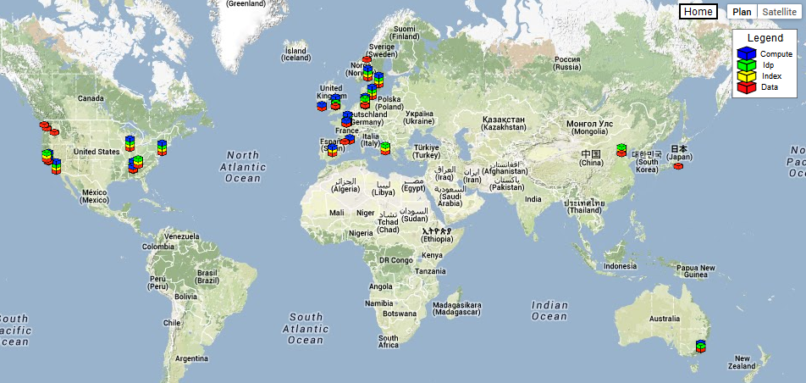
Integration and validation of a data grid software
N. Carenton-Madiec ¹, S. Denvil ¹, K. Berger ², A. Cofino ³
¹CNRS/IPSL ²DKRZ ³UNICAN
How to improve quality of deliverables in a collaborative effort context?
The Earth System Grid Federation
A System of Distributed Nodes
A Graduated Set of Services
The Earth System Grid Federation (ESGF) is a collaboration of groups, agencies and institutions around the world, that are dedicated to the development and operation of a long-term system for the management, access and analysis of climate data produced by CMIP, CORDEX or PMIP in HPC centers. Some of the challenges that ESGF is committed to address include:
Data Node
HPC Center #1
HPC Center #2
Node
Index Node
Node
Node
Node
WEB PORTAL
Identity Provider
DATA INDEXING &SEARCH
DATA
PUBLISHING
Compute Node
NODE MGR
Client
NODE REGISTRY
USER REGISTRATION
The enormous scale of the data holdings, moving from Peta-bytes to Exa-bytes
Support for both model output and a wide variety of observational data
The distributed nature of the data archives, which are geographically distributed and autonomously operated
Node
Node
Node
ACCESS CONTROL
ANALYSIS & VISUALIZATION
DATA ACCESS
HPC Center #3
HPC Center #4
HPC Center #5
An Integrated Software Stack
A Worldwide Infrastructure & Team
Data Node: Node Manager, Publisher, Postgres, Thredds Data Server, Security Filters, Security Services, GridFTP
Developers community is spread around the world
Administrators community is spread around the world
Index Node: Apache Solr, ESGF Search, ESGF Web Portal
A Collaborative Project
Developers are specialized in one module of the stack
Changes are made independently from each other
Identity Provider: OpenID Identity Provider, Globus Simple CA, Globus MyProxy Server
Need for Integration & Validation Tools
Compute Node: Live Access Server
ESGF TEST FEDERATION
ESGF TEST SUITE
ESGF Test Suite – A single tool for multiple purposes
Technologies
Outlook
Designed to perform high level tests on ESGF nodes from the user’s perspective. The scope is to test a single data node and its three peer services (Identity Provider, index and compute services) Parallelized runs of the test suite on each node gives a status of the whole federation.
Python Nose: A testing framework where every test is written as an independent function, class or module
Python Requests: HTTP for humans
Python MyProxyClient: Globus MyProxy Support
Python Subprocess: Spawns system processes
Python Selenium: Automates browser actions
Python MultiProcessing: Parallelizes tasks
Additional tests ran from the server side would bring lower level sanity checks
A test suite is a requirement to set up a continuous integration system that facilitates deployment and improves stability
A continuous integration system is a requirement to set up a continuous deployment system that improves reactivity
For Developers
For Admins
Integration Tests
Non regression Tests
Post Deployment Tests
Monitoring
EGU 2014 – ESSI2.8 – Earth Science on Cloud, HPC and Grid

