Slide 1


Slide 2

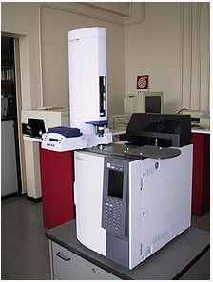
Presented By: Shahzada Muhammad Ghayur Ul Mulk
Gas chromatography

Slide 3


What is Gas Chromatography
Gas chromatography (GC) is an analytical technique used to separate the chemical components from the Sample of mixture then used to Examine the separate Chemical Compound
Gas Chromatography allow us to separate the mixture which are very volatile which consist of low boiling point
They are thermally stable they do not degrade in the Gas Chromatography system their molecular weight is below 1250 Da (Dalton)
Gas Chromatography is a widely used technique across most industries: for quality control in the manufacture of many products from cars to chemicals to pharmaceuticals; for research purposes from the analysis of meteorites and for safety from environmental to food to forensics.

Slide 4
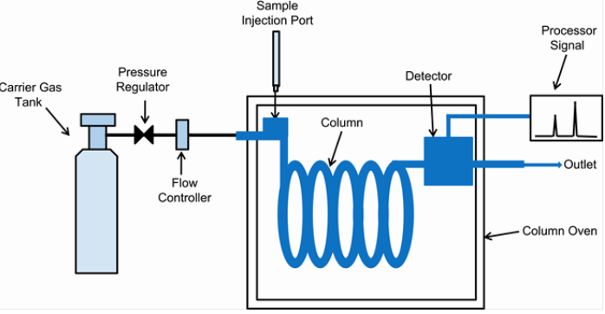

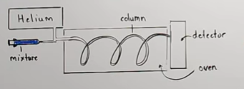
Procedure of Gas Chromatography
The first we will inject the liquid the mixture of a compound in Carrier Gas Tank
The Carrier Gas tank will move the volatile liquid forward will move toward the oven(the entire region ) which consist of High Temperature
The liquid will be Evaporate into Gaseous Phase Now we have the mixture of Gaseous Compound
The liquid will be mixed with the Helium (Inner gas ) will combine with the mixture and carry the mixture toward the column
The lining of the column is coated with high Boiling liquid material it will act as a stationary phase
As Gaseous will move toward the stationary phase those molecules are attracted strongly at the liquid stationary phase will spend much time at the column
The speed of the gas particle will decrease and will move slowly as compare to those gas particle which does not form bond with the column will move much quicker
In this way we can collect and separate our individual gaseous at the detector Region

Slide 5
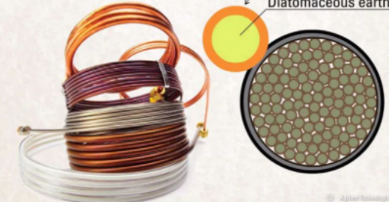
Types Of Column
Packed Column
Most Widely used column in Gas Chromatography
Length is equal to 2-6 m
The internal dia is 2-4 mm
Made up of Glass, Aluminum, stainless steel, fluorocarbon Polymer
Used to handle Larger Samples

Slide 6

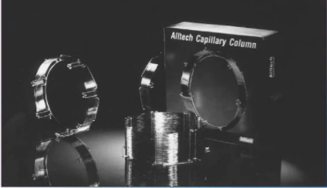
Types Of Column
Capillary Column
The Column is coated with Fused slica coated with protective polymer
The length of the column is 100 mm
We can increase the resolution by increasing the length of the column
The internal dia is 150-300 micro meter
Used to handle small samples

Slide 7

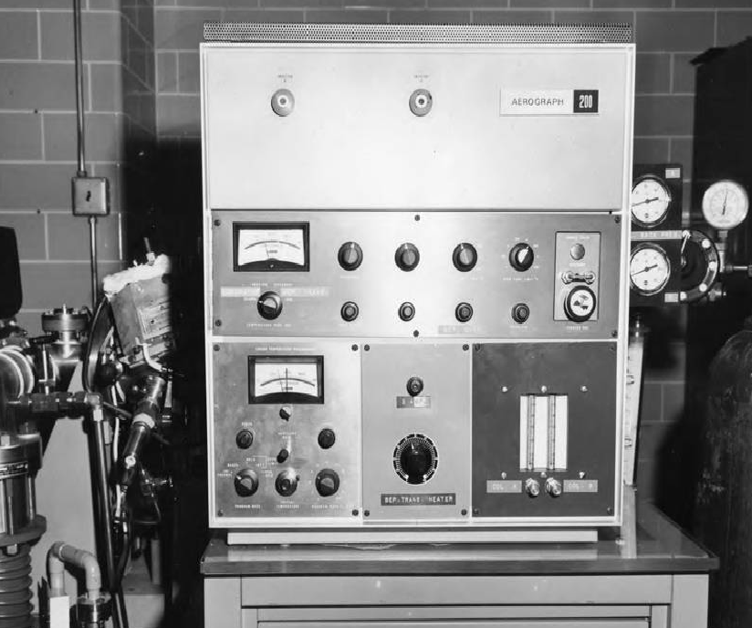
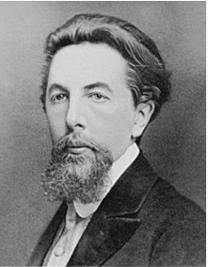
History of Gas Chromatography
1903 in the work of the Russian scientist, Mikhail Semenovich Tswett, who separated plant pigments by liquid column chromatography
Pigments are defined as the set of compounds that have an intense color and are used in the coloring of other materials

Slide 8
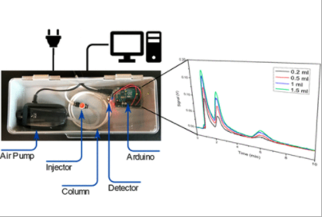
Development of a Low-Cost and Versatile Gas Chromatography
the column selection and operating parameters are critically important for a clean and well-resolved chromatogram

Slide 9


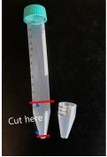
Selection/Operating parameters
Tygon tubing Aluminum or stainless-steel tubing can also be used instead of Tygon, which would allow the column to be heated to a high temperature for better gas separation we will prefer Tygon Tubing for Better We elected the soft and low-cost Tygon tubing
Then Tygon tubing will cut off to create a Cone Shape that exist at the end of the column to fit comfortably with Flammable Gas Sensor

Slide 10
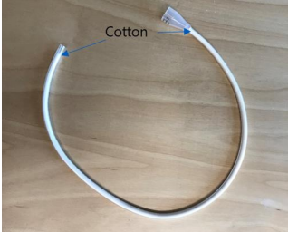

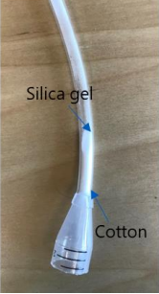
Selection/Operating parameters
The end of the Tygon tubing is first capped with a small piece of cotton to prevent any Stationary Phase material from falling out
While silica gel was used as the primary stationary phase material for this project
Different stationary phase material is then filled into the tubing with a funnel and shaken to pack the material tight together
The other end of the tubing is also capped with a small piece of cotton to close off the column
The length and diameter of the column can be adjusted to the user’s preference
Notes:
Stationary Phase are the column

Slide 11

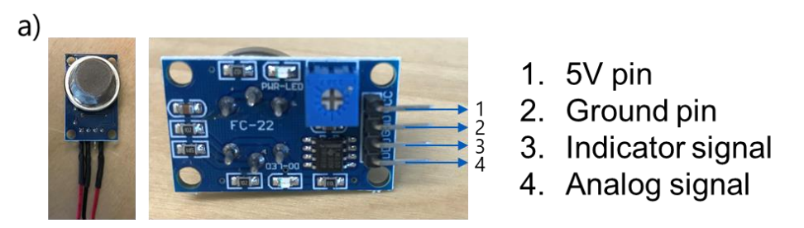
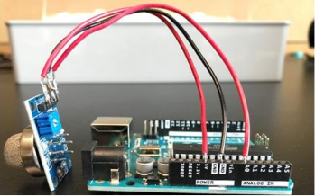
Assembly of the GC System
We will use Arduino Board connected with the Gas Sensor
The 5V and ground pin are to be connected to the 5V and ground socket on the Arduino board
Both The Analog and Indicator Signal is used in term of Digit Value when the Gas is detected

Slide 12
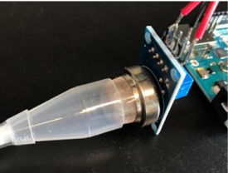
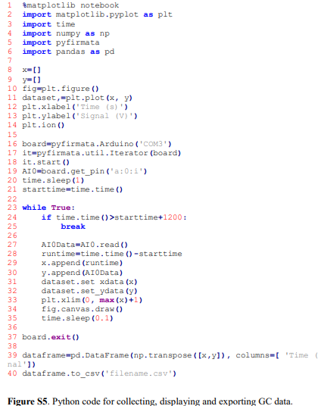
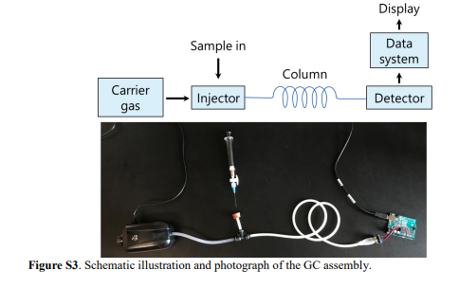
Functional of Gc System
Once the column and the sensor are both ready, the GC system can be assembled in a series
Arduino Board which enable the communication between python and Ardunio Board
Python code that collects and displays data during a GC run

Slide 13
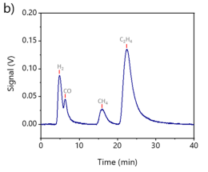
Functional of Gc System
Voltage signals generated by the gas sensor are recorded by an Arduino board and can be displayed in real-time from a connected computer
While there are several software languages that are capable of communicating with an Arduino circuit board, we chose Python as the programming language well-integrated into many branches of chemical science .
We would get different peak which will represent different components

Slide 14

Thank You For Your Time

