Slide 1
Oscilloscope based in FPGA
Project Status
PIEIC
Diogo Fernandes – PG47150
José Tomás Abreu – PG47386

Slide 2
Agenda
Digital Filters
FIR
IIR
Sampling and Filtering
Low Pass Filter
Filter Calculation
Frequency Response
Results
High Pass Filter
Filter Calculation
Frequency Response
Results
Band Pass Filter
Filter Calculation
Frequency Response
Results

Slide 3
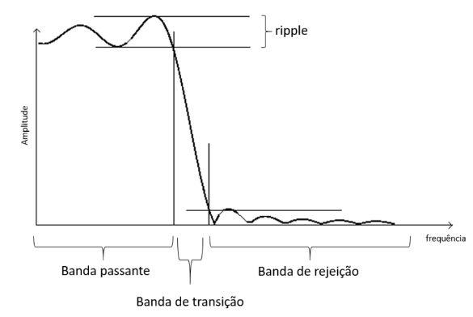
Digital Filters
IIR (Infinite Impulse Response)
Similar to analog filters
More efficient
Unstable
FIR (Finite Impulse Response)
Better response
Stable
Robust
Linear phase

Slide 4


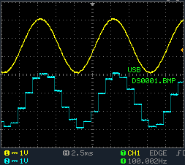
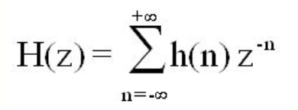
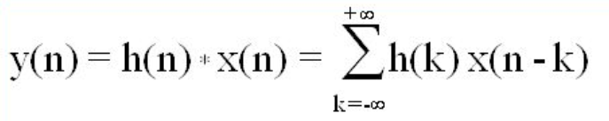
Sampling and Filtering
Sample Frequency: fs = 1 kHz
ak = 0 for FIR filter

Slide 5
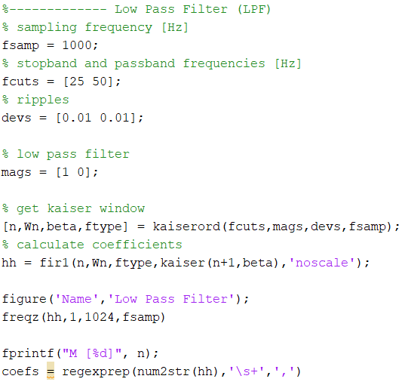
Low Pass Filter

Slide 6
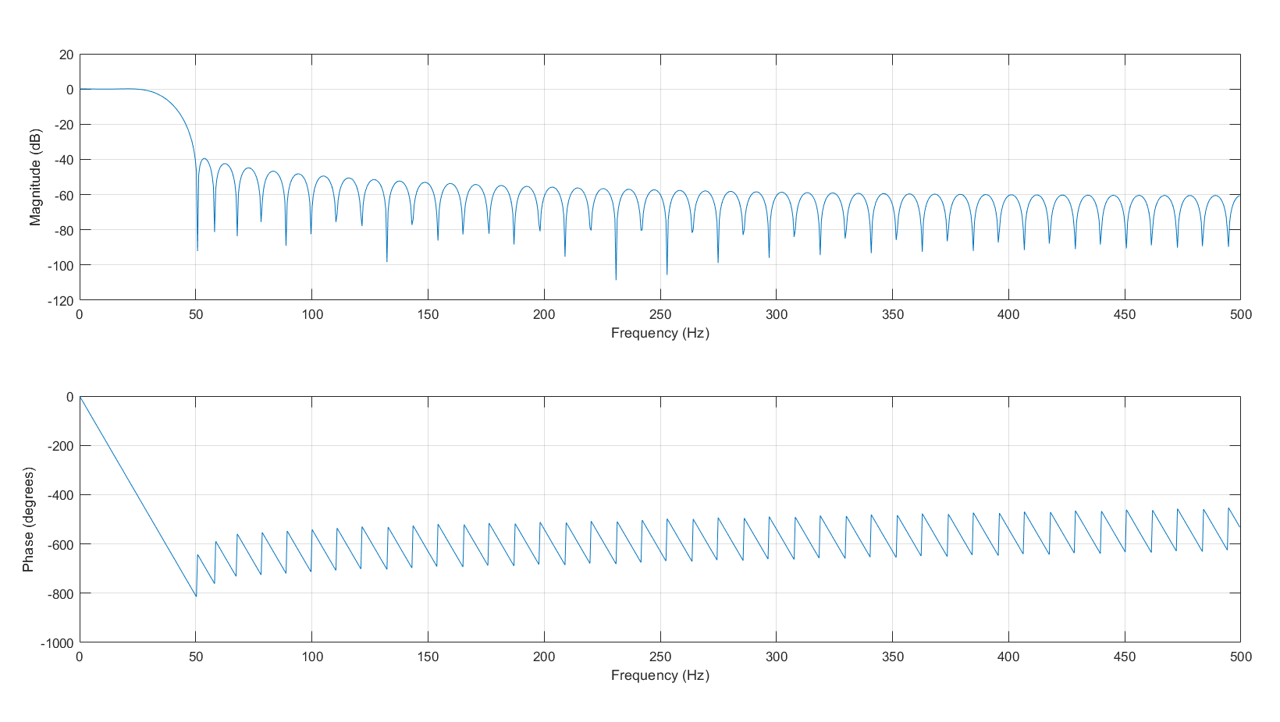
Low Pass Filter

Slide 7
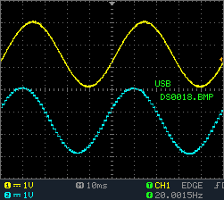
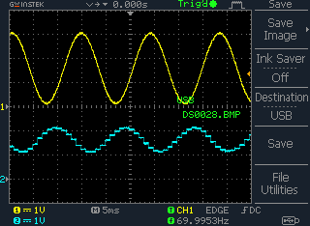
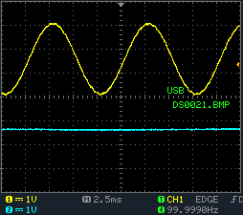
Low Pass Filter

Slide 8
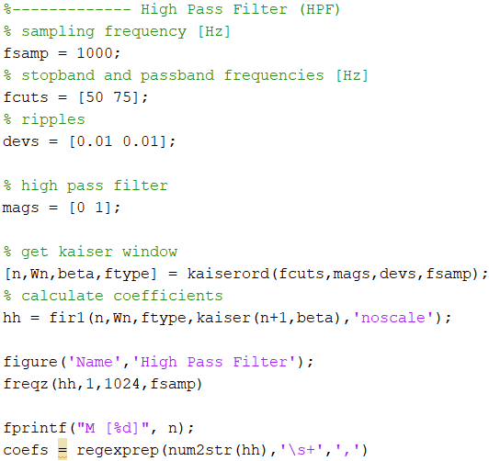
High Pass Filter

Slide 9
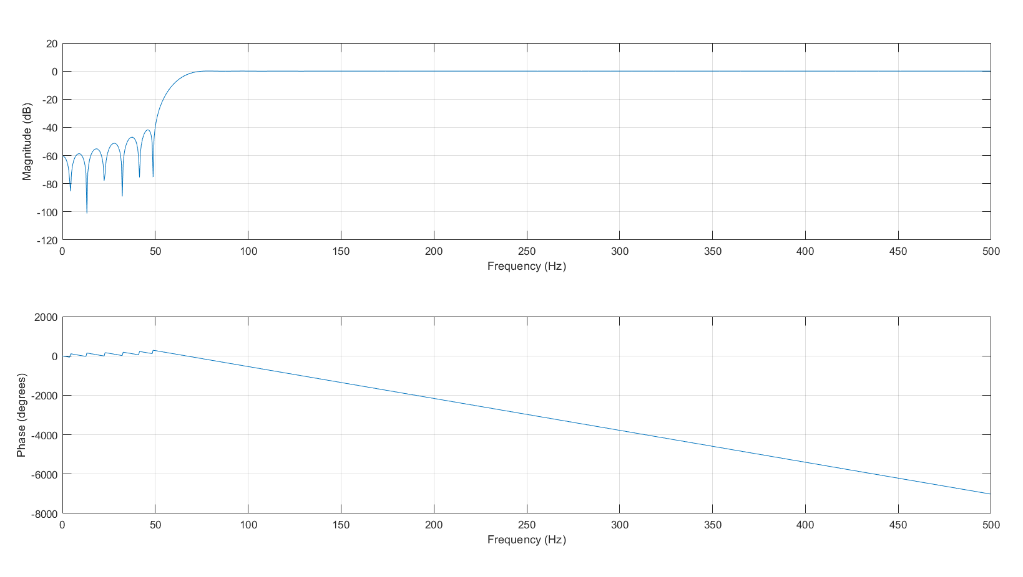
High Pass Filter

Slide 10
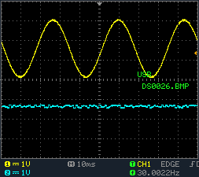
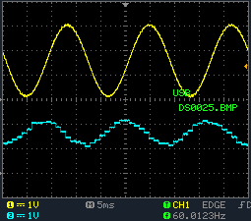
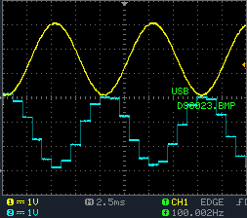
High Pass Filter

Slide 11
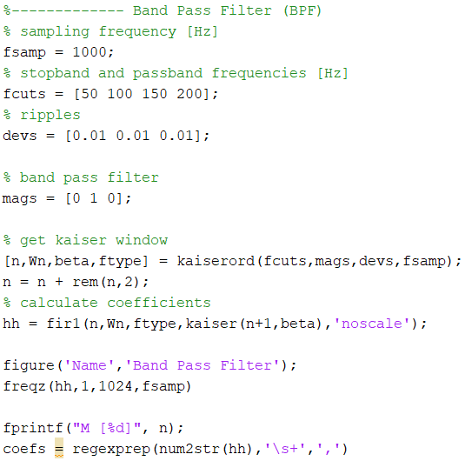
Band Pass Filter

Slide 12
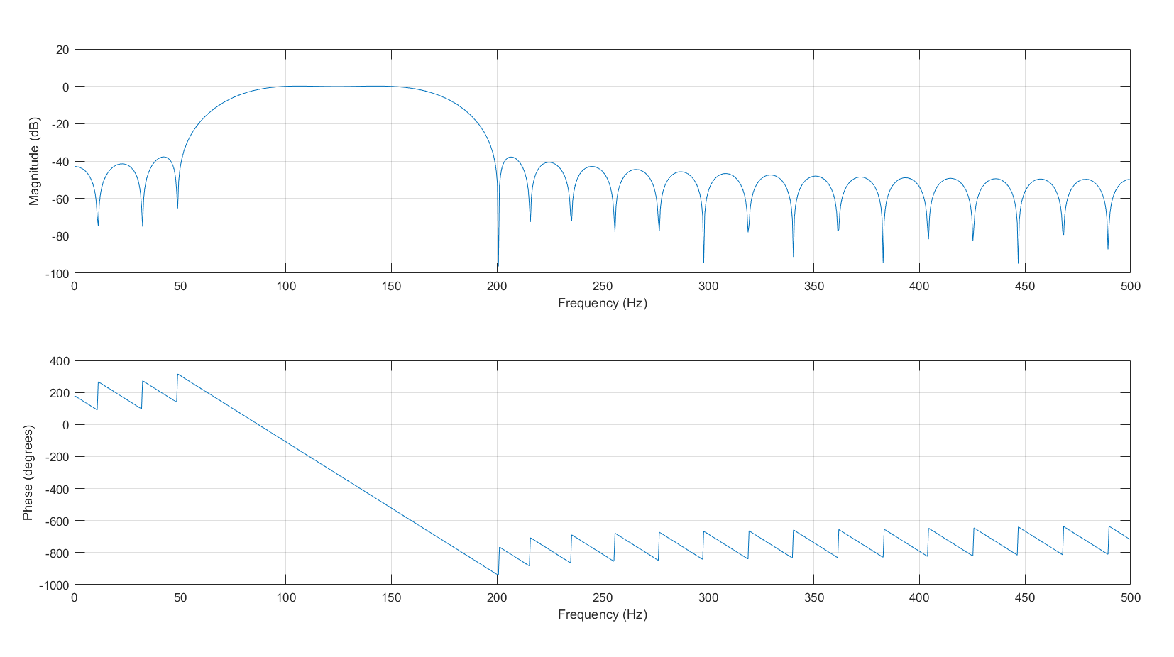
Band Pass Filter

Slide 13
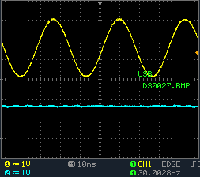
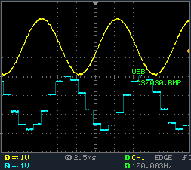
Band Pass Filter

Slide 14
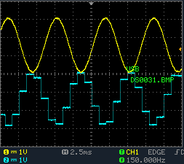
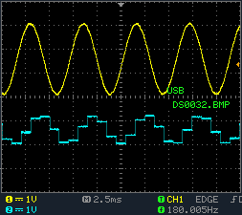
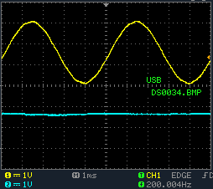
Band Pass Filter

Slide 15
Questions?

