Slide 1





Osciloscópio baseado em FPGA
Diogo Miguel Cunha Fernandes, PG47150
José Tomás Lima de Abreu, PG47386
Orientação:
Professor Doutor Jorge Cabral
Professor Doutor Rui Machado
Professora Sofia Paiva
Projeto Integrador em Eletrónica Industrial e Computadores
Universidade do Minho 2021/2022

Slide 2


ZYBO (Zynq Board) Project
Main steps
Create a project with Vivado
Create the verilog file that behaves as expected
Simulate
Add an AXI interface
Create bitstream
Create Linux Image with Petalinux
Use Vitis for hardware configuration and to create the software application
Run and test the application!

Slide 3
ZYBO (Zynq Board) Project
Main steps
Create a project with Vivado
Create the verilog file that behaves as expected
Simulate
Add an AXI interface
Create bitstream
Create Linux Image with Petalinux
Use Vitis for hardware configuration and to create the software application
Run and test the application!

Slide 4
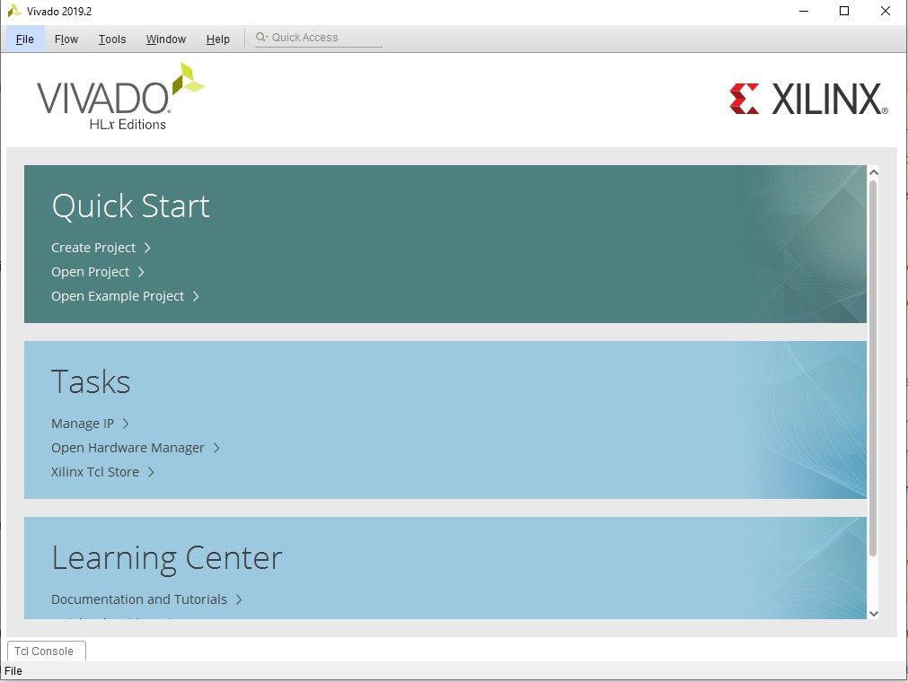
Vivado Project
Create a new Vivado Project:
“File -> Project -> New…”

Slide 5
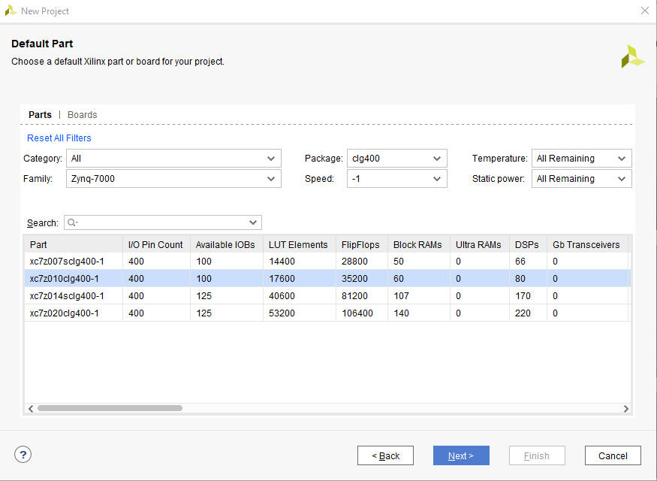
Vivado Project
Create a new Vivado Project:
Add Constrains… (optional)
will be added later
Default Part:
Family: Zynq-7000
Package: clg400
Speed: -1
Part: xc7z010clg400-1

Slide 6
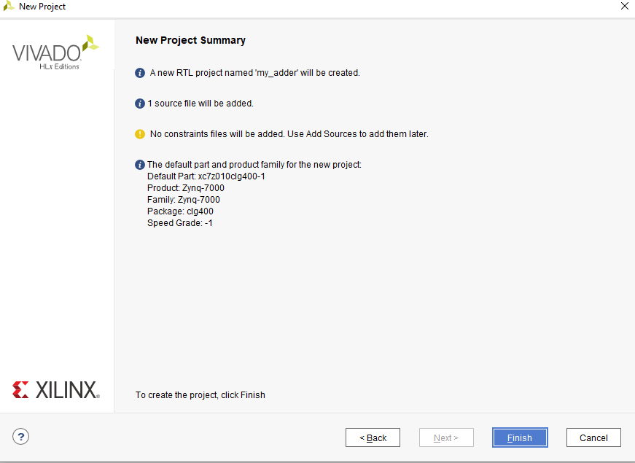
Vivado Project
Create a new Vivado Project:

Slide 7
Vivado Project – Verilog source file
my_adder.v
`timescale 1ns / 1ps
module my_adder(
);
endmodule
Inputs?
(………)
Outputs?

Slide 8
Vivado Project – Verilog source file
my_adder.v
`timescale 1ns / 1ps
module my_adder(
input wire[31:0] i_add_axi, input wire[3:0] i_add_gpio, input wire i_clear_result, input wire i_push_button, input wire clk,
output reg[31:0] o_result_axi, output wire[3:0] o_result_gpio
);
endmodule
Inputs?
Outputs?

Slide 9
THANK YOU!
ANY QUESTIONS?
mr.gomes@dei.uminho.pt

