Slide 1
SLiPaD
Smart Lighting with Parking Detection
Implementation
Embedded Systems
Group 9: Diogo Fernandes – A88262
José Tomás Abreu – A88218

Slide 2
Agenda
Problem Statement Review
Hardware Implementation
Test cases
Software Implementation
Test cases
Conclusion
Future Work

Slide 3
Agenda
Problem Statement Review
Hardware Implementation
Test cases
Software Implementation
Test cases
Conclusion
Future Work

Slide 4
Problem Statement Review

Slide 5
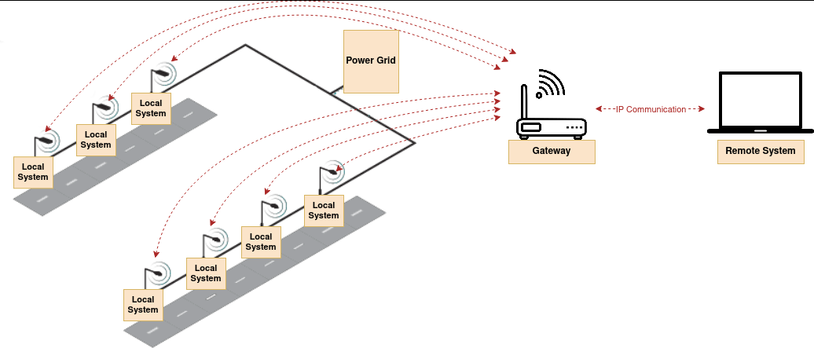
Network Architecture

Slide 6
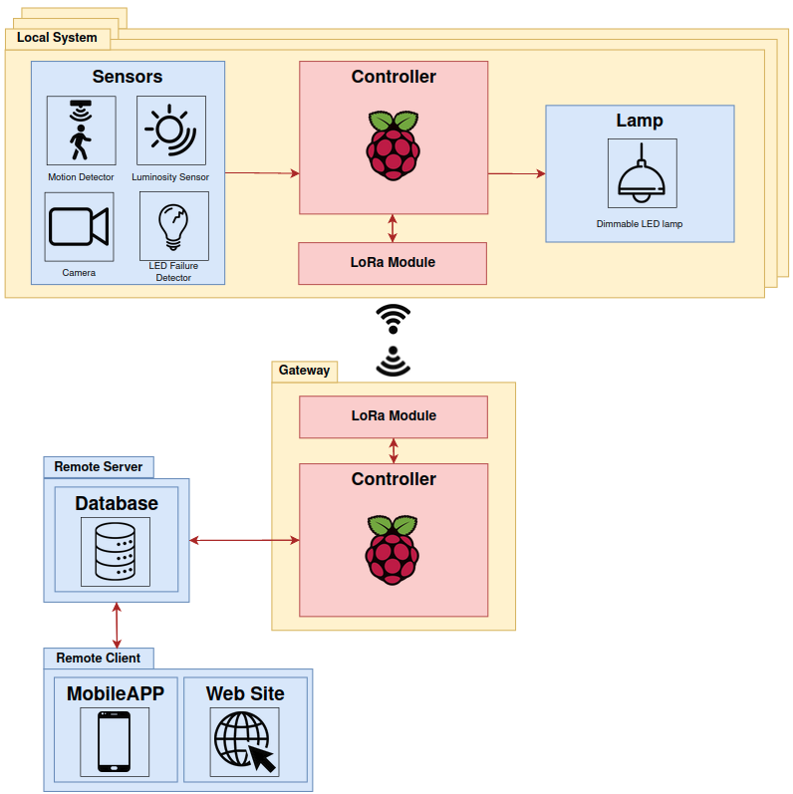
Local system Overview

Slide 7
Hardware Implementation

Slide 8
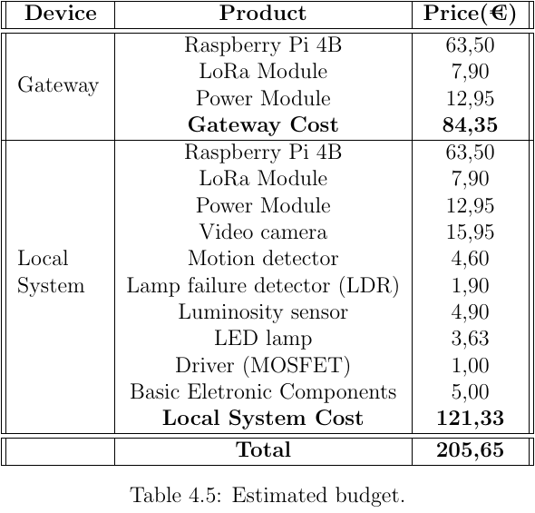
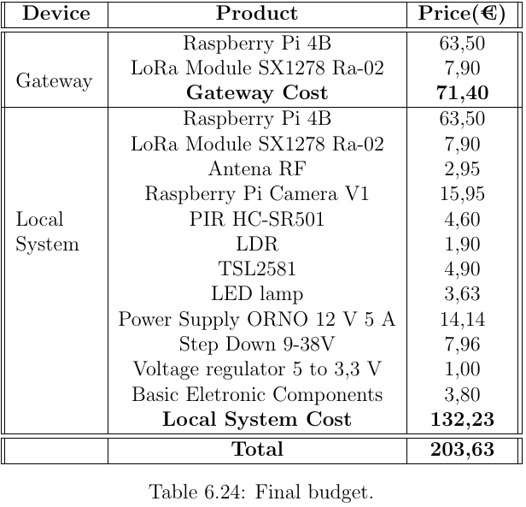
Expenses Comparison

Slide 9
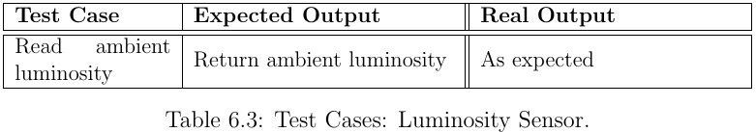
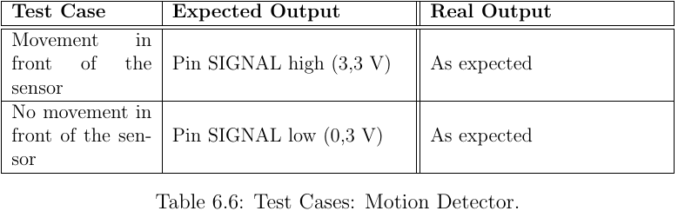
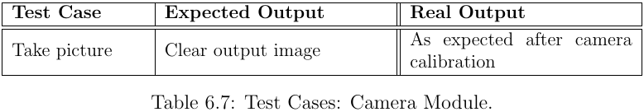
Test Cases

Slide 10
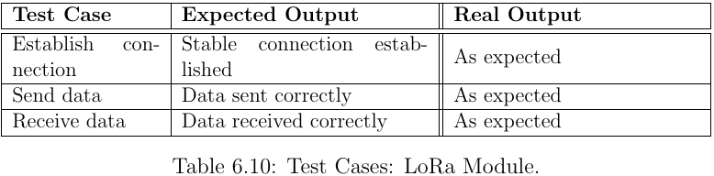
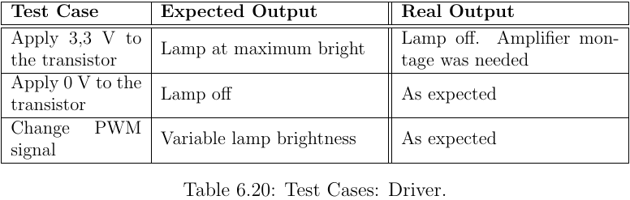
Test Cases

Slide 11
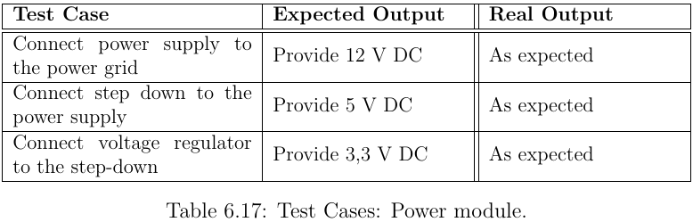
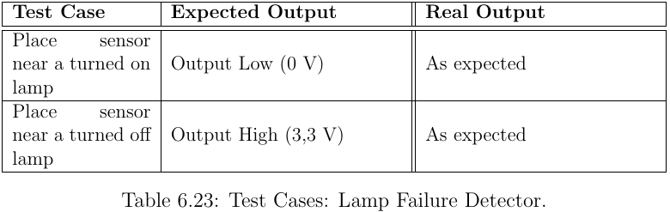
Test Cases

Slide 12
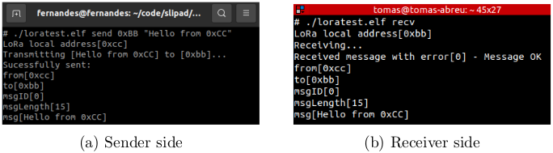
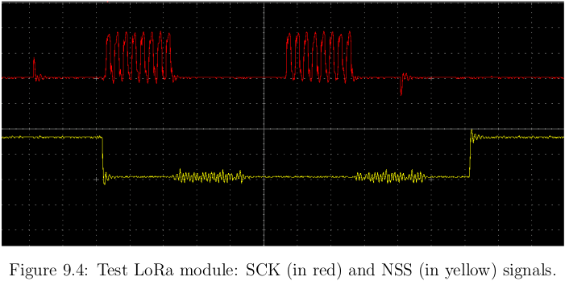
Test Cases

Slide 13
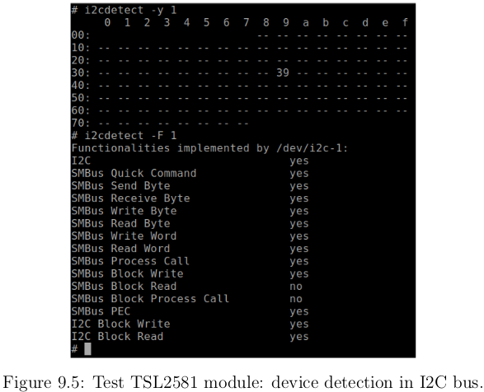
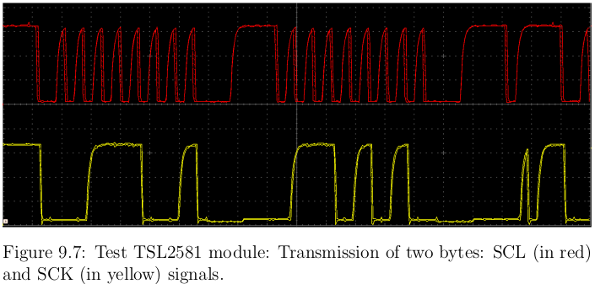
Test Cases

Slide 14
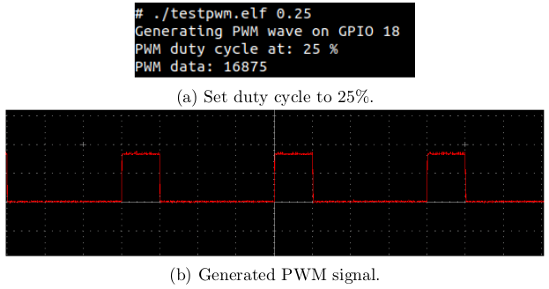
Test Cases

Slide 15
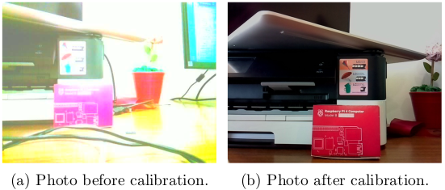
Test Cases

Slide 16
Software Implementation

Slide 17
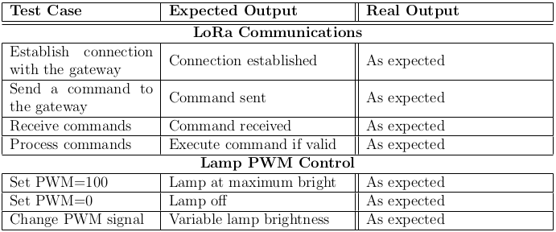
Local System
Test Cases

Slide 18
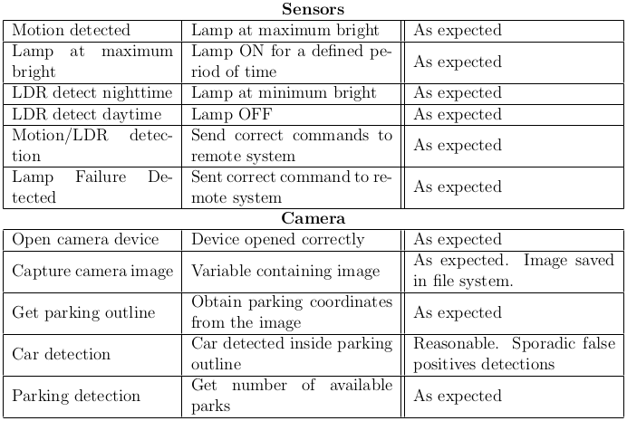
Local System
Test Cases

Slide 19
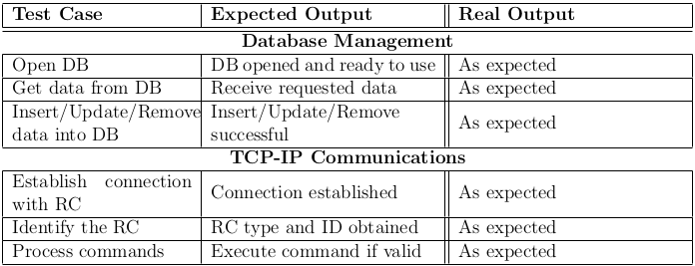
Remote System
Test Cases

Slide 20
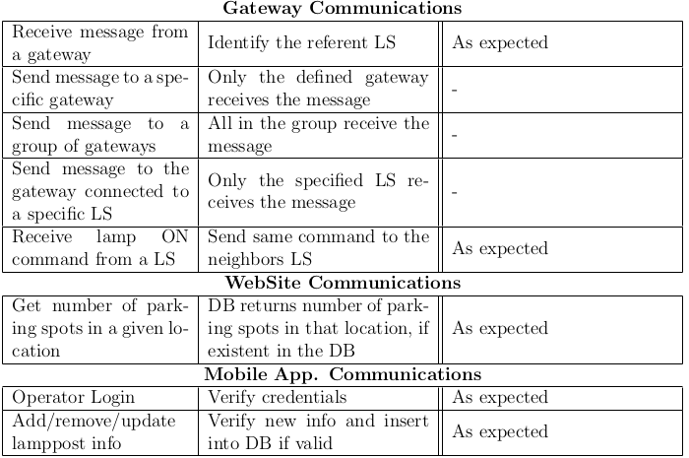
Remote System
Test Cases

Slide 21
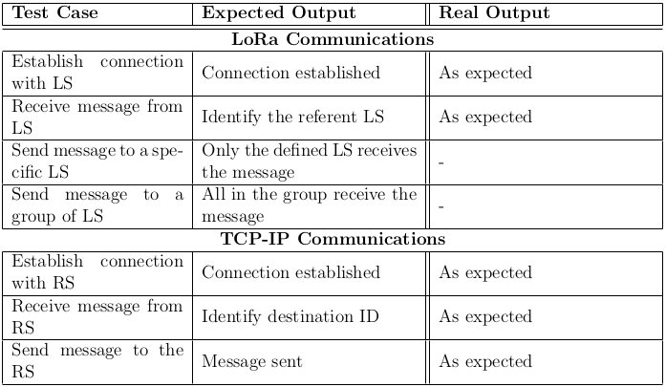
Gateway
Test Cases

Slide 22
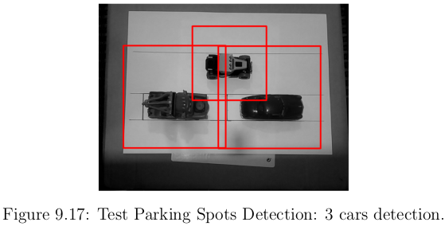
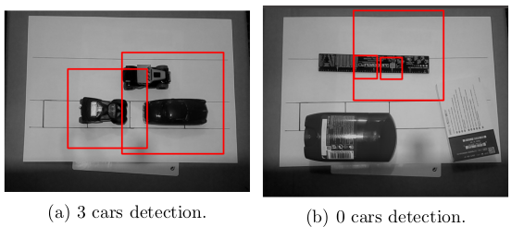
Test Cases

Slide 23
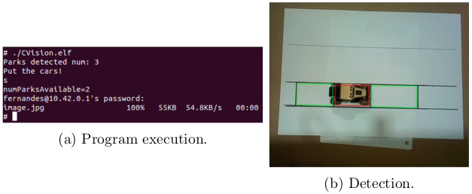
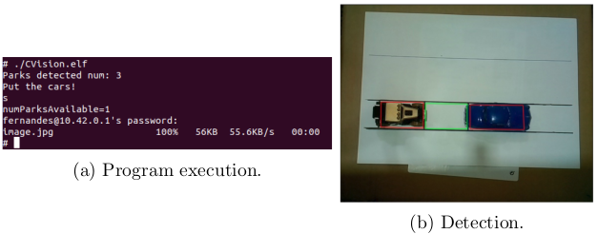
Test Cases

Slide 24
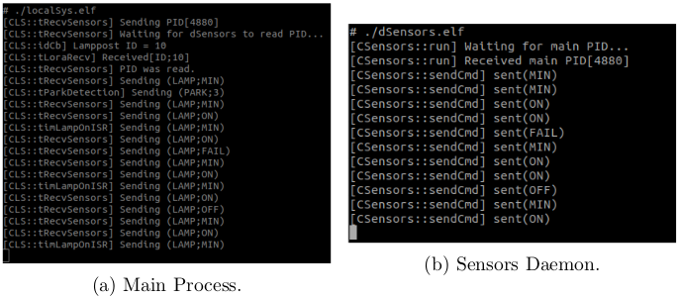
Test Cases

Slide 25
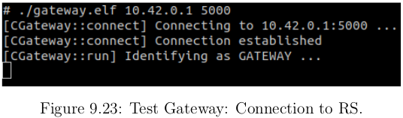
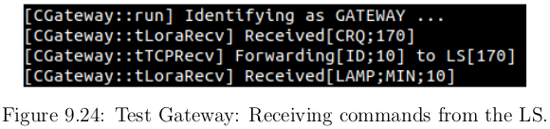
Test Cases

