Slide 1
Smart City
Project Plan
Embedded Systems
Group 9: Diogo Fernandes – A88262
José Tomás Abreu – A88218

Slide 2
Agenda
Problem Statement
Network Architecture
System Overview
Hardware Architecture
Local System
Base Station
Remote System
Gantt Chart

Slide 3
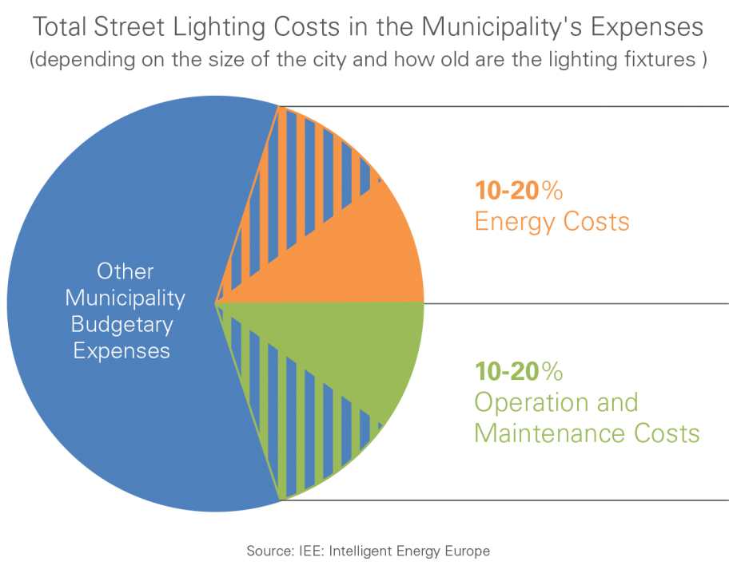
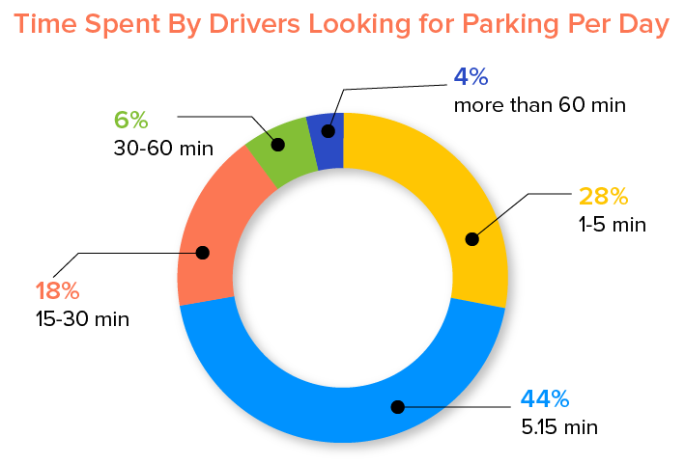
Problem Statement
Energy Crisis
63,3 % of electrical energy production comes from fossil fuels.
Street lamps:
Huge energy consumption
Contribute to light pollution
An average car is parked 95 % of the time.
Looking for parking spots increases the carbon dioxide production and fuel and energy consumption

Slide 4
Problem Statement
Creation of a centralized system, composed by smart street poles
Intelligent streetpole:
Turns on only when movement is detected
Adjusts the luminosity according to light conditions
Detect lamp failure
Communicates wirelessly with a base station
Base Station:
An inteligent street pole that controls the network of smart street lamps
Finds empty parking spots
Knowledge of each lamp post operating conditions

Slide 5
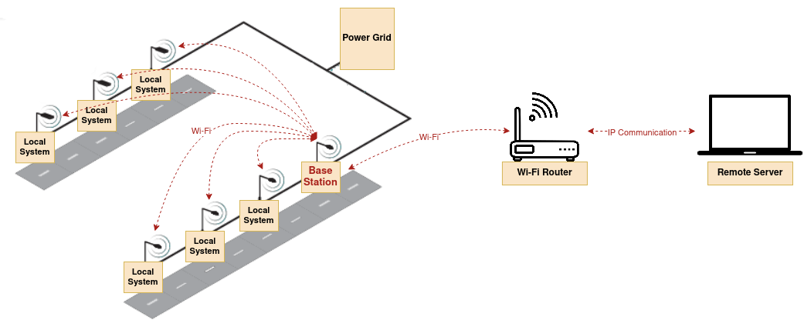
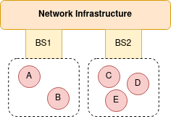
Network Architecture

Slide 6
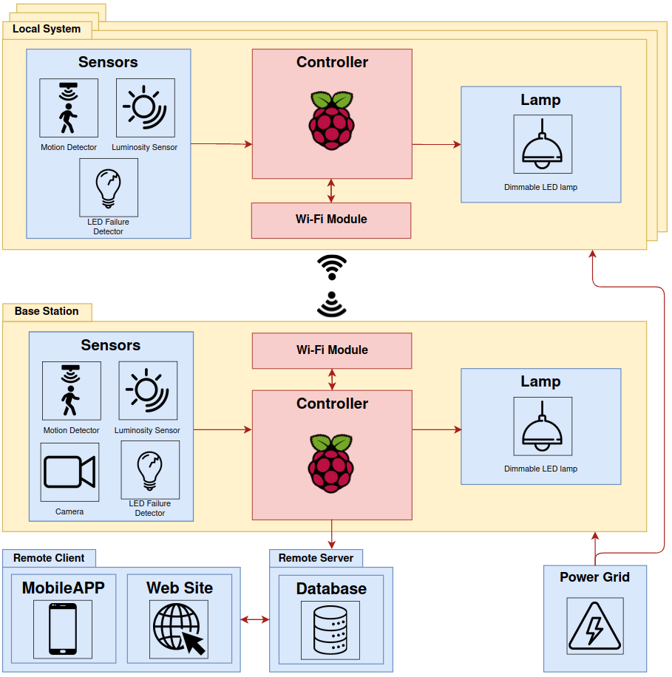
System Overview

Slide 7
System Requirements
Functional Requirements:
Sensors data acquisition
Motion detection
Control of a street lamp
Control a network of street poles
Wireless communication between local systems and base station
Access system information through a mobile application
Empty parking spots detection
Add lamp post location through a mobile application
Access available parking spots location through a web site

Slide 8
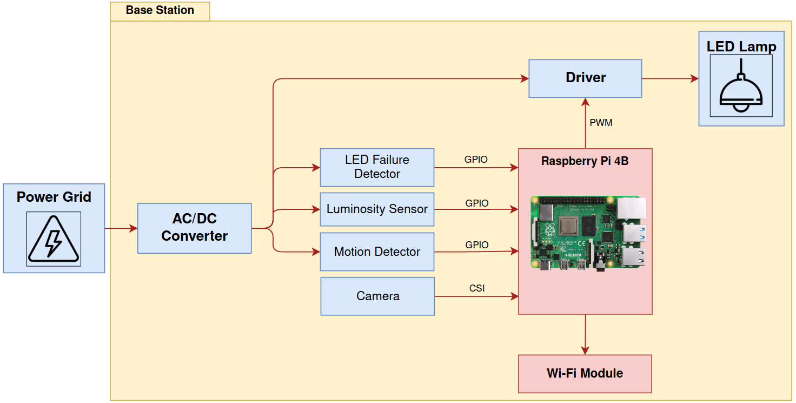
Hardware Architecture

Slide 9
Base Station and Local System

Slide 10
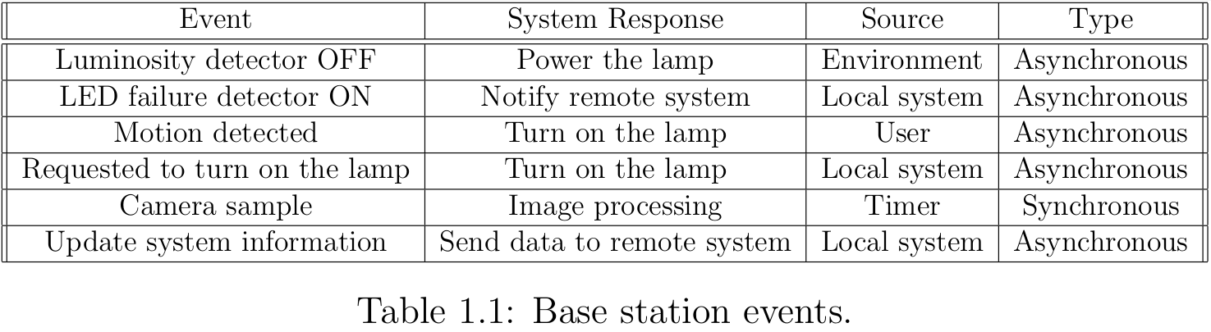
Base Station
System Events

Slide 11
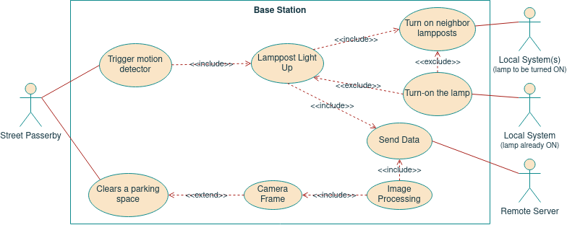
Base Station
Use Cases Diagram

Slide 12
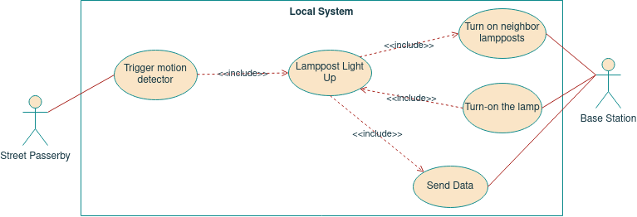
Local System
Use Cases Diagram

Slide 13
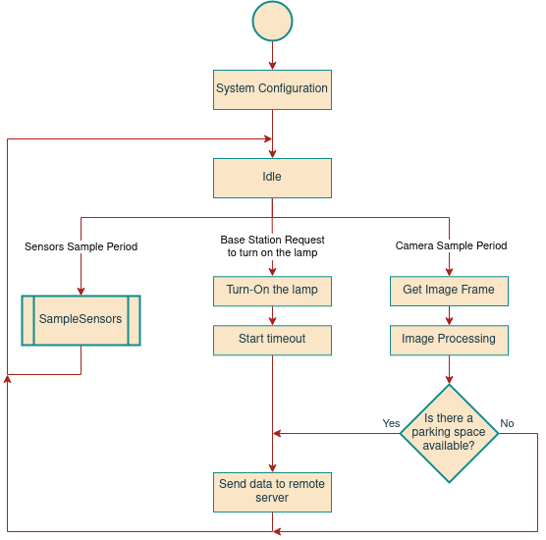
Base Station
State Chart

Slide 14
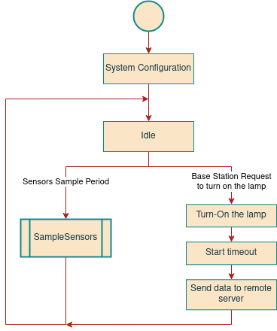
Local System
State Chart

Slide 15
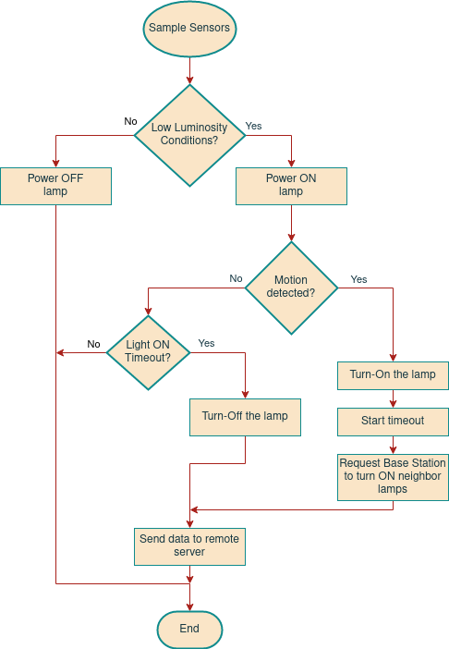
Sample Sensors

Slide 16
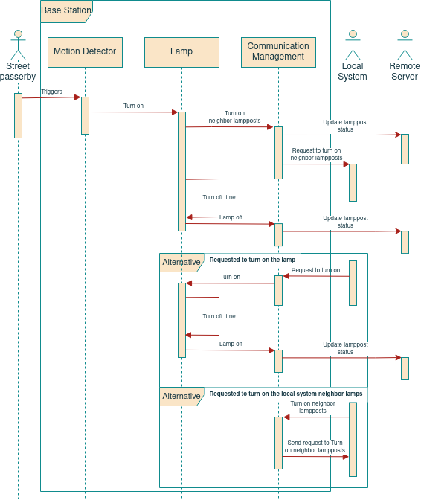
Base Station: Sequence Diagram

Slide 17
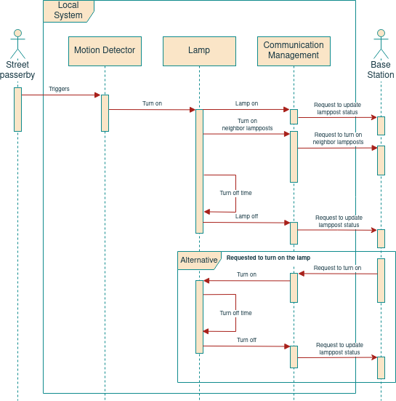
Local System: Sequence Diagram

Slide 18
Remote System

Slide 19
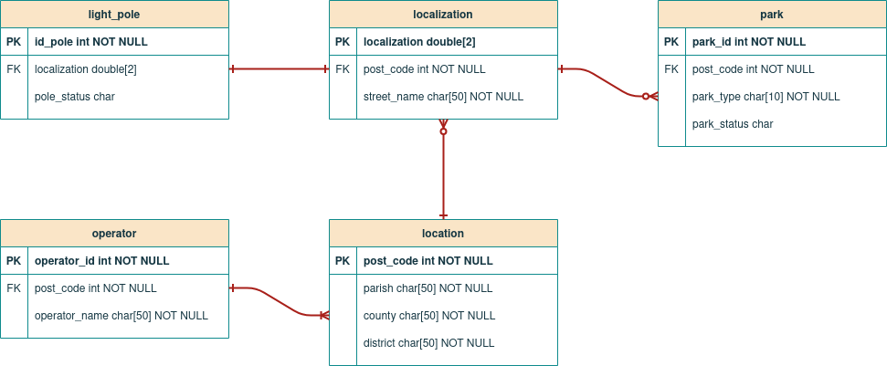
Database

Slide 20
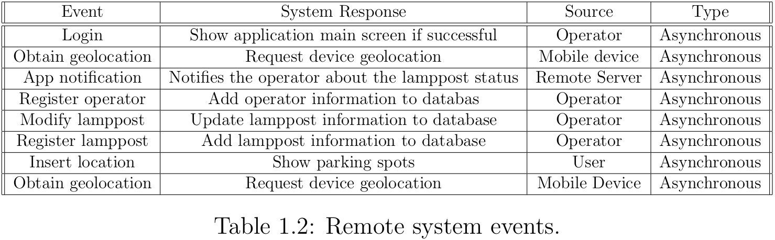
Remote System
System Events

Slide 21
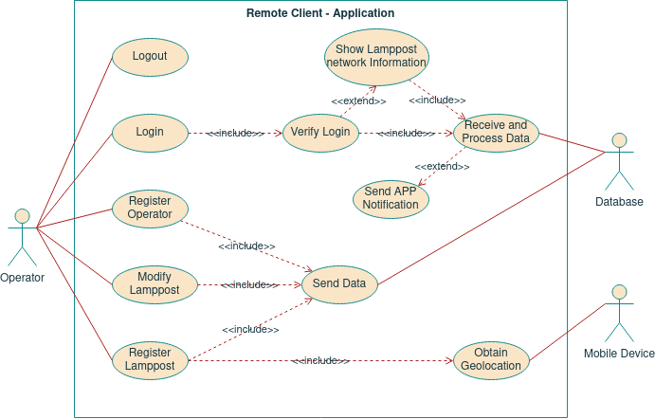
Remote System: Application
Use Cases Diagram

Slide 22
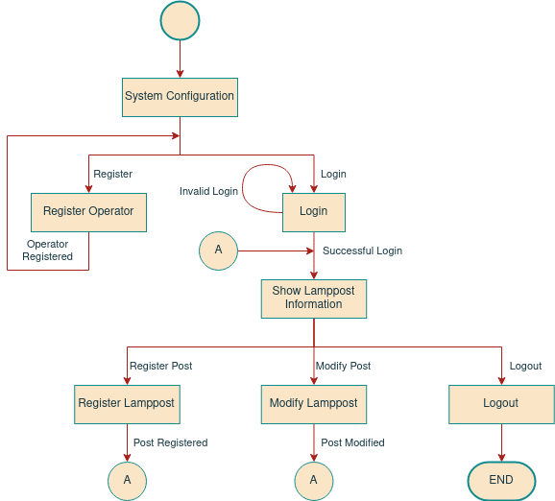
Remote System: Application
State Chart

Slide 23
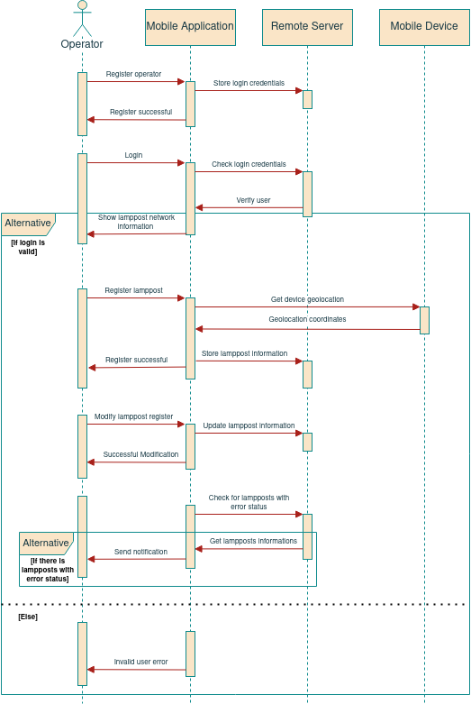
Remote System: Application Sequence Diagram

Slide 24
Remote System: Web Site
Use Cases Diagram

Slide 25
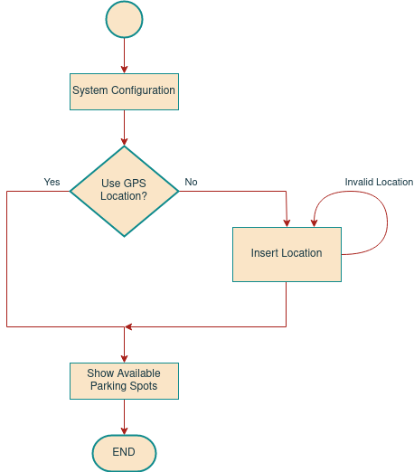
Remote System: Web Site
State Chart

Slide 26
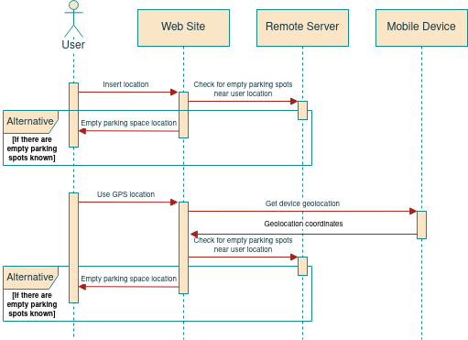
Remote System: Web Site
Sequence Diagram

Slide 27
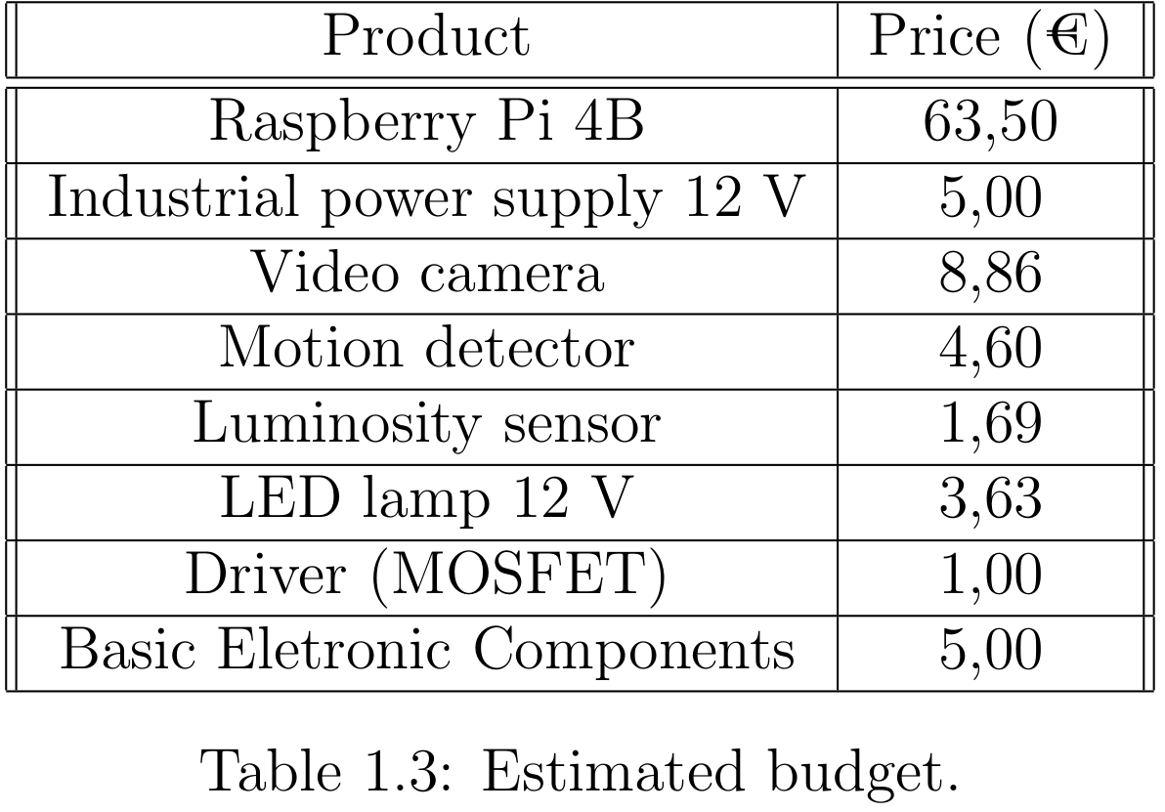
Estimated Budget

Slide 28
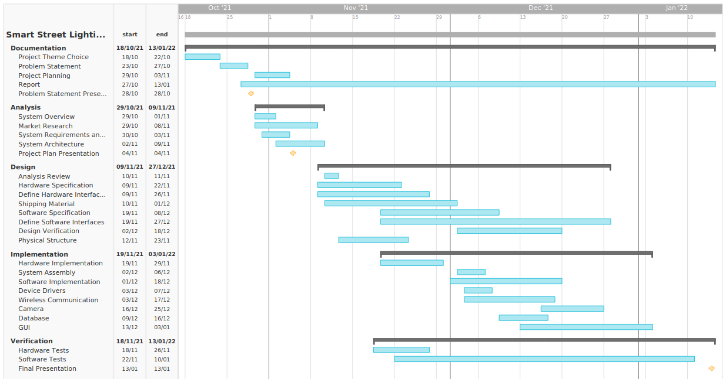
Gantt Diagram

Slide 29
Questions?

