Slide 1
Smart City
Project Plan
Embedded Systems
Group 9: Diogo Fernandes – A88262
José Tomás Abreu – A88218

Slide 2
Agenda
Problem Statement
Network Architecture
System Overview
Hardware Architecture
Local System
Base Station
Remote System
Gantt Chart

Slide 3
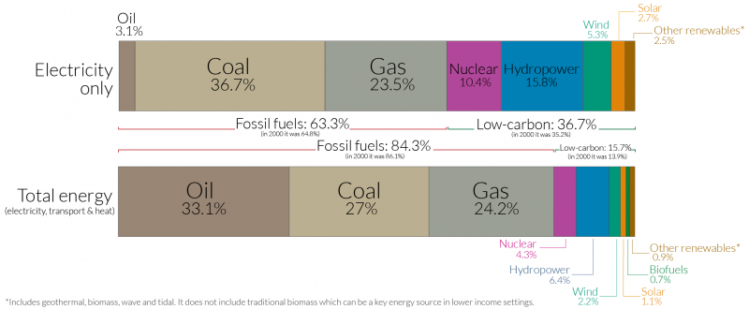
Problem Statement
Energy Crisis
63,3 % of electrical energy production comes from fossil fuels.
An average car is parked 95 % of the time.
Looking for parking spots increases the carbon dioxide production and fuel and energy consumption
Street lamps:
Huge energy consumption
Contribute to light pollution
World Energy Production by Source, Our World in Data

Slide 4
Problem Statement
Creation of a centralized system, composed by smart street poles
Intelligent streetpole:
Turns on only when movement is detected
Adjusts the luminosity according to light conditions
Knows if the lamp is working when it should
Finds empty parking spots
Communicates wirelessly to the monitoring device
Monitoring device:
Control a network of smart street lamps
Knowledge of each lamp post operating conditions

Slide 5
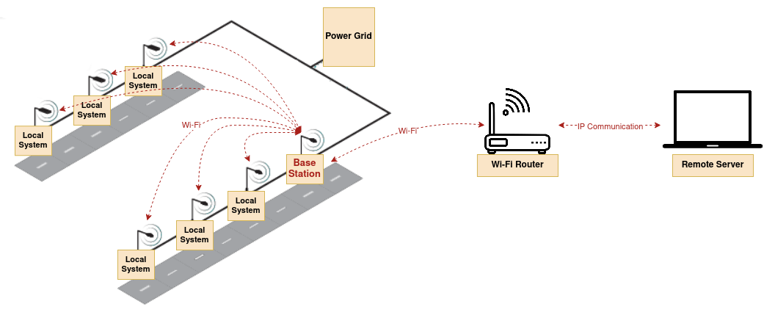
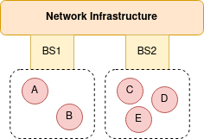
Network Architecture

Slide 6
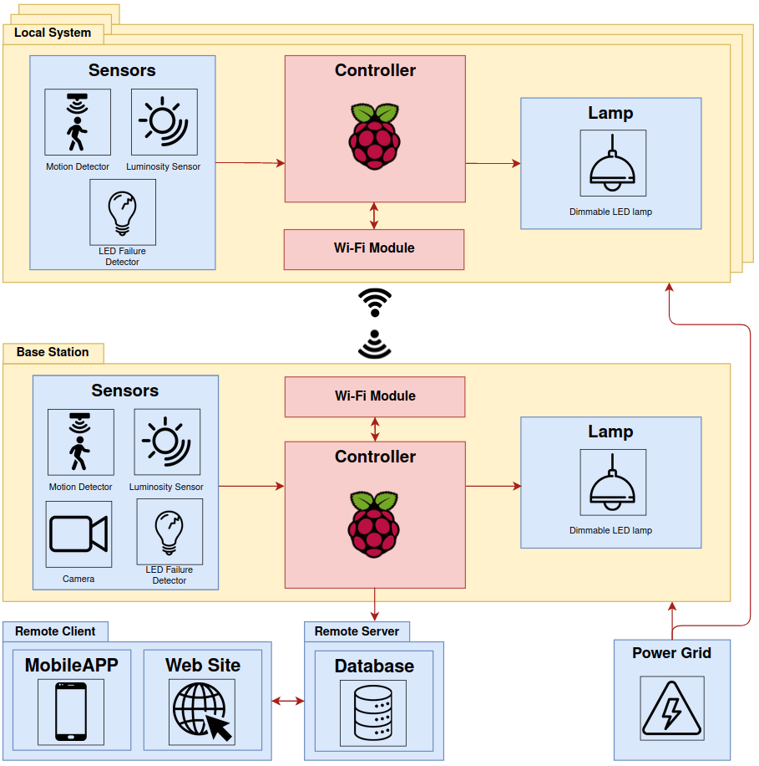
System Overview

Slide 7
System Requirements
Functional Requirements:
Sensors data acquisition
Motion detection
Control of a street lamp
Control a network of street poles
Wireless communication between local systems and base station
Access system information through a mobile application
Empty parking spots detection
Add lamp post location through a mobile application
Access available parking spots location through a web site

Slide 8
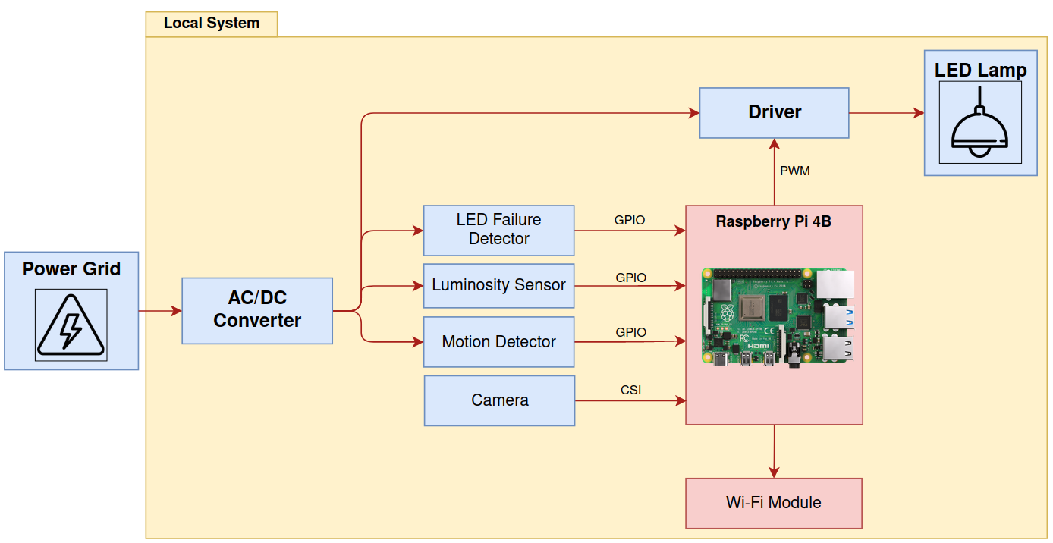
Hardware Architecture

Slide 9
Base Station and Local System

Slide 10
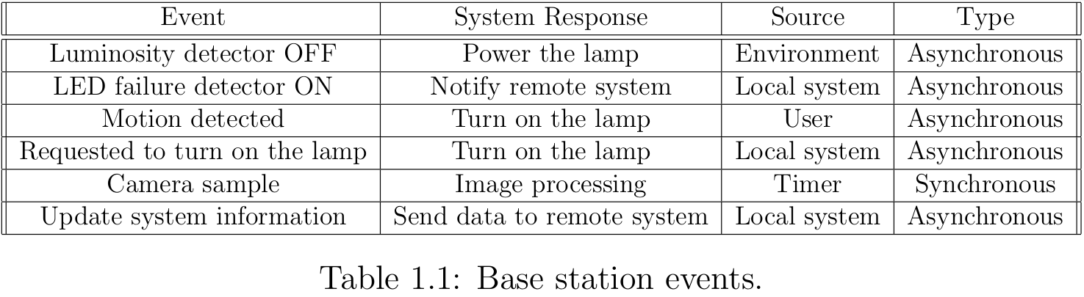
Base Station
System Events

Slide 11
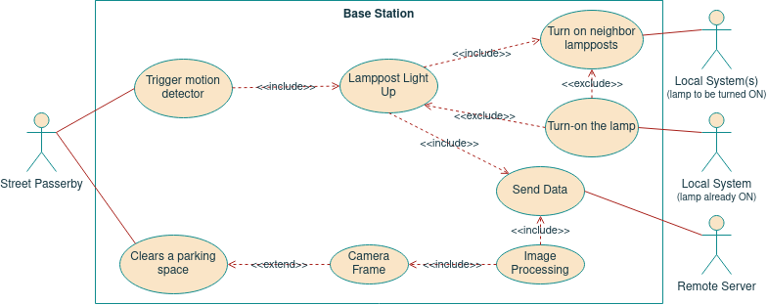
Base Station
Use Cases Diagram

Slide 12
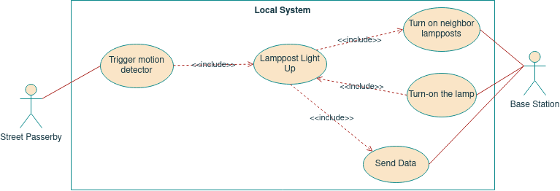
Local System
Use Cases Diagram

Slide 13
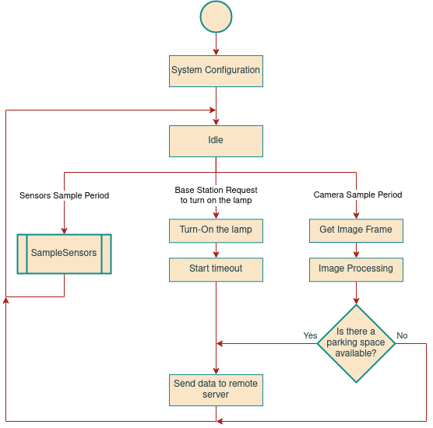
Base Station
State Chart

Slide 14
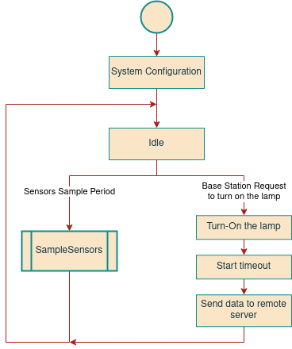
Local System
State Chart

Slide 15
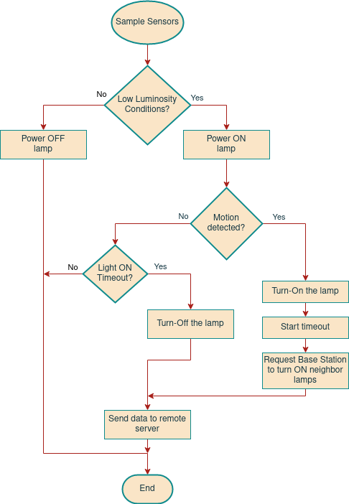
Sample Sensors

Slide 16
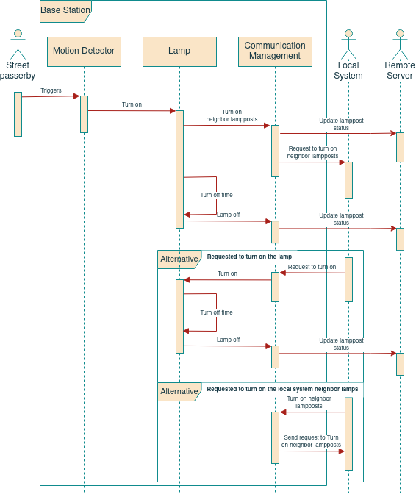
Base Station
Sequence Diagram

Slide 17
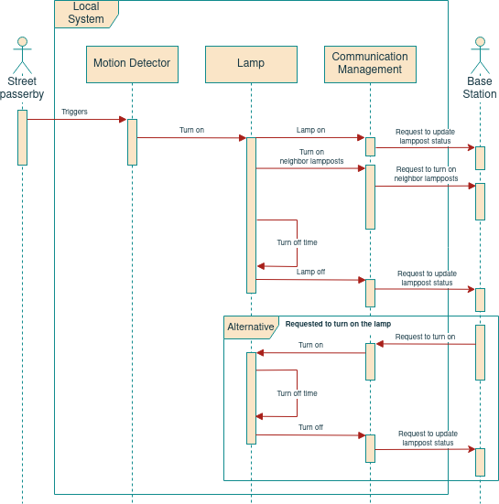
Local System
Sequence Diagram

Slide 18
Remote System

Slide 19
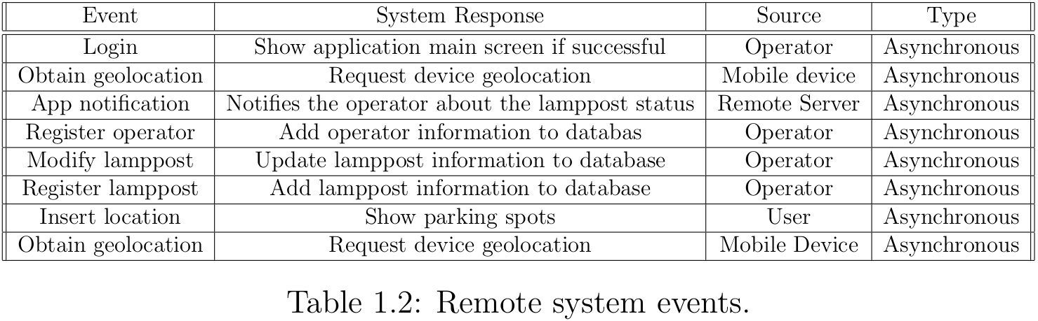
Remote System
System Events

Slide 20
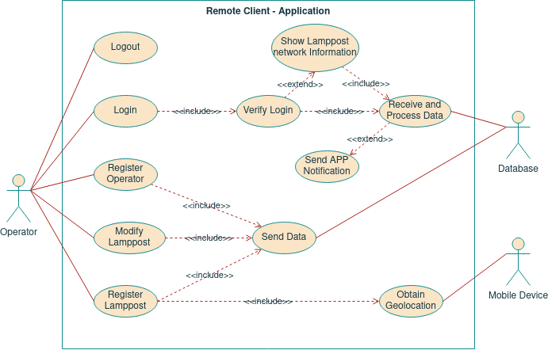
Remote System: Application
Use Cases Diagram

Slide 21
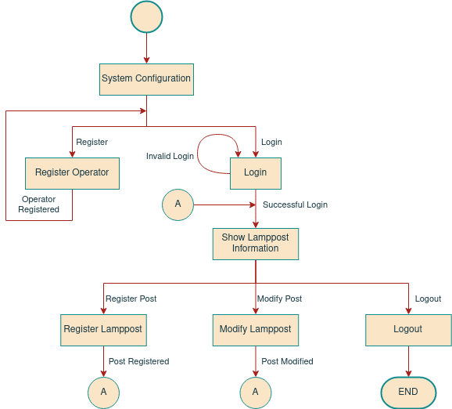
Remote System: Application
State Chart

Slide 22
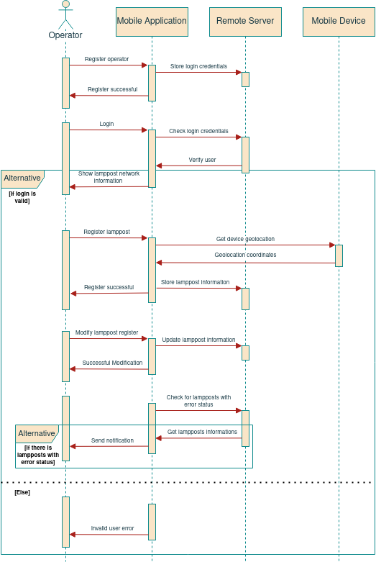
Remote System: Application
Sequence Diagram

Slide 23
Remote System: Web Site
Use Cases Diagram

Slide 24
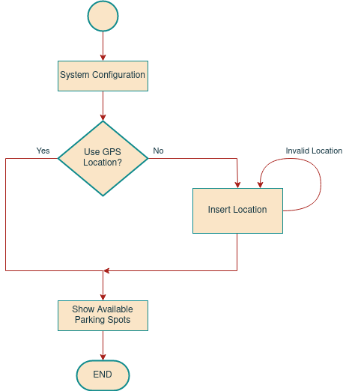
Remote System: Web Site
State Chart

Slide 25
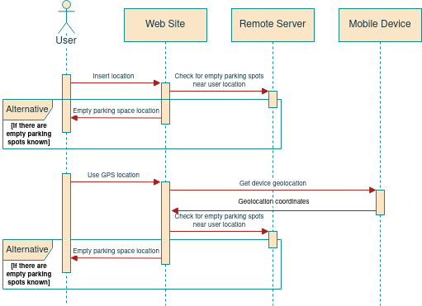
Remote System: Web Site
Sequence Diagram

Slide 26
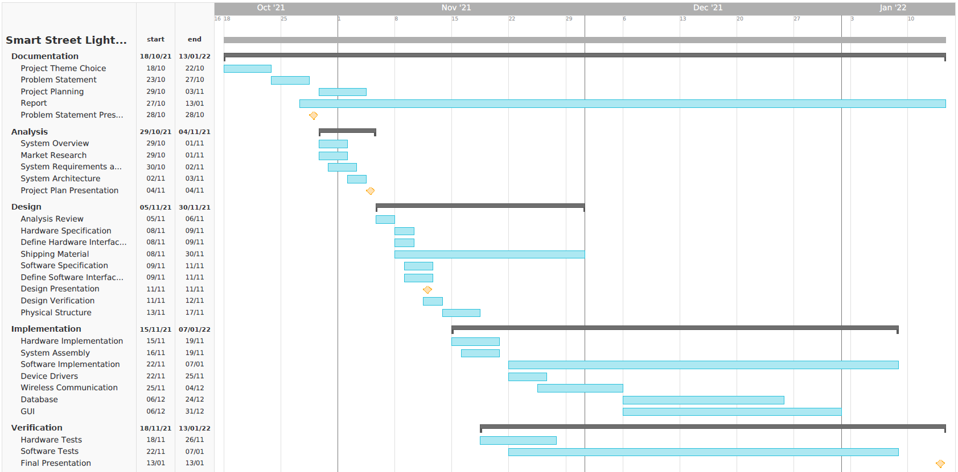
Gantt Diagram

