Slide 1
Smart Street Lighting
Project Plan
Embedded Systems
Diogo Fernandes – A88262
José Tomás Abreu – A88218

Slide 2
Agenda
Problem Statement
Market Research
System Overview
Requirements
Constraints
Hardware Architecture
Software Architecture
Gantt Chart

Slide 3
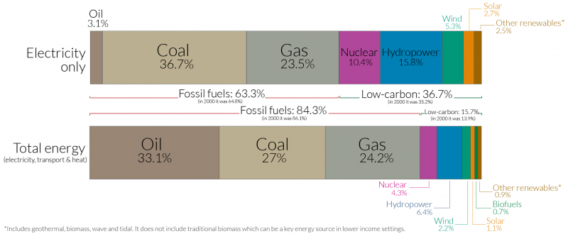
Problem Statement
Energy Crisis
63,3 % of electrical energy production comes from fossil fuels
Street lamps:
Huge energy consumption
Contribute to light pollution
World Energy Production by Source, Our World in Data

Slide 4
Problem Statement
Creation of a monitoring device, capable of controlling an intelligent street lamps network
Intelligent street lamp:
Turns on only when movement is detected
Adjust the luminosity according to the environment
Knows if the lamp is working when it should
Communicates wirelessly to the monitoring device
Monitoring device:
Control a network of smart street lamps
Knowledge of each lamp post operating conditions

Slide 5
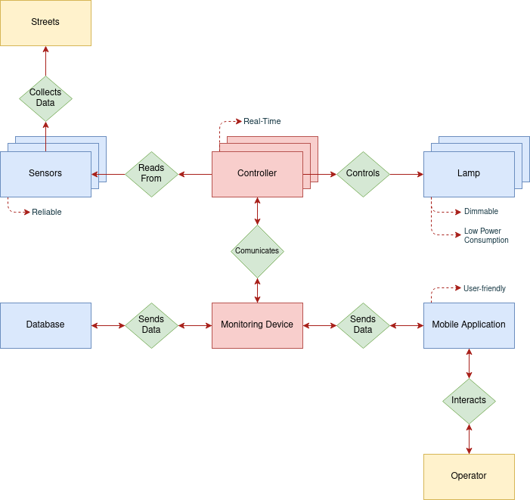
Problem Statement Analysis

Slide 6
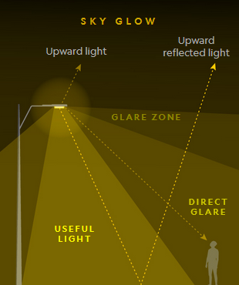
Market Study
Most of current lamps used in public lighting are High Pressure Sodium
Yellow-orange, monochromatic glow
Cheaper and more efficient than incandescent lights
Higher maintenance and operation cost than LED lamps
Not a directional light
Lamps Unwanted Glare, National Geographic

Slide 7
Market Study
Telensa is the market share leader in smart street lighting, with PLANet system.
Wireless nodes connecting individual lights
Dedicated network owned by the city
Central management application
Doncaster, in England, houses over 45000 smart Telensa street lights.
Reduces maintenance costs (use of automatic fault reporting, improving maintenance quality)
Savings of 1,5million euros annually, with potential to increase this in the future.

Slide 8
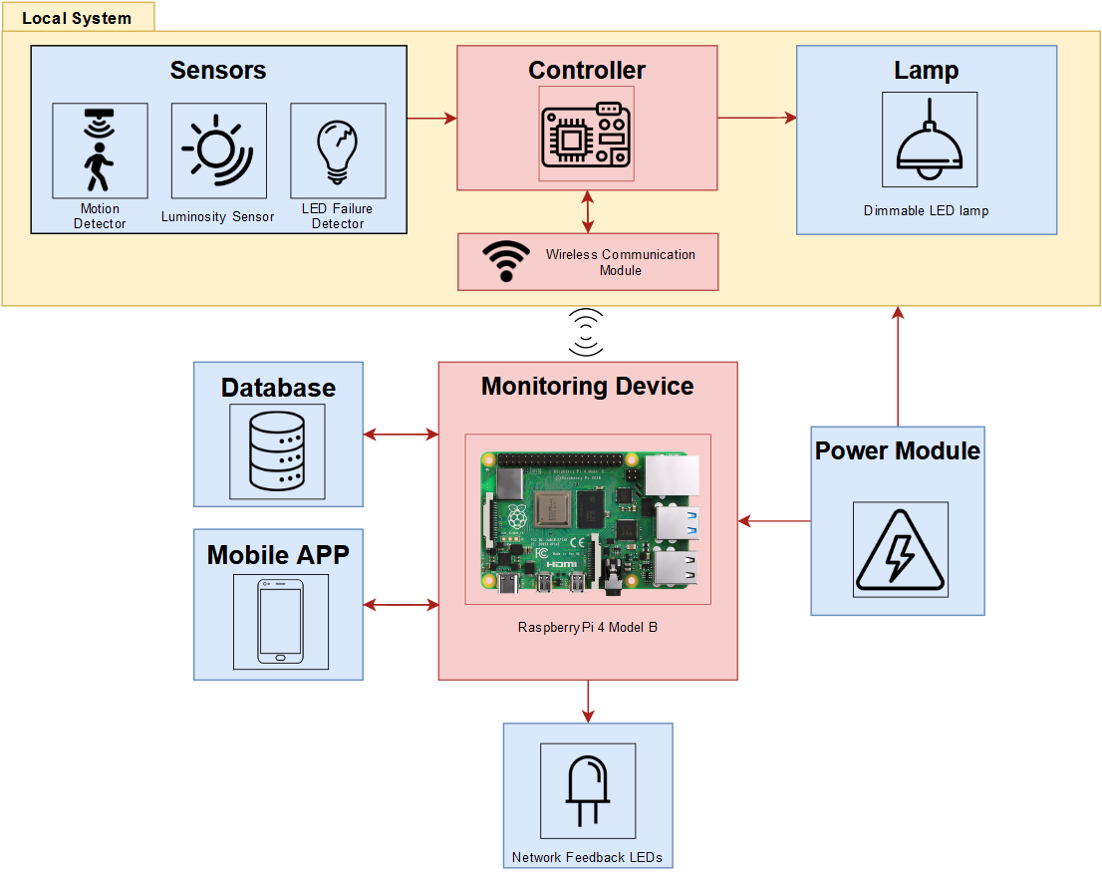
System Overview

Slide 9
System Requirements
Functional Requirements:
Sensors data acquisition
Motion detection
Control of a street lamp
Control a network of street poles
Wireless communication
Access system information through a mobile application
Non-Functional Requirements:
User friendly mobile application
Ambient luminosity sensing
Lower power comsumption than actual street lights
Soft Real-Time Embedded System

Slide 10
System Constraints
Buildroot
C/C++
Device Drivers
Raspberry Pi (Linux)
Cyber-Physical System (CPS)
Makefiles Pthreads
Two members team
Project deadline at the end of the semester
Low budget

Slide 11
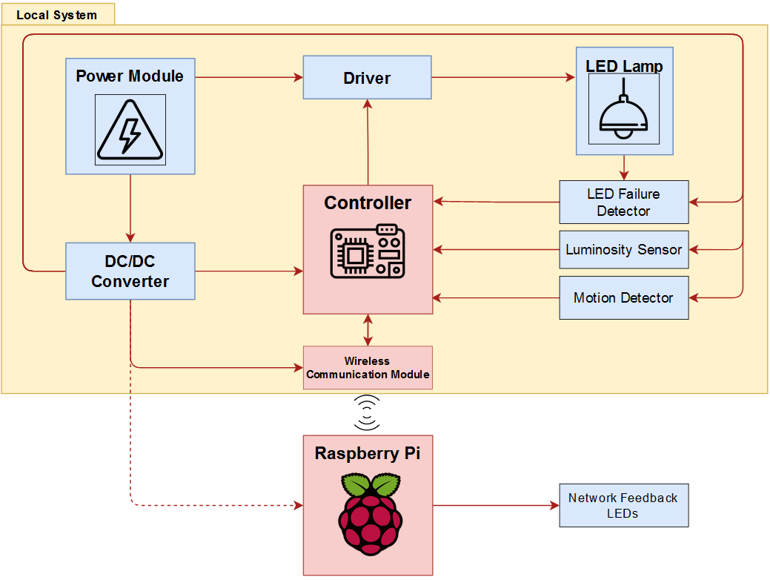
Hardware Architecture

Slide 12
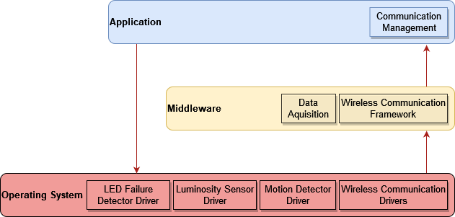
Software Architecture
Local System:

Slide 13
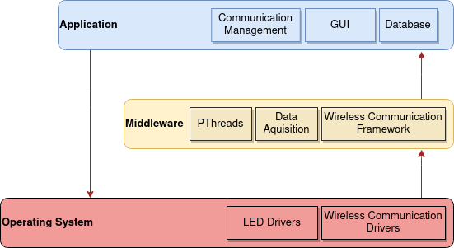
Software Architecture
Monitoring System:

Slide 14
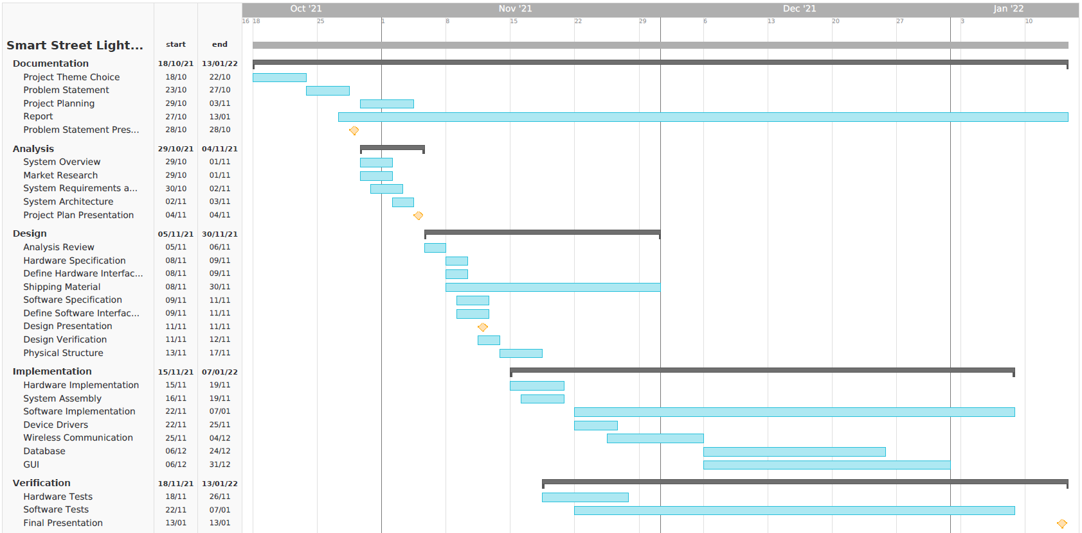
Gantt Diagram

