Slide 1
SLiPaD
Smart Lighting with Parking Detection
Project Status
Embedded Systems
Group 9: Diogo Fernandes – A88262
José Tomás Abreu – A88218

Slide 2
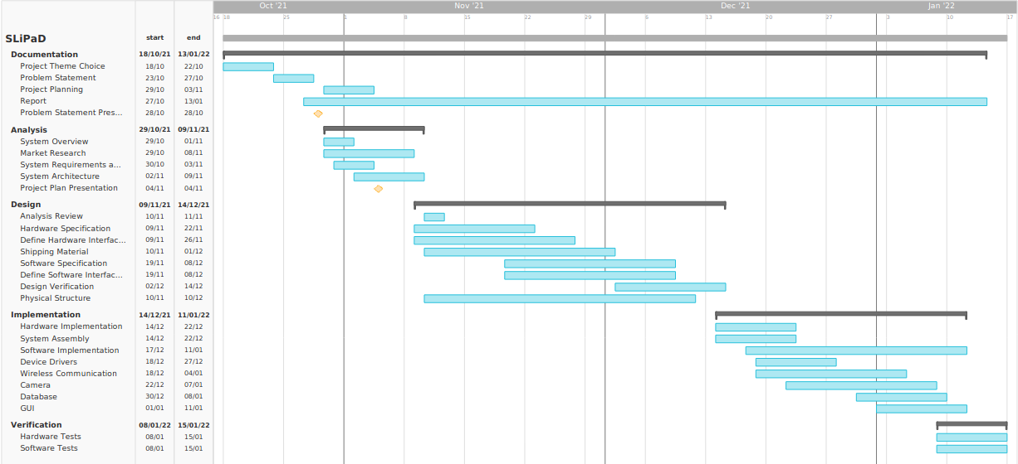
Gantt Chart

Slide 3
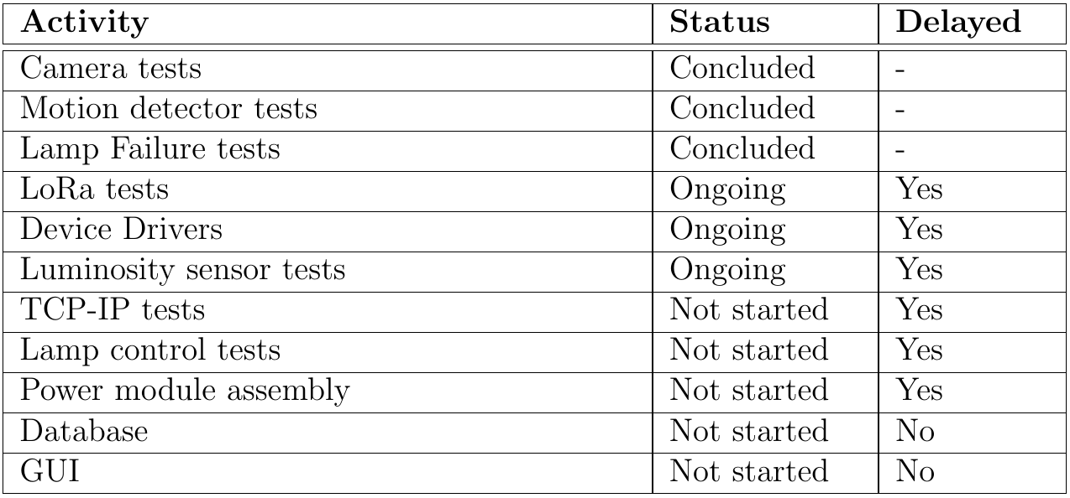
Current Project Status

