Slide 1
BDC – Bomb Defuse Car
Analysis
Embedded Systems
José Silva – A74327
Henrique Tavares - A74638

Slide 2
Agenda
Problem Statement
Market Study
Requirements
Constraints
Hardware Overview
Software Overview
Resources
System Stack
Events
Uses Cases
Sequential Diagram
State Diagram

Slide 3
Problem Statement
Nowadays, terrorism is a main concern to every country and society.
The most common method of terrorism is through bombs, usually put in places of difficult access. When seen in time, is necessary to deactivate the bomb as fast as possible, so we need to get close to the bomb, which can be dangerous at times. So, in order to preserve human life, robots are sent for deactivation.
Our goal is to create BDC, a vehicle capable of cute wires while streaming to a dispositive. Within that dispositive someone can control it’s trajectory and take decisions – with a simple interface - in order to defuse the bomb.

Slide 4
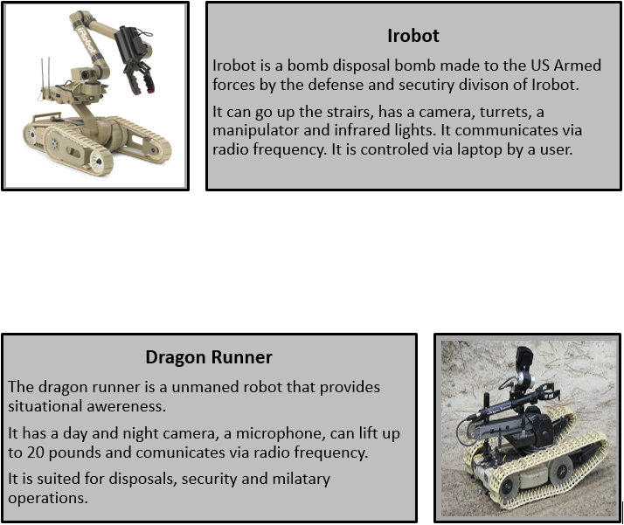
Market Study

Slide 5
Requeriments
Functional Requirements:
Be controlled to go to a place and cut the desired wires:
Be controlled by user;
Stream video;
Control a mechanical arm;
Cut wires;
Non-Functional Requirements:
Low budget
Maintainability
Security
Sturdiness

Slide 6
Constraints
Using Raspberry Pi3
PThreads
C/C++
Implement device drivers

Slide 7
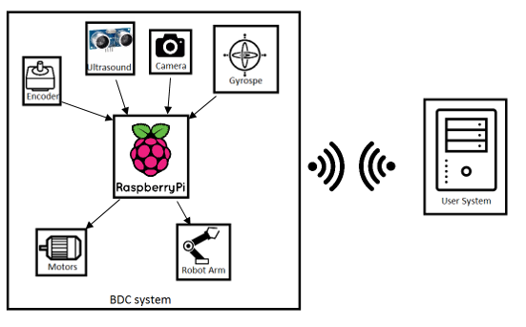
Hardware Overview

Slide 8
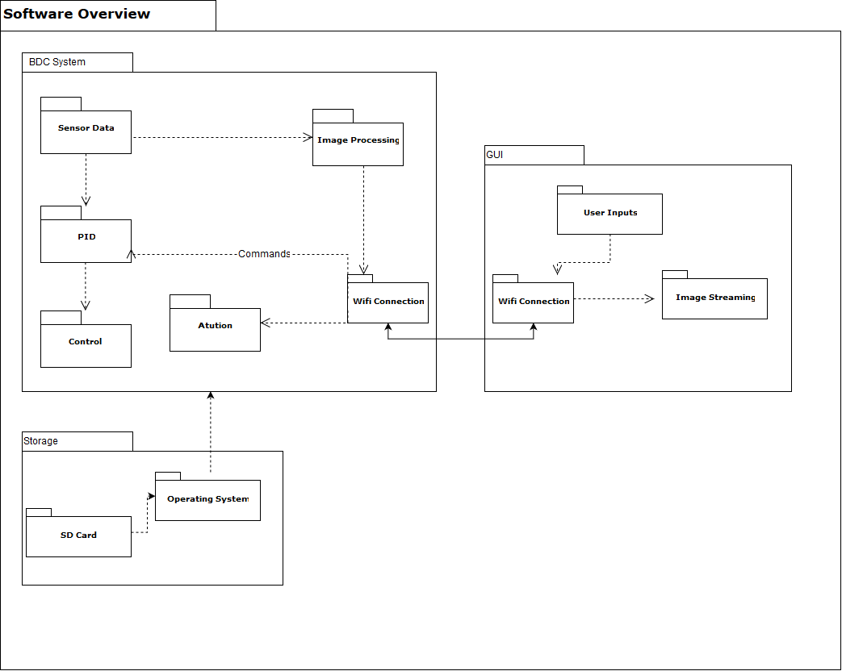
Software Overview

Slide 9
Resources
Hardware Resources
Motor;
Sensors:
Ultrasound;
Camera;
Gyroscope;
Raspberry Pi3:
Wifi module;
Sd Card
Software Resources
Embedded Linux;
QT;
Pthreads;
C/C++;

Slide 10
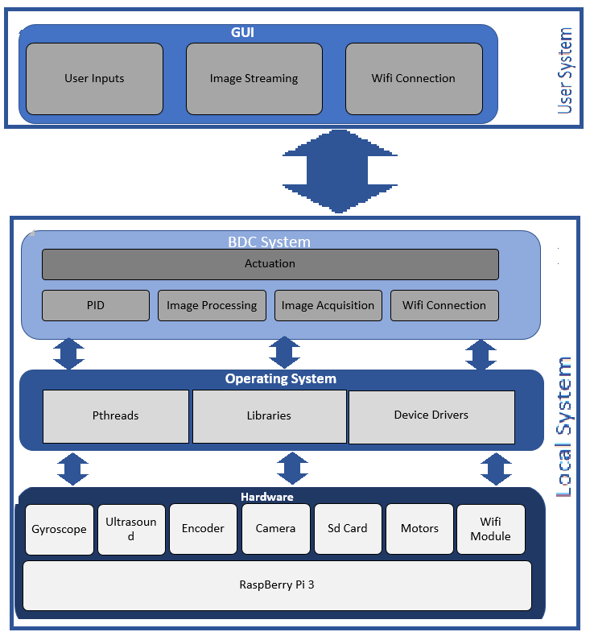
System Stack

Slide 11
Local System Events
Event | Source | System Response | Event Type
Wifi Connection | User | Asynchronous | Getting a connection to the user interface
Wifi Connection Lost | BDC | Asynchronous | Losing the connection
Obstructed way | BDC | Asynchronous | Impossible for the BDC to go through
Cutting wire | User | Asynchronous | To cut the wire
Colision Avoidance | BDC | Synchronous | Sensing the danger of colisions
Image Stream | BDC | Synchronous | Constant stream of video
Alarm alert | BDC | Asynchronous | Giving an alarm

Slide 12
User System Events
Event | Source | System Response | Event Type
Movement commands | User | Asynchronous | Controlling the BDC
Alerts | BDC | Asynchronous | Getting the alerts emitted from the BDC

Slide 13
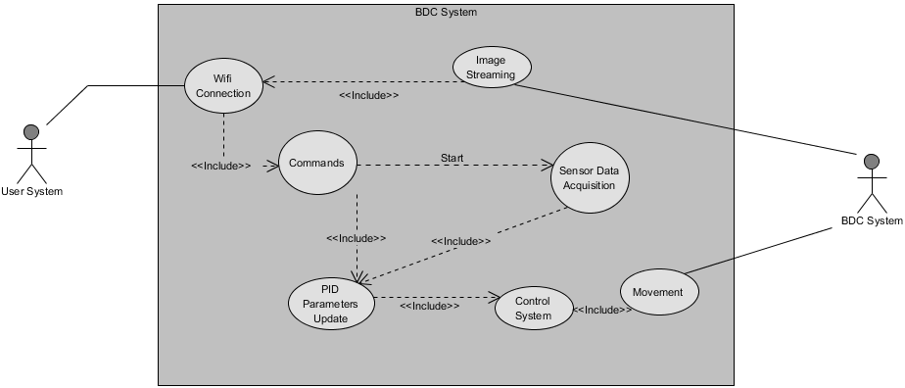
Local System Use Cases

Slide 14
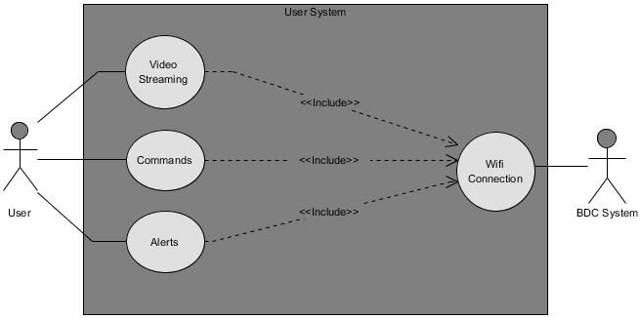
User System Use Cases

Slide 15
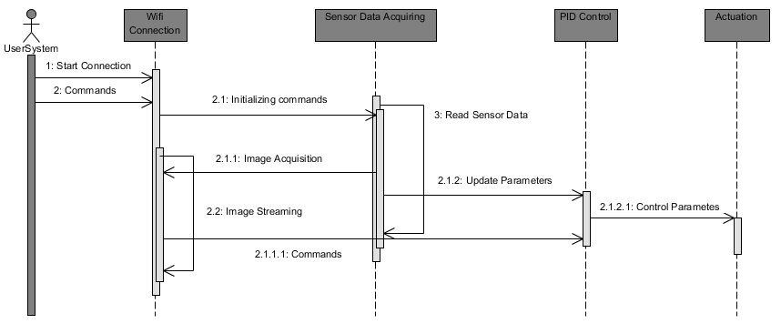
Local System Sequential Diagrams

Slide 16
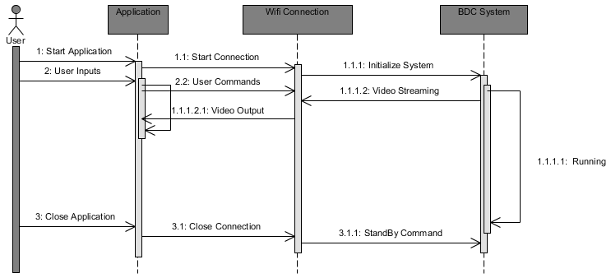
User System Sequential Diagram

Slide 17
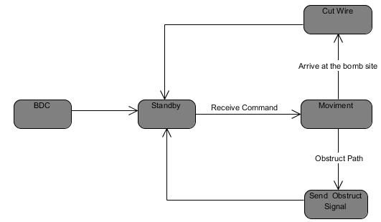
Local System State Diagram

Slide 18
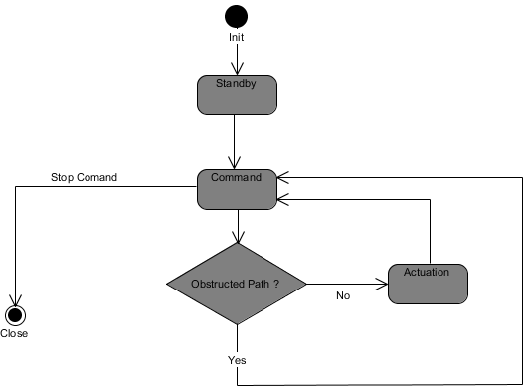
User System State Diagram

Slide 19
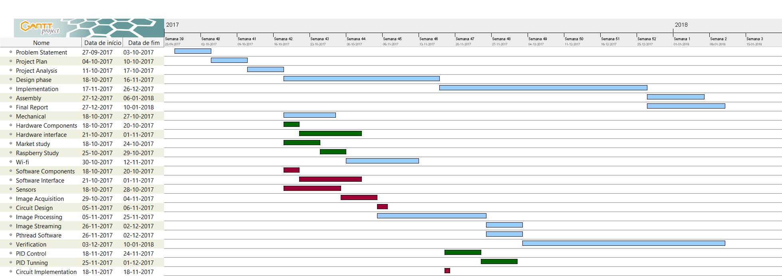
Gant Diagram

