Slide 1

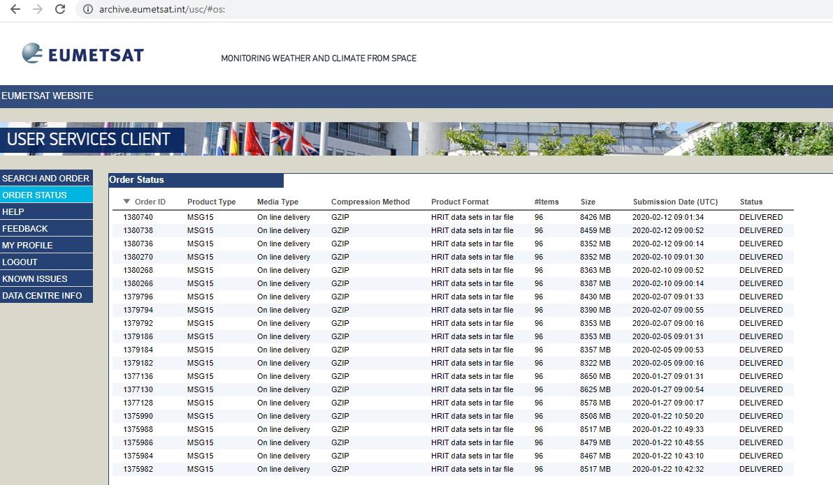


mon, wed and fri
mon, wed and fri
Scan for missing MSG data
Send email report
Send links for missing data to FTP
Get links
Run selenium ordering script for each link
store03
RSS_OPS01
eogrid.esrin.esa.int/msgdata_missingslots
Get the delivered order_ids list
Run download and process MSG orders scripts
with selenium script get the "DELIVERED" order_ids
Send order_ids listo to FTP
tue, thu and sat
tue, thu and sat

