Slide 1
VEHICLE IMAGES RECOGNITION SYSTEM
PROJECT FINAL DELIVERY
Team Members:
Kaushik Manjunatha
Rahul Bojja
FNU Esther Priyadarshini

Slide 2
Description of the Project
Develop an image classification system.
Automatically identifying and classifying vehicles.
To improve traffic conditions.
Ensure efficient emergency services.
Analyze the data from traffic cameras to curb misuse of designated lanes.
Problem Statement
Motor vehicles frequently violate designated bus and ambulance lanes, leading to disruptions in public transportation flow.
This intrusion contributes to traffic congestion and hampers the efficiency of emergency services.

Slide 3
Project Defense and Progress report tasks that are implemented/ not implemented
Data source is from Kaggle.
Using an image processing library(OpenCV) to resize image but stored in mongodb instead of HDFS.
Store data in MongoDB.
Splitted the dataset into Training and Test datasets.
Employed deep learning/ Machine Learning model.
Spark pipeline is created and used Spark MLLib.
Instead of Tableau Visualizations we used matplotlib libraries

Slide 4
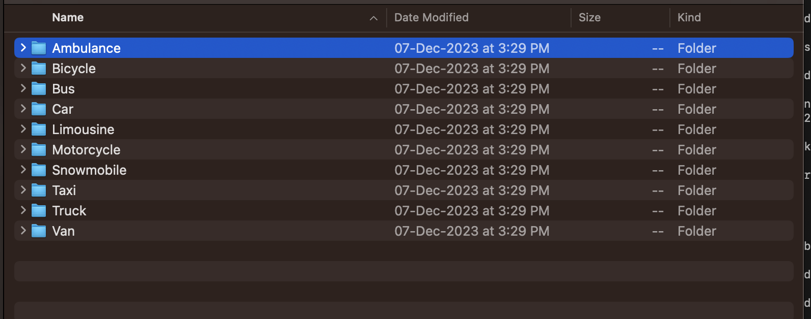
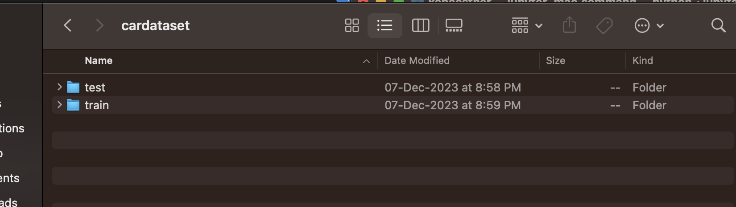
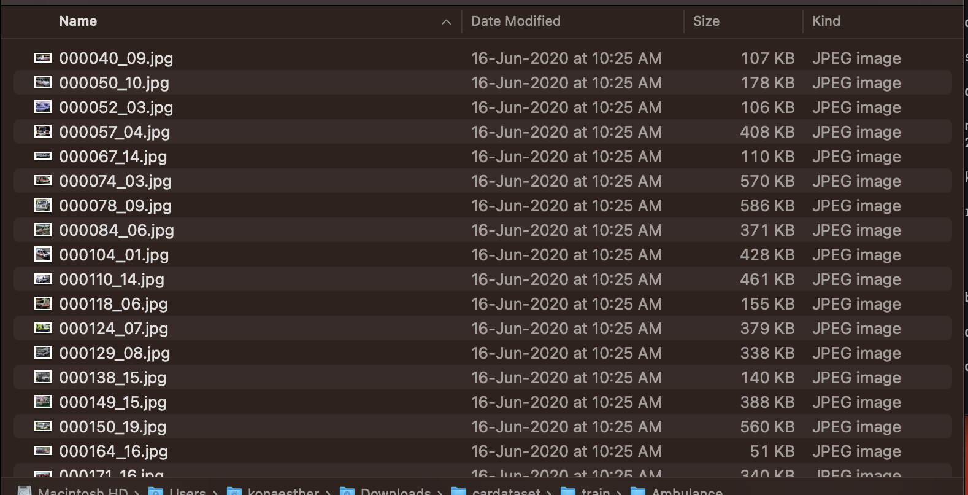
Dataset and Classes:

Slide 5
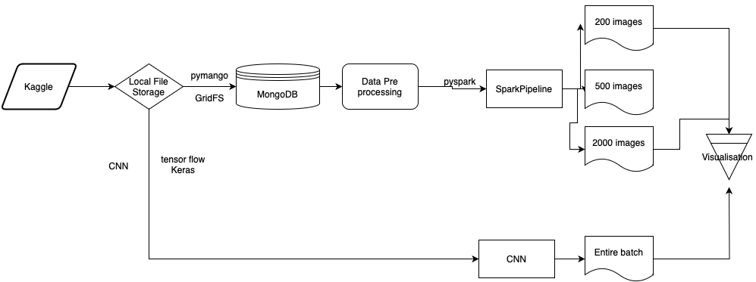
Project Implementation

Slide 6
Project Implementation
Data Source is from Kaggle.
Data is then inserted into MongoDB using MongoClient from pymongo driver.
GridFS object is used to store the image files into collection.
The script sets a base directory path of image files and lists all subdirectories in this path.
For each subdirectory, it reads all files and, if they are image files, opens them in binary mode.
Each image file is read and its data is stored in the MongoDB database using GridFS.
The file's name and its subdirectory name (used as a label) are stored as metadata.
The get_images_by_label function is written to retrieve images from MongoDB based on a given label. It queries the GridFS collection for files whose metadata matches the specified label(Car , Ambulance, etc,.).

Slide 7
Project Implementation Cont..
Each retrieved file is read into a BytesIO object and then opened as an image using the PIL library (Image.open(io.BytesIO(grid_out.read()))).
The labeled dataset is then used by spark frame for further processing.
Data is stored in terms of objects/documents in Mongodb.
Convolution neural network for image analysis and classification is done where we created convolution base, compiled and trained the model, evaluated the model using tensorflow and keras.
We leverage Spark's Machine Learning library (pyspark.ml) to create a machine learning pipeline.
The MulticlassClassificationEvaluator is used for evaluating the model's performance, which is a common practice in Spark's ML tasks.

Slide 8
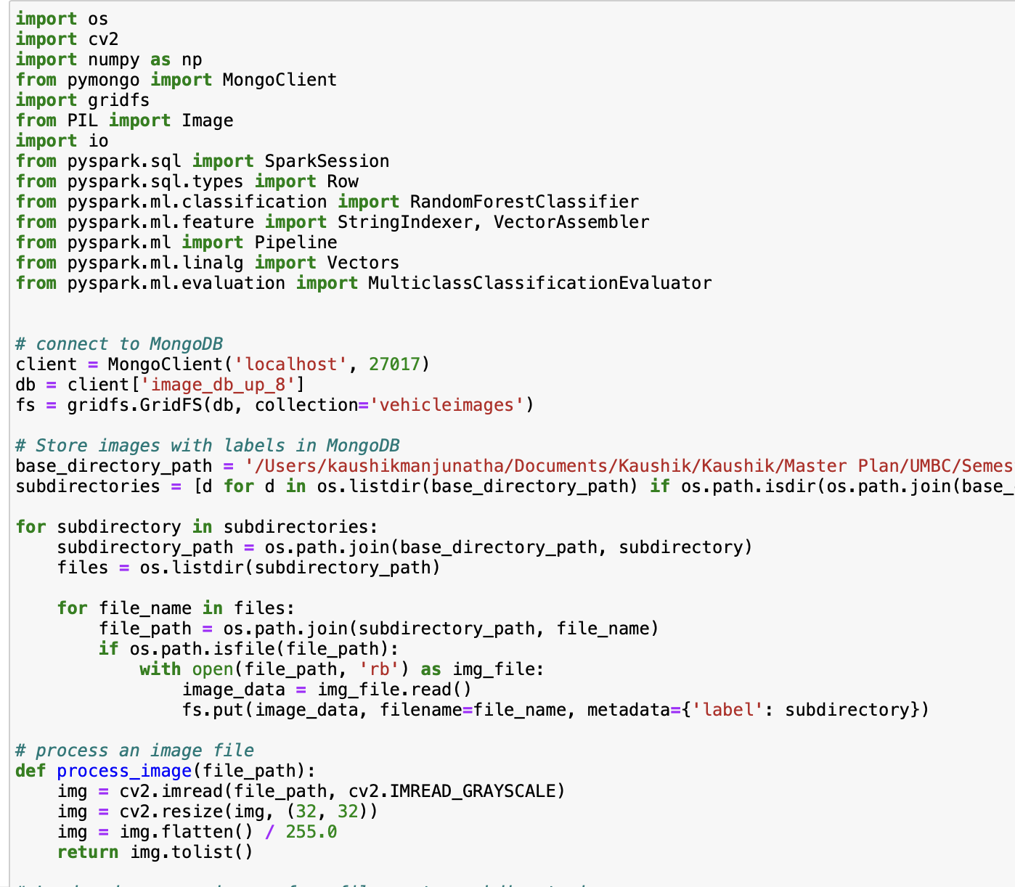
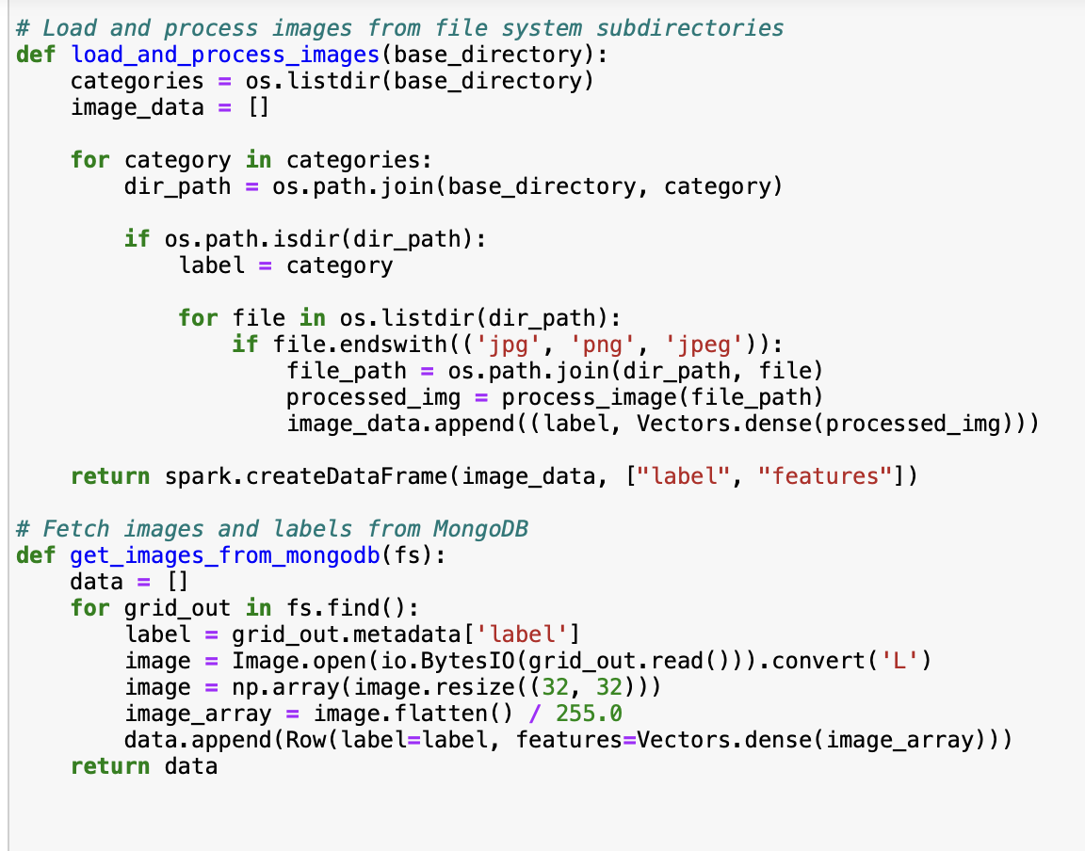

Slide 9
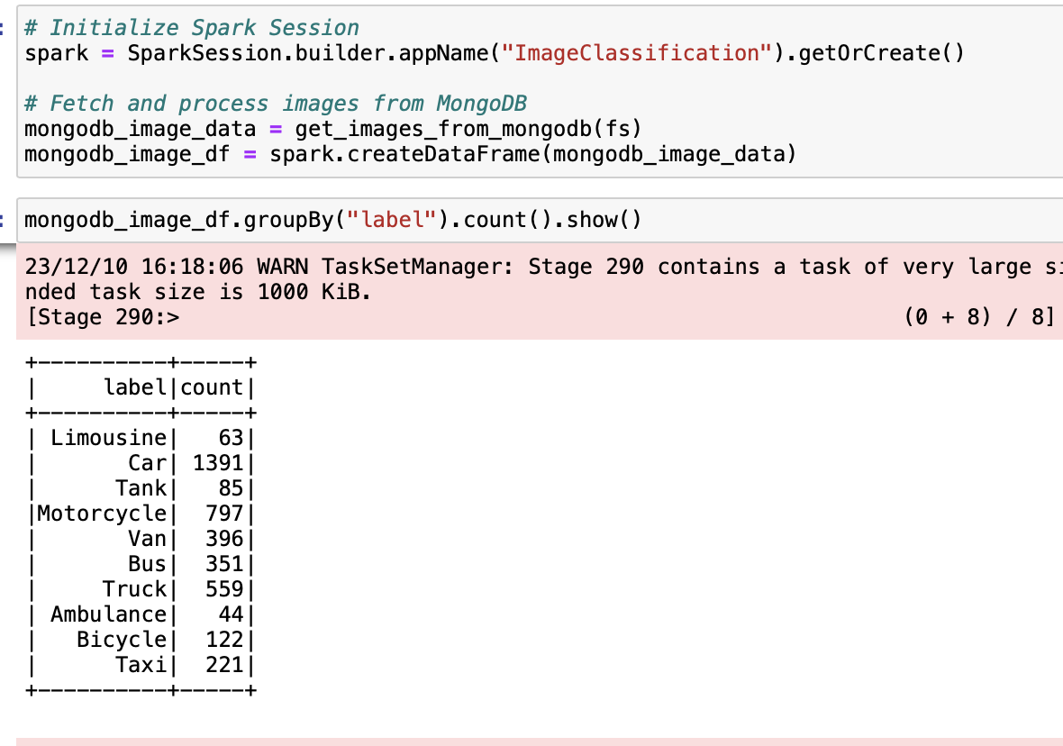

Slide 10
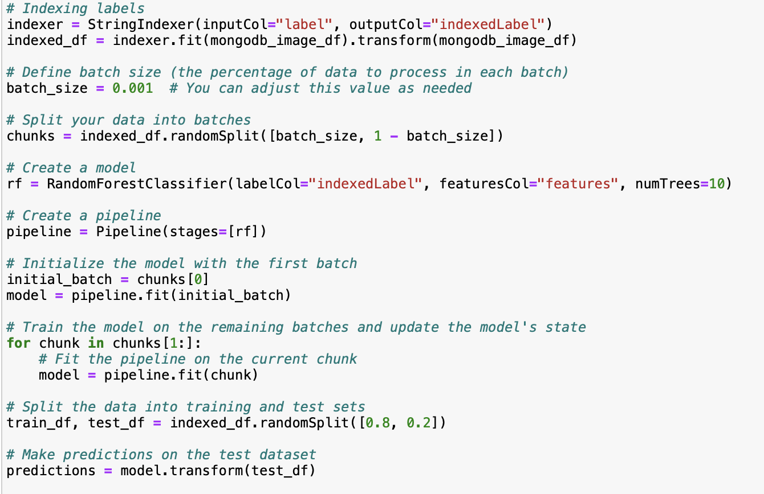
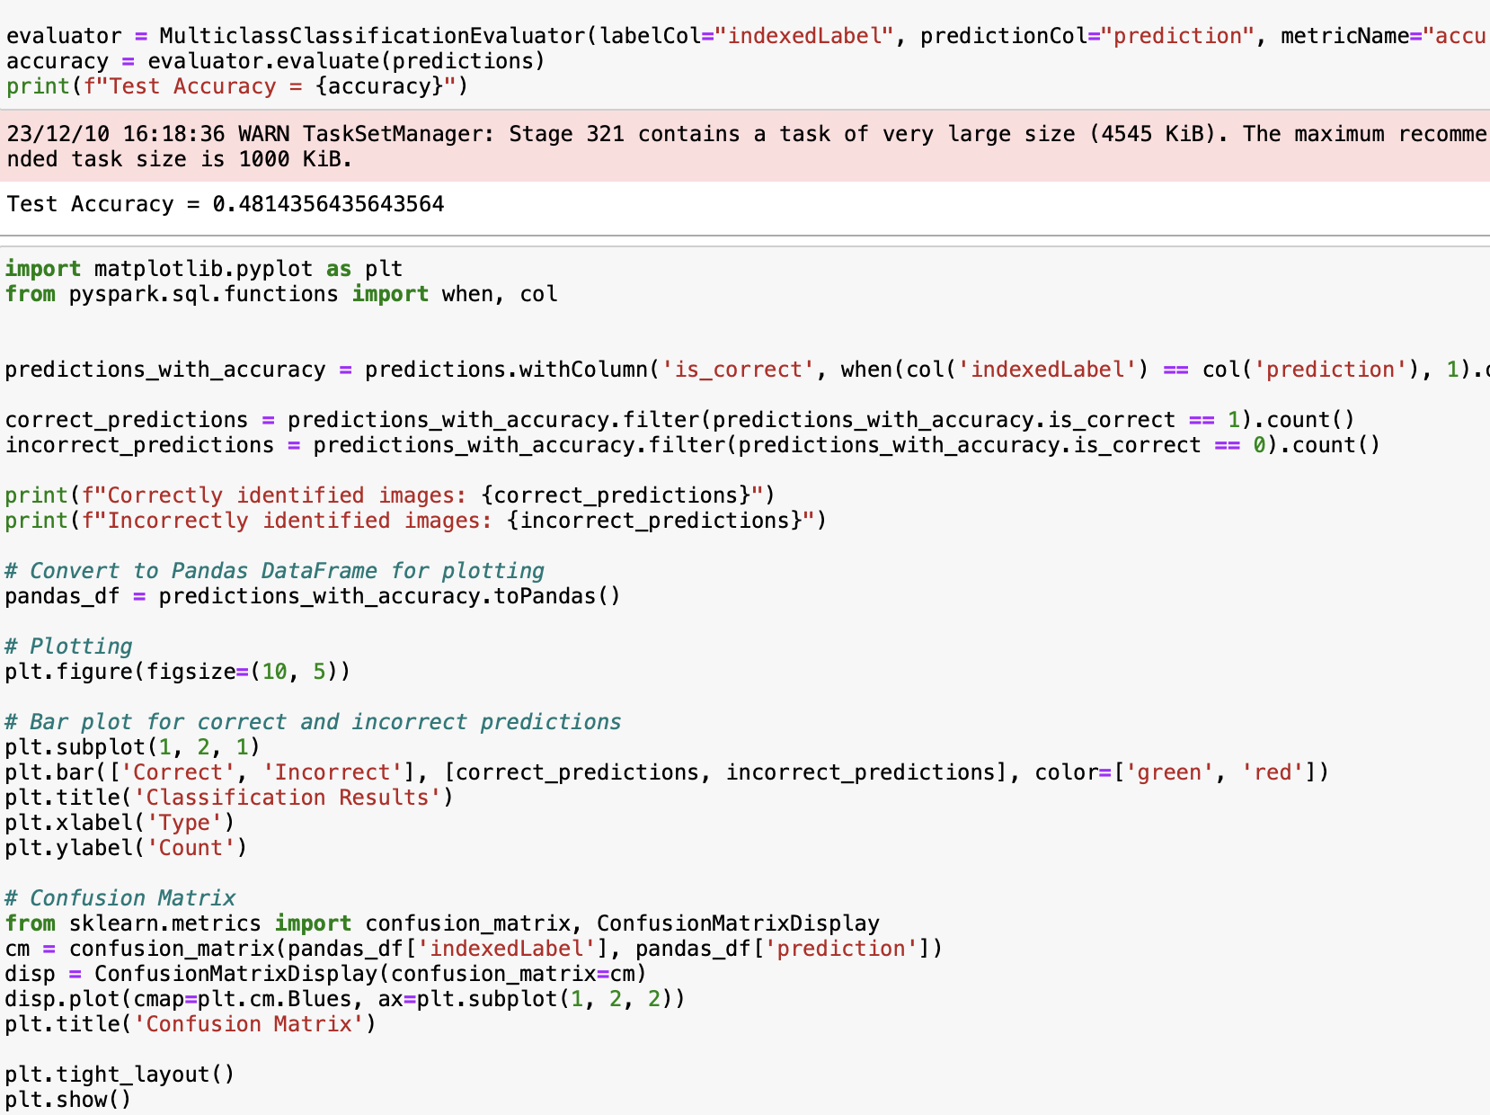

Slide 11
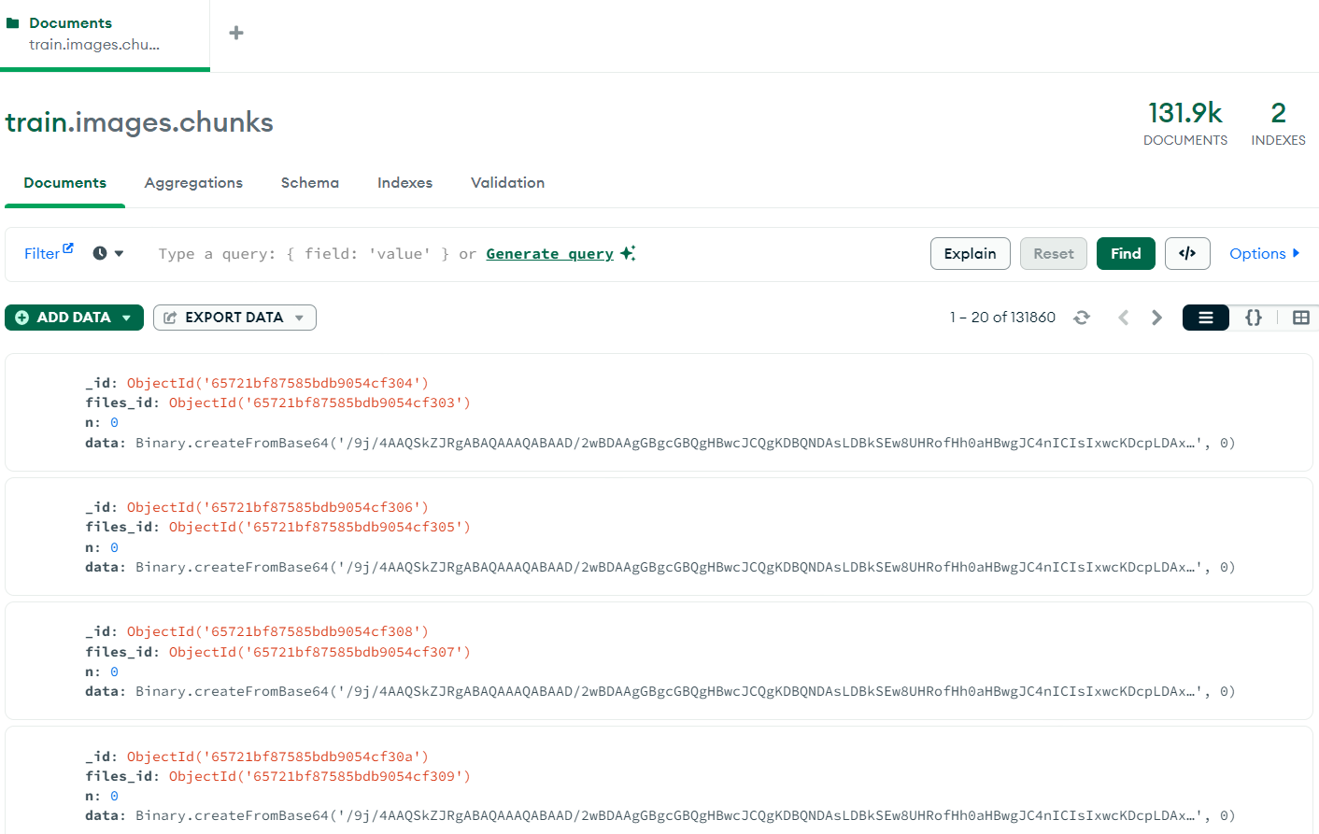
Results
Inserted the train data and test/validation data into MongoDB.
Retrieved the data from MongoDB and Performed Data Preprocessing, training, modelling and evaluation of the dataset.

Slide 12
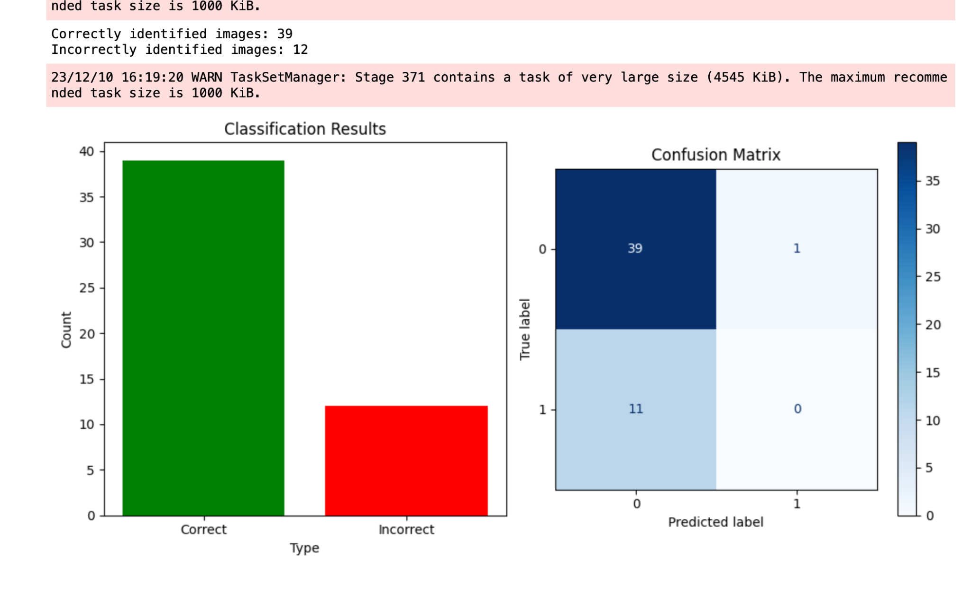

For Batch Size 200

Slide 13
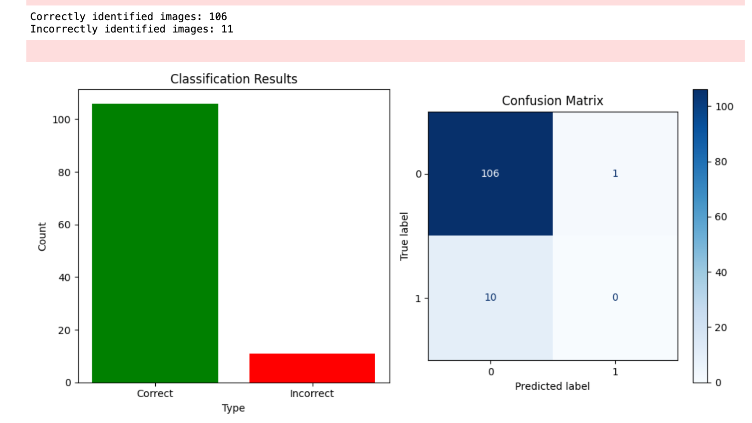

Batch Size 500

Slide 14
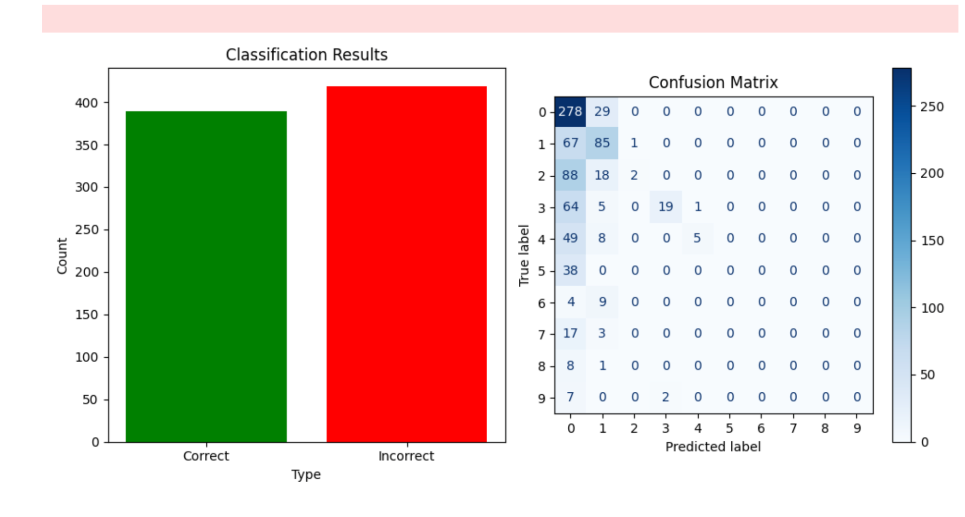
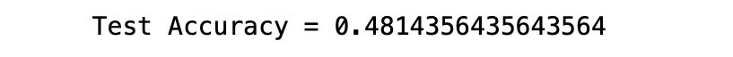
For Batch Size 2000

Slide 15
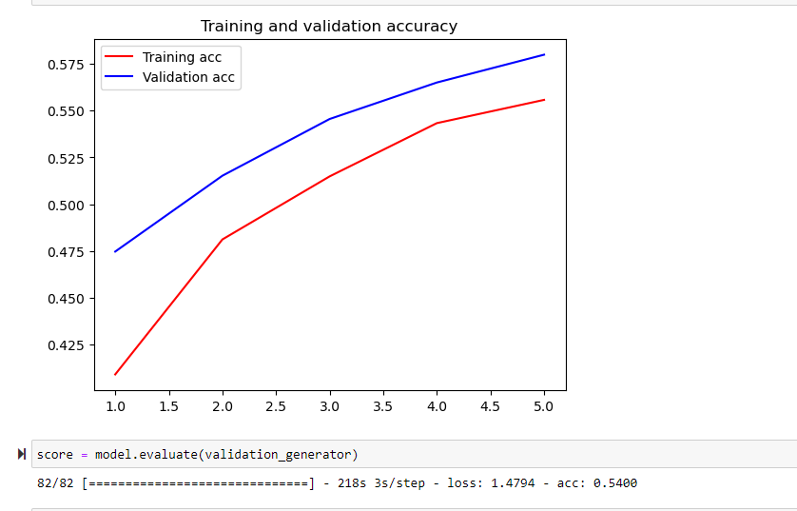
Results Contd..
Used different models to train the data set but we got higher accuracy by using CNN.
We got accuracy of around 59% for test and 54% for the train.

Slide 16
Conclusion and Lessons Learnt from the Project
By implementing the distributed processing using Spark, we could considerably reduce the training time and processing load on the system.
There is further scope to increase accuracy using suitable Machine Learning models compatible with Spark.
Training for higher batch sizes requires higher capacity processors.
We tried google collab and databricks as an alternative.
Encountered an issue while loading image files to data bricks as there was an individual file size limit for the free version.

Slide 17
Lessons Learnt
Integrating Spark, MongoDB and Python was challenging because of some compatibility issues. However, by installing some additional software we could solve this issue.
Retrieving data from MongoDB also was challenging but after getting help from the community we could fix the issue.
There will always be hiccups along the way while using big data processing platforms. However, there are community forums to help.
Opting to use cloud computing for this purpose reduces significant hassle of setting up the architecture.

Slide 18
References
Stack Overflow - Where Developers Learn, Share, & Build ...Stack Overflowhttps://stackoverflow.com
Apache Spark DocumentationApache Sparkhttps://spark.apache.org › documentation
MongoDB Developer Community ForumsMongoDBhttps://www.mongodb.com › community › forums
CNN for Deep Learning | Convolutional Neural NetworksAnalytics Vidhyahttps://www.analyticsvidhya.com › blog › 2021/05 › c...

Slide 19
Thank you

