Slide 1
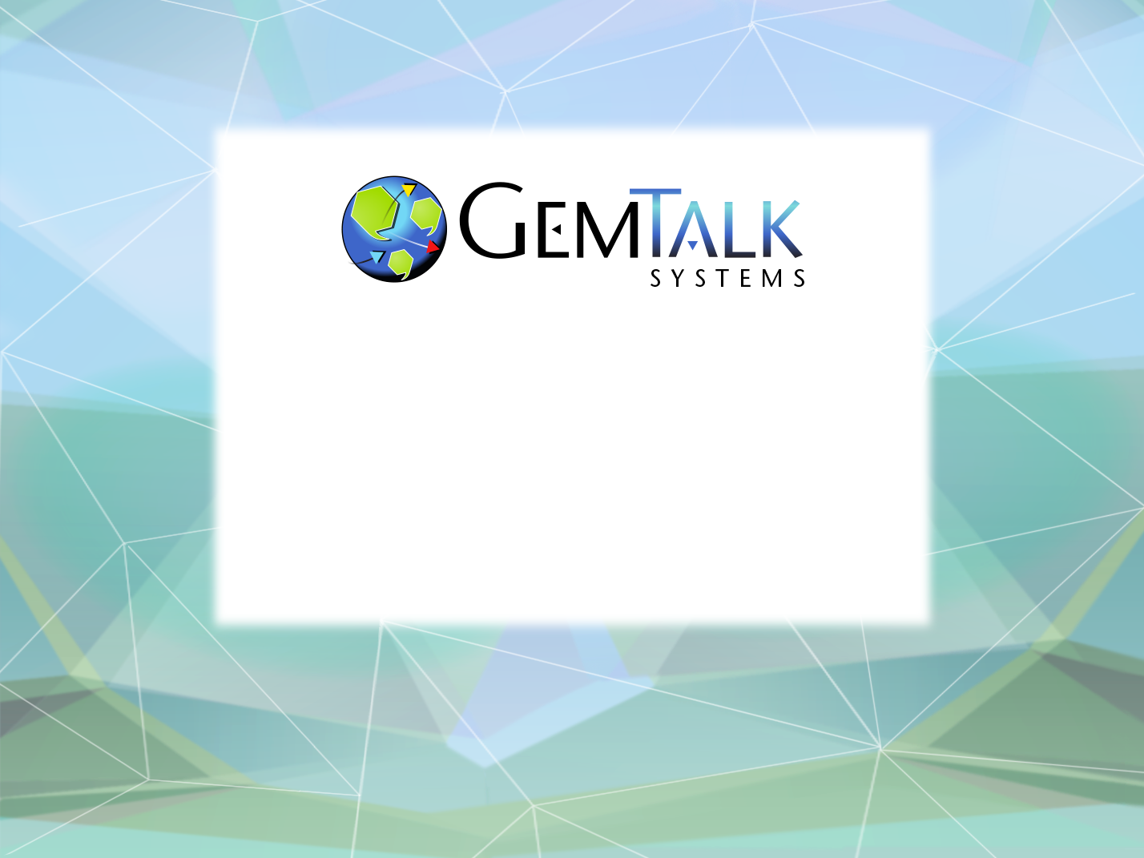
GemStone/S 64 Update
Norm Green
Senior VP & CTO
ESUG 2019
Cologne, Germany

Slide 2
Part 1
GemTalk the Company

Slide 3
GemTalk History
37 Years of Continuous Operation!
Founded: 1982 (as Servio Logic Corporation)
First Version of GemStone Shipped: 1986
Name Changed from Servio to GemStone: 1995
Acquired by Brokat: July 2000
Management buyout: June 2001
Acquired by VMware: May 2010
Acquired by GemTalk Systems: May 2013

Slide 4


Container Shipping Vertical
GemStone/S Powered Business
- since 2016
- since 2000
20% of the world’s container shipments are managed by GemStone/S.
13,000,000,000 objects / 2,500 GB

Slide 5




Financial and Trading Vertical
GemStone/S Powered Business
Kapital is the world’s leading derivatives trading and management system – since 1993
DBO is a very large precious metals trading and settlement system.
- since 1990
ICE is the world’s fastest growing electronic trading exchange
– since 1994
MAS – Investor call management workflow system. – since 1995

Slide 6




Manufacturing Vertical
GemStone/S Powered Business
Works application for semiconductor manufacturing
– since 1991
Semiconductor manufacturing software – since 1998
Manufacturing software – since 2012
Adhesives Manufacturing – since 1997

Slide 7

GemStone/S Powered Business
Utilities Vertical
TCMS II- Trouble Call Management System V2
Power Billing – Customer Billing Application – since 1992
GemTalk provides remote administration and emergency on-call support to augment FPL staff

Slide 8


GemStone/S Powered Business
Telecommunications Vertical
CONDIS – Inventory and cable management – since 1993
Telecom Service Provisioning – since 2004

Slide 9


Government Vertical
GemStone/S Powered Business
Border Security – since 1996
Visa Processing – since 2004
Dutch Agricultural Institute – agriculture data collection
– since 1998

Slide 10















GemTalk Partners

Slide 11



GemTalk In the Community…
Conferences and Groups
Pharo Consortium (Industrial Member)
ESUG (Platinum Sponsor)
FAST (Platinum Sponsor)
Camp Smalltalk
Charlotte, NC (March, 2019)
Portland OR (October, 2019)

Slide 12
ESUG 2019
Martin – Threads, Critical Sections, Tuesday, 5 pm
Norm – Roadmap, Wednesday 9 am
James – Pharo on GS, Wednesday, 9:30 am
Dale – Turning a Tonal Class File into a Shell Script, Wednesday, 4 pm
BOF – Wednesday, 16:45, rear courtyard area.

Slide 13

GemTalk – The Next Generation
Welcome Kurt Kilpela!
Joined GemTalk on May 6, 2019
Best Cover Letter Ever:
Early in my education, I was introduced to Smalltalk. Prior to this, my training was in Java, C, and C++. Initially, Smalltalk felt bizarre. In just a few days, I fell in love.

Slide 14
Part 2
GemStone Software:
A Lightning Tutorial

Slide 15
How Many Have Actually Used GemStone ?
How Many Have A Good Feel For What GemStone Is?

Slide 16
So What Is This GemStone Thing?
A solution to the limitations of traditional Smalltalk:
Object space limited to one VM.
Object space limited to one host.
Object space limited to available RAM.
Object changes (since last image save) lost when VM exits.
A solution to Object-Relational Mapping
Objects are stored as objects in an object repository.
No rows, columns, tables, foreign keys, or joins.
GemStone is the original NoSQL database.

Slide 17
Welcome To The World Of GemStone!
Object space visible to thousands of VMs on thousands of machines.
Object space limited by disk, not RAM.
Object changes managed by ACID transactions
Atomic
Consistent
Isolated
Durable
Object changes guaranteed persistent once committed.

Slide 18
Key Features Of GemStone
Scalability
Billions of objects
Thousands of users.
Thousands of machines.
Thousands of transactions per second.
Terabytes of data.

Slide 19
Key Features Of GemStone
Concurrency
Multiple user sessions.
Built-in database transactions.
Commit
Abort
Continue
Optimistic Concurrency
Reduced Conflict Collections
Pessimistic Concurrency
Object-level read/write locks.
Namespaces
Shared and private.

Slide 20
Key Features Of GemStone
Security
Object-level security.
User, group, world permissions.
Login Security
User-id / Password
Single-Sign-On (GSSAPI / Kerberos)
LDAP
PAM
X509 Certificate
Administrative Privileges
#GarbageCollection
#OtherPassword
#SystemControl

Slide 21
Key Features Of GemStone
100% Smalltalk (“It’s turtles, all the way down”)
All objects, all the time.
Classes, methods, blocks, exceptions.
ANSI Smalltalk compliant

Slide 22
Key Features Of GemStone
Very Large Collection Support
Collections of millions of objects.
Optimized searches using b-tree Indexes:
Equality Indexes (a = b)
AllEmployees detect:{:each| each.lastName = ‘Ducasse’ }
Identity Indexes (a == b)
AllEmployees select:{:each| each.countryOfOrigin == #France }

Slide 23
Key Features Of GemStone
Interfaces to Other Smalltalks
VisualWorks® - GemBuilder for VisualWorks®
VA Smalltalk® - GemBuilder for VA Smalltalk®
Pharo – tODE (open source)
Jade / Jadeite (Dolphin, open source)
gt4Gemstone
Interfaces To Other Languages
C/C++ - GemBuilder for C
Java – GemBuilder for Java
Interfaces to Relational Databases
Oracle – GemConnect for Oracle
Sybase – GemConnect for Sybase (open source)

Slide 24
GemStone/S 64 Platforms
Server (Database)
Linux x86_64
Apple Darwin 64 bit
Oracle Solaris amd64
Oracle Solaris SPARC 64 bit
IBM AIX PowerPC 64 bit
Client
All of the above, and:
Microsoft Windows 7, 8, 10
Raspberry Pi (experimental)

Slide 25
GemBuilder for Smalltalk (GBS) Platforms
Cincom® VisualWorks® 8.3.2, 7.10.1
MS Windows 7/8 32 bit
MS Windows 7/8/10 64 bit
Linux 32/64 bit
Instantiations VA Smalltalk™ 9.1, 8.6.3
MS Windows 7/8

Slide 26
Jade IDE
Open source IDE for all versions of GemStone
Written in Dolphin Smalltalk by James Foster
MS Windows only
Supports all versions of GemStone
Free of charge
Rich set of tools
Browsers
Inspectors
Debuggers
https://github.com/jgfoster/Jade

Slide 27
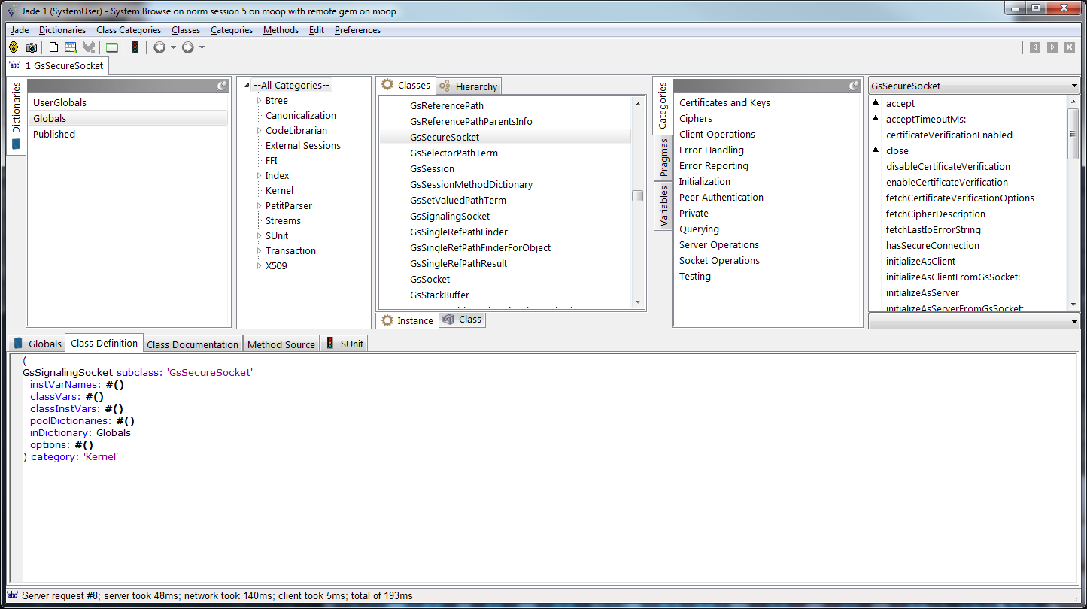
Jade System Browser

Slide 28
Jadeite IDE
Fork of the Jade project
Currently in development at GemTalk for a customer in Europe
Support for source code control with Rowan and Git
Support for Tonal file format
Migration tools from other SCM systems

Slide 29
GemStone/S Licensing Models
Community Editions
Free (as in beer) for any use (including commercial)
Now includes GemBuilder for Smalltalk !
Perpetual
Buy once, own it forever
Annual Subscription
Pay annually, cancel any time.
Value Added Reseller (VAR)
Percentage of royalties

Slide 30
GemStone Community Edition
 | Starter | Limited | Full | Extended SPC | Extended CPU | Extended Full
License Kind | Perpetual | Subscription | Subscription | Subscription | Subscription | Subscription
Cores | 2 | 2 | 2 | 2 | 4 | 4
SPC | 1 G | 2 G | 2G | 4G | 2G | 4G
Gems | 10 | 20 | Unlimited | Unlimited | Unlimited | Unlimited
Disk | 10G | 50G | Unlimited | Unlimited | Unlimited | Unlimited
Development DB | Unlimited | Unlimited | Unlimited | Unlimited | Unlimited | Unlimited
Production DB | 1 | 2 | Unlimited | Unlimited | Unlimited | Unlimited
Tech Support | Community | Community | 5 tickets | 10 tickets | 10 tickets | 20 tickets
Price | Free | Free | $1500/yr | $3000/yr | $3000/yr | $6000/yr
Distribution | With Product | Email addr | Sales | Sales | Sales | Sales
Source: http://gemtalksystems.com/index.php/lc-licensing/

Slide 31
Support Models
Web Support (24 x 7)
https://techsupport.gemtalksystems.com
Help requests processed 8 am – 5 pm Pacific Time
Emergency 24 x 7 Support
Available for a premium
GemTalk provides an emergency phone number
Call back to the customer within 15 minutes
Mailing Lists
GLASS – Open source projects: Seaside / GLASS / tODE
GemStone Smalltalk – GemStone-specific
Sign up at:
https://lists.gemtalksystems.com/mailman/listinfo/

Slide 32
Part 3
Roadmap

Slide 33
GS/64 Server Releases
Version 3.6
Summer, 2020
Version 3.5
3.5.0: June, 2019
3.5.1: Q4-2019
Version 3.4
3.4.4: July 2019
3.4.5: TBD

Slide 34
GBS for VisualWorks® Release Pipeline
Version 8.4
8.4.0: June 2019
8.4.1: TBD
Version 8.5
Summer 2020

Slide 35




New In Version 3.5
GemStone/64 in the Hybrid Cloud
X509 Certificate security for all connections
Login with certificate, CA cert and private key
Cloud / Firewall-friendly network connections
Tolerance for high latency networks (aka the Internet)
Object Filtering
Restrict which objects may/may not go to the cloud
On-Premise
Cloud
External
Cloud
(AWS)
GemStone
Database
Smalltalk Images

Slide 36
New In Version 3.5
Solo Smalltalk Execution
No running database required!
Execute Smalltalk code from the command line
topaz> set solologin on
topaz> login
[Info]: LNK client/gem GCI levels = 35001/35001
[Info]: Read-Only Repository: /export/moop2/users/normg/product/bin/extent0.dbf
successful Solo login
send GsSecureSocket httpsClientExampleForHost: 'www.google.com' certificateDirectory: '/etc/ssl/certs'
Secure connection established
Current cipher in use is: ECDHE-RSA-CHACHA20-POLY1305 TLSv1.2 Kx=ECDH Au=RSA Enc=CHACHA20/POLY1305(256) Mac=AEAD
Sending a 40 byte request to client: GET / HTTP/1.1 Host: www.google.com
Waiting for response from server...finished reading 1397 bytes from server.
HTTP/1.1 200 OK
Date: Fri, 31 Aug 2018 19:00:46 GMT
Expires: -1
Cache-Control: private, max-age=0
Content-Type: text/html; charset=ISO-8859-1
…

Slide 37
Solo Mode Script Example
#!/usr/bin/env topaz
set solologin on
set u DataCurator p swordfish
login
run
| c |
"Get dir contents"
c := GsFile contentsOfDirectory: '/home/normg/local/gartst' onClient: false .
“select files larger than 64K”
^ c select:[:e| |stat|
stat := GsFile stat: e isLstat: false.
stat _isSmallInteger not and:[stat isDirectory not and:[stat size > 65536 ]]
].
%
quit
normg@moop>solo.tpz |grep \# |egrep -v "\|"
#1 /export/moop3/users/normg/gartst/gem_29147.code_log
#2 /export/moop3/users/normg/gartst/gem_29125.code_log
#3 /export/moop3/users/normg/gartst/gem_17645.code_log
#4 /export/moop3/users/normg/gartst/gem_29106.code_log
#5 /export/moop3/users/normg/gartst/gem_29119.code_log
#6 /export/moop3/users/normg/gartst/gem_16461.code_log
#7 /export/moop3/users/normg/gartst/gem_29140.code_log
#8 /export/moop3/users/normg/gartst/gem_15972.code_log

Slide 38
New In Version 3.5
New Public Key Infrastructure (PKI) Classes
Object
GsTlsCredential
GsTlsPublicKey
GsTlsPrivateKey
GsX509Certificate
Array
GsX509CertificateChain

Slide 39
New In Version 3.5
Support for Latest Crypto Algorithms
Message Digests
SHA3 (224, 256, 384, 512 bits)
HMAC
Authenticated Encryption Modes
OCB, GCM, ChaCha20
Support for Digital Signatures
Sign with private key, verify with public key

Slide 40
New In Version 3.5
Support for Digital Envelopes
Securely exchange messages or objects over insecure link
Requires 2 key pairs for both sender and receiver
Encryption keys (public/private)
Signing keys (public/private)
Class Heirarchy:
Object
GsDigitalEnvelope
Sender:
Encrypt message with recipient’s public key
Sign message with sender’s private key
Recipient:
Decrypt message with recipient’s private key
Verify message signature with sender’s public key

Slide 41
New In Version 3.5
Remove 2 Spin Locks From Shared Memory
Free Fame Lock
Free Page Cache Entry Lock
Replace with Atomic Bit Arrays
Bits set/cleared using atomic assembler instructions
Avoids spinning (aka waiting) for a lock.

Slide 42
Upcoming In Version 3.6
Support for DARE (Data At Rest Encryption)
Optional encryption of database extents and tranlogs
Encryption done at the database page level
Each page is encrypted individually
Salt: hashed page ID
Uses XTS-AES Encryption
XTS == XEX-based tweaked-codebook mode with ciphertext stealing
Support for 128 and 256 bit XTS keys
XTS is supported by: BestCrypt, TrueCrypt, VeraCrypt, DiskCryptor, MS Bitlocker, wolfCrypt.
Private key (and passphrase) required to start the an encrypted GemStone database.

Slide 43
Upcoming In Version 3.6
Support for DARE (Data At Rest Encryption)
Creating an encrypted database extent:
$GEMSTONE/bin/copydbf –e dbCert.pem –s 128 \
–K /home/normg/certs \
$GEMSTONE/data/extent0.dbf $GEMSTONE/data/extent0.sdbf
Starting an encrypted database:
$GEMSTONE/bin/startstone –D dbPrivateKey.pem \
–J ~/secrets/passphrase.txt –K /home/normg/keys
-z $GEMSTONE/data/system.conf normstone

Slide 44
Upcoming In Version 3.6
Substring Indexed Queries (maybe)
Search an indexed collection for a substring
Regex Indexed Queries (maybe)
Search an indexed collection for keys that match a regex expression.
Native Support for Pharo Clients (maybe)
Native Support for the Rowan Package Manager
Support for FileTree and Tonal formats
No Monticello / Metacello required

Slide 45
Upcoming In Version 3.6
Better Instance Migration (maybe)
Vision (no code yet):
User Provides:
List of old classes
List of new classes
Blocks to migrate old instances to new
GemStone Will:
Start multiple C threads to scan the database and migrate the instances.
Commit all migrations at the end in one logical transaction.

Slide 46
Upcoming In Version 3.6
<Your Suggestions Here>
Send us your suggestions, feedback and feature requests.
How ?
Email
Mailing Lists
Sign up at: https://lists.gemtalksystems.com/mailman/listinfo/
Twitter: @GemTalkSystems

Slide 47

Questions?
Norman R. Green
Senior VP & Chief Technical Officer
®
GemTalk Systems LLC
15220 NW Greenbrier Pkwy., Suite 240
Beaverton, Oregon, 97006
Mobile: (503) 804-2041
norm.green@gemtalksystems.com
www.gemtalksystems.com

