Slide 1
Approach and Assumptions for the
Entity Resolution Exercise
For the Sr. Data Engineer, MDM position at HubSpot
By Eric Wolfson

Slide 2




Tools / Languages Used in this project
Python 3.11 [1]
Pandas library for Python [2]
MS SQL Server 2022 [3]
(with pypyodbc library in Python for connecting)
Dagster [4]

Slide 3
Reasons for Dagster
Dagster allows stages of the pipeline to be recompiled and run independently of one another by storing and returning data at each asset.
It works well with creating views in SQL so that only the SQL queries that are needed at specific stages can be run.
Each step in the conversion process is treated as a Dagster asset, which makes it simple to add a step in the pipeline. All that needs to be added is the @asset annotation.
A feature for running assets automatically can be easily implemented (slides 19-22 show an explanation):
For this project, when a csv file in the working directory is updated, the path in the pipeline for that data is run automatically. This is checked every 45 seconds.
We can run only the specific paths of the pipeline needed every time a file is updated.

Slide 4
Steps In Dagster Data Pipeline
Retrieve data for CSV files and load into DataFrames
crm_dataframe_from_csv asset
acme_dataframe_from_csv asset
rapid_data_dataframe_from_csv asset
Load dataframes in SQL table
load_crm_into_db asset
load_acme_into_db asset
rapid_data_dataframe_from_csv asset
Merge duplicates in RapidData (I chose to merge based on name, email_address and ip_address):
resolve_rapid_data_duplicates asset
Merge the three tables using SQL joins:
combine_exact_contacts asset
Pull data from SQL Server database back to Python Pandas:
extrapolate_data asset

Slide 5
Steps In Dagster Data Pipeline II
5) Fill in null values with placeholder values of correct type for the final CSV file (int, JSON, string…):
clean_data asset
6) Fill in missing values (country, company_revenue, company_employees, company_industry):
extrapolate_data asset
7) Combine common contacts one final time (I chose to merge based on name and phone number)
Combine_post_merge asset
8) Store final table in csv result file
Create_csv asset

Slide 6
Use of SQL and Python/Pandas
For the merging of the 3 csv files, SQL (SQL Server) was used.
Merging tables in SQL using an RDBMS is faster than merging DataFrames in Python, which will help significantly when using large datasets. [5]
SQL Server Joins are multithreaded operations (using the ODBC driver), where merge in Pandas is single threaded. [6]
In addition, data is stored in a tree-like data structure in order to perform operations more quickly. [7]
Pandas is easier for cleaning data, filling in null values, and running operations that extrapolate data.

Slide 7
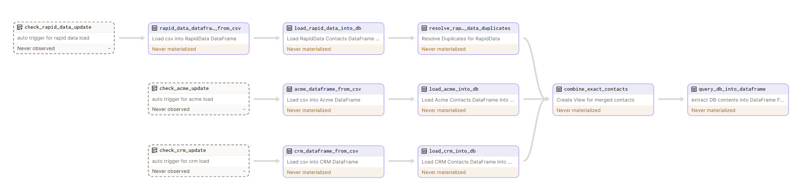
Data Pipeline For Entity Resolution In Dagster

Slide 8
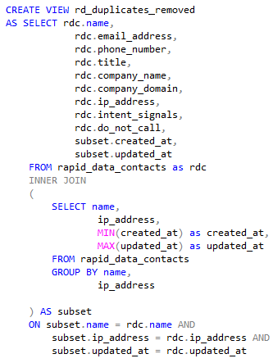
Step for Condensing rapid_data_contacts table
rd_duplicates_removed

Slide 9
Columns in the DataSets
There are common columns in all 3 datasets, and columns in each of the datasets that are unique to that dataset.
The joining of the tables in one table attempts to combine the three datasets by checking for field similarity for the records for common columns.
Afterwards, the non common columns are added from the other datasets for that record in the new table.
The result after the SQL join operation is a table with all the columns that are common for the datasets, and each non common column in the new table for each record.

Slide 10
Merging using SQL (combine_exact_contents) Shown on next 3 slides
The following steps were taken in the SQL merging asset:
The CRM table was merged with the reduced RapidData table using a full join for merging and “Coalesce” function for taking only the non null values for the new columns.
The Acme data table was merged with the above result table using a full join for merging and Coalesce function for taking only the non null values for the new columns.
To preserve as much date information as possible, I decided to take the smallest created_at date from the three tables for a common record and largest updated_at date for those common records, to treat them as though they are all one contact record.

Slide 11
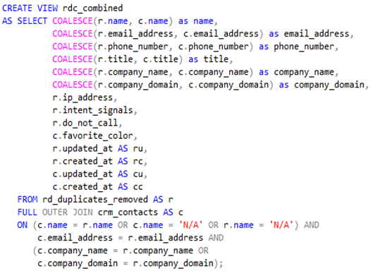
crm_contacts table
rd_duplicates_removed view
rdc_combined view

Slide 12
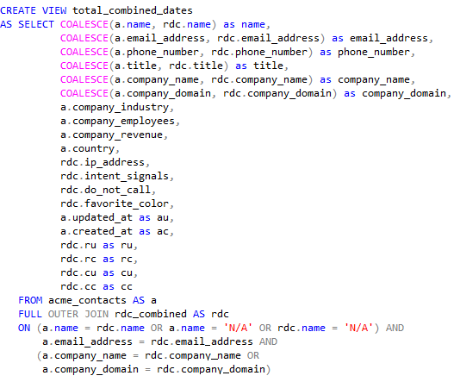
rd_duplicates_removed view
acme_contacts table
total_combined_dates view

Slide 13
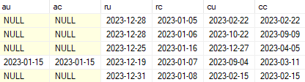
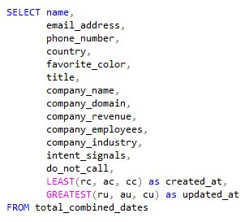
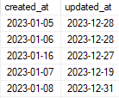
Merging of date information
crm_contacts, acme_contacts and rapid_data_contacts
each have updated_at and created_at dates for each record
We take the greatest of the three updated_at fields for the combined contact
We take the least of the three created_at fields for the combined contact
This is done to preserve the most date information across equivalent contacts by treating them as one record

Slide 14
Handling Null Values
For strings that have missing values and can not be determined based on other data, “N/A” was filled in.
For JSON strings that have missing values, [] was used
For the do_not_call boolean, False was filled in for missing values to maintain consistent data types
-1 was filled in to missing integer types

Slide 15
Final Cleanup In Python (See comments in code for explanation of Steps)
In the last few assets, cleanup was done to get the correct types in each cell for each null value. This is done so that the final csv can be pulled in from elsewhere (some other system into another database), and not need to be processed to fit the datatypes of the new table.’
In the extrapolate data asset, missing values were filled in that could be inferred from other data. For example if we have 2 records:
1) Name: “Full Name”, Company Name: “SemiConductors Inc.”Country: “USA”, Company Employees: 1000, Company Revenue: 1000000, Company Industry: “Semi Conductors”
2) Name: “Full Name 2”, Company Name: “SemiConductors Inc.”, Country: “N/A”, Company Employees: -1, Company Revenue: -1, Company Industry: “N/A”
We can fill in Country, Company Employees, Company Revenue and Company Industry for the second record since we can infer them from the first record that has the same company name
Lastly, we merge records based on common name and phone number (limitations discussed in next slide)

Slide 16
Assumptions and Limitations I
One assumption I made was that if a record with a name, email_address and ip_address were all the same, it represented the same individual.
It is most likely the case that it represents the same individual, but a downside is that it is possible that it doesn’t and may result in a small amount of contacts being lost (This is shown on the next slide).
Another assumption in the final post merge at the end of the pipeline is that two records with same name and phone number are the same contact. While likely, there may be a small amount of contacts lost.

Slide 17
Assumptions and Limitations II
Integer fields (like company revenue and company employees) was filled in with -1. The reason is to be consistent across data types, but anyone processing the final result will have to code into their system a conditional that processes -1 as a missing value
Boolean values that are missing are filled in with “False”. This is inaccurate data but the tradeoff was used to have consistent data types (as opposed to putting “N\A” for a boolean field).

Slide 18
Assumptions and Limitations III
Despite the fact that SQL join is faster than Pandas merge, there are limitations with using an RDBMS to begin with.
One limitation is the need to incorporate more tools and make the system more complex (by incorporating SQL Server, for example)
The other is that there is an overhead to make a call to the database from Pandas and vice verse. Moving data from the RDBMS and back is expensive.
The benefits of using SQL would be most apparent when using very large datasets to offset the overhead of moving data back and forth to and from the RDBMS.

Slide 19

Automatic running of data paths
To run the pipeline you can either click “Materialize All” in the top right corner or wait until 45 seconds have passed and the pipeline will run automatically.
For the first automatic run, the entire pipeline with all paths will materialize. Auto-materialize must be set to on (in the top right corner of the window

Slide 20
Automatic running of data paths II
Each of the paths representing the input csv files are triggered using an @observable_source_asset annotation.
For each subsequent trigger, only the paths in the pipeline that have data that needs to be modified will be materialized.
For instance, if the acme__contacts.csv file was updated only, at the next trigger only acme_dataframe_from_csv and load_acme_into_db will be run before the SQL merging.
The tables that were already loaded for the last run for RapidData and CRM will be used.
There is no need to run those other assets in the pipeline again since they will just end up producing the same result regardless.

Slide 21
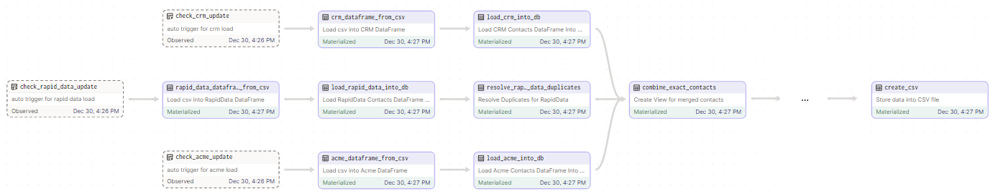
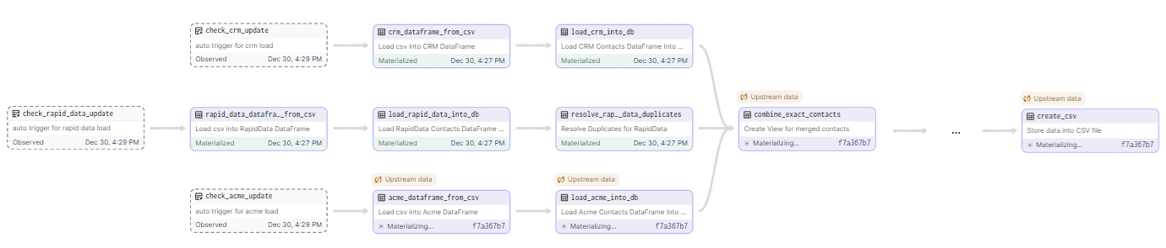
Automatic running of data paths III
In this example, acme__contacts.csv has been modified, and at the next check this path will be materialized
The trigger occurs and only the path that has assets that need to be modified are re-materialized:

Slide 22
References
[1]: https://www.python.org/
[2]: https://pandas.pydata.org/
[3]: https://www.microsoft.com/en-us/sql-server/
[4]: https://dagster.io/
[5]: https://www.scaler.com/topics/pandas/sql-vs-pandas/
[6]: https://learn.microsoft.com/en-us/sql/relational-databases/native-client/odbc/creating-a-driver-application-multithreaded-applications?view=sql-server-ver16
[7]: https://www.pragimtech.com/blog/sql-optimization/how-is-data-stored-in-sql-database/

