Slide 1
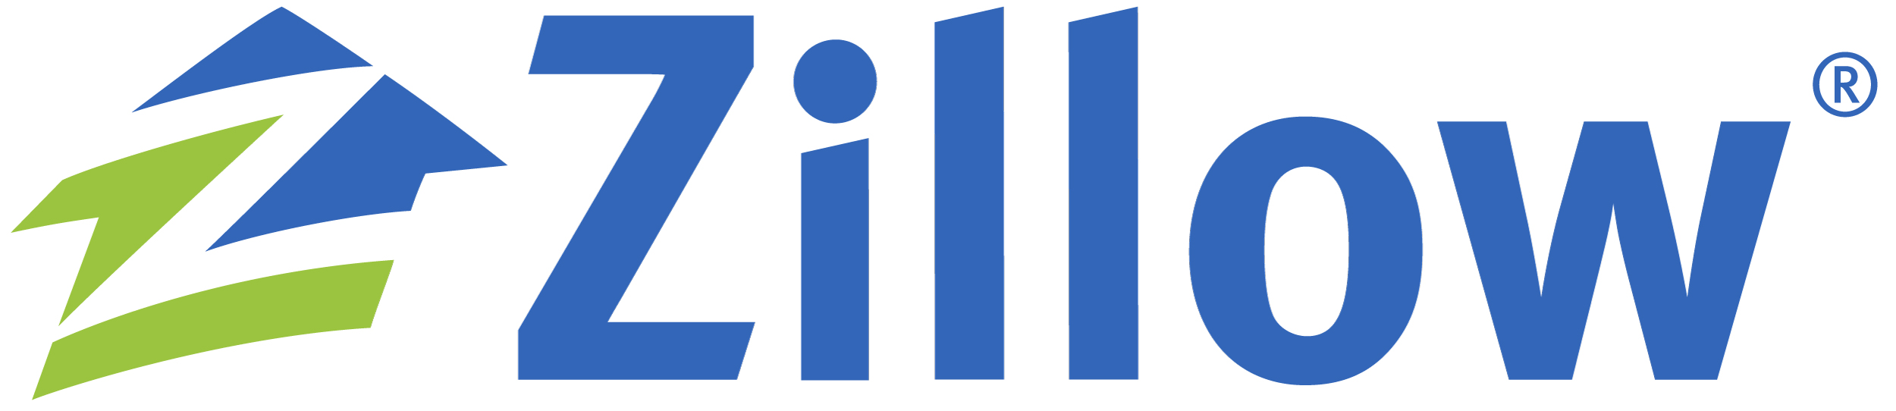

ETL Project: San Diego Real Estate
Kim Rones, Jeff Hartung, Chris Franchi, Ed Shafron
Database for San Diego real estate (one table at the address level, the other the zip code level). This database can be utilized for subsequent projects.

Slide 2
Extract:
Zillow and Property Shark.
Scraped from Zillow (Reformatted) csv.
Zillow scrape to fit Property Shark scrape.
Then used that data to scrape from Property Shark.
Implemented Chromedriver/Selenium to loop through both web pages.
Imported API output (stored as a .txt file)

Slide 3
Transform:
Transformed the property shark as null values had no place holder.
Transformed from CSV files to JSON Format.
Split up addresses to make new columns within CSV files.
Had to clean up redundant columns.
Filtered out erroneous entries in CSV file.
Converted dtypes (i.e. string → integer/float)
Joined our dataframes utilizing the .merge function.
Renamed columns/variables to follow the same convention.
Used a timestamp to scrape data from Zillow and loaded into MongoDB.

Slide 4
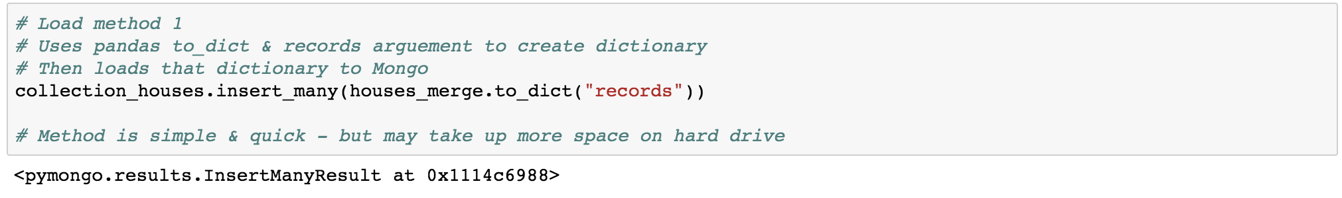
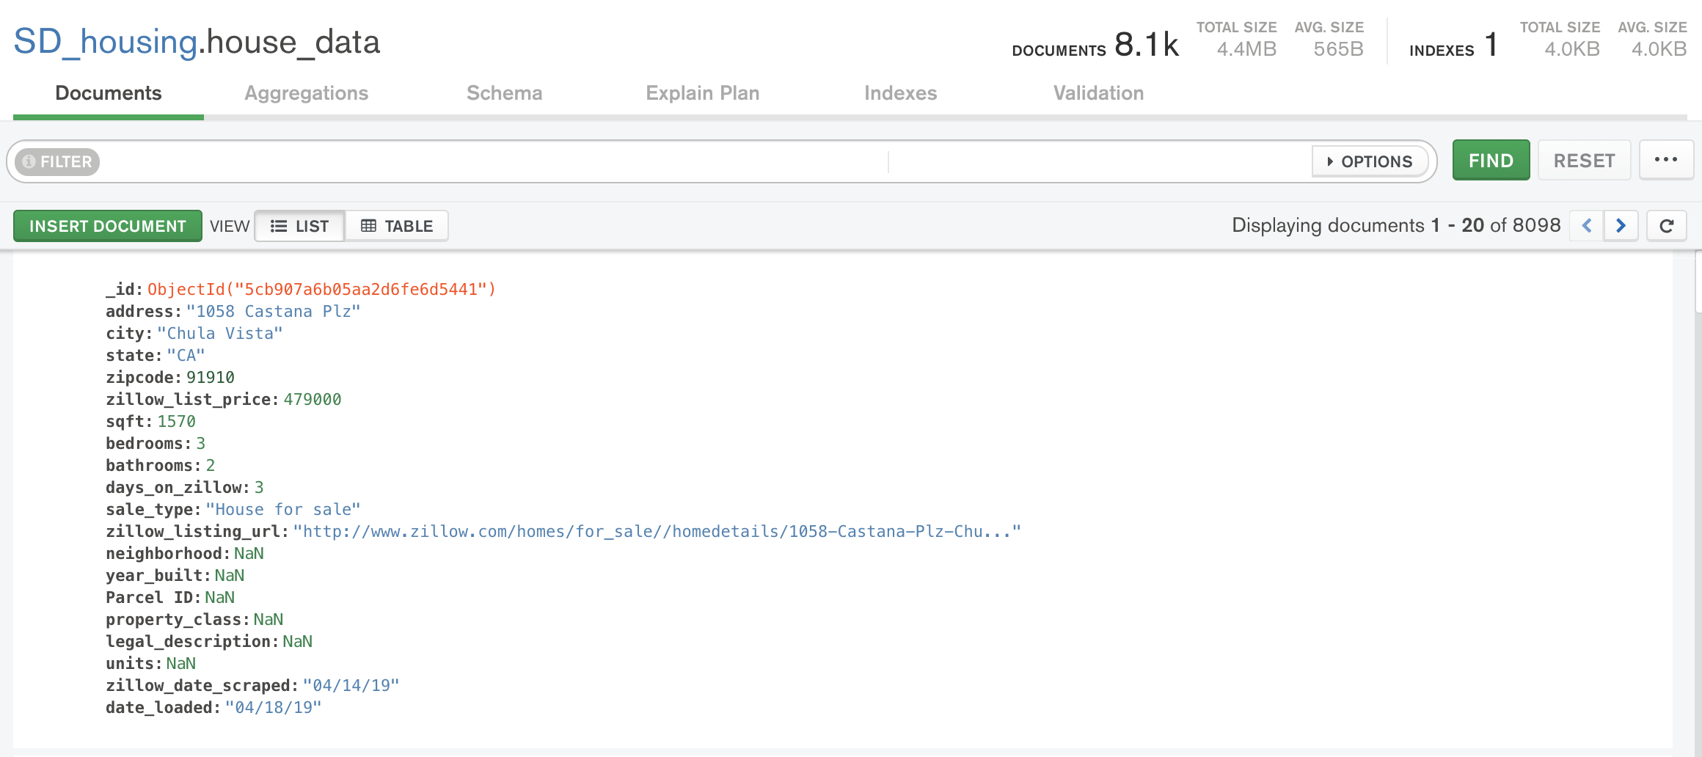
Loading to Mongo – method 1
Result: 4.4 MB

Slide 5
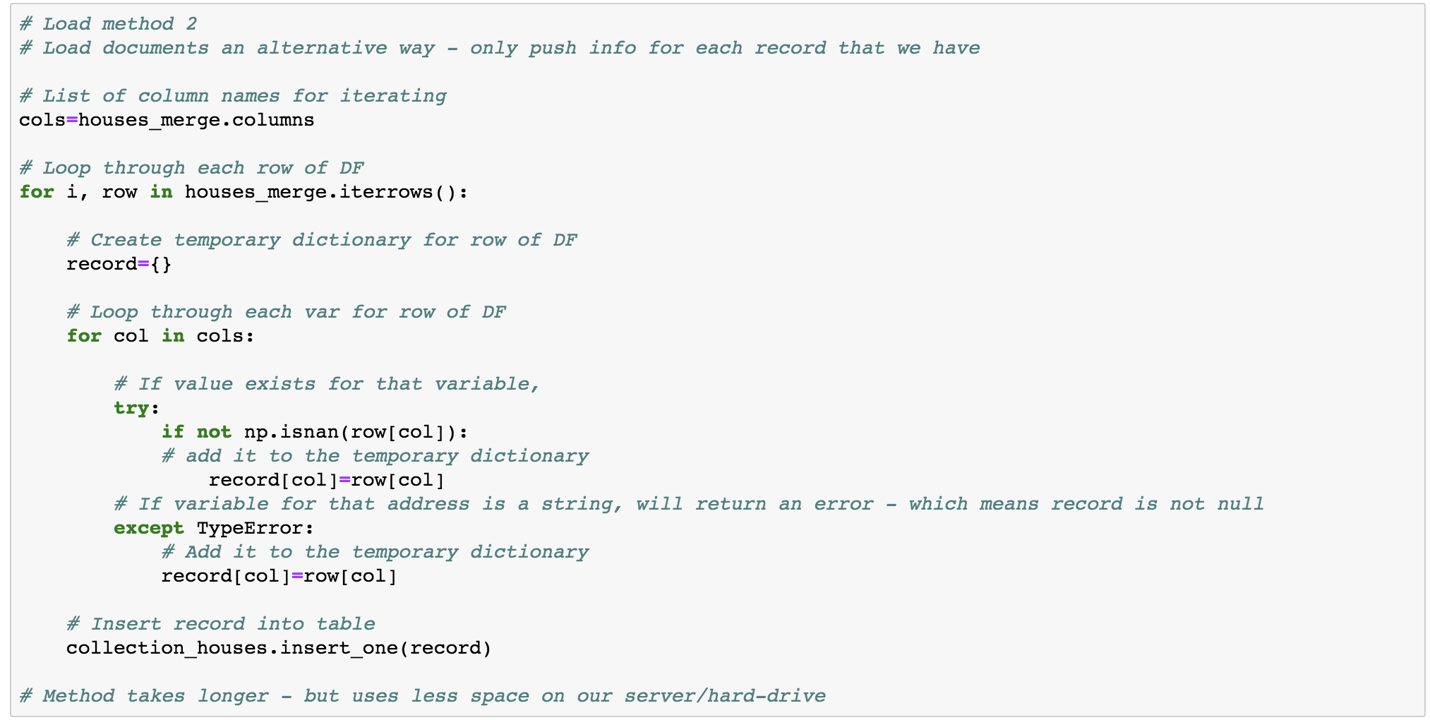
Loading to Mongo – method 2

Slide 6
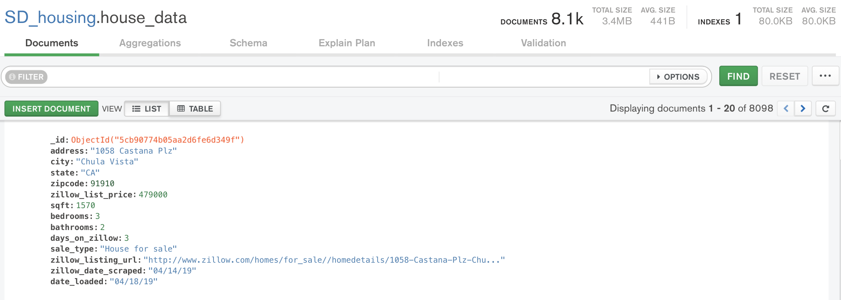
Loading to Mongo – method 2
Result:3.4 MB

Slide 7
What we Learned as a Team..
Challenges:
Benefits:
Website we were scraping was not consistent in format for each zip code.
Captcha when downloading from Zillow.
Adapting the open source code overcome a few errors.
Figuring out how to load records into Mongo to exclude “NA” entries.
The frustration & timeliness helped us learn about using web scraping and logic.
Used multiple sources to scrape data: csv, json, MongoDB, BeautifulSoup, noSQL.
Found code online and didn’t need to create the code ourselves (Zillow).
Less storage on hard drive.

