Slide 1
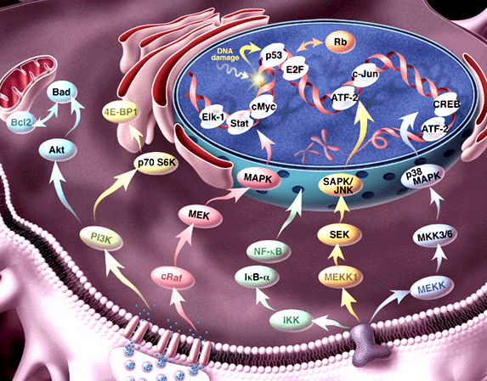
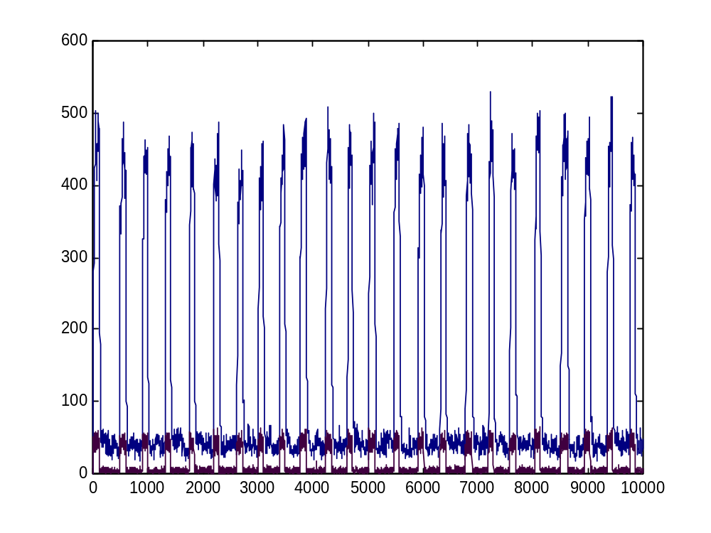
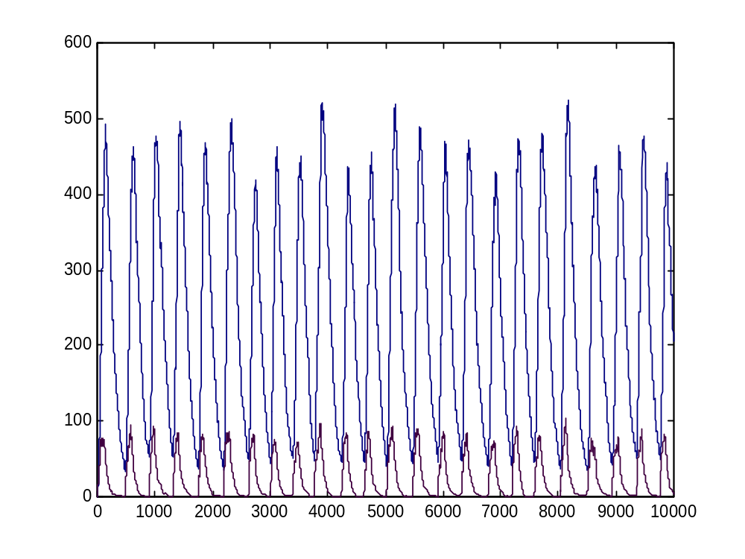
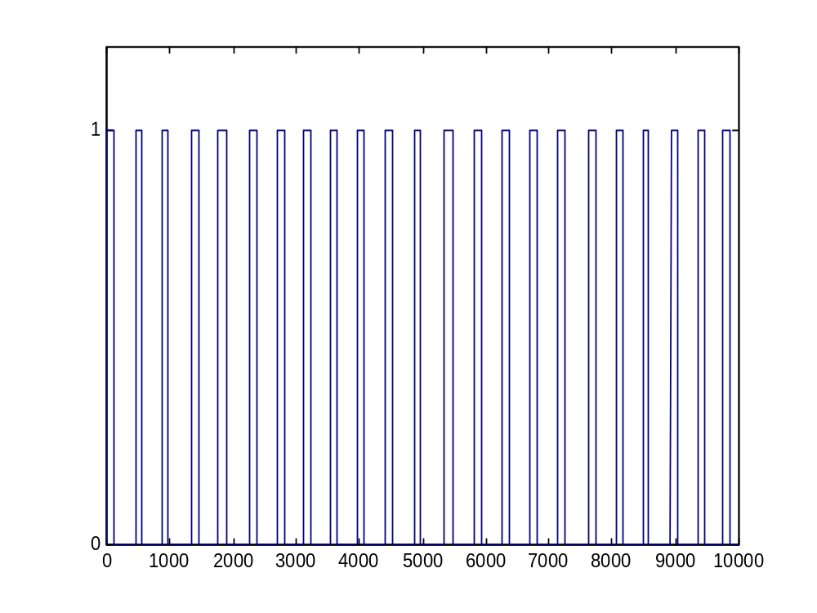
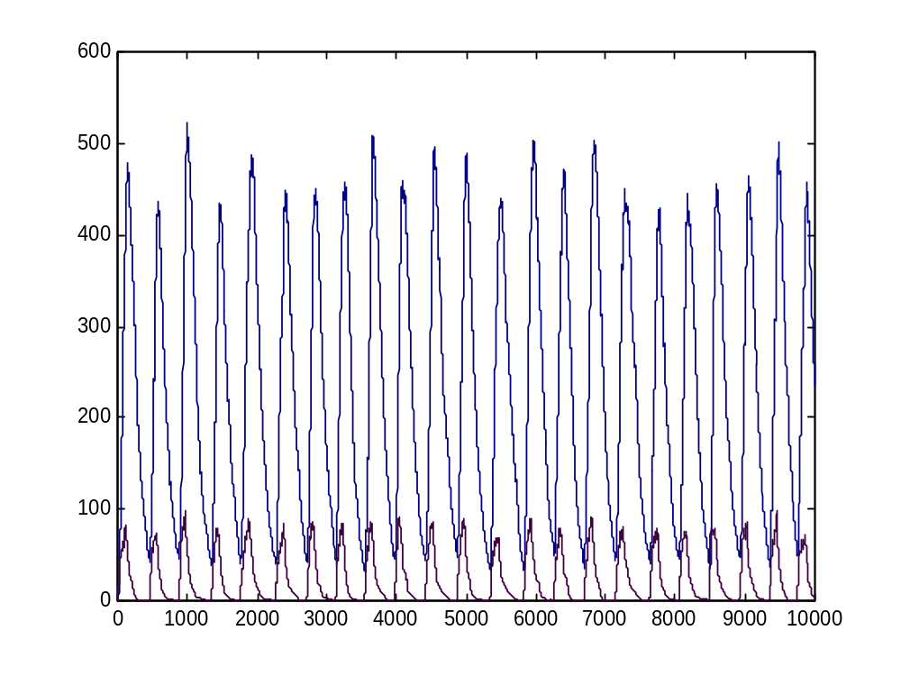
Computer Simulation of Biomolecular Processes Using Stochastic Process Algebra
Aviv Regev^{1,2}, William Silverman², Naama Barkai³, and Ehud Shapiro¹
¹Department of Cell Research and Immunology, Faculty of Life Sciences, Tel Aviv University, Tel Aviv, 69978, Israel. ² Department of Computer Science and Applied math, and ³ Department of Molecular Genetics and Department of Physics of Complex Systems, Weizmann Institute of Science, Rehovot, Israel. {aviv, bill, udi@wisdom.weizmann.ac.il}, Barkai@wisemail.weizmann.ac.il
Our approach: A discrete model based on the π-calculus, a process algebra. This model is amenable to computer simulation, analysis and formal verification at different levels of abstraction.
Quantitative modeling: We developed a new computer system, called PSI, for representation and simulation of biochemical networks. It is based on a stochastic version of the calculus, where actions are assigned rates. The PSI system was used to model the circadian clock.
The circadian clock module: The ability of the calculus to capture modular structures was employed to investigate the clock at molecular and modular levels, and show that both are equally good at capturing its behavior.
A formalism for Biochemical networks
The goal:
A formal language to describe biochemical processes
• Metabolic pathways
• Signal transduction networks
• Transcriptional regulatory circuits
The molecule as a computational process
Represent a molecular structure by the process in which it may participate
A language describing
Dynamics
Molecular composition
Biochemical detail
of interaction
With formal semantics
Has the power to
Simulate
Analyze
Compare
The stochastic π-calculus (sπ)
A community of interacting processes
Processes are defined by their potential communication activities
Communication occurs via channels
Each channel is assigned with a rate
Communication content: change of channel names (mobility)
PSI: A computer simulation system
Write,run, trace and monitor sπ programs of biochemical networks
Biochemical networks in the (stochastic) π-calculus
The circadian clock: Molecular Implementation
(Barkai and Leibler, 2000)
Domains, molecules, systems ≈ Processes
SYSTEM ::= ERK1 | ERK1 | …
ERK1 ::= (new backbone) (Nt_LOBE |CATALYTIC_LOBE |Ct_LOBE)
A
R
Complementary molecular determinants ≈
Channel names and co-names
T_LOOP (tyr )::= tyr ? (tyr’ ).T_LOOP(tyr’)
A
degradation
degradation
R
A
R
UTR_{A}
translation
UTR_{R}
translation
transcription
A_RNA
transcription
R_RNA
P_{A}
A_GENE
P_{R}
R_GENE
Y
pY
A^{gene_a}_{::=} PROMOTED_A + BASAL_A
PROMOTED_A::= pA ? {e}.ACTIVATED_TRANSCRIPTION_A(e)
BASAL_A::= bA ? [].( A^{gene_a} | A^{mRNA_a})
ACTIVATED_TRANSCRIPTION_A::=
τ₁ . (ACTIVATED_TRANSCRIPTION_A | A^{mRNA_a}) +
e ? [] . A^{gene_a}
A_Gene
Molecular interaction and modification ≈
Rate-based communication and change of channel names
tyr ! (p-tyr) . KINASE_ACTIVE_SITE | tyr ? (tyr’) . T_LOOP →
KINASE_ACTIVE_SITE | T_LOOP {p-tyr / tyr }
A^{mRNA_a}::= TRANSLATION_A + DEGRADATION_mA
TRANSLATION_A::= utrA ? [] . (A^{mRNA_a} | A^{prot_A})
DEGRADATION_mA::= degmA ? [] . 0
A_RNA
A^{prot_A}::= (new e1,e2,e3)
PROMOTION_A-R + BINDING_R + DEGRADATION_A
PROMOTION_A-R ::= pA!{e2}.e2![].A^{prot_A} + pR!{e3}.e3![].A^{prot_A}
BINDING_R ::= rbs ! {e1} . BOUND_A^{prot_A}
BOUND_A^{prot_A}::= e1 ! [].A^{prot_A} + degpA ? [].e1 ![].0
DEGRADATION_A::= degpA ? [].0
A_protein
The circadian clock:
Hysteretic oscillator module
Conclusions
A formal representation language for biochemical networks, based on the stochastic π-calculus
Integrating information on molecular composition, biochemical interaction and dynamic behavior
The PSI system for quantitative simulation of biochemical networks
Modeling biochemical systems at different levels of abstraction
Assigning the function of the hysteretic module in the circadian clock, by PSI simulations at molecular and modular levels
References
Milner R. (1999) Communicating and mobile systems: The π-calculus. Cambridge University Press.
Barkai N. and Leibler S. (2000) Circadian clocks limited by noise. Nature 403: 267-268
The PSI system and additional material are available from www.wisdom.weizmann.ac.il/~aviv
ON_H-MODULE(C_{A})::=
{C_{A}<=T1} . OFF_H-MODULE(C_{A}) +
{C_{A}>T1} .
(rbs ! {e1} . ON_DECREASE +
e1 ! [] . ON_H_MODULE +
pR ! {e2} . (e2 ! [] .0 | ON_H_MODULE) +
τ1 . ON_INCREASE)
ON_INCREASE::= {C_{A}++} . ON_H-MODULE
ON_DECREASE::= {C_{A}--} . ON_H-MODULE
ON
OFF_H-MODULE(C_{A})::=
{C_{A}>T2} . ON_H-MODULE(C_{A}) +
{C_{A}<=T2} .
(rbs ! {e1} . OFF_DECREASE +
e1 ! [] . OFF_H_MODULE +
τ2 . OFF_INCREASE )
OFF_INCREASE::= {C_{A}++} . OFF_H-MODULE
OFF_DECREASE::= {C_{A}--} . OFF_H-MODULE
OFF
A module
R

