Slide 1
Biomolecular Processes as Concurrent Computation:
Modeling Molecular Processes in the π-calculus Process Algebra

Slide 2
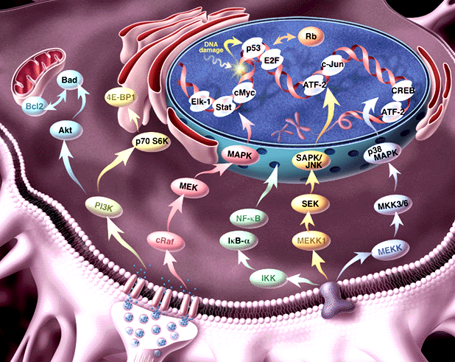
Intracellular biochemical processes
Transcriptional regulation
Metabolic pathways
Signal transduction

Slide 3
Signal transduction (ST) pathways
Pathways of molecular interactions that provide communication between the
cell membrane and intracellular end-points, leading to some change in the cell.

Slide 4
RTK
RTK
G protein receptors
Cytokine receptors
DNA damage, stress sensors
G_{β}
G_{α}
SHC
GRB2
G_{γ}
RAB
RhoA
RAC/Cdc42
C-ABL
Multiple connections:
feedback, cross talk
SOS
Ca⁺²
GCK
PAK
HPK
RAS
GAP
PYK2
Modular
at domain, component and pathway level
?
PKA
RAF
MOS
TLP2
MEKK1,2,3,4
MAPKKK5
MLK/DLK
ASK1
MAPKKK
MKK1/2
MKK4/7
MKK3/6
MAPKK
PP2A
MAPK
ERK1/2
JNK1/2/3
P38 α/β/γ/δ
Rsk,
MAPKAP’s
TFs, cytoskeletal proteins
Kinases, TFs
Cell division, Differentiation
Inflammation, Apoptosis

Slide 5
What is missing from the picture?
Information about
  Dynamics
  Molecular structure
  Biochemical detail of interaction
The Power to
  simulate
  analyze
  compare
Formal semantics
Script:
Characters +Plot
Movie

Slide 6
Our Goal
A formal representation language for molecular processes
Powerful and essential
Dynamic and executable (simulation)
Analyzable (comparative and functional studies)

Slide 7
The molecule as a computational process
Represent a structure by its potential behavior: by the process in which it can participate
Example: An enzyme as the enzymatic reaction process, in which it may participate

Slide 8
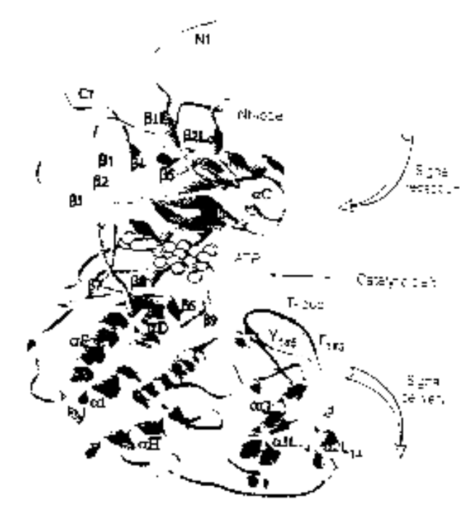
Example: ERK1 Ser/Thr kinase
Structure
Process
NH₂
Binding MP1 molecules
Nt lobe
Regulatory T-loop:
Change conformation
Kinase site:
Phosphorylate Ser/Thr residues
(PXT/SP motifs)
ATP binding site:
Bind ATP, and use it for phsophorylation
p-Y
Catalytic core
p-T
Ct lobe
Binding to substrates
COOH

Slide 9
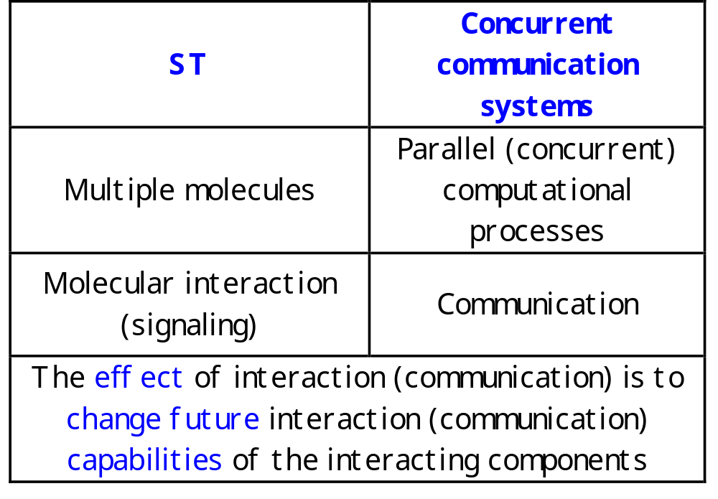
The correspondence between molecular and computational processes

Slide 10
The π-calculus
(Milner, Walker and Parrow)
A program specifies a network of interacting processes
Processes are defined by their potential communication activities
Communication occurs via channels, defined by names
Communication content: Change of channel names (mobility)

Slide 11
The π-calculus: Formal structure
Syntax
How to formally write a specification?
Congruence laws
When are two specifications the same?
Reaction rules
How does communication occur?

Slide 12
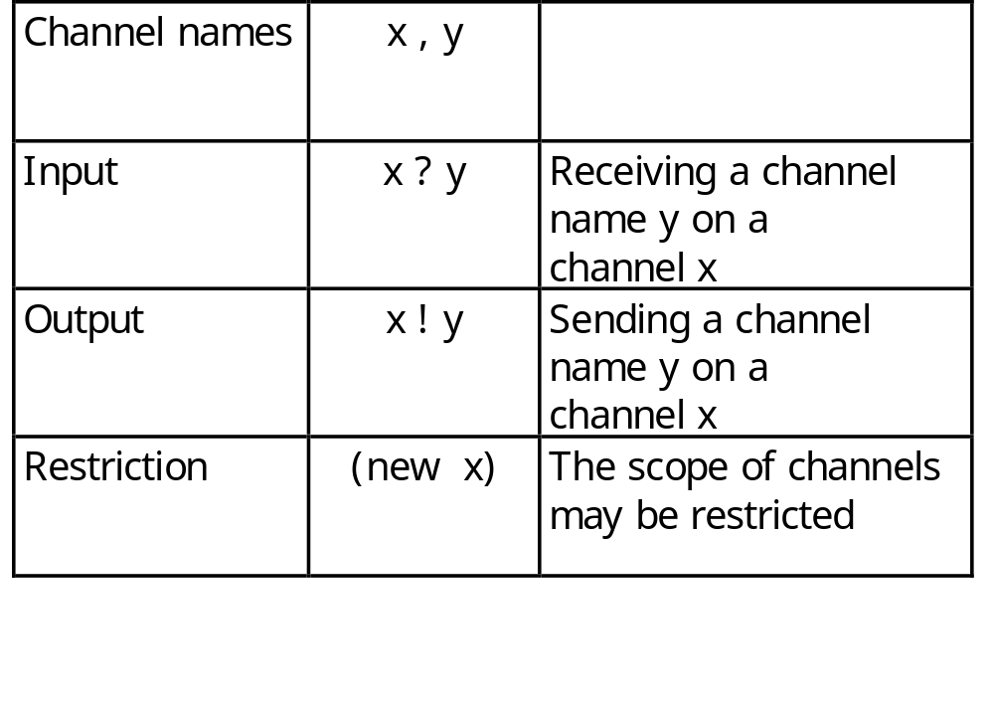
Syntax: Channels
All communication events, input or output, occur on channels

Slide 13
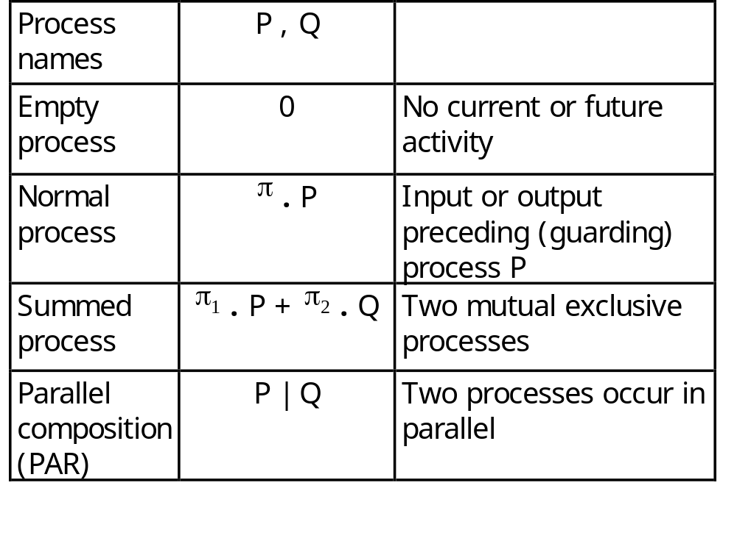
Syntax: Processes
Processes are composed of communication events
and of other processes

Slide 14
The π-calculus: Reduction rules
COMM:
Ready to send z
on x
Ready to receive y
on x
Actions consumed;
Alternative choices discarded
( … + x ! z . Q ) | (… + x ? y . P) → Q | P {z/y}
z replaces y in P

Slide 15
Principles for mapping ST to π-calculus
ERK1
Domains, molecules, systems ≈ Processes
SYSTEM ::= ERK1 | ERK1 | …
ERK1 ::= (new internal_channels)
(Nt_LOBE |CATALYTIC_LOBE |Ct_LOBE)
Molecular determinants ≈
Global (free) channel names and co-names
T_LOOP (tyr )::=
tyr ? (tyr’ ).T_LOOP(tyr’)
Y

Slide 16
Principles for mapping ST to π-calculus
ERK1
Molecular integrity (molecule) ≈
Local channels as unique identifiers
ERK1 ::= (new backbone)
(Nt_LOBE |CATALYTIC_LOBE |Ct_LOBE)
MP1
Molecule binding ≈ Exporting local channels
mp1 ! {backbone} . backbone ! { … } |
mp1 ? {cross_backbone} . cross_backbone ? {…}
Y
ERK1
MEK1

Slide 17
Principles for mapping ST to π-calculus
Y
Molecular interaction and modification ≈
Communication and change of channel names
tyr ! p-tyr . KINASE_ACTIVE_SITE | … + tyr ? Tyr’ . T_LOOP
→
KINASE_ACTIVE_SITE | T_LOOP {p-tyr / tyr }
Y
Applied to the RTK-Ras-MAPK mitogenic pathway

Slide 18
Stochastic π-calculus
(Priami, 1995)
Stochastic effects on molecular interaction
Every channel x or internal communication τ attached with a delay parameter d
Delay for each communication is chosen from an exponential distribution with d
At each time step all enabled communications occur
(s)PiFCP simulation system

Slide 19
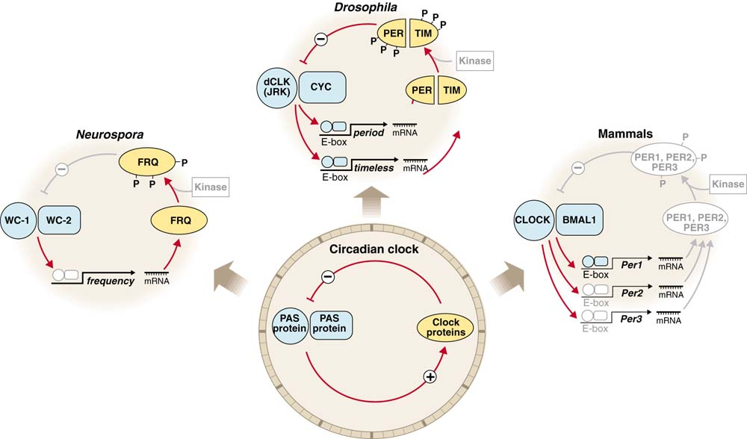
Circadian Clocks: Implementations
J. Dunlap, Science (1998) 280 1548-9

Slide 20
The circadian clock machinery
(Barkai and Leibler, Nature 2000)
A
R
degradation
A
R
degradation
UTR_{A}
UTR_{R}
translation
translation
A_RNA
R_RNA
transcription
transcription
P_{A}
P_{R}
A_GENE
R_GENE
Appropriate behavior requires different rates

Slide 21
The machinery in π-calculus: “A” molecules
A^{gene_a}_{::=} PROMOTED_A + BASAL_A
PROMOTED_A::= pA ? {e} . ACTIVATED_TRANSCRIPTION_A(e)
BASAL_A::= bA ? []. ( A^{gene_a} | A^{mRNA_a})
ACTIVATED_TRANSCRIPTION_A::=
τ₁ . (ACTIVATED_TRANSCRIPTION_A | A^{mRNA_a}) + e ? [] . A^{gene_a}
Gene
A^{mRNA_a}::= TRANSLATION_A + DEGRADATION_mA
TRANSLATION_A::= utrA ? [] . (A^{mRNA_a} | A^{prot_A})
DEGRADATION_mA::= degmA ? [] . 0
RNA
A^{prot_A}::= (new e1,e2,e3)
PROMOTION_A-R + BINDING_R + DEGRADATION_A
PROMOTION_A-R ::= pA ! {e2} . e2 ! [] . A^{prot_A} +
pR ! {e3} . e3 ! [] . A^{prot_A}
BINDING_R ::= rbs ! {e1} . BOUND_A^{prot_A}
BOUND_A^{prot_A}::= e1 ! [] . A^{prot_A} + degpA ? [] .e1 ![] . 0
DEGRADATION_A::= degpA ? [] . 0
Protein

Slide 22
The machinery in π-calculus: “R” molecules
R^{gene_r}_{::=} PROMOTED_R + BASAL_R
PROMOTED_R::= pR ? {e} . ACTIVATED_TRANSCRIPTION_R(e)
BASAL_R::= bR ? []. ( R^{gene_r} | R^{mRNA_r})
ACTIVATED_TRANSCRIPTION_R::=
τ₂ . (ACTIVATED_TRANSCRIPTION_R | R^{mRNA_r}) + e ? [] . R^{gene_r}
Gene
R^{mRNA_r}::= TRANSLATION_R + DEGRADATION_mR
TRANSLATION_R::= utrR ? [] . (R^{mRNA_r} | R^{prot_R})
DEGRADATION_mR::= degmR ? [] . 0
RNA
R^{prot_R}::= BINDING_R + DEGRADATION_A
BINDING_A ::= rbs ? {e} . BOUND_R^{prot_R}
BOUND_R^{prot_R}::= e1 ! [] . R^{prot_R}
DEGRADATION_R::= degpR ? [] . 0
Protein

Slide 23
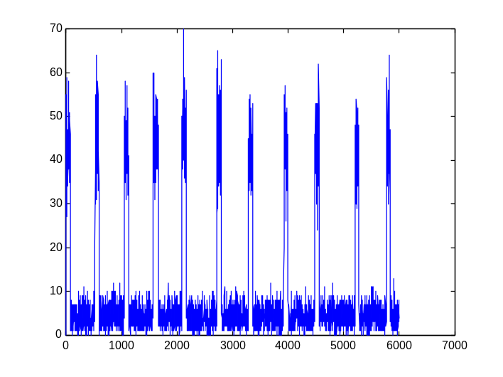
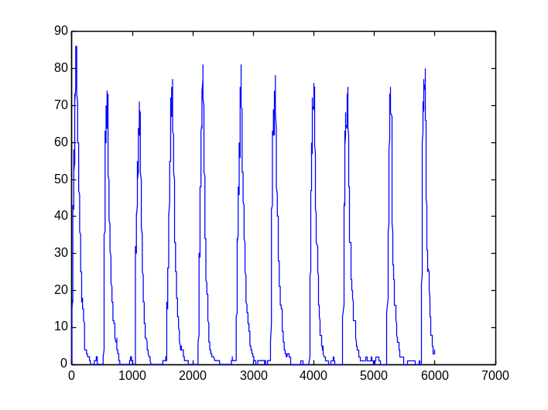
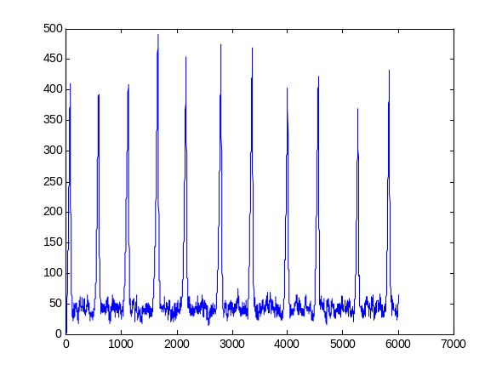
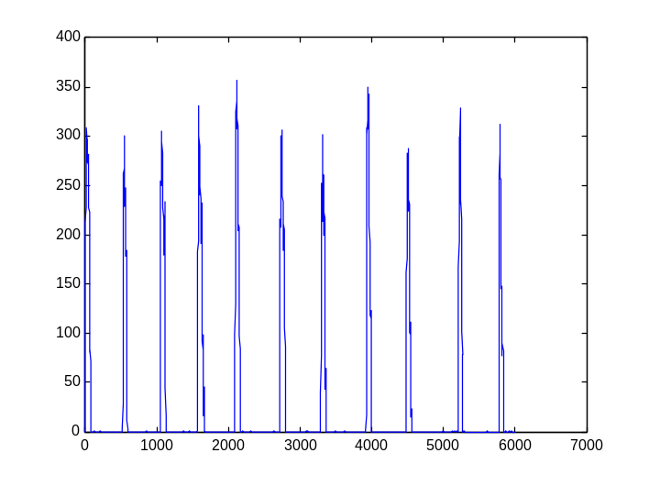
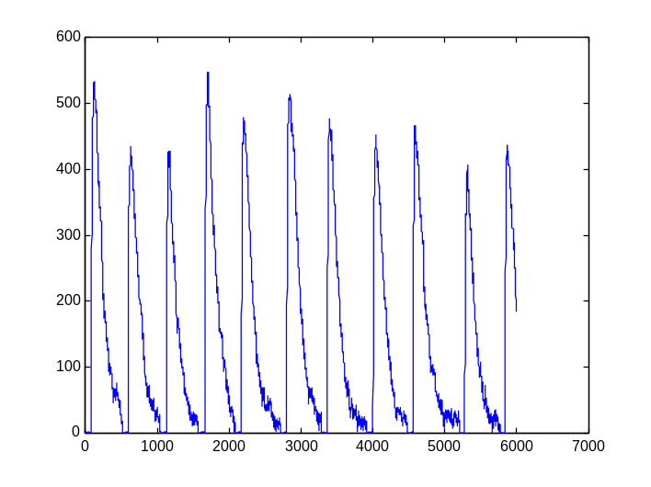
sPiFCP simulation
A mRNA
R mRNA
A-R complex
Free A protein
Free R protein
Robust to a wide range of parameters

Slide 24
Modular Cell Biology
How to identify and compare modules and prove their function?
Semantic concept: Two processes are equivalent if can be exchanged within any context without changing system behavior
Build two representations in the π-calculus
  molecular level (implementation)
  functional module level (specification)
Show the equivalence of both representations
  by computer simulation
  by formal verification

Slide 25
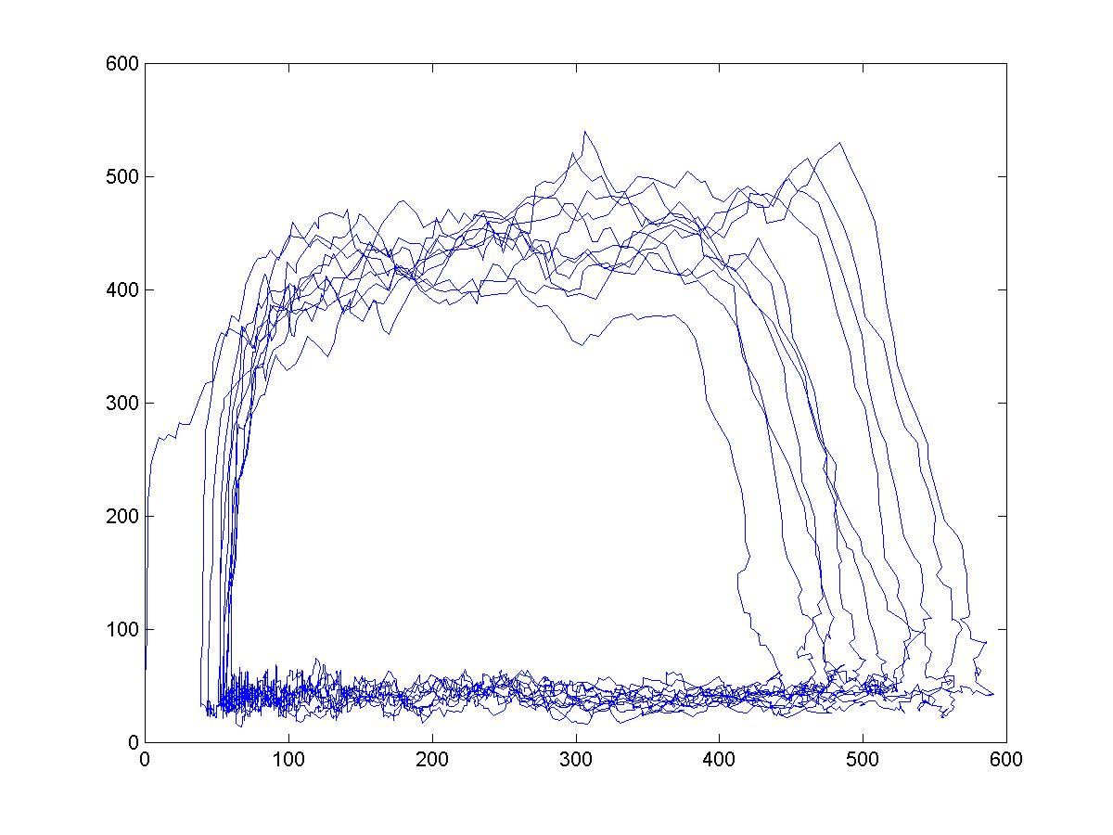
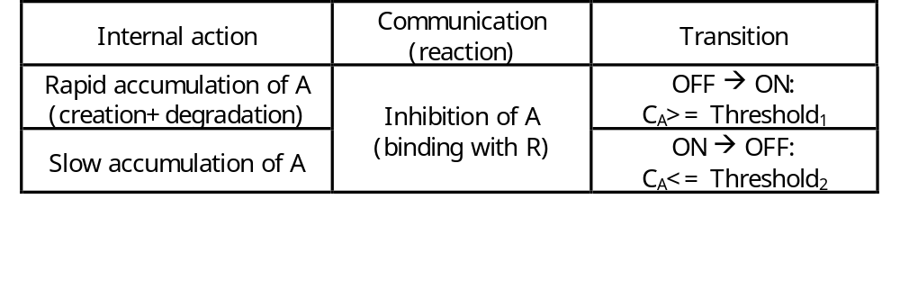
The circadian clock hysteresis module
A
ON
A
Fast
Fast
OFF
R
R

Slide 26
Hysteresis module
ON_H-MODULE(C_{A})::=
{C_{A}<=T1} . OFF_H-MODULE(C_{A}) +
{C_{A}>T1} .
(rbs ! {e1} . ON_DECREASE +
e1 ! [] . ON_H_MODULE +
pR ! {e2} . (e2 ! [] .0 | ON_H_MODULE) + τ1 . ON_INCREASE )
ON_INCREASE::= {C_{A}++} . ON_H-MODULE
ON_DECREASE::= {C_{A}--} . ON_H-MODULE
OFF_H-MODULE(C_{A})::=
{C_{A}>T2} . ON_H-MODULE(C_{A}) +
{C_{A}<=T2} .
(rbs ! {e1} . OFF_DECREASE +
e1 ! [] . OFF_H_MODULE +
τ2 . OFF_INCREASE )
OFF_INCREASE::= {C_{A}++} . OFF_H-MODULE
OFF_DECREASE::= {C_{A}--} . OFF_H-MODULE
ON
OFF

Slide 27
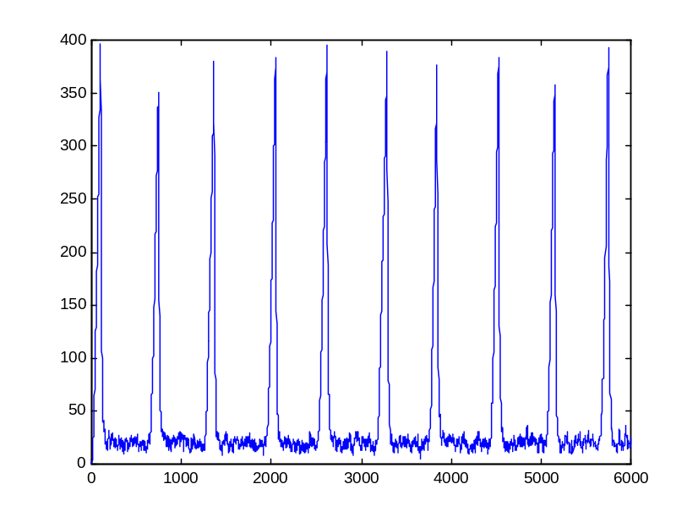
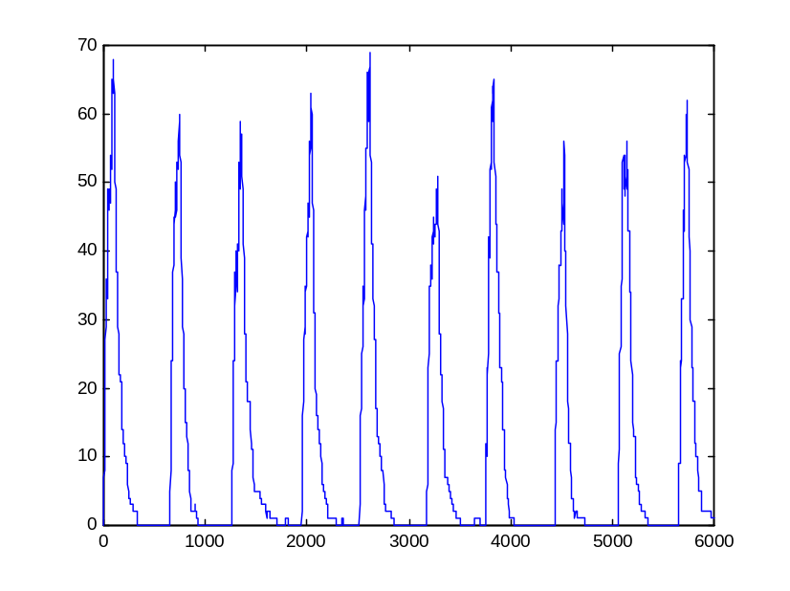
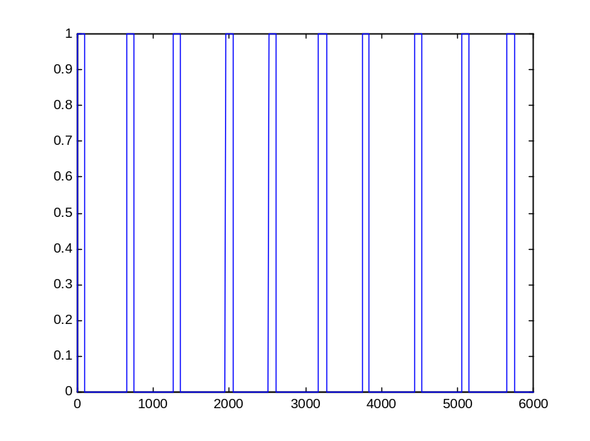
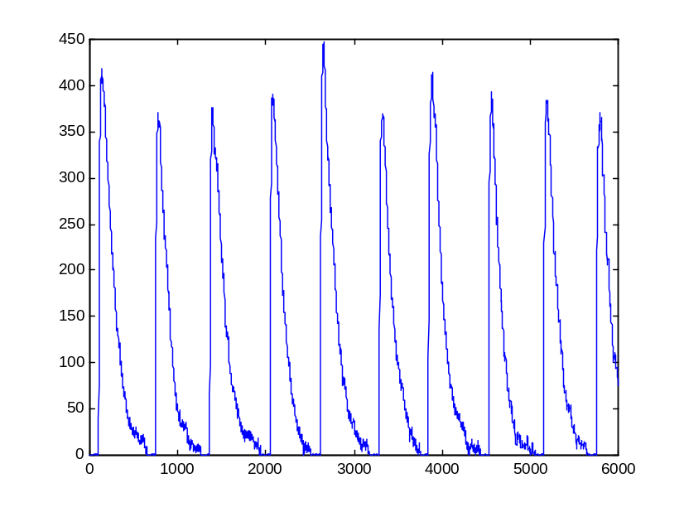
sPiFCP simulation
Bound R
R mRNA
A module (ON)
Free R protein

Slide 28
The homology of process:
Biological formal verification
Homologous pathways share both components and interaction structure
The π-calculus model includes both structure and dynamics
Two models can be formally compared to determine the degree of mutual similarity of their behavior (bisimulation)
A homology measure of molecular processes could determined based on such bisimilarity

Slide 29
TAU
Eva Jablonka
Yehuda Ben-Shaul
WIS
Udi Shapiro
Bill Silverman
Naama Barkai

