Slide 1
Biomolecular processes as concurrent computation

Slide 2
Goal
Represent a wide variety of chemical, biochemical and molecular systems as concurrent computation in the stochastic pi-calculus

Slide 3
Course Outline
Lecture 1+2 (19 April; 3 May)
  Introduction
  The electron theory of chemical bonds
Lecture 3 (10 May)
  Modular representation of chemical reactions
  Membranes and transport
Lecture 4+5 (17 May, 24 May)
  Enzymatic reactions and metabolism
Lecture 6 (31 May)
  Polymers

Slide 4
Course Outline
Lecture 7 (7 June)
  Molecular machines
Lecture 8 (14 June)
  Regulatory networks
Lecture 9 (28 June)
  Signal transduction

Slide 5
Course Outline
In each unit
  Chemistry/Biology backgrounder
  Modeling principles in stochastic pi-calculus
  Examples
  Exercises
  References and supplementary reading

Slide 6
Course Requirements
Exercises: Weekly. Write and execute pi-calculus programs. Can be submitted in pairs (CS and biology students)
Project: Model and analyze by simulation a larger system (e.g. from a list of suggested ones). Can be done individually or in teams combining CS and biology students
Grading: 6/8 best exercises (10% each) + project (40%).

Slide 7
Course Team
 | Room | Tel | E-mail
Barak Shenhav (TA) | Mayer 412 | 3098 | shenhav@bioinformatics
Aviv Regev | Ziskind 02 | 4459 | aviv@wisdom
Ehud Shapiro | Ziskind 123 | 4506 | udi@wisdom

Slide 8
Motivation
Biochemical processes as concurrent computation

Slide 9
Molecular Biology is…
Sequence: Sequence of DNA and Proteins
Structure: 3D Structure of Proteins and other biomolecules and molecular complexes
Interaction: How do these molecules interact?

Slide 10
Sharing Scientific Knowledge
Sequence and structure: encoded, shared, processed and updated via computers.
Molecular interactions: shared via articles.
Why?

Slide 11
Computer Languages for Sharing Biological Knowledge
Sequence: Strings over {A,C,T,G}
Structure: Labeled 3D Graphs
Interaction: ?

Slide 12
The “New Biology”
The cell as an information processing device
Cellular information processing and passing are carried out by networks of interacting molecules
Ultimate understanding of the cell requires an information processing model
Which?

Slide 13
Describing the Cell
Compositional, executable representations of biological knowledge
Executable – to enable computer simulation and analysis
Compositional – so that a representation of the cell can be composed bottom-up

Slide 14
“We have no real ‘algebra’ for describing regulatory circuits across different systems...”
- T. F. Smith (TIG 14:291-293, 1998)
“The data are accumulating and the computers are humming, what we are lacking are the words, the grammar and the syntax of a new language…”
- D. Bray (TIBS 22:325-326, 1997)

Slide 15
Computer Languages for Sharing Biological Knowledge
Sequence: Strings over {A,C,T,G}
Structure: Labeled 3D Graphs
Interaction: ?
  Answer: Process description language

Slide 16
Molecules as Processes
Molecule | Process
Interaction capability | Channel
Interaction | Communication
Modification | State and/or channel change

Slide 17
The pi-Calculus
(Milner, Walker and Parrow 1989)
A program specifies a network of interacting processes
Processes are defined by their potential communication activities
Communication occurs on complementary channels, identified by names
Communication content: Change of channel names (mobility)
Stochastic version (Priami 1995) : Channels are assigned rates

Slide 18
Unit 1: The valence theory of chemical bonds

Slide 19
The Chemical Reaction
Unbalanced equation
N₂O₅ → NO₂ + O₂
Reactant
Products
The chemical equation is used to describe the changes that occur during a chemical reaction.
Problem: If not balanced, atoms are not conserved

Slide 20
The Chemical Reaction
Balanced Equation
2N₂O₅ → 4NO₂ + O₂
Stoichiometric Coefficients
Balanced equations describe the overall stoichiometric relations between the reactants and products of complex reactions.
Problem: Tells us nothing about the exact way the reaction takes place at the molecular level

Slide 21
The Chemical Reaction
Reaction Mechanism
Unimolecular
Elementary reactions
(1) (N₂O₅ → NO₂ + NO₃) ^{X} 2
(2) NO₂ + NO₃ → NO + NO₂ + 0₂
(3) NO₃ + NO → 2NO₂
Bimolecular
2N₂O₅ → 4NO₂ + O₂
A series of elementary (uni- or bi-molecular) reactions forms a mechanism for the way in which a stoichiometric reaction takes place.

Slide 22
The Chemical Bond
Chemical bonds as the “glue” that holds atoms together to form molecules
Valence - the property of an atom to form bonds, e.g.
  Univalent – capable of forming a single chemical bond
  H – valence of 1
  C – valence of 4
  Na – valence of +1
  Some elements (e.g. N, S, P) have multiple possible valences

Slide 23
Covalent and Ionic Bonds
A covalent bond results when a pair of electrons is shared between two atoms (unsigned valence)
In ion formation, the sharing is so unequal that electrons are transferred from one atom to another (signed valence)

Slide 24
Octet Structures
 | ..
: | Ne | :
 | ..
 | ..
: | Ar | :
 | ..
 | He | :
 | Li⁺ | :
 | .
· | C | ·
 | .
 | H | ·

Slide 25
Bond Diagrams
A covalent bond is a sharing of a pair of electrons, so that both atoms have filled octets
→ |  |  |  |  | ←
H | · |  |  | · | H
H | : | H
In double and triple bonds two or three pairs are shared between the same two atoms
: | N | ::: | N | :
In ionic bonds electrons are gained and lost. The attraction between positive and negative charge results in an ionic bond
 | Na | ·
 | ..
: | Cl | ·
 | ..
 | ..
: | Na⁺ | :
 | ..
 | ..
: | Cl⁻ | :
 | ..
+ →

Slide 26
The pi-Calculus
Syntax and Semantics - I

Slide 27
Na + Cl ↔ Na⁺ + Cl⁻
-language(psifcp).
global(e1(100),e2(10)).
System::= Na | Na | Cl | Cl .
Na::= e1 ! [] , Na_plus .
Na_plus::= e2 ? [] , Na .
Cl::= e1 ? [] , Cl_minus .
Cl_minus::= e2 ! [] , Cl .
nacl_1.cp

Slide 28
Process Definition
System::= Na | Na | Cl | Cl .
Na::= e1 ! [] , Na_plus .
Na_plus::= e2 ? [] , Na .
Cl::= e1 ? [] , Cl_minus .
Cl_minus::= e2 ! [] , Cl .
.
<Left hand side>
(Process name)
::=
<Right hand side>
(Communication clause, body)
nacl_1.cp

Slide 29
Channel Names and Communication Actions
global channel declaration
global(e1(100),e2(10)).
Na::= e1 ! [] , Na_plus .
Na_plus::= e2 ? [] , Na .
Cl::= e1 ? [] , Cl_minus .
Cl_minus::= e2 ! [] , Cl .
e1 ? [ ] – input (receive)
action
e1 ! [ ] – output (send)
action
Complementary channel co-name
Channel name
Nil message (alert)
nacl_1.cp

Slide 30
Guarded Communication Clauses
Na::= e1 ! [] , Na_plus .
Na_plus::= e2 ? [] , Na .
Cl::= e1 ? [] , Cl_minus .
Cl_minus::= e2 ! [] , Cl .
,
<Communication action>
Input or output guard
(prefix)
<Right hand side>
e.g. Body
nacl_1.cp

Slide 31
Parallel Composition
System::= Na | Na | Cl | Cl .
Na::= e1 ! [] , Na_plus .
Na_plus::= e2 ? [] , Na .
Cl::= e1 ? [] , Cl_minus .
Cl_minus::= e2 ! [] , Cl .
|
<Call>
<Call>
Parallel composition (PAR)
nacl_1.cp

Slide 32
Communication and alternation between states - I
Ready to send an alert on e1
Ready to receive an alert on e1
Na | Cl
e1 ! [] , Na_plus | e1 ? [] , Cl_minus
COMM:
Communication actions consumed;
Prefixes released
Na_plus | Cl_minus
nacl_1.cp

Slide 33
Communication and alternation between states - II
Ready to send an alert on e2
Ready to receive an alert on e2
Na_plus | Cl_minus
e2 ? [] , Na | e2 ! [] , Cl
COMM:
Communication actions consumed;
Prefixes released
Na | Cl
When multiple copies of Na and Cl exist, the first and second interactions do not necessarily involve the same instances of Na and Cl
nacl_1.cp

Slide 34
Na + Cl ↔ Na⁺ + Cl⁻
Atoms and ions | Processes | Na, Na_plus Cl Cl_minus
Reaction capabilities (valence electrons) | Communication actions (alerts) | e1 ! [] e1 ? [] e2 ! [] e2 ? []
Reaction | Communication and state alteration | COMM

Slide 35
Chemical Kinetics

Slide 36
Reversibility of Chemical Reactions: Equilibrium
H₂ ↔ 2H
Chemical reactions are reversible
Under certain conditions (concentration, temperature) both reactants and products exist together in equilibrium state

Slide 37
Reaction Rates
Net reaction rate = forward rate – reverse rate
In equilibrium: Net reaction rate = 0
When reactants “just” brought together: Far from equilibrium, focus only on forward rate
But, same arguments apply to the reverse rate

Slide 38
The Differential Rate Law
How does the rate of the reaction depend on concentration? E.g.
m+n: Overall order of the reaction
3A + 2B → C + D
rate = k [A]^{m}[B]^{n}
(Specific reaction) rate constant
Order of reaction with respect to A
Order of reaction with respect to B

Slide 39
Rate Constants and Reaction Orders
Each reaction is characterized by its own rate constant, depending on the nature of the reactants and the temperature
In general, the order with respect to each reagent must be found experimentally (not necessarily equal to soichiometric coefficienct)

Slide 40
Elementary Processes and Rate Laws
Reaction mechanism: The collection of elementary processes by which an overall reaction occurs
The order of an elementary process is predictable
Unimolecular | A* → B | k [A] | First order
Bimolecular | A + B → C + D | k [A] [B] | Second order
Termolecular | A + B + C → D + E | k [A] [B] [C] | Third order

Slide 41
Stochastic pi-Calculus

Slide 42
Coupled chemical reactions as stochastic processes (Gillespie 76,77)*
N chemical species, each in quantity X_{i} in volume V
Can participate in R reactions, each characterized by a reaction parameter c_{μ} (similar to rate constant)
What is the next time step and which reaction would occur in it ?
h_{i}c_{i}δt - probability that the next reaction is R_{i}, where h_{i} – number of combinations of reactants
P(τ,μ) – probability that the time step is τ and the reaction is Rμ
*Full details in Gillespie 76,77, and later on

Slide 43
Monte-Carlo Algorithm for Exact Stochastic Simulation of Coupled Chemical Reactions
A Monte-Carlo technique to simulate the stochastic process described by P(τ,μ)
Initialization: Set t₀, t_{stop}, reaction parameters c₁-c_{M} and types, species quantities X₁-X_{N}.
Monte-Carlo step: Select random τ and μ according to P(τ,μ) (based on all h_{i}c_{i})
Update system: Advance t and update products and reactant species to reflect one R_{μ} reaction. Re-calculate h_{i}c_{i} for reactions whose reactants have changed
Repeat 2-3 until t >= t_{stop}

Slide 44
Monte-Carlo Algorithm for Exact Stochastic Simulation of Coupled Chemical Reactions
Each run – one possible realization
Must carry out several independent runs from same initial conditions but with different random seeds
Number of runs depends on system (and desired confidence)
In practice, between 3 and 10 runs often suffice

Slide 45
Stochastic (Chemical) pi-Calculus
Every channel is attached with the reaction parameter (“base rate”) of its corresponding reaction
2. A global (external) clock is maintained
3. The “actual rate” (c_{μ}h_{μ})of the reaction is determined. For a bimolecular reaction:
Rate = <base rate> * <#sends> * <#receives>
4. The clock is advanced and a communication is selected according to Gillespie’s algorithm
5. The selected communication is carried out
6. Steps 3-5 are repeated (until t<t_{stop})

Slide 46
Base Rate
A base rate is defined for each channel when the channel is declared. A base rate is a real non-negative number.
Only a single base rate per global channel
A channel with a base rate of 0 acts as a sink – all messages on the channel are discarded
If no specific base rate is determined, then the default base rate applies
If no default base rate is determined, then the default is instantaneous (infinite rate)
Infinite channels and alternative rate calculation methods may be defined (below and Unit 3)

Slide 47
Na + Cl ↔ Na⁺ + Cl⁻
base rate
setting
global(e1(100),e2).
baserate(10).
Na::= e1 ! [] , Na_plus .
Na_plus::= e2 ? [] , Na .
Cl::= e1 ? [] , Cl_minus .
Cl_minus::= e2 ! [] , Cl .
default baserate
nacl_1.cp

Slide 48
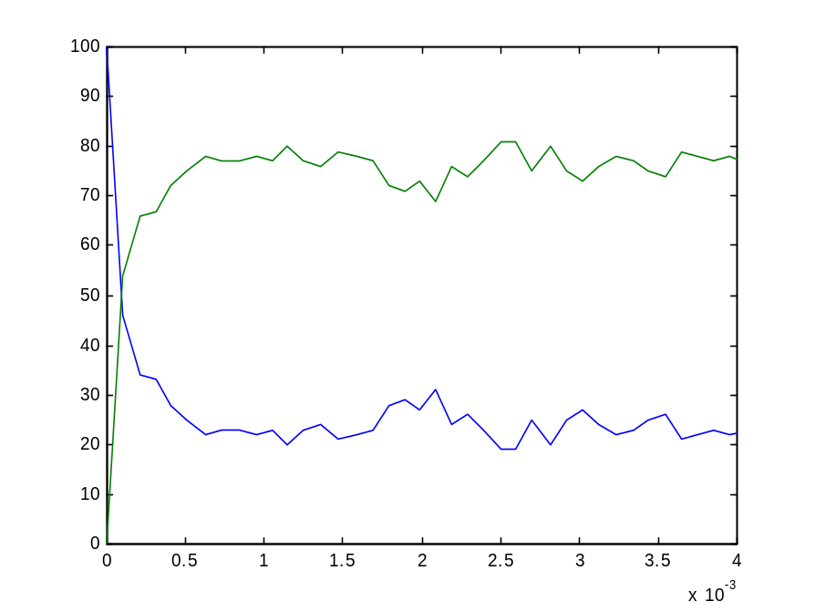
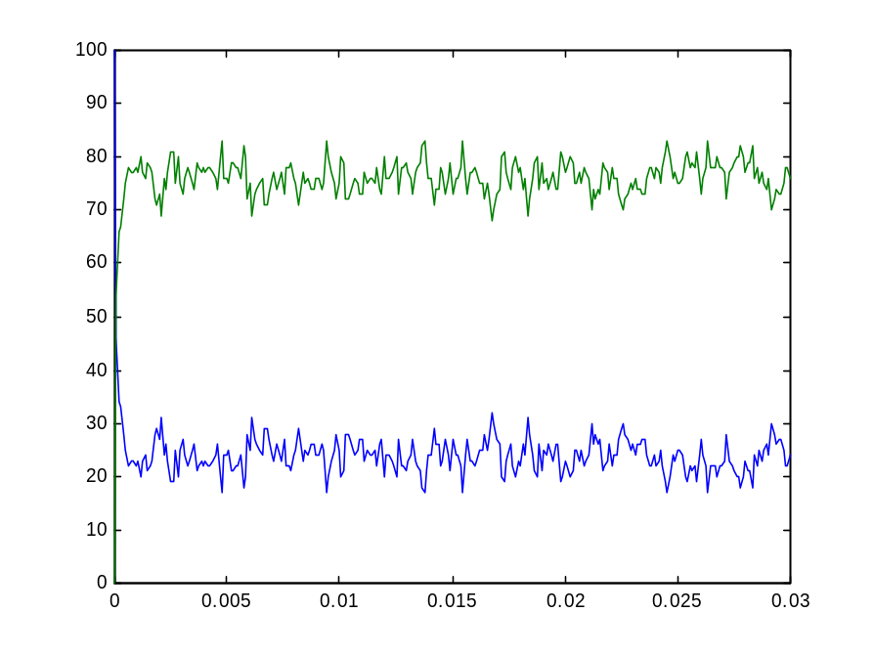
Na + Cl ↔ Na⁺ + Cl⁻
nacl_1.cp

Slide 49
Using BioPSI

Slide 50
BioPSI architecture
BioPSI:
(Stochastic) Pi-calculus
Logix:
Flat Concurrent Prolog
C emulator

Slide 51
Na + Cl ↔ Na⁺ + Cl⁻
N1 - number of Na processes
N2 - number of Cl processes
-language(psifcp).
global(e1(100),e2(10)).
System(N1,N2)::=
<< CREATE_Na(N1) | CREATE_Cl(N2) .
CREATE_Na(C)::=
{C =< 0} , true ; {C > 0} , {C--} | Na | self . CREATE_Cl(C)::=
{C =< 0} , true ; {C > 0} , {C--} | Cl | self >> . Na::= e1 ! [] , Na_plus .
Na_plus::= e2 ? [] , Na .
Cl::= e1 ? [] , Cl_minus .
Cl_minus::= e2 ! [] , Cl .
Multiple process spawning will be discussed later

Slide 52
Starting Logix: Compilation
wisdom:~/Course/Electron_1->116% logix
Weizmann Institute Logix 2.2 07/11/00 - 13:12:58
Copyright (C) 1991, Weizmann Institute of Science - Rehovot, ISRAEL
Welcome to SGI Logix !
12/04/01 - 19:02:46
@c(nacl_1)
<1> started
<1> source : /home/aviv/Course/Electron_1/nacl_1.cp - 20010412190219
<1> interpret : export([System / 2, Na / 0, Na_plus / 0, Cl / 0, Cl_minus / 0])
<1> file : /home/aviv/Course/Electron_1/nacl_1.bin - written
<1> terminated
@
c(<file name>)
Any change, including in rates, requires re-compilation

Slide 53
Starting Logix: Running
Welcome to SGI Logix !
12/04/01 - 19:13:59
@run(nacl_1#"System"(10,10),1)
<1> started
source : /home/aviv/Course/Electron_1/nacl_1.cp - 20010412190219
interpret : export([System / 2, Na / 0, Na_plus / 0, Cl / 0, Cl_minus / 0])
file : /home/aviv/Course/Electron_1/nacl_1.bin - written
done @ 1.000443 : seconds = 4
run(<path>#<goal>,<limit>)
GC = garbage collection

Slide 54
Starting Logix: Aborting
@run(nacl_1#"System"(2,2))
<1> started
@spr
<1> suspended
nacl_1 # .Na_plus.comm(global.e1(100)!, global.e2(10)!)
nacl_1 # .Na.comm(global.e1(100)!, global.e2(10)!)
nacl_1 # .Cl_minus.comm(global.e1(100)!, global.e2(10)!)
nacl_1 # .Cl.comm(global.e1(100)!, global.e2(10)!)
@a(1)
<1> aborted
@
run(<path>#<goal>)
abort abort(all) abort(N)
a a(all) a(N)
suspend (s) and resume (re) used similarly

Slide 55
Starting Logix: Recording
@record(nacl_1#"System"(10,10),nacl_out,1)
<1> started
done @ 1.000443 : seconds = 3
@
record(<path>#<goal>,<output file>,<limit>)

Slide 56
Starting Logix: Record file
Time
0.002118
-.Na
-.Cl
+.Na_plus
+.Cl_minus
0.003595
-.Na
-.Cl
+.Na_plus
+.Cl_minus
0.003888
-.Cl_minus
-.Na_plus
+.Cl
+.Na
Consumed processes
Spawned processes

Slide 57
Processing the Record file
wisdom:~/Course/Electron_1->131% psi2t nacl_out
wisdom:~/Course/Electron_1->132% more nacl_out.names
time Cl Cl_minus Na Na_plus
2 Cl
3 Cl_minus
4 Na
Na_plus
wisdom:~/Course/Electron_1->133% more nacl_out.table
9.1e-06 10 0 10 0
1.00044 4 6 4 6
2.00000 3 6 3 6
Coloumn identity and order (numbered)
in .table file
Number of processes (col) in each time point (row)
Psi2t can be used while the record file is being written
The default scale is 1

Slide 58
Processing the Record file: Scaling
wisdom:~/Course/Electron_1->138% psi2t nacl_out 0.01
wisdom:~/Course/Electron_1->139% more nacl_out.table
9.1e-06 10 0 10 0
0.01176 2 8 2 8
0.02259 2 8 2 8
0.03342 2 8 2 8
0.04665 3 7 3 7
0.05753 5 5 5 5
0.06827 3 7 3 7
0.07856 1 9 1 9
0.09131 3 7 3 7
0.10197 3 7 3 7
0.11228 2 8 2 8
0.12290 3 7 3 7
0.01 scale in processed record

Slide 59
Plotting Output
Na + Cl ↔ Na⁺ + Cl⁻
The tab-delimited .table file can be used by many applications (e.g. MatLab, Excel). In Matlab use the load and plot commands, e.g:
load nacl_out.table
plot(nacl_out(:,1),nacl_out(:,4), nacl_out(:,1),nacl_out(:,5))
nacl_1.cp

Slide 60
Recording Consecutive Runs
The random seed is reset only when exiting and re-entering the Logix system
Global channels may require resetting to avoid conflicts (prgcs command)
If a record was suspended (nothing left to do but time limit not reached) then the clock is not reset

Slide 61
Exercise #1: Using Logix
Write a BioPSI program for the reaction K + F → K⁺ + F⁻
Use the attached code (System process) to spawn K and F processes
Run the program, each time with different rates and initial quantities
Plot the results of each run. Remember to use scaling to obtain enough data points: when to scaling are suggested, use the refined one to plot the events up to steady state.
Submit: program code, record, .table and .names files, plots
p.s. : For comments use % at beginning of line
Run # | e1 | e2 | K | F | T_stop | Scale
1 | 1 | 0.01 | 50 | 50 | 100 | 1
2 | 0.1 | 0.1 | 100 | 100 | 10 | 0.1 and 0.001
3 | 10 | 1 | 20 | 20 | 0.5 | 0.001 and 0.00001
4 | 0.00001 | 0.0000001 | 100 | 100 | 20000 | 10 and 100

Slide 62
Some Useful Logix Commands
Ctrl+G | Quitting
Ctrl+C | Quitting (after record)
Ctrl+P | Previous Command
Ctrl+F | Forward
Ctrl+B | Back
See Appendix B for BioPSI unique commands
Use ph for BioPSI help

