Slide 1
Biomolecular processes as concurrent computation

Slide 2
Goal
Represent a wide variety of chemical, biochemical and molecular systems as concurrent computation in the stochastic pi-calculus

Slide 3
Course Outline
Lecture 1+2 (19 April; 3 May)
  Introduction
  The electron theory of chemical bonds
Lecture 3 (10 May)
  Modular representation of chemical reactions
  Membranes and transport
Lecture 4+5 (17 May, 24 May)
  Enzymatic reactions and metabolism
Lecture 6 (31 May)
  Polymers

Slide 4
Course Outline
Lecture 7 (7 June)
  Molecular machines
Lecture 8 (14 June)
  Regulatory networks
Lecture 9 (28 June)
  Signal transduction

Slide 5
Course Outline
In each unit
  Chemistry/Biology backgrounder
  Modeling principles in stochastic pi-calculus
  Examples
  Exercises
  References and supplementary reading

Slide 6
Course Requirements
Exercises: Weekly. Write and execute pi-calculus programs. Can be submitted in pairs (CS and biology students)
Project: Model and analyze by simulation a larger system (e.g. from a list of suggested ones). Can be done individually or in teams combining CS and biology students
Grading: 6/8 best exercises (10% each) + project (40%).

Slide 7
Course Team
 | Room | Tel | E-mail
Barak Shenhav (TA) | Mayer 412 | 3098 | Barak.Shenhav@weizmann
Aviv Regev | Ziskind 02 | 4459 | aviv@wisdom
Ehud Shapiro | Ziskind 123 | 4506 | udi@wisdom
www.wisdom.weizmann.ac.il/~shenhav/bpcc2001

Slide 8
Motivation
Biochemical processes as concurrent computation

Slide 9
Molecular Biology is…
Sequence: Sequence of DNA and Proteins
Structure: 3D Structure of Proteins and other biomolecules and molecular complexes
Interaction: How do these molecules interact?

Slide 10
Sharing Scientific Knowledge
Sequence and structure: encoded, shared, processed and updated via computers.
Molecular interactions: shared via articles.
Why?

Slide 11
Computer Languages for Sharing Biological Knowledge
Sequence: Strings over {A,C,T,G}
Structure: Labeled 3D Graphs
Interaction: ?

Slide 12
The “New Biology”
The cell as an information processing device
Cellular information processing and passing are carried out by networks of interacting molecules
Ultimate understanding of the cell requires an information processing model
Which?

Slide 13
Describing the Cell
Compositional, executable representations of biological knowledge
Executable – to enable computer simulation and analysis
Compositional – so that a representation of the cell can be composed bottom-up

Slide 14
“We have no real ‘algebra’ for describing regulatory circuits across different systems...”
- T. F. Smith (TIG 14:291-293, 1998)
“The data are accumulating and the computers are humming, what we are lacking are the words, the grammar and the syntax of a new language…”
- D. Bray (TIBS 22:325-326, 1997)

Slide 15
Computer Languages for Sharing Biological Knowledge
Sequence: Strings over {A,C,T,G}
Structure: Labeled 3D Graphs
Interaction: ?
  Answer: Process description language

Slide 16
Molecules as Processes
Molecule | Process
Interaction capability | Channel
Interaction | Communication
Modification | State and/or channel change

Slide 17
The pi-Calculus
(Milner, Walker and Parrow 1989)
A program specifies a network of interacting processes
Processes are defined by their potential communication activities
Communication occurs on complementary channels, identified by names
Communication content: Change of channel names (mobility)
Stochastic version (Priami 1995) : Channels are assigned rates

Slide 18
Unit 1: The valence theory of chemical bonds

Slide 19
The Chemical Reaction
Unbalanced equation
N₂O₅ → NO₂ + O₂
Reactant
Products
The chemical equation is used to describe the changes that occur during a chemical reaction.
Problem: If not balanced, atoms are not conserved

Slide 20
The Chemical Reaction
Balanced Equation
2N₂O₅ → 4NO₂ + O₂
Stoichiometric Coefficients
Balanced equations describe the overall stoichiometric relations between the reactants and products of complex reactions.
Problem: Tells us nothing about the exact way the reaction takes place at the molecular level

Slide 21
The Chemical Reaction
Reaction Mechanism
Unimolecular
Elementary reactions
(1) (N₂O₅ → NO₂ + NO₃) ^{X} 2
(2) NO₂ + NO₃ → NO + NO₂ + 0₂
(3) NO₃ + NO → 2NO₂
Bimolecular
2N₂O₅ → 4NO₂ + O₂
A series of elementary (uni- or bi-molecular) reactions forms a mechanism for the way in which a stoichiometric reaction takes place.

Slide 22
The Chemical Bond
Chemical bonds as the “glue” that holds atoms together to form molecules
Valence - the property of an atom to form bonds, e.g.
  Univalent – capable of forming a single chemical bond
  H – valence of 1
  C – valence of 4
  Na – valence of +1
  Some elements (e.g. N, S, P) have multiple possible valences

Slide 23
Covalent and Ionic Bonds
A covalent bond results when a pair of electrons is shared between two atoms (unsigned valence)
In ion formation, the sharing is so unequal that electrons are transferred from one atom to another (signed valence)

Slide 24
Octet Structures
 | ..
: | Ne | :
 | ..
 | ..
: | Ar | :
 | ..
 | He | :
 | Li⁺ | :
 | .
· | C | ·
 | .
 | H | ·

Slide 25
Bond Diagrams
A covalent bond is a sharing of a pair of electrons, so that both atoms have filled octets
→ |  |  |  |  | ←
H | · |  |  | · | H
H | : | H
In double and triple bonds two or three pairs are shared between the same two atoms
: | N | ::: | N | :
In ionic bonds electrons are gained and lost. The attraction between positive and negative charge results in an ionic bond
 | Na | ·
 | ..
: | Cl | ·
 | ..
 | ..
: | Na⁺ | :
 | ..
 | ..
: | Cl⁻ | :
 | ..
+ →

Slide 26
The pi-Calculus
Syntax and Semantics - I

Slide 27
Na + Cl ↔ Na⁺ + Cl⁻
-language(psifcp).
global(e1(100),e2(10)).
System::= Na | Na | Cl | Cl .
Na::= e1 ! [] , Na_plus .
Na_plus::= e2 ? [] , Na .
Cl::= e1 ? [] , Cl_minus .
Cl_minus::= e2 ! [] , Cl .
nacl_1.cp

Slide 28
Process Definition
System::= Na | Na | Cl | Cl .
Na::= e1 ! [] , Na_plus .
Na_plus::= e2 ? [] , Na .
Cl::= e1 ? [] , Cl_minus .
Cl_minus::= e2 ! [] , Cl .
.
<Left hand side>
(Process name)
::=
<Right hand side>
(Communication clause, body)
nacl_1.cp

Slide 29
Channel Names and Communication Actions
global channel declaration
global(e1(100),e2(10)).
Na::= e1 ! [] , Na_plus .
Na_plus::= e2 ? [] , Na .
Cl::= e1 ? [] , Cl_minus .
Cl_minus::= e2 ! [] , Cl .
e1 ? [ ] – input (receive)
action
e1 ! [ ] – output (send)
action
Complementary channel co-name
Channel name
Nil message (alert)
nacl_1.cp

Slide 30
Guarded Communication Clauses
Na::= e1 ! [] , Na_plus .
Na_plus::= e2 ? [] , Na .
Cl::= e1 ? [] , Cl_minus .
Cl_minus::= e2 ! [] , Cl .
,
<Communication action>
Input or output guard
(prefix)
<Right hand side>
e.g. Body
nacl_1.cp

Slide 31
Parallel Composition
System::= Na | Na | Cl | Cl .
Na::= e1 ! [] , Na_plus .
Na_plus::= e2 ? [] , Na .
Cl::= e1 ? [] , Cl_minus .
Cl_minus::= e2 ! [] , Cl .
|
<Call>
<Call>
Parallel composition (PAR)
nacl_1.cp

Slide 32
Communication and alternation between states - I
Ready to send an alert on e1
Ready to receive an alert on e1
Na | Cl
e1 ! [] , Na_plus | e1 ? [] , Cl_minus
COMM:
Communication actions consumed;
Prefixes released
Na_plus | Cl_minus
nacl_1.cp

Slide 33
Communication and alternation between states - II
Ready to send an alert on e2
Ready to receive an alert on e2
Na_plus | Cl_minus
e2 ? [] , Na | e2 ! [] , Cl
COMM:
Communication actions consumed;
Prefixes released
Na | Cl
When multiple copies of Na and Cl exist, the first and second interactions do not necessarily involve the same instances of Na and Cl
nacl_1.cp

Slide 34
Na + Cl ↔ Na⁺ + Cl⁻
Atoms and ions | Processes | Na, Na_plus Cl Cl_minus
Reaction capabilities (valence electrons) | Communication actions (alerts) | e1 ! [] e1 ? [] e2 ! [] e2 ? []
Reaction | Communication and state alteration | COMM

Slide 35
Chemical Kinetics

Slide 36
Reversibility of Chemical Reactions: Equilibrium
H₂ ↔ 2H
Chemical reactions are reversible
Under certain conditions (concentration, temperature) both reactants and products exist together in equilibrium state

Slide 37
Reaction Rates
Net reaction rate = forward rate – reverse rate
In equilibrium: Net reaction rate = 0
When reactants “just” brought together: Far from equilibrium, focus only on forward rate
But, same arguments apply to the reverse rate

Slide 38
The Differential Rate Law
How does the rate of the reaction depend on concentration? E.g.
m+n: Overall order of the reaction
3A + 2B → C + D
rate = k [A]^{m}[B]^{n}
(Specific reaction) rate constant
Order of reaction with respect to A
Order of reaction with respect to B

Slide 39
Rate Constants and Reaction Orders
Each reaction is characterized by its own rate constant, depending on the nature of the reactants and the temperature
In general, the order with respect to each reagent must be found experimentally (not necessarily equal to soichiometric coefficienct)

Slide 40
Elementary Processes and Rate Laws
Reaction mechanism: The collection of elementary processes by which an overall reaction occurs
The order of an elementary process is predictable
Unimolecular | A* → B | k [A] | First order
Bimolecular | A + B → C + D | k [A] [B] | Second order
Termolecular | A + B + C → D + E | k [A] [B] [C] | Third order

Slide 41
Stochastic pi-Calculus

Slide 42
Coupled chemical reactions as stochastic processes (Gillespie 76,77)*
N chemical species, each in quantity X_{i} in volume V
Can participate in R reactions, each characterized by a reaction parameter c_{μ} (similar to rate constant)
What is the next time step and which reaction would occur in it ?
h_{i}c_{i}δt - probability that the next reaction is R_{i}, where h_{i} – number of combinations of reactants
P(τ,μ) – probability that the time step is τ and the reaction is Rμ
*Full details in Gillespie 76,77, and later on

Slide 43
Monte-Carlo Algorithm for Exact Stochastic Simulation of Coupled Chemical Reactions
A Monte-Carlo technique to simulate the stochastic process described by P(τ,μ)
Initialization: Set t₀, t_{stop}, reaction parameters c₁-c_{M} and types, species quantities X₁-X_{N}.
Monte-Carlo step: Select random τ and μ according to P(τ,μ) (based on all h_{i}c_{i})
Update system: Advance t and update products and reactant species to reflect one R_{μ} reaction. Re-calculate h_{i}c_{i} for reactions whose reactants have changed
Repeat 2-3 until t >= t_{stop}

Slide 44
Monte-Carlo Algorithm for Exact Stochastic Simulation of Coupled Chemical Reactions
Each run – one possible realization
Must carry out several independent runs from same initial conditions but with different random seeds
Number of runs depends on system (and desired confidence)
In practice, between 3 and 10 runs often suffice

Slide 45
Stochastic (Chemical) pi-Calculus
Every channel is attached with the reaction parameter (“base rate”) of its corresponding reaction
2. A global (external) clock is maintained
3. The “actual rate” (c_{μ}h_{μ})of the reaction is determined. For a bimolecular reaction:
Rate = <base rate> * <#sends> * <#receives>
4. The clock is advanced and a communication is selected according to Gillespie’s algorithm
5. The selected communication is carried out
6. Steps 3-5 are repeated (until t<t_{stop})

Slide 46
Base Rate
A base rate is defined for each channel when the channel is declared. A base rate is a real non-negative number.
Only a single base rate per global channel
A channel with a base rate of 0 acts as a sink – all messages on the channel are discarded
If no specific base rate is determined, then the default base rate applies
If no default base rate is determined, then the default is instantaneous (infinite rate)
Infinite channels and alternative rate calculation methods may be defined (below and Unit 3)

Slide 47
Na + Cl ↔ Na⁺ + Cl⁻
base rate
setting
global(e1(100),e2).
baserate(10).
Na::= e1 ! [] , Na_plus .
Na_plus::= e2 ? [] , Na .
Cl::= e1 ? [] , Cl_minus .
Cl_minus::= e2 ! [] , Cl .
default baserate
nacl_1.cp

Slide 48
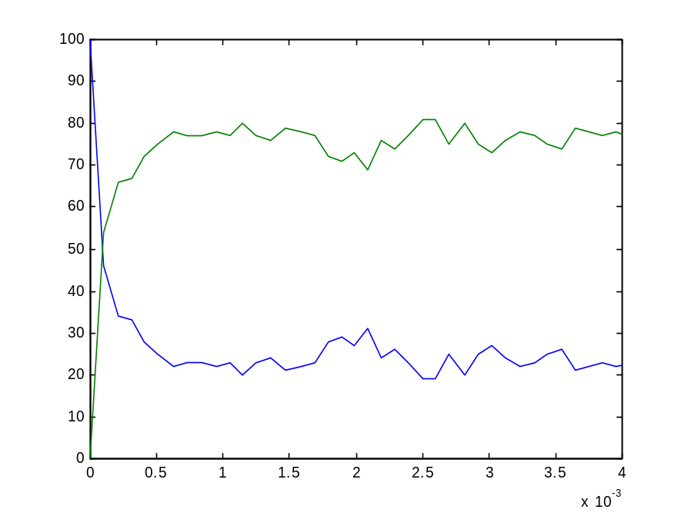
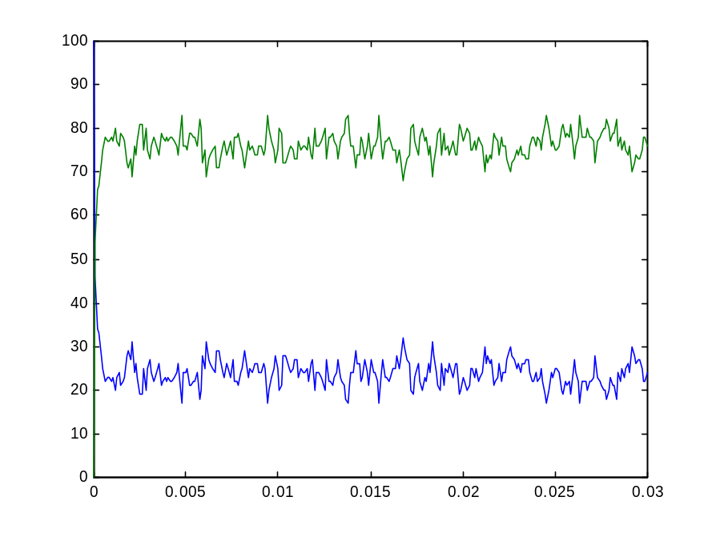
Na + Cl ↔ Na⁺ + Cl⁻
nacl_1.cp

Slide 49
Using BioPSI

Slide 50
BioPSI architecture
BioPSI:
(Stochastic) Pi-calculus
Logix:
Flat Concurrent Prolog
C emulator

Slide 51
Na + Cl ↔ Na⁺ + Cl⁻
N1 - number of Na processes
N2 - number of Cl processes
-language(psifcp).
global(e1(100),e2(10)).
System(N1,N2)::=
<< CREATE_Na(N1) | CREATE_Cl(N2) .
CREATE_Na(C)::=
{C =< 0} , true ; {C > 0} , {C--} | Na | self . CREATE_Cl(C)::=
{C =< 0} , true ; {C > 0} , {C--} | Cl | self >> . Na::= e1 ! [] , Na_plus .
Na_plus::= e2 ? [] , Na .
Cl::= e1 ? [] , Cl_minus .
Cl_minus::= e2 ! [] , Cl .
Multiple process spawning will be discussed later

Slide 52
Starting Logix: Compilation
wisdom:~/Course/Electron_1->116% logix
Weizmann Institute Logix 2.2 07/11/00 - 13:12:58
Copyright (C) 1991, Weizmann Institute of Science - Rehovot, ISRAEL
Welcome to SGI Logix !
12/04/01 - 19:02:46
@c(nacl_1)
<1> started
<1> source : /home/aviv/Course/Electron_1/nacl_1.cp - 20010412190219
<1> interpret : export([System / 2, Na / 0, Na_plus / 0, Cl / 0, Cl_minus / 0])
<1> file : /home/aviv/Course/Electron_1/nacl_1.bin - written
<1> terminated
@
c(<file name>)
Any change, including in rates, requires re-compilation

Slide 53
Starting Logix: Running
Welcome to SGI Logix !
12/04/01 - 19:13:59
@run(nacl_1#"System"(10,10),1)
<1> started
source : /home/aviv/Course/Electron_1/nacl_1.cp - 20010412190219
interpret : export([System / 2, Na / 0, Na_plus / 0, Cl / 0, Cl_minus / 0])
file : /home/aviv/Course/Electron_1/nacl_1.bin - written
done @ 1.000443 : seconds = 4
run(<path>#<goal>,<limit>)
GC = garbage collection

Slide 54
Starting Logix: Aborting
@run(nacl_1#"System"(2,2))
<1> started
@spr
<1> suspended
nacl_1 # .Na_plus.comm(global.e1(100)!, global.e2(10)!)
nacl_1 # .Na.comm(global.e1(100)!, global.e2(10)!)
nacl_1 # .Cl_minus.comm(global.e1(100)!, global.e2(10)!)
nacl_1 # .Cl.comm(global.e1(100)!, global.e2(10)!)
@a(1)
<1> aborted
@
run(<path>#<goal>)
abort abort(all) abort(N)
a a(all) a(N)
suspend (s) and resume (re) used similarly

Slide 55
Starting Logix: Recording
@record(nacl_1#"System"(10,10),nacl_out,1)
<1> started
done @ 1.000443 : seconds = 3
@
record(<path>#<goal>,<output file>,<limit>)

Slide 56
Starting Logix: Record file
Time
0.002118
-.Na
-.Cl
+.Na_plus
+.Cl_minus
0.003595
-.Na
-.Cl
+.Na_plus
+.Cl_minus
0.003888
-.Cl_minus
-.Na_plus
+.Cl
+.Na
Consumed processes
Spawned processes

Slide 57
Processing the Record file
wisdom:~/Course/Electron_1->131% psi2t nacl_out
wisdom:~/Course/Electron_1->132% more nacl_out.names
time Cl Cl_minus Na Na_plus
2 Cl
3 Cl_minus
4 Na
Na_plus
wisdom:~/Course/Electron_1->133% more nacl_out.table
9.1e-06 10 0 10 0
1.00044 4 6 4 6
2.00000 3 6 3 6
Coloumn identity and order (numbered)
in .table file
Number of processes (col) in each time point (row)
Psi2t can be used while the record file is being written
The default scale is 1

Slide 58
Processing the Record file: Scaling
wisdom:~/Course/Electron_1->138% psi2t nacl_out 0.01
wisdom:~/Course/Electron_1->139% more nacl_out.table
9.1e-06 10 0 10 0
0.01176 2 8 2 8
0.02259 2 8 2 8
0.03342 2 8 2 8
0.04665 3 7 3 7
0.05753 5 5 5 5
0.06827 3 7 3 7
0.07856 1 9 1 9
0.09131 3 7 3 7
0.10197 3 7 3 7
0.11228 2 8 2 8
0.12290 3 7 3 7
0.01 scale in processed record

Slide 59
Plotting Output
Na + Cl ↔ Na⁺ + Cl⁻
The tab-delimited .table file can be used by many applications (e.g. MatLab, Excel). In Matlab use the load and plot commands, e.g:
load nacl_out.table
plot(nacl_out(:,1),nacl_out(:,4), nacl_out(:,1),nacl_out(:,5))
nacl_1.cp

Slide 60
Recording Consecutive Runs
The random seed is reset only when exiting and re-entering the Logix system
Global channels may require resetting to avoid conflicts (prgcs command)
If a record was suspended (nothing left to do but time limit not reached) then the clock is not reset

Slide 61
Exercise #1: Using Logix
Write a BioPSI program for the reaction K + F → K⁺ + F⁻
Use the attached code (System process) to spawn K and F processes
Run the program, each time with different rates and initial quantities
Plot the results of each run. Remember to use scaling to obtain enough data points: when to scaling are suggested, use the refined one to plot the events up to steady state.
Submit: program code, record, .table and .names files, plots
p.s. : For comments use % at beginning of line
Run # | e1 | e2 | K | F | T_stop | Scale
1 | 1 | 0.01 | 50 | 50 | 100 | 1
2 | 0.1 | 0.1 | 100 | 100 | 10 | 0.1 and 0.001
3 | 10 | 1 | 20 | 20 | 0.5 | 0.001 and 0.00001
4 | 0.00001 | 0.0000001 | 100 | 100 | 20000 | 10 and 100

Slide 62
Some Useful Logix Commands
Ctrl+G | Quitting
Ctrl+C | Quitting (after record)
Ctrl+P | Previous Command
Ctrl+F | Forward
Ctrl+B | Back
See Appendix B for BioPSI unique commands
Use ph for BioPSI help

Slide 63
The pi-Calculus
Syntax and Semantics - II

Slide 64
Na + Cl ↔ Na⁺ + Cl⁻
Atoms and ions | Processes | Na, Na_plus Cl Cl_minus
Reaction capabilities (valence electrons) | Communication actions (alerts) | e1 ! [] e1 ? [] e2 ! [] e2 ? []
Reaction | Communication and state alteration | COMM
Reaction rate | Channel rate | Gillespie’s algorithm

Slide 65
Na + Cl ↔ Na⁺ + Cl⁻
-language(psifcp).
global(e1(100),e2(10)).
baserate(10).
System::= Na | Na | Cl | Cl .
Na::= e1 ! [] , Na_plus .
Na_plus::= e2 ? [] , Na .
Cl::= e1 ? [] , Cl_minus .
Cl_minus::= e2 ! [] , Cl .
nacl_1.cp

Slide 66
Na + Cl ↔ Na⁺ + Cl⁻
~ 70-80 Na+; 20-30 Na. Why?
nacl_1.cp

Slide 67
Na + Cl ↔ Na⁺ + Cl⁻
2nd order forward and reverse reactions, at equilibrium
-k1[Na][Cl] + k2[Na+][Cl-] = 0
10(100-[Na])² = 100[Na]²
[Na] = 100√10 / (10 + √ 10)
= 24.025...

Slide 68
Na + K + 2Cl ↔ Na⁺ + K⁺ + 2Cl⁻
One molecule (Cl) is able to interact with more than one partner (Na or K)
Each reaction has a different base rate
We will use
  A different communication channel per each partner (same as e1 and e2 for forward and reverse reactions before)

Slide 69
Na + K + 2Cl ↔ Na⁺ + K⁺ + 2Cl⁻
Several alternative reactions are offered (enabled) by the same atom at the same time, but only a single one can actually occur (Cl + Na → , Cl + K →)
We will use
  A mutual exclusive (stochastic) choice construct to choose between the different options (all offered simultaneously, but only one is selected).

Slide 70
K + Na + 2Cl ↔ K⁺ + 2Cl⁻ + Na⁺
-language(psifcp).
global(e1(100),e2(10),e3(30),e4(20)).
System::= Na | Cl | Cl | K
Na::= e1 ! [] , Na_plus .
Na_plus::= e2 ? [] , Na .
K::= e3 ! [] , K_plus .
K_plus::= e4 ? [] , K .
Cl::= e1 ? [] , Cl_minus ;
e3 ? [] , Cl_minus .
Cl_minus::= e2 ! [] , Cl ;
e4 ! [] , Cl .
knacl_2.cp

Slide 71
Guarded Homogenous* Choice
Na::= e1 ! [] , Na_plus .
Na_plus::= e2 ? [] , Na .
K::= e3 ! [] , K_plus .
K_plus::= e4 ? [] , K .
Cl::= e1 ? [] , Cl_minus ;
e3 ? [] , Cl_minus .
Cl_minus::= e2 ! [] , Cl ;
e4 ! [] , Cl .
,
;
<Communication action>
<Right hand side>
…
,
.
<Communication action>
<Right hand side>
*Homogenous: All input (output) guards
knacl_2.cp

Slide 72
Choice in Communication
Ready to send an alert on e1
Ready to send an alert on e3
Na | K | Cl
e1 ! [] , Na_plus | e3 ! [] , K_plus |
e1 ? [] , Cl_minus ; e3 ? [] , Cl_minus .
Ready to receive an alert on e1
Ready to receive an alert on e3
e1
COMM+PAR+STRUCT:
Alternatives discarded;
Probabilistic choice
e3
Na_plus | K |
Cl_minus
Na | K _plus |
Cl_minus
knacl_2.cp

Slide 73
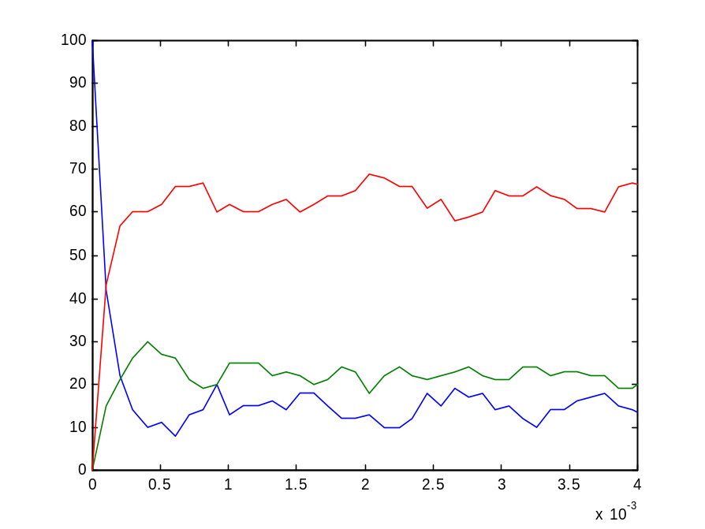
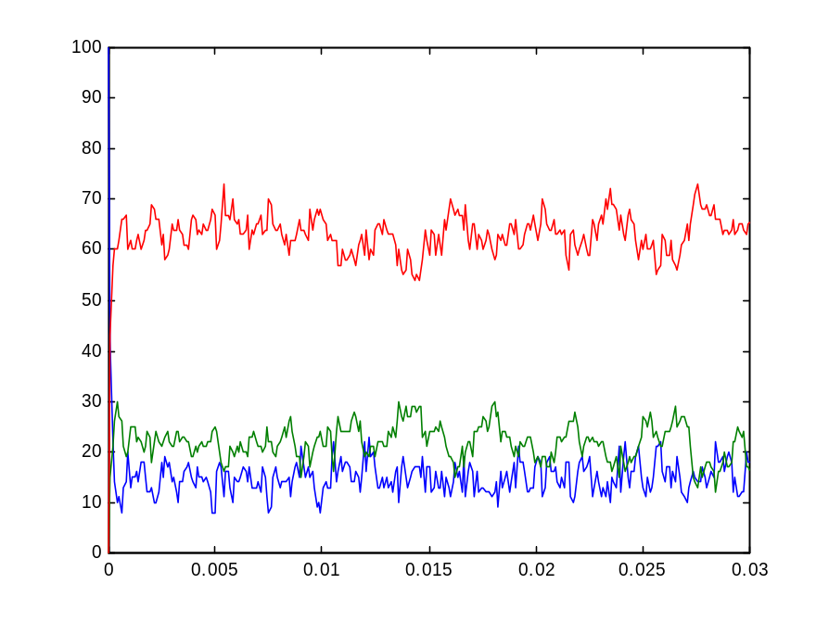
Na + K + 2Cl ↔ Na⁺ + K⁺ + 2Cl⁻
100,100,100
knacl_2.cp

Slide 74
Na + K + 2Cl ↔ Na⁺ + K⁺ + 2Cl⁻
Multiple reaction capabilities | Choice | e1 ! [] , … ; e2 ! [] , … .
Alternative reactions | Mutual exclusive, probabilistic choice; discarding of alternative communication | COMM (PAR and STRUCT)

Slide 75
Mg + 2Cl ↔ MgCl₂
Cl | : | Mg | : | Cl
One atom (Mg) sharing electrons with two other (Cl) atoms
Represent as two consecutive interactions
Intermediate state: Mg⁺
At Mg+ state can either
  Return to Mg state
  Proceed to Mg⁺² state

Slide 76
Mg + 2Cl ↔ MgCl₂
Intermediate states can be represented as
  Explicit processes
  Implicit local processes
  Implicit, sequential guards

Slide 77
Mg + 2Cl ↔ MgCl₂
The two alternatives in an intermediate state (lose or gain an electron) are represented as mixed choice between
  Output action (lose a second electron)
  Input action (gain back an electron)

Slide 78
Mg + 2Cl ↔ MgCl₂
-language(psifcp).
global(e1(10),e2(100),e3(50),e4(5)).
System::= Mg | Cl | Cl .
Mg::= e1 ! [] , Mg_plus .
Mg_plus::= e2 ! [] , Mg_plus2 ;
e3 ? [] , Mg .
Mg_plus2::= e4 ? [] , Mg_plus .
Cl::= e1 ? [] , Cl_minus ;
e2 ? [] , Cl_minus .
Cl_minus::= e3 ! [] , Cl ;
e4 ! [] , Cl .
mgcl2_3.cp

Slide 79
Mixed Choice
Mg::= e1 ! [] , Mg_plus .
Mg_plus::= e2 ! [] , Mg_plus2 ;
e3 ? [] , Mg .
Mg_plus2::= e4 ? [] , Mg_plus .
Cl::= e1 ? [] , Cl_minus ;
e2 ? [] , Cl_minus .
Cl_minus::= e3 ! [] , Cl ;
e4 ! [] , Cl .
,
;
<Communication action>
<Right hand side>
…
,
.
<Communication action>
<Right hand side>
mgcl2_3.cp

Slide 80
Intermediate States
Mg | Cl | Cl
e1 ! [] , Mg_plus |
e1 ? [] , Cl_minus ; e2 ? [] , Cl_minus |
e1 ? [] , Cl_minus ; e2 ? [] , Cl_minus
e3
e1
e2 ! [] , Mg_plus2 ; e3 ? [] , Mg |
e3 ! [] , Cl ; e4 ! [] , Cl |
e1 ? [] , Cl_minus ; e2 ? [] , Cl_minus .
Mg_plus | Cl_minus | Cl
e2
Mg_plus2 | Cl_minus | Cl_minus
mgcl2_3.cp

Slide 81
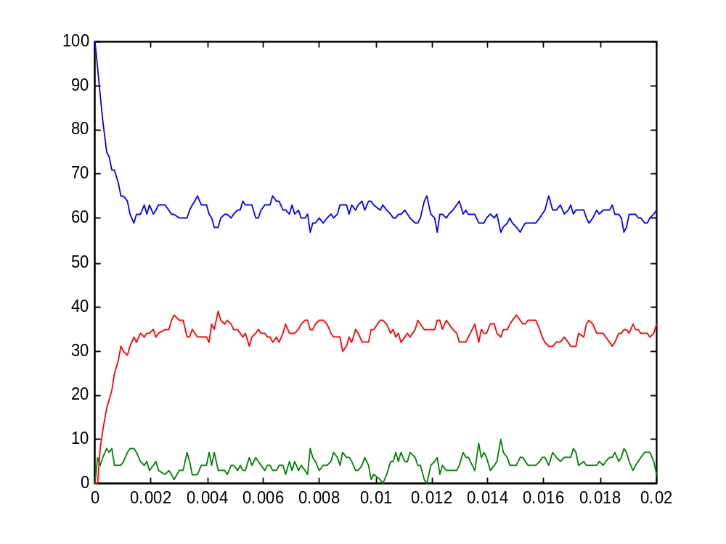
Mg + 2Cl ↔ MgCl₂
Mg
Mg⁺²
Mg⁺
100, 100
mgcl2_3.cp

Slide 82
Mg + 2Cl ↔ MgCl₂
-language(psifcp).
global(e1(10),e2(100),e3(50),e4(5)).
System::= Mg | Cl | Cl .
Mg::=
e1 ! [] , << e2 ! [] , Mg_plus2 ;
e3 ? [] , Mg >> .
Mg_plus2::=
e3 ? [] , << e2 ! [] , Mg_plus2 ;
e3 ? [] , Mg >> .
Cl::= e1 ? [] , e3 ! [] , Cl ;
e2 ? [] , e4 ! [] , Cl .
mgcl2_4.cp

Slide 83
Implicit representation of intermediate states: Local (sub) Processes
Mg::=
e1 ! [] , << e2 ! [] , Mg_plus2 ;
e3 ? [] , Mg >> .
Mg_plus2::=
e3 ? [] , << e2 ! [] , Mg_plus2 ;
e3 ? [] , Mg >> .
Cl::= e1 ? [] , e3 ! [] , Cl ;
e2 ? [] , e4 ! [] , Cl .
<< <right hand side> >>
New (process)
scope
mgcl2_4.cp

Slide 84
Implicit representation of states: Sequential Guards
Mg::=
e1 ! [] , << e2 ! [] , Mg_plus2 ;
e3 ? [] , Mg >> .
Mg_plus2::=
e3 ? [] , << e2 ! [] , Mg_plus2 ;
e3 ? [] , Mg >> .
Cl::= e1 ? [] , e3 ! [] , Cl ;
e2 ? [] , e4 ! [] , Cl .
,
,
,
;
<Communication>
…
<Communication>
<Right hand side>
…
,
,
,
.
<Communication>
…
<Communication>
<Right hand side>
mgcl2_4.cp

Slide 85
Mg + 2Cl ↔ MgCl₂
Alternative reverse capabilities (electron donor and acceptor) | Mixed Choice | e1 ? [] , … ; e2 ! [] , … .
Reaction intermediates | Explicit or implicit intermediate states (processes, local (sub)processes or sequential guards) | Mg_plus << >> e1 ? [ ] , e2 ? [ ] , …
Implicit representations are sometimes more difficult to trace
(more in Unit 2)

Slide 86
Exercise #2 – Question 1
Write pi-calculus programs for the following reactions
  Al + 3Cl ↔ AlCl₃ ((Al⁺³ + 3Cl⁻) ionic bond)
  H₂ + Cl₂ ↔ 2HCl (covalent bond)

Slide 87
Ionic and Covalent Bonds
In ionic bonds electrons are gained and lost. The attraction between positive and negative charge results in an ionic bond
 | Na | ·
 | ..
: | Cl | ·
 | ..
 | ..
: | Na⁺ | :
 | ..
 | ..
: | Cl⁻ | :
 | ..
+ →
A covalent bond is a sharing of a pair of electrons, so that both atoms have filled octets
→ |  |  |  |  | ←
H | · |  |  | · | Cl
H | : | Cl
..
 | :
..
..
 | :
..

Slide 88
H + Cl ↔ HCl
So far, in ionic bonds, the reverse reaction did not necessarily occur b/w the same two atoms that participated in the forward one.
In a covalent bond, a molecule is formed, and the two products are specifically bonded

Slide 89
H + Cl ↔ HCl
We will represent specific bonding and unbonding by using local, private channels
In the forward reaction, when a bond is formed, a private channels is established between the two atoms:
  A private channel is declared in one of the atoms
  The channel is sent as a message, to be received by the other atoms
This channel will be used for the reverse reaction
Later, we will see an alternative approach to this problem

Slide 90
H + Cl ↔ HCl
-language(psifcp).
global(e1(100)).
System::= H | H | Cl | Cl
H::= << electron(10) .
e1 ! {electron} , H_plus .
H_plus::= electron ? [] , H >> .
Cl::=
e1 ? {e} , e ! [] , Cl .
hcl_5.cp

Slide 91
Local Channel Declaration
H::= << electron(10) .
e1 ! {electron} , H_plus .
H_plus::= electron ? [] , H >> .
Cl::=
e1 ? {e} , e ! [] , Cl .
<Process>
::=
<< channel(rate) .
<right hand side> .
<local process definition> >>
Optional
.
Channel scope
hcl_5.cp

Slide 92
Channel tuples: Messages and channel declarations
H::= << electron(10) .
e1 ! {electron} , H_plus .
H_plus::= electron ? [] , H >> .
Cl::= e1 ? {e} , e ! [] , Cl .
e1 ? {channel₁ , … , channel_{n}} – input (receive) action
e1 ! {channel₁ , … , channel_{n}} – output (send) action
<< channel₁ , … , channel_{n} . <right hand side> . <local process> >>
hcl_5.cp

Slide 93
Channel tuples: Channel Typing (Sorts)
A channel’s sort (type): The kind of message that the channel sends and receives, e.g.
BioPSI typing is flat (not recursive). This is not generally true for pi-calculus.
A type mismatch will cause a run-time error.
a ! [] (a’s type is nil alert)
b ? {x1,x2,x3} (b’s type is a tuple of size 3)
a ! [] | a ? {y}

Slide 94
Channel tuples: Channel Typing (Sorts)
Channel types are determined at run time. Due to mobility static analysis is problematic.
It is the programmer’s responsibility to make sure that there are no type mismatches
a ? {b} , b ! {c}

Slide 95
Communication: Local channel mobility
H | Cl
<< electron(10) . e1 ! {electron} , H_plus >> |
e1 ? {e} , e ! [] , Cl
e1
electron
{electron/e}
electron ? [] , H | electron ! [] , Cl
The same (private, local) electron channel
hcl_5.cp

Slide 96
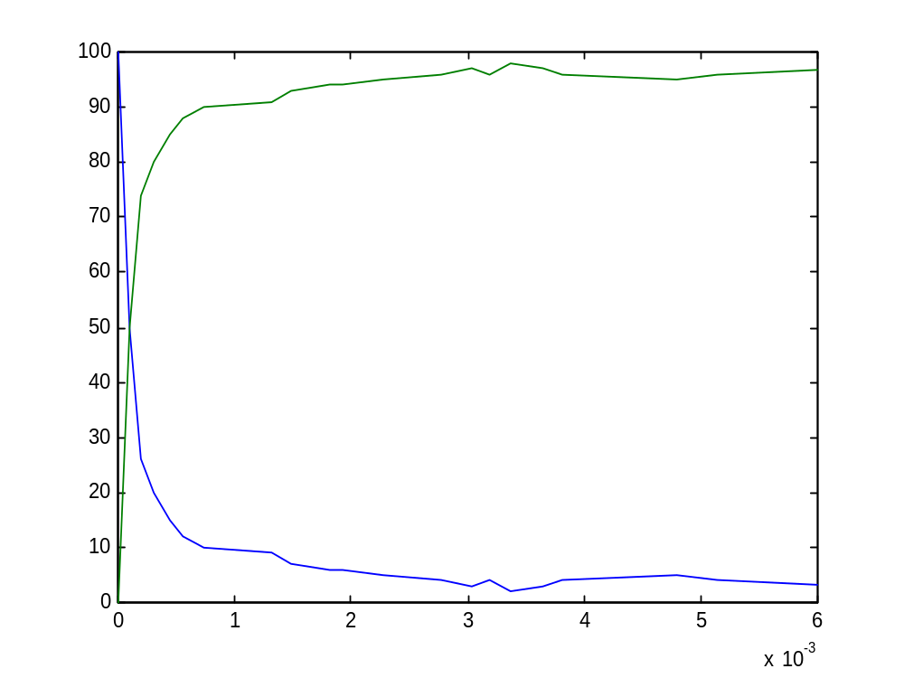
H + Cl ↔ HCl
H_plus
H
hcl_5.cp

Slide 97
H + Cl ↔ HCl
-language(psifcp).
global(e1(100)).
System::= H | H | Cl | Cl
H+electron(10)::=
e1 ! {electron} , H_plus(electron).
H_plus(e)::= e ? [] , H .
Cl::= e1 ? {electron} , Cl_minus(electron). Cl_minus(e)::= e ! [] , Cl .
hcl_6.cp

Slide 98
Local Channel Declaration - Alternative
H+electron(10)::=
e1 ! {electron} , H_plus(electron).
H_plus(e)::= e ? [] , H .
Cl::= e1 ? {e} , Cl_minus(e). Cl_minus(e)::= e ! [] , Cl .
.
<Process>+channel(rate)
::=
<right hand side>
.
<Process>+(ch₁(r₁),…, ch_{n}(r_{n}))
::=
<right hand side>
Channel(s) scope
hcl_6.cp

Slide 99
Channel tuples: Parameters
H+electron(10)::=
e1 ! {electron} , H_plus(electron).
H_plus(e)::= e ? [] , H .
Cl::= e1 ? {e} , Cl_minus(e).
Cl_minus(e)::= e ! [] , Cl .
<Process>(channel₁, … ,channel_{n}) – declaration or call
hcl_6.cp

Slide 100
Communication: Local channel mobility
H | Cl
e1 ! {electron} , H_plus(electron) |
e1 ? {e} , Cl_minus(e).
e1
electron
{electron/e}
electron ? [] , H | electron ! [] , Cl
The same (private, local) electron channel
hcl_6.cp

Slide 101
H + Cl ↔ HCl
Molecular identity | Local scopes for channels (and processes) | H::= << electron. … >> H+electron::= …
Creation of molecule | Communication and mobility of local channel names (scope extrusion) | e1 ? {e} , e ! [] , … e1 ? {e} , Cl_minus(e)
hcl_5.cp

Slide 102
Exercise #2 - Question 2 Transition States
High energy activated complexes of the reactants that must be formed if reaction is to lead to products.
Have only a transitory existence
Once formed, they must lead to products or lose excess energy and return to reactants
Activated
complex
A + B ↔ (AB)‡
(AB)‡ → C + D
A + B → C + D
Elementary bimolecular process

Slide 103
Exercise #2 - Question 2
Write a pi-calculus program representing this mechanism and its reverse (together)
A+B ↔ (AB)‡ → C+D
C+D ↔ (CD)‡ → A+B
A+B ↔ C+D
Assume:
  C is derived from A
  D is derived from B
  (CD)‡ and (AB)‡ should be defined implicitly
Hint: private channels for both reactions of an activated complex

Slide 104
H + H ↔ H₂
A symmetric interaction: the same type of atom serves both “roles”, in a symmetrical interaction between two instances of the same kind of atom process
We will represent this by mixed choice, using the same channel once for input and once for output
This works since choice is mutually exclusive
Rate calculation is modified for symmetric interaction

Slide 105
H + H ↔ H₂
-language(psifcp).
global(e(10),e1(10)).
System::= H | H .
H+electron(0.1)::=
e1 ! {electron} , H_BoundH(electron) ;
e1 ? {e2} , H_BoundH(e2) ;
e ! {electron} , H_Bound(electron) . H_BoundH(el)::= el ? [] , H ;
el ! [] , H.
H_Bound(el)::= el ? [] , H .
h2_7.cp

Slide 106
Mixed choice on the same channel: Symmetric Communication
H+electron(0.1)::=
e1 ! {electron} , H_BoundH(electron) ;
e1 ? {e2} , H_BoundH(e2) ;
e ! {electron} , H_Bound(electron) .
H_BoundH(el)::= el ? [] , H ;
el ! [] , H.
H_Bound(el)::= el ? [] , H .
Rate calculation for symmetric interactions:
<baserate>*<#sends>*<#receives-1>/2
c_{μ}=2k_{μ}
h2_7.cp

Slide 107
Symmetric Communication
H | H
H
e1 ! {electron} , H_BoundH(electron) ;
e1 ? {e2} , H_BoundH(e2) ;
e ! {electron} , H_Bound(electron) |
e1 ! {electron} , H_BoundH(electron) ;
e1 ? {e2} , H_BoundH(e2) ;
e ! {electron} , H_Bound(electron)
H
e1
{electron/e2}
H_BoundH(electron) | H_BoundH(electron)
h2_7.cp

Slide 108
Symmetric Communication
H_BoundH(electron) | H_BoundH(electron)
electron ? [] , H ;
electron ! [] , H |
electron ? [] , H ;
electron ! [] , H
electron
H | H
h2_7.cp

Slide 109
Channel Typing: Asymmetric and symmetric channels
Symmetric (“homodimerization”) and asymmetric (“bimolecular”) channels are distinguished by their rate calculation
The same channel (name) cannot be used for both types of communication
BioPSI identifies them at run time (due to mobility). An ambiguity would cause a run-time error.
It is the programmer’s responsibility to ensure correct use.
In fact, in the program we have just seen there is a problem with “electron” channel which may be used as both (after sent)

Slide 110
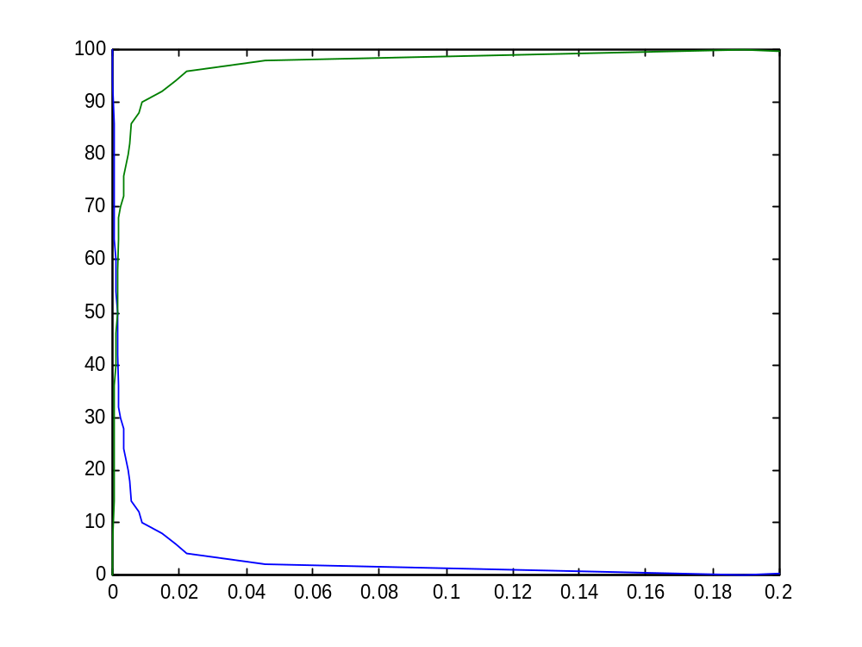
H + H ↔ H₂
H_BoundH
H
h2_7.cp

Slide 111
H + H ↔ H₂
Symmetric interaction | Mixed choice on the same channel (special rate calculation) | H_BoundH(el)::= el ? [ ] , H ; el ! [ ] , H.
h2_7.cp

Slide 112
Exercise #2 – Question 1
Write pi-calculus programs for the following reactions
  Al + 3Cl → AlCl₃ ((Al⁺³ + 3Cl⁻) ionic bond)
  H₂ + Cl₂ → 2HCl (covalent bond)
Hint: Each H₂ (Cl₂) molecule is initialized as two H_BoundH processes with the same private channel.

Slide 113
O + O ↔ O₂ ?
Symmetric interaction, sharing two electrons (double bond)
Naïve suggestion: Two consecutive symmetric interactions (analogous to the MgCl₂ case)

Slide 114
O + O ↔ O₂ ?
-language(psifcp).
global(e1(100),e2(100)).
System::= O | O | O | O | O . O+electron1(10)::=
e1 ! {electron1} , O_Bound1(electron1) ;
e1 ? {electron1} , O_Bound1(electron1) .
O_Bound1(el1)+electron2(0.1)::=
el1 ! [] , O ;
el1 ? [] , O ;
e2 ! {electron2} , O_Bound2(el1,electron2) ;
e2 ? {electron2} , O_Bound2(el1,electron2) .
O_Bound2(el1,el2)::=
el2 ! [] , O_Bound1(el1) ;
el2 ? [] , O_Bound1(el1) .
O2_8.cp

Slide 115
O + O ↔ O₂ ?
Binding first electron
O+electron1(10)::=
e1 ! {electron1} , O_Bound1(electron1) ;
e1 ? {electron1} , O_Bound1(electron1) .
O_Bound1(el1)+electron2(0.1)::=
el1 ! [] , O ;
el1 ? [] , O ;
e2 ! {electron2} , O_Bound2(el1,electron2) ;
e2 ? {electron2} , O_Bound2(el1,electron2).
O_Bound2(el1,el2)::=
el2 ! [] , O_Bound1(el1) ;
el2 ? [] , O_Bound1(el1) .
Binding second electron
O2_8.cp

Slide 116
O + O ↔ O₂ ?
An O process may share its two electrons with a single other O process (leading to O₂) or with two other O processes (leading to O_{n}). This is incorrect.
We will solve this by limiting O’s capability for symmetric interaction
O2_8.cp

Slide 117
Solution 1: Single channel for double bond
Symmetric interaction (double bond)
global(e(10),ee(2)).
O+electron(0.1)::=
ee ! {electron} ,O_Double_Bound(electron) ;
ee ? {electron} , O_Double_Bound(electron) ;
e ? {electron} , O_Bound1(electron) . O_Double_Bound(el)::=
el ! [] , O ;
el ? [] , O .
O_Bound1(el)::=
el ! [] , O ;
e ? {electron1}, O_Bound2(el,electron1) . O_Bound2(el,electron1)::=
electron1 ! [] , O_Bound1(el) ;
el ! [] , O_Bound1(electron1) .
Asymmetric interaction (two single bonds)
Creation of a double bond as an atomic interaction
o2_9.cp

Slide 118
Solution 2: Restricting the second electron
New tuple definition
global(e(10),e1(2)).
O+(electron(0.1),e2(infinite))::=
e1 ! {electron,e2} , O_Bound1_O(electron,e2);
e1 ? {electron,e2} , O_Bound1_O(electron,e2) ;
e ? {electron} , O_Bound1(electron) .
O_Bound1_O(el,e)::=
e ! [] , O_Double_Bound(el);
e ? [] , O_Double_Bound(el).
O_Double_Bound(el)::=
el ! [] , O ;
el ? [] , O .
Creation of a double bond as two interactions: The second is restricted and infinite in rate

Slide 119
Infinite channels
All actions on inifinite channels occur instantaneously:
  As soon as they are enabled
  Before the clock is advanced and a new (non-inifinte) action is selected
Are primarily used for encoding purposes

Slide 120
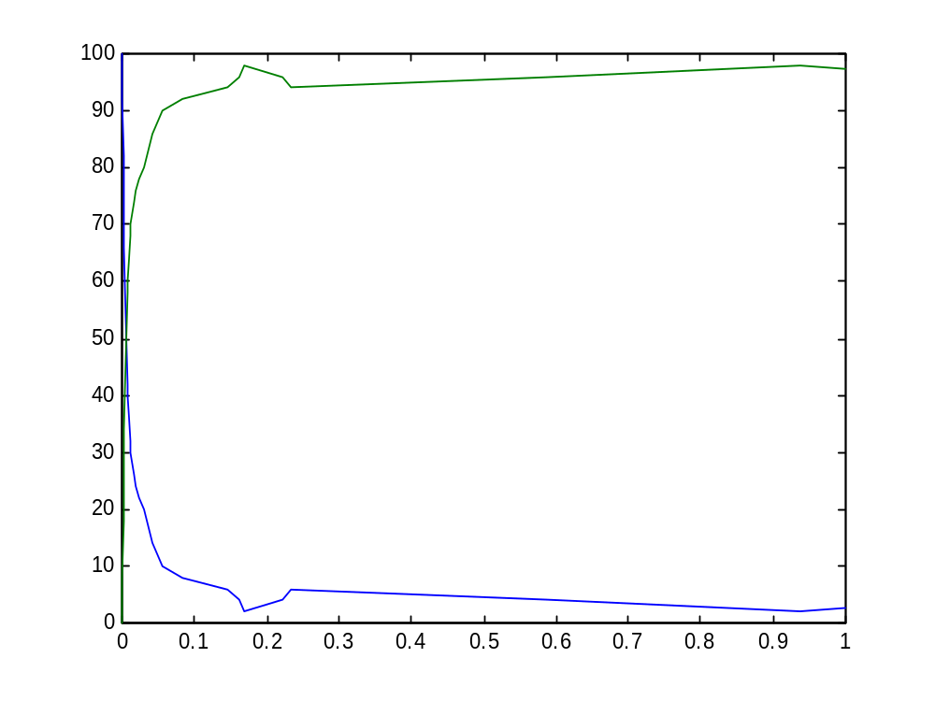
O + O ↔ O₂
O_Double_Bound
O
o2_9.cp

Slide 121
O + O ↔ O₂
Multiple bonds
Limiting symmetric interactions
Atomic interactions for multiple bonds
(ee channel)
Using a restricted channel for second bond, with infinite rate (O+e2(infinite))

Slide 122
Lattices, molecules and networks
Ionic compounds | Ionic | Lattice | Global channels
Molecular covalent compounds | Covalent | Discrete molecular units | Global and local channels
Network covalent compounds | Covalent | Network | Global and local channels (“On”*)
* A real network covalent compounds is e.g. SiO₂

Slide 123
H + O ↔ H₂O + O₂ + H₂
Building a complex system by “mix and match”
We already have all the components: single and double, symmetric and asymmetic bonds for H and O

Slide 124
H + O ↔ H₂O + O₂ + H₂
-language(psifcp).
global(e(10),ee(2)).
System::= h2_7#System | o2_9#System .

Slide 125
External Calls: Multi Module Programs
-language(psifcp).
global(e(10),ee(2)).
System::= h2_7#System | o2_9#System .
<module name> # <process name>
Global channels are shared across modules:
There mustn’t be a rate conflict between modules.

Slide 126
External Calls: Export
-language(psifcp).
global(e1(100),e2(10)).
export(System).
System::= Na | Na | Cl | Cl .
Na::= e1 ! [] , Na_plus .
Na_plus::= e2 ? [] , Na .
Cl::= e1 ? [] , Cl_minus .
Cl_minus::= e2 ! [] , Cl .
Only the System process can be called externally
@c(nacl_1)
<1> started
<1> source : /home/aviv/Course/Electron_1/nacl_1.cp – 20010413140021
<1> interpret : export([System / 2])
<1> file : /home/aviv/Course/Electron_1/nacl_1.bin – written
<1> terminated

Slide 127
Inclusion of external files: Rate parameter files
-language(psifcp).
-include(rates).
global(e(R1),ee(R2)).
System::= h2_7#System | o2_9#System .
H2o*_10.cp
R1 => 10.
R2 => 2.
rates.cp

Slide 128
Multiple Process Calls: Arithmetics and Logix Commands
System(N1)::=
<< CREATE_H(N1).
CREATE_H(C)::=
{C =< 0} , true ;
{C > 0} , {C--} | H | self >> .
Logix variables
(as parameters)
Logix ask guards
iteration
The empty process
(also 0)
Logix goal
h2_7*.cp

Slide 129
Logix Variables
A new argument which is a logix variable is initially uninstantiated
A Logix variable may have a value which is an arbitrary Logix term.
Such values may be tested by a Logix ask guard or manipulated by a Logix goal or by a Logix tell guard

Slide 130
Self Iteration
self is a reserved word in context (it may be used as a channel name as well*)
self may be used to iterate any process, including anonymous (local) processes (e.g. sequential guards, inner scopes)
It always iterates to the innermost predicate, starting with the last guard preceding the period. Use with care.
Not recommended ☺

Slide 131
Self Iteration - Examples
A::= x ? [] , self ;
y ? [] , self .
Iterate to A
Iterates to
z ? [] , self
A::= x ? [] , z ? [] , self ;
y ? [] , w ? [] , self .
Iterates to
w ? [] , self

Slide 132
H + O ↔ H₂O + O₂ + H₂
-language(psifcp).
global(e(10),ee(2)).
System(N1,N2)::=
h2_7#System(N1) | o2_9#System(N2).
h2o_10.cp

Slide 133
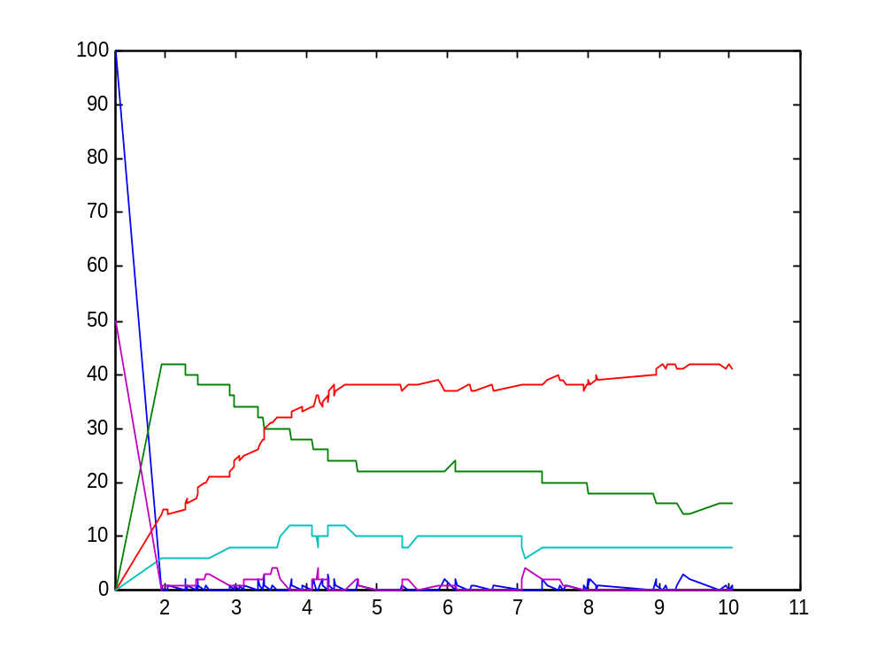
H + O ↔ H₂O + O₂ + H₂
H
O
O_Bound2
(H₂O)
H_Bound_H
(H₂)
O_Double_Bound
(O₂)
h2o_10.cp

Slide 134
Limitations
Interactions explained by more than pair-wise sharing of electrons, e.g.
  Resonance structures (benzen, ozone)
  Lattice energies of ionic compounds (MgCl₂, NaCl)
Limitations on global interactions, e.g.
  Network covalent bonds
Higher order entities., e.g.
  Radicals

Slide 135
Exercise #2 - Question 1 + 2
In each case:
  Represent each atom (and its related chemical species) as a separate .cp program. For example, for H2 you have free H atom, H bound to H, and H bound to Cl, all in a single file h.cp
  Use a “Logix loop” to spawn of multiple processes
  Write a system program to initialize the system, based on parameters (see attached table for process quantities)
  Use a common rates file for all the rate parameters

Slide 136
Exercise #2 – Question 1
Write pi-calculus programs for the following reactions
  Al + 3Cl ↔ AlCl₃ ((Al⁺³ + 3Cl⁻) ionic bond)
  H₂ + Cl₂ ↔ 2HCl (covalent bond)

Slide 137
Exercise #2 - Question 2
Write a pi-calculus program representing this mechanism and its reverse (together)
A+B ↔ (AB)‡ → C+D
C+D ↔ (CD)‡ → A+B
A+B ↔ C+D
Assume:
  C is derived from A
  D is derived from B
  (CD)‡ and (AB)‡ should be defined implicitly
Hint: private channels for both reactions of an activated complex

Slide 138
Exercise #2 - Question 1+2
Reaction | Initial Quantities | Rates (forw,rev) | Time limit (scale)
Al + 3Cl ↔ AlCl₃ (Al⁺³ + 3Cl⁻) | Al=50 Cl =150 | Al ↔ Al⁺¹ (10,50) Al⁺¹ ↔ Al⁺² (100,50) Al⁺² ↔ Al⁺³ (200,10) | 0.05 (0.001)
H₂ + Cl₂ ↔ 2HCl | H₂ = Cl₂ = 100 HCL, H, Cl = 0 | 2H ↔ H₂ (20,0.5) 2Cl ↔ Cl₂ (20,0.5) H + Cl ↔ HCl (100,0.5) | 30 (0.1)
A+B ↔ C+D (with activated complexes) | A = B = 100 C = D = 0 | A+B ↔ (AB)‡ (100,20) (AB)‡ → C+D (100) C+D ↔ (CD)‡ (10,100) (CD)‡ → A+B (10) | 0.5 (0.01)

Slide 139
Exercise #2 - Questions 1+2
In each case:
  Submit code, .table and .names files, and plot change of reactants and products
  Represent each atom (and its related chemical species) as a separate .cp programs. For example, for H2 you have free H atom, H bound to H, and H bound to Cl
  Use a “Logix loop” to spawn of multiple processes
  Write a system program to initialize the system, based on parameters (see attached table for process quantities)
  Use a common rates file for all the rate parameters

Slide 140
Exercise #2 – Question 3 (bonus*)
In an ozone (O₃) molecule, a resonance structure exists, where three O atoms are sharing 3 electron pairs (see picture): 2 electron pairs are shared in “the usual way”. The third pair is shared by all three atoms.
Try to write a pi-calculus program to describe this molecule.
Even an unsuccessful (but interesting) attempt can gain points.
O
O
O

Slide 141
Supplementary Material
Milner, R. (1999) Communicating and Mobile Systems: The pi-Calculus. Cambridge University Press.
Mahan and Myers (1987) University Chemistry. 4th Edition. Addison-Wesley. Chapters 2, 6, 9
Chang R. (1991) Chemistry. McGraw-Hill. Chapters 3.1, 9, 13
Silverman W. (2001) BioPSI Appendices.
Gillespie D.T. (1976) A general method for numerically simulating the stochastic time evolution of coupled chemical reactions. Journal of Computational Physics 22: 403-434.
Gillespie D. T. (1977) Exact stochastic simulation of coupled chemical reactions. Journal of Physical Chemistry 81: 2340-2361.

