Slide 1
Unit 4: Enzymatic Reactions

Slide 2
Catalysis
A catalyst is a substance that increases the rate of a chemical reaction without itself being consumed
The catalyst may react to form an intermediate but it is regenerated in a subsequent step of the reaction

Slide 3
Catalysis
A catalyst speeds up a reaction by providing a set of elementary steps with more favorable kinetics than those that exist in its absence
The rate constant largely depends on the activation energy of a reaction (the minimum amount of energy required to initiate reaction)

Slide 4
Catalysis
In many cases, a catalyst increases the reaction rate by lowering the activation energy: In lowers it both for the forward and the reverse reaction
A+B → C+D
A+B → C+D
k
k_{c}
E_{a}
A+B
Potential energy
E’_{a}
Potential energy
A+B
C+D
C+D
- catalyst
+ catalyst
Reaction progress
Reaction progress

Slide 5
Enzyme Catalysis
Enzymes are biological catalysts
They are typically large protein molecules
They differ from chemical catalysts in four important aspects

Slide 6
Enzyme Catalysis
Higher reaction rates: enzymes increase the rates of biochemical reactions by 10⁶-10¹²
Milder reaction conditions: Enzymatically catalyzed reactions occur at mild temperature, pressure, and nearly neutral pH.
Greater reaction specificity: Enzymes are typically highly specific, acting only on certain reactant molecules, called substrates, and rarely have side products
Capacity for regulation: The catalytic activities of many enzymes are affected by substances other than their substrates, by various mechanisms.

Slide 7
Enzyme Nomenclature
Alcohol dehydrogenase
Substrate
Catalytic action
-ase suffix
This is an alternative name (for “common use”). In addition, an enzyme has a systematic name (unambigous) and a classification number
(e.g. EC 3.4.17.1 for carboxypeptidase A, whose systematic name is peptidyl-L amino acid hydrolase)

Slide 8
Substrate Specificity
A variety of non-covalent bonds are involved in the binding of substrates to enzymes
The “Lock-and-Key Model:
A complementarity exists between enzymes and their substrates
We will represent this by channel name complementarity

Slide 9
Substrate Specificity
Geometric complementarity: A substrate-binding site on the enzyme consists of an indentation or cleft that is complementary in shape to the substrate
Electronic complementarity: The amino acids at the binding site are arranged to interact specifically with the substrate in an “attractive” manner
Induced-fit: The substrate-binding sites of most enzymes are largely preformed but undergo some conformational change on substrate binding

Slide 10
Enzyme Kinetics: Single Substrate Reactions
E + S → P + E
E + S ↔ ES → P + E
k₁
k₂
K₋₁
E – Enzyme
S – Substrate
ES – Enzyme-substrate complex
P – Product(s)
→ Could also be reversible reaction

Slide 11
Single Substrate (reversible) reaction: Private Channels
-language(psifcp).
global(e_s_bind(20),e_p_bind(10)).
System(N1,N2)::= << CREATE_ENZYME(N1) |
CREATE_SUBSTRATE(N2) .
CREATE_ENZYME(C)::= {C =< 0} , true ;
{C > 0} , {C--} | Enzyme | self .
CREATE_SUBSTRATE(C)::= {C =< 0} , true ;
{C > 0} , {C--} | Substrate | self
>> .
From now on CREATE calls will usually be omitted from slides
single_template_private_rev.cp

Slide 12
Single Substrate (reversible) reaction: Private Channels
Enzyme+(es_unbind(0.8),es_react(0.1))::=
<< e_s_bind ! {es_unbind,es_react} , ES ;
e_p_bind ! {es_unbind,es_react} , ES .
ES::= es_unbind ? [] , Enzyme ;
es_react ? [] , Enzyme
>> .
Substrate::= e_s_bind ? {unbind,react} , Bound_S(unbind,react).
Product::= e_p_bind ? {unbind,react} , Bound_S(unbind,react).
Bound_S(unbind,react)::= unbind ! [] , Substrate ;
react ! [] , Product .
single_template_private_rev.cp

Slide 13
Single Substrate (reversible) reaction: Private Channels
Enzyme+(es_unbind(0.8),es_react(0.1)) | Substrate
e_s_bind ! {es_unbind,es_react} , ES ; … |
e_s_bind ? {unbind,react} , Bound_S(unbind,react)
es_unbind
e_s_bind
ES | Bound_S(es_unbind,es_react)
es_unbind ? [] , Enzyme ; es_react ? [] , Enzyme |
es_unbind ! [] , Substrate ; es_react ! [] , Product
es_react
Enzyme | Product
single_template_private_rev.cp

Slide 14
Single Substrate (reversible) reaction: Private Channels
Enzyme | Product
e_p_bind ! {es_unbind,es_react} , ES ; … |
e_p_bind ? {unbind,react} , Bound_S(unbind,react)
es_react
e_s_bind
ES | Bound_S(es_unbind,es_react)
es_unbind ? [] , Enzyme ; es_react ? [] , Enzyme |
es_unbind ! [] , Substrate ; es_react ! [] , Product
es_unbind
Enzyme | Substrate

Slide 15
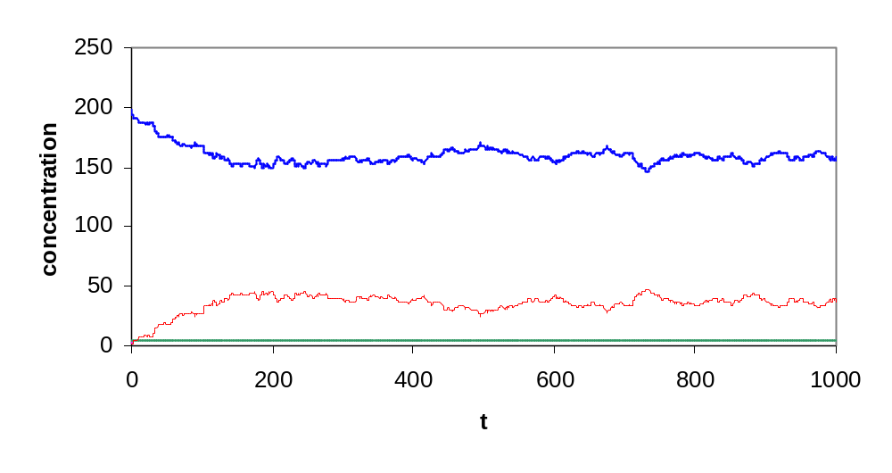
Single Substrate (reversible) reaction: Private Channels
S
P
ES
5 E, 200 S
single_template_private_rev.cp

Slide 16
Single Substrate (reversible) reaction: Timers (modular)
-language(psifcp).
global(e_s_bind(20),es_unbind(0.8),es_react(0.1),e_p_bind(10)).
System(N1,N2)::= << CREATE_ENZYME(N1) |
CREATE_SUBSTRATE(N2) |
timer#Timer(es_unbind) |
timer#Timer(es_react) .
…
>> .
single_template_timer_rev.cp

Slide 17
Single Substrate (reversible) reaction: Timers (modular)
Enzyme::= e_s_bind ! [] , ES ;
e_p_bind ! [] , ES .
ES::= es_unbind ? [] , Enzyme | Substrate ;
es_react ? [] , Enzyme | Product .
Substrate::= e_s_bind ? [] , true .
Product::= e_p_bind ? [] , true .
single_template_timer_rev.cp

Slide 18
Single Substrate (reversible) reaction: Timers (modular)
-language(psifcp).
Timer(channel)::= channel ! [] , Timer .
A “General purpose” (parametric) timer process
timer.cp

Slide 19
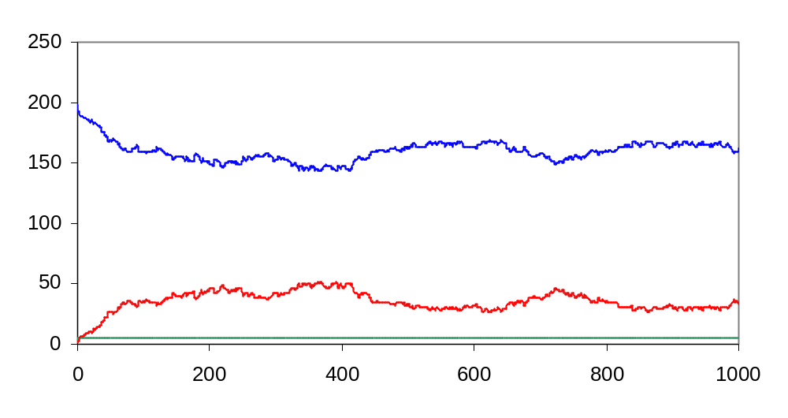
Single Substrate (reversible) reaction: Timers (modular)
S
P
ES

Slide 20
Single Substrate (irreversible)
-language(psifcp).
global(e_s_bind(20), dummy(1)).
Enzyme+(es_unbind(0.8),es_react(0.1))::=
<< e_s_bind ! {es_unbind,es_react} , ES .
ES::= es_unbind ? [] , Enzyme ;
es_react ? [] , Enzyme
>> .
Substrate::=
e_s_bind ? {unbind,react} , Bound_S(unbind,react).
Product::= dummy ? [] , true .
Bound_S(unbind,react)::= unbind ! [] , Substrate ;
react ! [] , Product .

Slide 21
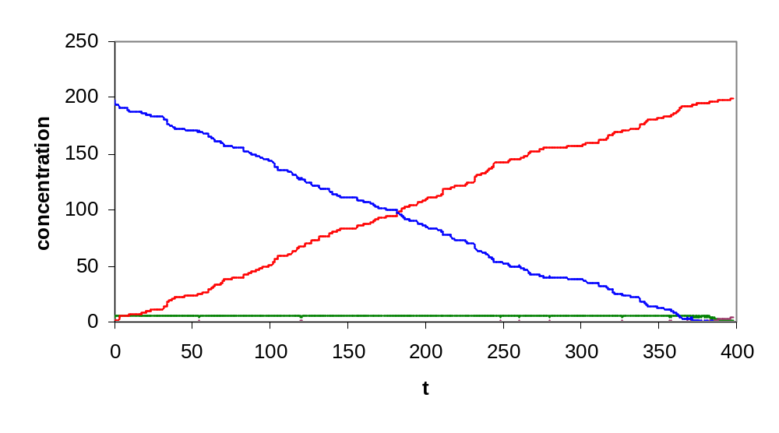
Single Substrate (irreversible) reaction
P
S
ES
E

Slide 22
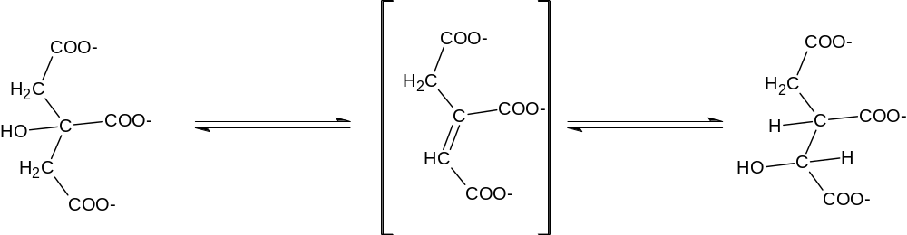
Citrate Isocitrate
Aconitase
H₂O
H₂O
H₂O
H₂O

Slide 23
Exercise 6 – Question 1
Write two programs for the aconitase reversible single substrate reaction (ignore the water molecules)
  Using private channels
  Using timers
Run each program with the following parameters (below), and provide the usual output (you may prepare .names, .table, plots etc only for the first program).
What can you conclude by comparing the E, S, and ES quantities in the different runs?

Slide 24
Exercise 6 – Question 1
Run # | E | S | t (scale)
1 | 100 | 100 | 50 (1)
2 | 10 | 1000 | 200 (1)
3 | 1 | 100 | 200 (1)
In all runs:
k₁ = 30 ; k₋₁ = 10 ; k₂ = 1 ; k₋₂ = 0.5 ; [P]=0

Slide 25
Co-factors
Apoenzyme
(inactive)
+
Co-factor
Holoenzyme
(active)
In some reactions, enzymes are associated with small molecule co-factors, which act as the enzyme’s “chemical teeth”.
There are two types of co-factors
  Metal ions (e.g. Cu⁺², Fe⁺³)
  Organic molecules = co-enzymes (e.g. NAD+)

Slide 26
Co-enzymes
Co-enzymes are also distinguished by their type of association
  Co-substrates are only transiently associated with a given enzyme molecule (e.g. NAD⁺)
  Prosthetic groups are permanently associated with the protein, often by covalent bonds (e.g. heme group of cytochrome c)

Slide 27
Co-enzymes
Co-enzymes are chemically changed by the enzymatic reaction in which they participate
In order to complete the catalytic cycle, the coenzyme must be regenerated to its original state
For prosthetic groups regeneration occurs in a separate phase of the enzymatic reaction sequence
For co-substrates the regeneration reaction may be catalyzed by a different enzyme

Slide 28
Enzyme Kinetics:
Bi-substrate Reactions
A + B P + Q
E
Sequential reactions
  Ordered
  Random
Ping-pong reactions

Slide 29
Sequential Reactions
Reactions in which all substrates must combine with the enzyme before a reaction can occur and products released
Ordered mechanism: Compulsory order of substrate addition to the enzyme
Random order: No preference to the order of substrate addition

Slide 30
Sequential Reactions: Ordered
Leading
substrate
Following
substrate
A
B
P
Q
E
EA
EAB-EPQ
EQ
E

Slide 31
Bi-Substrate ordered (irreversible): Private Channels
-language(psifcp).
global(e_s1_bind(20), es1_s2_bind(20), dummy(1)).
System(N1,N2,N3)::=
<< CREATE_E(N1) | CREATE_S1(N2) | CREATE_S2(N3) .
CREATE_E(C)::= {C =< 0} , true ;
{C > 0} , {C--} | E | self .
CREATE_S1(C)::= {C =< 0} , true ;
{C > 0} , {C--} | S(e_s1_bind) | self .
CREATE_S2(C)::= {C =< 0} , true ;
{C > 0} , {C--} | S(es1_s2_bind) | self.
>> .
seqpriv.cp

Slide 32
Bi-Substrate ordered (irreversible): Private Channels
E+(es1_unbind(0.8), s1s2_react(0.1))::= <<
e_s1_bind ! {es1_unbind, s1s2_react} , E_bound_S1 . E_bound_S1+(es1_s2_unbind(0.8), ep2_unbind(1))::=
<< es1_unbind ? [] , E ;
es1_s2_bind ! {es1_s2_unbind, ep2_unbind} , E_bound_S1_S2.
E_bound_S1_S2::=
es1_s2_unbind ? [] , E_bound_S1 ;
s1s2_react ? [] , E_Bound_P2 .
E_Bound_P2::= ep2_unbind ? [] , E >> >> .
S(bind)::= bind ? {unbind,react} , Bound_S(unbind,react).
Bound_S(bind,unbind,react)::= unbind ! [] , S(bind);
react ! [] , P .
Product::= dummy ? [] , true .
seqpriv.cp

Slide 33
Bi-Substrate ordered (irreversible): Private Channels
E+(es1_unbind, s1s2_react) | S(e_s1_bind) | S(es1_s2_bind)
e_s1_bind ! {es1_unbind, s1s2_react} , E_bound_S1 |
e_s1_bind ? {unbind,react} , Bound_S(e_s1_bind, unbind,react)
es1_s2_bind ? {unbind,react} , Bound_S(es1_s2_bind, unbind,react)
e_s1_bind
(global)
es1_unbind
(local)
E_bound_S1+(es1_s2_unbind, ep2_unbind) |
Bound_S(e_s1_bind, es1_unbind, s1s2_react) |
es1_s2_bind ? {unbind,react} , Bound_S(es1_s2_bind, unbind,react)
es1_unbind ? [] , E ;
es1_s2_bind ! {es1_s2_unbind, ep2_unbind) , E_bound_S1_S2 |
es1_unbind ! [] , S(e_s1_bind); s1s2_react ! [] , P |
es1_s2_bind ? {unbind,react} , Bound_S(es1_s2_bind,unbind,react)
es1_s2_bind
(global)
seqpriv.cp

Slide 34
Bi-Substrate ordered (irreversible): Private Channels
E_bound_S1_S2 |
es1_unbind ! [] , S(e_s1_bind); s1s2_react ! [] , P |
Bound_S(es1_s2_bind, es1_s2_unbind, ep2_unbind)
es1_s2_unbind
(private)
es1_s2_unbind ? [] , E_bound_S1 ; s1s2_react ? [] , E_Bound_P2 |
es1_unbind ! [] , S(e_s1_bind); s1s2_react ! [] , P |
es1_s2_unbind ! [] , S(es1_s2_bind); ep2_unbind ! [] , P
s1s2_react
(private)
ep2_unbind ? [] , E | P |
es1_s2_unbind ! [] , S(es1_s2_bind); ep2_unbind ! [] , P
ep2_unbind
(private)
E | P | P
seqpriv.cp
We did not distinguish between the two products, and have a problem to trace the product. This is not a general problem of the “private channel” approach – just a result of the parametric definition of substrates

Slide 35
Bi-Substrate ordered (irreversible): Modular
-language(psifcp).
global(e_s1_bind(20), es1_s2_bind(20), es1_unbind(0.8), s1s2_react(0.1), es1_s2_unbind(0.8), ep2_unbind(1), dummy(1)).
System(N1,N2,N3)::=
<< CREATE_E(N1) | CREATE_S1(N2) | CREATE_S2(N3) |
Timer(es1_unbind) | Timer(es1_s2_unbind) |
Timer(s1s2_react) | Timer(ep2_unbind) .
CREATE_E(C)::= {C =< 0} , true ;
{C > 0} , {C--} | E | self .
CREATE_S1(C)::= {C =< 0} , true ;
{C > 0} , {C--} | S1 | self .
CREATE_S2(C)::= {C =< 0} , true ;
{C > 0} , {C--} | S2 | self >> .
seqtimer.cp

Slide 36
Bi-Substrate ordered (irreversible): Modular
E::= e_s1_bind ! [] , E_bound_S1 .
E_bound_S1::= es1_unbind ? [] , E | S1 ;
es1_s2_bind ! , E_bound_S1_S2 .
E_bound_S1_S2::=
es1_s2_unbind ? [] , E_bound_S1 | S2 ;
s1s2_react ? [] , E_Bound_P2 | P1 .
E_Bound_P2::= ep2_unbind ? [] , E | P2 .
S1::= e_s1_bind ? [] , true .
S2::= es1_s2_bind ? [] , true .
P1::= dummy ? [] , true .
P2::= dummy ? [] , true .
seqtimer.cp

Slide 37
Bi-Substrate ordered (irreversible): Modular
E | S1 | S2 |
Timer(e_s1_unbind) | Timer(es1_s2_unbind) |
Timer(s1s2_react) | Timer(ep2_unbind)
e_s1_bind ! [] , E_bound_S1 |
e_s1_bind ? [] , true |
es1_s2_bind ? [] , true | …
es1_unbind
(global)
e_s1_bind
(global)
E_bound_S1 | es1_s2_bind ? [] , true | Timer(e_s1_unbind) | …
es1_unbind ? [] , E | S(e_s1_bind) ;
es1_s2_bind ! , E_bound_S1_S2 |
es1_s2_bind ? [] , true | es1_unbind ! [] , Timer(es1_unbind) | …
es1_s2_bind
(global)
seqtimer.cp

Slide 38
Bi-Substrate ordered (irreversible): Modular
E_bound_S1_S2 | Timer(es1_s2_unbind) | Timer(s1s2_react) | …
es1_s2_unbind
(global)
es1_s2_unbind ? [] , (E_bound_S1 | S1) ;
s1s2_react ? [] , (E_Bound_P2 | P1) |
es1_s2_unbind ! [], Timer(es1_s2_unbind) | s1s2_react ! [] , Timer(s1s2_react) | …
s1s2_react
(global)
E_Bound_P2 | P1 | Timer(ep2_unbind) | …
ep2_unbind
(global)
E | P1 | P2 | …
seqtimer.cp

Slide 39
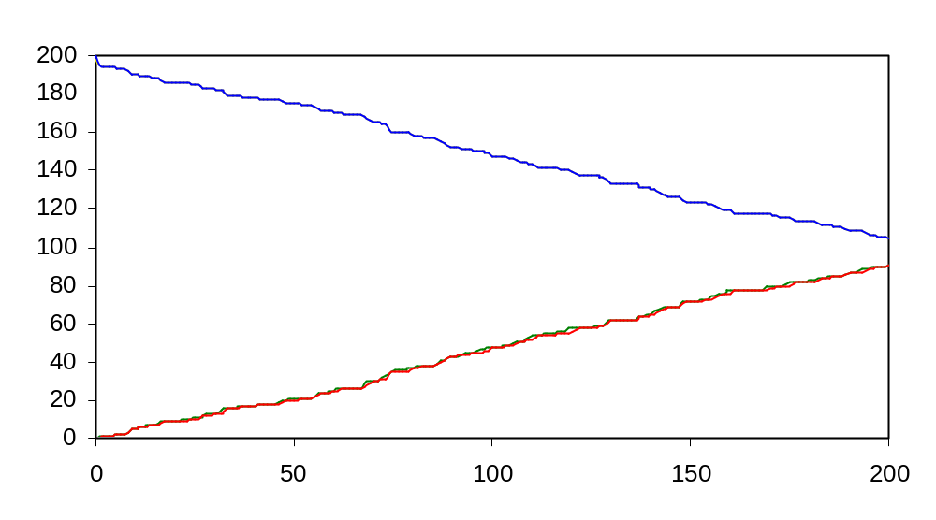
Bi-Substrate ordered (irreversible): Modular
S1, S2
P1, P2
seqtimer.cp

Slide 40
Biochemical Example (reversible):
Lactate dehydrogenase
Enzyme = Lactate dehydrogenase (LDH)
S1 (leading) = Pyruvate
S2 (following) = NADH
(1) LDH + Pyruvate ↔ LDH:Pyruvate (E+S1 ↔ ES1)
(2) LDH:Pyruvate + NADH ↔ LDH:Lactate:NAD+ (ES1+S2 ↔EP1P2)
(3) LDH:Lactate:NAD+ ↔ LDH:Lactate + NAD+ (EP1P2 ↔ EP1 + P2)
(4) LDH:Lactate ↔ Lactate (EP1 ↔ E + P1)

Slide 41
Exercise 6: Question 2
Write a program for the LDH reversible reaction, using a modular approach.
Use the following parameters
Quantities | Rates (f – forward; r-reverse) | t (scale)
[LDH] = 10 [pyruvate] = 100 [NADH] = 100 | (1f) 20 (1r) 0.8 (2f) 30 (2r) 1 (3f) 1 (3r) 20 (4f) 1 (4r) 20 | 1000 (1)

Slide 42
Sequential Reactions: Random
A
B
P
Q
EA
EQ
E
EAB-EPQ
E
EB
EP
B
A
Q
P

Slide 43
Sequential random: Modular
-language(psifcp).
global(e_s1_bind(20), e_s2_bind(20), es1_unbind(0.8), es2_unbind(0.8), s1s2_react(0.1), ep1_unbind(1), ep2_unbind(1), dummy(1)).
System(N1,N2,N3)::=
<< CREATE_E(N1) | CREATE_S1(N2) | CREATE_S2(N3) |
Timer(es1_unbind) | Timer(es2_unbind) |
Timer(s1s2_react) | Timer(ep1_unbind) |
Timer(ep2_unbind) .
… >> .
random.cp

Slide 44
Sequential random: Modular
E::= e_s1_bind ! [] , E_bound_S1 ;
e_s2_bind ! [] , E_bound_S2 .
E_Bound_S1::= es1_unbind ? [] , E | S1 ;
e_s2_bind ! [] , E_bound_S1_S2 .
E_Bound_S2::= es2_unbind ? [] , E | S2 ;
e_s1_bind ! [] , E_bound_S1_S2 .
E_bound_S1_S2::= es2_unbind ? [] , E_Bound_S1 | S2;
es1_unbind ? [] , E_Bound_S2 | S1;
s1s2_react ? [] , E_Bound_P1_P2 .
E_Bound_P1_P2::= ep1_unbind ? [] , E_P2 | P1 ;
ep2_unbind ? [] , E_P1 | P2 .
E_P2::= ep2_unbind ? [] , E | P2 .
E_P1::= ep1_unbind ? [] , E | P1 .
S1::= e_s1_bind ? [] , true .
S2::= e_s2_bind ? [] , true .
P1::= dummy ? [] , true .
P2::= dummy ? [] , true .
random.cp

Slide 45
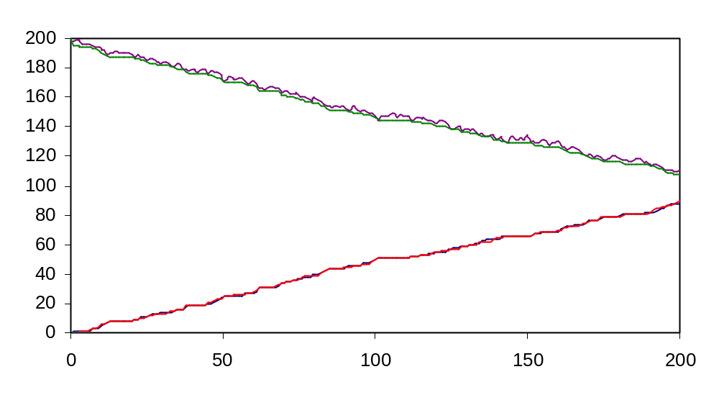
Sequential Random: Modular
S1, S2
P1, P2
The product and Substrate plots do not completely overlap
random.cp

Slide 46
Biochemical Example: Hexokinase
Mg⁺²-ATP
Glucose
ADP
G6P
Hexokinase
Hexokinase:
Glucose:
ATP
Hexokinase
Glucose
Mg⁺²-ATP
G6P
ADP

Slide 47
Ping-pong Reactions
Reactions in which one or more products are released before all substrates have been added.
In ping-pong reactions the substrates A and B do not encounter each other on the surface of the enzyme

Slide 48
Ping-pong Reactions
Ping: displacing X from A to E
Pong: displacing X from F (E-X) to B
A
P
B
Q
E
EA-FP
F (E-X)
FB-EQ
E
A stable intermediate, in which X is tightly (often covalently) bound to the enzyme

Slide 49
Ping Pong Reactions (Irreversible)
-language(psifcp).
global(e_s1_bind(20), f_s2_bind(20), es1_unbind(0.8), fs2_unbind(0.8), es1_react(0.1), fs2_react(1), dummy(1)).
System(N1,N2,N3)::= <<
CREATE_E(N1) | CREATE_S1(N2) | CREATE_S2(N3) |
Timer(es1_unbind) | Timer(es2_unbind) |
Timer(fs2_react) | Timer(es1_react) .
… >> .
pingpong.cp

Slide 50
Ping Pong Reactions (Irreversible)
E::= e_s1_bind ! [] , E_bound_S1 .
E_bound_S1::= es1_unbind ? [] , E | S1 ;
es1_react ? [] , EX | P1 .
EX::= f_s2_bind ! [] , EX_bound_S2 .
EX_bound_S2::= fs2_unbind ? [] , EX | S2 ;
fs2_react ? [] , E | P2 .
S1::= e_s1_bind ? [] , true .
S2::= f_s2_bind ? [] , true .
P1::= dummy ? [] , true .
P2::= dummy ? [] , true .
pingpong.cp

Slide 51
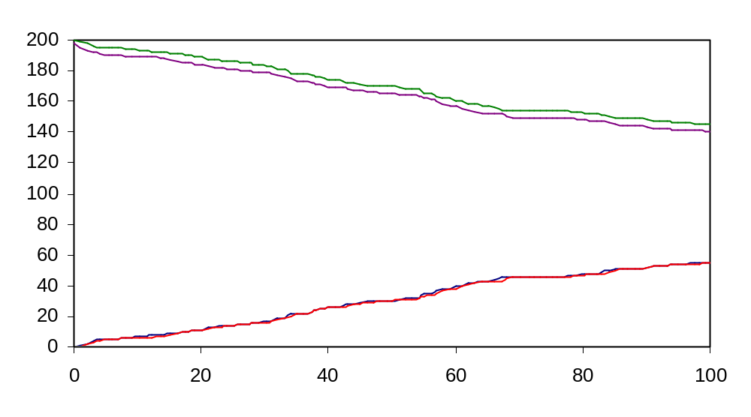
Ping-pong (irreversible)
S1, S2
P1, P2
A wider “gap” (mostly between substrates)
pingpong.cp

Slide 52
Biochemical Example:
Succinyl CoA Synthetase (SCS)
Ping: displacing Phosphate from Succinyl-P to SCS
Pong: displacing P from P-SCS to GDP
Succinyl-P
Succinate
GDP
GTP
SCS
“P-SCS”
SCS

Slide 53
Regulation of Enzymes
Many substances alter the activity of an enzyme by reversibly combining with it in the way that influences the binding of substrate or its turnover to product
Sunstances that reduce an enzyme’s activity in this way are termed reversible inhibitors

Slide 54
Enzyme Inhibitors
Enzyme inhibitors act through a variety of mechanisms, for example
  Structurally resemble the substrate but either do not react or react very slowly
  Affect catalytic activity without interfering with substrate binding.

Slide 55
Competitive Inhibition
Competitive inhibitor: A substance that competes directly with a normal substrate for an enyzme’s substrate-binding site
Usually resembles the substrate so that it can specifically bind to the active site…
But differs from the substrate so that it cannot react as the substrate does

Slide 56
Competitive Inhibition
E + S ES P + E
k₁
k₂
+
K₋₁
I
EI
+ S
No Reaction
A competitive inhibitor reduces the concentration of free enzyme available for substrate binding

Slide 57
Competitive Inhibition
-language(psifcp).
global(e_s_bind(20),es_unbind(0.8),e_i_bind(20), ei_unbind(0.8),es_react(0.1),e_p_bind(10)).
System(N1,N2,N3)::= << CREATE_ENZYME(N1) |
CREATE_SUBSTRATE(N2) |
CREATE_INHIBITOR(N3) |
timer#Timer(es_unbind) |
timer#Timer(ei_unbind) |
timer#Timer(es_react) .
… >> .
comp.cp

Slide 58
Competitive Inhibition
Enzyme::= e_s_bind ! [] , ES ;
e_i_bind ! [] , EI .
ES::= es_unbind ? [] , Enzyme | Substrate ;
es_react ? [] , Enzyme | Product .
EI::= ei_unbind ? [] , Enzyme | Inhibitor .
Substrate::= e_s_bind ? [] , true .
Product::= e_p_bind ? [] , true .
Inhibitor::= e_i_bind ? [] , true .
comp.cp

Slide 59
Competitive Inhibition
Enzyme | Substrate | Inhibitor | Timer(ei_unbind)| …
e_s_bind ! [] , ES ; e_i_bind ! [] , EI |
e_i_bind ? [] , true |
e_s_bind ? [] , true .
e_i_bind
ei_unbind
EI | Substrate | Timer(ei_unbind)
ei_unbind ? [] , (Enzyme | Inhibitor) |
Substrate | ei_unbind ! [] , Timer(ei_unbind)
comp.cp

Slide 60
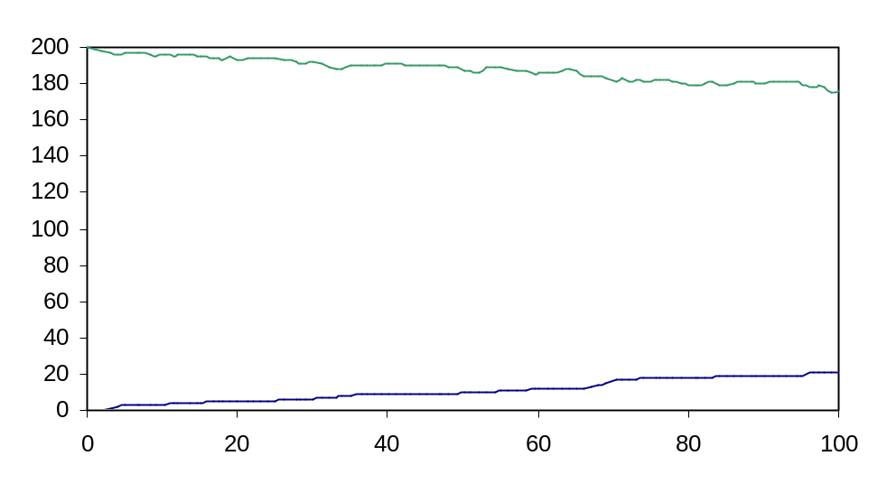
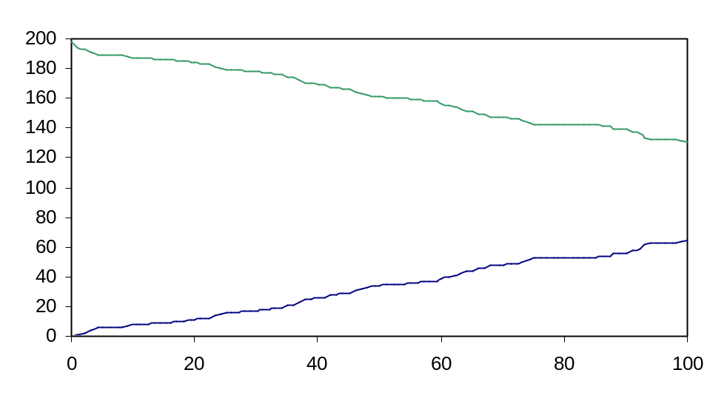
Competitive Inhibition
S
+ inhibitor (400)
P
S
P
- inhibitor
5E, 200S
comp.cpc

Slide 61
Biochemical Example:
Succinate Dehydrogenase (SDH)
SDH + Succinate SDH:Suc. Fumarate + SDH
k₁
k₂
+
K₋₁
Fumarate
SDH:Fumarate
+ Succinate
No Reaction

Slide 62
Exercise 6: Question 3
ATP is a competitive inhibitor for hexokinase (as opposed to the substrate ATP-Mg). Using a modular approach write a program for the hexokinase reactions. Assume a random mechanism, and an irreversible catalysis. Assume that the binding of ATP, MgATP and Glucose to their binding site is independent of whether the other binding site is occupied (e.g. MgATP binds at the same rate to the free enzyme and to a glucose-bound one. It does not bind of course to an ATP-bound enzyme. Thus, only a single pair of hex_mgatp_bind and unbind channels are necessary (see list of reactions below)

Slide 63
Exercise 6 – Question 3
Note that as a competitive inhibitor ATP may bind the enzyme at any stage that ATP_Mg would. However, no catalytic event will take place when ATP is bound to the enzyme.
Run the program in the presence and absence of the ATP competitor. In addition to the usual output, compare and discuss the results

Slide 64
Exercise 6 - Question 3
Hexokinase + MgATP ↔ Hexo:MgATP
Hexo-MgATP + Glucose ↔ Hexo:MgATP:Glucose
Hexo + Glucose ↔ Hexo:Glucose
Hexo:Glucose + MgATP ↔ Hexo:MgATP:Glucose
Hexo:MgATP:Glucose → Hexo:ADP:G6P
Hexo:ADP:G6P→Hexo:ADP + G6P
Hexo:ADP:G6P→Hexo:G6P + ADP
Hexo:ADP → Hexokinase + ADP
Hexo:G6P → Hexokinase + G6P

Slide 65
Exercise 6: Question 3
Quantities | Rates | t (scale)
[Hexokinase] = 5 [ATP_Mg] = 200 [Glucose] = 200 [ATP] = 0,100, or 400 (3 runs, all other parameters remain the same) | Hexo-ATP binding 30 Hexo-ATP unbinding 0.4 Hexo-MgATP binding 10 Hexo-MgATP unbinding 0.4 Hexo-Glucose binding 20 Hexo-Glucose unbinding 0.8 Hexo:Glu:MgATP reaction 0.1 Hexo:G6P release (G6P released) 1 Hexo:ADP release (ADP released) 1 | 200 (1)

Slide 66
Uncompetitive Inhibition
An uncompetitive inhibitor binds directly to the enzyme-substrate complex but not to the free enzyme
It need not resemble the substrate, and presumably distorts the active site, thereby rendering the enzyme catalytically inactive

Slide 67
Uncompetitive Inhibition
E + S ES P + E
k₁
k₂
K₋₁
+
I
ESI
No Reaction
The inhibitor affects the catalytic function of the enzyme but not its substrate binding. In actuality, uncompetitive inhibition is significant only in multi-substrate enzymes

Slide 68
Uncompetitive Inhibition
-language(psifcp).
global(e_s_bind(20), es_unbind(0.8), es_i_bind(20), esi_unbind(0.8), es_react(0.1), e_p_bind(10)).
System(N1,N2,N3)::= << CREATE_ENZYME(N1) |
CREATE_SUBSTRATE(N2) |
CREATE_INHIBITOR(N3) |
timer#Timer(es_unbind) |
timer#Timer(es_react) |
timer#Timer(esi_unbind) .
…
>> .
noncomp.cp

Slide 69
Uncompetitive Inhibition
Enzyme::= e_s_bind ! [] , ES .
ES::= es_unbind ? [] , Enzyme | Substrate ;
es_react ? [] , Enzyme | Product ;
es_i_bind ! [] , ESI .
ESI::= esi_unbind ? [] , ES | Inhibitor .
Substrate::= e_s_bind ? [] , true .
Product::= e_p_bind ? [] , true .
Inhibitor::= es_i_bind ? [] , true .
noncomp.cp

Slide 70
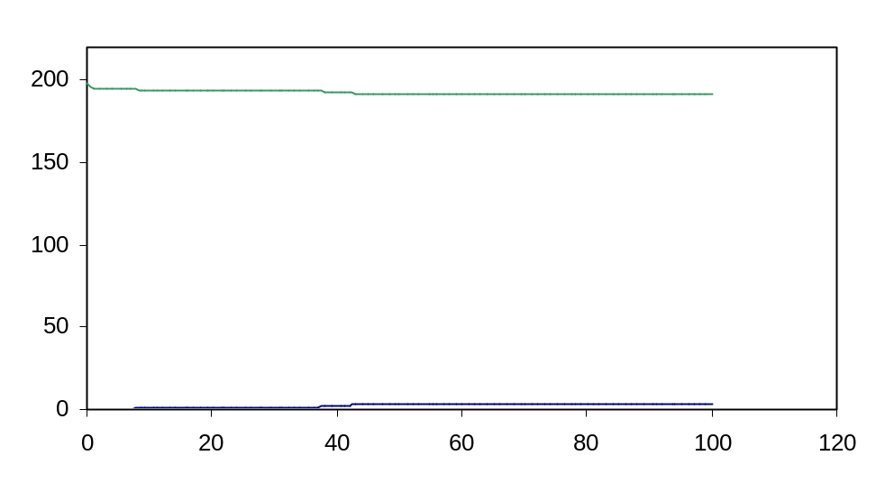
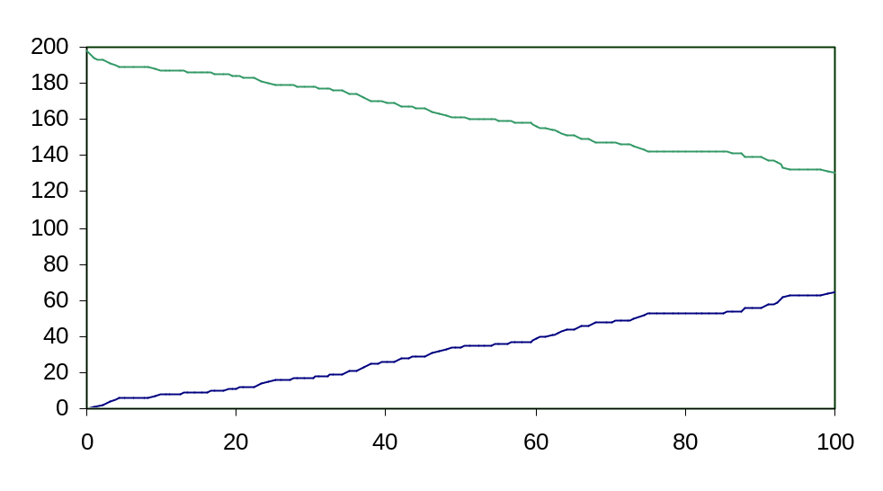
Uncompetitive Inhibition
S
+ inhibitor (5)
P
S
- inhibitor
P
5E, 200S
noncomp.cp

Slide 71
Mixed (non-competitive) Inhibition
A mixed (non-competitive) inhibitor binds both the free enzyme and the enzyme-substrate complex
Presumably, it binds to enzyme sites that participate in both substrate binding and catalysis.

Slide 72
Mixed Inhibition
E + S ES P + E
k₁
k₂
+
K₋₁
+
I
I
EI
ESI
No Reaction
Mixed inhibition (as uncompetitive) is an important feature in the kinetics of multi-substrate enzymes

Slide 73
Mixed Inhibition
-language(psifcp).
global(e_s_bind(20),es_unbind(0.8),e_i_bind,ei_unbind, es_i_bind(20),esi_unbind(0.8),es_react(0.1),e_p_bind(10)).
System(N1,N2,N3)::= <<
CREATE_ENZYME(N1) | CREATE_SUBSTRATE(N2) | CREATE_INHIBITOR(N3)|
timer#Timer(es_unbind) | timer#Timer(es_react) |
timer#Timer(esi_unbind) | timer#Timer(ei_unbind) .
…
>> .
mixed.cp

Slide 74
Mixed Inhibition
Enzyme::= e_s_bind ! [] , ES ;
e_i_bind ! [] , EI .
EI::= ei_unbind ? [] , Enzyme | Inhibitor .
ES::= es_unbind ? [] , Enzyme | Substrate ;
es_react ? [] , Enzyme | Product ;
es_i_bind ! [] , ESI .
ESI::= esi_unbind ? [] , ES | Inhibitor .
Substrate::= e_s_bind ? [] , true .
Product::= e_p_bind ? [] , true .
Inhibitor::= es_i_bind ? [] , true ;
e_i_bind ? [] , true .
mixed.cp

Slide 75
Irreversible Inactivation
An inhibitor which binds irreversibly to an enzyme is an inactivator
Irreversible inactivation kinetically resembles noncompetitive inhibition

Slide 76
Regulation of Enzyme Activity
Control of enzyme availability: How much enzyme is present in the cell
  Enzyme synthesis rate
  Enzyme degradation rate
Control of enzyme activity: Structural alterations (allosteric effects) in enzymes influence their substrate binding rates
  Covalent modification
  Small molecules binding (allosteric effectors)
Enzymes as (biochemical) substrates

Slide 77
References
Voet D., Voet J.G. and Pratt C.W. (1999) Fundamentals of Biochemistry. Wiley. Chapters 11-12.

