Slide 1
Unit 5: Molecular Machines and Biopolymers

Slide 2
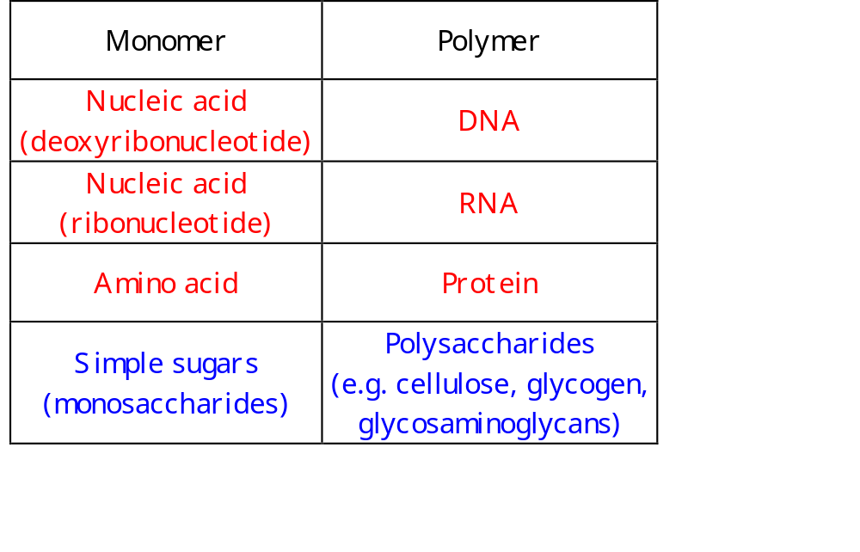
Biopolymers

Slide 3
Molecular Machines
The synthesis and processing of DNA, RNA and proteins is carried out by sophisticated “molecular machines”
These are typically multi-protein complexes
In some cases, other molecules (e.g. RNA) also participate
The key components are enzymes, which catalyze the necessary reactions
Accessory proteins are required to mediate non-catalytic actions, such as binding

Slide 4
From DNA to Protein
Replication
(+repair)
DNA
Transcription
hnRNA
Splicing
mRNA
Translation
Polypeptide
M
L
I
V
G
Folding, modification
Folded, mature Protein

Slide 5
DNA: Base Pairing and Sequence Complementarity
Base pairing
A-T C-G
3’
5’
A
T
P
P
3’
3’
5’
5’
T
A
P
P
3’
3’
5’
G
C
P
5’
P
3’
3’
5’
G
C
P
P
5’
3’
3’
P
5’
C
G
P
3’
ATGGC
TACCG
Sequence complementarity:

Slide 6
Synthesis (Replication)
Based on sequence complementarity
Each strand serves as a template for the synthesis of the other, complementary strand
From one double stranded molecules (dsDNA) two double stranded ones are formed, in a semi-conservative way
Performed by the replication machinery, which includes the DNA Polymerase I enzyme

Slide 7
DNA Synthesis
Initiation
  Opening the double stranded molecule, separating it to two strands
  Priming a short RNA fragment
Propagation
  Elongation 5’→ 3’ (Note: Okazaki fragments)
Termination
  “Pasting” (ligation) of the end of one fragment to the beginning of the other

Slide 8
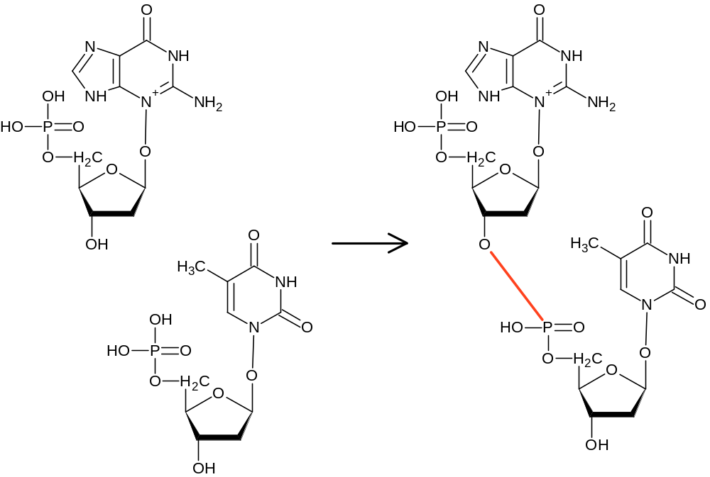
Phosphodiester Bonds and DNA Elongation
3’
5’
Phosphodiester
bond

Slide 9
RNA Synthesis (Transcription)
Based on sequence complementarity
A complementary single strand of RNA (ssRNA) is transcribed from one (“non-coding”) strand of a dsDNA molecule
Only relatively short pieces of DNA are transcribed to RNA
Typically only one of the strands serves as template for RNA
Sense (coding) strand
5’
5’
RNA
3’
3’
5’
Antisense (noncoding) strand

Slide 10
RNA Transcription Machinery
Initiation (Pre-initiation complex)
  Pre-initiation complex of proteins binds at specific short DNA promoter sequences
  RNA Polymerase is recruited and initiates
Elongation (RNA polymerase)
  5’ → 3’ polymerization of ribonucleotides based on the DNA template. A transient DNA-RNA hybrid forms
Termination (Termination Factors)
  A complex multi step process involving RNA secondary structure (formed by internal complementarity) and special proteins

Slide 11
RNA Transcription - Initiation
TATA
IID
Transcription start site
TATA
IIB
IIA
IIB
IIA
TATA
IIF
PolII
IIB
IIF
IIA
PolII
TATA
IIE
IIB
IIF
IIE
IIA
PolII
IIH
IIH
TATA
Start transcription

Slide 12
RNA Transcription: Initiation
Once one transcription complex evacuated the promoter, another can form there, and follow suit
In some cases (rRNA) the only limitation on consecutive imitiation is a steric one, and transcription initiates ~ 1 per second

Slide 13
RNA Transcription - Elongation
Base
Base
P
P
Sugar
Sugar
2’
OH
OH
OH
H
Ribonucleotide
(RNA)
Deoxyribonucleotide
(DNA)

Slide 14
RNA Transcription - Elongation
5’
P
Seed
Free nucleotides
3’
OH
5’
5’
P
P
3’
OH
3’
OH
5’
5’
P
Polymerized nucleotides
P
3’
OH
3’
OH
5’
P
5’
P
3’
OH
3’
OH
5’
P
Growing end
3’
OH

Slide 15
RNA Transcription:
Processive Elongation
1. An open “transcription bubble”
2. Base pairing of a new ribonucleotide to a complementary dexoyribonucleotide (A-U ; C-G)
3. Formation of phosphodiester bond
4. Progress to next nucleotide: A transient DNA-RNA hybrid forms, and the bubble “travels” with the progressing enzyme
5. The in vivo rate: 20-50 nts/sec

Slide 16
RNA Elongation: Model
Each DNA and RNA nucleotide (base) - a process
Polymerized processes are linked by private channels
Base pairing is formed on global channels
RNA polymerase interacts with both the incoming nucleotide and the growing end to catalyze the formation of a phosphodiester bond

Slide 17
RNA Elongation
Sense (coding) strand
5’
5’
RNA
3’
3’
5’
Antisense (noncoding) strand
T
A
T
Growing end (RAS)
G
C
A
5’
3’
C
G
RNA
Seed
U
A
G
G
RNA
Pol
DNA
Seed
A
T
C
C
A
DNA
3’
5’
DAS

Slide 18
RNA Elongation:
Initiated System
abp - Base pairing A (DNA) with U (RNA)
-language(psifcp).
global(abp(1),tbp(1),dummy(1)).
baserate(infinite).
System(C1,C2,C3)+(to_ras(1),to_das(1),to_d5,to_d3,bp)::=
<< Pol(to_ras, to_das) |
D_Seed(abp, to_d3, bp)
Seed_RAS(abp, bp, to_ras) |
DAS(tbp,to_d3,to_d5,to_das) |
Create_Polymer(C1,to_d5) |
Create_Ar(C2) | Create_Ur(C2) .
tbp - Base pairing T (DNA) with A (RNA)
DNA seed (A)
RNA seed (U)
“Ready for transcription end” of DNA (T)
Growing end (RAS)
5’
3’
Creation of DNA polymer and ribonucleotides (A, U)
RNA
Seed
U
RNA
Pol
DNA
Seed
A
T
C
C
A
DNA
3’
5’
rnapol_1.cp
DAS

Slide 19
RNA Elongation:
Initiated System
Create_Polymer(C,to_d3)::=
{C =< 0} , true ;
{C > 0} , {C--} |
<< to_d5a , to_d5b . D_Nuc(abp,to_d3,to_d5a) | D_Nuc(tbp,to_d5a,to_d5b) | Create_Polymer(C,to_d5b) >>.
Create_Ar(C)::= {C =< 0} , true ;
{C > 0} , {C--} | R_Nuc(tbp) | self. Create_Ur(C)::= {C =< 0} , true ;
{C > 0} , {C--} | R_Nuc(abp) | self >> .
rnapol_1.cp

Slide 20
RNA Elongation:
Initiated System
U
A
C2 A’s
C3 U’s
U
A
A
U
U
A
Seed_RAS (U)
to_d5a
to_d5b
bp
to_d3
to_d5
3’
D_Seed (A)
DAS (T)
A
T
A
T
A
T
5’
to_ras
to_das
(AT)_{C1}
PolII
rnapol_1.cp

Slide 21
RNA Elongation
Pol(to_ras,to_das)::=
to_ras ? {to_r5} , to_das ! {to_r5,to_ras} , Pol .
D_Seed(base,to_d5,bp)::=
dummy ? [] , true .
D_Nuc(base,to_d3,to_d5)::=
to_d3 ? {to_pol} , DAS(base,to_d3,to_d5,to_pol) .
DAS(base,to_d3,to_d5,to_pol)+bp::=
base ! {bp,to_pol} , bp ? [] , to_d5 ! {to_pol} ,
D_Bound(base,to_d3,to_d5,bp).
D_Bound(base,to_d3,to_d5,bp)::=
dummy ? [] , true .
rnapol_1.cp

Slide 22
RNA Elongation
Seed_RAS(base,bp,to_pol)+to_r3::=
to_pol ! {to_r3} , Seed_R_Pol(base,bp,to_r3).
R_Nuc(base)::=
base ? {bp,to_pol} , to_pol ? {to_r5,to_ras} ,
bp ! [], RAS(base,bp,to_ras,to_r5) .
RAS(base,bp,to_pol,to_r5)+to_r3::=
to_pol ! {to_r3} , R_Pol(base,bp,to_r5,to_r3) .
Seed_R_Pol(base,bp,to_r3)::=
dummy ? [] , true .
R_Pol(base,bp,to_r5,to_r3)::=
dummy ? [] , true .
rnapol_1.cp

Slide 23
RNA Elongation - Step I
Pol
5’
3’
U
to_das
DAS(tbp,to_d3,to_d5,to_das)+bp | R_Nuc(tbp)
bp
3’
A
T
A
5’
tbp ! {bp,to_das} , bp ? [] , to_d5 ! {to_das} ,
D_Bound(tbp , to_d3,to_d5,bp) |
tbp ? {bp,to_pol} , to_pol ? {to_r5,to_ras} , bp ! [],
RAS(tbp,bp,to_ras,to_r5) .
Step Ia: Base
pairing
tbp
(global)
bp ? [] , to_d5 ! {to_das} , D_Bound(tbp , to_d3,to_d5,bp) |
to_das ? {to_r5,to_ras} , bp ! [], RAS(tbp,bp,to_ras,to_r5) .
Pol
5’
to_das
3’
U
A
bp
bp
A
T
A
3’
5’
rnapol_1.cp

Slide 24
RNA Elongation - Step I
to_ras
5’
to_r3
3’
U
Pol
Seed_RAS(abp,bp,to_ras)+to_r3 |
Pol(to_ras,to_das)
to_das
A
T
A
3’
5’
to_ras ! {to_r3} , Seed_R_Pol(abp,bp,to_r3) |
to_ras ? {to_r5} , to_das ! {to_r5,to_ras} , Pol
Step 1b: PolII interacts with the RNA growing end
to_ras (private)
5’
to_r3
3’
Seed_R_Pol(abp,bp,to_r3) |
to_das ! {to_r3,to_ras} , Pol
U
Pol
to_das
A
T
A
3’
5’
The order of Step Ia and Ib is not determined
rnapol_1.cp

Slide 25
RNA Elongation: Step II
Pol
to_r3
to_das
5’
U
A
3’
bp
bp
3’
A
T
A
5’
to_das ! {to_r3,to_ras} , Pol |
to_das ? {to_r5,to_ras} , bp ! [], RAS(tbp,bp,to_ras,to_r5)
Step II: PolII forms the bond with incoming nucleotide (passing of private to_r3 channel)
to_das
(private)
Pol | bp ! [], RAS(tbp,bp, to_ras, to_r3)
to_ras
Pol
5’
to_r3
3’
U
A
to_das
bp
bp
A
T
A
3’
5’
rnapol_1.cp

Slide 26
RNA Elongation: Step III
Pol
to_ras
to_r3
5’
U
A
3’
to_das
bp
bp
A
T
A
to_d5a
3’
to_d5
5’
bp ! [], RAS(tbp,bp, to_ras, to_r3) |
bp ? [] , to_d5 ! {to_das} , D_Bound(tbp , to_d3,to_d5,bp) |
D_Nuc(abp, to_d5, to_d5a)
bp ! [], RAS(tbp,bp,to_ras,to_r3) |
bp ? [] , to_d5 ! {to_das} , D_Bound(tbp,to_d3,to_d5,bp) |
to_d5 ? {to_pol} , DAS(abp,to_d5,to_d5a,to_pol)
bp
(private channel)
Step III:
Movement forward
to_d5
(private channel)
to_ras
Pol
to_r3
RAS(tbp,bp,to_ras,to_r3) |
D_Bound(tbp,to_d3,to_d5,bp) |
DAS(abp,to_d5,to_d5a,to_das)
5’
3’
U
A
to_das
bp
bp
A
T
A
to_d5a
3’
to_d5
5’
rnapol_1.cp

Slide 27
Some limitations
Irreversible base pairing
All interaction with polymerase on private channels
No “movement” of open bubble: formation of fully attached hybrid

Slide 28
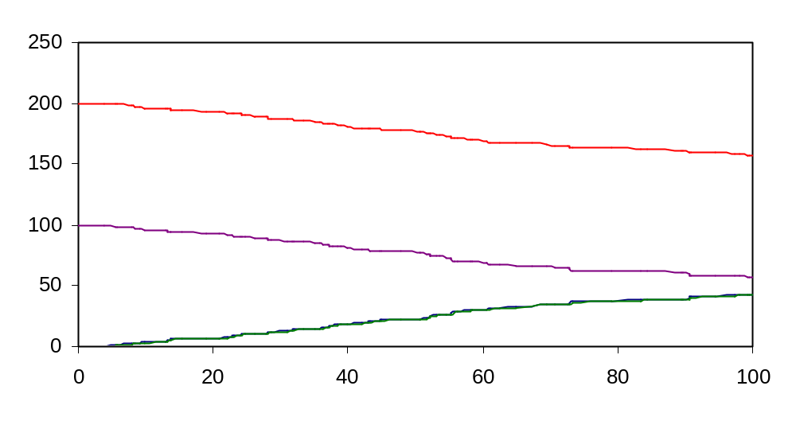
RNA Elongation: Results
R_Nuc
D_Nuc
D_Bound
R_Pol

Slide 29
Biopolymers

Slide 30
Polysaccharides
Polysaccharides, also known as glycans consist of simple sugars (monosaccharides, e.g. glucose) linked together by glycosidic bonds
They are classified to
  Homo-polysaccharides: one type of monomer
  Hetero-polysaccharides: more than one type of monomer
Polysaccharides fullfill various roles
  Structure (cellulose, chitin)
  Storage (starch, glycogen)
  Extracellular space (glycoaminoglycans)

Slide 31
Polysaccharides:
Glycosidic Bonds and Branching
In contrast to proteins and nucleic acids, polysaccharides can form branched as well as linear polymers. Why?
Glycosidic linkages can be made to any of the hydroxyl groups of a monosaccharide
As a result, a single monomer may be bound to more than two counterparts, and form a branch point
Fortunately (for structural biologist…), most polysaccharides are linear and those that branch do so in only a few well defined ways

Slide 32
Glycogen
Glycogen is a branched polysaccharide composed of glucose monomers
There are two alternative reactions
  Elongation: α(1→ 4) bond
  Branching: α(1→6) bond

Slide 33
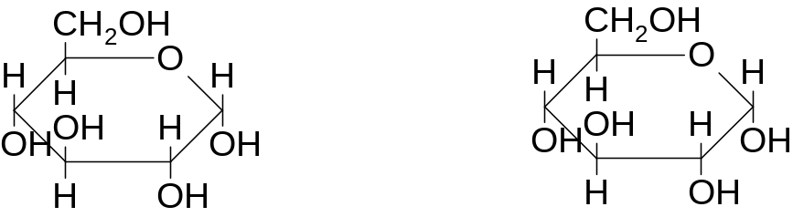
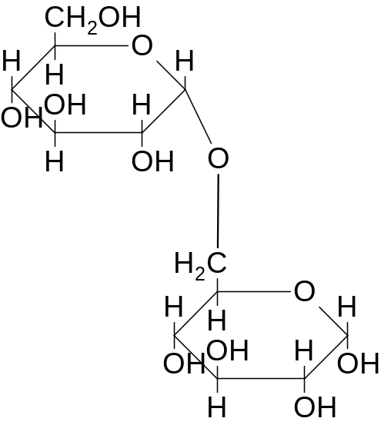
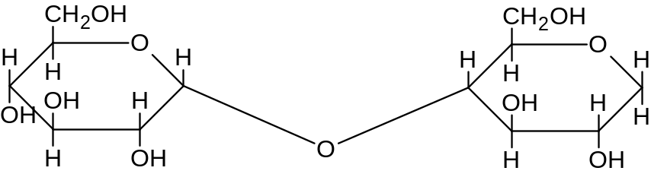
Glycosidic Bonds in Glycogen
6
6
D-glucose
5
+
5
D-glucose
4
4
1
3
1
3
2
2
1
α(1→6)
α(1→4)
6
1
4

Slide 34
Elongation
Glycogen
Synthase
1
4
UDP-glucose + Glycogen (n residues) → Glycogen (n+1 residues)
U
P
Glucose
1
4
1
4
1
4
1
4
Seed
O
O
O

Slide 35
Branching
O
4
1
O
4
1
O
4
1
O
4
O
4
1
O
4
1
1
O
4
1
O
4
Branching enzyme
(1,4 → 1,6 transglycosylase)
O
4
1
O
4
1
O
4
1
O
4
6
O
4
1
4
1
4
1
4
4
1
4
1
4
1
4
4
1
4
1
4
1
4
O
O
O
O
O
O
O
O
O
O
O

Slide 36
Glycogen Elongation - “Rules”
Initiation is done by a third enzyme (glycogenin) which forms an initial “primer” (7 residues long). We will refer to this as a seed.
Elongation is allowed only from growing 4’ ends
After branching there may be more than one such end
Elongation may proceed in parallel at each of these ends

Slide 37
Glycogen Branching - “Rules”
A branch is created by
  Tranfering a 7-residue segment from the end of a chain
  To the C6-OH group of a glucose residue on the same or another glycogen chain
  Each transferred segment must come from a chain of at least 11 residues, and
  The new branch point must be at least 4 residues away from any other branch points
This branching pattern of glycogen was optimized by evolution for efficient storage and mobilization of glucose

Slide 38
Glycogen - Definitions I
Each glycogen “strand” is directional and has
  a root side (1, seed, not growing)
  a leaf side (4, growing end)
leaf side
leaf side
O
4
O
4
1
1
4
O
4
O
1
1
4
O
4
O
1
1
4
root side
O
4
root side
O
leaf side
root side
1
1
O
O
4
4
1
4
4
4
1
4
1
4
1
4
4
1
4
1
4
1
4
O
O
O
O
O
O
O
O
O
O
O

Slide 39
Glycogen - Definitions II
A residue may be
  On a straight segment (no brachpoints to the leaf side)
  On a branched segment (there’s a brachpoint on the leaf side)
  A branch point (Branch_Glucose)
A
B
C
leaf side
leaf side
O
4
O
4
1
A
1
A
O
4
O
4
1
1
4
O
4
O
1
1
4
root side
O
4
root side
O
leaf side
A
root side
O
B
O
B
4
1
4
1
4
1
4
C
1
1
1
C
1
4
4
1
4
4
4
4
1
4
4
O
O
O
O
O
O
O
O
O
O
O

Slide 40
Glycogen - Definitions III
Residues on straight segments are either
  Polymerization enabled (the leaf only) Leaf_Glucose
  Cleavage and branch enabled (at distance 7 exactly from the leaf and at distance 4 at least from the closest branch point/root) BCE_Glucose
  Branch enabled but not cleavage enabled (at distance other than 7 from the leaf and at distance 4 at least from the closest branch point/root) BNCE_Glucose
  Disabled (not the leaf and at distance less than 4 from the closest branch point/root) Disabled_Glucose

Slide 41
Glycogen - Definition IV
Residues on a branched segment are either
  Branch enabled but not cleavage enabled (at distance 4 at least from the flanking branch points/root on both sides) BNCE_Glucose
  Disabled (at distance less than 4 from at least one of its flanking branch points/root) Disabled_Branched_Glucose

Slide 42
Glycogen - Definitions V
We will use several counters to indicate a residue’s position
  LC (leaf counter): Distance from leaf
  RC (root counter): Distance from root or from flanking branch point on root side
  LBC (leaf-branch counter): Distance from flanking branch point on leaf side
O
4
O
4
1
1
4
O
4
O
1
1
4
O
4
O
1
1
4
LC=1
RC=3
O
4
RC=3
LBC=2
O
1
1
O
O
4
4
1
4
4
4
1
4
1
4
1
4
4
1
4
1
4
1
4
O
O
O
O
O
O
O
O
O
O
O

Slide 43
Glycogen - LC Counter Update
LC
  Initialized to zero
  Updated upon extension +1
  Updated upon cleavage -7 (in remaining segment residues)
O
4
O
4
1
1
4
O
4
O
1
1
4
O
4
O
1
1
4
O
4
O
1
1
O
O
4
4
1
4
4
4
1
4
1
4
1
4
4
1
4
1
4
1
4
O
O
O
O
O
O
O
O
O
O
O

Slide 44
Glycogen - RC Counter Update
RC
  Initialized to RC of neighbor on root side + 1
  Updated upon cleavage (in cleaved segment residues) to RC of new root side neighbor + 1
  Updated upon insertion (in segment on leaf-side of the new branch point) to RC - (RC of new branch point)
O
4
O
4
1
1
4
O
4
O
1
1
4
O
4
O
1
1
4
O
4
O
1
1
O
O
4
4
1
4
4
4
1
4
1
4
1
4
4
1
4
1
4
1
4
O
O
O
O
O
O
O
O
O
O
O

Slide 45
Glycogen - LBC Counter Update
LBC
  Initialized to zero
  Updated upon insertion (in segment on root-side of the new branch point) to LBC of leaf side neighbor + 1
O
4
O
4
1
1
4
O
4
O
1
1
4
O
4
O
1
1
4
O
4
O
1
1
O
O
4
4
1
4
4
4
1
4
1
4
1
4
4
1
4
1
4
1
4
O
O
O
O
O
O
O
O
O
O
O

Slide 46
Glycogen - Counter Updates
Counter updating will be performed by communication on private channels linking the residues
All such private channels will be instantaneous
All reactions (elongation, cleavage and branching) will be carried out on channels with finite rate
As a result, counter updating will be done in zero time, and will not interfere with the kinetics of biochemical reactions
Important note: once cleavage occurred (and before branching did), the cleaved branch cannot be elongated any more!!

Slide 47
Glycogen - I
-language(psifcp).
global(glycogen(1), udp_glucose(1), dummy(1), branch(1), cleave(1)).
baserate(infinite).
System(N1,N2,N3,N4)::=
<< CREATE_Seed_Glucose(N1) | CREATE_UDP_Glucose(N2) |
CREATE_Glycogen_Synthase(N3) | CREATE_Branching_Enzyme(N4).
CREATE_Seed_Glucose(C)+(RC,LC,LBC)::=
{C =< 0} , true ;
{C > 0} , {C--} | {RC = 0} | {LC = 0} | {LBC = 0} |
Seed_Glucose(RC,LC,LBC) | self .
CREATE_UDP_Glucose(C)+(LC,LBC)::=
{C =< 0} , true ;
{C > 0} , {C--} | {LC = 0} | {LBC = 0} |
UDP_Glucose(LC,LBC) | self .
CREATE_Glycogen_Synthase(C)::= ...
CREATE_Branching_Enzyme(C)::= ... >> .
glycogen_1.cp

Slide 48
Glycogen - II
Seed_Glucose(RC,LC,LBC)::=
glycogen ? {to_leaf} , to_leaf ! {RC,LBC} , Root_Glucose(to_leaf,RC,LC,LBC) . Root_Glucose(to_leaf,RC,LC,LBC)::=
to_leaf ? {LC,LBC} , {LC++} ,
Root_Glucose(to_leaf,RC,LC,LBC) .
UDP_Glucose(LC,LBC)+(to_root,to_leaf)::=
udp_glucose ! {to_root} , to_root ? {RC,LBC} ,
{RC++} , to_root ! {LC,LBC} ,
Glucose(to_root,to_leaf,RC,LC,LBC) .
glycogen_1.cp

Slide 49
Glycogen - III
Glucose(to_root, to_leaf, RC, LC, LBC)::=
{LC <0}, screen#display("error - LC<0") ;
{LC>=0},
<< {LBC = 0} ,
<< {LC = 0} , Leaf_Glucose ;
{LC = 7 , RC >= 4} , BCE_Glucose ;
{LC > 0 , LC =\= 7 , RC >= 4} , BNCE_Glucose ; {LC > 0 , RC < 4} , Disabled_Glucose >> ;
{LBC > 0} ,
<< {RC >= 4 , LBC >=4} , BNCE_Glucose ; {RC < 4} , Disabled_Branched_Glucose;
{LBC < 4} , Disabled_Branched_Glucose >> .
Error message
Straight segment
Branched segment
glycogen_1.cp

Slide 50
Glycogen - IV
Leaf_Glucose::=
glycogen ? {to_leaf} , to_leaf ! {RC,LBC} ,
to_leaf ? {LC,LBC} , {LC++} , to_root !
{LC,LBC} , Glucose(to_root,to_leaf,RC,LC,LBC);
to_root ? {RC,_} ,
<< {RC >=0} , {RC++} , Glucose ;
{RC < 0} , Disabled_Leaf_Glucose >> .
Disabled_Leaf_Glucose::=
to_root ? {RC,_} , {RC++} , Glucose .
glycogen_1.cp

Slide 51
Glycogen - V
BNCE_Glucose::=
to_leaf ? {LC,LBC} , {LC++} ,
<< {LBC = 0} , to_root ! {LC,LBC} , Glucose;
{LBC > 0} , {LBC++} , to_root ! {LC,LBC} , Glucose >>;
to_root ? {RC,_} ,
<< {RC >=0} , {RC++} , to_leaf ! {RC,LBC} , Glucose ;
{RC < 0} , to_leaf ! {RC, LBC} , Disabled_Glucose >> ;
branch ? {to_branch} , Branch_Synch(to_branch,RC,LC,LBC) .
Branch_Synch(to_branch,RC,LC,LBC)+(RC1,LBC1)::=
{RC1=0} | {LBC1=1} |
<< to_branch ! {RC1,LBC} , to_leaf ! {RC1,LBC} ,
to_root ! {LC,LBC1} ,
Branch_Point(to_root,to_branch,to_leaf) >> .
Disabled_Glucose::=
to_leaf ? {LC,LBC} , {LC++} ,
<< {LBC = 0} , to_root ! {LC,LBC} , Glucose ;
{LBC > 0} , {LBC++} , to_root ! {LC,LBC} , Glucose >> ;
to_root ? {RC,_} , {RC++} , to_leaf ! {RC,LBC} , Glucose .
glycogen_1.cp

Slide 52
Glycogen - VI
BCE_Glucose+(new_to_root,RC1,LC1,LBC1)::=
<< to_leaf ? {LC,LBC} , {LC++} ,
<< {LBC = 0} , to_root ! {LC,LBC} , Glucose ;
{LBC > 0} , {LBC++} , to_root ! {LC,LBC} , Glucose >> ;
to_root ? {RC,_} ,
<< {RC >=0} , {RC++} , to_leaf ! {RC,LBC} , Glucose ;
{RC < 0} , to_leaf ! {RC,LBC} , Disabled_Glucose >> ;
branch ? {to_branch} , Branch_Synch(to_branch,RC,LC,LBC) ;
cleave ! {new_to_root} , {LC1 = -1} | {RC1 = -1} |
Cleave_Synch(to_leaf) .
Cleave_Synch(to_leaf)::=
to_root ! {LC1,LBC} , to_leaf ! {RC1, LBC} ,
new_to_root ? {RC,_} , {RC++} , to_leaf ! {RC,LBC} , Glucose(new_to_root,to_leaf, RC, LC, LBC) >>.
glycogen_1.cp

Slide 53
Glycogen - VII
Disabled_Branched_Glucose::=
to_leaf ? {LC,LBC} , {LC++} ,
<< {LBC = 0} , to_root ! {LC,LBC} , Glucose ;
{LBC > 0} , {LBC++} , to_root ! {LC,LBC} , Glucose >> ;
to_root ? {RC,_} , {RC++} , to_leaf ! {RC,LBC} , Glucose >>.
Branch_Point(to_root,to_branch,to_leaf)::=
to_root ? {_,_} , self ;
to_branch ? {_,_} , self ;
to_leaf ? {_,_} , self .
Glycogen_Synthase::=
udp_glucose ? {to_root} , glycogen ! {to_root} ,
Glycogen_Synthase.
Branching_Enzyme::=
cleave ? {to_branch} , branch ! {to_branch} ,
Branching_Enzyme .
glycogen_1.cp

Slide 54
Glycogen - Initiation
Glycogen_Synthase |
UDP_Glucose(LC,LBC)+(to_root,to_leaf)|
Seed_Glucose(RC,LC,LBC)
LC, LBC = 0
RC, LC, LBC = 0
udp_glucose ? {to_root} , glycogen ! {to_root} , Glycogen_Synthase |
udp_glucose ! {to_root} , to_root ? {RC,LBC} , {RC++} ,
to_root ! {LC,LBC} , Glucose(to_root, to_leaf,RC,LC,LBC) |
glycogen ? {to_leaf} , to_leaf ! {RC,LBC} , Root_Glucose(to_leaf,RC,LC,LBC)
udp_glucose
(global)
glycogen ! {to_root} , Glycogen_Synthase |
to_root ? {RC,LBC} , {RC++} , to_root ! {LC,LBC},Glucose(to_root,to_leaf,RC,LC,LBC)| glycogen ? {to_leaf} , to_leaf ! {RC,LBC} , Root_Glucose(to_leaf,RC,LC,LBC)
glycogen
(global)
Glycogen_Synthase |
to_root ? {RC,LBC} , {RC++} ,to_root ! {LC,LBC} ,Glucose(to_root,to_leaf,RC,LC,LBC)| | to_root ! {RC,LBC} , Root_Glucose(to_root,RC,LC,LBC)
glycogen_1.cp

Slide 55
Glycogen - Initiation
Glycogen_Synthase |
to_root ? {RC,LBC} , {RC++} ,to_root ! {LC,LBC} ,Glucose(to_root,to_leaf,RC,LC,LBC)| | to_root ! {RC,LBC} , Root_Glucose(to_root,RC,LC,LBC)
to_root
(private)
RC =1 ; LC, LBC = 0
Glycogen_Synthase |
to_root ! {LC,LBC} ,Glucose(to_root,to_leaf,RC,LC,LBC)| | Root_Glucose(to_root,RC,LC,LBC)
RC, LC, LBC = 0
Glycogen_Synthase |
to_root ! {LC,LBC} ,Glucose(to_root,to_leaf,RC,LC,LBC)| |
to_root ? {LC,LBC} , {LC++} , Root_Glucose(to_root,RC,LC,LBC)
to_root
(private)
RC =1 ; LC, LBC = 0
Glycogen_Synthase |
Glucose(to_root,to_leaf,RC,LC,LBC) |
Root_Glucose(to_root,RC,LC,LBC)
RC, LBC = 0 ; LC =1
glycogen_1.cp

Slide 56
Glycogen - Elongation
LC, LBC = 0
RC =1 ; LC=0, LBC = 0
Glycogen_Synthase | Root_Glucose(to_root,RC,LC,LBC) |
Leaf_Glucose(to_root,to_leaf,RC,LC,LBC) |
UDP_Glucose(LC,LBC)+(to_root,to_leaf)
udp_glucose ? {to_root} , glycogen ! {to_root} , Glycogen_Synthase |
Root_Glucose(to_root,RC,LC,LBC) |
glycogen ? {to_leaf} , to_leaf ! {RC,LBC} , to_leaf ? {LC,LBC} , {LC++} ,
to_root ! {LC,LBC} , Glucose(to_root,to_leaf,RC,LC,LBC);
to_root ? {RC,_} , << {RC >=0} , {RC++} , Glucose ; {RC < 0} , Disabled_Leaf_Glucose >> |
udp_glucose ! {to_root} , to_root ? {RC,LBC} , {RC++} , to_root ! {LC,LBC} , Glucose(to_root, to_leaf,RC,LC,LBC)
udp_glucose
(global)
glycogen ! {to_root} , Glycogen_Synthase | Root_Glucose(to_root,RC,LC,LBC) |
glycogen ? {to_leaf} , to_leaf ! {RC,LBC} , to_leaf ? {LC,LBC} , {LC++} ,
to_root ! {LC,LBC} , Glucose(to_root,to_leaf,RC,LC,LBC);
to_root ? {RC,_} , << {RC >=0} , {RC++} , Glucose ; {RC < 0} , Disabled_Leaf_Glucose >> |
to_root ? {RC,LBC} , {RC++} , to_root ! {LC,LBC} ,Glucose(to_root, to_leaf,RC,LC,LBC)
glycogen_1.cp

Slide 57
Glycogen - Elongation
LC, LBC = 0
glycogen
(global)
RC =1 ; LC=0, LBC = 0
Glycogen_Synthase | Root_Glucose(to_root,RC,LC,LBC) |
to_root ! {RC,LBC} , to_root ? {LC,LBC} , {LC++} , to_root ! {LC,LBC} ,
Glucose(to_root, to_root,RC,LC,LBC) |
to_root ? {RC,LBC} , {RC++} , to_root ! {LC,LBC},Glucose(to_root, to_leaf,RC,LC,LBC)
RC = 2; LC, LBC = 0
to_root
(private)
RC =1 ; LC=0, LBC = 0
Glycogen_Synthase | Root_Glucose(to_root,RC,LC,LBC) |
to_root ? {LC,LBC},{LC++},to_root ! {LC,LBC} , Glucose(to_root, to_root,RC,LC,LBC) |
to_root ! {LC,LBC},Glucose(to_root, to_leaf,RC,LC,LBC)
to_root
(private)
RC =1 ; LC=1, LBC = 0
RC = 2; LC=0; LBC = 0
Glycogen_Synthase | Root_Glucose(to_root,RC,LC,LBC) |
to_root ! {LC,LBC} , Glucose(to_root, to_root,RC,LC,LBC) |
Glucose(to_root, to_leaf,RC,LC,LBC)
glycogen_1.cp

Slide 58
Glycogen - Elongation
RC = 2; LC=0; LBC = 0
Glycogen_Synthase |
to_root ? {LC,LBC} , {LC++} ,Root_Glucose(to_root,RC,LC,LBC) |
to_root ! {LC,LBC} , Glucose(to_root, to_root,RC,LC,LBC) |
Leaf_Glucose(to_root, to_leaf,RC,LC,LBC)
Glycogen_Synthase |
to_root ? {LC,LBC} , {LC++} ,Root_Glucose(to_root,RC,LC,LBC) |
to_root ! {LC,LBC} , Glucose(to_root, to_root,RC,LC,LBC) |
glycogen ? {to_leaf} , to_leaf ! {RC,LBC} , to_leaf ? {LC,LBC} , {LC++} ,
to_root ! {LC,LBC} , Glucose(to_root,to_leaf,RC,LC,LBC);
to_root ? {RC,_} , << {RC >=0} , {RC++} , Glucose ; {RC < 0} , Disabled_Leaf_Glucose …
RC =1 ; LC=1, LBC = 0
to_root
(private)
RC, LBC = 0 ; LC = 2
Glycogen_Synthase |
Root_Glucose(to_root,RC,LC,LBC) |
Disabled_Glucose(to_root, to_root,RC,LC,LBC) |
Leaf_Glucose(to_root, to_leaf,RC,LC,LBC)
glycogen_1.cp

Slide 59
Glycogen - Cleavage
RC = 4; LC=7, LBC =0
Branching enzyme |
BCE_Glucose+(new_to_root,RC1,LC1,LBC1) | ...
cleave ? {to_branch} , branch ! {to_branch} , Branching_Enzyme |
to_root ? {LC,LBC} , ... ; to_root ? {RC,_} ,...;
branch ? {to_branch} , Branch_Synch(to_branch,RC,LC,LBC) ;
cleave ! {new_to_root} , {LC1 = -1} | {RC1 = -1} | Cleave_Synch(to_leaf) | ...
RC = 4; LC=7, LBC =0;
RC1=-1; LC1=-1
cleave
(global)
branch ! {new_to_root} , Branching_Enzyme | Cleave_Synch(to_root) | ...
Leaf
Root
L
BNCE
BNCE
BNCE
BNCE
BNCE
BNCE
BCE
D
D
D
R
Assume a chain size 12 was synthesized already.
The residue at position 7 can be cleaved (BCE)
The residues one place up and down from it are BNCE
glycogen_1.cp

Slide 60
Glycogen - Cleavage
RC = 4; LC=7, LBC =0;
RC1=-1; LC1=-1
Cleave_Synch(to_root) |
Disabled_Glucose | BNCE_Glucose | ...
RC = 3; LC=8, LBC =0;
to_root ! {LC1,LBC} , to_root ! {RC1, LBC} , new_to_root ? {RC,_} ,
{RC++} , to_root ! {RC,LBC} , Glucose(new_to_root, to_root, RC, LC, LBC) |
to_root ? {LC,LBC} , {LC++} , << {LBC = 0} , to_root ! {LC,LBC} , Glucose ;
{LBC > 0} , {LBC++} , to_root ! {LC,LBC} , Glucose >> ;
to_root ? {RC,_} , {RC++} , to_leaf ! {RC,LBC} , Glucose |
BNCE_Glucose | ...
to_root
(private)
RC = 3; LC=-1+1=0, LBC =0
to_root ! {RC1, LBC} , new_to_root ? {RC,_} , {RC++} , to_root ! {RC,LBC} ,
Glucose(new_to_root, to_root, RC, LC, LBC) |
to_root ! {LC,LBC} , Glucose |
BNCE_Glucose | ...
Will propagate back and become leaf since LC=0
Leaf
Root
Freeze (disabled) until linked to branch point
L
D
D
R
glycogen_1.cp

Slide 61
Glycogen - Cleavage
RC = 4; LC=7, LBC =0;
RC1=-1; LC1=-1
RC = 5; LC=6, LBC =0;
to_root ! {RC1, LBC} , new_to_root ? {RC,_} , {RC++} , to_root ! {RC,LBC} ,
Glucose(new_to_root, to_root, RC, LC, LBC) |
to_root ? {LC,LBC} , … ;
to_root ? {RC,_} , << {RC >=0} , {RC++} , to_root ! {RC,LBC} , Glucose ;
{RC < 0} , to_root ! {RC, LBC} , Disabled_Glucose >> ;
branch ? {to_branch} , Branch_Synch(to_branch,RC,LC,LBC)
to_root
(private)
RC = -1; LC=6, LBC =0;
new_to_root ? {RC,_} , {RC++} , to_root ! {RC,LBC} ,
Glucose(new_to_root, to_root, RC, LC, LBC) |
to_root ! {RC, LBC} , Disabled_Glucose >>
to_root
(private)
Will propagate the disabling signal and become a Disabled_Glucose
Freeze (disabled) until linked to branch point
=> Cannot branch on itself!
L
D
D
R
glycogen_1.cp

Slide 62
Glycogen - Link to branch point
new_to_root ? {RC,_} , {RC++} , to_root ! {RC,LBC} ,
Glucose(new_to_root, to_root, RC, LC, LBC) |
branch ! {new_to_root} , Branching_Enzyme |
to_root ? {LC,LBC} , ... ;
to_root ? {RC,_} , ... ;
branch ? {to_branch} , Branch_Synch(to_branch,RC,LC,LBC)
branch
(global)
new_to_root ? {RC,_} , {RC++} , to_root ! {RC,LBC} ,
Glucose(new_to_root, to_root, RC, LC, LBC) |
Branching_Enzyme |
Branch_Synch(new_to_root ,RC,LC,LBC)+(RC1,LBC1)
RC=4; LC=1; LBC=0
RC1=0 ; LBC1=1
L
BNCE
D
D
D
R
Assume elongation via new leaf to minimum length of 5
(two polymerization events)
glycogen_1.cp

Slide 63
Glycogen - Link to branch point
RC = 4; LC=7, LBC =0;
RC1=-1; LC1=-1
new_to_root ? {RC,_} , {RC++} , to_root ! {RC,LBC} ,
Glucose(new_to_root, to_root, RC, LC, LBC) |
new_to_root ! {RC1,LBC} , to_root ! {RC1,LBC} , to_root ! {LC,LBC1} ,
Branch_Point(to_root,new_to_root,to_root)
RC=4; LC=1; LBC=0
RC1=0 ; LBC1=1
new_to_root
(private)
to_root ! {RC,LBC} , Glucose(new_to_root, to_root, RC, LC, LBC) |
to_root ! {RC1,LBC} , to_root ! {LC,LBC1} ,
Branch_Point(to_root,new_to_root,to_root)
RC = 1; LC=7, LBC =0;
RC1=-1; LC1=-1
RC=4; LC=1; LBC=0
RC1=0 ; LBC1=1
to_root
(private)
propagation
from branch
point and from cleave point
to_root
(private)
to_root
(private)
Glucose(new_to_root, to_root, RC, LC, LBC) | Branch_Point(to_root,new_to_root,to_root)
glycogen_1.cp

Slide 64
Glycogen - Resolvent
(1 seed, 1 synthase, 1 branching enzyme, 15 UDP-glucose)
spr
...
.Root_Glucose.comm(.UDP_Glucose.to_root!)
Disabled_Branched_Glucose.comm(.UDP_Glucose.to_root!, .UDP_Glucose.to_root!, 1, 4, 4, global.branch(1)!, global.cleave(1)!, global.glycogen(1)!)
Disabled_Branched_Glucose.comm(.UDP_Glucose.to_root!,.UDP_Glucose.to_root!, 2, 3, 3, global.branch(1)!, global.cleave(1)!, global.glycogen(1)!)
Disabled_Branched_Glucose.comm(.UDP_Glucose.to_root!,.UDP_Glucose.to_root!, 3, 2, 2, global.branch(1)!, global.cleave(1)!, global.glycogen(1)!)
.Branch_Point.comm(.UDP_Glucose.to_root!, BCE_Glucose.new_to_root!, .UDP_Glucose.to_root!)
Disabled_Glucose.comm(BCE_Glucose.new_to_root!,.UDP_Glucose.to_root!, 1, 8, 0, global.branch(1)!, global.cleave(1)!, global.glycogen(1)!)
Disabled_Glucose.comm(.UDP_Glucose.to_root!,.UDP_Glucose.to_root!, 2, 7, 0, global.branch(1)!, global.cleave(1)!, global.glycogen(1)!)
Disabled_Glucose.comm(.UDP_Glucose.to_root!,.UDP_Glucose.to_root!, 3, 6, 0, global.branch(1)!, global.cleave(1)!, global.glycogen(1)!)
glycogen_1.cp

Slide 65
Glycogen - Resolvent
(1 seed, 1 synthase, 1 branching enzyme, 15 UDP-glucose)
BNCE_Glucose.comm(.UDP_Glucose.to_root!, .UDP_Glucose.to_root!, 4, 5, 0, global.branch(1)!, global.cleave(1)!, global.glycogen(1)!)
BNCE_Glucose.comm(.UDP_Glucose.to_root!, .UDP_Glucose.to_root!, 5, 4, 0, global.branch(1)!, global.cleave(1)!, global.glycogen(1)!)
BNCE_Glucose.comm(.UDP_Glucose.to_root!, .UDP_Glucose.to_root!, 6, 3, 0, global.branch(1)!, global.cleave(1)!, global.glycogen(1)!)
BNCE_Glucose.comm(.UDP_Glucose.to_root!, .UDP_Glucose.to_root!, 7, 2, 0, global.branch(1)!, global.cleave(1)!, global.glycogen(1)!)
BNCE_Glucose.comm(.UDP_Glucose.to_root!, .UDP_Glucose.to_root!, 8, 1, 0, global.branch(1)!, global.cleave(1)!, global.glycogen(1)!)
Disabled_Glucose.comm(.UDP_Glucose.to_root!,.UDP_Glucose.to_root!, 1, 1, 0, global.branch(1)!, global.cleave(1)!,global.glycogen(1)!)
Leaf_Glucose.comm(.UDP_Glucose.to_root!, .UDP_Glucose.to_leaf, 2, 0, 0, global.branch(1)!, global.cleave(1)!, global.glycogen(1)!)
Leaf_Glucose.comm(.UDP_Glucose.to_root!, .UDP_Glucose.to_leaf, 9, 0, 0, global.branch(1)!, global.cleave(1)!, global.glycogen(1)!)
.Glycogen_Synthase.comm(global.glycogen(1)!, global.udp_glucose(1)!)
.Branching_Enzyme.comm(global.branch(1)!, global.cleave(1)!)
glycogen_1.cp

Slide 66
Glycogen - Conclusion
BNCE
9,0,0
Leaf
8,1,0
7,2,0
Disabled
6,3,0
5,4,0
Branch Point
4,5,0
Disabled Branched
3,6,0
2,7,0
Root
1,8,0
1,4,4
2,3,3
3,2,2
1
1,1,0
2,0,0
RC,LC,LBC (LC irrelevant in Disabled_Branched)
glycogen_1.cp

Slide 67
References
Voet D., Voet J.G. and Pratt C.W. (1999) Fundamentals of Biochemistry. Wiley. Chapters 8.2, 15.2, 25.1

