Slide 1
Cellular communication: Biomolecular Processes as Concurrent Computation
Aviv Regev
March 2000

Slide 2
Biological communication systems
Molecules
Cells
Organisms
Communication
Cells
Tissues
Animal societies

Slide 3
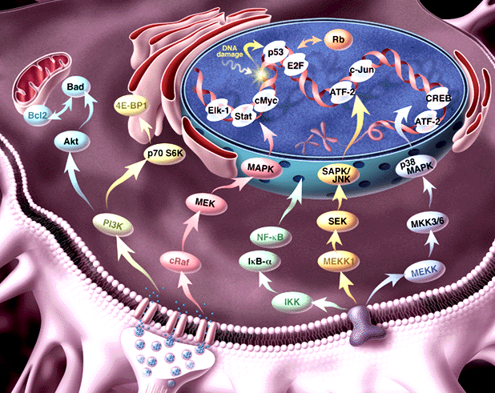
Intracellular biochemical processes
Transcriptional regulation
Metabolic pathways
Signal transduction

Slide 4
Proteomics
Genome
P_{A}
P_{B}
~100,000
P_{C}
P_{D}
Transcription
Degradation
Splicing
Transcriptosome
~10,000
UTR_{A}
UTR_{A}
UTR_{B}
UTR_{B}
UTR_{A2}
UTR_{A1}
UTR_{B1}
~110,000 - 125,000

Slide 5
Proteomics
Translation
Localization
Post-translational modification
Degradation
Proteome
~10,000 (?)
B
A
A
B
B
B
A
~500,000 - 1,000,000
A
B
A
B
Degradation
P
Localization
Post-translational modification
6x10⁹ protein molecules / cell

Slide 6
Signal transduction (ST) pathways
Pathways of molecular interactions that provide communication between the
cell membrane and intracellular end-points, leading to some change in the cell.

Slide 7
From receptors on the cell membrane
RTK
RTK
G protein receptors
Cytokine receptors
DNA damage, stress sensors
G_{β}
G_{α}
SHC
GRB2
G_{γ}
RAB
RhoA
RAC/Cdc42
C-ABL
Multiple connections:
feedback, cross talk
SOS
Ca⁺²
GCK
PAK
HPK
RAS
GAP
PYK2
Modular
at domain, component and pathway level
?
PKA
RAF
MOS
TLP2
MEKK1,2,3,4
MAPKKK5
MLK/DLK
ASK1
MAPKKK
MKK1/2
MKK4/7
MKK3/6
MAPKK
PP2A
MAPK
ERK1/2
JNK1/2/3
P38 α/β/γ/δ
Rsk,
MAPKAP’s
TFs, cytoskeletal proteins
Kinases, TFs
Cell division, Differentiation
Inflammation, Apoptosis
To intracellular (functional) end-points

Slide 8
The RTK-MAPK pathway:
Biochemical Interaction = Signal Propagation
Signal initiation: Binding of dimeric growth factor molecule (GF) to two RTK receptor molecules
Dimerization of receptors and cross-tyrosine phosphorylation
Binding of adaptor (SHC) to phosphorylated tyrosine
Recruitment of Raf to membrane by Ras
Activation of Raf protein kinase
MAPK phosphorylation cascade:
RAF  MKK  ERK1
GF
GF
RTK
RTK
SHC
GRB2
SOS
RAS
GAP
RAF
MP1
MKK1/2
PP2A
ERK1/2
MKP1/2/3

Slide 9
What is missing from the picture?
Information about
  Dynamics
  Molecular structure
  Biochemical detail of interaction
The Power to
  simulate
  analyze
  compare
Formal semantics
Script:
Characters +Plot
Movie

Slide 10
Outline
Our approach: ST as concurrent computation
Process algebra: The π-calculus
Principles of modeling ST in π-calculus (characters)
Benefits of the approach:
  full modeling (plot)
  simulation (movie)
  comparative analysis (the homology of process)

Slide 11
Our approach
Goal: Find an appropriate model for
  molecular structure (characters)
  and behavior (plot)
  within a formal semantics (movie)
Computer Science analogy:
Process algebra as a formalism for modeling of distributed computer systems

Slide 12
Our approach: Biological processes as concurrent computation
We suggest
  The molecule as a computational process
  Biochemical interaction as communication
  Use process algebra to model ST
Benefits
  Unified view
  Simulation and analysis
  Comparative power and scalability

Slide 13
The molecule as a computational process
Represent a structure by its potential behavior = by the process in which it can participate
Example:
An enzyme (protein molecule)
as the enzymatic reaction process, in which it may participate

Slide 14
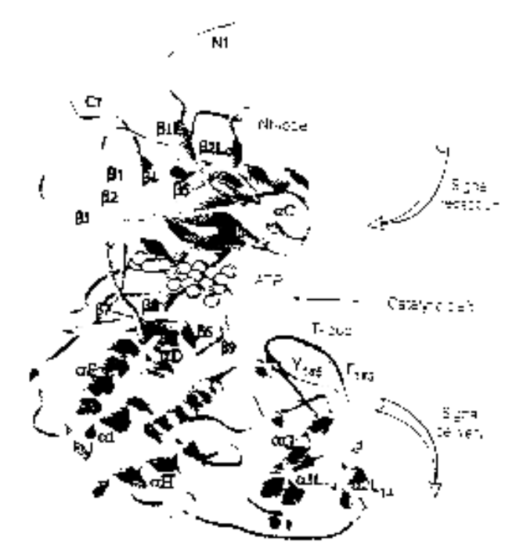
Example: ERK1 Ser/Thr kinase
Structure
Process
NH₂
Binding MP1 molecules
Nt lobe
Regulatory T-loop:
Change conformation
Kinase site:
Phosphorylate Ser/Thr residues
(PXT/SP motifs)
ATP binding site:
Bind ATP, and use it for phsophorylation
p-Y
Catalytic core
p-T
Ct lobe
Binding to substrates
COOH

Slide 15
Interaction as communication
Each interaction enables or disables other interactions
Example:
  Proteins A, B, and C
  Proteins A and B interact
  Protein A phosphorylates a residue on B
  Protein C can bind only to the phosphorylated protein B

Slide 16
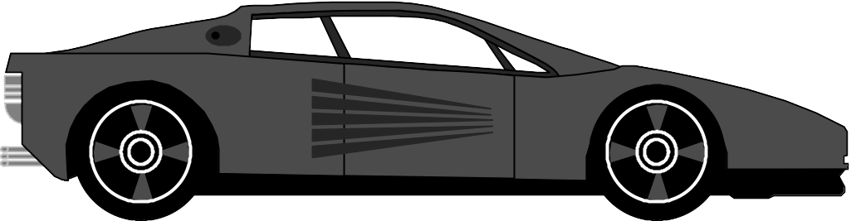
Concurrent communication systems
talk₁
switch₁
BASE₁
IDLEBASE₂
alert₁
alert₂
give₁
give₂
CENTRE₁

Slide 17
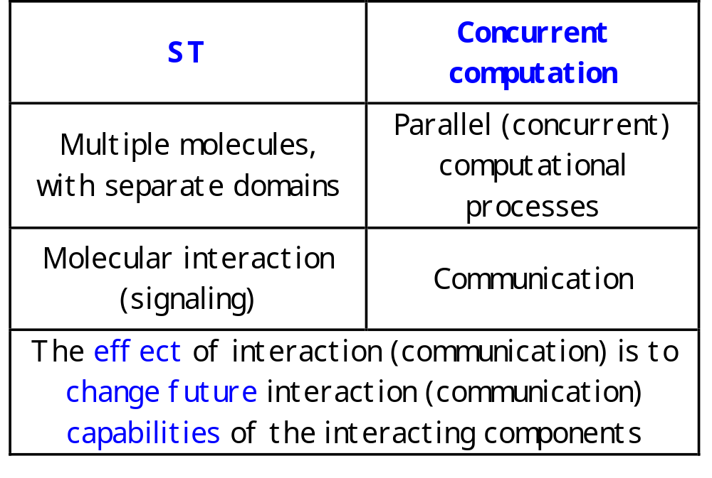
ST as concurrent computation

Slide 18
An example
A system: Proteins A, B, and C
Communication: Protein A and B can interact
Message: Protein A phosphorylates a residue on B
Meaning of message: This enables Protein B to bind to C

Slide 19
Process algebras (calculi)
Small formal languages capable of expressing the essential mechanism of concurrent computation

Slide 20
The π-calculus
(Milner, Walker and Parrow)
A community of interacting processes
Processes are defined by their potential communication activities
Communication occurs via channels, defined by names
Communication content: Change of channel names (mobility)

Slide 21
The π-calculus: Formal structure
Syntax
How to formally write a specification?
Congruence laws
When are two specifications the same?
Reaction rules
How does communication occur?

Slide 22
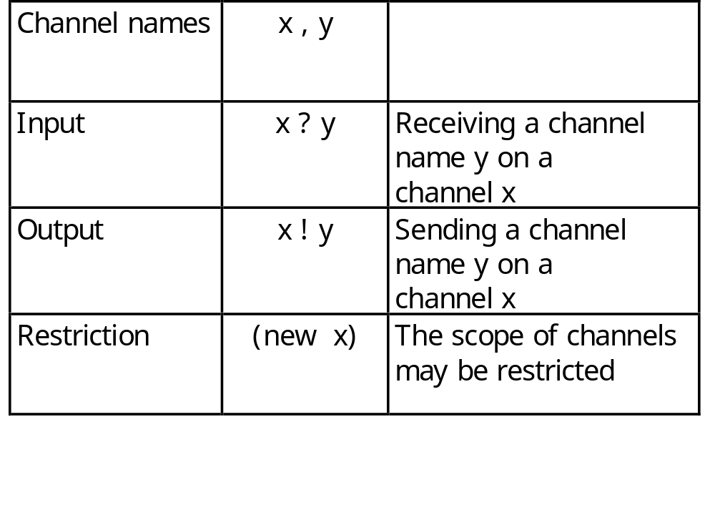
Syntax: Channels
All communication events, input or output, occur on channels

Slide 23
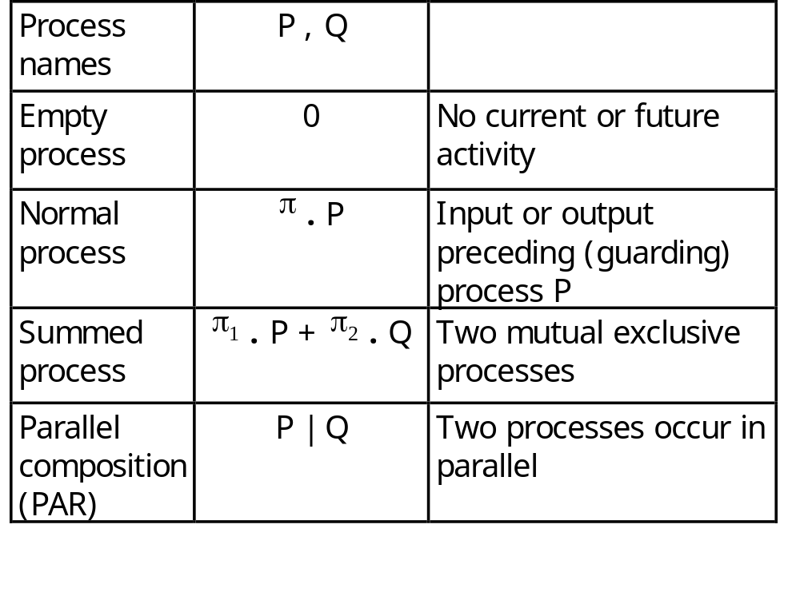
Syntax: Processes
Processes are composed of communication events
and of other processes

Slide 24
Principles for mapping ST to π-calculus
ERK1
Domain = Process
SYSTEM ::= ERK1 | ERK1 | …
ERK1 ::= (new internal_channels)
(Nt_LOBE |CATALYTIC_LOBE |Ct_LOBE)
Residues = Global (free) channel names and co-names
T_LOOP (tyr )::=
tyr ? (tyr’ ).PHOSPH_SITE(tyr’)
Y

Slide 25
The π-calculus: Reduction rules
COMM:
Ready to send z
on x
Ready to receive y
on x
Actions consumed;
Alternative choices discarded
( … + x ! z . Q ) | (… + x ? y . P)  Q | P {z/y}
z replaces y in P

Slide 26
Principles for mapping ST to π-calculus
ERK1
Molecular integrity (molecule) =
Local channels as unique identifiers
ERK1 ::= (new backbone)
(Nt_LOBE |CATALYTIC_LOBE |Ct_LOBE)
MP1
Molecule binding = Exporting local channels
mp1 ! {backbone} . backbone ! { … } |
mp1 ? {cross_backbone} . cross_backbone ? {…}
Y
ERK1
MEK1

Slide 27
Principles for mapping ST to π-calculus
Y
Molecular interaction and modification =
Communication and change of channel names
tyr ! p-tyr . KINASE_ACTIVE_SITE | … + tyr ? Tyr’ . T_LOOP
→
KINASE_ACTIVE_SITE | T_LOOP {p-tyr / tyr }
Y

Slide 28
Results:
Unified view of structure and dynamics
Detailed molecular information (complexes, molecules, domains, residues) in visible form
Complex dynamic behavior (feedback, cross-talk, split and merge) without explicit modeling
Modular system

Slide 29
Full code for MAPK^{ERK1} cascade
MEK1::=(new mek backbone1 backbone2 atp_binding_site mek_kinase) (MEK1_FREE_MP1_BINDING_SITE | MEK1_CATALYTIC_CORE)
MEK1_FREE_MP1_BINDING_SITE::= mp1_prs?{cross_mp1,cross_mp2,cross_mp3}.cross_mp1!{mek}. MEK1_BOUND_MP1_BINDING_SITE
MEK1_BOUND_MP1_BINDING_SITE::= (new a) (RESTRICTED_BINDING(a, cross_mp2, cross_mp3, mek_kinase, tyr, thr, backbone3) |
a?{}.backbone3?{}.mek?{}.MEK1_FREE_MP1_BINDING_SITE)
MEK1_CATALYTIC_CORE::= (MEK1_ATP_BINDING_SITE | MEK1_ACTIVE_SITE | MEK1_ACTIVATION_LIP)
MEK1_ACTIVATION_LIP(ser, ser, backbone1, backbone2)::= ACTIVATION_LOOP(ser, ser, backbone1, backbone2)
MEK_ATP_BINDING_SITE::= ATP_BS(atp, atp_binding_site)
MEK1_ACTIVE_SITE::= LIP_REGULATED_KINASE_ACTIVE_SITE(mek_kinase,atp_binding_site,p-ser,p-ser,ser,p-ser,thr,p-thr,backbone2,backbone3)
ERK1::=(new erk erk_nt backbone1 backbone2 backbone3 atp_binding_site erk_kinase)
(ERK1_FREE_Nt_LOBE | ERK1_CATALYTIC_CORE | ERK1_FREE_Ct_LOBE)
ERK1_FREE_Nt_LOBE::= mp1_erk1?{cross_mp1,cross_mp2,cross_mp3).cross_mp1!{erk1}.ERK1_MP1_BOUND_Nt_LOBE
ERK1_MP1_BOUND_Nt_LOBE::= (new a) (RESTRICTED_BINDING (a, cross_mp2, cross_mp3, erk_kinase, thr, ser, backbone1) |
a?{}.backbone1?{}.erk?{}.ERK1_FREE_Nt_LOBE)
ERK1_CATALYTIC_CORE::= (ERK1_ATP_BINDING_SITE | ERK1_FREE_ACTIVE_SITE | ERK1_T_LOOP)
ERK1_T_LOOP(thr, tyr, backbone1, backbone2)::= ACTIVATION_LOOP(thr, tyr, backbone1, backbone2)
ERK1_ATP_BINDING_SITE::= ATP_BS(atp,atp_binding_site)
ERK1_ACTIVE_SITE::= LIP_REGULATED_KINASE_ACTIVE_SITE(erk_kinase, atp_binding_site, p-thr, p-tyr, ser, p-ser, thr, p-thr, backbone2)
ERK1_FREE_Ct_LOBE::= (new a) (BINDING(a,erk_srs,srs_erk,erk_nt,erk_kinase,thr,ser,backbone3) |
a?{}.backbone3?{}.ERK1_FREE_Ct_LOBE)
MP1::= (new mp1 mp2 mp3 mp4) (FREE_MEK_BS | (FREE_ERK_BS + FREE_RAF_BS))
FREE_MEK_BS::= mp1_prs!{mp1,mp3,mp4}.mp1?{cross_mol}.cross_mol?{}.FREE_MEK_BS
FREE_ERK_BS::= mp1_erk!{mp2,mp4,mp3}.mp2?{cross_mol}.cross_mol?{}.FREE_ERK_BS + FREE_RAF_BS
FREE_RAF_BS::= mp1_raf!{mp2,mp4,mp3}.mp2?{cross_mol}.cross_mol?{}.FREE_ERK_BS + FREE_RAF_BS
GF
GF
RTK
RTK
GRB2
SHC
SOS
RAS
GAP
RAF
MP1
MKK1/2
PP2A
MKP1/2/3
ERK1/2

Slide 30
π-calculus programs for ST pathways
Unified coding of detailed and disparate data
The PiFCP and SPiFCP systems: semi- and fully quantitative (stochastic) computer simulation and tracing
Modular biology
  π-calculus models for molecular and functional levels
  Homology of processes

Slide 31
Modular Cell Biology
RAF
MOS
TLP2
MEKK1,2,3,4
MAPKKK5
MLK/DLK
ASK1
MAPKKK
MKK1/2
MKK4/7
MKK3/6
MAPKK
PP2A
MAPK
ERK1/2
JNK1/2/3
P38 α/β/γ/δ
Molecular modules for particular functions
How to prove their function?
Evolution of whole modules
How to compare them to each other?
Example: MAPK amplifier module
How to identify/define modules?

Slide 32
Establishing module function by a computational approach
Build two representations in the π-calculus
  molecular level (implementation)
  functional module level (specification)
Show the equivalence of both representations
  by computer simulation
  by formal verification (bisimulation)

Slide 33
Conclusions
A comprehensive theory for
  Unified formal representation of pathways and modules
  Simulation and analysis
  Comparative studies of process homologies
We have developed
  The theory of molecular processes as concurrent computation
  A method for representing ST in the π-calculus
  The PiFCP and SPiFCP simulation systems

Slide 34
Future work
Study various systems with simulation tools
Improve representation
  Dual face of interaction
  Module and complex integrity
Comparative measures
  Pathway and function
  Process homology

Slide 35
Acknowledgements
TAU
Eva Jablonka
Yehuda Ben-Shaul
WIS
Udi Shapiro
Bill Silverman
Naama Barkai

