Slide 1
Modeling Signal Transduction with Process Algebra:
Integrating Molecular Structure and Dynamics
Aviv Regev
BigRoc Seminar
February 2000

Slide 2
Signal transduction (ST) pathways
Pathways of molecular interaction that provide communication between the
cell membrane and intracellular end-points, leading to some change in the cell

Slide 3
From receptors on the cell membrane
RTK
RTK
G protein receptors
Cytokine receptors
DNA damage, stress sensors
G_{β}
G_{α}
SHC
GRB2
G_{γ}
RAB
RhoA
RAC/Cdc42
C-ABL
Multiple connections:
feedback, cross talk
SOS
Ca⁺²
GCK
PAK
HPK
RAS
GAP
PYK2
?
Modular at domain, component and pathway level
PKA
RAF
MOS
TLP2
MEKK1,2,3,4
MAPKKK5
MLK/DLK
ASK1
MAPKKK
MKK1/2
MKK4/7
MKK3/6
MAPKK
PP2A
MAPK
ERK1/2
JNK1/2/3
P38 α/β/γ/δ
Rsk,
MAPKAP’s
TFs, cytoskeletal proteins
Kinases, TFs
Mitosis, Meiosis,
Differentiation, Development
Inflammation, Apoptosis
To intracellular (functional) end-points

Slide 4
What is missing from the picture?
Information about
  Dynamics
  Molecular structure
  Biochemical detail of interaction
The Power to
  simulate
  analyze
  compare
Formal semantics

Slide 5
“We have no real ‘algebra’ for describing regulatory circuits across different systems...”
- T. F. Smith TIG 14:291-293, 1998
“The data are accumulating and the computers are humming, what we are lacking are the words, the grammar and the syntax of a new language…”
- D. Bray TIBS 22:325-326, 1997

Slide 6
Requirements from a formalism for ST
Unified view of structure and dynamics
Formal semantics to allow experiment in silico (simulation, verification)
Compare networks within and between species
Scalable to other levels of organization

Slide 7
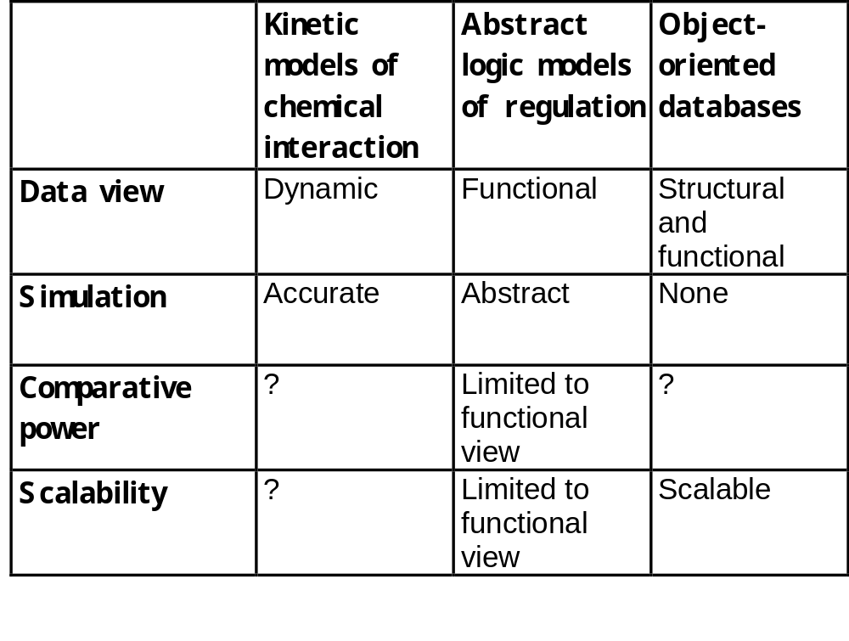
Previous approaches

Slide 8
Our approach
Formally model both molecular structure and behavior
CS analogy: process algebra as a formalism for modeling of distributed computer systems
We suggest:
1. The molecule as a computational process
2. Use process algebra to model ST

Slide 9
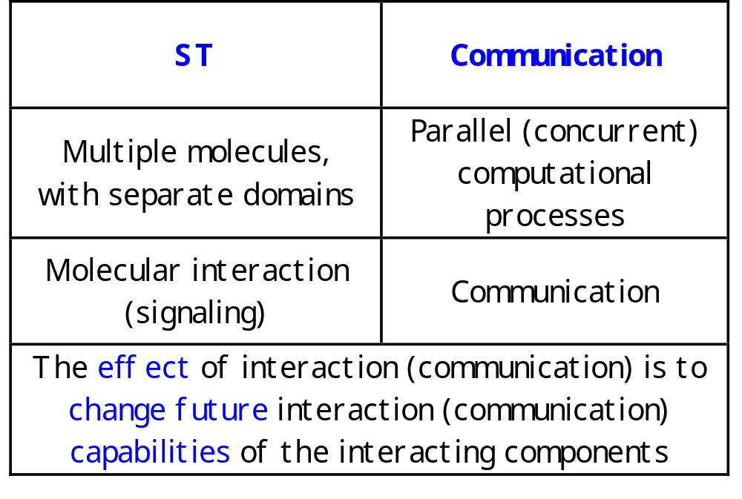
The ST communication analogy

Slide 10
An example
A system: Protein A, B, and C
Communication: Protein A and B can interact
Message: Protein A phosphorylates a residue on B
Meaning of message: This enables Protein B to bind to C

Slide 11
Process algebras (calculi)
Small formal languages capable of expressing the essential mechanism of concurrent computation

Slide 12
The π-calculus
(Milner, Walker and Parrow, 1989; Milner 1993, 1999)
A community of interacting processes
Processes are defined by their potential communication activities
Communication occurs via channels, defined by names
Communication content: Change of channel names (mobility)

Slide 13
The π-calculus: Formal structure
Syntax
How to formally write a specification?
Congruence laws
When are two specifications the same?
Reaction rules
How does communication occur?

Slide 14
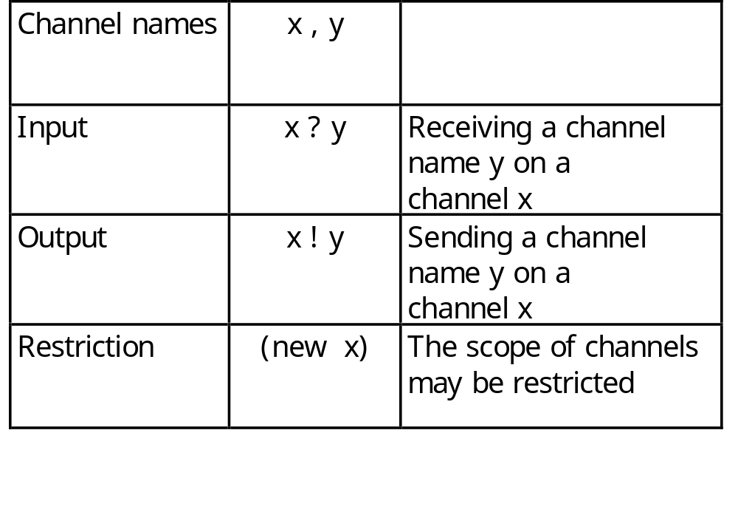
Syntax: Channels
All communication events, input or output, occur on channels

Slide 15
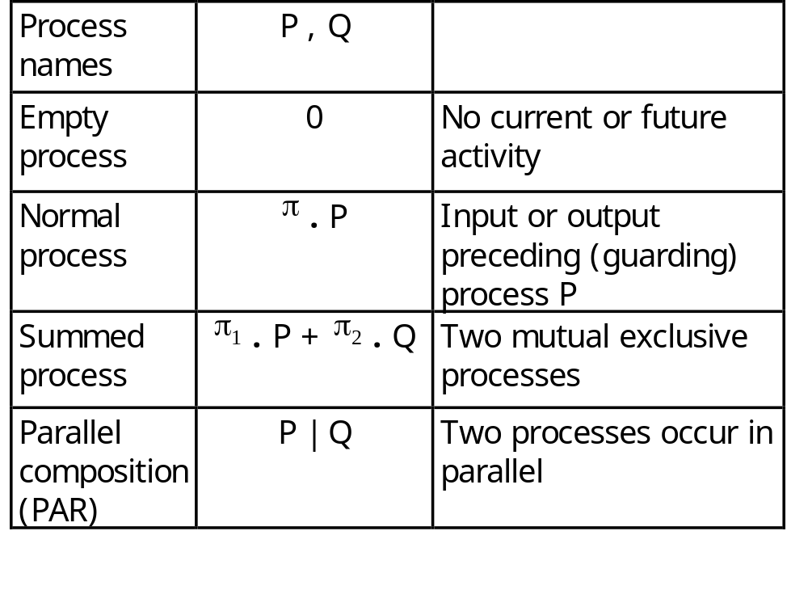
Syntax: Processes
Processes are composed of communication events
and of other processes

Slide 16
Mapping ST to π-calculus:
Visibility of molecular information
Domain = Process
SYSTEM ::= RECEPTOR | RECEPTOR | …
RECEPTOR ::= (new internal_channels) (EC |TM |CYT )
Residues = Channel names and co-names
PHOSPH_SITE (tyr )::=
tyr ! [] .PHOSPH_SITE +
kinase ? tyr . PHOSPH_SITE

Slide 17
The π-calculus: Reduction rules
COMM:
Ready to send z
on x
Ready to receive y
on x
Actions consumed;
Alternative choices discarded
( … + x ! z . Q ) | (… + x ? y . P)  Q | P {z/y}
z replaces y in P

Slide 18
Mapping ST to π-calculus:
Full dynamic behavior of network
Molecular interaction and modification =
Communication and change of channel names
kinase ! p-tyr . KINASE_ACTIVE_SITE |
… + kinase ? tyr . PHOSPH_SITE
→
PHOSPH_SITE {p-tyr / tyr } | KINASE_ACTIVE_SITE

Slide 19
Example: A π-calculus model of the RTK-MAPK pathway
GF
GF
RTK
RTK
Ligand binding
Ligand-induced receptor dimerization
Phosphorylation and de-phosphorylation (processive or not)
Phosphorylation-induced conformation and activity changes (activation loops)
Scaffolding and sequestration
SHC
GRB2
SOS
RAS
GAP
RAF
MKK1/2
PP2A
ERK1/2
MKP1/2/3

Slide 20
Full signaling in the π-calculus
Ordered regulation - prefixing
Enzymatic activity - recursion
Binding and sequestration- reciprocal communication and restriction

Slide 21
Results:
Unified view of structure and dynamics
Detailed molecular information (molecules, domains, residues) in visible form (generic contexts)
Complex dynamic behavior (feedback, cross-talk, split and merge) without explicit modeling
Modular system

Slide 22
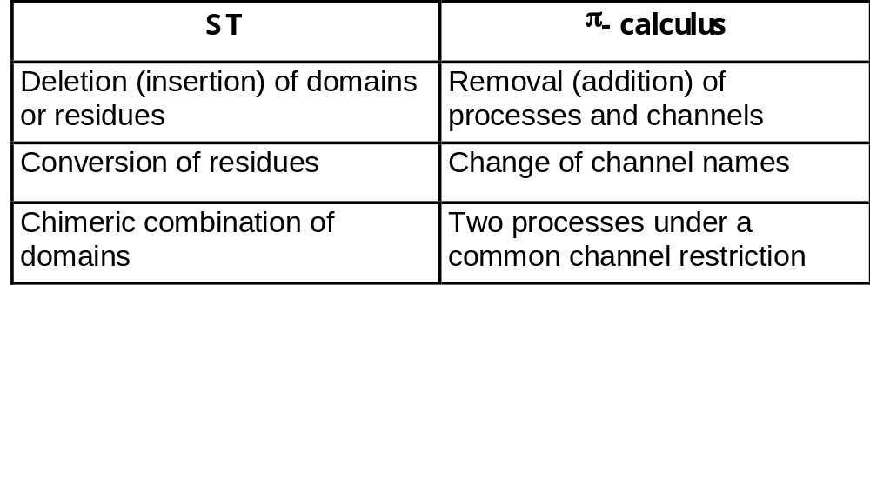
Experiment in silico:
Mutational analysis
Simulation
Formal verification

Slide 23
LIGAND::= (new ligand) (RECEPTOR_BD | RECEPTOR_BD)
Dominat negative: Remove one RECEPTOR_BD process in the LIGAND
LIGAND::= (new ligand ) (RECEPTOR_BD)
GF
GF
RTK
RTK
SHC
GRB2
SOS
RAS
GAP
SER₂₁₈ (Ser) ::=
Ser ! []. SER₂₁₈+ cross_enzyme ? Ser . SER₂₁₈
Constitutive mutant: Change Ser to pSer
SER₂₁₈ ::= pSer ! [] . SER₂₁₈
RAF
MKK1/2
PP2A
ERK1/2
MKP1/2/3

Slide 24
Experiment in silico:
Simulation
Goal: Simulate events in ST pathways
A Flat Concurrent Prolog (FCP)-based emulator
  Input: π-calculus specifications (PiFCP)
  Output: Step-by-step simulation of communication events
Stochastic version (under development)

Slide 25
Future prospects:
Homology of process
Homologous pathways share both components and interaction structure
The π-calculus model includes both structure and dynamics
Two models can be formally compared to determine the degree of mutual similarity of their behavior (bisimulation)
A homology measure of ST pathways is determined based on such bisimilarity

Slide 26
Conclusions
A comprehensive theory for:
  Unified formal description
  Analysis and verification
  Comparative studies of process homologies
Current and future work includes:
  Investigate various systems with PiFCP
  Stochastic version
  Extension of the model

Slide 27
Acknowledgements
Eva Jablonka
Udi Shapiro
Bill Silverman

