Slide 1
Representing Biomolecular Processes with Process Algebra: π-Calculus as a formalism for Signal Transduction Networks
Aviv Regev and Ehud Shapiro
February 2000

Slide 2
Biological communication systems
Molecules
Cells
Organisms
Communication
Cells
Tissues
Animal societies

Slide 3
Signal transduction (ST) pathways
Pathways of molecular interaction that provide communication between the
cell membrane and intracellular end-points, leading to some change in the cell

Slide 4
RTK
RTK
G protein receptors
Cytokine receptors
DNA damage, stress sensors
G_{β}
G_{α}
SHC
GRB2
G_{γ}
RAB
RhoA
RAC/Cdc42
C-ABL
SOS
Ca⁺²
GCK
PAK
HPK
RAS
GAP
PYK2
?
PKA
RAF
MOS
TLP2
MEKK1,2,3,4
MAPKKK5
MLK/DLK
ASK1
MKK1/2
MKK4/7
MKK3/6
PP2A
ERK1/2
JNK1/2/3
P38 α/β/γ/δ
Rsk,
MAPKAP’s
TFs, cytoskeletal proteins
Kinases, TFs
Mitosis, Meiosis,
Differentiation, Development
Inflammation, Apoptosis

Slide 5
From receptors on the cell membrane
RTK
RTK
G protein receptors
Cytokine receptors
DNA damage, stress sensors
G_{β}
G_{α}
SHC
GRB2
G_{γ}
RAB
RhoA
RAC/Cdc42
C-ABL
Multiple connections:
feedback, cross talk
SOS
Ca⁺²
GCK
PAK
HPK
RAS
GAP
PYK2
?
Modular at domain, component and pathway level
PKA
RAF
MOS
TLP2
MEKK1,2,3,4
MAPKKK5
MLK/DLK
ASK1
MAPKKK
MKK1/2
MKK4/7
MKK3/6
MAPKK
PP2A
MAPK
ERK1/2
JNK1/2/3
P38 α/β/γ/δ
Rsk,
MAPKAP’s
TFs, cytoskeletal proteins
Kinases, TFs
Mitosis, Meiosis,
Differentiation, Development
Inflammation, Apoptosis
To intracellular (functional) end-points

Slide 6
What is missing from the picture?
Information about
  Dynamics
  Molecular structure
  Biochemical detail of interaction
The Power to
  simulate
  analyze
  compare
Formal semantics
Script:
Characters +Plot
Movie

Slide 7
“We have no real ‘algebra’ for describing regulatory circuits across different systems...”
- T. F. Smith (TIG 14:291-293, 1998)
“The data are accumulating and the computers are humming, what we are lacking are the words, the grammar and the syntax of a new language…”
- D. Bray (TIBS 22:325-326, 1997)

Slide 8
Our approach
Model both molecular structure (characters) and behavior (plot), within a formal semantics (movie)
CS analogy: process algebra as a formalism for modeling of distributed computer systems

Slide 9
Our approach
We suggest:
  The molecule as a computational process
  Use process algebra to model ST
Benefits:
  Unified view
  Simulation and analysis
  Comparative power and scalability

Slide 10
Outline
Example: The MAPK RTK pathway
ST as concurrent computation
The π-calculus
Principles of modeling ST in π-calculus (characters)
Full model of the MAPK cascade (script)
Simulation (plot)
Comparative analysis

Slide 11
RTK
RTK
G protein receptors
Cytokine receptors
DNA damage, stress sensors
G_{β}
G_{α}
SHC
GRB2
G_{γ}
RAB
RhoA
RAC/Cdc42
C-ABL
SOS
Ca⁺²
GCK
PAK
HPK
RAS
GAP
PYK2
?
PKA
RAF
MOS
TLP2
MEKK1,2,3,4
MAPKKK5
MLK/DLK
ASK1
MKK1/2
MKK4/7
MKK3/6
PP2A
ERK1/2
JNK1/2/3
P38 α/β/γ/δ
Rsk,
MAPKAP’s
TFs, cytoskeletal proteins
Kinases, TFs
Mitosis, Meiosis,
Differentiation, Development
Inflammation, Apoptosis

Slide 12
The RTK-MAPK pathway
GF
GF
Dimeric growth factors (GF) binds two RTK receptors
Dimerization of receptors and cross-tyrosine phosphorylation
Binding of adaptor (SHC) to phosphorylated tyrosine
Recruitment of Raf to membrane by Ras
Activation of Raf protein kinase
MAPK phosphorylation cascade:
RAF  MKK  ERK1
(MP1 tethered couples)
RTK
RTK
SHC
GRB2
SOS
RAS
GAP
RAF
MP1
MKK1/2
PP2A
ERK1/2
MKP1/2/3

Slide 13
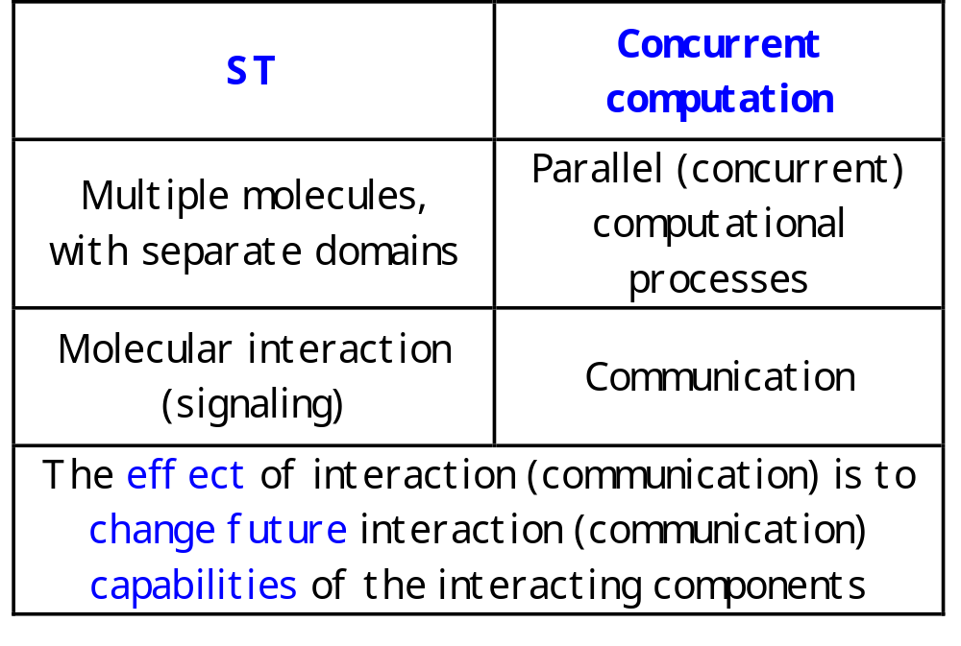
ST as concurrent computation

Slide 14
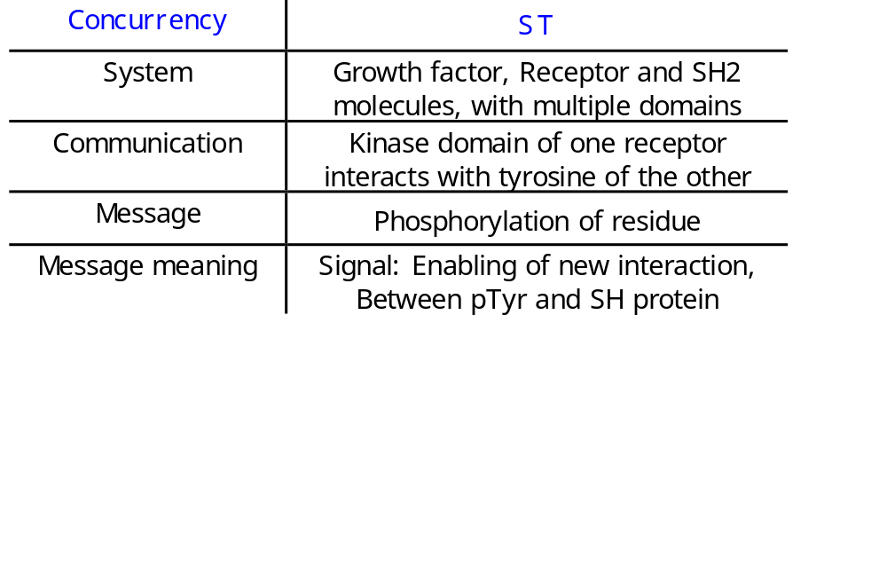
RTK
ECM
cytoplasm
pY
SHC
Y
Y
Y

Slide 15
The π-calculus
(Milner, Walker and Parrow, 1989; Milner 1993, 1999)
A community of interacting processes
Processes are defined by their potential communication activities
Communication occurs via channels, defined by names
Communication content: Change of channel names (mobility)

Slide 16
The π-calculus: Formal structure
Syntax
How to formally write a specification?
Congruence laws
When are two specifications the same?
Reaction rules
How does communication occur?

Slide 17
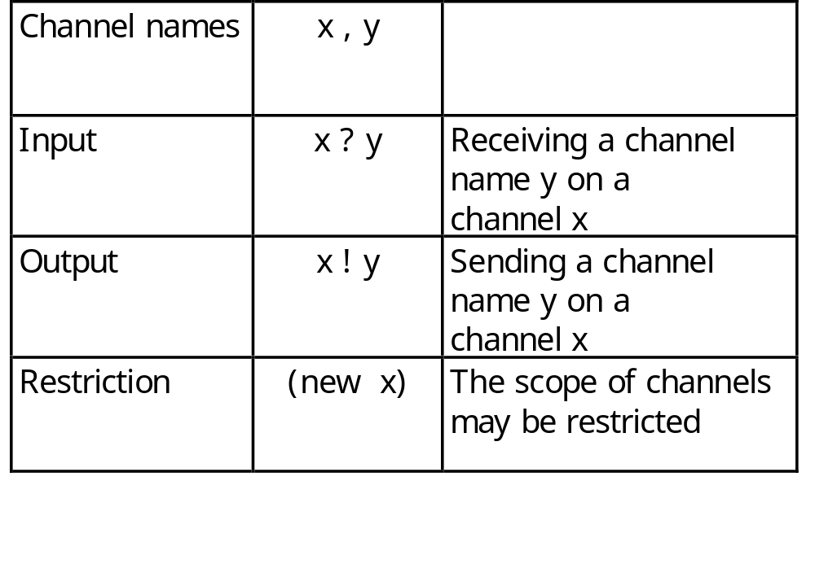
Syntax: Channels
All communication events, input or output, occur on channels

Slide 18
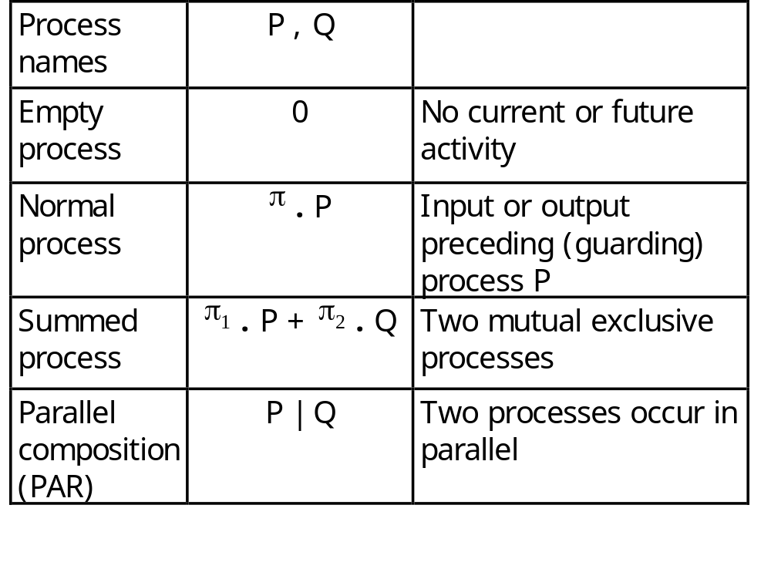
Syntax: Processes
Processes are composed of communication events
and of other processes

Slide 19
Principles for mapping ST to π-calculus
Domain = Process
SYSTEM ::= RECEPTOR | RECEPTOR | …
RECEPTOR ::= (new internal_channels) (EC |TM |CYT )
Residues = Global (free) channel names and co-names
PHOSPH_SITE (tyr )::=
tyr ! [] .PHOSPH_SITE +
kinase ? tyr . PHOSPH_SITE
Y

Slide 20
The π-calculus: Reduction rules
COMM:
Ready to send z
on x
Ready to receive y
on x
Actions consumed;
Alternative choices discarded
( … + x ! z . Q ) | (… + x ? y . P)  Q | P {z/y}
z replaces y in P

Slide 21
Principles for mapping ST to π-calculus
Molecular interaction and modification =
Communication and change of channel names
kinase ! p-tyr . KINASE_ACTIVE_SITE | … + kinase ? tyr . PHOSPH_SITE
→
KINASE_ACTIVE_SITE | PHOSPH_SITE {p-tyr / tyr }
Y
Y

Slide 22
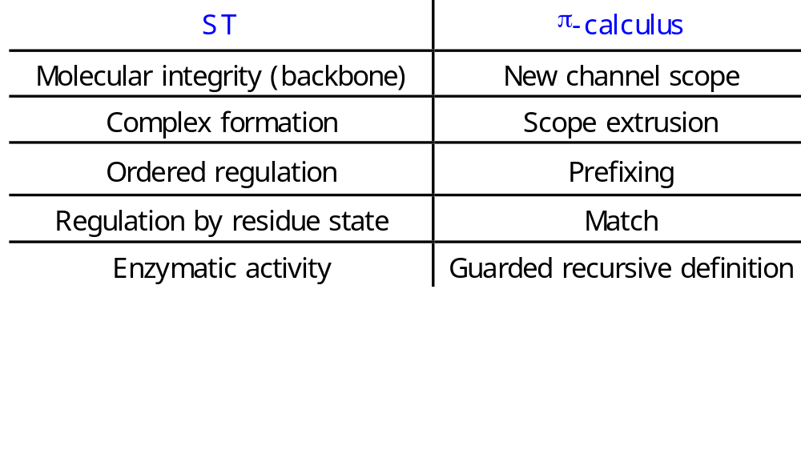
RTK in the π-calculus
ECM
cytoplasm
pY
SHC
Y
Y
Y

Slide 23
Unified view of structure and dynamics
Characters: Detailed molecular information (molecules, domains, residues) in visible form
Script: Complex dynamic behavior (feedback, cross-talk, split and merge) without explicit modeling
Modular system

Slide 24
The MAPK^{ERK1} cascade
Optional: RAF-MEK or MEK-ERK bind mutual adaptor MP1
At each step: Upstream kinase phosphorylates the T-loop of the downstream kinase (2 sites)
T-loop induces conformation of active site
  Upon phosphorylation: opening
  Upon de-phosphorylation: closing
MP1
RAF
ERK1
MEK1

Slide 25
Full code for MAPK^{ERK1} cascade
MEK1::=(new mek backbone1 backbone2 atp_binding_site mek_kinase) (MEK1_FREE_MP1_BINDING_SITE | MEK1_CATALYTIC_CORE)
MEK1_FREE_MP1_BINDING_SITE::= mp1_prs?{cross_mp1,cross_mp2,cross_mp3}.cross_mp1!{mek}. MEK1_BOUND_MP1_BINDING_SITE
MEK1_BOUND_MP1_BINDING_SITE::= (new a) (RESTRICTED_BINDING(a, cross_mp2, cross_mp3, mek_kinase, tyr, thr, backbone3) |
a?{}.backbone3?{}.mek?{}.MEK1_FREE_MP1_BINDING_SITE)
MEK1_CATALYTIC_CORE::= (MEK1_ATP_BINDING_SITE | MEK1_ACTIVE_SITE | MEK1_ACTIVATION_LIP)
MEK1_ACTIVATION_LIP(ser, ser, backbone1, backbone2)::= ACTIVATION_LOOP(ser, ser, backbone1, backbone2)
MEK_ATP_BINDING_SITE::= ATP_BS(atp, atp_binding_site)
MEK1_ACTIVE_SITE::= LIP_REGULATED_KINASE_ACTIVE_SITE(mek_kinase,atp_binding_site,p-ser,p-ser,ser,p-ser,thr,p-thr,backbone2,backbone3)
ERK1::=(new erk erk_nt backbone1 backbone2 backbone3 atp_binding_site erk_kinase)
(ERK1_FREE_Nt_LOBE | ERK1_CATALYTIC_CORE | ERK1_FREE_Ct_LOBE)
ERK1_FREE_Nt_LOBE::= mp1_erk1?{cross_mp1,cross_mp2,cross_mp3).cross_mp1!{erk1}.ERK1_MP1_BOUND_Nt_LOBE
ERK1_MP1_BOUND_Nt_LOBE::= (new a) (RESTRICTED_BINDING (a, cross_mp2, cross_mp3, erk_kinase, thr, ser, backbone1) |
a?{}.backbone1?{}.erk?{}.ERK1_FREE_Nt_LOBE)
ERK1_CATALYTIC_CORE::= (ERK1_ATP_BINDING_SITE | ERK1_FREE_ACTIVE_SITE | ERK1_T_LOOP)
ERK1_T_LOOP(thr, tyr, backbone1, backbone2)::= ACTIVATION_LOOP(thr, tyr, backbone1, backbone2)
ERK1_ATP_BINDING_SITE::= ATP_BS(atp,atp_binding_site)
ERK1_ACTIVE_SITE::= LIP_REGULATED_KINASE_ACTIVE_SITE(erk_kinase, atp_binding_site, p-thr, p-tyr, ser, p-ser, thr, p-thr, backbone2)
ERK1_FREE_Ct_LOBE::= (new a) (BINDING(a,erk_srs,srs_erk,erk_nt,erk_kinase,thr,ser,backbone3) |
a?{}.backbone3?{}.ERK1_FREE_Ct_LOBE)
MP1::= (new mp1 mp2 mp3 mp4) (FREE_MEK_BS | (FREE_ERK_BS + FREE_RAF_BS))
FREE_MEK_BS::= mp1_prs!{mp1,mp3,mp4}.mp1?{cross_mol}.cross_mol?{}.FREE_MEK_BS
FREE_ERK_BS::= mp1_erk!{mp2,mp4,mp3}.mp2?{cross_mol}.cross_mol?{}.FREE_ERK_BS + FREE_RAF_BS
FREE_RAF_BS::= mp1_raf!{mp2,mp4,mp3}.mp2?{cross_mol}.cross_mol?{}.FREE_ERK_BS + FREE_RAF_BS

Slide 26
Full code for MAPK^{ERK1} cascade
RESTRICTED_BINDING(a,mot1,mot2,enzyme,res1,res2,bb)::= RES_BIND1(mot1,mot2) + RES_BIND2(mot2,mot1)
RES_BIND1(mot1,mot2)::=
mot1?{cross_enzyme,cross_res1,cross_res2}.mot2!{enzyme,res1,res2}.bb!{cross_enzyme,cross_res1,cross_res2}.a!{}
RES_BIND2(mot1,mot2)::=
mot2!{enzyme,res1,res2}.mot1?{cross_enzyme,cross_res1,cross_res2}. bb!{cross_enzyme,cross_res1,cross_res2}.a!{}
BINDING(a, mot1, mot2, new_mot, enzyme, res1, res2, bb)::= BINDING1 + BINDING2
BINDING1::=
mot1?{cross_mot,cross_enzyme,cross_res1,cross_res2}.cross_mot!{enzyme,res1,res2}. bb!{cross_enzyme,cross_res1,cross_res2}.a!{}
BINDING2::=
mot2!{new_mot,enzyme,res1,res2}.new_mot?{cross_enzyme,cross_res1,cross_res2}.bb!{cross_enzyme,cross_res1,cross_res2}.a!{}
ACTIVATION_LOOP(res1, res2, bb1, bb2)::= DIRECT(res1, res2, bb1, bb2) + INDIRECT(res1, res2, bb1, bb2)
DIRECT::= res1?{cross_enzyme}.cross_enzyme?{res1'}.bb2!{res1',res2}.ACTIVATION_LOOP(res1', res2, bb1, bb2) +
res2?{cross_enzyme}.cross_enzyme?{res2'}.bb2!{res1,res2'}.ACTIVATION_LOOP(res1, res2', bb1, bb2)
INDIRECT::= backbone1(cross_enzyme,cross_motif1,cross_motif2).
[cross_motif1=res1].cross_enzyme?{res1'}.bb2!{res1',res2}.INDIRECT(res1',res2,bb1,bb2)+
[cross_motif2=res2].cross_enzyme?{res2'}.bb2!{res1,res2'}.INDIRECT(res1,res2',bb1,bb2)+
[otherwise].bb1!{}.ACTIVATION_LOOP
ATP_BINDING_SITE(atp,atp_bs)::= atp?{adp}.atp_bs!{}.adp!{}.ATP_BS
LIP_REGULATED_KINASE_ACTIVE_SITE(enzyme, atp_bs, res1, res2, res3, modres3, res4, modres4, bb1, bb2)::=
bb1?{res1',res2'}.[(res1', res2')=(res1,res2)].ACTIVE_SITE
ACTIVE_SITE ::=atp_bs?{}.(DIRECT_KINASE + INDIRECT_KINASE)
DIRECT_KINASE::= res3!{enzyme}.enzyme!{modres3}.ACTIVE_SITE + res4!{enzyme}.enzyme!{modres4}.ACTIVE_SITE +
bb1?{res1',res2'}.[(res1', res2') ne (res1,res2)].LIP_REGULATED_KINASE_ACTIVE_SITE
INDIRECT_KINASE::=bb2(cross_enzyme,cross_res1,cross_res2). (enzyme!{modres3}.atp_bs.INDIRECT_KINASE +
enzyme!{modres4}.atp_bs.INDIRECT_KINASE + bb2!{}.ACTIVE_SITE + bb1?{res1',res2'}.
[(res1', res2') ne (res1,res2)].bb2!{}.LIP_REGULATED_KINASE_ACTIVE_SITE)

Slide 27
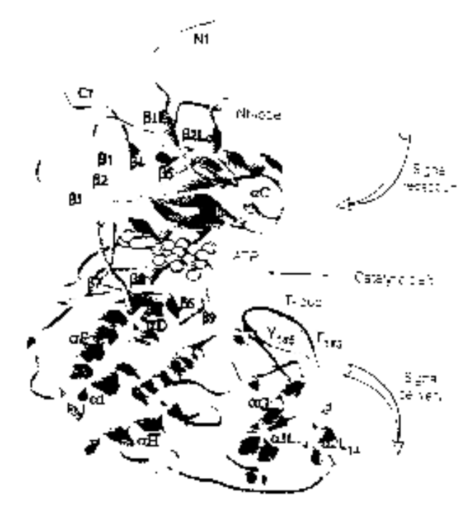
ERK1
NH₂
Binding to upstream components: the MP1 scaffold molecule
Nt lobe
Regulatory T-loop: obstructs the active site when its Thr and Tyr are not phosphorylated
Kinase site: Ser/Thr kinase, recognizes PXT/SP motifs
ATP binding site: loaded with ATP, used for phsophorylation
p-Y
Catalytic core
p-T
Ct lobe
Binding to downstream components (substrates)
COOH

Slide 28
MEK1
NH₂
Binding to adaptor
MP1 binding site
Regulatory T-loop: obstructs the active site when its Thr and Tyr are not phosphorylated
Kinase site: Ser/Thr kinase, recognizes PXT/SP motifs
ATP binding site: loaded with ATP, used for phsophorylation
p-S
Catalytic core
p-S
COOH

Slide 29
Direct phosphorylation of ERK1 by MEK1
(1) ERK1::= (new backbone atp_bs erk_kinase)
(Nt_LOBE | ERK1_CATALYTIC_CORE | Ct_LOBE)
(2) ERK1_CATALYTIC_CORE::=
(ATP_BS | ACTIVE_SITE | T_LOOP)
(3) T_LOOP(thr,tyr)::= DIRECT + INDIRECT
(4) DIRECT::=
thr ? cross_enzyme . cross_enzyme ? thr .
backbone ! {thr,tyr} . T_LOOP +
tyr ? cross_enzyme . cross_enzyme ? tyr .
backbone ! {thr,tyr} . T_LOOP

Slide 30
(1) MEK1::= (new backbone atp_bs mek_kinase)
(MP1_BS | MEK1_CATALYTIC_CORE)
(2) MEK1_CATALYTIC_CORE::=
(ATP_BS | ACTIVE_SITE | ACTIVATION_LIP)
(3) ACTIVE_SITE::= backbone ? {res1,res2}.
[(res1,res2)=(p-ser,p-ser)].ACTIVE_KINASE
(4) ACTIVE_KINASE::= atp_bs .
(NON_PROCESSIVE + PROCESSIVE)
(5) NON_PROCESSIVE::=
thr ! {mek_kinase} . mek_kinase ! {p-thr} . ACTIVE_KINASE +
tyr ! {mek_kinase} . mek_kinase ! {p-tyr} . ACTIVE_KINASE +
backbone ? {res1,res2}.
[(res1,res2)=(p-ser,p-ser)].ACTIVE_SITE

Slide 31
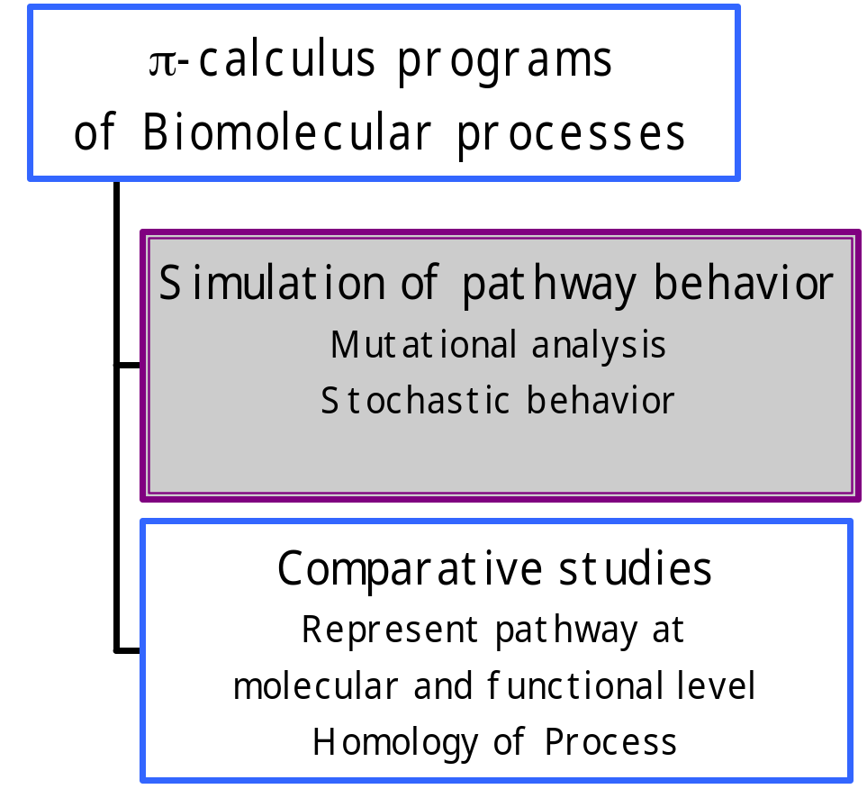
Experiment in silico
Goal: Simulate events in ST pathways, represented in the π-calculus
Problem: Previous implementations (Pict, Join-calculus) are inadequate for synchronous simulation

Slide 32
The PiFCP simulation system
Based on the Logix system (Flat Concurrent Prolog)
Supports synchronous interaction
  guarded atomic unification as a basic operation in FCP
  input and output guards, mixed choice
Surface syntax (PiFCP)
  insulated from general Logix procedures

Slide 33
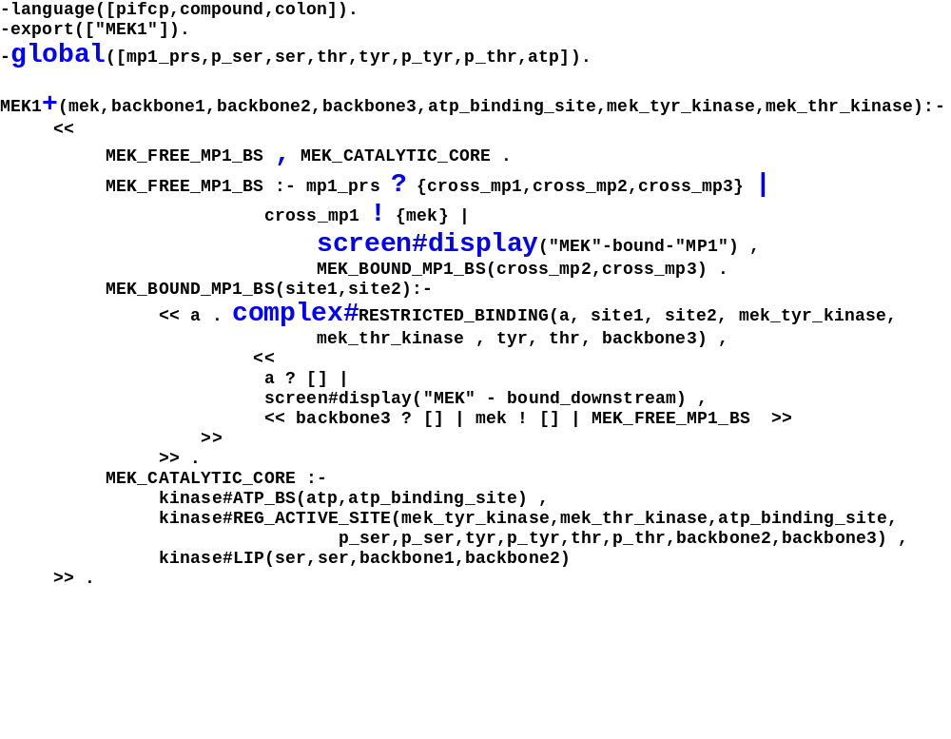
mek1.cp

Slide 34
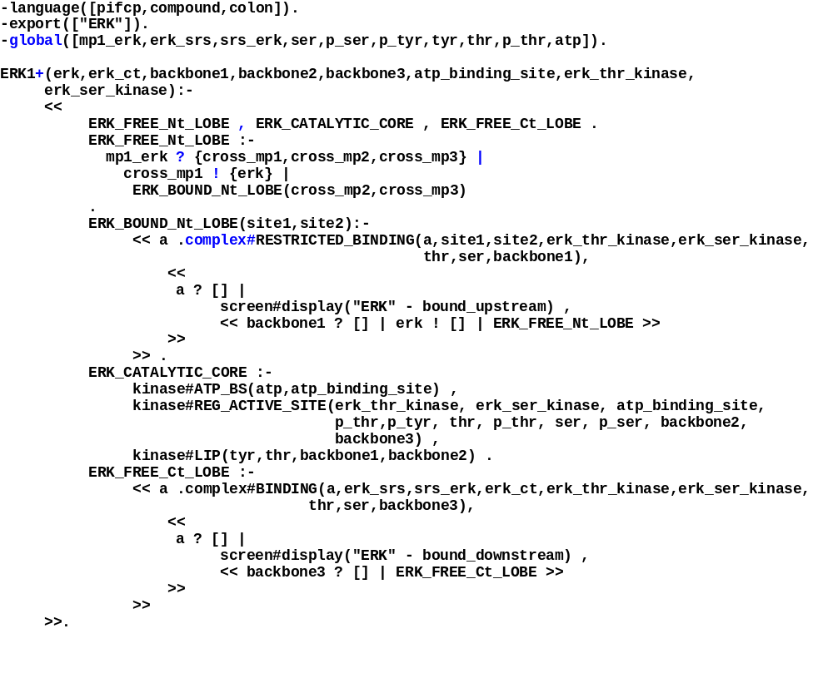
erk1.cp

Slide 35
The PiFCP simulation system
Compiler: Generate FCP computational processes from input PiFCP code
  Each free/declared channel  FCP message stream
  Each process  FCP process
Debugger: Specific scenario (movie)
  Step-by-step execution
  tracing of computation/simulation

Slide 36
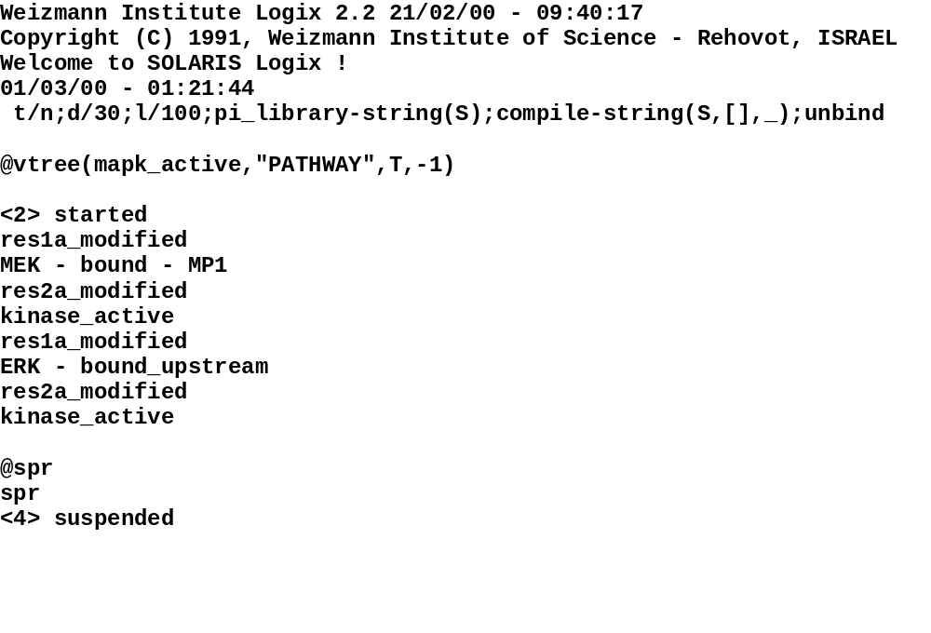
MEK1/ERK1 session
“output” (printout)

Slide 37
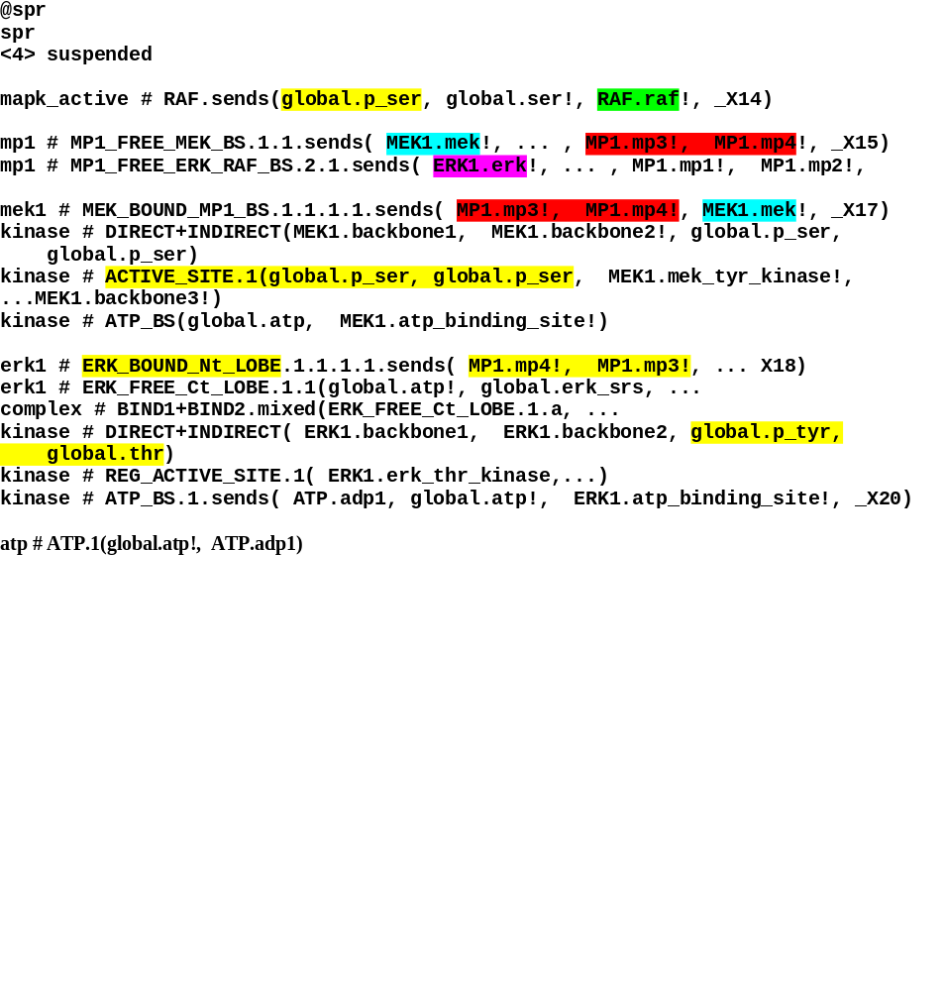
MEK1/ERK1 session
Restricted channels (location, association)
RESOLVENT
Global channel (residue) and related process (molecule) state

Slide 38
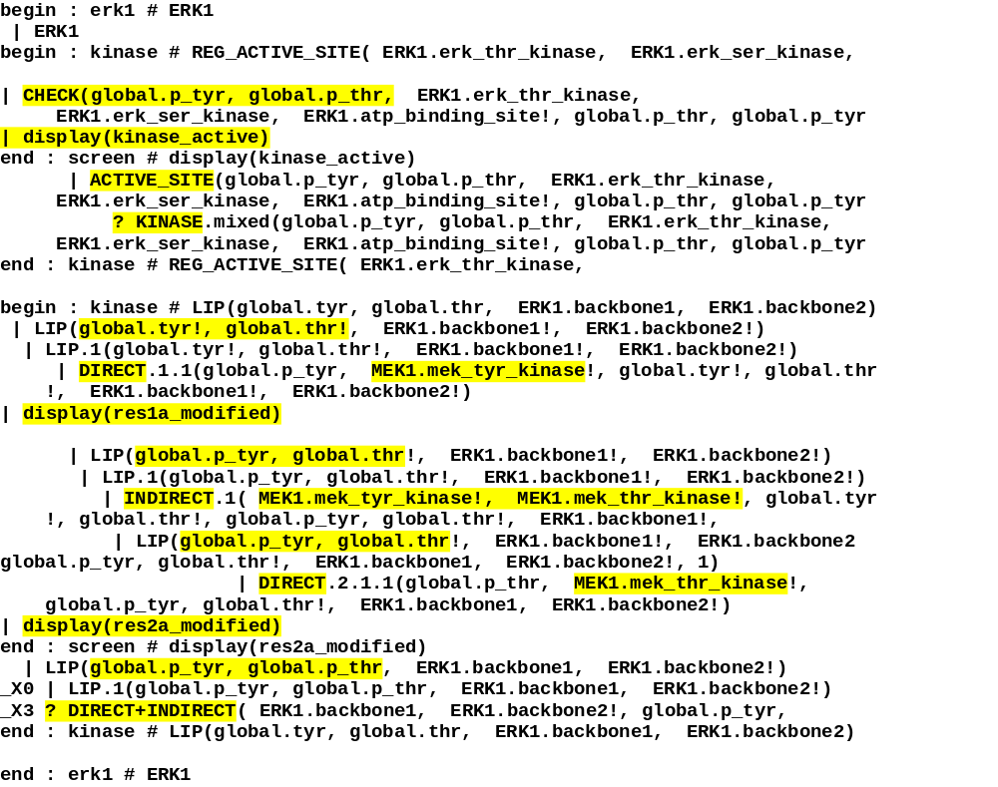
MEK1 trace

Slide 39
Conclusions
A comprehensive theory for:
  Unified formal representation of pathways and modules
  Simulation and analysis
  Comparative studies of process homologies
We have developed:
  A method for representing ST in π-calculus
  The PiFCP simulation system (Semi-quantitative)

Slide 40
Future work
Improve representation:
  Dual face of interaction
  Module and complex integrity
Simulation
  Improved tracing tools
  Stochastic version: Different rates for different reactions
Comparative measures
  Pathway and function
  Process homology

Slide 41
Acknowledgements
WIS
Bill Silverman
Naama Barkai
TAU
Eva Jablonka
Yehuda Ben-Shaul

