Slide 1
The BioPSI Project:
Concurrent Processes Come Alive
www.wisdom.weizmann.ac.il/~aviv

Slide 2
Biological communication systems
Molecules
Cells
Organisms
Communication
Cells
Tissues
Animal societies

Slide 3
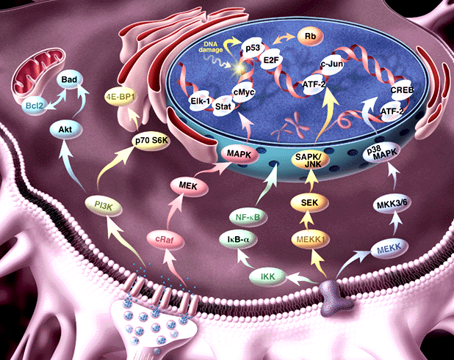
Pathway Informatics:
From molecule to process
Genome, transcriptosome, proteome
Regulation of expression; Signal Transduction; Metabolism

Slide 4
The molecular “parts-list”: The genome
Genome
P_{A}
P_{B}
~100,000
P_{C}
P_{D}
Transcription
Splicing

Slide 5
The molecular “parts-list”:
The transcriptomes
Transcription
Splicing
Transcriptosome
~10,000
UTR_{A}
UTR_{A}
UTR_{B}
UTR_{B}
UTR_{A2}
UTR_{A1}
UTR_{B1}
~110,000 - 125,000
Translation
Degradation
Localization

Slide 6
The molecular “parts-list”: The proteomes
Translation
Degradation
Localization
Proteome
~10,000 (?)
B
A
A
B
B
B
A
~500,000 - 1,000,000
A
B
A
B
P
Degradation
Localization
Post-translational modification
6x10⁹ protein molecules / cell

Slide 7
Biochemical networks in a nutshell
Multiple protein molecules, each composed of domains
Domains interact with one another
Interaction depends on motif complementarity (structural, biochemical, etc.)
The result: biochemical modification, e.g.
  Covalent changes
  Conformation changes
  Complex formation
  Re-location
Biochemical modification changes function

Slide 8
Pathway Informatics:
From molecule to process
Genome, transcriptosome, proteome
Regulation of expression; Signal Transduction; Metabolism

Slide 9
What is missing from the pictures?
Information about
  Dynamics
  Molecular structure
  Biochemical detail of interaction
The Power to
  simulate
  analyze
  compare
Formal semantics
Script:
Characters +Plot
Movie

Slide 10
Previous approaches
Continous differential equations / Stochastic Monte-Carlo simulation
Boolean networks
Graph based models
Object-oriented databases
The compositionality problem: Lack of integration between molecular detail and biochemical dynamics

Slide 11
Our Goal:
A formal compositional representation language for molecular processes

Slide 12
Biochemical networks are complex
Concurrent - Many copies of various molecules
Mobile - Dynamic changes in network wiring
Hierarchical - Functional modules
… But similar to computational ones

Slide 13
Our Approach:
Represent and study biochemical networks as concurrent computation

Slide 14
Molecules as processes
Represent a structure by its potential behavior: by the process in which it can participate
Example: An enzyme as the enzymatic reaction process, in which it may participate

Slide 15
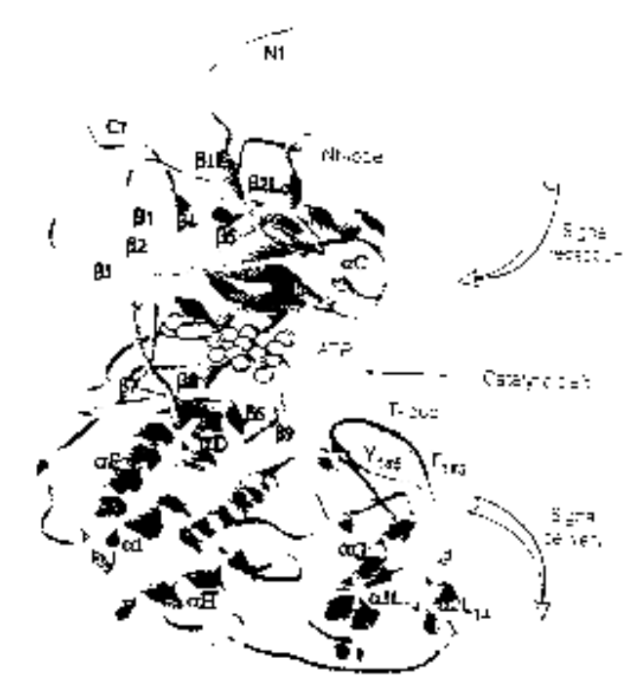
Example: ERK1 Ser/Thr kinase
Structure
Domains
Motifs
Process
NH₂
Binding MP1 molecules
Nt lobe
Regulatory T-loop:
Change conformation
Kinase site:
Phosphorylate Ser/Thr residues
(PXT/SP motifs)
ATP binding site:
Bind ATP, and use it for phsophorylation
p-Y
Catalytic core
p-T
Ct lobe
Binding to substrates
COOH

Slide 16
The π-calculus
(Milner, Walker and Parrow 1989)
A program specifies a network of interacting processes
Processes are defined by their potential communication activities
Communication occurs on complementary channels, identified by names
Communication content: Change of channel names (mobility)
Stochastic version (Priami 1995) : Channels are assigned rates

Slide 17
The π-calculus: Formal structure
Syntax
How to formally write a specification?
Congruence laws
When are two specifications the same?
Reaction rules
How does communication occur?

Slide 18
Processes
P – Process
P|Q – Two parallel processes
ERK1
SYSTEM ::= … | ERK1 | ERK1 | … | MEK1 | MEK1 | …
ERK1 ::= (new internal_channels)
(Nt_LOBE |CATALYTIC_CORE |Ct_LOBE)
Domains, molecules, systems ~ Processes

Slide 19
Global communication channels
x ? {y} –Input into y on channel x
x ! {z} – Output z on channel x
MEK1
ERK1
T_LOOP (tyr )::=
tyr ? (tyr’ ).T_LOOP(tyr’)
KINASE_ACTIVE_SITE::=
tyr ! {p-tyr} . KINASE_ACTIVE_SITE
Y
Complementary molecular structures ~
Global channel names and co-names

Slide 20
Communication and global mobility
Ready to send p-tyr
on tyr !
Ready to receive on tyr ?
MEK1
ERK1
tyr ! p-tyr . KINASE_ACTIVE_SITE + … | … + tyr ? tyr’ . T_LOOP
Y
Actions consumed
alternatives discarded
p-tyr replaces tyr
KINASE_ACTIVE_SITE | T_LOOP {p-tyr / tyr }
pY
Molecular interaction and modification ≈
Communication and change of channel names

Slide 21
Local restricted channels
(new x) P – Local channel x, in process P
ERK1
ERK1 ::= (new backbone)
(Nt_LOBE |CATALYTIC_CORE |Ct_LOBE)
Compartments (molecule,complex,subcellular)
~ Local channels as unique identifiers

Slide 22
Communication and scope extrusion
(new x) (y ! {x}) – Extrusion of local channel x
MP1
(new backbone) mp1 ! {backbone} . backbone ! { … } |
mp1 ? {cross_backbone} . cross_backbone ? {…}
MEK1
ERK1
Complex formation ~ Exporting local channels

Slide 23
Stochastic π-calculus
(Priami, 1995, Priami et al 2000)
Every channel x attached with a base rate r
A global (external) clock is maintained
The clock is advanced and a communication is selected according to a race condition
Modification of the race condition and actual rate calculation according to biochemical principles (Regev, Priami et al., 2000)

Slide 24
The BioPSI system
BioPSI:
(Stochastic) Pi-calculus
Why FCP?
Ability to pass logical variables in messages
(→ mobility)
Guarded atomic unification
(→ synchronized communication)
Previous implementations lack in synchronicity and choice
Logix:
Flat Concurrent Prolog
C emulator

Slide 25
The BioPSI system: Channels
Each channel is an object, associated with a base rate: finite (> 0) or infinite
Processes send requests to channels through FCP vector (send, receive, send&receive,withdraw)
If rate inifinite: Request satisfied when enabled
If rate finite: Requests are queued
Channel
Name
Type
Brate
Send list
Receive list
Ref. count

Slide 26
The BioPSI system: Processes
Each process is transformed to an FCP procedure
The channel set associated with each process is identified (global, arguments, newly declared, and input-bound)
Maintains segment of short-circuit per each channel, to monitor channel propagation and termination

Slide 27
The BioPSI system: Communication
Channel x
Channel y
…
Channel z
Y?
Infinite,
both send
and receive
requests
N?
Compute reaction rate
Transmit
Compute reaction rate
Compute reaction rate
Select channel (probabilistic)
Transmit

Slide 28
The BioPSI system:
Synchronization and Choice
The channel synchronizes the completion of send and receive requests
The process does not proceed before alternative messages are withdrawn (choice)
Note: Withdrawal is not synchronized

Slide 29
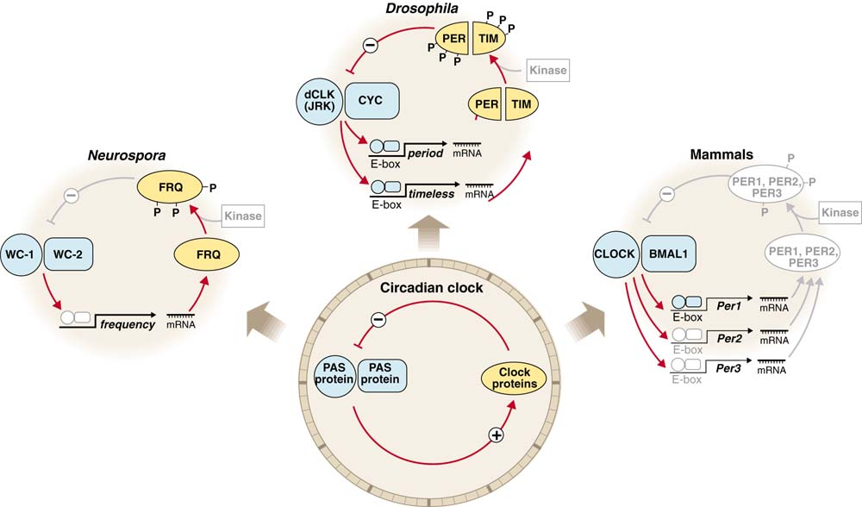
Circadian Clocks: Implementations
J. Dunlap, Science (1998) 280 1548-9

Slide 30
The circadian clock machinery
(Barkai and Leibler, Nature 2000)
A
R
degradation
A
R
degradation
UTR_{A}
UTR_{R}
translation
translation
A_RNA
R_RNA
transcription
transcription
P_{A}
P_{R}
A_GENE
R_GENE
Differential rates: Very fast, fast and slow

Slide 31
The machinery in π-calculus: “A” molecules
A_GENE::= PROMOTED_A + BASAL_A
PROMOTED_A::= pA ? {e}.ACTIVATED_TRANSCRIPTION_A(e)
BASAL_A::= bA ? [].( A_GENE | A_RNA)
ACTIVATED_TRANSCRIPTION_A::=
τ₁ . (ACTIVATED_TRANSCRIPTION_A | A_RNA) +
e ? [] . A_GENE
A_Gene
RNA_A::= TRANSLATION_A + DEGRADATION_mA
TRANSLATION_A::= utrA ? [] . (A_RNA | A_PROTEIN)
DEGRADATION_mA::= degmA ? [] . 0
A_RNA
A_PROTEIN::= (new e1,e2,e3)
PROMOTION_A-R + BINDING_R + DEGRADATION_A
PROMOTION_A-R ::= pA!{e2}.e2![]. A_PROTEIN +
pR!{e3}.e3![]. A_PRTOEIN
BINDING_R ::= rbs ! {e1} . BOUND_A_PRTOEIN
BOUND_A_PROTEIN::= e1 ? [].A_PROTEIN + degpA ? [].e1 ![].0
DEGRADATION_A::= degpA ? [].0
A_protein

Slide 32
The machinery in π-calculus: “R” molecules
R_GENE::= PROMOTED_R + BASAL_R
PROMOTED_R::= pR ? {e}.ACTIVATED_TRANSCRIPTION_R(e)
BASAL_R::= bR ? [].( R_GENE | R_RNA)
ACTIVATED_TRANSCRIPTION_R::=
τ₂ . (ACTIVATED_TRANSCRIPTION_R | R_RNA) +
e ? [] . R_GENE
R_Gene
RNA_R::= TRANSLATION_R + DEGRADATION_mR
TRANSLATION_R::= utrR ? [] . (R_RNA | R_PROTEIN)
DEGRADATION_mR::= degmR ? [] . 0
R_RNA
R_PROTEIN::= BINDING_A + DEGRADATION_R
BINDING_R ::= rbs ? {e} . BOUND_R_PRTOEIN
BOUND_R_PROTEIN::= e1 ? [] . A_PROTEIN + degpR ? [].e1 ![].0
DEGRADATION_R::= degpR ? [].0
R_protein

Slide 33
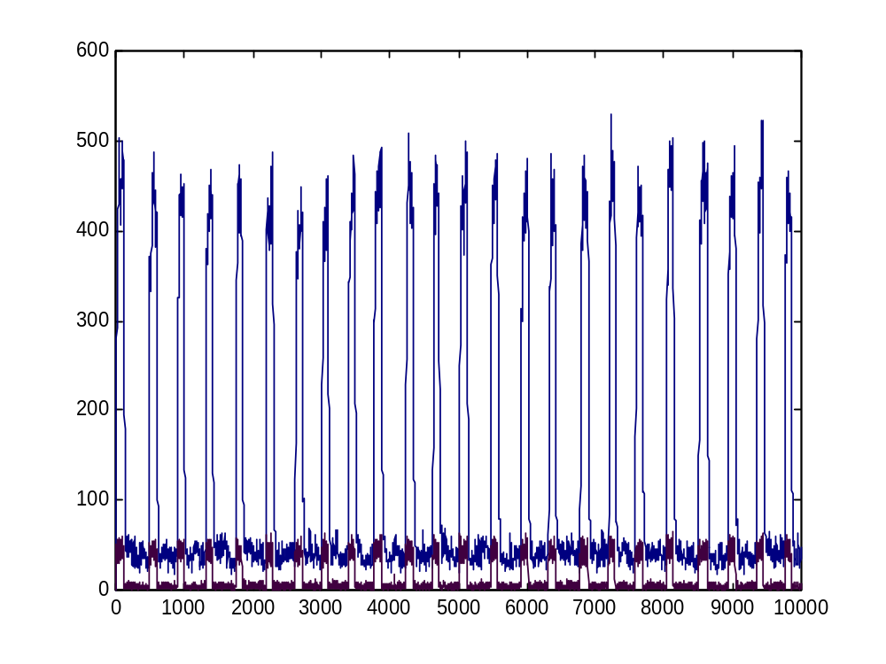
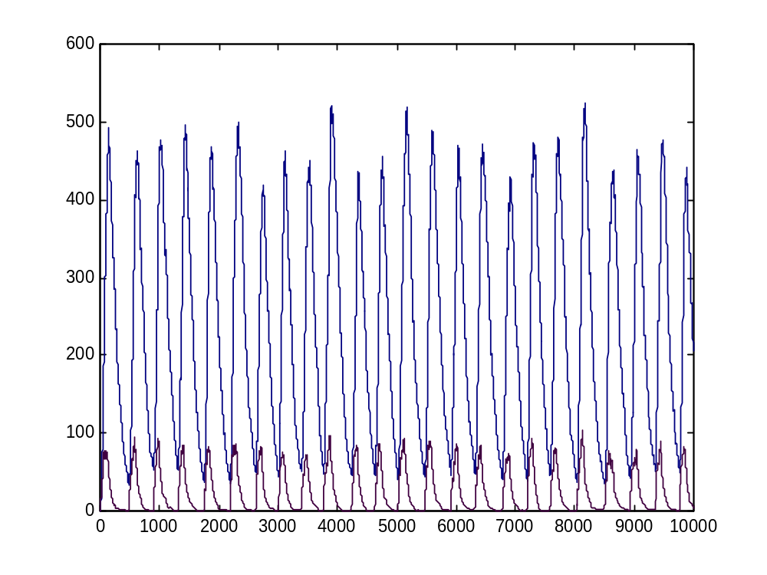
PSI simulation
A
R
Robust to a wide range of parameters

Slide 34
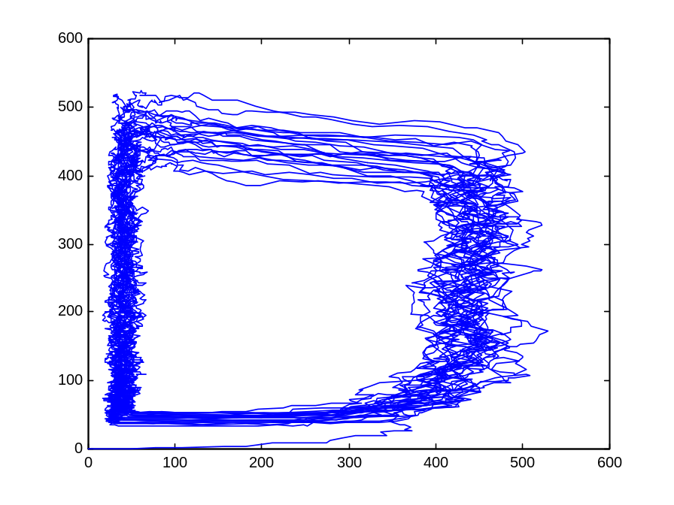
The A hysteresis module
A
ON
A
Fast
Fast
OFF
R
R
The entire population of A molecules (gene, RNA, and protein) behaves as one bi-stable module

Slide 35
Modular Cell Biology
? How to identify and compare modules and prove their function?
! Semantic concept: Two processes are equivalent if can be exchanged within any context without changing system behavior

Slide 36
Modular Cell Biology
Build two representations in the π-calculus
  Implementation (how?): molecular level
  Specification (what?): functional module level
Show the equivalence of both representations
  by computer simulation
  by formal verification

Slide 37
The circadian specification
R
Counter_A
R
degradation
OFF
ON
UTR_{R}
translation
R_RNA
P_{R}
transcription
R_GENE
R (gene, RNA, protein) processes are unchanged (modularity)

Slide 38
Hysteresis module
ON_H-MODULE(C_{A})::=
{C_{A}<=T1} . OFF_H-MODULE(C_{A}) +
{C_{A}>T1} .
(rbs ! {e1} . ON_DECREASE +
e1 ! [] . ON_H_MODULE +
pR ! {e2} . (e2 ! [] .0 | ON_H_MODULE) +
τ1 . ON_INCREASE)
ON_INCREASE::= {C_{A}++} . ON_H-MODULE
ON_DECREASE::= {C_{A}--} . ON_H-MODULE
ON
OFF_H-MODULE(C_{A})::=
{C_{A}>T2} . ON_H-MODULE(C_{A}) +
{C_{A}<=T2} .
(rbs ! {e1} . OFF_DECREASE +
e1 ! [] . OFF_H_MODULE +
τ2 . OFF_INCREASE )
OFF_INCREASE::= {C_{A}++} . OFF_H-MODULE
OFF_DECREASE::= {C_{A}--} . OFF_H-MODULE
OFF

Slide 39
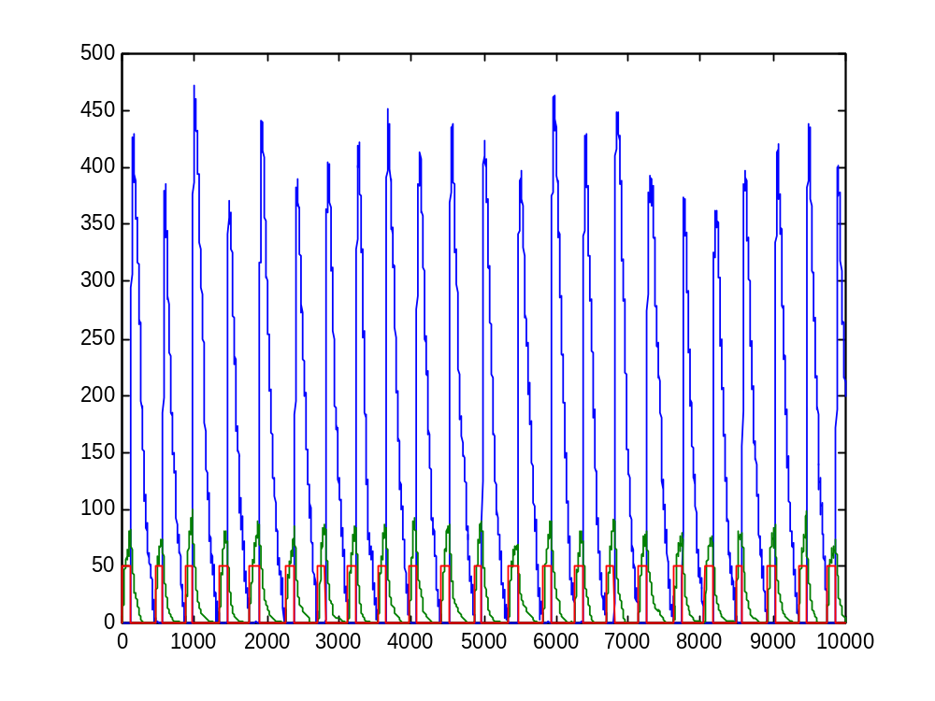
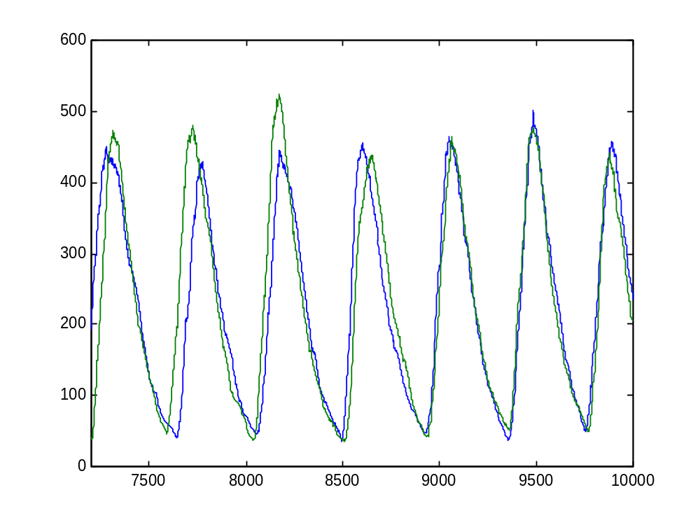
PSI simulation
Module, R protein and R RNA
R (module vs. molecules)

Slide 40
The benefits of a modular approach
Hierarchical organization of complex networks
A single framework for molecular and functional studies
Single study for variable levels of knowledge
Captures an essential principle of biochemical systems
Example: Gating of the cell cycle by the circadian clock

Slide 41
A
R
degradation
A
R
degradation
Gene copy number
UTR_{A}
translation
UTR_{R}
translation
transcription
A_RNA
transcription
R_RNA
P_{A}
P_{R}
A_GENE
R_GENE
R
t
Counter_A
R
degradation
OFF
ON
UTR_{R}
translation
transcription
R_RNA
P_{R}
R_GENE

Slide 42
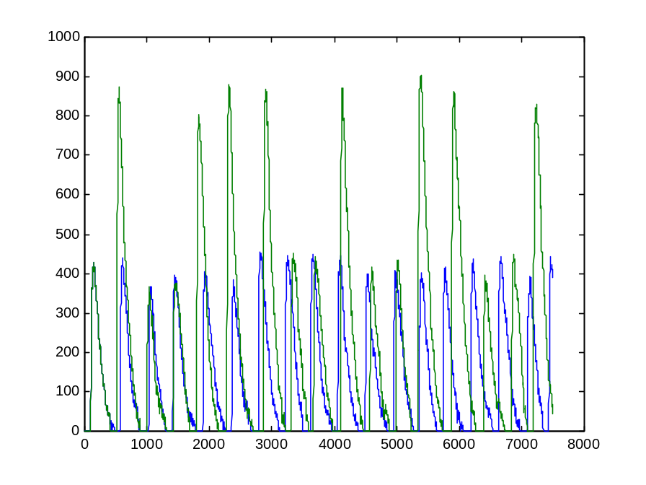
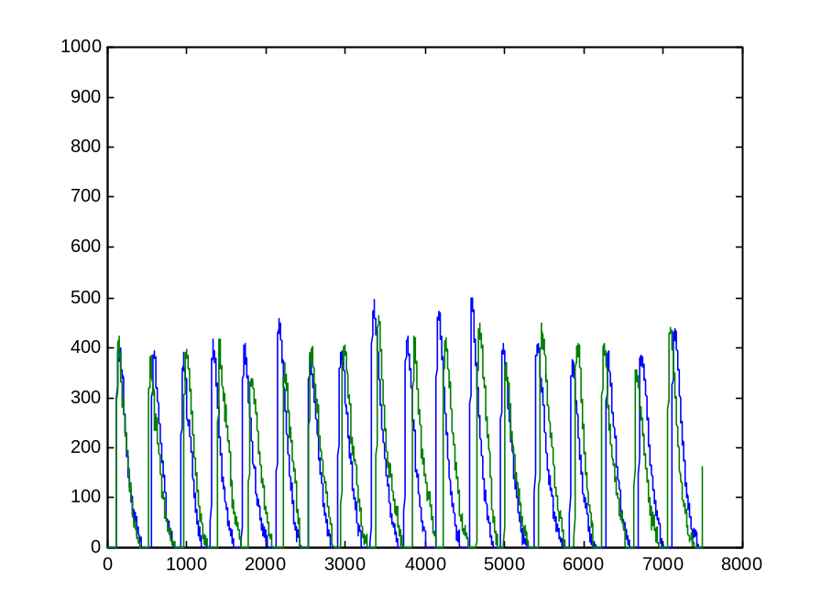
Cell cycle gating by the circadian clock
Without gating
With gating

Slide 43
The next step:
The homology of process

Slide 44
The BioPSI team
Udi Shapiro (WIS)
Bill Silverman (WIS)
Aviv Regev (TAU, WIS)
Eva Jablonka (TAU)
BioPSI Collaborations
Naama Barkai (WIS)
Corrado Priami (U. Verona)
Vincent Schachter (Hybrigenics)
Eric Neumann (3rd millenium)
www.wisdom.weizmann.ac.il/~aviv

