Slide 1
Modeling Pathways with the π-Calculus and Ambient Calculus:
Concurrent Processes Come Alive
Aviv Regev
Dept. Cell Research and Immunology, Tel Aviv University
Dept. Computer Science and Applied Math, Weizmann Institute of Science
Joint work with Udi Shapiro, Bill Silverman, Naama Barkai, Corrado Priami, Katya Panina, and Luca Cardelli

Slide 2
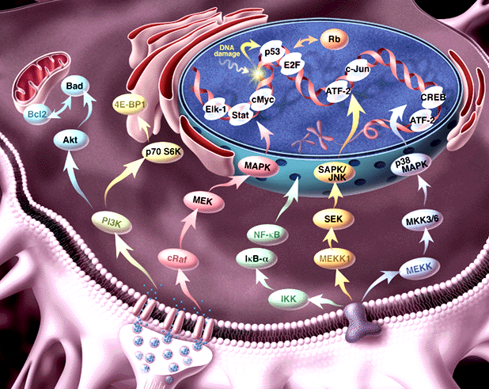
Pathway informatics:
From molecule to process
Genome, transcriptosome, proteome
Regulation of expression; Signal Transduction; Metabolism

Slide 3
Our goal:
A formal representation language for molecular processes
Information about
  Dynamics
  Molecular structure
  Biochemical detail of interaction
The Power to
  simulate
  analyze
  compare
Formal semantics

Slide 4
Biochemical networks are complex
Concurrent, compositional
Mobile (dynamic wiring)
Modular, hierarchical
… but similar to concurrent computation

Slide 5
Molecules as processes
Represent a structure by its potential behavior: by the process in which it can participate
Example: An enzyme as the enzymatic reaction process, in which it may participate

Slide 6
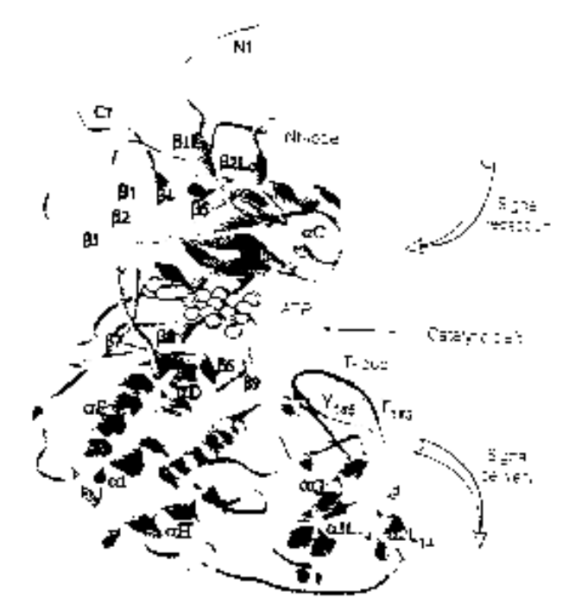
Example: ERK1 Ser/Thr kinase
Structure
Process
NH₂
Binding MP1 molecules
Nt lobe
Regulatory T-loop:
Change conformation
Kinase site:
Phosphorylate Ser/Thr residues
(PXT/SP motifs)
ATP binding site:
Bind ATP, and use it for phsophorylation
p-Y
Catalytic core
p-T
Ct lobe
Binding to substrates
COOH

Slide 7
The π-calculus
(Milner, Walker and Parrow 1989)
A program specifies a network of interacting processes
Processes are defined by their potential communication activities
Communication occurs on complementary channels, identified by names
Communication content: Change of channel names (mobility)
Stochastic version (Priami 1995) : Channels are assigned rates

Slide 8
Processes
P – Process
P|Q – Two parallel processes
ERK1
SYSTEM ::= … | ERK1 | ERK1 | … | MEK1 | MEK1 | …
ERK1 ::= (new internal_channels)
(Nt_LOBE |CATALYTIC_CORE |Ct_LOBE)
Domains, molecules, systems ~ Processes

Slide 9
Global communication channels
x ? [y] –Input into y on channel name x?
x ! [z] – Output z on channel co-named x!
MEK1
ERK1
T_LOOP (tyr )::=
tyr ? [tyr].T_LOOP(tyr)
KINASE_ACTIVE_SITE::=
tyr ! [p-tyr] . KINASE_ACTIVE_SITE
Y
Complementary molecular structures ~
Global channel names and co-names

Slide 10
Communication and global mobility
Ready to send p-tyr
on tyr !
Ready to receive on tyr ?
MEK1
ERK1
tyr ! [p-tyr] . KINASE_ACTIVE_SITE + … | … + tyr ? [tyr] . T_LOOP
Y
Actions consumed
alternatives discarded
p-tyr replaces tyr
KINASE_ACTIVE_SITE | T_LOOP {p-tyr / tyr}
pY
Molecular interaction and modification ~
Communication and change of channel names

Slide 11
Local restricted channels
(new x) P – Local channel x, in process P
ERK1
ERK1 ::= (new backbone)
(Nt_LOBE |CATALYTIC_CORE |Ct_LOBE)
Compartments (molecule,complex,subcellular)
~ Local channels as unique identifiers

Slide 12
Communication and scope extrusion
(new x) (y ! [x]) – Extrusion of local channel x
MP1
(new backbone) mp1_erk ! [backbone] . mp1_mek ! [backbone] . … |
mp1_erk ? [cross_backbone] . cross_backbone ? […] |
mp1_mek ? [cross_backbone] . cross_backbone ! […]
MEK1
ERK1
Complex formation ~ Exporting local channels

Slide 13
Stochastic π-calculus
(Priami, 1995, Regev, Priami et al 2000)
Every channel x attached with a base rate r
A global (external) clock is maintained
The clock is advanced and a communication is selected according to a race condition
Modification of the race condition and actual rate calculation according to biochemical principles (Regev, Priami et al., 2000)
BioPSI simulation system

Slide 14
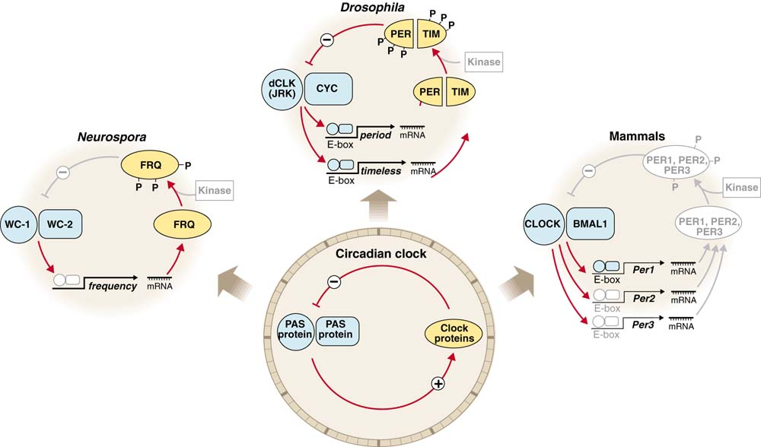
Circadian clocks: Implementations
J. Dunlap, Science (1998) 280 1548-9

Slide 15
The circadian clock machinery
(Barkai and Leibler, Nature 2000)
A
R
degradation
A
R
degradation
UTR_{A}
UTR_{R}
translation
translation
A_RNA
R_RNA
transcription
transcription
P_{A}
P_{R}
A_GENE
R_GENE
Differential rates: Very fast, fast and slow

Slide 16
The machinery in π-calculus: “A” molecules
A_GENE::= PROMOTED_A + BASAL_A
PROMOTED_A::= pA ? {e}.ACTIVATED_TRANSCRIPTION_A(e)
BASAL_A::= bA ? [].( A_GENE | A_RNA)
ACTIVATED_TRANSCRIPTION_A::=
τ₁ . (ACTIVATED_TRANSCRIPTION_A | A_RNA) +
e ? [] . A_GENE
A_Gene
RNA_A::= TRANSLATION_A + DEGRADATION_mA
TRANSLATION_A::= utrA ? [] . (A_RNA | A_PROTEIN)
DEGRADATION_mA::= degmA ? [] . 0
A_RNA
A_PROTEIN::= (new e1,e2,e3)
PROMOTION_A-R + BINDING_R + DEGRADATION_A
PROMOTION_A-R ::= pA!{e2}.e2![]. A_PROTEIN +
pR!{e3}.e3![]. A_PRTOEIN
BINDING_R ::= rbs ! {e1} . BOUND_A_PRTOEIN
BOUND_A_PROTEIN::= e1 ? [].A_PROTEIN + degpA ? [].e1 ![].0
DEGRADATION_A::= degpA ? [].0
A_protein

Slide 17
The machinery in π-calculus: “R” molecules
R_GENE::= PROMOTED_R + BASAL_R
PROMOTED_R::= pR ? {e}.ACTIVATED_TRANSCRIPTION_R(e)
BASAL_R::= bR ? [].( R_GENE | R_RNA)
ACTIVATED_TRANSCRIPTION_R::=
τ₂ . (ACTIVATED_TRANSCRIPTION_R | R_RNA) +
e ? [] . R_GENE
R_Gene
RNA_R::= TRANSLATION_R + DEGRADATION_mR
TRANSLATION_R::= utrR ? [] . (R_RNA | R_PROTEIN)
DEGRADATION_mR::= degmR ? [] . 0
R_RNA
R_PROTEIN::= BINDING_A + DEGRADATION_R
BINDING_R ::= rbs ? {e} . BOUND_R_PRTOEIN
BOUND_R_PROTEIN::= e1 ? [] . A_PROTEIN + degpR ? [].e1 ![].0
DEGRADATION_R::= degpR ? [].0
R_protein

Slide 18
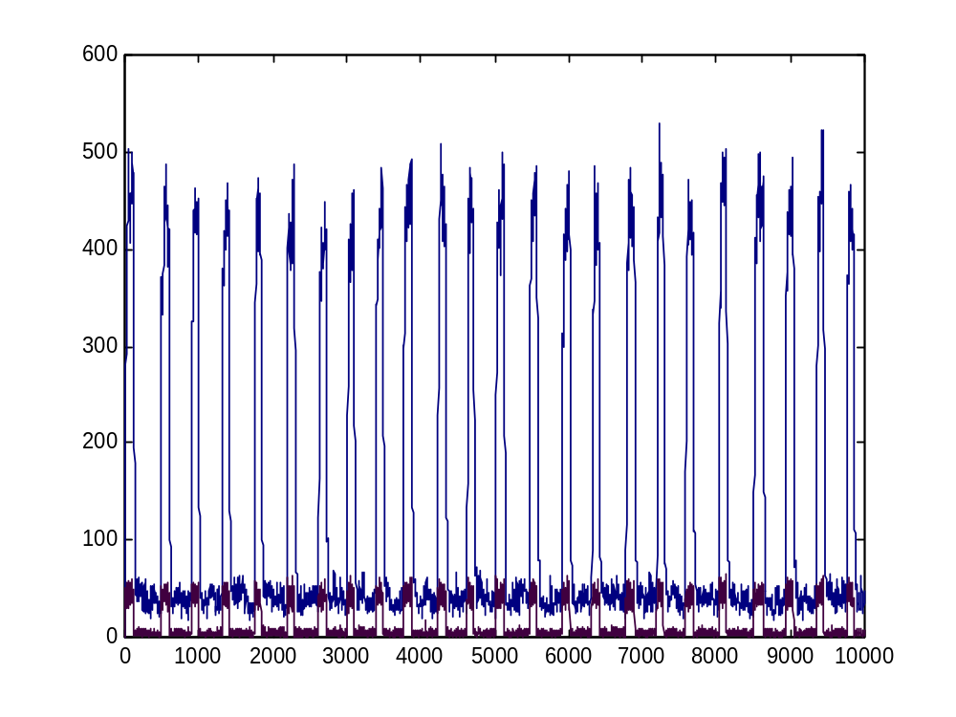
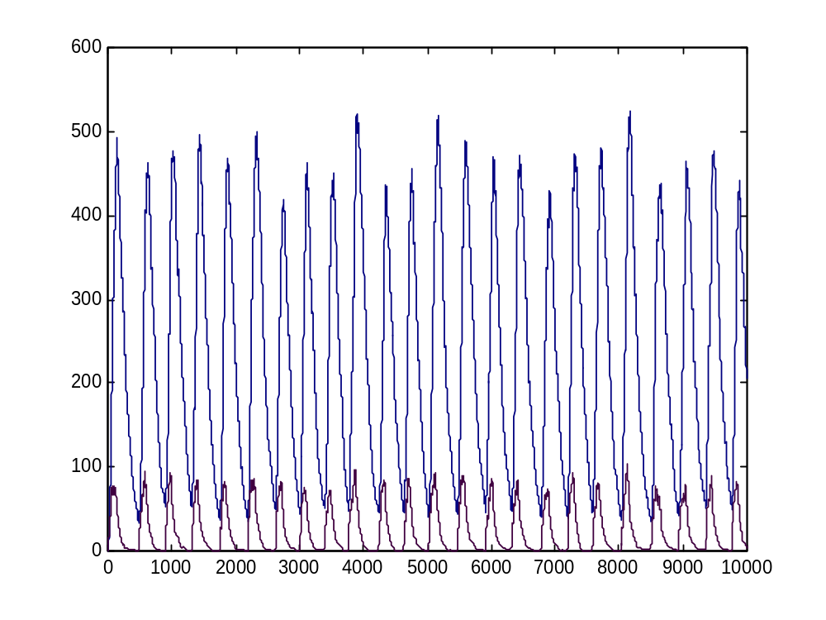
BioPSI simulation
A
R
Robust to a wide range of parameters

Slide 19
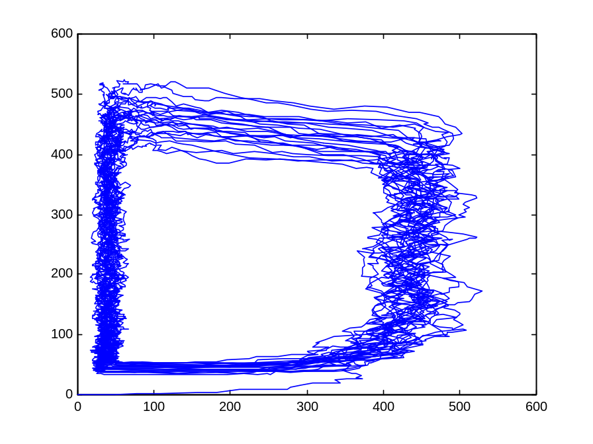
The A hysteresis module
A
ON
A
Fast
Fast
OFF
R
R
The entire population of A molecules (gene, RNA, and protein) behaves as one bi-stable module

Slide 20
Modular cell biology
? How to identify modules and prove their function?
! Semantic concept: Two processes are equivalent if can be exchanged within any context without changing observable system behavior

Slide 21
Modular cell biology
Build two representations in the π-calculus
  Implementation (how?): molecular level
  Specification (what?): functional module level
Show the equivalence of both representations
  by computer simulation
  by formal verification

Slide 22
The circadian specification
R
Counter_A
R
degradation
OFF
ON
UTR_{R}
translation
R_RNA
P_{R}
transcription
R_GENE
R (gene, RNA, protein) processes are unchanged (modular;compositional)

Slide 23
Hysteresis module
ON_H-MODULE(C_{A})::=
{C_{A}<=T1} . OFF_H-MODULE(C_{A}) +
{C_{A}>T1} .
(rbs ! {e1} . ON_DECREASE +
e1 ! [] . ON_H_MODULE +
pR ! {e2} . (e2 ! [] .0 | ON_H_MODULE) +
τ1 . ON_INCREASE)
ON_INCREASE::= {C_{A}++} . ON_H-MODULE
ON_DECREASE::= {C_{A}--} . ON_H-MODULE
ON
OFF_H-MODULE(C_{A})::=
{C_{A}>T2} . ON_H-MODULE(C_{A}) +
{C_{A}<=T2} .
(rbs ! {e1} . OFF_DECREASE +
e1 ! [] . OFF_H_MODULE +
τ2 . OFF_INCREASE )
OFF_INCREASE::= {C_{A}++} . OFF_H-MODULE
OFF_DECREASE::= {C_{A}--} . OFF_H-MODULE
OFF

Slide 24
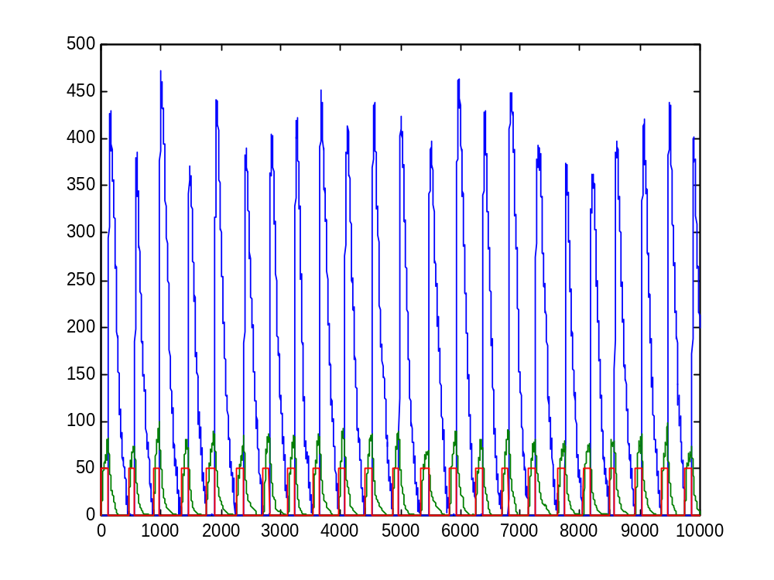
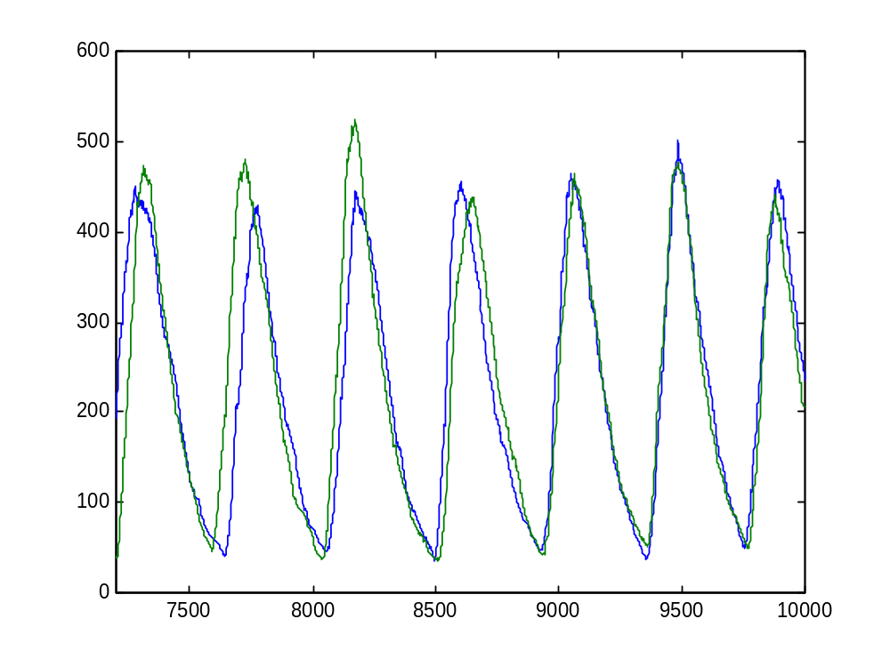
BioPSI simulation
Module, R protein and R RNA
R (module vs. molecules)

Slide 25
The benefits of a modular approach
Hierarchical organization of complex networks
A single framework for molecular and functional studies (variable levels of knowledge)
Example: Gating of the cell cycle by the circadian clock

Slide 26
Gating of the cell division cycle by the circadian clock
Barkai and Leibler have shown that the stochastic clock model is robust to random perturbations in transcription rates
… but the cell division cycle may perturb transcription rates in a regular way
Cell division is gated by the ciracdian clock in many unicellular organisms

Slide 27
Gating of the cell division cycle by the circadian clock
Euglena
0
12
24
1 division
Chlamydonomas
0
12
24
multiple fissions
Synechococcus
0
12
24
multiple divisions
multiple divisions
Prochlorococcus
0
12
24
2 successive
replication cycles
2 successive
divisions

Slide 28
A
R
degradation
A
R
degradation
Gene copy number
UTR_{A}
translation
UTR_{R}
translation
transcription
A_RNA
transcription
R_RNA
P_{A}
P_{R}
A_GENE
R_GENE
R
t
Counter_A
R
degradation
OFF
ON
UTR_{R}
translation
transcription
R_RNA
P_{R}
R_GENE

Slide 29
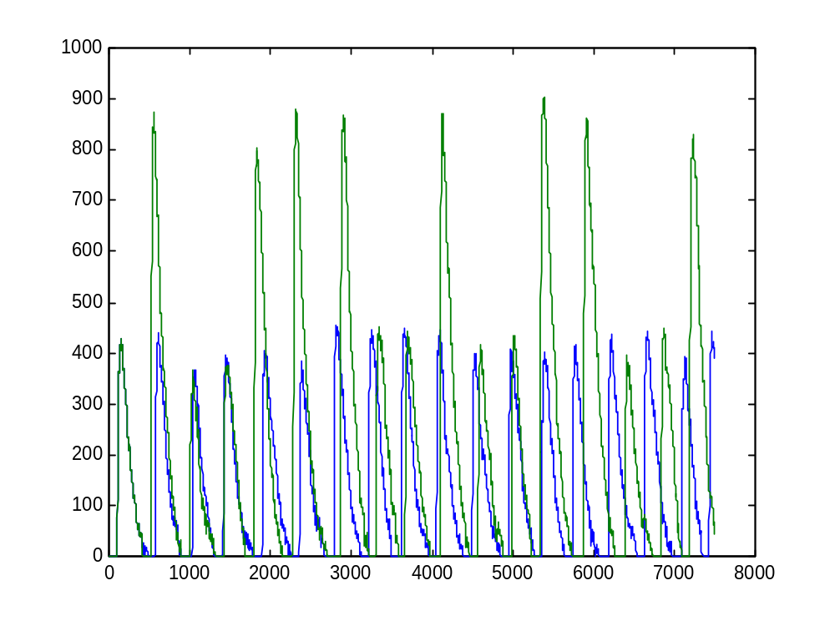
Cell cycle effect on the circadian clock
Without gating

Slide 30
A
R
degradation
A
R
degradation
Gene copy number
UTR_{A}
translation
UTR_{R}
translation
transcription
A_RNA
transcription
R_RNA
P_{A}
P_{R}
A_GENE
R_GENE
R
t
Counter_A
R
degradation
OFF
ON
UTR_{R}
translation
transcription
R_RNA
P_{R}
R_GENE

Slide 31
Who is the gatekeeper?
Gatekeeper | Gate point | Result
A only | Entry only | Cycle out of phase
A module | Entry only or entry and exit | Cycle out of phase
A and R | Entry only | Cycle out of phase
A and R | Entry (A and R) and exit (R) | Cycle in phase
R only (with module or molecules) | Entry and exit | Cycle in phase

Slide 32
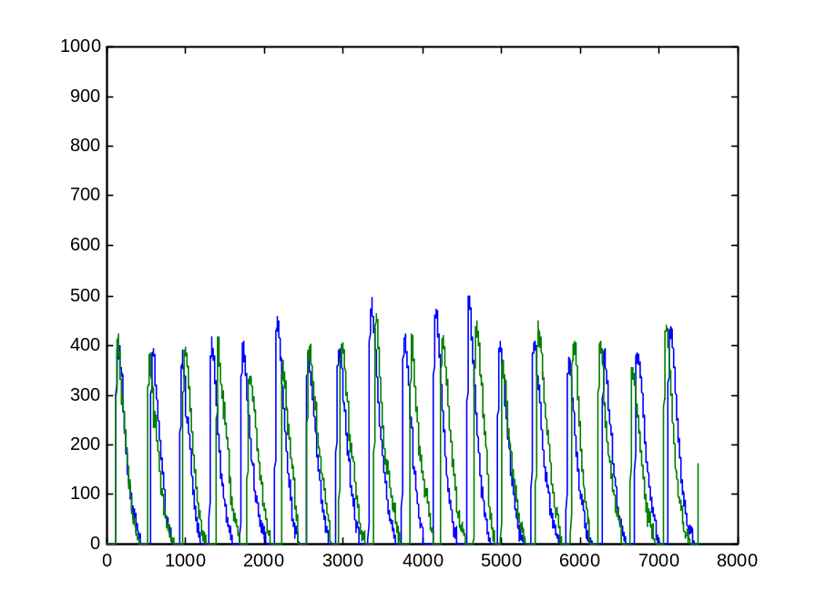
Cell cycle gating by the circadian clock
Without gating
With R gating

Slide 33
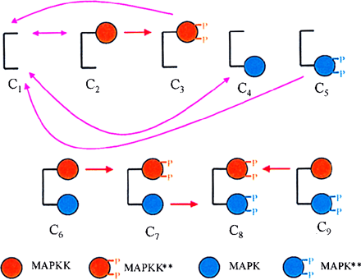
Why pi ?
Compositional
  Molecular
  Incremental
  Preservation through transitions
  Straightforward manipulation
Modular
  Scalable
  Comparative
Levchenko et al., 2000

Slide 34
Goal:
Representation of compartments
Sub-cellular compartments
Multi-molecular complexes
Multicellular organization

Slide 35
Mobile compartments
Sub-cellular compartments
Complex Formation and breaking
Multicellular organization

Slide 36
Mobile compartments
Merging, budding, bursting, assimilation
Complex Formation and breaking
Multicellular organization

Slide 37
Mobile compartments
Merging, budding, bursting, assimilation
Complex Formation and breaking
Cellular movement

Slide 38
Mobile compartments and molecules
Merging, budding, bursting, assimilation
Complex Formation and breaking
Movement of molecules between compartments
Cellular movement
Receptors, channels and transporters

Slide 39
The ambient calculus
(Cardelli and Gordon)
An ambient is a bounded place where computation happens
Ambient
Processes

Slide 40
The ambient calculus
(Cardelli and Gordon)
The ambient’s boundary restricts process interactions across it
Ambient
Processes

Slide 41
The ambient calculus
(Cardelli and Gordon)
Processes can move in and out of ambients
Ambient
Processes
Ambient are mobile processes, too !

Slide 42
Compartments as ambients
a[P] – Process P inside ambient a
[P] – Process P inside unnamed ambient
Cell
cell [ P | Q | R | nuc [R] ]
P
Nucleus
Q
R
R
Cells, vesicles, compartments ~ Ambients

Slide 43
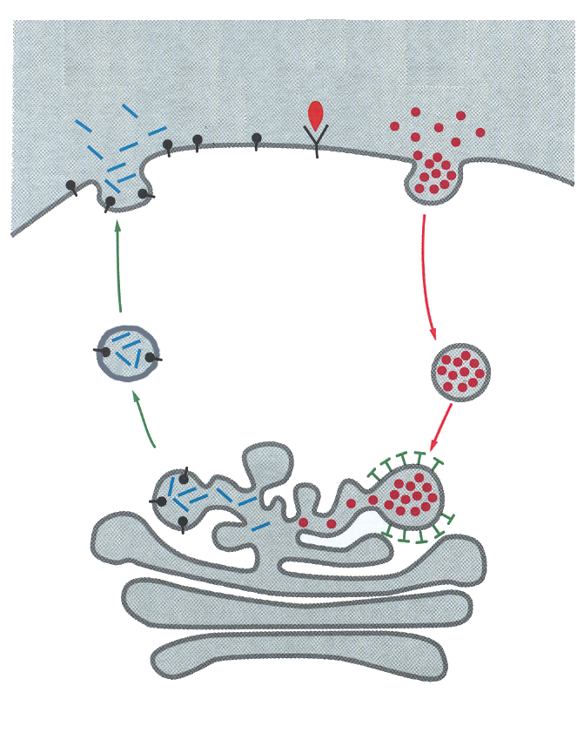
Synchronized ambient movement
enter/accept exit/expel merge+/merge-
vesicle
merge
enter
Lysozome
vesicle[merge- c. P|Q] |
lysozome [merge+ c . R|S]
→
lysozome [P|Q|R|S]
exit
merge
Enter, exit, merge ~
Budding-in or -out, endo- or exo-cytosis

Slide 44
Molecules and complexes
enter/accept exit/expel merge+/merge-
Mol1
Mol2
Mol1 [P|merge+ c.Q]
Mol2[merge- c. R|S] |
→
Complex [P|Q|R|S]
P
Q
R
S
Complex
P
Q
R
S
Merge, enter, exit (with private channels) ~
Complex formation and breakage,
molecule re-localization

Slide 45
Communication across ambient boundaries
c* | Standard (same ambient)
c# | Sibling to sibling
c^(c_) | child to parent (parent to child)
c#
Mol1
Mol2
P
Q
R
S
c*
c* and c# ~
Intra- and inter-molecular interactions

Slide 46
Intersecting ambient boundaries: Receptors, channels and transporters
c^(c_) | child to parent (parent to child)
c^^
cell
rec
rec
rec
Child-to-grandparent
communication
cell
cell
c^
cell
“Natural” representation:
Intersecting, embedded
ambient ??
Child-to-parent
communication;
Breaking receptor
ambient
Cell surface
receptor
rec

Slide 47
Cellular ambient calculus
Uniform treatment of molecular interaction and localization
Compositional and modular approach to representation and analysis
The next step: The homology of process

Slide 48
Udi Shapiro (WIS)
Bill Silverman (WIS)
Katya Panina (WIS)
Naama Barkai (WIS)
Corrado Priami (U. Verona)
Luca Cardelli (Cambridge)
www.wisdom.weizmann.ac.il/~aviv

