Slide 1
The BioPSI Project:
Representation and Simulation of
Molecular Processes
Aviv Regev
Bill Silverman
Udi Shapiro

Slide 2
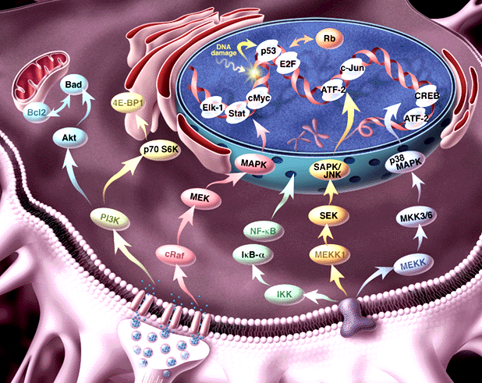
Pathway Informatics:
From molecule to process
Genome, transcriptosome, proteome
Regulation of expression; Signal Transduction; Metabolism

Slide 3
Our Goal:
A formal representation language for molecular processes
Information about
  Dynamics
  Molecular structure
  Biochemical detail of interaction
The Power to
  simulate
  analyze
  compare
Formal semantics

Slide 4
Biochemical networks as concurrent computation
Concurrent, compositional
Mobile (dynamic wiring)
Modular, hierarchical

Slide 5
The π-calculus
(Milner, Walker and Parrow 1989)
A program specifies a network of interacting processes
Processes are defined by their potential communication activities
Communication occurs on complementary channels, identified by names
Communication content: Change of channel names (mobility)
Stochastic version (Priami 1995) : Channels are assigned rates

Slide 6
Processes
P – Process
P|Q – Two parallel processes
ERK1
SYSTEM ::= … | ERK1 | ERK1 | … | MEK1 | MEK1 | …
ERK1 ::= (new internal_channels)
(Nt_LOBE |CATALYTIC_CORE |Ct_LOBE)
Domains, molecules, systems ~ Processes

Slide 7
Global communication channels
x ? [y] –Input into y on channel x
x ! [z] – Output z on channel x
MEK1
ERK1
T_LOOP (tyr )::=
tyr ? [tyr].T_LOOP(tyr)
KINASE_ACTIVE_SITE::=
tyr ! [p-tyr] . KINASE_ACTIVE_SITE
Y
Complementary molecular structures ~
Global channel names and co-names

Slide 8
Communication and global mobility
Ready to send p-tyr
on tyr !
Ready to receive on tyr ?
MEK1
ERK1
tyr ! [p-tyr] . KINASE_ACTIVE_SITE + … | … + tyr ? [tyr] . T_LOOP
Y
Actions consumed
alternatives discarded
p-tyr replaces tyr
KINASE_ACTIVE_SITE | T_LOOP {p-tyr / tyr }
pY
Molecular interaction and modification ~
Communication and change of channel names

Slide 9
Local restricted channels
(new x) P – Local channel x, in process P
ERK1
ERK1 ::= (new backbone)
(Nt_LOBE |CATALYTIC_CORE |Ct_LOBE)
Compartments (molecule,complex,subcellular)
~ Local channels as unique identifiers

Slide 10
Communication and scope extrusion
(new x) (y ! [x]) – Extrusion of local channel x
MP1
(new backbone) mp1 ! [backbone] . backbone ! [ … ] |
mp1 ? [cross_backbone] . cross_backbone ? […]
MEK1
ERK1
Complex formation ~ Exporting local channels

Slide 11
The Simulation Engine
(Stochastic) Pi-calculus
Flat Concurrent Prolog
Ability to pass logical variables in messages
(→ mobility)
Guarded atomic unification
(→ synchronized communication)
Previous implementations lack in synchronicity and choice
Flat Concurrent Prolog
C

Slide 12
The Simulation Engine
Processes (FCP procedures) send requests to channels (FCP objects)
The channel synchronizes the completion of send and receive requests and withdrawal of alternative choices
Debugging and tracing tools
Channel
Name
Send list
Receive list
Brate*
Type*
*Stochastic version
(Priami, Regev et al. 2000)

Slide 13
The RTK-MAPK pathway
GF
GF
RTK
RTK
16 molecular species
24 domains; 15 sub-domains
Four cellular compartments
Binding, dimerization, phosphorylation,
de-phosphorylation, conformational changes, translocation
~100 literature articles
250 lines of code
SHC
GRB2
SOS
RAS
MKP1
PP2A
GAP
RAF
MKK1
ERK1
IEP
MP1
IEP
J
F
IEG

Slide 14
Mutation Analysis
Process | Perturbation | Signal
Raf | ↑ | ↑
MP1 | ↑ | ↓
MP1 and MEK | ↑ | ↑
Erk | ↑ | ↑
MKP | ↑ | ↓
Ligand | Monomer | ↓ (Slight)
Receptor | Deleted intracellular domain | ↓
Raf | Membrane localized | Ligand independent
Erk | Constitutively active | Ligand independent
Most were
buffered by
the system
except at
extreme
“doses”
Quantitative
Functional

Slide 15
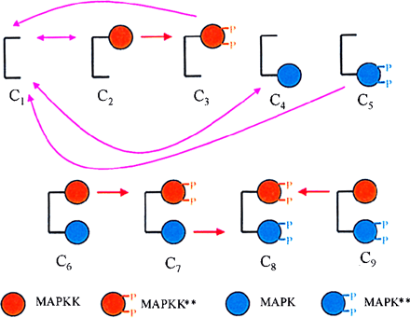
Why Pi ?
Compositional
  Molecular
  Incremental
  Preservation through transitions
  Straightforward manipulation
Modular
  Scalable
  Comparative
Levchenko et al., 2000

Slide 16
The BioPSI team
Udi Shapiro (WIS)
Bill Silverman (WIS)
Aviv Regev (TAU, WIS)
BioPSI Collaborations
Naama Barkai (WIS)
Corrado Priami (U. Verona)
www.wisdom.weizmann.ac.il/~aviv

