Slide 1
Biomolecular processes as concurrent computation
Introduction

Slide 2
Goal
Represent a wide variety of chemical, biochemical and molecular systems as concurrent computation in the stochastic pi-calculus

Slide 3
Course Outline
Lecture 1+2 (19 April; 3 May)
  Introduction
  The electron theory of chemical bonds
Lecture 3 (10 May)
  Modular representation of chemical reactions
  Membranes and transport
Lecture 4+5 (17 May, 24 May)
  Enzymatic reactions and metabolism
Lecture 6 (31 May)
  Polymers

Slide 4
Course Outline
Lecture 7 (7 June)
  Molecular machines
Lecture 8 (14 June)
  Regulatory networks
Lecture 9 (28 June)
  Signal transduction

Slide 5
Course Outline
In each unit
  Chemistry/biology backgrounder
  Modeling principles in stochastic pi-calculus
  Examples
  Exercises
  References and supplementary reading

Slide 6
Course Requirements
Exercises: Weekly. Write and execute pi-calculus programs. Can be submitted in pairs (CS and biology students)
Project: Model and analyze by simulation a larger system (e.g. from a list of suggested ones). Can be done individually or in teams combining CS and biology students
Grading: 6/8 best exercises (10% each) + project (40%).

Slide 7
Course Team
 | Room | Tel | E-mail
Barak Shenhav (TA) | Mayer 412 | 3098 | shenhav@bioinformatics
Aviv Regev | Ziskind 02 | 4459 | aviv@wisdom
Ehud Shapiro | Ziskind 123 | 4506 | udi@wisdom

Slide 8
Motivation
Biochemical processes as concurrent computation

Slide 9
Molecular Biology is…
Sequence: Sequence of DNA and proteins
Structure: 3D Structure of Proteins and other biomolecules and molecular complexes
Interaction: How do these molecules interact?

Slide 10
Sharing Scientific Knowledge
Sequence and structure: encoded, shared, processed and updated via computers.
Molecular interactions: shared via articles.
Why?

Slide 11
Computer Languages for Sharing Biological Knowledge
Sequence: Strings over {A,C,T,G}
Structure: Labeled 3D Graphs
Interaction: ?

Slide 12
The “New Biology”
The cell as an information processing device
Cellular information processing and passing are carried out by networks of interacting molecules
Ultimate understanding of the cell requires an information processing model
Which?

Slide 13
Describing the Cell
Compositional, executable representations of biological knowledge
Executable – to enable computer simulation and analysis
Compositional – so that a representation of the cell can be composed bottom-up

Slide 14
“We have no real ‘algebra’ for describing regulatory circuits across different systems...”
- T. F. Smith (TIG 14:291-293, 1998)
“The data are accumulating and the computers are humming, what we are lacking are the words, the grammar and the syntax of a new language…”
- D. Bray (TIBS 22:325-326, 1997)

Slide 15
Computer Languages for Sharing Biological Knowledge
Sequence: Strings over {A,C,T,G}
Structure: Labeled 3D Graphs
Interaction: ?
  Answer: Process description language

Slide 16
Molecules as Processes
Molecule | Process
Interaction capability | Channel
Interaction | Communication
Modification | State and/or channel change

Slide 17
The pi-Calculus
(Milner, Walker and Parrow 1989)
A program specifies a network of interacting processes
Processes are defined by their potential communication activities
Communication occurs on complementary channels, identified by names
Communication content: Change of channel names (mobility)
Stochastic version (Priami 1995) : Channels are assigned rates

Slide 18
Unit 1: The valence theory of chemical bonds

Slide 19
The Chemical Reaction
Unbalanced equation
N₂O₅ → NO₂ + O₂
Reactant
Products
The chemical equation is used to describe the changes that occur during a chemical reaction.
Problem: If not balanced, atoms are not conserved

Slide 20
The Chemical Reaction
Balanced Equation
2N₂O₅ → 4NO₂ + O₂
Stoichiometric Coefficients
Balanced equations describe the overall stoichiometric relations between the reactants and products of complex reactions.
Problem: Tells us nothing about the exact way the reaction takes place at the molecular level

Slide 21
The Chemical Reaction
Reaction Mechanism
Unimolecular
Elementary reactions
(1) (N₂O₅ → NO₂ + NO₃) ^{X} 2
(2) NO₂ + NO₃ → NO + NO₂ + 0₂
(3) NO₃ + NO → 2NO₂
Bimolecular
2N₂O₅ → 4NO₂ + O₂
A series of elementary (uni- or bi-molecular) reactions forms a mechanism for the way in which a stoichiometric reaction takes place.

Slide 22
The Chemical Bond
Chemical bonds as the “glue” that holds atoms together to form molecules
Theories of valence
  Lewis electron-dot diagrams
  VSEPR (valence shell electron-pair repulsion theory)
Both theories useful to correctly predict many features of bonding (but it must actually be explained by quantum mechanics)

Slide 23
Valence
The property of an atom to form bonds, e.g.
  Univalent – capable of forming a single chemical bond
The valence may be unsigned or signed
Examples:
  H – valence of 1
  C – valence of 4
  Na – valence of +1
  Some elements (e.g. N, S, P) have multiple possible valences

Slide 24
Lewis’ Octet Theory
A covalent bond results when a pair of electrons is shared between two atoms (unsigned valence)
In ion formation, the sharing is so unequal that electrons are transferred from one atom to another (signed valence)

Slide 25
Lewis’ Octet Theory
1 | 2 | 3 | 4 | 3 | 2 | 1 | 0
+1 | +2 | +3 | +4 | +5 | +6 | +7 | +8
-7 | -6 | -5 | -4 | -3 | -2 | -1 | 0
₁H |  |  |  |  |  |  | ₂He
₃Li | ₄Be | ₅B | ₆C | ₇N | ₈O | ₉F | ₁₀Ne
₁₁Na | ₁₂Mg | ₁₃Al | ₁₄Si | ₁₅P | ₁₆S | ₁₇Cl | ₁₈Ar
₁₉K | ₂₀Ca
Stable non-reactive elements: Have 2 (He), 10 (Ne) or 18 (Ar) electrons: 0 valence
Needs to acquire 4 electrons to be surrounded by 8
Needs to acquire 1 electron to be surrounded by 8

Slide 26
Lewis’ Octet Theory
The first 2, 10, 18 (etc) electrons form a kernel or closed shell
Those electrons outside a kernel but not yet sufficient in number to form a full octet are the valence electrons, e.g.
    Cl: 17 electrons – 10 kernel electrons =
    7 valence electrons
Sharing takes place so that both atoms can have filled octets

Slide 27
Octet Structures
 | ..
: | Ne | :
 | ..
 | ..
: | Ar | :
 | ..
 | He | :
 | Li⁺ | :
 | .
· | C | ·
 | .
 | H | ·

Slide 28
Covalent Bond Diagrams
H
H | : | H
 |  | ..
H | : | C | : | H
 |  | ..
Electron dot diagrams
H
H
H | — | H
 |  | |
H | — | C | — | H
 |  | |
Valence diagrams
H
A bond is a sharing of a pair of electrons, so that both atoms have filled octets
→ |  |  |  |  | ←
H | · |  |  | · | H
H | : | H

Slide 29
Lone Electron Pairs
Lone pair, an extra pair of valence electrons, not used in bonding
H⁺
 | ..
· | N | ·
 | .
 |  | ..
H | : | N | : | H
 |  | ..
 |  | ..
H | : | N | : | H
 |  | ..
H
H
Lewis Base, has one or more lone pairs

Slide 30
Double and Triple Bonds
Sharing of two or three pairs of electrons
H
H
.. |  | ..
C | :: | C
.. |  | ..
: | N | ::: | N | :
H
H
Ethylene (C₂H₄)
Dinitrogen (N₂)

Slide 31
Some Limitations
Quadruple bonds cannot be formed by most elements (including the first 20). Why?
O₂ does not exactly follow the octet rule for binding
Resonance structures

Slide 32
Ionic Bonds
Filled octets achieved by gaining or losing electrons (rather than sharing)
As a result, each atom has a net positive or negative charge and is an ion
The attraction between positive and negative ions results in an ionic bond
 | Na | ·
 | ..
: | Cl | ·
 | ..
 | ..
: | Na⁺ | :
 | ..
 | ..
: | Cl⁻ | :
 | ..
+ →

Slide 33
Polar Bonds
ideal ionic bond
polar covalent bond
non-polar covalent bond
complete transfer of electronic charge
partial transfer of charge (unequal sharing)
electron pairs are shared equally (only when both are identical, e.g. H₂)

Slide 34
Radicals
“Parts” of chemical formula of special significance, e.g.
  H2O: H and OH radicals
  CH₃
Have an odd number of electrons
The ordinary free radical is univalent, and highly reactive

Slide 35
Bond and Bond-Dissociation Energies
In a diatomic molecule, the bond energy is the amount of energy required to convert a molecule into atoms.
In a polyatomic molecule the energy of atomization is the sum of all bond energies
The closest measure of a specific bond’s energy in a polyatomic molecule is called a bond-dissociation energy.
The energy of a chemical reaction can be calculated from bond-dissociation energies

Slide 36
Summary
Lewis dot diagrams are one method of explaining the observed valence of the first 20 elements
In these diagrams covalent bonding is shown as sharing of valence electron pairs between atoms so that atoms can have close octet structures
Single, double and triple bonds have one, two and three pairs of shared electrons
In ionic bonds, electrons are transferred so the resulting ions have close octets.

Slide 37
The pi-Calculus
Syntax and Semantics - I

Slide 38
Na + Cl ↔ Na⁺ + Cl⁻
-language(psifcp).
global(e1(100),e2(10)).
System::= Na | Na | Cl | Cl .
Na::= e1 ! [] , Na_plus .
Na_plus::= e2 ? [] , Na .
Cl::= e1 ? [] , Cl_minus .
Cl_minus::= e2 ! [] , Cl .
nacl_1.cp

Slide 39
Process Definition
System::= Na | Na | Cl | Cl .
Na::= e1 ! [] , Na_plus .
Na_plus::= e2 ? [] , Na .
Cl::= e1 ? [] , Cl_minus .
Cl_minus::= e2 ! [] , Cl .
.
<Left hand side>
(Process name)
::=
<Right hand side>
(Communication clause, body)
nacl_1.cp

Slide 40
Channel Names and Communication Actions
global channel declaration
global(e1(100),e2(10)).
Na::= e1 ! [] , Na_plus .
Na_plus::= e2 ? [] , Na .
Cl::= e1 ? [] , Cl_minus .
Cl_minus::= e2 ! [] , Cl .
e1 ? [ ] – input (receive)
action
e1 ! [ ] – output (send)
action
Complementary channel co-name
Channel name
Nil message (alert)
nacl_1.cp

Slide 41
Guarded Communication Clauses
Na::= e1 ! [] , Na_plus .
Na_plus::= e2 ? [] , Na .
Cl::= e1 ? [] , Cl_minus .
Cl_minus::= e2 ! [] , Cl .
,
<Communication action>
Input or output guard
(prefix)
<Right hand side>
e.g. Body
nacl_1.cp

Slide 42
Parallel Composition
System::= Na | Na | Cl | Cl .
Na::= e1 ! [] , Na_plus .
Na_plus::= e2 ? [] , Na .
Cl::= e1 ? [] , Cl_minus .
Cl_minus::= e2 ! [] , Cl .
|
<Call>
<Call>
Parallel composition (PAR)
nacl_1.cp

Slide 43
Communication and alternation between states - I
Ready to send an alert on e1
Ready to receive an alert on e1
Na | Cl
e1 ! [] , Na_plus | e1 ? [] , Cl_minus
COMM:
Communication actions consumed;
Prefixes released
Na_plus | Cl_minus
nacl_1.cp

Slide 44
Communication and alternation between states - II
Ready to send an alert on e2
Ready to receive an alert on e2
Na_plus | Cl_minus
e2 ? [] , Na | e2 ! [] , Cl
COMM:
Communication actions consumed;
Prefixes released
Na | Cl
When multiple copies of Na and Cl exist, the first and second interactions do not necessarily involve the same instances of Na and Cl
nacl_1.cp

Slide 45
Na + Cl ↔ Na⁺ + Cl⁻
Atoms and ions | Processes | Na, Na_plus Cl Cl_minus
Reaction capabilities (valence electrons) | Communication actions (alerts) | e1 ! [] e1 ? [] e2 ! [] e2 ? []
Reaction | Communication and state alteration | COMM

Slide 46
Chemical Kinetics

Slide 47
Reversibility of Chemical Reactions: Equilibrium
H₂ (g) ↔ 2H (g)
Chemical reactions are reversible
Under certain conditions (concentration, temperature) both reactants and products exist together in equilibrium state

Slide 48
Equilibrium State
Dynamic balance: Both forward and reverse reactions continue to occur
Spontaneous: Systems move towards an equilibrium state spontaneously
Reversible: The nature and properties of the equilibrium state are the same, regardless of the direction from which it is reached

Slide 49
The Equilibrium Constant
aA + bB ↔ cC + dD
The ideal law of chemical equilibrium
K = [C]^{c}[D]^{d} / [A]ª[B]^{b}

Slide 50
Reaction Rates
Thermodynamics determines which direction any change must take place to give equilibrium
Chemical kinetics tells us at what rate the change will take place and how the manner in which it takes place affects these rates (temperature, concentration)

Slide 51
Reaction Rates
Net reaction rate = forward rate – reverse rate
In equilibrium: Net reaction rate = 0
When reactants “just” brought together: Far from equilibrium, focus only on forward rate
But, same arguments apply to the reverse rate

Slide 52
Reaction Rates
aA + bB → cC + dD
Forward rate = -1/a d[A]/dt =
-1/b d[B]/dt =
1/c d[C]/dt =
1/d d[D]/dt

Slide 53
The Differential Rate Law
How does the rate of the reaction depend on concentration?
Can often be expressed as a product of reagents concentrations, each raised to some power, e.g.
3A + 2B → C + D
-1/3 d[A]/dt = d[C]/dt = k [A]^{m}[B]^{n}
m+n: Overall order of the reaction
(Specific reaction) rate constant
Order of reaction with respect to A
Order of reaction with respect to B

Slide 54
The Integrated Rate Law
How does the concentration depend on time?
First-order reaction
N₂O₅ → 2NO₂ + 1/2O₂
-d[N₂O₅]/dt = k[N₂O₅]
-ln(C/C₀) = kt
Second-order reaction
C₄H₆(g) → 1/2C₈H₁₂(g)
-d[C₄H₆]/dt=k[C₄H₆]²
1/C – 1/C₀ = kt
lnC
α=-k
1/C
α=-k
t
t

Slide 55
Rate Constants
The rate constant, k, is the rate of the reaction when all concentrations are 1
Each reaction is characterized by its own rate constant, depending on the nature of the reactants and the temperature
Understanding and predicting the rate constants based on the electronic structure of reactants and products is one of the goals of Theoretical Chemistry

Slide 56
Reaction Orders
n, m are not necessarily equal to the stoichoimetric coefficients in the net reaction
In general, the order with respect to each reagent must be found experimentally and cannot be predicted or deduced from the balanced equation for the reaction

Slide 57
Reaction Mechanisms and Rate Laws
Reaction mechanism: The collection of elementary processes by which an overall reaction occurs
  Unimolecular process: e.g. decomposition
  O₃* → O₂ + O
  Bimolecular process: e.g.
  Cl + CH₄ → CH₃ + HCl
  Termolecular process: Extremely rare.

Slide 58
Elementary Processes and Rate Laws
The order of an elementary process is predictable
Unimolecular | A* → B | k [A] | First order
Bimolecular | A + B → C + D | k [A] [B] | Second order
Termolecular | A + B + C → D + E | k [A] [B] [C] | Third order

Slide 59
Reaction Mechanism and Rate Law
Rate limiting
(slowest) reaction
k₁
K₁[A][B]
A + B → E + F
A + E → H
A + F → G
H + G + B → C + D
Overall rate identical to that of rate limiting step
K₁[A][B]
3A + 2B → C + D
A complicated mechanism may result in a very simple rate law. For example, not all reaction that follow second-order rate laws are necessarily bimolecular elementary processes.

Slide 60
Reaction rates and equilibria
k₁
CO + NO₂ ↔ CO₂ + NO
k₋₁
K_{eq} = k₁/k₋₁
This relationship holds for the equilibrium constant and the rate constants for the forward and reverse of any elementary process

Slide 61
The Principle of Detailed Balancing
k₁
NO₂ + F₂ ↔ NO₂F + F
k₋₁
K_{eq} = k₁k₂/k₋₁ k₋₂
k₂
F + NO₂ ↔ NO₂F
k₋₂
2NO₂ + F₂ ↔ 2NO₂F
The principle of microscopic reversibility:
For reaction with complex mechanisms, the condition for equilibrium is that each elementary process and its reverse proceed at the same rate

Slide 62
Transition States
High energy activated complexes of the reactants that must be formed if reaction is to lead to products.
Have only a transitory existence
Once formed, they must lead to products or lose excess energy and return to reactants
Activated
complex
A + B ↔ (AB)‡
(AB)‡ → C + D
A + B → C + D
Elementary bimolecular process

Slide 63
Stochastic pi-Calculus

Slide 64
Coupled chemical reactions as stochastic processes*
A volume V which contains molecules of N chemically active species S_{i} (i=1,…,N), (and possibly molecules of inert species as well), where
X_{i} - current number of molecules of chemical species S_{i} in V.
R_{μ} (μ=1,…,M) – The (elementary) chemical reactions in which the N species may participate
c_{μ}, reaction parameters. c_{μ}δt is the average probability that a particular combination of R_{μ} reactant molecules will react accordingly in the next time interval δt.
*Full details in Gillespie 76,77

Slide 65
Reaction parameters and reaction rate constants
For a bimolecular reaction
S_{i}+S_{j} → products (i≠j), with no correlations or fluctuations
K_{μ} = V*c_{μ}
In particular, when V=1,
K_{μ} = c_{μ}

Slide 66
Coupled chemical reactions as stochastic processes*
P (τ,μ) dτ – The probability at time t that the next reaction in V will occur in the differential time interval (t+τ,t+τ+dτ) and will be an Rμ reaction
h_{μ}c_{μ} δt – The probability that an Rμ reaction will occur in V in the next time interval δt .
h_{μ} - Number of distinct molecular reactant combinations for reaction Rμ found in V at time t. e.g. for the bimolecular reaction above h_{μ}= X_{i}+X_{j}
*Full details in Gillespie 76,77

Slide 67
Gillespie’s Algorithm for Exact Stochastic Simulation of Coupled Chemical Reactions
A Monte-Carlo technique to simulate the stochastic process described by P(τ,μ)
0) Initialization: Set t₀, t_{stop}, reaction parameters c₁-c_{M} and types, species quantities X₁-X_{N}. Calculate h_{i}c_{i}
Monte-Carlo step: Select random τ and μ according to P(τ,μ)
Update system: Advance t and update products and reactant species to reflect one R_{μ} reaction. Re-calculate h_{i}c_{i} for reactions whose reactants have changed
Repeat 1-2 until t >= t_{stop}

Slide 68
Gillespie’s Algorithm for Exact Stochastic Simulation of Coupled Chemical Reactions
Each run – one possible realization
Must carry out several independent runs from same initial conditions but with different random seeds
Number of runs depends on system (and desired confidence)
In practice, between 3 and 10 runs often suffice

Slide 69
Monte-Carlo Step
P(τ,μ) = h_{μ}c_{μ} e^{- Σ hνcντ} = P₁(τ)*P₂(μ|τ)
Probability that (whichever) next reaction will occur b/w t+τ and t+τ+dτ
Probability that next reaction will be Rμ given that the next reaction occurs at t+τ
a_{μ} = h_{μ}c_{μ}
a = Σ h_{μ}c_{μ}
P1(τ) = Σ P(τ,μ) = a e^{-aτ}
P₂(μ|τ) = P(τ,μ) / Σ P(τ,μ)= a_{μ}/a
Generate random values, r1 and r2 from the uniform distribution in the unit interval
^{μ−1}
^{μ}
τ = (1/a) ln (1/r1)
Σ_{ν=1}a_{ν}< r₂a <= Σ_{ν=1}a_{ν}

Slide 70
Stochastic (Chemical) pi-Calculus
Every channel is attached with the reaction parameter (“base rate”) of its corresponding reaction
2. A global (external) clock is maintained
3. The “actual rate” (c_{μ}h_{μ})of the reaction is determined. For a bimolecular reaction:
Rate = <base rate> * <#sends> * <#receives>
4. The clock is advanced and a communication is selected according to Gillespie’s algorithm
5. The selected communication is carried out
6. Steps 3-5 are repeated (until t<t_{stop})

Slide 71
Stochastic pi-Calculus
A base rate is defined for each channel when the channel is declared. A base rate is a real non-negative number
A channel with a base rate of 0 acts as a sink – all messages on the channel are discarded
If no specific base rate is determined, then the default base rate applies
If no default base rate is determined, then the default is infinite
Infinite channels and alternative rate calculation methods will be discussed later (below and Unit 3)

Slide 72
Na + Cl ↔ Na⁺ + Cl⁻
base rate
setting
global(e1(100),e2).
baserate(10).
Na::= e1 ! [] , Na_plus .
Na_plus::= e2 ? [] , Na .
Cl::= e1 ? [] , Cl_minus .
Cl_minus::= e2 ! [] , Cl .
default baserate
nacl_1.cp

Slide 73
Using BioPSI

Slide 74
BioPSI architecture
BioPSI:
(Stochastic) Pi-calculus
Logix:
Flat Concurrent Prolog
C emulator

Slide 75
Channels
Channel
Each channel is a mutable FCP record, associated with a base rate: finite (> 0) or infinite
Processes send requests to channels through FCP vector (e.g. send, receive, withdraw)
If rate inifinite: Request satisfied when enabled
If rate finite: Requests are queued
Name
Type
Base rate
Send list
Receive list
Ref. count

Slide 76
Processes
Each process is transformed to an FCP procedure
The channel set associated with each process is identified (global, arguments, newly declared, and input-bound)
Increments and decrements (via monitor) the channels’ reference counts, to monitor channel propagation and termination

Slide 77
Communication
Channel x
Channel y
…
Channel z
Y?
Infinite,
both send
and receive
requests
N?
Compute reaction rate
Transmit
Compute reaction rate
Compute reaction rate
Select channel (probabilistic)
Transmit

Slide 78
Na + Cl ↔ Na⁺ + Cl⁻
-language(psifcp).
global(e1(100),e2(10)).
System(N1,N2)::=
<< CREATE_Na(N1) | CREATE_Cl(N2) .
CREATE_Na(C)::=
{C =< 0} , true ; {C > 0} , {C--} | Na | self . CREATE_Cl(C)::=
{C =< 0} , true ; {C > 0} , {C--} | Cl | self >> . Na::= e1 ! [] , Na_plus .
Na_plus::= e2 ? [] , Na .
Cl::= e1 ? [] , Cl_minus .
Cl_minus::= e2 ! [] , Cl .
Multiple process spawning will be discussed later

Slide 79
Starting Logix: Compilation
wisdom:~/Course/Electron_1->116% logix
Weizmann Institute Logix 2.2 07/11/00 - 13:12:58
Copyright (C) 1991, Weizmann Institute of Science - Rehovot, ISRAEL
Welcome to SGI Logix !
12/04/01 - 19:02:46
@c(nacl_1)
<1> started
<1> source : /home/aviv/Course/Electron_1/nacl_1.cp - 20010412190219
<1> interpret : export([System / 2, Na / 0, Na_plus / 0, Cl / 0, Cl_minus / 0])
<1> file : /home/aviv/Course/Electron_1/nacl_1.bin - written
<1> terminated
@
c(<file name>)

Slide 80
Starting Logix: Running
Welcome to SGI Logix !
12/04/01 - 19:13:59
@run(nacl_1#"System"(10,10),1)
<1> started
source : /home/aviv/Course/Electron_1/nacl_1.cp - 20010412190219
interpret : export([System / 2, Na / 0, Na_plus / 0, Cl / 0, Cl_minus / 0])
file : /home/aviv/Course/Electron_1/nacl_1.bin - written
done @ 1.000443 : seconds = 4
run(<path>#<goal>,<limit>)

Slide 81
Starting Logix: Aborting
@run(nacl_1#"System"(2,2))
<1> started
@spr
<1> suspended
nacl_1 # .Na_plus.comm(global.e1(100)!, global.e2(10)!)
nacl_1 # .Na.comm(global.e1(100)!, global.e2(10)!)
nacl_1 # .Cl_minus.comm(global.e1(100)!, global.e2(10)!)
nacl_1 # .Cl.comm(global.e1(100)!, global.e2(10)!)
@a(1)
<1> aborted
@
run(<path>#<goal>)
abort abort(all) abort(N)
a a(all) a(N)
suspend (s) and resume (re) used similarly

Slide 82
Starting Logix: Recording
@record(nacl_1#"System"(10,10),nacl_out,1)
<1> started
done @ 1.000443 : seconds = 3
@
record(<path>#<goal>,<output file>,<limit>)

Slide 83
Starting Logix: Record file
Time
0.002118
-.Na
-.Cl
+.Na_plus
+.Cl_minus
0.003595
-.Na
-.Cl
+.Na_plus
+.Cl_minus
0.003888
-.Cl_minus
-.Na_plus
+.Cl
+.Na
Consumed processes
Spawned processes

Slide 84
Processing the Record file
wisdom:~/Course/Electron_1->131% psi2t nacl_out
wisdom:~/Course/Electron_1->132% more nacl_out.names
time Cl Cl_minus Na Na_plus
2 Cl
3 Cl_minus
4 Na
Na_plus
wisdom:~/Course/Electron_1->133% more nacl_out.table
9.1e-06 10 0 10 0
1.00044 4 6 4 6
2.00000 3 6 3 6
Coloumn identity and order (numbered)
in .table file
Number of processes (col) in each time point (row)
Psi2t can be used while the record file is being written
The default scale is 1

Slide 85
Processing the Record file: Scaling
wisdom:~/Course/Electron_1->138% psi2t nacl_out 0.01
wisdom:~/Course/Electron_1->139% more nacl_out.table
9.1e-06 10 0 10 0
0.01176 2 8 2 8
0.02259 2 8 2 8
0.03342 2 8 2 8
0.04665 3 7 3 7
0.05753 5 5 5 5
0.06827 3 7 3 7
0.07856 1 9 1 9
0.09131 3 7 3 7
0.10197 3 7 3 7
0.11228 2 8 2 8
0.12290 3 7 3 7
0.01 scale in processed record

Slide 86
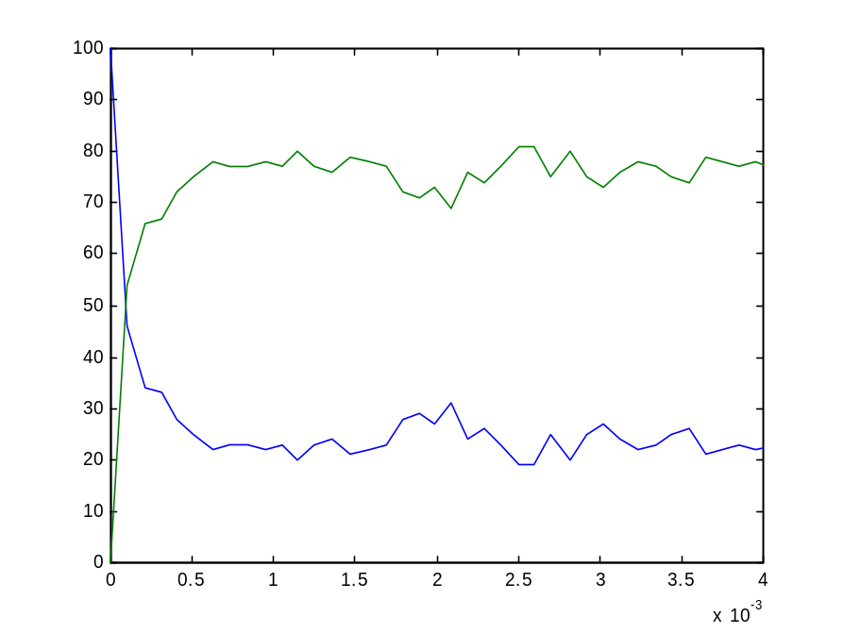
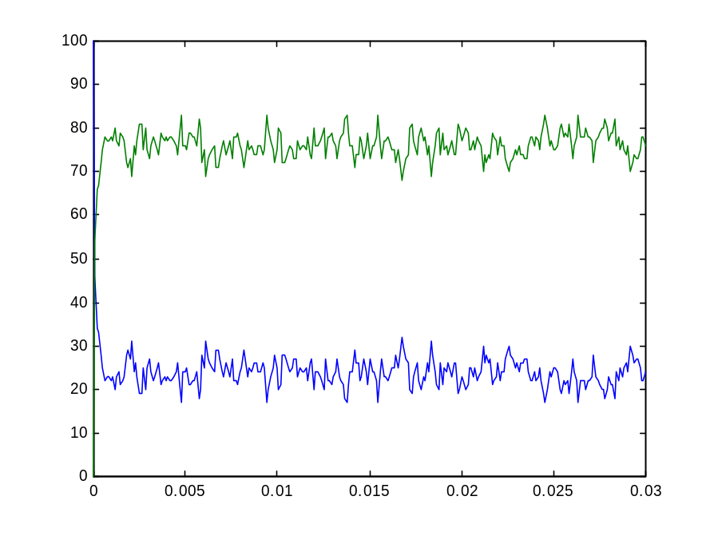
Plotting Output
Na + Cl ↔ Na⁺ + Cl⁻
The tab-delimited .table file can be used by many applications (e.g. MatLab, Excel). In Matlab use the load and plot commands, e.g:
load nacl_out.table
plot(nacl_out(:,1),nacl_out(:,4), nacl_out(:,1),nacl_out(:,5))
nacl_1.cp

Slide 87
Recording Consecutive Runs
The random seed is reset only when exiting and re-entering the Logix system
Global channels may require resetting to avoid conflicts (prgcs command)
If a record was suspended (nothing left to do but time limit not reached) then the clock is not reset

Slide 88
Some Useful Logix Commands
Ctrl+G | Quitting
Ctrl+C | Quitting (after record)
Ctrl+P | Previous Command
Ctrl+F | Forward
Ctrl+B | Back
See Appendix B for BioPSI unique commands
Use ph for BioPSI help

Slide 89
Exercise #1: Using Logix
Write a BioPSI program for the reaction K + F → K⁺ + F⁻
Use the attached code (System process) to spawn K and F processes
Run the program, each time with different rates and initial quantities
Plot the results of each run. Remember to use scaling to obtain enough data points: when to scaling are suggested, use the refined one to plot the events up to steady state.
Submit: program code, record, .table and .names files, plots
p.s. : For comments use % at beginning of line
Run # | e1 | e2 | K | F | T_stop | Scale
1 | 1 | 0.01 | 50 | 50 | 100 | 1
2 | 0.1 | 0.1 | 100 | 100 | 10 | 0.1 and 0.001
3 | 10 | 1 | 20 | 20 | 0.5 | 0.001 and 0.00001
4 | 0.00001 | 0.0000001 | 100 | 100 | 20000 | 10 and 100

