Slide 1
Biomolecular processes as concurrent computation
Unit 1: The electron theory of chemical bonds

Slide 2
Ionic Bonds
In ionic bonds electrons are gained and lost. The attraction between positive and negative charge results in an ionic bond
 | Na | ·
 | ..
: | Cl | ·
 | ..
 | ..
: | Na⁺ | :
 | ..
 | ..
: | Cl⁻ | :
 | ..
+ →
In ionic bonds, the reverse reaction does not necessarily occur b/w the same two atoms that participated in the forward one.
..
 | :
..

Slide 3
Na + Cl ↔ Na⁺ + Cl⁻
Atoms and ions | Processes | Na, Na_plus Cl Cl_minus
Reaction capabilities (valence electrons) | Communication actions (alerts) | e1 ! [] e1 ? [] e2 ! [] e2 ? []
Reaction | Communication and state alteration | COMM
Reaction rate | Channel rate | Gillespie’s algorithm

Slide 4
Na + K + 2Cl ↔ Na⁺ + K⁺ + 2Cl⁻
Multiple reaction capabilities | Choice | e1 ! [] , … ; e2 ! [] , … .
Alternative reactions | Mutual exclusive, probabilistic choice; discarding of alternative communication | COMM (PAR and STRUCT)

Slide 5
Mg + 2Cl ↔ MgCl₂
Alternative reverse capabilities (electron donor and acceptor) | Mixed Choice | e1 ? [] , … ; e2 ! [] , … .
Reaction intermediates | Explicit or implicit intermediate states (processes, local (sub)processes or sequential guards) | Mg_plus << >> e1 ? [ ] , e2 ? [ ] , …
Implicit representations are sometimes more difficult to trace

Slide 6
Covalent Bonds
A covalent bond is a sharing of a pair of electrons, so that both atoms have filled octets
→ |  |  |  |  | ←
H | · |  |  | · | Cl
H | : | Cl
..
 | :
..
..
 | :
..
In a covalent bond, a molecule is formed, and the two products are specifically bonded

Slide 7
H + Cl ↔ HCl
Molecular identity | Local scopes for channels (and processes) | H::= << electron. … >> H+electron::= …
Creation of molecule | Communication and mobility of local channel names (scope extrusion) | e1 ? {e} , e ! [] , … e1 ? {e} , Cl_minus(e)
hcl_5.cp

Slide 8
O + O ↔ O₂
Multiple bonds
Limiting symmetric interactions
Atomic interactions for multiple bonds
(ee channel)
Using a restricted channel for second bond, with infinite rate (O+e2(infinite))

Slide 9
Lattices, molecules and networks
Ionic compounds | Ionic | Lattice | Global channels
Molecular covalent compounds | Covalent | Discrete molecular units | Global and local channels
Network covalent compounds | Covalent | Network | Global and local channels (“On”*)
* A real network covalent compounds is e.g. SiO₂

Slide 10
Limitations
“Atom” centered view is cumbersome and inappropriate when complex molecules are involved
E.g. C (valence of 4) and N (valence of 3) become highly difficult to model even for simple compounds

Slide 11
Limitations
Lack in explicit modeling of higher order entities
  radicals, molecules
  Limitations on global interactions of such entities
Interactions explained by more than pair-wise sharing of electrons, e.g.
  Resonance structures (benzen, ozone)
  Lattice energies of ionic compounds (MgCl₂, NaCl)

Slide 12
Lone Electron Pairs
Lone pair, an extra pair of valence electrons, not used in bonding
H⁺
 | ..
· | N | ·
 | .
 |  | ..
H | : | N | : | H
 |  | ..
 |  | ..
H | : | N | : | H
 |  | ..
H
H
Lewis Base, has one or more lone pairs

Slide 13
Resonance Structures
In certain bonding situations two alternative resonance electron dot structures can be suggested. For example in the ozone molecule:
-1
+1
+1
-1
O
O
O
O
O
O

Slide 14
Resonance Structures
The incorrect view assumes that both forms exist and that the electron go back and forth between both forms, resulting over time in the average
The correct view is that there is really only one form corresponding to the average. The two forms are only a conceptual method for getting this average. The actual bonding is represented by
-1/2
+1
-1/2
O
O
O

Slide 15
Exercise 3 – Question 1A
(i) Which process does the following program model ? (running it won’t help ☺ )
(ii) Which kind of compound will be formed and which bonds will be involved?
(iii) What is the inherent limitation in using this program to model the process in (i)?

Slide 16
Exercise 3 – Question 1A
-language(psifcp).
global(e(20)).
baserate(0.1).
System(N1)::= << CREATE_C(N1) .
CREATE_C(C)::= {C =< 0} , true ;
{C > 0} , {C--} | << el1, el2, el3, el4 . C(e,e,e,e,el1,el2,el3,el4) >> | self . >> .
C(e1,e2,e3,e4,el1,el2,el3,el4)::=
e1 ! {el1} , C(el1,e2,e3,e4,e1,el2,el3,el4) ;
e1 ? {el1} , C(el1,e2,e3,e4,e1,el2,el3,el4) ;
e2 ! {el2} , C(e1,el2,e3,e4,el1,e2,el3,el4) ;
e2 ? {el2} , C(e1,el2,e3,e4,el1,e2,el3,el4) ;
e3 ! {el3} , C(e1,e2,el3,e4,el1,el2,e3,el4) ;
e3 ? {el3} , C(e1,e2,el3,e4,el1,el2,e3,el4) ;
e4 ! {el4} , C(e1,e2,e3,el4,el1,el2,el3,e4) ;
e4 ? {el4} , C(e1,e2,e3,el4,el1,el2,el3,e4) .

Slide 17
Exercise 3 – Question 1B (bonus*)
In an ozone (O₃) molecule, a resonance structure exists, where three O atoms are sharing 3 electron pairs (see picture): 2 electron pairs are shared in “the usual way”. The third pair is shared by all three atoms.
Try to write a pi-calculus program to describe this molecule (no need to run it).
More information on resonance in O3 can be found in Mahan, pp 280-281
Even an unsuccessful (but interesting) attempt can gain points.
O
O
O

Slide 18
Unit 2: Molecules, Radicals and Functional Groups

Slide 19
Radicals
Parts of molecules which have special significance
For example, H₂O can be divided to two parts H and OH.
We can consider H₂0 as formed from combining these two radicals

Slide 20
Free Radicals
Radicals sometimes exist as independent free, entities
Free radicals possess an odd number of electrons (one or more unpaired electrons)
The ordinary free radical is univalent, capable of forming a single chemical bond
Usually short lived and highly reactive
Many chemical reactions take place with radicals as reactive intermediates

Slide 21
Radicals
Inorganic |  | Organic (i.e. carbon compounds)
Formula | Name | Formula | Name
H | Hydrogen | CH₃ | Methyl
F | Fluorine | CH₃CH₂ | Ethyl
Cl | Chlorine | CH₃CH₂CH₂ | n-Propyl
Li | Lithium | CH₃CHCH₃ | Isopropyl
Na | Sodium | (CH₃)₃C | tert-Butyl
OH | Hydroxyl | C₆H₅ | Phenyl
NH₂ | Amine | C₆H₅CH₂ | Benzyl
HO₂ | Hydroperoxyl | (C₆H₅)₃C | Triphenylmethyl
NO | Nitric oxide | H₂C=CHCH₂ | Allyl
NO₂ | Nitrogen dioxide | CH₃C=O | Acetyl
ClO₂ | Chlorine dioxide | [(CH₃)₃C]₂NO | di-tert butyl nitrooxide
Stable free radicals, do not interact with themselves, only with other radicals

Slide 22
(Organic) Functional Groups
Carbon based compounds are termed organic
Organic compounds are composed of functional groups
A functional group is the part of a molecule a having special arrangements of atoms that is largely responsible for the chemical behavior of the parent molecule
Different molecules containing the same kind of functional group react similarly

Slide 23
A Modular Approach to Radicals, Groups and Compounds
For a reaction of the type
A+B → C
We will
  Represent A, B as processes
  Upon interaction
    A, B processes will be terminated
    A new process, C, will be spawned
Example: O + H → O₂ + H₂ + H₂O

Slide 24
A Modular Approach to Radicals, Groups and Compounds
For reverse unimolecular reaction
C → A + B
Before, we had two counterparts (Bound_A and Bound_B) which unbound from each other
Now, we have a single reactant process C
In the pi-calculus we are limited to pair wise interactions

Slide 25
A Modular Approach to Radicals, Groups and Compounds
We will add a Timer process that will offer the complementary communication required by the pi-calculus.
We will use a single instance of this process to ensure a correct rate calculation

Slide 26
2H ↔ H₂
language(psifcp).
global(eCH(33),eHO(40),eHH(40),breakHH(0.25)).
System(N1)::=
<< timer_0#Timer_HH | CREATE_H(N1).
CREATE_H(C)::= {C =< 0} , true ; {C > 0} , {C--} | H | self >> .
H::= eHH ? [] , HH ;
eHH ! [] , true ;
eHO ! [] , true ;
eCH ! [] , true .
HH::= breakHH ? [] , H | H .
h2_1.cp

Slide 27
Timer Processes
-language(psifcp).
global(breakOH(0.25), breakHOH(0.25),breakOO(0.2), breakHH(0.25), breakCO(0.1), breakCOH(0.3), breakCH(0.37)).
Timer::= Timer_OH | Timer_OO | Timer_HH | Timer_CO | Timer_CH | Timer_COH.
Timer_OH::= breakOH ! [] , Timer_OH.
Timer_HOH::= breakHOH ! [] , Timer_OH.
Timer_OO::= breakOO ! [] , Timer_OO.
Timer_HH::= breakHH ! [] , Timer_HH.
Timer_CO::= breakCO ! [] , Timer_CO.
Timer_CH::= breakCH ! [] , Timer_CH.
Timer_COH::= breakCOH ! [] , Timer_COH.
timer_0.cp

Slide 28
2H ↔ H₂
H | H | Timer_HH
breakHH ? [] , H | H |
breakHH ! [] , Timer_HH
H | H | Timer_HH
Two H processes are spawned
h2_1.cp

Slide 29
2H ↔ H₂
HH | Timer_HH
eHH ? [] , HH ; eHH ! [] , true ; … |
eHH ? [] , HH ; eHH ! [] , true ; … |
Timer_HH
HH | true | Timer_HH
Molecule process
Empty processes are removed from the system
h2_1.cp

Slide 30
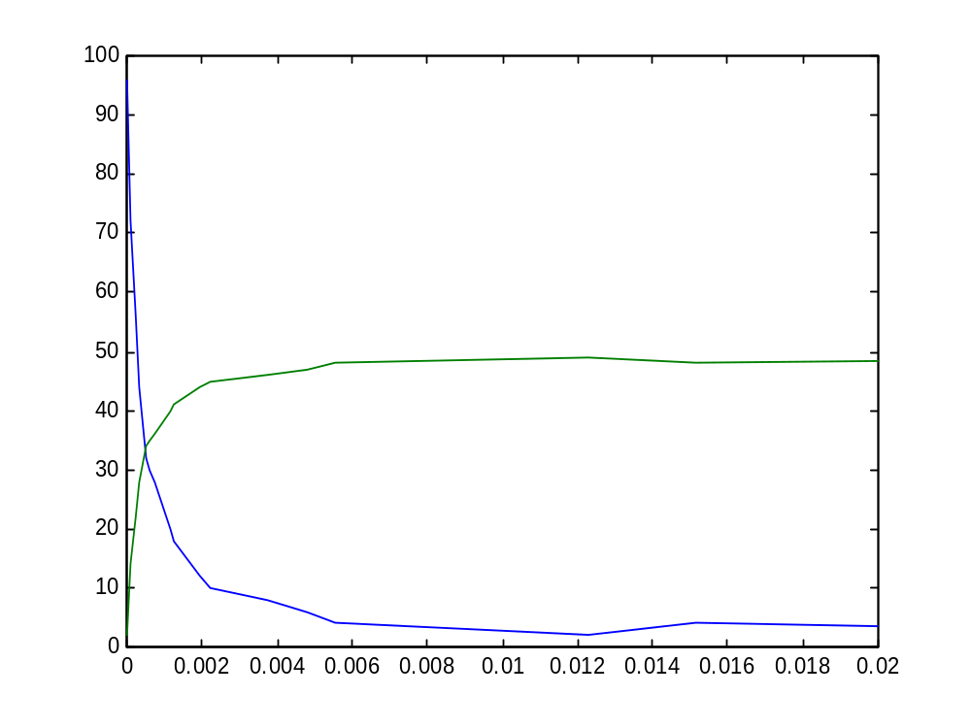
2H ↔ H₂
h2_1.cp

Slide 31
Exercise 3: Question 2
As we saw, the reaction A+B ↔ C can be modeled in pi-calculus in two ways
In the first one
  An A_Bound and B_Bound processes are created as a result of the forward reaction, sharing the same private channel.
  The reverse reaction occurs by communication on this private channel.
  An example for this is the HCl program from unit 1
In the second one
  A single C process is created by the forward reaction (A and B “disappear”).
  The reverse reaction occurs by communication between a C process an a specific Timer process (one copy)
  An example is the H-OH unbinding we saw in this unit

Slide 32
Exercise 3: Question 2
Why do these two alternative unimolecular unbinding reactions yield the same results in our algorithm, which correspond to the correct rate calculation rule for a unimolecular elementary reaction (k*[C]) ?

Slide 33
2O ↔ O₂
-language(psifcp).
global(eeCO(100), eCOH(37), eHO(40), eeOO(50), breakOH(0.25), breakHOH(0.25), breakOO(0.2)).
System(N1)::=
<< timer_0#Timer_OO | CREATE_O(N1). CREATE_O(C)::= {C =< 0} , true ; {C > 0} , {C--} | O | self >> .
O::= eeOO ? [] , OO ;
eeOO ! [] , true ;
eHO ? [] , OH ;
eeCO ! [] , true .
OH::= breakOH ? [] , O | h2_1#H ;
eHO ? [] , H2O ;
eCOH ! [] , true .
OO::= breakOO ? [] , O | O .
H2O::= breakHOH ? [] , OH | h2_1#H .
o2_2.cp

Slide 34
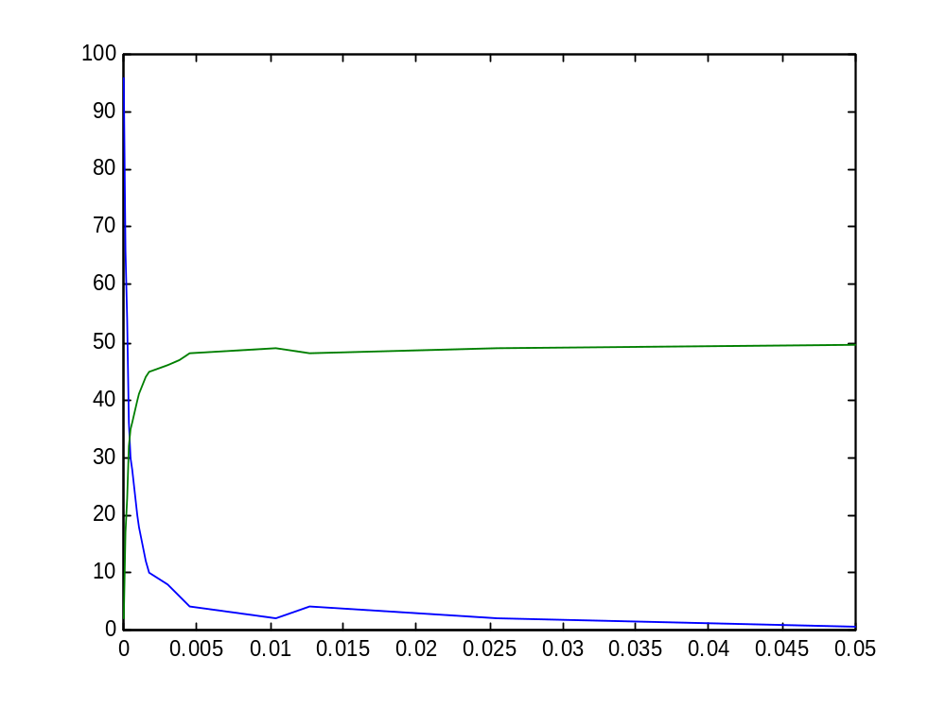
2O ↔ O₂
o2_2.cp

Slide 35
H₂ + O₂ ↔ H₂O
-language(psifcp).
SystemHO(N1,N2)::=
h2_1#System(N1) | o2_2#System(N2) |
timer_0#Timer_OH.
h2o_3.cp

Slide 36
2H ↔ H₂
language(psifcp).
global(eCH(33),eHO(40),eHH(40),breakHH(0.25)).
System(N1)::=
<< timer_0#Timer_HH | CREATE_H(N1).
CREATE_H(C)::= {C =< 0} , true ; {C > 0} , {C--} | H | self >> .
H::= eHH ? [] , HH ;
eHH ! [] , true ;
eHO ! [] , true ;
eCH ! [] , true .
HH::= breakHH ? [] , H | H .
h2_1.cp

Slide 37
2O ↔ O₂
-language(psifcp).
global(eeCO(100), eCOH(37), eHO(40), eeOO(50), breakOH(0.25), breakHOH(0.25), breakOO(0.2)).
System(N1)::=
<< timer_0#Timer_OO | CREATE_O(N1). CREATE_O(C)::= {C =< 0} , true ; {C > 0} , {C--} | O | self >> .
O::= eeOO ? [] , OO ;
eeOO ! [] , true ;
eHO ? [] , OH ;
eeCO ! [] , true .
OH::= breakOH ? [] , O | h2_1#H ;
eHO ? [] , H2O ;
eCOH ! [] , true .
OO::= breakOO ? [] , O | O .
H2O::= breakHOH ? [] , OH | h2_1#H .
o2_2.cp

Slide 38
OH + H → H₂O
OH | H | Timer_OH | Timer_HOH
breakOH ? [] , O | h2_1#H ; eHO ? [] , H2O ; … |
eHH ? [] , HH ; eHH ! [] , true ;eHO ! [] , true ; … |
breakOH ! [] , Timer_OH |
Timer_HOH
breakOH
eOH
O | H | H
Timer_OH | Timer_HOH
H2O |
Timer_OH | Timer_HOH
h2o_3.cp; o2_2.cp ; h1_1.cp

Slide 39
H₂O → OH + H
H2O | Timer_OH | Timer_HOH
breakHOH ? [] , OH | h2_1#H |
Timer_OH |
breakHOH ! [] , Timer_HOH |
breakHOH
OH | H |
Timer_OH | Timer_HOH
h2o_3.cp; o2_2.cp ; h1_1.cp

Slide 40
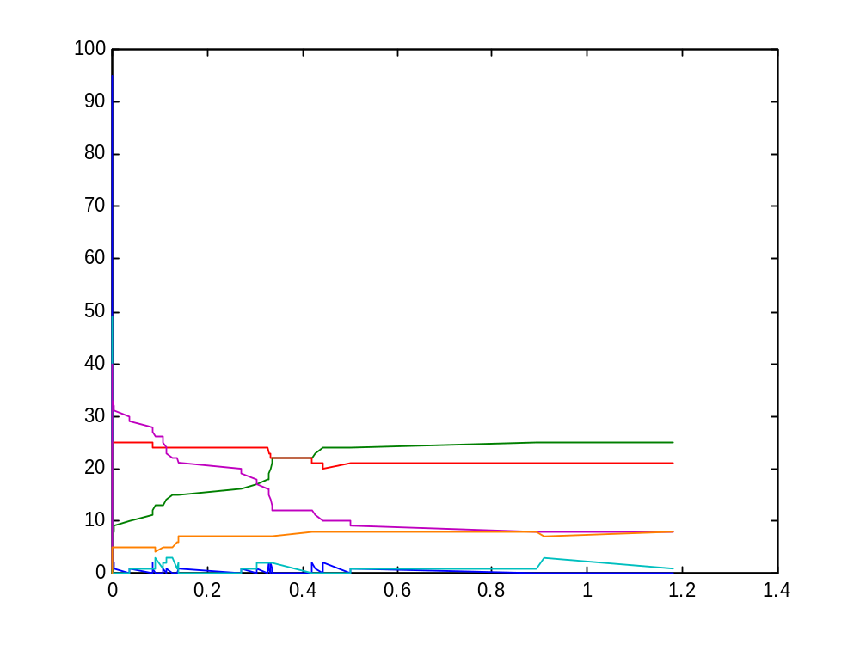
H₂ + O₂ ↔ H₂O
OH
H₂O
HH
OO
O , H
h2o_3.cp; o2_2.cp ; h1_1.cp

Slide 41
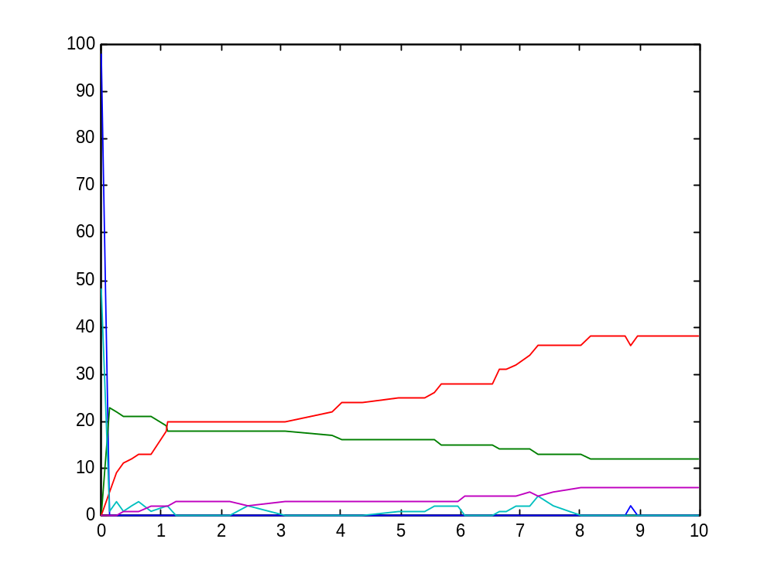
H₂ + O₂ ↔ H₂O
H₂O
H₂
O₂
O , H
h2o_old.cp ; h2_old.cp ;
o2_old.cp ; timer_old.cp
*Same rates as in Unit 1

Slide 42
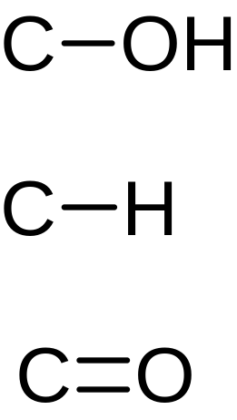
C + O + H

Slide 43
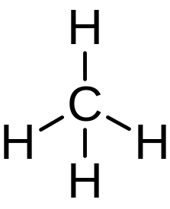
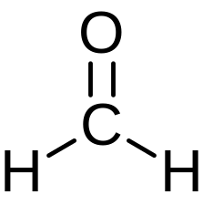
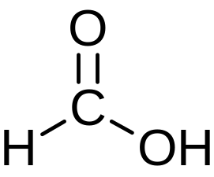
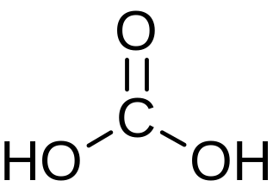
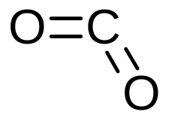
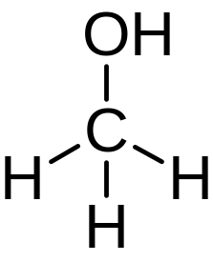
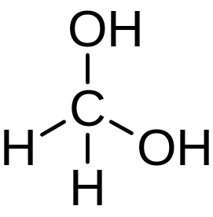
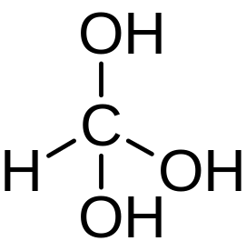
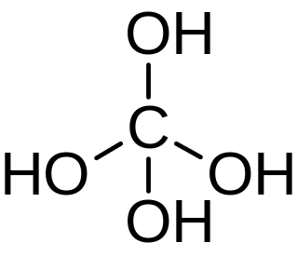
C + O + H
methane
Carbon dioxide
Fomaldehyde
Methanoic (formic) acid
Methanol

Slide 44
C + O + H
C
C=O
C-H
C-OH
HO-C=O
H-C=O

Slide 45
C + O + H
-language(psifcp).
global(eCH(33),eeCO(100),eCOH(37),breakOO(0.1),breakCO(0.1),breakCOH(0.3),breakCH(0.37)).
System(N1)::= << timer_0#Timer_CO |
timer_0#Timer_COH |
timer_0#Timer_CH |
CREATE_C(N1) . CREATE_C(C)::= {C =< 0} , true ; {C > 0} , {C--} | C | self >> .
coh_4.cp

Slide 46
C + O + H
C::= eCH ? [] , CH ;
eeCO ? [] , CO ;
eCOH ? [] , COH .
CH::= eCH ? [] , CH2 ;
eeCO ? [] , HCO ;
eCOH ? [] , HCOH .
CO::= eCH ? [] , HCO ;
eeCO ? [] , CO2 ;
eCOH ? [] , COOH .
COH::= eCH ? [] , HCOH ;
eeCO ? [] , COOH ;
eCOH ? [] , COHOH .
coh_4.cp

Slide 47
C + O + H
CH2::= eCH ? [] , CH3 ;
eeCO ? [] , H2CO ;
eCOH ? [] , H2COH .
HCO::= eCH ? [] , HCOH ;
eeCO ? [] , COOH ;
eCOH ? [] , COHOH .
HCOH::= eCH ? [] , H2COH ;
eCOH ? [] , HCOHOH .
CO2::= breakCO ? [] , CO | o2_2#O .
COOH::= eCH ? [] , HCOOH ;
eCOH ? [] , COOHOH .
COHOH::= eCH ? [] , HCOHOH ;
eeCO ? [] , COOHOH ;
eCOH ? [] , COHOHOH .
coh_4.cp

Slide 48
C + O + H
CH3::= eCH ? [] , CH4 ;
eCOH ? [] , H3COH .
H2CO::= breakCH ? [] , HCO | h2_1#H ;
breakCO ? [] , CH2 | o2_2#O .
H2COH::= eCH ? [] , H3COH ;
eCOH ? [] , H2COHOH .
HCOHOH::= eCH ? [] , H2COHOH ;
eCOH ? [] , HCOHOHOH .
COOHOH::= breakCO ? [] , COHOH | o2_2#O ;
breakCOH ? [] , COOH | o2_2#OH.
COHOHOH::= eCH ? [] , HCOHOHOH ;
eCOH ? [] , COHOHOHOH .
coh_4.cp

Slide 49
C + O + H
CH4::= breakCH ? [] , CH3 | h2_1#H .
H3COH::= breakCH ? [] , H2COH | h2_1#H ;
breakCOH ? [] , CH3 | o2_2#OH . H2COHOH::= breakCH ? [] , HCOHOH | h2_1#H ;
breakCOH ? [] , H2COH | o2_2#OH . HCOHOHOH::= breakCH ? [] , COHOHOH | h2_1#H ;
breakCOH ? [] , HCOHOH | o2_2#OH . COHOHOHOH::= breakCOH ? [] , COHOHOH | o2_2#OH.
HCOOH::= breakCH ? [] , COOH | h2_1#H ;
breakCO ? [] , HCOH | o2_2#OO ;
breakCOH ? [] , HCO | o2_2#OH .
coh_4.cp

Slide 50
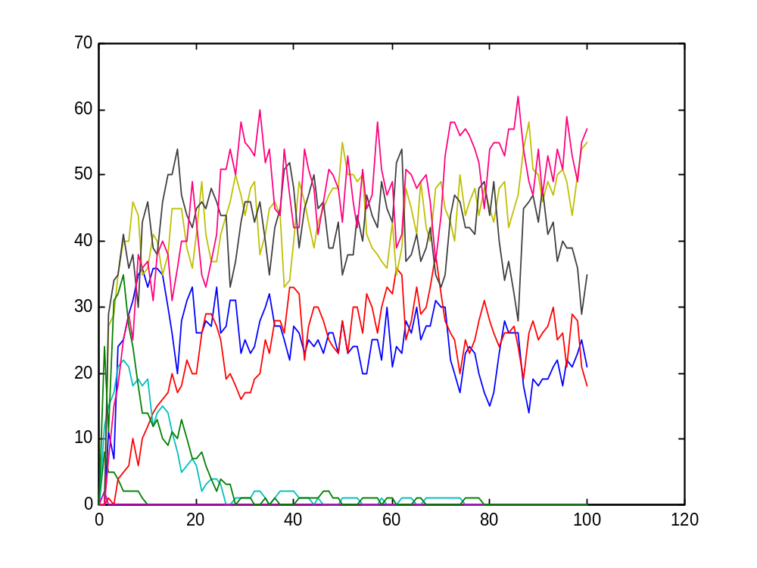
C + O + H
hco_6.cp ; coh_4.cp

Slide 51
Exercise 3: Question 3
In the above C+H+O program, only the last step was reversible
Add reversibility also at the previous step (univalent C radicals)
Bonus: Modify to yield a completely reversible mechanism (i.e. for each step of bond formation allow a reverse step of bond breakage as well).
Assume all bond breaking rates identical to those in the final products.
coh_5.cp

Slide 52
Organic Compounds, Functional Groups and Reactions

Slide 53
Organic Compounds and Reactions
So far, we have focused on reactions involving atoms, and including atomization of compounds
From now on, we will focus on reactions involving almost exclusively compounds and functional groups

Slide 54
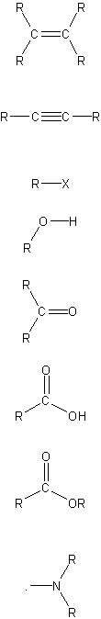
Some Functional Groups
Group | Name | Typical reactions
 | Carbon-carbon double bond | Addition reactions (e.g. with halogen); hydrogenation to alkanes
 | Carbon-carbon triple bond | Addition reactions; hydrogenation to alkenes or alkanes
 | Halogen | Exchange reactions CH₃CH₂Br + KI → CH₃CH₂I + KBr
 | Hydroxyl | Esterification ; Oxidation (to aldehydes, ketones, carboxylic acids)
 | Carboxyl | Esterification (with alcohols)
 | Ester | Hydrolysis to acids and alcohols
 | Amine | Formation of ammonium salts with acids

Slide 55
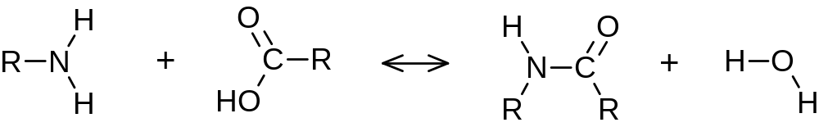
Condensation and hydrolysis
Amine
Carboxyl
Amide

Slide 56
Condensation and hydrolysis
Amine
Carboxyl
Amide
eRN
eRC
amine
hydrolysis
eRN
eRC
R(eRN)
R(eRC)
R(eRN)
R(eRC)
NH2(eRN)
COOH(eRC)
Amide(eRN,eRC)

Slide 57
RNH₂ + RCOOH ↔ RNHCOR + H₂O
-language(psifcp).
global(amine(10),hydrolysis(1)).
R_Amine+eRN::= NH2(eRN) | R(eRN) .
R_Carboxyl+eRC::= R(eRC) | COOH(eRC) .
NH2(eRN)::=
amine ? {eRC1} , Amide(eRN,eRC1) | H2O .
Amide(eRN,eRC)::=
hydrolysis ? [] , COOH(eRC) | NH2(eRN) .
COOH(eRC)::= amine ! {eRC} , true .
R(e)::= e ! [] , self .
H2O::= hydrolysis ! [] , true .
condensation_peptide_1.cp

Slide 58
RNH₂ + RCOOH → RNHCOR + H₂O
R_Amine+eRN | R_Carboxyl+eRC
NH2(eRN) | R(eRN) | R(eRC) | COOH(eRC) .
amine ? {eRC1} , Amide(eRN,eRC1) | H2O | eRC ! [] , self |
amine ! {eRC} , true | eRN ! [] , self
amine
Amide(eRN,eRC) | H2O |
eRC ! [] , self | eRN ! [] , self
condensation_peptide_1.cp

Slide 59
RNHCOR + H₂O → RNH₂ + RCOOH
hydrolysis ? [] , COOH(eRC) | NH2(eRN) |
hydrolysis ! [] , true |
R(eRN) | R(eRC)
hydrolysis
COOH (eRC) | NH2(eRN) |
R(eRN) | R(eRC)
In this private channels eRN and eRC are not used for any interaction in this example. However, they open up this opportunity
condensation_peptide_1.cp

Slide 60
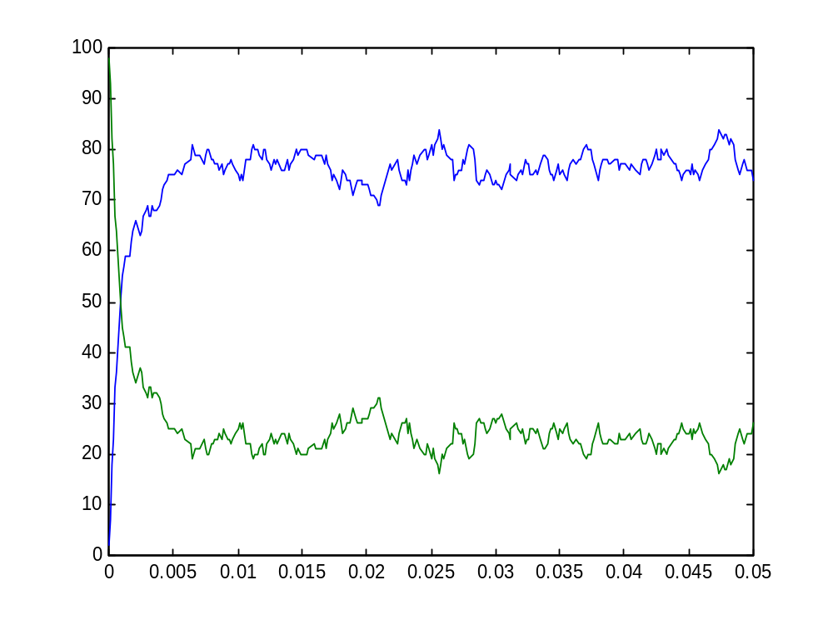
RNH₂ + RCOOH ↔ RNHCOR + H₂O
condensation_peptide_1.cp

Slide 61
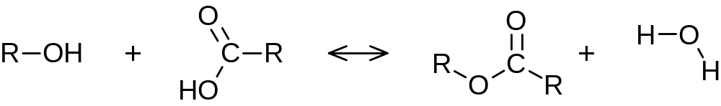
Exercise 3: Question 4
A similar condensation (hydrolysis) reaction occurs between a carboxylic and alcohol groups, to create (break) an ester bond
Write and run a program which includes both an hydroxyl, carboxyl and amine compounds (where both esters and amides may be formed)
Hydroxyl
Carboxyl
Ester

Slide 62
Exercise 3: Instructions and Parameters
As usual, submit program, .table and .names files, and plot your results
Use modules and rates files when convenient
You can zip all your files in one archive when submitting via e-mail
In programming assignments rates and quantities are according to the following table

Slide 63
Exercise 3: Instructions and Parameters
Reaction | Initial Quantities* | Rates | Time limit (scale)
C + H + O → | [C]= 200 [H] = 800 [O] = 400 | As in example cho_4.cp from class | 100 (1)
ROH + RCOOH ↔ RCOOR + H2O | [ROH] = 100 [RCOOH] = 200 [RNH2] = 100 | For creation and hydrolysis of amide, same rates as in class For creation and hydrolysis of ester Forward (condensation): 20 Reverse (hydrolysis): 0.1 | 0.05 (0.0001)
* All other quantities are 0 at initialization

