Slide 1
Notices
Instantaneous channels (with infinite rate) are a separate type of channel, distinct from the usual (rated) ones, and cannot be used for symmetric interactions
A call for a process (Remote Process Call = RPC) has the general form LogixPath#LogixGoal

Slide 2
Notices
LogixPath may be the name of a module (e.g. nacl_1) or a transformation of a UNIX path:
dir₁/dir₂/…/dir_{n}/module.cp → dir₁#dir₂#…#dir_{n}#module
LOGIX treats an alphanumeric name which begins with a lower case letter as a string, hence it does not require quotes
Any other names starting with upper case letter (except for Logix variables) require quotes
LogixGoal may be any process defined within the target module. Since BioPSI processes start with upper case letter they must be quoted

Slide 3
Unit 2: Molecules, Radicals and Functional Groups

Slide 4
Radicals and Functional Groups
Free radicals are highly reactive, typically univalent, “parts” of molecules
Organic compounds are composed of functional groups
A functional group is the the part of a molecule a having special arrangements of atoms that is largely responsible for the chemical behavior of the parent molecule
We focus on reactions involving almost exclusively organic compounds and functional groups

Slide 5
A Modular Approach to Radicals, Groups and Compounds
For a reaction of the type
A+B → C
We will
  Represent A, B as processes
  Upon interaction
    A, B processes will be terminated
    A new process, C, will be spawned
Example: O + H → O₂ + H₂ + H₂O

Slide 6
A Modular Approach to Radicals, Groups and Compounds
For reverse unimolecular reaction
C → A + B
Before, we had two counterparts (Bound_A and Bound_B) which unbound from each other
Now, we have a single reactant process C
In the pi-calculus we are limited to pair wise interactions

Slide 7
A Modular Approach to Radicals, Groups and Compounds
We will add a Timer process that will offer the complementary communication required by the pi-calculus.
We will use a single instance of this process to ensure a correct rate calculation

Slide 8
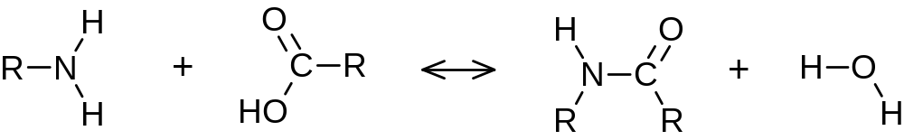
Condensation and hydrolysis
Amine
Carboxyl
Amide
eRN
eRC
amine
hydrolysis
eRN
eRC
R(eRN)
R(eRC)
R(eRN)
R(eRC)
NH2(eRN)
COOH(eRC)
Amide(eRN,eRC)

Slide 9
RNH₂ + RCOOH ↔ RNHCOR + H₂O
-language(psifcp).
global(amine(10),hydrolysis(1)).
R_Amine+eRN::= NH2(eRN) | R(eRN) .
R_Carboxyl+eRC::= R(eRC) | COOH(eRC) .
NH2(eRN)::=
amine ? {eRC1} , Amide(eRN,eRC1) | H2O .
Amide(eRN,eRC)::=
hydrolysis ? [] , COOH(eRC) | NH2(eRN) .
COOH(eRC)::= amine ! {eRC} , true .
R(e)::= e ! [] , self .
H2O::= hydrolysis ! [] , true .
condensation_peptide_1.cp

Slide 10
Unit 3: Programming and Tracing Polymers, Compartments and other Quantitative Aspects

Slide 11
Chain Reaction and Polymerization
Multi-step reaction mechanisms in which certain steps may be repeated indefinitely.
Typically involve three types of steps
  Intiation reaction
  Chain propagation reaction(s)
  Chain termination reaction
Occur in flames, explosions, atmosphetic and life processes, and are important for the creation of synthetic polymers

Slide 12
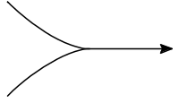
Polymerization
Seeds
Monomers
Y
Y
A
A
A
A
A
A
A
A
A
Y
Initiation
Propagation
Y
A*
A
Y
A
A*
Y
A
A
A*
A
A
Y
A
A
A*
Termination
Y
A
A
A
A
A
A
Y
Y
A
A
A*
Polymer

Slide 13
Synthetic polymers: Polyethylene
Initiation
Y + CH2=CH2 → Y-CH2-CH2*
Propagation
Y-(CH2-CH2)_{n}- CH2-CH2* + CH2=CH2 → Y-(CH2-CH2)_{n+1}-CH2-CH2*
Termination
Y-(CH2-CH2)_{n}- CH2-CH2* +
Y-(CH2-CH2)_{m}- CH2-CH2* →
Y-(CH2-CH2)_{m+n+2}-Y

Slide 14
Polyethylene - Initiation
alkene_Y
polyCC
polyCC_L
polyCC_R
Y + CH2=CH2 → Y----CH2-CH2*
Y+polyCC
Ethylene
Bound_Y
(polyCC)
EthylR
(polyCC_L)+ polyCC_R

Slide 15
Polyethylene - Propagation
pCC
pCC_L
pCC_R
pCC_L
pCC_R
pCC_L
+pCC_R
Y-------------(CH2-CH2)------------(CH2-CH2)------------CH2-CH2* + CH2=CH2
→
Y-(CH2-CH2)₂-------- CH2-CH2 -------CH2-CH2*
Bound_Y
(pCC)
EthylP
(pCC_L, pCC_R)
EthylP
(pCC_L , pCC_R)
EthylR
(pCC_L) +pCC_R
Ethylene
alkene_R
pCC_R
pCC_L
pCC_R
pCC_L
+pCC_R
EthylP
(pCC_L, pCC_R)
EthylR
(pCC_L) +pCC_R

Slide 16
Polyethylene - Termination
pCC_L
pCC_L
Y-(CH2-CH2)_{n}---- CH2-CH2* + Y-(CH2-CH2)_{m}---- CH2-CH2*
→
Y-(CH2-CH2)_{n}- CH2-CH2 ------CH2-CH2 -(CH2-CH2)_{m}- Y
EthylR
(pCC_L) +pCC_R
EthylR
(pCC_L) +pCC_R
poly_R*
pCC_L
pCC_R
pCC_R
pCC_L
EthylP_term
(pCC_L, pCC_R)
EthylP_term
(pCC_L, pCC_R)
* poly_R is a symmetric channel
(either pCC_R or pCC_R could end up as the shared channel)

Slide 17
Polyethylene
-language(psifcp).
global(dummy, alkene_Y(1), alkene_R(10), poly_R(1)).
System(N1,N2)::=
CREATE_Y(N1) | CREATE_Ethylene(N2) .
CREATE_Y(C)::=
{C =< 0} , true ;
{C > 0} , {C--} | Y | self .
CREATE_Ethylene(C)::=
{C =< 0} , true ;
{C > 0} , {C--} | Ethylene | self .
Polyethylene_1.cp

Slide 18
Polyethylene
Y+polyCC::=
alkene_Y ! {polyCC} , Y_bound(polyCC) .
Y_bound(polyCC)::= dummy ? [] , true .
Ethylene::=
alkene_Y ? {polyCC_L} , EthylR(polyCC_L) ;
alkene_R ? {polyCC_L} , EthylR(polyCC_L) . EthylR(polyCC_L)+polyCC_R::=
alkene_R ! {polyCC_R} , EthylP(polyCC_L, polyCC_R) ;
poly_R ! {polyCC_R} , EthylP_term(polyCC_L, polyCC_R);
poly_R ? {polyCC_R} , EthylP_term(polyCC_L, polyCC_R). EthylP(polyCC_L, polyCC_R)::=
dummy ? [] , true .
EthylP_term(polyCC_L, polyCC_R)::=
dummy ? [] , true .
Polyethylene_1.cp

Slide 19
Initiation
Y+polyCC | Ethylene
alkene_Y ! {polyCC} , Y_bound(polyCC) |
alkene_Y ? {polyCC_L} , EthylR(polyCC_L) ;
alkene_R ? {polyCC_L} , EthylR(polyCC_L) .
alkene_Y
Y_bound(polyCC) | EthylR(polyCC)+polyCC_R
Polyethylene_1.cp

Slide 20
Propagation
EthylR(polyCC)+polyCC_R | Ethylene
alkene_R ! {polyCC_R} , EthylP(polyCC, polyCC_R) ; … | alkene_Y ? {polyCC_L} , EthylR(polyCC_L) ;
alkene_R ? {polyCC_L} , EthylR(polyCC_L) .
alkene_R
EthylP(polyCC,polyCC_R) | EthylR(polyCC_R)+polyCC_R
Polyethylene_1.cp

Slide 21
Termination
EthylR(polyCC_R)+polyCC_R | EthylR(polyCC_R)+polyCC_R
alkene_R ! {polyCC_R} , EthylP(polyCC_R, polyCC_R) ;
poly_R ! {polyCC_R} , EthylP_term(polyCC_R, polyCC_R);
poly_R ? {polyCC_R} , EthylP_term(polyCC_R, polyCC_R) |
alkene_R ! {polyCC_R} , EthylP(polyCC_R, polyCC_R) ;
poly_R ! {polyCC_R} , EthylP_term(polyCC_R, polyCC_R);
poly_R ? {polyCC_R} , EthylP_term(polyCC_R, polyCC_R).
poly_R
EthylP_term(polyCC_R, polyCC_R)|EthylR(polyCC_R, polyCC_R)
Polyethylene_1.cp

Slide 22
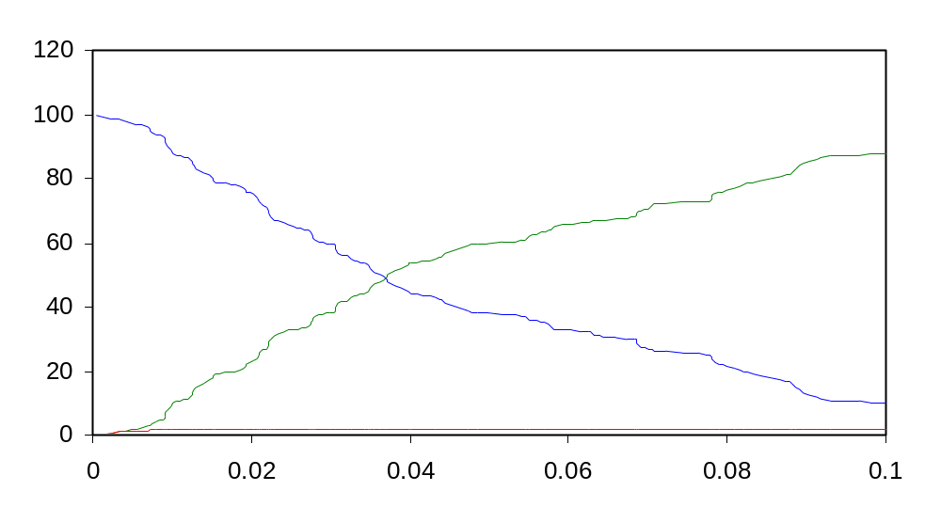
Polyethylene
(100 Ethylene ; 2 Y seeds)
EthylP
EthylR
Ethylene
Polyethylene_1.cp

Slide 23
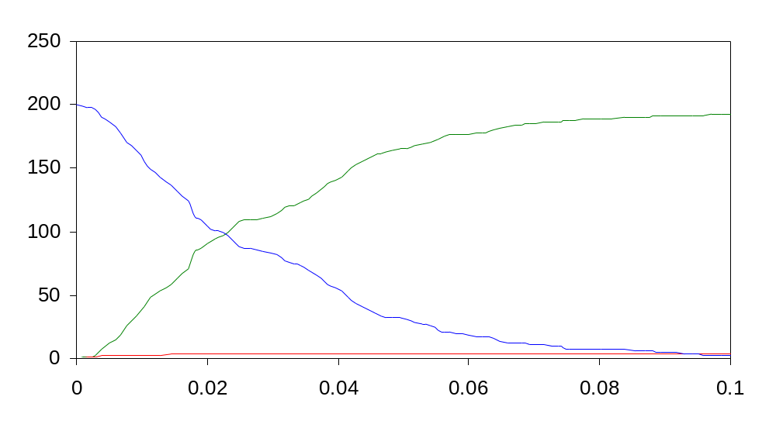
Polyethylene
(200 Ethylene, 4 Y seeds)
EthylP
EthylR
Ethylene

Slide 24
What Else Would We Like to Trace?
What is the length of each molecule?
What is the position of each of the monomers inside the polymer?
How can we follow the process of polymerization?

Slide 25
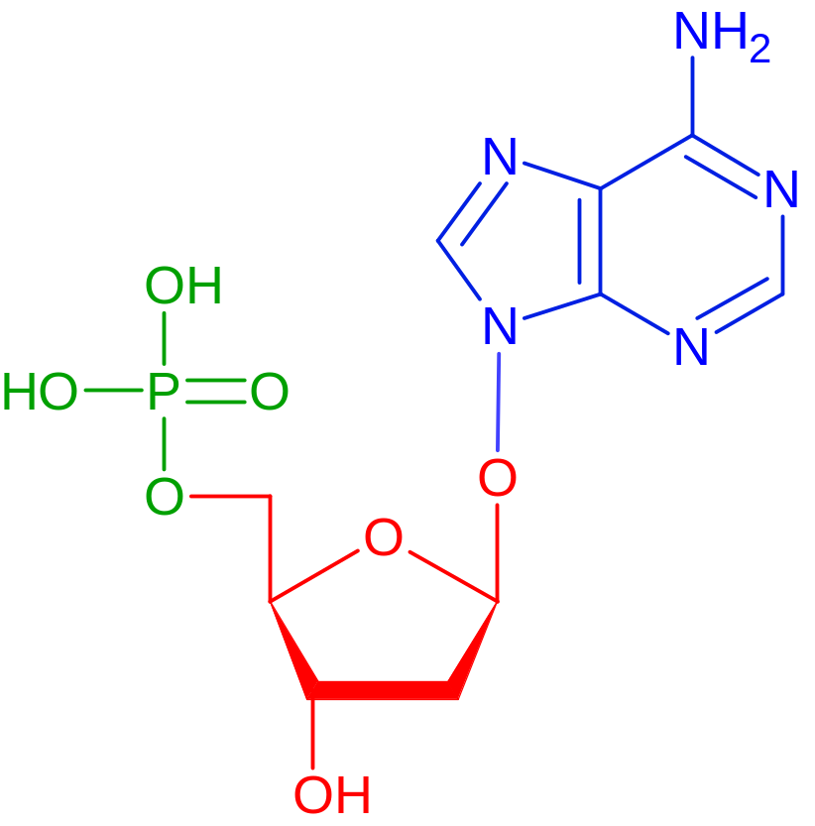
Nucleic Acids
Base*
Phosphate
5’
Base
P
Sugar
5’
Phosphoester
bond
3’
3’
Sugar
(pentose = 5 C)
Adenine (here)*; Guanine, Thymine, Cytosine, Uracil

Slide 26
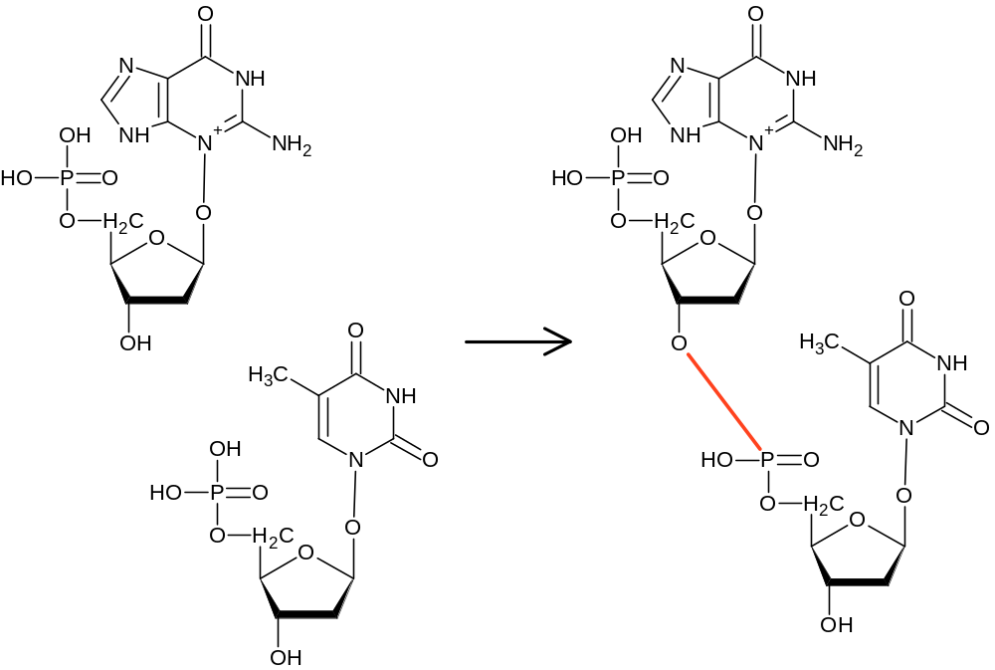
Phosphodiester Bonds and Nucleic Acid Polymerization
3’
5’
Phosphodiester
bond

Slide 27
Nucleic Acid Polymerization is Directional
Polymerization proceeds in the 5’→3’ direction:
The 5’ phosphate of a free nucleotide binds to the 3’ growing end of an existing chain
In cells this process requires a complex machinery (as we will learn later on)
For now, we will focus on the chain propagation mechanism.

Slide 28
Phosphodiester Bonds and Nucleic Acid Polymerization
5’
P
Seed
Free nucleotides
3’
5’
5’
P
P
3’
3’
5’
5’
P
Polymerized nucleotides
P
3’
3’
5’
P
5’
P
3’
3’
5’
P
Growing end
3’

Slide 29
Nucleic Acid Polymerization
-language(psifcp).
global(hydroxyl_P(1)).
System(N1,N2)::=
<< CREATE_Nucleotide(N1) |
CREATE_Seed_Nucleotide(N2).
CREATE_Nucleotide(C)::=
{C =< 0} , true ;
{C > 0} , {C--} | Nucleotide | self .
CREATE_Seed_Nucleotide(C)::=
{C =< 0} , true ;
{C > 0} , {C--} | Seed_Nucleotide | self
>> .
phosphodiester_sugar_phosphate_7a.cp

Slide 30
Nucleic Acid Polymerization
Seed_Nucleotide::=
<< hydroxyl_P ? {pd_ester} , Seed_Bound(pd_ester) .
Seed_Bound(pd_ester)::=
pd_ester ! [] , Seed_Nucleotide >> .
Nucleotide+pde(0.001)::=
<< hydroxyl_P ! {pde} , Nucleotide_5_Bound(pde) .
Nucleotide_5_Bound(pde)::=
pde ? [] , Nucleotide ;
hydroxyl_P ? {pd_ester} ,
Nucleotide_5_3_Bound(pde,pd_ester).
Nucleotide_3_Bound(pd_ester)::=
pd_ester ! [] , Nucleotide .
Nucleotide_5_3_Bound(pde,pd_ester)::=
pde ? [] , Nucleotide_3_Bound(pd_ester) ;
pd_ester ! [] , Nucleotide_5_Bound(pde) >> .
phosphodiester_sugar_phosphate_7a.cp

Slide 31
Initiation
5’
P
3’
pde
5’
P
Seed_Nucleotide | Nucleotide+pde
3’
hydroxyl_P ? {pd_ester} , Seed_Bound(pd_ester) |
hydroxyl_P ! {pde} , Nucleotide_5_Bound(pde)
hydroxyl_P
pde
Seed_Bound(pde) | Nucleotide_5_Bound(pde)
pde ! [] , Seed_Nucleotide | pde ? [] , Nucleotide ; …
phosphodiester_sugar_phosphate_7a.cp

Slide 32
Elongation
5’
P
3’
pde
5’
P
3’
pde
Nucleotide_5_Bound(pde) | Nucleotide+pde
5’
P
pde ? [] , Nucleotide ;
hydroxyl_P ? {pd_ester} , Nucleotide_5_3_Bound(pde,pd_ester) |
hydroxyl_P ! {pde} , Nucleotide_5_Bound(pde)
3’
pde
hydroxyl_P
Nucleotide_5_3_Bound(pde, pde) | Nucleotide_5_Bound(pde)
pde ? [] , Nucleotide_3_Bound(pde) ;
pde ! [] , Nucleotide_5_Bound(pde) |
pde ? [] , Nucleotide ;
hydroxyl_P ? {pd_ester} , Nucleotide_5_3_Bound(pde,pd_ester)
phosphodiester_sugar_phosphate_7a.cp

Slide 33
Cleavage
5’
P
3’
pde
Nucleotide_5_3_Bound(pde, pde) |
Nucleotide_5_3_Bound(pde,pde)
5’
P
3’
pde
pde ? [] , Nucleotide_3_Bound(pde) ;
pde ! [] , Nucleotide_5_Bound(pde) |
pde ? [] , Nucleotide_3_Bound(pde) ;
pde ! [] , Nucleotide_5_Bound(pde)
5’
P
3’
pde
5’
P
3’
pde
5’
5’
P
P
Nucleotide_5_Bound(pde) |
Nucleotide_3_Bound(pde)
3’
pde
3’
pde
5’
5’
P
P
3’
3’
phosphodiester_sugar_phosphate_7a.cp

Slide 34
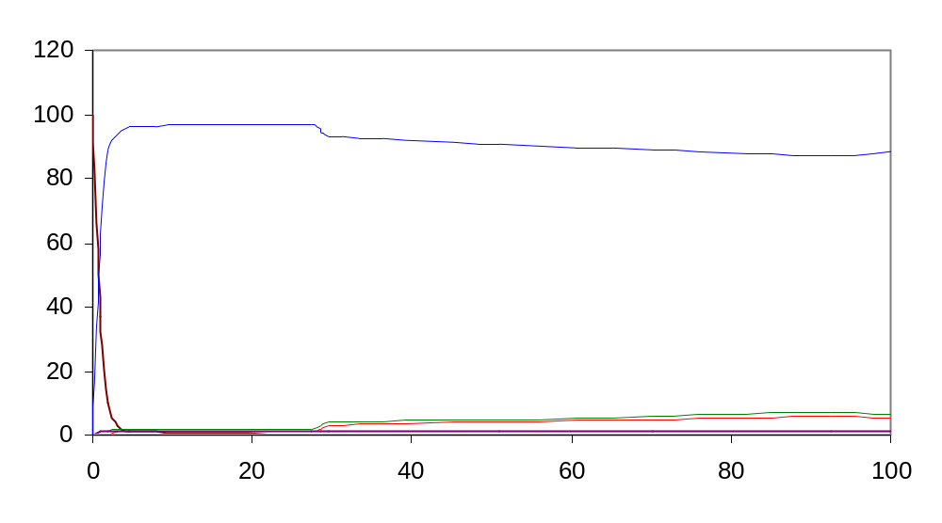
Phosphodiester bonds and nucleic acid polymerization
5’
P
1 Bound Seed + 5 “3_Bound”
= 6 “5_Bound” = 6 polypeptides
3’
5’
P
3’
5’
P
3’
P
5’
3’
5’
P
3’
phosphodiester_sugar_phosphate_7a.cp

Slide 35
What Else Would We Like to Trace?
What is the length of each molecule?
What is the position of each of the monomers inside the polymer?
How can we follow the process of polymerization?
Which chains are formed by cleavage?

Slide 36
Exercise 4 – Question 1
Does the nucleic acid program ensure directionality? Explain your answer

Slide 37
Exercise 4 – Question 2
A similar directional polymer is formed from monomer amino acids by the creation of a peptide bond. Each amino acid has two functional groups: an amine group and a carboxyl group. The two can form an amide (peptide) bond (See previous lesson). The resulting polymer is a polypeptide.

Slide 38
Exercise 4 – Question 2
Based on the nucleic acid example, write a program for the formation and cleavage of such “polypeptides”
Assume:
  The polypeptide is initiated from a Seed
  It is created in a directional fashion
  COOH (in seed or end of existing polymer) ←NH2(in incoming monomer): The NH2 group in each amino acid is “enabled” before the COOH group
  You should distinguish between Seed, free amino acids, COOH-bound, NH2-bound and COOH AND NH2 bound monomers.

Slide 39
Exercise 4 – Question 2
Run # | Initial Quantities | Rates | Time limit (scale)
1 | 2 seeds, 200 AAs | Propagation rate= 1 (polymerization and initition at same rate, use same channel) Cleavage rate = 0.005 | 100 (0.1)
2 | 2 seeds, 100 AAs | Propagation rate =1 Cleavage rate = 0.0005 | 100(0.1)
In addition to the standard (code, record, .table, .names, plot)
also determine how many individual chains you have at the
end of the run

Slide 40
Quantitative Options
Representing each molecule as a separate process can be costly
In some cases we do not wish to represent each molecule as a separate process, but would rather represent only molecular species as distinct processes
In other cases we would like to follow other quantitative aspects. E.g the location of a nucleotide in a polymer.

Slide 41
Quantitative Options
We will use Logix variables as counters to account for the number of molecules we have in each species
We will use this counters as message multipliers to ensure the correct rate calculation
We can also use counters in processes to represent location (in polymer) or other relevant quantitative properties

Slide 42
Variables
Variables are denoted by alphanumeric strings, beginning with an upper case alphabetic character
The string may contain an underscore character (_) or be a single underscore character.
We may use variables as parameters and in messages (we can mix in one tuple channels and variables)
May be used in various arithmetic and logic operations (e.g. summation, comparison)
We’ve all ready seen some examples in the spawning loop (e.g. {R++} or {R>0} )

Slide 43
Variables
We are using Logix variables, which can be assigned a value only once. Hence, every operation (e.g. R++) creates a new variable, which is assigned the new value
The new variable is local to the process in which the operation was performed, and is distinct from all other variables in other processes (that appear to have the same name)

Slide 44
Na + Cl → Na⁺ + Cl⁻
Each process: One chemical species (4 process in the system at all times)
A counter is maintained in every process.
The counter is initialized according to the starting quantities
Following each communication the reactant process decrements its own counter and alerts the relevant product process to increment its counter
The counter is used as a message multiplier

Slide 45
Na + Cl → Na⁺ + Cl⁻
language(psifcp).
global(e1(90),e2(10)).
-baserate(infinite).
System(N1,N2,N3,N4)+(e3,e4)::=
<< Na | Cl | Na_plus | Cl_minus .
Na::= e1 ! N1 * [] , {N1--} , e3 ! [] , Na ;
e3 ? [] , {N1++} , Na .
Na_plus::= e2 ? N3 * [] , {N3--} , e3 ! [] , Na_plus ;
e3 ? [] , {N3++} , Na_plus .
Cl::= e1 ? N2 * [] , {N2--} , e4 ! [] , Cl ;
e4 ? [] , {N2++} , Cl .
Cl_minus::= e2 ! N4 * [] , {N4--} , e4 ! [] , Cl_minus;
e4 ? [] , {N4++} , Cl_minus
>> .
<channel> ! <multiplier> * <message>
<channel> ? <multiplier> * <message>
nacl_1b.cp

Slide 46
What Else Would We Like to Trace?
The values of each Process Counter at each time point

Slide 47
Logix Variables
Variable values can be displayed on the screen or written into a file by using e.g.
  screen#display(counter = CA)
  screen#display(counter = CA,append(filename))
Use this command as you would use any other call to a process

Slide 48
Logix Variables
language(psifcp).
global(e1(90),e2(10)).
-baserate(infinite).
System(N1,N2,N3,N4)+(e3,e4)::=
<< Na | Cl | Na_plus | Cl_minus .
Na::= e1 ! N1 * [] , {N1--} , e3 ! [] ,
screen#display(counter=N1,append(count_txt)) | Na ;
e3 ? [] , {N1++} , Na .
Na_plus::= e2 ? N3 * [] , {N3--} , e3 ! [] , Na_plus ;
e3 ? [] , {N3++} , Na_plus .
Cl::= e1 ? N2 * [] , {N2--} , e4 ! [] , Cl ;
e4 ? [] , {N2++} , Cl .
Cl_minus::= e2 ! N4 * [] , {N4--} , e4 ! [] , Cl_minus;
e4 ? [] , {N4++} , Cl_minus
>> .

Slide 49
Logix Variables
autumn:~/Course/->122% + count_txt
counter = 3
counter = 2
counter = 1
counter = 2
counter = 1
counter = 0
counter = 1
counter = 0
counter = 0
counter = 2
counter = 2
counter = 1
counter = 1
autumn:~/Course/Electron_1/quant->123%

Slide 50
BioPSI Time
The current time can also be similarly accessed and displayed.
A special FCP procedure now(Now) is available in status.cp, which put the current time in the variable Now.
The value of this variable can be displayed by the usual procedure

Slide 51
BioPSI Time
language(psifcp).
global(e1(90),e2(10)).
-baserate(infinite).
System(N1,N2,N3,N4)+(e3,e4)::=
<< Na | Cl | Na_plus | Cl_minus .
Na::= e1 ! N1 * [] , {N1--} , e3 ! [] ,
status#now(Now) |
screen#display(counter=N1,append(count_txt)) |
screen#display(time=Now, append(count_txt)) | Na ;
e3 ? [] , {N1++} , Na .
Na_plus::= e2 ? N3 * [] , {N3--} , e3 ! [] , Na_plus ;
e3 ? [] , {N3++} , Na_plus .
Cl::= e1 ? N2 * [] , {N2--} , e4 ! [] , Cl ;
e4 ? [] , {N2++} , Cl .
Cl_minus::= e2 ! N4 * [] , {N4--} , e4 ! [] , Cl_minus;
e4 ? [] , {N4++} , Cl_minus
>> .

Slide 52
BioPSI Time
time = 0.772126
counter = 1
time = 0.78111
counter = 0
time = 0.782549
counter = 0
time = 0.787277
counter = 1
time = 0.806448
counter = 1
time = 0.814189
counter = 0
time = 0.829158
…

Slide 53
Exercise 4 – Question 3
Repeat the following programs (same initial quantities, rates, and durations) with a “quantitative modular approach”
  Exercise 1 question 1
  Condensation_peptide_1.cp (example from previous lesson; Initial quantities: 100 of each reactant)
  Challenge: H + H ↔ H2 (Just code)
Submit program and the resolvent after each run.

Slide 54
Exercise 4 – Question 3
Note: Use spr command after the record completes. If you wish to have a file with the resolvent you can use the UNIX script command (See instruction in end of lecture)

Slide 55
Polyethylene (Revisited)
So far, we did not explicitly model the location of the residue on the polyethylene polymer.
To this end, we will now use location counters, which we will send as messages on the private channels between the different units

Slide 56
Polyethylene
-language(psifcp).
global(dummy, alkene_Y(1), alkene_R(10), poly_R(1)).
baserate(1).
System(N1,N2) + RC ::=
<< {RC = 0} |CREATE_Y(N1) | CREATE_Ethylene(N2) .
CREATE_Y(C)::=
{C =< 0} , true ;
{C > 0} , {C--} | Y(RC) | self .
CREATE_Ethylene(C)::=
{C =< 0} , true ;
{C > 0} , {C--} | Ethylene | self
>>.
pcount_2a.cp

Slide 57
Polyethylene
Y(RC)+polyCC(infinite)::=
alkene_Y ! {polyCC} , Y_bound(polyCC) .
Y_bound(polyCC)::=
polyCC ! {RC} , dummy ? [] , true .
Ethylene::=
alkene_Y ? {polyCC_L} , EthylR(polyCC_L) ;
alkene_R ? {polyCC_L} , EthylR(polyCC_L) .
EthylR(polyCC_L)+polyCC_R(infinite)::=
alkene_R ! {polyCC_R} , EthylP(polyCC_L, polyCC_R) ;
poly_R ! {polyCC_R} , EthylP_term(polyCC_L, polyCC_R);
poly_R ? {polyCC_R} , EthylP_term(polyCC_L, polyCC_R).
EthylP(polyCC_L, polyCC_R)::=
polyCC_L ? {RC}, {RC++}, polyCC_R ! {RC} ,
EthylP_Count(RC).
EthylP_Count(RC)::= dummy ? [] , true .
EthylP_term(polyCC_L, polyCC_R)::=
polyCC_L ? {_} , EthylP_term_count .
EthylP_term_count::= dummy ? [] , true .
{_}
A sink for messages
pcount_2a.cp

Slide 58
What Else Would We Like to Trace?
The private channels linking the polymerized monomers
The internal position counter of each monomer
Reconstruct the architecture based on counters and channels

Slide 59
Compartments and Re-Localization
-language(psifcp).
global(inside,outside).
baserate(1).
System(N)::= Membrane | CREATE_H_plus(N) .
CREATE_H_plus(C)::=
{C =< 0} , true ;
{C > 0} , {C--} | H_plus(outside) | self .
Membrane::=
inside ! {outside} , Membrane ;
outside ! {inside} , Membrane .
H_plus(location)::=
location ? {new_location} , H_plus(new_location) .
osmosis_1.cp

Slide 60
What Else Would We Like to Trace?
The localization of each process based on its channel parameter

Slide 61
BioPSI in depth
Tracing and debugging - I

Slide 62
BioPSI Architecture
BioPSI:
(Stochastic) Pi-calculus
Logix:
Flat Concurrent Prolog
C emulator

Slide 63
Channels
Channel
Each channel is associated with a base rate:
finite (> 0) or infinite
Includes a reference count – how many processes “own” this channel
Lists for send and receive requests
Name
Type
Base rate
Send list
Receive list
Ref. count

Slide 64
Processes
Each process is transformed to a procedure
The channel set associated with each process is identified (global, arguments, newly declared, and input-bound)
Processes send channel requests to a monitor

Slide 65
Communication Monitor
Create one or more channels
Start a (compound) communication: The communication may include offers to send and/or receive for many channels.
Synchronizes withdrawal of offers from choice constructs
Close a channel: Count down the channel's reference count, and dispose of the channel if the count goes to zero.
Note that the reference count is incremented when a channel is propagated to more than one
continuation process

Slide 66
Communication Monitor
Channel x
Channel y
…
Channel z
Y?
N?
Infinite
Y?
Both send and receive
N?
Compute reaction rate
Transmit
Queue
Compute reaction rate
Compute reaction rate
Select channel and time step (probabilistic)
Transmit

Slide 67
The Resolvent
The current (“leftover”) set of unterminated processes in the system
Can be accessed at any time doing the run, or when the computation suspends
Shows a list of all processes with their associated channels

Slide 68
The Resolvent
@spr
<2> suspended
osmosis_1 # .Membrane.comm(global.inside(1)!, global.outside(1)!)
osmosis_1 # .H_plus.comm(global.outside(1)!)
osmosis_1 # .H_plus.comm(global.outside(1)!)
osmosis_1 # .H_plus.comm(global.outside(1)!)
osmosis_1 # .H_plus.comm(global.outside(1)!)
osmosis_1 # .H_plus.comm(global.outside(1)!)
osmosis_1 # .H_plus.comm(global.outside(1)!)
osmosis_1 # .H_plus.comm(global.outside(1)!)
osmosis_1 # .H_plus.comm(global.outside(1)!)
osmosis_1 # .H_plus.comm(global.outside(1)!)
osmosis_1 # .H_plus.comm(global.outside(1)!)
osmosis_1 # .H_plus.comm(global.outside(1)!)
osmosis_1 # .H_plus.comm(global.outside(1)!)
osmosis_1 # .H_plus.comm(global.outside(1)!)
osmosis_1 # .H_plus.comm(global.outside(1)!)
osmosis_1 # .H_plus.comm(global.outside(1)!)
osmosis_1 # .H_plus.comm(global.outside(1)!)
osmosis_1 # .H_plus.comm(global.inside(1)!)
osmosis_1 # .H_plus.comm(global.inside(1)!)
osmosis_1 # .H_plus.comm(global.inside(1)!)
osmosis_1 # .H_plus.comm(global.inside(1)!)
osmosis_1 # .H_plus.comm(global.inside(1)!)
osmosis_1 # .H_plus.comm(global.inside(1)!)
osmosis_1 # .H_plus.comm(global.inside(1)!)
osmosis_1 # .H_plus.comm(global.inside(1)!)
osmosis_1 # .H_plus.comm(global.inside(1)!)
osmosis_1 # .H_plus.comm(global.inside(1)!)
osmosis_1 # .H_plus.comm(global.inside(1)!)
osmosis_1 # .H_plus.comm(global.inside(1)!)
osmosis_1 # .H_plus.comm(global.inside(1)!)
osmosis_1 # .H_plus.comm(global.inside(1)!)
osmosis_1 # .H_plus.comm(global.inside(1)!)
osmosis_1 # .H_plus.comm(global.inside(1)!)
osmosis_1 # .H_plus.comm(global.inside(1)!)
osmosis_1 # .H_plus.comm(global.inside(1)!)
osmosis_1 # .H_plus.comm(global.inside(1)!)
osmosis_1 # .H_plus.comm(global.inside(1)!)
osmosis_1 # .H_plus.comm(global.inside(1)!)
osmosis_1 # .H_plus.comm(global.inside(1)!)
osmosis_1 # .H_plus.comm(global.outside(1)!)
osmosis_1 # .H_plus.comm(global.outside(1)!)
osmosis_1 # .H_plus.comm(global.outside(1)!)
osmosis_1 # .H_plus.comm(global.outside(1)!)
osmosis_1 # .H_plus.comm(global.outside(1)!)
osmosis_1 # .H_plus.comm(global.outside(1)!)
osmosis_1 # .H_plus.comm(global.outside(1)!)
osmosis_1 # .H_plus.comm(global.outside(1)!)
osmosis_1 # .H_plus.comm(global.outside(1)!)
osmosis_1 # .H_plus.comm(global.outside(1)!)
osmosis_1 # .H_plus.comm(global.outside(1)!)
osmosis_1 # .H_plus.comm(global.outside(1)!)

Slide 69
The Resolvent
pcount_2a # Y_bound.1.comm(global.dummy(1)!)
pcount_2a # Y_bound.1.comm(global.dummy(1)!)
pcount_2a # EthylP_Count.comm(1, global.dummy(1)!)
pcount_2a # EthylP_Count.comm(2, global.dummy(1)!)
pcount_2a # EthylP_Count.comm(3, global.dummy(1)!)
pcount_2a # EthylP_Count.comm(4, global.dummy(1)!)
pcount_2a # EthylP_Count.comm(1, global.dummy(1)!)
pcount_2a # EthylP_Count.comm(5, global.dummy(1)!)
pcount_2a # EthylP_Count.comm(2, global.dummy(1)!)
…
count_2a # EthylP_Count.comm(47, global.dummy(1)!)
pcount_2a # EthylP_Count.comm(44, global.dummy(1)!)
pcount_2a # EthylP_term_count.comm(48, global.dummy(1)!)
pcount_2a # EthylP_term_count.comm(45, global.dummy(1)!)
pcount_2a # Ethylene.comm(global.alkene_R(10)!, global.alkene_Y(1)!,global.dummy(1)!, global.poly_R(1))
…
pcount_2a.cp

Slide 70
The Resolvent
@record(nacl_1b#"System"(100,100,0,0),nacl1b_rec,0.01)
<1> started
done @ 0.010008 : seconds = 7
@spr
<1> suspended
nacl_1b # Na.comm(29, global.e1(90)!, .System.e3!)
nacl_1b # Cl.comm(29, global.e1(90)!, .System.e4!)
nacl_1b # Na_plus.1.1.comm(70, global.e2(10), .System.e3!)
nacl_1b # Cl_minus.1.1.comm(70, global.e2(10), .System.e4!)
@
nacl_1b.cp

Slide 71
Display Options
None – no messages displayed
Active – Display all active message actions
Sender - display each message’s sender in the form Process(Channel name, Multiplier, Action)
No_sender – Only display a messages action (default)

Slide 72
Display Options
Options(New)
“New” May be a single one or a LOGIX list of options (e.g. [active,sender])

Slide 73
Using the Debugger: Trace
@pdb(pcount_2a#"System"(2,100))
<1> started
pcount_2a Debug Reduction Started
pcount_2a System :- ?
query -> trace

Slide 74
Using the Debugger: Trace
pcount_2a Ethylene.comm(global.alkene_R(10)!, global.alkene_Y(1)!,global.dummy(1)!, global.poly_R(1)) :-
  EthylR(EthylR.polyCC_right, global.alkene_R(10)!, global.dummy(1)!, global.poly_R(1))
pcount_2a EthylP(EthylR.polyCC_right, EthylR.polyCC_right, global.dummy(1)!):-
  EthylP.comm(EthylR.polyCC_right,EthylR.polyCC_right, global.dummy(1)!).
pcount_2a EthylP.1.1.comm(EthylR.polyCC_right, global.dummy(1)!) :-
  EthylP_Count(1, global.dummy(1)!).
…
A trace of all the reductions in the system

Slide 75
Using the Debugger: Breakpoints
@pdb(pcount_2a#"System"(2,100))
<1> started
pcount_2a Debug Reduction Started
pcount_2a System :- ?
query -> break("EthylP_Count")
pcount_2a System :- ?
query ->
System suspends when the computation reaches the specified process
Enter – continue computation

Slide 76
Using the Debugger: Breakpoints
query ->
pcount_2a EthylP_Count(1, global.dummy(1)!) :-
EthylP_Count.comm(1, global.dummy(1)!).
query ->
pcount_2a EthylP_Count(2, global.dummy(1)!) :-
EthylP_Count.comm(2, global.dummy(1)!).
query ->
pcount_2a EthylP_Count(3, global.dummy(1)!) :-
EthylP_Count.comm(3, global.dummy(1)!).
query ->
pcount_2a EthylP_Count(4, global.dummy(1)!) :-
EthylP_Count.comm(4, global.dummy(1)!).
query ->
pcount_2a EthylP_Count(1, global.dummy(1)!) :-
EthylP_Count.comm(1, global.dummy(1)!).
query ->

Slide 77
Using the Debugger: Breakpoints
query ->
pcount_2a EthylP_Count(5, global.dummy(1)!) :-
EthylP_Count.comm(5, global.dummy(1)!).
query -> debug
@debug? -> resolvent
pcount_2a Debug Reduction Suspended
pcount_2a goal - 1 Y_bound.1.comm(global.dummy(1)!)
pcount_2a goal - 2 Y_bound.1.comm(global.dummy(1)!)
pcount_2a goal - 3 EthylP_Count.comm(1, global.dummy(1)!)
pcount_2a goal - 4 EthylP_Count.comm(2, global.dummy(1)!)
pcount_2a goal - 5 EthylP_Count.comm(3, global.dummy(1)!)
pcount_2a goal - 6 EthylP_Count.comm(4, global.dummy(1)!)
…

Slide 78
Using the Debugger: Resuming and Aborting
@debug? -> resume
pcount_2a Debug Reduction Resumed
@debug? -> query
pcount_2a EthylP_Count(5, global.dummy(1)!) :-
EthylP_Count.comm(5, global.dummy(1)!).
query -> debug
@debug? -> abort
pcount_2a Debug Reduction Aborted
<1> terminated
@

Slide 79
Tree Traces
@vtree (pcount_2a,"System"(2,100),Tree)
<1> started
@ctree(Tree)
@ptree(Tree)
vtree(Path, Goal, Tree) – execute Goal with respect to Path* and prepare Tree
ctree(Tree) – close tree terminating all further construction
ptree(Tree) – Print tree (default: in prefix order)

Slide 80
Tree Trace: Prefix Order
begin : pcount_2a # System
| System
# psi_monitor # global_channels([alkene_R(global.alkene_R(10)!, 10),
alkene_Y(global.alkene_Y(1)!, 1), dummy(global.dummy(1)!, 1), poly_R(
global.poly_R(1), 1)], <CHANNEL>)
| .System(2, 100, global.alkene_R(10)!, global.alkene_Y(1)!, global.dummy(1)
!, global.poly_R(1))
| .System.(2, 100, global.alkene_R(10)!, global.alkene_Y(1)!, global.dummy(
1)!, global.poly_R(1))
| System.1(2, 100, global.alkene_R(10)!, global.alkene_Y(1)!,
global.dummy(1)!, global.poly_R(1))
| 0 = 0
| CREATE_Y(2, global.alkene_Y(1)!, global.dummy(1)!)
| CREATE_Ethylene(100, global.alkene_R(10)!, global.alkene_Y(1)!,
global.dummy(1)!, global.poly_R(1))
| diff(100, 1, 99)
| Ethylene(global.alkene_R(10)!, global.alkene_Y(1)!, global.dummy(1)!,
global.poly_R(1))
# - A remote process call (delimited by begin: and end:)
| - reduced goal, indentation indicates the depth of the call within a module

Slide 81
Tree Trace: Prefix Order
| Ethylene.comm(global.alkene_R(10)!, global.alkene_Y(1)!, global.dummy(1)!
, global.poly_R(1))
_ | EthylR([EthylR.polyCC_right], global.alkene_R(10)!, global.dummy(1)!,
global.poly_R(1))
_ | EthylR.([EthylR.polyCC_right], global.alkene_R(10)!, global.dummy(1)!,
global.poly_R(1), 0, [EthylR.polyCC_right])
_ | EthylR.comm([EthylR.polyCC_right], global.alkene_R(10)!, global.dummy(1)!
, global.poly_R(1), 0, [EthylR.polyCC_right])
_ | EthylP_term([EthylR.polyCC_right], [EthylR.polyCC_right], global.dummy(1)!
)
_ | EthylP_term.comm([EthylR.polyCC_right], [EthylR.polyCC_right],
global.dummy(1)!)
_ | EthylP_term.1(global.dummy(1)!)
_ | EthylP_term_count(45, global.dummy(1)!)
_ ? EthylP_term_count.comm(45, global.dummy(1)!)
_
? – A goal which has not been reduced

Slide 82
Tree Traces: Options
ptree(Tree, options)
In addition to the usual options, may also decide between
  prefix – Tree displayed in prefix order (default)
  execute - Tree displayed in execution order

Slide 83
Trace Tree: Execution Order
@ptree(Tree,execute)
System
# psi_monitor # global_channels([alkene_R(global.alkene_R(10)!, 10),
alkene_Y(global.alkene_Y(1)!, 1), dummy(global.dummy(1)!, 1), poly_R(
global.poly_R(1), 1)], <CHANNEL>)
.System(2, 100, global.alkene_R(10)!, global.alkene_Y(1)!, global.dummy(1)!,
global.poly_R(1))
.System.(2, 100, global.alkene_R(10)!, global.alkene_Y(1)!, global.dummy(1)!,
global.poly_R(1))
System.1(2, 100, global.alkene_R(10)!, global.alkene_Y(1)!, global.dummy(1)!,
global.poly_R(1))
0 = 0
CREATE_Y(2, global.alkene_Y(1)!, global.dummy(1)!)
CREATE_Ethylene(100, global.alkene_R(10)!, global.alkene_Y(1)!, global.dummy(1
)!, global.poly_R(1))
diff(2, 1, 1)
diff(100, 1, 99)
Y(global.alkene_Y(1)!, global.dummy(1)!)
…

Slide 84
Notes
Tree is not a file . If you wish to preserve things as a file use the UNIX “script” command
If you see during tree printing the following, do not worry
autumn:~/Course/->118% script file.txt
Script started, file is file.txt
…
autumn:~/Course/->101% ctrl+D
Script done, file is file.txt
(GC)Lost Process: psi_utils#update_indent/0(21, 1, X525410:526644, X525411:526645).
Lost Process: psi_utils#update_indent/0(21, 2, X525411:526645, X525412:526646).
Lost Process: psi_utils#update_indent/0(22, 2, X525412:526646, X525413:526647).

Slide 85
Current Limitations of Tools
No indication of time is available in any of the tools (except the record)
Different private channels with the same “name” cannot be distinguished from one another
Lack of post-processing tools (similar to psi2t), for production of alternative concise views (e.g. graphics)

