Slide 1
Unit 6: Regulatory Circuits

Slide 2
Gene Expression:
From DNA to Protein
Replication
(+repair)
DNA
Transcription
hnRNA
Splicing
mRNA
Translation
Polypeptide
M
L
I
V
G
Folding, modification
Folded, mature Protein

Slide 3
Gene Expression:
From DNA to Protein
We will shift our level of abstraction
Before, we treated each DNA, RNA or amino acid monomer as our essential process
Now, we will treat functional units as essential processes
    Genes
    RNA molecules
    Proteins

Slide 4
Multi-Step Regulation of Gene Expression
nucleus
cytosol
Degraded mRNA
mRNA degradation control
DNA
Primary RNA transcript
mRNA
mRNA
Transcription
control
RNA
processing
control
RNA
transport
control
mRNA translation control
Protein
protein activity control
Active Protein
Protein
degradation control
Degraded Proteinn

Slide 5
Two Views of Regulation
The biochemical view: What are the specific biochemical events that regulate gene expression? E.g. how is transcription regulated?
The logical view: What is the functional outcome of a regulatory event: up-regulation (activation) or down-regulation (inhibition)?

Slide 6
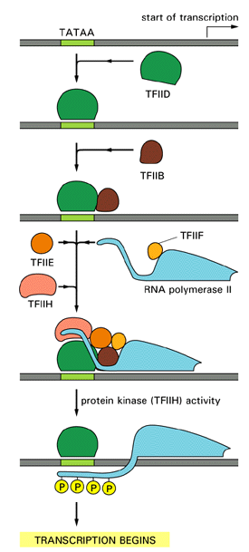
Basal Transcription
TFIID binds specifically to TATA sequence
TFIIB enters the complex
PolII-TFIIF enter
TFIIE and H enter
TFIIH phosphorylates PolII;
Pol II is released from the TF complex and
can start transcription

Slide 7
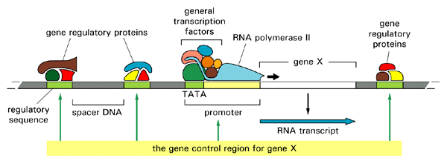
Regulation of Transcription: Biochemical View
Specific transcription factors

Slide 8
Transcription Factors
Most transcription factors are DNA-binding proteins
They recognize and bind regulatory DNA motifs: relatively specific short sequences of DNA
These regulatory sequences may be in the vicinity of the promoter (RNAPII binding site) or at a distance (enhancers)

Slide 9
Transcription Factors
Transcription factors modulate basal transcription levels, either activating or repressing it
In many cases this is mediated by facilitating (positive control) or hindering (negative control) the assembly of the general transcription complex
The ability of the regulatory protein to bind to DNA is often regulated as well

Slide 10
The Principles:
Prokaryotic Regulation of Transcription

Slide 11
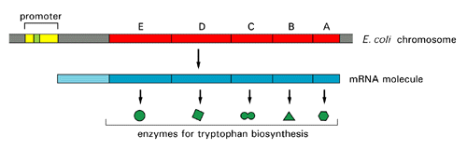
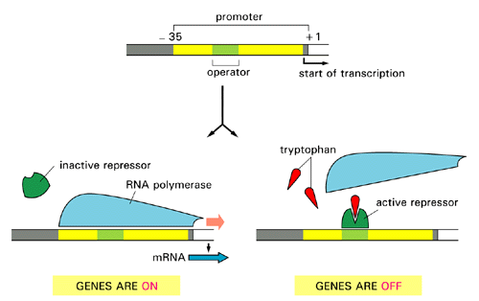
Example: The Tryptophan Repressor
The Trp operon: Several enzymes for tryptophan biosynthesis under one promoter
The Trp promoter: A repressor-trp complex binds and prevents Pol-II binding

Slide 12
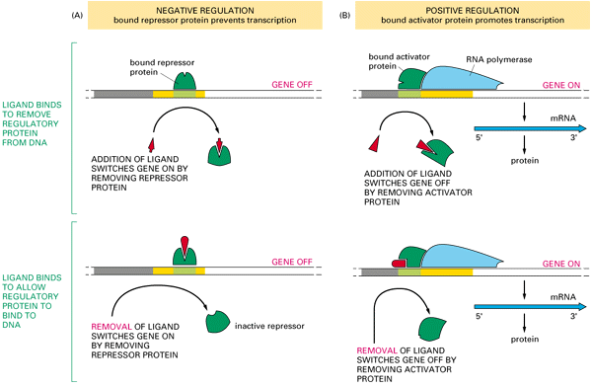
Activators and Repressors
A repressor prevents transcription when bound to DNA.
An activator enhances transcription when bound to DNA.
A small molecule may bind and change the conformation of the TF.
In some cases this will promote binding. In others it will inhibit it.

Slide 13
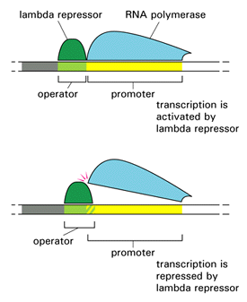
Activator and Repressor
ON
The function of the “lambda repressor” protein depends on its precise placement on its binding site
OFF

Slide 14
Activator and Repressor
ON
The function of the “lambda repressor” protein depends on its precise placement on its binding site
OFF

Slide 15
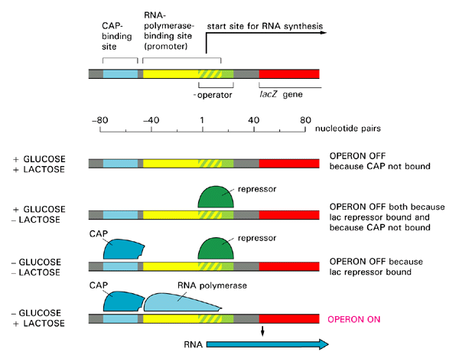
Multiple Controls:
The lac Operon “logic”
Lactose binds to the lac repressor and removes it from the promoter
Glucose decreases the concentration of cAMP, which releases CAP, causing it to unbind from the promoter. Only when there is lactose and there is no glucose will the CAP be bound and the repressor not, and the operon will be ON

Slide 16
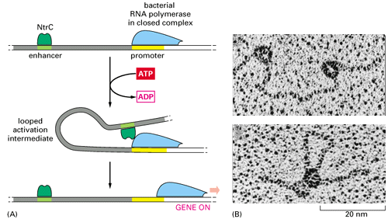
Regulation At a Distance: Enhances
NtrC is a bacterial regulatory protein that activates transcription by interacting with the PolII complex. NtrC is bound to a distant enhancer. The DNA loops out to allow NtrC at the enhancer to interact with the PolII complex at the promoter
The DNA serves as a tether that facilitates interaction between different bound proteins

Slide 17
Eukaryotic Transcription
Most prokaryotic genes are controlled by only one or two gene regulatory proteins
The regulation of higher eukaryotic genes is much more complex, where tens of transcriptional activators and repressors may bind to a large regulatory region
For example, the control region of the eve gene of the fruit fly (Drosophila) is 20,000 nt long, and has binding sites for over 20 proteins

Slide 18
Gene Control Region
regulatory sequences
promoter

Slide 19
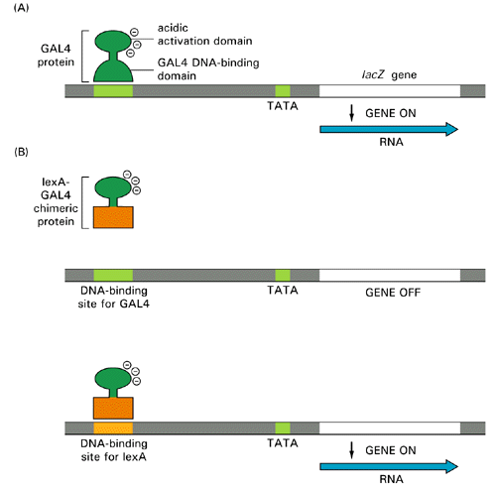
Eukaryotic Activators
Many activators accelerate the assembly of general transcription factors.
Most have a modular design. In the simplest cases, one part (binding domain) of the protein recognizes the regulatory site and binds to the DNA, while another activation domain, contacts the transcription mahcinery and accelarates initiation.

Slide 20
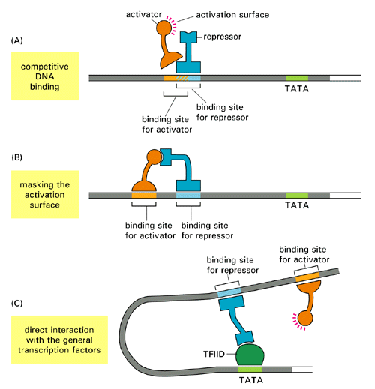
Eukaryotic Repressors
Repressors may work in several ways:
Compete with an activator on overlapping sites.
Bind the activation site of an activator, preventing its interaction with the transcription machinery
Directly interact with the transcription machinery, blocking assembly

Slide 21
Combinatorial Regulation
This combination of multiple regulatory sites (and proteins) for a single gene allows fine-tuning of transcription and its levels
The action of many transcription factors depends on the formation of the correct complex at the regulatory site.
For example, some factors do not bind to DNA directly but are recruited by binding to other DNA binding proteins.
The same protein may serve as an activator or repressor, depending on the context in which it is present

Slide 22
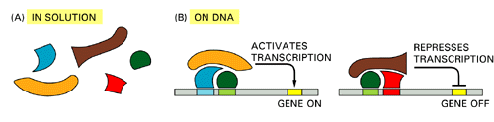
Context-Dependent Function
Some activator proteins do not directly interact with the PolII complex, but rather mediate the binding of other proteins (one contributes a DNA binding domain, and another an activation domain)
The green protein may be part of an activation or repression complex, depending on the context in which it binds to the DNA:
What other proteins are present?
What other binding sequences are in the promoter?

Slide 23
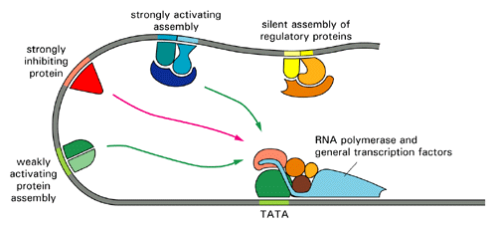
Combinatorial Regulation
Multiple sets of proteins, organized in several “modules”, can work together to influence a promoter. It is not yet understood in detail how the integration of multiple inputs is achieved.

Slide 24
Combinatorial Regulation
The activity of a gene regulatory protein can itself be regulated, e.g.
  Transcriptionally – control over the quantity of proteins
  Post-translationally – control over the quantity of active (binding-enabled) protein in the nucleus
This leads to the formation of complex regulatory circuits

Slide 25
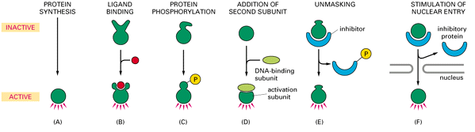
Regulating regulatory proteins
Change in conformation by ligand binding. Only bound protein can bind DNA
Only dimer complex of two proteins can bind DNA
In order to bind DNA, the protein must first be translocated to the nucleus
How much protein is created?
Transcription, splicing, degradation, translation
Change in conformation by protein phosphorylation. Only phospho-protein can bind DNA
Binding site is revealed only after removal of an inhibitor

Slide 26
The lac Operon “logic”
By using two regulatory proteins (CAP and Lac repressor), and controling their binding by two different sugars, transcription is accurately controlled: Only when glucose is absent and lactose is present the operon is switched ON
Activates lactose metabolism only when there is lactose to metabolize and there is no glucose to metabolize

Slide 27
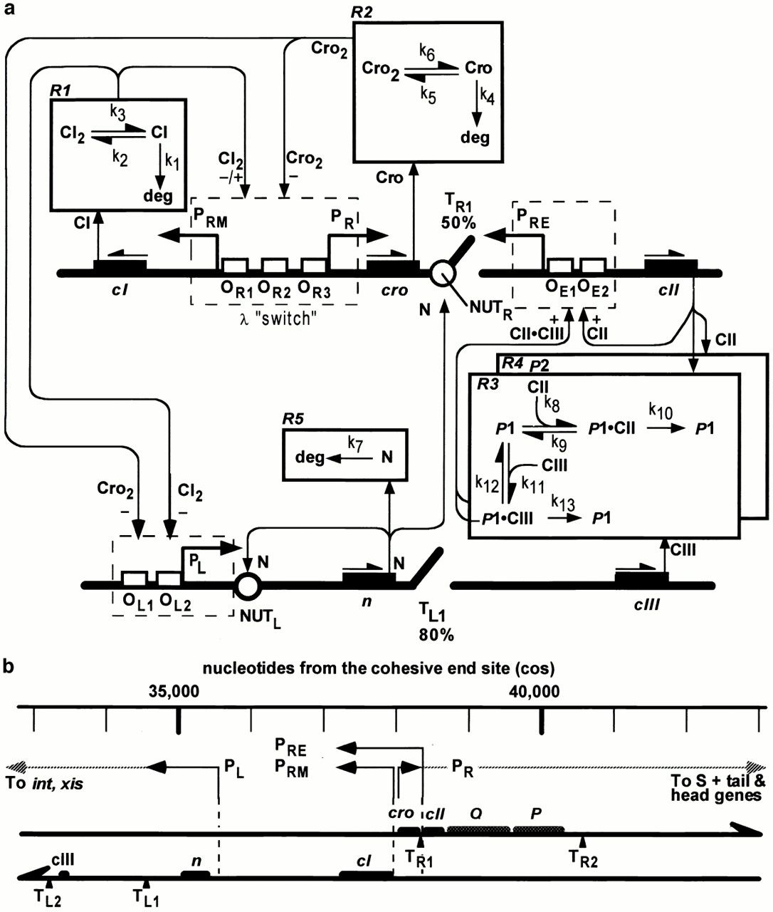
The Lysis/lysogeny logic
(Shapiro and McAdams, 1995; Arkin et al 1998)

Slide 28
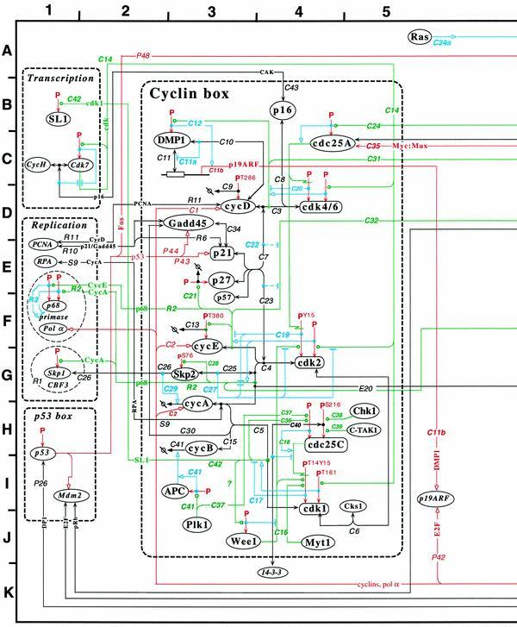
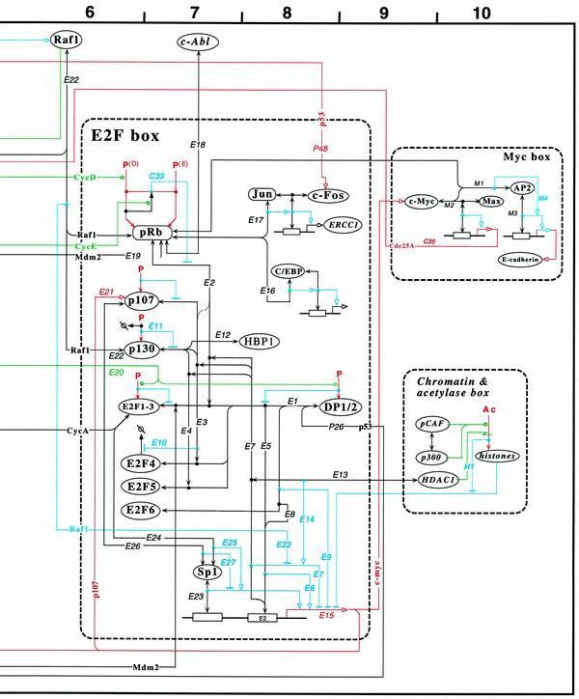
The Cell Cycle “logic”
Kohn, 1999

Slide 29
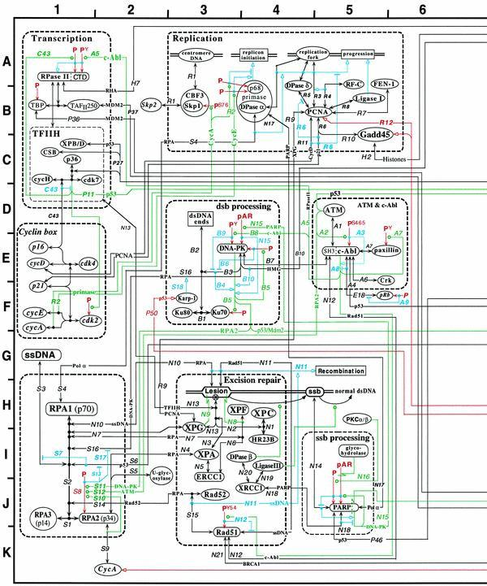
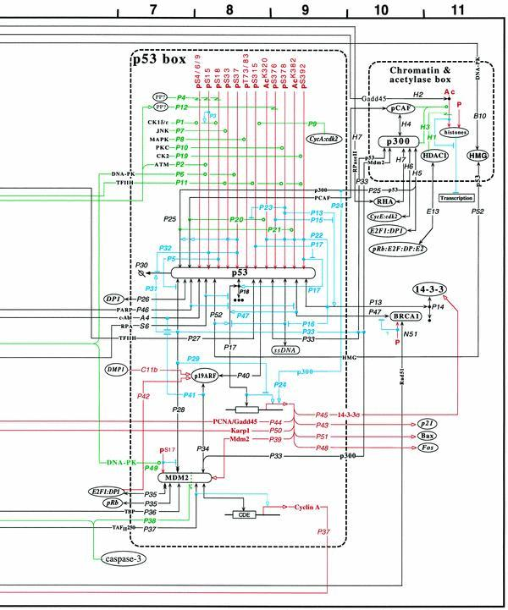
The Cell Cycle Logic (cont)
Kohn, 1999

Slide 30
Modeling Approaches
Logical – treat as Boolean (AND, OR, NOT etc) system
Biochemical – model biochemical events as accurately as possible
Hybrid – Abstract some of the biochemical details away while modeling others in detail

Slide 31
Example: The Circadian Clock
Many organisms (including humans), employ different “programs” in light and dark conditions
The switch between the two programs is the result of the entrainment of an internal oscillator by external conditions (light and dark)
The internal oscillator is termed the circadian clock

Slide 32
The Circadian clock
Circadian clock can be found in many organisms including cyanobacteria, fungi, flies, mouse and humans
They may have evolved more than once in evolution
While they differ in the biochemical detail, it appears there is an underlying “design principle” in their regulatory logic
This logic allows faithful intrinsic oscillation of these molecular clocks

Slide 33
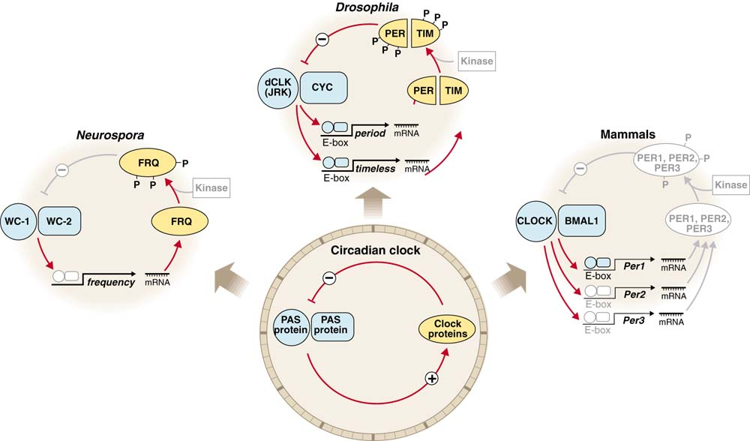
The Circadian Clock
Flies
Fungi
Mammals
In all cases, there are two integrated regulatory loops:
A positive and a negative one

Slide 34
The Circadian Model
(Barkai and Leibler, 2000)
A
R
degradation
A
R
degradation
UTR_{A}
UTR_{R}
translation
translation
A_RNA
R_RNA
transcription
transcription
P_{A}
P_{R}
A_GENE
R_GENE

Slide 35
The Circadian Model: Dependency on Differential Rates
Oscillations will be achieved only if there is a certain “imbalance” in the rates in the system
  “A” related processes are fast (basal and activated transcription, translation, and RNA and protein degradation)
  “R” related processes are significantly slower (e.g. almost no basal transcription)
  A-R binding is extremely fast
A hybrid approach: A “logical” model is not enough, but a full biochemical one is currently impossible

Slide 36
The Circadian Clock: System
-language(psifcp).
-include(rates).
global(pA(R1),bA(R2),transcribeA(R13),utrA(R3), degmA(R4),degpA(R12),pR(R5),rbs(R6),bR(R8), transcribeR(R14),utrR(R9),degmR(R10),degpR(R11)).
System::=
activator#A_GENE |
repressor#R_GENE |
timer#Timer(transcribeA) |
timer#Timer(transcribeR) |
machineries#BASAL_TRANSCRIPTION |
machineries#BASAL_TRANSLATION |
machineries#RNA_DEGRADATION |
machineries#PROTEIN_DEGRADATION .
clock.cp

Slide 37
The Circadian Clock:
“Gene A”, “RNA A”
-language(psifcp).
-include(rates).
global(pA(R1),bA(R2),transcribeA(R13),utrA(R3),
degmA(R4),degpA(R12),pR(R5),rbs(R6)).
A_GENE::= << PROMOTED_A + BASAL_A .
PROMOTED_A::=
pA ? {unbind_A} , ACTIVATED_TRANSCRIPTION_A(unbind_A) .
BASAL_A::=
bA ? [] , A_GENE | A_RNA .
ACTIVATED_TRANSCRIPTION_A(unbind)::=
transcribeA ? [] , A_RNA | ACTIVATED_TRANSCRIPTION_A ;
unbind ? [] , A_GENE >> .
A_RNA::= << TRANSLATION_A + DEGRADATION_mA .
TRANSLATION_A::= utrA ? [] , A_RNA | A_PROTEIN .
DEGRADATION_mA::= degmA ? [] , true >> .
activator.cp

Slide 38
Syntax Note: Summing Processes
Processes with a guarded choice construct are called normal processes
Such processes may be summed together, to create a third process, with a combined choice construct, e.g.
A::= x ? [] , A1 ;
y ? [] , A2 .
B::= z ? [] , B1 ;
w ? [] , B2 .
C::= A + B .
x ? [] , A1 ;
y ? [] , A2 ;
z ? [] , B1 ;
w ? [] , B2 .

Slide 39
The Circadian Clock: “Protein A”
A_PROTEIN::=
<< release_AR(infinite),unbind_A_pA(R7a),unbind_A_pR(R7b).
PROMOTION_AR + BINDING_R + DEGRADATION_A .
PROMOTION_AR::=
pA ! {unbind_A_pA} , unbind_A_pA ! [] , A_PROTEIN ;
pR ! {unbind_A_pR} , unbind_A_pR ! [] , A_PROTEIN .
BINDING_R::=
rbs ! {release_AR} , BOUND_A_PROTEIN .
BOUND_A_PROTEIN::=
degpA ? [] , release_AR ! [] , true ;
release_AR ? [] , A_PROTEIN .
DEGRADATION_A::=
degpA ? [] , true >> .
activator.cp

Slide 40
The Circadian Clock:
“Gene R”, “RNA R”
-language(psifcp).
-include(rates).
global(bR(R8),transcribeR(R14),utrR(R9),degmR(R10),degpR(R11),pR(R5),rbs(R6)).
R_GENE::= << PROMOTED_R + BASAL_R .
PROMOTED_R::=
pR ? {unbind_A} , ACTIVATED_TRANSCRIPTION_R(unbind_A) .
BASAL_R::=
bR ? [] , R_GENE | R_RNA .
ACTIVATED_TRANSCRIPTION_R(unbind)::=
transcribeR ? [] , R_RNA | ACTIVATED_TRANSCRIPTION_R ;
unbind ? [] , R_GENE >> .
R_RNA::= << TRANSLATION_R + DEGRADATION_mR .
TRANSLATION_R::= utrR ? [] , R_RNA | R_PROTEIN .
DEGRADATION_mR::= degmR ? [] , true >> .
repressor.cp

Slide 41
The Circadian Clock: “Protein R”
R_PROTEIN::=
<< BINDING_A + DEGRADATION_R .
BINDING_A::=
rbs ? {release_A} , BOUND_R_PROTEIN(release_A) .
BOUND_R_PROTEIN(release)::=
release ? [] , R_PROTEIN ;
degpR ? [] , release ! [] , true .
DEGRADATION_R::=
degpR ? [] , true >> .
repressor.cp

Slide 42
The Circadian Clock: Machineries
-language(psifcp).
-include(rates).
global(bA(R2),bR(R8),utrA(R3),utrR(R9),degmA(R4),degmR(R10), degpA(R12), degpR(R11)).
BASAL_TRANSCRIPTION::=
bA ! [] , BASAL_TRANSCRIPTION ;
bR ! [] , BASAL_TRANSCRIPTION .
BASAL_TRANSLATION::=
utrA ! [] , BASAL_TRANSLATION ;
utrR ! [] , BASAL_TRANSLATION .
RNA_DEGRADATION::=
degmA ! [] , RNA_DEGRADATION ;
degmR ! [] , RNA_DEGRADATION .
PROTEIN_DEGRADATION::=
degpA ! [] , PROTEIN_DEGRADATION ;
degpR ! [] , PROTEIN_DEGRADATION .
machineries.cp

Slide 43
The Circadian Clock: Rates
Molecular event | Channel name | Constant | Rate
Basal Transcription A | bA | R2 | 4
Basal Transcription R | bR | R8 | 0.001
Activated Transcription A | transcribeA | R13 | 40
Activated Transcription A | transcribeR | R14 | 2
Translation A | utrA | R3 | 1
Translation R | utrR | R9 | 0.1
Degradation RNA A | degmA | R4 | 1
Degradation RNA R | degmR | R10 | 0.02
Degradation Protein A | degpA | R12 | 0.1
Degradation Protein A | degpR | R11 | 0.01
Binding of A to promoter A | pA | R1 | 10
Binding of A to promoter R | pR | R5 | 10
Unbinding of A from pA | unbind_A_pA* | R7a | 10
Unbinding of A from pR | unbind_A_pR* | R7b | 100
Binding of A to R | rbs | R6 | 100
* private
rates.cp

Slide 44
Basal Transcription
A_GENE | R_GENE | Timer(transcribeA) | Timer(transcribeR) | BASAL_TRANSCRIPTION | BASAL_TRANSLATION |
RNA_DEGRADATION | PROTEIN_DEGRADATION
pA ? {unbind_A} , ACTIVATED_TRANSCRIPTION_A(unbind_A) ;
bA ? [] , A_GENE | A_RNA |
pR ? {unbind_A} , ACTIVATED_TRANSCRIPTION_R(unbind_A) ;
bR ? [] , R_GENE | R_RNA |
bA ! [] , BASAL_TRANSCRIPTION ; bR ! [] , BASAL_TRANSCRIPTION
bA (4)
bR (0.001)
A_GENE | A_RNA | R_GENE |
BASAL_TRANSCRIPTION | …
A_GENE | R_GENE | R_RNA |
BASAL_TRANSCRIPTION | …

Slide 45
Translation and RNA degradation
… | A_RNA | R_RNA | … | BASAL_TRANSLATION | RNA_DEGRADATION
utrA ? [] , A_RNA | A_PROTEIN ; degmA ? [] , true |
utrR ? [] , R_RNA | R_PROTEIN ; degmR ? [] , true |
utrA ! [] , BASAL_TRANSLATION ; utrR ! [] , BASAL_TRANSLATION |
degmA ! [] , RNA_DEGRADATION ; degmR ! [] , RNA_DEGRADATION
utrA (1)
degmR (0.02)
degmA (1)
utrR (0.1)
A_RNA |
A_PROTEIN |
R_RNA |
BASAL_TRANSLATION |
RNA_DEGRADATION .
R_RNA |
BASAL_TRANSLATION |
RNA_DEGRADATION .
A_RNA |
R_RNA |
A_PROTEIN |
BASAL_TRANSLATION |
RNA_DEGRADATION .
A_RNA |
BASAL_TRANSLATION |
RNA_DEGRADATION .

Slide 46
Protein A and R
A_PROTEIN | R_PROTEIN | A_GENE | R_GENE | PROTEIN_DEGRADATION
pA ! {unbind_A_pA} , unbind_A_pA ! [] , A_PROTEIN ;
pR ! {unbind_A_pR} , unbind_A_pR ! [] , A_PROTEIN ;
rbs ! {release_AR} , BOUND_A_PROTEIN ;
degpA ? [] , true |
rbs ? {release_A} , BOUND_R_PROTEIN(release_A) ;
degpR ? [] , true |
pA ? {unbind_A} , ACTIVATED_TRANSCRIPTION_A(unbind_A) ;
bA ? [] , A_GENE | A_RNA |
pR ? {unbind_A} , ACTIVATED_TRANSCRIPTION_R(unbind_A) ;
bR ? [] , R_GENE | R_RNA |
degpA ! [] , PROTEIN_DEGRADATION ;
degpR ! [] , PROTEIN_DEGRADATION
A
R
GA
GR
PDEG
A - GA
A - GR
A - R
A - deg machin.
R - deg machin.
pA(10)
pR(10)
rbs(100)
degpA(0.1)
degpR(0.01)

Slide 47
Activated Transcription
A_PROTEIN | A_GENE | R_GENE
pA ! {unbind_A_pA} , unbind_A_pA ! [] , A_PROTEIN ;
pR ! {unbind_A_pR} , unbind_A_pR ! [] , A_PROTEIN ;
rbs ! {release_AR} , BOUND_A_PROTEIN ;
degpA ? [] , true |
pA ? {unbind_A} , ACTIVATED_TRANSCRIPTION_A(unbind_A) ;
bA ? [] , A_GENE | A_RNA |
pR ? {unbind_A} , ACTIVATED_TRANSCRIPTION_R(unbind_A) ;
bR ? [] , R_GENE | R_RNA
pA(10)
pR(10)
unbind_A_pA ! [] , A_PROTEIN |
ACTIVATED_TRANSCRIPTION_A(unbind_A_pA) |
R_GENE
unbind_A_pR ! [] , A_PROTEIN |
ACTIVATED_TRANSCRIPTION_R(unbind_A_pR) |
A_GENE

Slide 48
Activated Transcription
pA(10)
unbind_A_pA ! [] , A_PROTEIN |
ACTIVATED_TRANSCRIPTION_A(unbind_A_pA) |
Timer(transcribeA)
unbind_A_pA ! [] , A_PROTEIN |
transcribeA ? [] , A_RNA | ACTIVATED_TRANSCRIPTION_A ;
unbind_A_pA? [] , A_GENE |
transcribeA ! [] , Timer
Transcription event. RNA molecule released. Protein_A remains bound to promoter A
transcribeA(40)
unbind_A_pA(10)
Unbinding event. Protein_A released from promoter A
unbind_A_pA ! [] , A_PROTEIN |
A_RNA |
ACTIVATED_TRANSCRIPTION_A |
Timer(transcribeA)
A_PROTEIN |
A_GENE |
Timer(transcribeA)

Slide 49
A-R Binding
A_PROTEIN | R_PROTEIN | …
pA ! {unbind_A_pA} , unbind_A_pA ! [] , A_PROTEIN ;
pR ! {unbind_A_pR} , unbind_A_pR ! [] , A_PROTEIN ;
rbs ! {release_AR} , BOUND_A_PROTEIN ;
degpA ? [] , true |
rbs ? {release_A} , BOUND_R_PROTEIN(release_A) ;
degpR ? [] , true | …
rbs(100)
BOUND_A_PROTEIN | BOUND_R_PROTEIN(release_AR) |
PROTEIN_DEGRADATION
degpA ? [] , release_AR ! [] ,true ;
release_AR ? [] , A_PROTEIN |
release_AR ? [] , R_PROTEIN ;
degpR ? [] , release_AR ! [] , true |
degpA ! [] , PROTEIN_DEGRADATION ;
degpR ! [] , PROTEIN_DEGRADATION
degpA(0.1) followed by release_AR
degpR(0.01) followed by release_AR
R_PROTEIN |
PROTEIN_DEGRADATION
A_PROTEIN |
PROTEIN_DEGRADATION

Slide 50
The Circadian Model
(Barkai and Leibler, 2000)
A
R
degradation
A
R
degradation
UTR_{A}
UTR_{R}
translation
translation
A_RNA
R_RNA
transcription
transcription
P_{A}
P_{R}
A_GENE
R_GENE

Slide 51
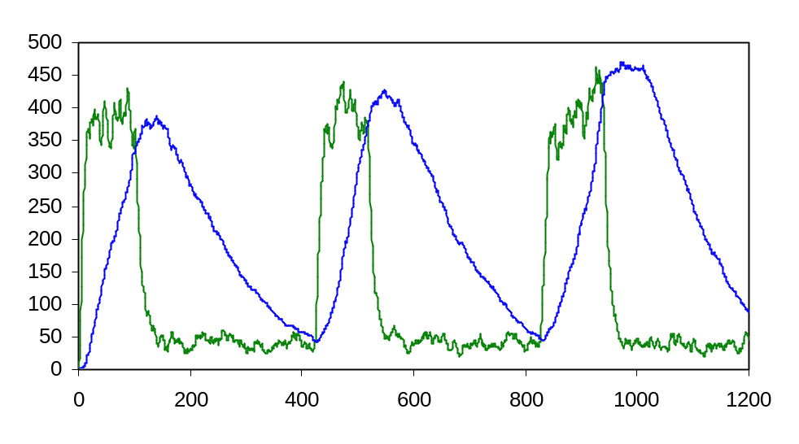
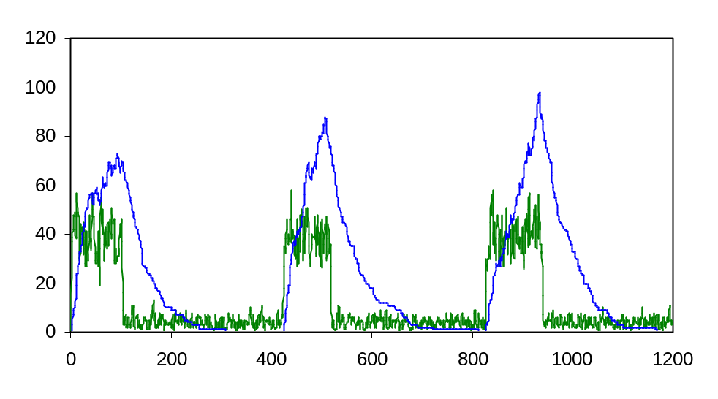
Circadian Clock: Results
Protein A
Protein R
RNA R
RNA A

Slide 52
Exercise 7
Modify the circadian clock program in the following ways:
  (a) Run the same system but with the same rates for the transcription of R and A (basal=2; activated=40) (1000 units)
  (b) Abolish the negative feedback of R (600 units)
  (no binding between A and R)
  (c) Abolish the positive feedback of A on its own transcription (no binding of A to its promoter) (2000 units)
  (d) Abolish the positive feedback of A completely
  (no binding of A to any promoter) (1000 units)
  (e) The R repression mechanism is mediated by competing with A on the promoter (rather than by binding the A protein). R’s binding rate to pA and pR is 100. Its unbinding rate is 10 (800 units)

Slide 53
Exercise 7
In each case, run the clock program for the noted time units, and plot (scale 1) the behavior of the protein and RNA molecules of each species (note: for the total protein you must sum the free and bound processes).
Submit code and plots.
Explain the difference in the results between these runs and the “original” one. If A control “light genes” and R controls “day genes” what is the effect of each of these changes on the organism?
Note: these runs take significantly longer than previous programs. Submission in 3 weeks.

Slide 54
Biochemical Model: Arkin’s Stochastic Model
A detailed stochastic model of the kinetics of transcription and translation and degradation (in prokaryotes)
Includes initiation, propagation and termination stages in each of these processes
Was used as an underlying biochemical model of the transcription, translation and degradation events in the lysis/lysogeny circuit

Slide 55
References
General Introduction: Alberts et al. (1994) Molecular Biology of the Cell, Chapter 9, pp.401-433
The Circadian Clock: Barkai and Leibler (2000) Circadian clocks limited by noise. Nature 403:267-268
Stochastic mechanism of gene expression: McAdams and Arkin (1997) Stochastic mechanisms in gene expression. PNAS 94:814-819
Lysis/Lysogeny: Arkin et al (1998) Stochastic kinetic analysis of developmental pathway bifurcation in phage lambda infected Escherichia coli. Genetics 149: 1633-1648
Cell cycle: Kohn (1999) Molecular interaction map of the mammalian cell cycle control and DNA repair systems
The tryptophan operon: Santillian and Mackey (2001) Dynamic regulation of the tryptophan operon: A modeling study and comparison with experimental data. PNAS 98: 1364-1369

