Slide 1
Modeling a Molecular Computing Device Using ∏-Calculus
Ya’ara Goldschmidt
Yaki Setty
Department of Applied Math – Bioinformatics
June 2001

Slide 2
2 Approaches of Implementation
Finite Automaton.
Markov Model.

Slide 3
First Stage
Code the Basic Reactions
“Get wet” with some code.
“Feel” how the system behaves.
Find the appropriate rates and concentrations to use.
Compare the results to real life.

Slide 4
The Reactants and Products
DNA input molecule – I
DNA transition molecule(s) - T
Restriction Enzyme – FokI (buffer and ATP)
(Ligase)
I
T
INew
T
FokI
FokI

Slide 5
The Basic Reactions
I – input (DNA)
T – Transition State (DNA)
Fok – Nuclease (Enzyme)
eTI
T + I ⇔ TI
breakTI
eTFok
T + Fok ⇔ TFok
breakTFok
eTIFok
TI + Fok ⇔ TIFok
breakTIFok
eITFok
TFok + I ⇔ TIFok
breakITFok
eNS
TIFok ⇒ T + Fok + Inew

Slide 6
First Version (– Timers & Global Channels)
T::= eTI ! [], TI ;
eTFok ! [], TFok .
I::= eTI ? [], true ;
eITFok ! [] , TIFok .
TI::= breakTI ? [], T | I ;
eTIFok ! [], TIFok .
Fok::= eTFok ? [] , true ;
eTIFok ? [] , true .
TFok::= eITFok ? [] , true;
breakTFok ? [] , T | Fok.
TIFok::= eNS ? [] , T | Inew | Fok ;
breakTIFok ? [] , TI | Fok ;
breakITFok ? [] , I | TFok .
Inew::= dummy ? [] , true.

Slide 7
RbreakTI => 1 .
RbreakTFok => 1 .
RbreakTIFok => 1 .
ReNS => 0 .
RbreakITFok => 1 .
RateTI => 1 .
RateTFok => 1 .
RateTIFok => 1 .
RateITFok => 1 .

Slide 8
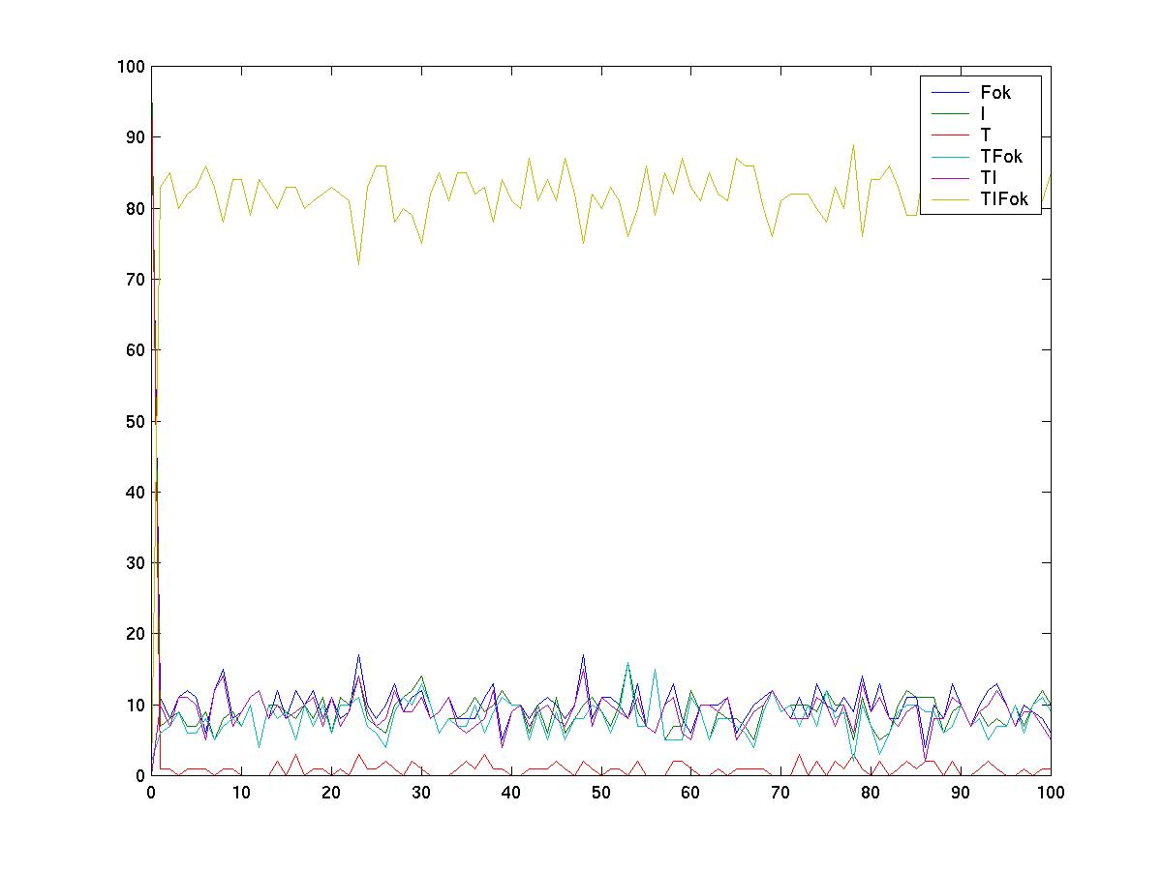
Is It Correct?
When all rates = 1:
A + B ⇔ C
[A][B]=[C]

Slide 9
Different Rates
What rates to take?
  The correct chemical ones were too small,
  so we changed the scale of all the rates (increased by 10² fold).
What is the number of molecules to input?
  Interpret the concentration of nM (10⁻⁹ mol/liter) to molecule numbers.
Ran several sets of rates to compare
to real life:

Slide 10
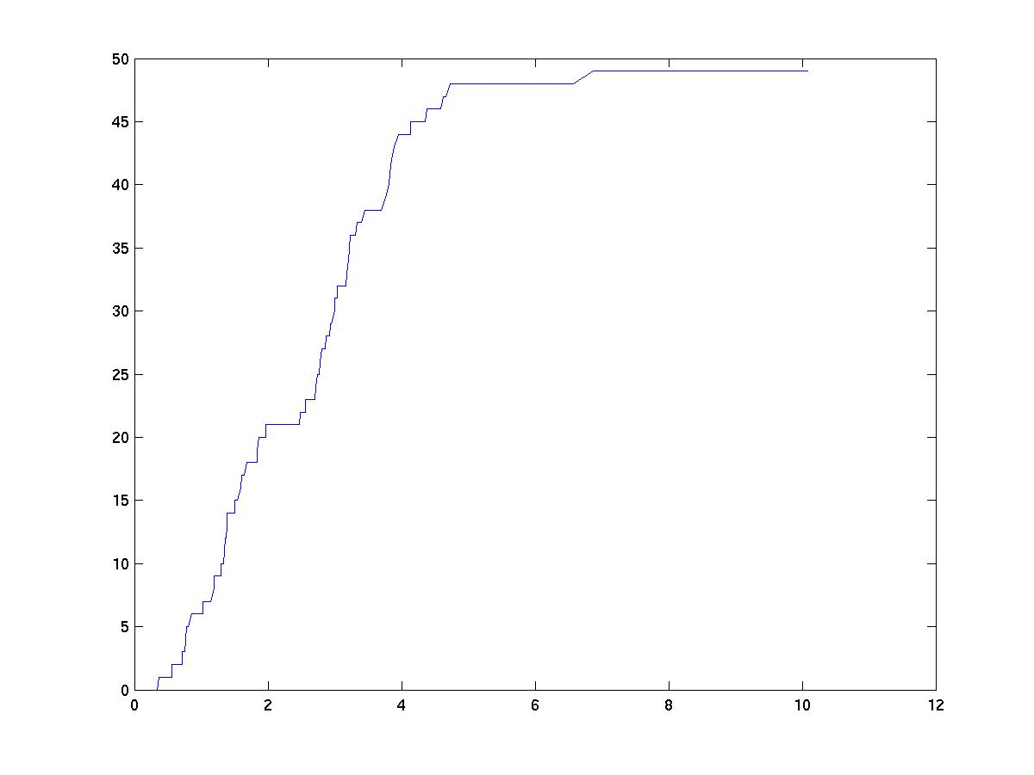
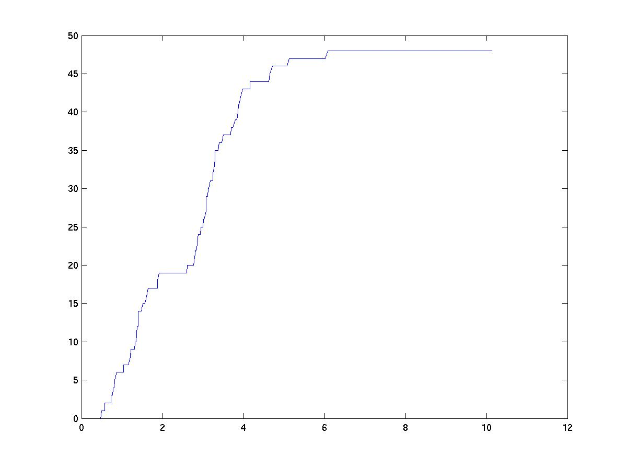
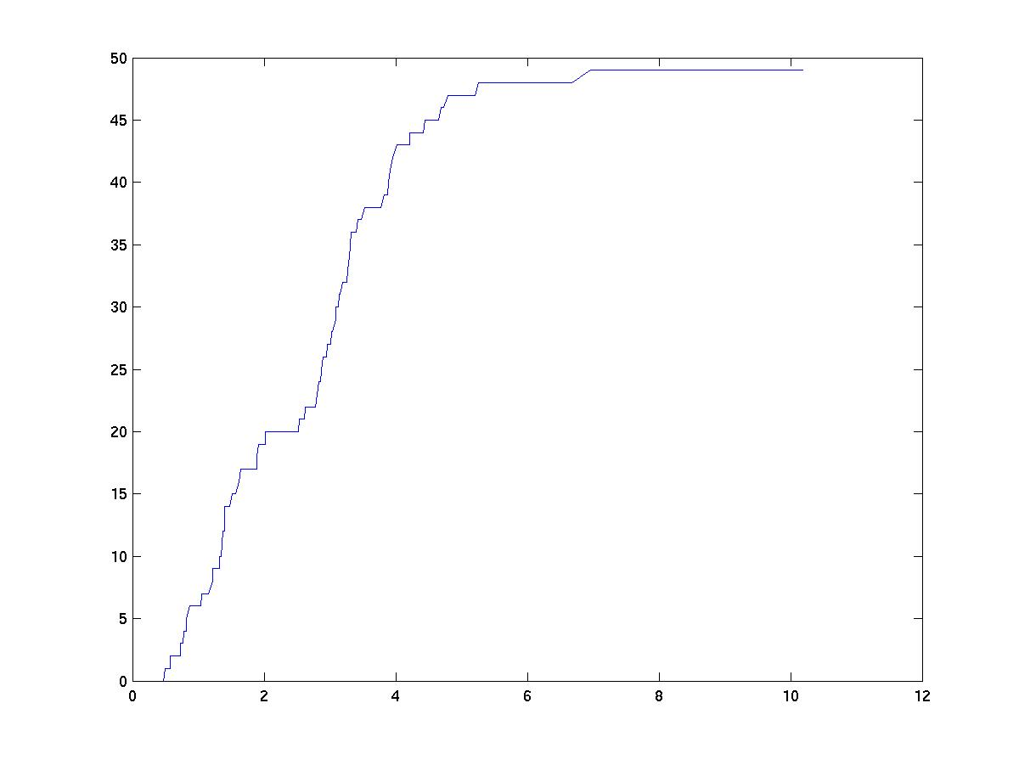

Slide 11
Second Version (– Counters & Private Channels)
Why counters?
  Allows using larger concentrations.
  Better running time.
Why not counters?
  Harder to trace and debug, it can be done only through the resolvent, or screen#display.
  Longer code.

Slide 12
System(NT,NI,NFok,NTI,NTFok,NTIFok,NInew) + (eTpI2TI,eTpFok2TFok,eTIFok2Fok,eTIFok2T,eTIFok2I,eTI2I,
eTFok2Fok,eTIpFok2TIFok,eIpTFok2TIFok)::=
<< T | I | TI | Fok | TFok | TIFok | Inew .
T::= eTI ! NT * [], {NT--} , eTpI2TI ! [] , T ; % T + I turn to TI
eTI2T ? [] , {NT++} , T ; % TI breaks into T & I
eTFok ! NT * [], {NT--} , eTpFok2TFok ! [] , T ; eTFok2T ? [] , {NT++} , T ; %TFok breaks to T + Fok
eTIFok2T ? [] , {NT++} , T . %TIFok breaks
I::= eTI ? NI * [] , {NI--} , I ;
eTI2I ? [] , {NI++} , I ; % TI broke into T + I
eITFok ! NI * [] , {NI--} , eIpTFok2TIFok ! [] , I ;
eTIFok2I ? [] , {NI++} , I . % TIFOK breaks .

Slide 13
TI::= eTpI2TI ? [] , {NTI++} , TI ; % Ti created
eTI2T ! NTI * [] , eTI2I ! [] , {NTI--},
screen#display(counterNTI1=NTI) | TI ; % TI breaks
eTIFok ! NTI * [] , {NTI--} , eTIpFok2TIFok ! [] ,
screen#display(counterNTI2=NTI) | TI ;
eTIFok2TI ? [] , {NTI++} , TI . %TIFok breaks .
Fok::= eTFok ? NFok * [] , {NFok--} , Fok ; % T + Fok create TFok
eTFok2Fok ? [] , {NFok++} , Fok ; %TFok breaks
eTIFok ? NFok * [] , {NFok--} , Fok ; %Fok + TI -> TIFOK
eTIFok2Fok ? [] , {NFok++} , Fok . %TIFok breaks.
TFok::= eTpFok2TFok ? [] , {NTFok++} , TFok ; %TFok created
eTFok2T ! NTFok * [] , eTFok2Fok ! [] , {NTFok--} , TFok ;
eITFok ? NTFok * [] , {NTFok--} , TFok ;
eTIFok2TFok ? [] , {NTFok++} , TFok .

Slide 14
TIFok::= eTIFok2Inew ! NTIFok * [] , eTIFok2T ! [] , eTIFok2Fok ! [] , {NTIFok--}, TIFok ;
eTIFok2TFok ! NTIFok * [] , eTIFok2I ! [] , {NTIFok--}, TIFok ;
eTIFok2TI ! NTIFok * [] , eTIFok2Fok ! [] , {NTIFok--}, TIFok ;
eTIpFok2TIFok ? [] , {NTIFok++} , TIFok ;
eIpTFok2TIFok ? [] , {NTIFok++} , TIFok .
Inew::= eTIFok2Inew ? [] , {NInew++} , Inew
>>.

Slide 15

Second Stage
Modeling a Finite Automaton
Project by Yaki Setty

Slide 16
Reminder: BioPSI Architecture
BioPSI:
(Stochastic) Pi-calculus
Logix:
Flat Concurrent Prolog
C emulator
Aviv Regev – bpcc class 1

Slide 17
FCP – Flat Concurrent Prolog
List Manipulations
We have used FCP variables as counters for the processes.
FCP variable in the automaton should hold a list of symbols as the input of the automaton.
According to the head symbol of the list, the automaton will move one step forward.

Slide 18
Lists – Data structure
A list is a recursive data structure.
Each element of the list is a Symbol.
A list can be represented as:
[a, b, a, b, a, a, …]
Head
(symbol)
Tail
(list)
The tail is recursively defined.

Slide 19
Recursive definition
[a, b, a, b, a, a]
[b, a, b, a, a]
a
[b, a, b, a, a]
…
a
[] (the empty list)

Slide 20
Code Example
With the help of Aviv Regev and Bill Silverman, the following code was produced:
The code starts out with a list of symbols.
According to the head of the list, it output the following:
‘Minnesota’ for M
‘NewYork’ for N
‘Oregon’ for O
‘Who Knows’ for none of the above.
Repeat until reaches the empty list.

Slide 21
The Full Code
Countries + MNO ::= { MNO = [M, N, O, P] } | Extract .
Extract(MNO) ::= { Country ← head(MNO) } |
{ MNO ← tail(MNO) } | Branch | Iterate.
Branch(Country) ::= { (Country = "M") } , Minnesota ;
{ (Country = "N") } , NewYork ;
{ (Country = "O") } , Oregon ;
{ otherwise } , NoneOfTheAbove .
Iterate(MNO) ::= { (MNO = [ ]) } , screen#display("The End") ;
{ otherwise } , Extract .
Minnesota(Country) ::= screen#display(Country - "Minnesota").
NewYork(Country) ::= screen#display(Country - "New York").
Oregon(Country) ::= screen#display(Country - "Oregon").
NoneOfTheAbove(Country)::=screen#display(Country - "Who Knows").
eg.cp

Slide 22
…Code Example
Countries + MNO ::= { MNO = [M, N, O, P] } | Extract .
The ‘Countries’ process initializes the program,
a private variable called MNO , holds the list.

Slide 23
…Code Example
Extract(MNO) ::=
{ Country ← head(MNO) } |
{ MNO ← tail(MNO) } | Branch | Iterate.
Extract process:
Separates the list to two.
Country holds the head of the list,
MNO becomes the tail of the list.
(There’s a way to use a string instead of list by FCP operations…)

Slide 24
…Code Example
Branch(Country) ::=
{ (Country = "M") }, Minnesota ;
{ (Country = "N") }, NewYork ;
{ (Country = "O") }, Oregon ;
{ otherwise }, NoneOfTheAbove.
Branch process switches between different cases, according to the Country variable.
Template: {Guards} , process

Slide 25
…Code Example
Iterate(MNO) ::= { (MNO = "") } , screen#display("The End") ;
{ otherwise } , Extract .
Iterate process determines whether the list is the empty list.
If MNO is the empty list →End
Else recall Extract process.

Slide 26
…Code Example
Minnesota(Country) ::=
screen#display(Country - "Minnesota").
NewYork(Country) ::=
screen#display(Country - "New York").
Oregon(Country) ::=
screen#display(Country - "Oregon").
NoneOfTheAbove(Country) ::=
screen#display(Country - "Who Knows").
These processes outputs the proper country.

Slide 27
Output
@run(eg#"States",5)
<17> started
M - Minnesota
N - New York
O - Oregon
The End
P - Who Knows
<17> terminated
@

Slide 28
A Finite Automaton
b
a
S0
S1
a
b
Acceptor
S0 start state

Slide 29
Initial State
Input : abab , State: S0 , Symbol: “”
b
a
a
S0
S1
b

Slide 30
Input : bab , State: S0 , Symbol: “a”
b
a
S0
S1
a
b

Slide 31
Input : ab , State: S1 , Symbol: “b”
b
a
S0
S1
a
b

Slide 32
Input : b , State: S1 , Symbol: “a”
b
a
S0
S1
a
b

Slide 33
Input : “” , State: S0 , Symbol: “b”
b
a
S0
S1
a
b
The word “abab” was accepted by the automaton.

Slide 34
Implementation of the Automaton
The automaton has 3 variables:
Input, Symbol and State.
The Input parameter is set by the user.
Symbol and State are ‘private’ parameters of the automaton.

Slide 35
Implementation of the Automaton
The three parameters of the automaton:
  Input – the part of the input yet to be read.
  Symbol – the symbol being read at this step.
  State – current state of the automaton.
At the initial state:
Symbol = “” , State = S0.

Slide 36
Automaton(Input) ::= { State = "S0" } | {Symbol = "" } | Extract .
%Cut the head of the input and store it in input.
%Input is the rest of the old input
%State doesn't change.
Extract(State,Input) ::=
{ string_to_dlist( Input, [Character | Tail], []) } |
{ list_to_string( Tail, Input' ) } |
{ list_to_string( [Character], Symbol ) }
| Branch.
Automaton.cp

Slide 37
%%% definition of the automaton directions
%%% each Symbol that was read from the input changes the state.
Branch(State,Symbol,Input) ::=
{ (State = "S0"), (Symbol = "a") , (Input =\= "") } , { State = S0 } | Extract ;
{ (State = "S0") ,(Symbol = "b") , (Input =\= "") } , { State = S1 } | Extract ;
{ (State = "S0") ,(Symbol = "a") , (Input = "") } , Acceptor ;
{ (State = "S0") ,(Symbol = "b") , (Input = "") } , DeadEnd ;
{ (State = "S1") , (Symbol = "a") , (Input =\= "") }, { State = S1 } | Extract ;
{ (State = "S1") , (Symbol = "b") , (Input =\= "") }, { State = S0 } | Extract ;
{ (State = "S1") ,(Symbol = "a") , (Input = "") } , DeadEnd ;
{ (State = "S1") ,(Symbol = "b") , (Input = "") } , Acceptor ;
{ (Symbol =/= "b") } , Error;
{ (Symbol =/= "a") } , Error.
% processes which stuck on dummy channel , dead end when a word was not accepted and acceptor when the word was accepted.
Acceptor ::= dunny ? [] , true.
DeadEnd ::= dunny ? [] , true.
Error ::= dunny ? [] , true.
Automaton.cp

Slide 38
The Automaton Code - Explanations
Automaton(Input) ::=
{ State = "S0" } | {Symbol = "" } | Extract .
Initial state, sets the parameters and call the Extract process.

Slide 39
…The Automaton Code
Extract(State,Input) ::=
{ string_to_dlist( Input, [Character | Tail], []) } |
{ list_to_string( Tail, Input' ) } |
{ list_to_string( [Character], Symbol ) } |
Branch .
Extract breaks the input into two.
Head of Input → Symbol .
The Rest Symbols of Input → Input .

Slide 40
…The Automaton Code
Branch(State,Symbol,Input) ::=
{ (State = "S0"),(Symbol = "a"),(Input =\= "") },{ State’ = “S0” } | Extract;
{ (State = "S0"),(Symbol = "b"),(Input =\= "") },{ State’ = “S1” } | Extract;
{ (State = "S0"),(Symbol = "a"),(Input = "") } , Acceptor ;
{ (State = "S0"),(Symbol = "b"),(Input = "") } , DeadEnd ;
{ (State = "S1"),(Symbol = "a"),(Input =\= "") },{ State’ = “S1” } | Extract;
{ (State = "S1"),(Symbol = "b"),(Input =\= "") },{ State’ = “S0” } | Extract;
{ (State = "S1"),(Symbol = "a"), (Input = "") }, DeadEnd ;
{ (State = "S1"),(Symbol = "b"),(Input = "") }, Acceptor ;
{ (Symbol =/= "b") }, Error ;
{ (Symbol =/= "a") }, Error .
Branch determines the automaton next move.
template: {guards} , {change State} , Process
b
a
a
b

Slide 41
…The Automaton Code
Acceptor ::= dunny ? [] , true.
DeadEnd ::= dunny ? [] , true.
Error ::= dunny ? [] , true.
These three processes indicate the decision of the automaton.

Slide 42
Some Outputs - Acceptance
<9>started
Input = abab
Symbol = a
State = S0
S0-a->S0
Input = bab
Symbol = b
State = S0
S0-b->S1
Input = ab
Symbol = a
State = S1
S1-a->S1
Input = b
Symbol = b
State = S1
accepted
@
1. @run("Automaton"#"Automaton"("abab"),1)
b
a
S0
S1
a
b

Slide 43
Some Outputs - DeadEnd
<10> started
Input = ababb
Symbol = a
State = S0
S0-a->S0
Input = babb
Symbol = b
State = S0
S0-b->S1
Input = abb
Symbol = a
State = S1
S1-a->S1
Input = bb
Symbol = b
State = S1
S1-b->S0
2. run("Automaton"#"Automaton"("ababb"),5)
Input = b
Symbol = b
State = S0
DeadEnd
@
b
a
S0
S1
a
b

Slide 44
Some Outputs - Error
3. run("Automaton"#"Automaton"("abcbb"),5)
<11> started
Input = abcbb
Symbol = a
State = S0
S0-a->S0
Input = bcbb
Symbol = b
State = S0
S0-b->S1
Input = cbb
Symbol = c
State = S1
error
@
b
a
S0
S1
a
b

Slide 45
Future Work
Combine the automaton with the reaction.
Check the automaton with more than one input string in the system.
Check that corresponds to real life chemistry.
Implement some more automatons.

Slide 46
The Combined Version
global(t(10),fok(10),s0a(10),s0b(10),s1a(10),s1b(10), timerBreakTI(10), timerBreakTIFok(10), timerReact(10),dunny(infinite)).
System(N_T,N_Fok,N_I,In)+(State0,State1)::= << {State0 ="S0"} | {State1="S1"} | timer#Timer(timerBreakTI)| timer#Timer(timerBreakTIFok)| timer#Timer(timerReact) | CREATE_T(N_T) | CREATE_I(N_I) | CREATE_FOK(N_Fok) .
CREATE_T(C)::= {C =< 0} , true ;
{C > 0} , {C--} | T(s0a,State0) | T(s1a,State1) | T(s0b,State1) | T(s1b,State0)| self .
CREATE_I(C)::= {C =< 0} , true ;
{C > 0} , {C--} | I(In, State0) | self .
CREATE_FOK(C)::= {C =< 0} , true ;
{C > 0} , {C--} | Fok | self
>> .

Slide 47
Fok::= fok ! [], true .
T(t,State)::= t ! {State}, true .
I(Input,State)+extract(infinite)::=
{Input = "",State = "S0"}, Acceptor;
{Input = "",State = "S1"}, DeadEnd;
{otherwise}, <<
Extract(Input) | I_temp(Input) .
Extract(Input) ::=
{ string_to_dlist( Input ,[Character | Tail],[]) } |
{ list_to_string( [Character], Symbol ) } |
{ list_to_string( Tail ,Input' ) } |
Branch .
Branch(Symbol, Input') ::=
extract ! {Symbol,Input'}, true .

Slide 48
I_temp(Input)::= extract ? {Symbol,Tail}, <<
{(Symbol = "a"),(State = "S0")}, I_bind(s0a,Tail) ;
{(Symbol = "a"),(State = "S1")}, I_bind(s1a,Tail) ;
{(Symbol = "b"),(State = "S0")}, I_bind(s0b,Tail) ;
{(Symbol = "b"),(State = "S1")}, I_bind(s1b,Tail) ;
{ otherwise } , Error
>> .
I_bind(channel,Tail)::=
channel ? {StateNew}, TI(channel,State,StateNew,Input,Tail)
>> .

Slide 49
TI(channel,State,StateNew,Input,Tail)::=
timerBreakTI ? [], T(channel,State) | I(Input,State) ;
fok ? [], TIFok(channel,State,StateNew,Input,Tail) .
TIFok(channel,State,StateNew,Input,Tail)::=
timerBreakTIFok ? [], TI(channel,State,StateNew,Input,Tail) | Fok ;
timerReact ? [], T(channel,State) | Fok | I(Tail,StateNew) .
Acceptor ::= dunny ? [] , true.
DeadEnd ::= dunny ? [] , true.
Error ::= dunny ? [] , true.

Slide 50
Summery of Problems We Encountered
Not knowing the behavior of the system in advanced, makes it very hard to debug.
Calculating what rates to use.
Calculating what concentrations to use.
Rates were too small for the system to handle.
  Changed the scale of all the rates.

