Slide 1
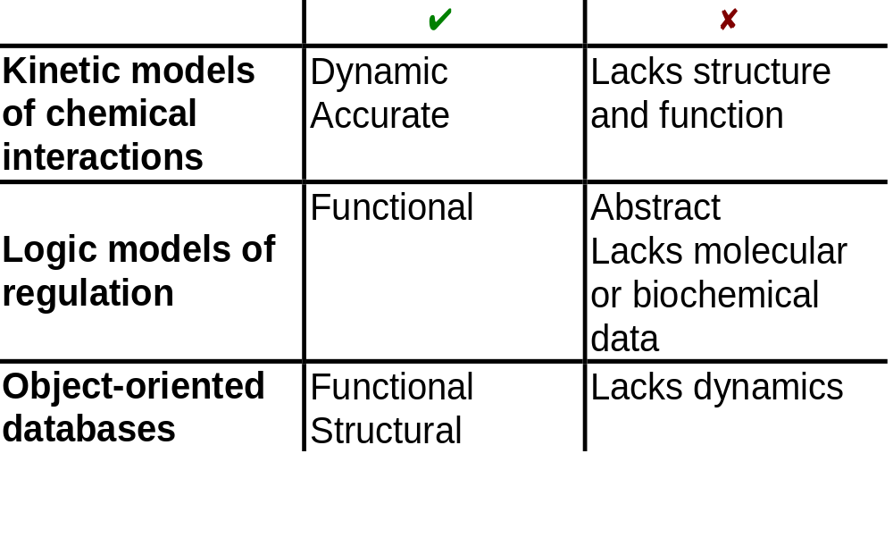


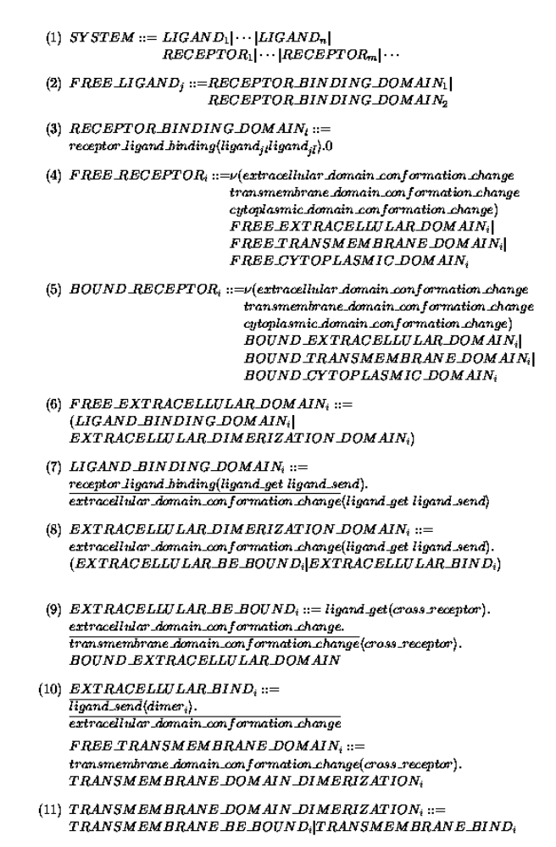


Modeling Signal Transduction With Process Algebra
Aviv Regev, Department of Cell Research and Immunology, Faculty of Life Sciences, Tel Aviv University, Tel Aviv, 69978, Israel. E-mail: aviv5@netvision.net.il
The problem: Although molecular information on signal transduction (ST) systems is rapidly accumulating, it is difficult to analyze it, since it is diverse, disparate and fraught with molecular details.
Our solution: A novel unifying view of ST as a mobile communication system that can be formally represented and analyzed by process algebras, such as the π calculus.
Results: A model for ST that is mathematically well-defined and biologically visible, which represents both dynamic behavior of the system (biochemical signaling, feedback, cross-talk) and the structural molecular implementation (residues, domains) underlying it. We employ this approach to:
1. Model the RTK-MAPK cascade ST pathway
2. Perform simulated or formal mutational analysis
3. Formally study the homology of processes
Conclusions: A novel theory and formal approach to biological communication systems is established that allows us to model, simulate, analyze and compare ST pathways. The approach can be reified and applied to communication systems at higher levels of organization.
The complexity of ST networks
A formalism for ST
From receptors on the cell membrane
Why ?
Unified view of disparate data
Experiment in silico (simulation, verification)
Comparative studies
Scalability to higher levels of organization
RTK
RTK
G protein receptors
Cytokine receptors
DNA damage, stress sensors
G_{β}
G_{α}
SHC
GRB2
G_{γ}
RAB
RhoA
RAC/Cdc42
C-ABL
SOS
Ca⁺²
GCK
PAK
HPK
Multiple connections
RAS
GAP
PYK2
?
Previous approaches
RAF
PKA
Modular at domain, component and pathway level
MOS
TLP2
MEKK1,2,3,4
MAPKKK5
MLK/DLK
ASK1
MKK1/2
PP2A
MKK4/7
MKK3/6
ERK1/2
JNK1/2/3
P38 α/β/γ/δ
Rsk,
MAPKAP’s
TFs, cytoskeletal proteins
Kinases, TFs
How ?
Model ST as a mobile communication system in a process algebra:
Combine molecular structure with dynamics
Mitosis, Meiosis,
Differentiation, Development
Inflammation, Apoptosis
To intracellular (functional) end-points
The π-calculus: highlights
A community of interacting processes
Processes are defined by their potential communication activities
Communication occurs via channels
Communication content: change of channel names (mobility)
ST as a mobile communication system
The functional domain = process
The component residues = channels
Molecular interaction and modification
=
communication and change of channel names
SYSTEM::=RECEPTOR₁|…|RECEPTOR_{n}|LIGAND₁|...|LIGAND_{m}|…
RECEPTOR_{i}::=EXTRACELL_{i}|TRANSMEMBRANAL_{i}|INTRACELL_{i}
The language
x,y Channel names
x(y) Input y on x
x<y> Output y on x
(νx) Create a new channel name x
processes
0 Empty process
π.P π is either input or output
P|Q parallel composition
π₁.P+π₂.Q mutual exclusive choice
Communication step
Before:
…+ x<z>.P | x(y).Q +…
Condition: same channel x
After:
P | Q {^{z}/_{y}}
Ready to send z on x
Ready to receive y on x
SERINE_PHOSPHORYLATION_SITE_{i}(Ser_{298l})::=
Ser_{298l}. SERINE _PHOSPHORYLATION_SITE_{i}(Ser_{298l}) +
mkk_kinase_{l}(Ser_{298l}’). SERINE _PHOSPHORYLATION_SITE_{i}(Ser_{298l}’)
z replaces y in Q
Communication is consumed
Alternative choices are discarded
…+kinase<p-tyrosine>.ACTIVE_KINASE_DOMAIN|kinase(tyrosine).PHOSPHORYLATION_SITE+...
→ ACTIVE_KINASE_DOMAIN | PHOSPHORYLATION_SITE{p-tyrosine/tyrosine}
Mutational analysis of the RTK-MAPK pathway
Deletion of domains / residues Remove processes / channels
Conversion of residues Change prefixes
Insertion of domains Add processes
Homology of processes
Parameters:
Method:
  The π-calculus model includes both structure and dynamics
  Two models can be formally compared to determine the degree of mutual similarity of their behavior (bisimulation)
  We determine a single homology measure of ST pathways based on such bisimilarity
Conclusions and prospects
Our π-calculus formalism for ST supports:
  Visible Molecular structure
  Full dynamic behavior
  Mutational analysis and simulated evolution
  Combined homology measure for structural and dynamic comparison
Further developments include:
  A stochastic version using Sπ-calculus
  Computerized “lab” for mutational analysis
  Standard numerical homology measure, combined with sequence homology
  Scaling to additional molecular and non-molecular mobile biological systems
Identical pathway in different organisms
Extra or missing domains or molecules
Difference in domain structure (residues)
Dominant negative mutant
wildtype: LIGAND::= ν (ligand) (RECEPTOR_BD | RECEPTOR_BD)
Remove one RECEPTOR_BD process in the LIGAND
mutant: LIGAND::= ν ligand (RECEPTOR_BD)
RAF
MOS
TLP2
MEKK1,2,3,4
MAPKKK5
MLK/DLK
ASK1
GF
GF
MKK1/2
MKK4/7
MKK3/6
RTK
RTK
ERK1/2
JNK1/2/3
P38 α/β/γ/δ
SHC
GRB2
Identical, additional, or missing interactions
SOS
RAS
GAP
RAF
Constitutive mutant
wildtype: SER₂₁₈(Ser₂₁₈)::=
Ser₂₁₈.SER₂₁₈(Ser₂₁₈) + cross_enzyme(Ser₂₁₈’) .SER₂₁₈(Ser₂₁₈’)
Change Ser to pSer
mutant: SER₂₁₈(pSer₂₁₈)::= pSER₂₁₈ .SER₂₁₈(pSer₂₁₈)
MKK1/2
PP2A
ERK1/2
MKP1/2/3

