Slide 1
Molecular Programming with Stochastic Pi Calculus:
Computer Representation of Biological Processes
Ehud Shapiro
Joint work with Aviv Regev and Bill Silverman

Slide 2
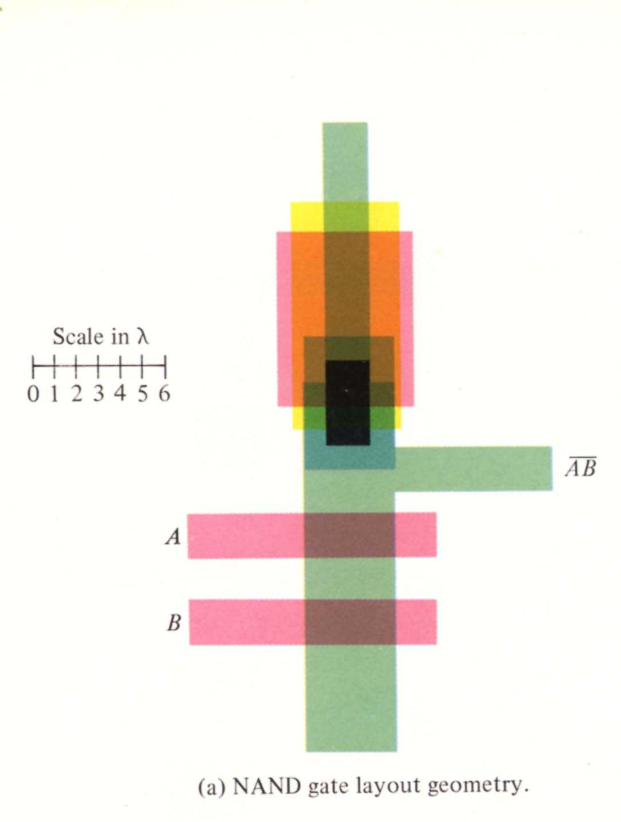
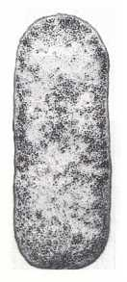
Scaling electro and bio devices
λ = 0.25 micron
in Pentium II
1 micron
E. Coli

Slide 3
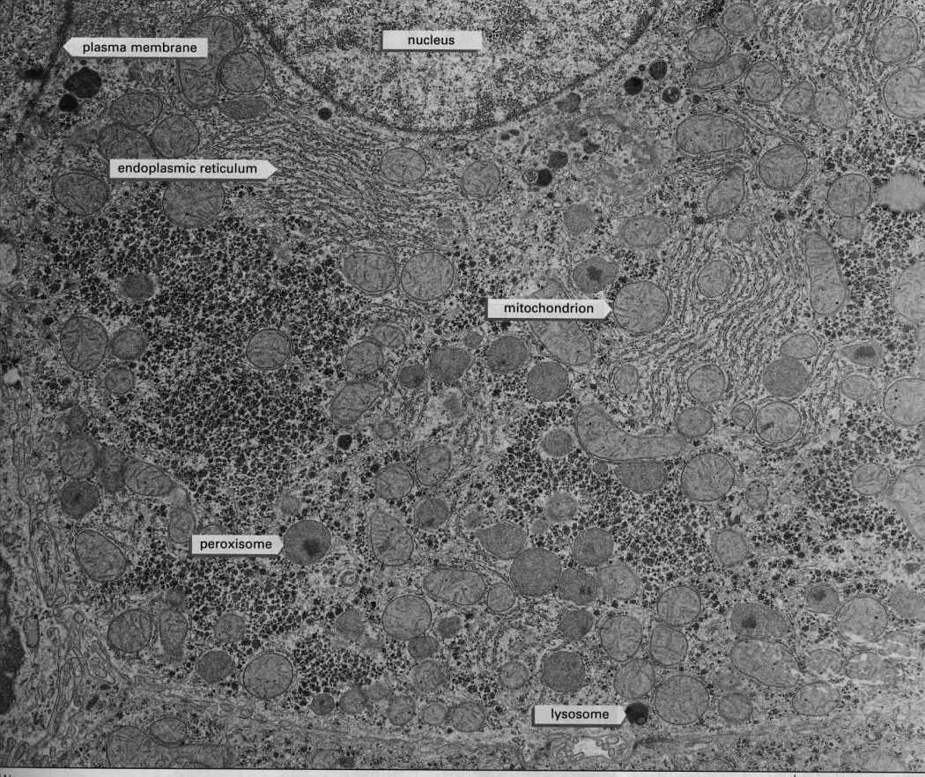
Notes:
<number>##
<footer>*
<header>*
08/11/2607/16/96

Slide 4
Molecular Biology is…
Sequence: Sequence of DNA and Proteins
Structure: 3D Structure of Proteins and other biomolecules and molecular complexes
Interaction: How do these molecules interact?

Slide 5
Sharing scientific knowledge
In the Sequence and Structure branches: Knowledge is encoded, shared, processed and updated via computers.
Knowledge about Molecular Interactions is shared via articles.
Why?

Slide 6
Computer languages for sharing biological knowledge
Sequence: Strings over {A,C,T,G}
Structure: Labeled 3D Graphs
Interaction: ?

Slide 7
The “New Biology”
The Cell as an information processing device
Cellular processes are information processing and information passing processes carried out by networks of interacting molecules
Ultimate understanding of the cell requires an information processing model.
Which?

Slide 8
Notes:
<number>##
<footer>*
<header>*
08/11/2607/16/96

Slide 9
Describing the Cell
To fully describe the cell we need a language (or languages) that facilitate the creation of…
Compositional, executable representations of biological knowledge
Executable – to enable computer simulation and analysis
Compositional – so that a representation of the cell can be composed bottom-up

Slide 10
“We have no real ‘algebra’ for describing regulatory circuits across different systems...”
- T. F. Smith (TIG 14:291-293, 1998)
“The data are accumulating and the computers are humming, what we are lacking are the words, the grammar and the syntax of a new language…”
- D. Bray (TIBS 22:325-326, 1997)
Notes:
<number>##
<footer>*
<header>*
08/11/2607/16/96

Slide 11
Computer languages for sharing biological knowledge
Sequence: Strings over {A,C,T,G}
Structure: Labeled 3D Graphs
Interaction: ?
  Answer: Process description language

Slide 12
Molecules as Processes
Molecule | Process
Interaction capability | Channel
Interaction | Communication
Modification | State and/or channel change

Slide 13
Which Process Description Language?
Many candidates
We chose a stochastic extension of the Pi Calculus
Why?
… We tried it and we like it
First step: Compile (full) Pi Calculus to FCP/Logix

Slide 14
Stochastic π-Calculus
(Priami, 1995)
Every channel x attached with a base rate r
A global (external) clock is maintained
The clock is advanced and a communication is selected according to a race condition
Rate calculation and race condition is unsuitable for chemical reactions
  Rate(A+B → C) = BaseRate *[A]*[B]
  [A] = number of A’s willing to communicate with B’s.
  [B] = number of B’s willing to communicate with A’s.

Slide 15
Biochemical Stochastic π-Calculus
(Regev, Priami, Silverman, Shapiro 2001)
Gillespie (1977): Accurate stochastic simulation of chemical reactions
Modification of the race condition and actual rate calculation according to biochemical principles
BioPSI simulation system:
  Compiles (full) Pi Calculus to FCP/Logix
  Incorporates Gillespie’s algorithm in the runtime engine

Slide 16
Programming Molecules with
Stochastic Pi Calculus
Active entities of interest (atoms, functional groups, molecules, molecular complexes) = processes
Interaction = synchronized pair-wise communication coupled with change of process state.
Interaction rates built into the language
With same principles specify chemistry, organic chemistry, enzymatic reactions, metabolic pathways, signal-transduction pathways…
Ultimately – the entire cell.
Key property – Compositionality of the Pi Calculus

Slide 17
Remainder of Lecture
Broad spectrum of examples
Multiple levels of abstraction
  Physical chemistry
  Organic Chemistry
  Biochemistry
  Molecular Biology

Slide 18
PSI notation (add rate syntax)
Prefix | ,
Parallel composition | |
Input | x ? {y,z,…} or x ? []
Output | x ! {y,z,…} or x ! []
Choice | ; or +
New | << x,y,… . Process >> Process+(x,y,…)
Parametric process definition | P(x,y,…)::= P(x,y,…)+(z,w,…) ::=
Arithmetic | FCP / Logix syntax

Slide 19
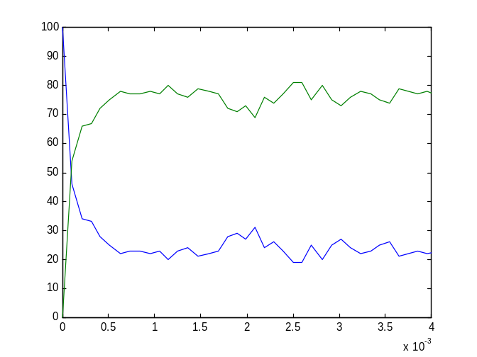
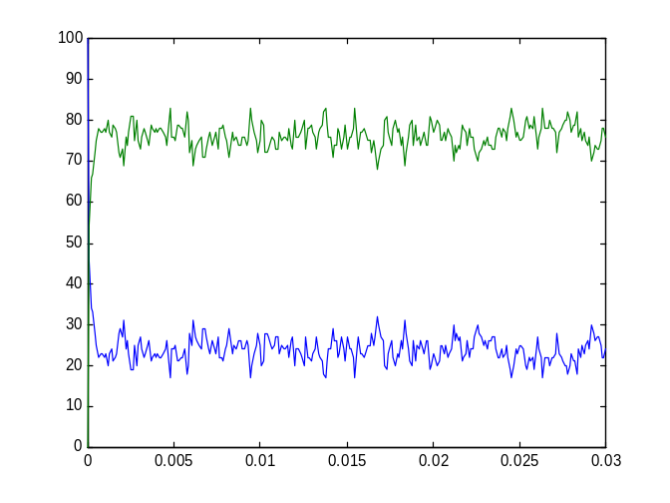
Na + Cl <→ Na+ + Cl-
global(e1(100),e2(10)).
Na::= e1 ! [] , Na_plus .
Na_plus::= e2 ? [] , Na .
Cl::= e1 ? [] , Cl_minus .
Cl_minus::= e2 ! [] , Cl .
Processes, guarded communication, alternation between two states. Reaction rates. (show spawning sooner)
nacl_1.cp

Slide 20
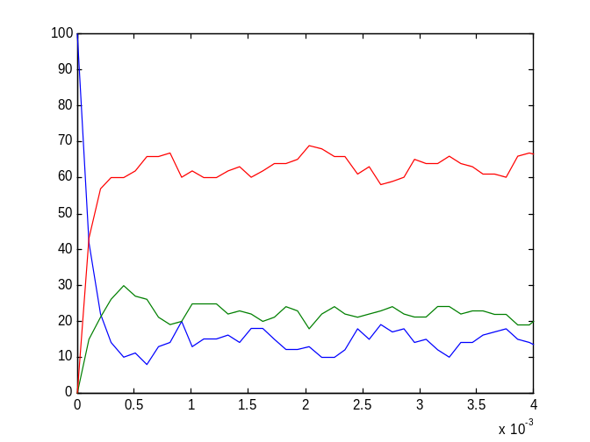
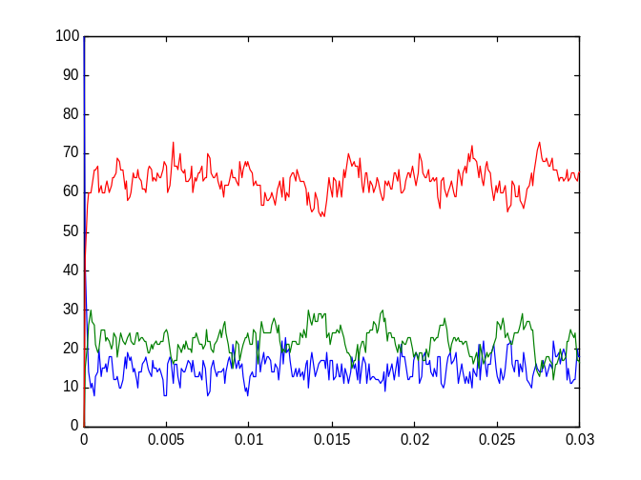
K + Na + 2Cl → K+ + 2Cl- + Na+
global(e1(100),e2(10),e3(30),e4(20).
Na::= e1 ! [] , Na_plus .
Na_plus::= e2 ? [] , Na .
K::= e3 ! [] , K_plus .
K_plus::= e4 ? [] , K .
Cl::= e1 ? [] , Cl_minus ;
e3 ? [] , Cl_minus .
Cl_minus::= e2 ! [] , Cl ;
e4 ! [] , Cl .
Guarded probabilistic choice
knacl_2.cp

Slide 21
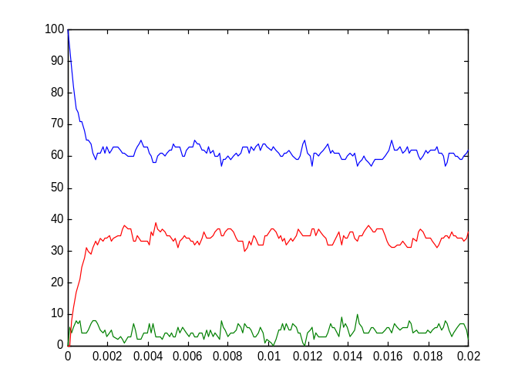
Mg + 2Cl → MgCl₂
global(e1(10),e2(100),e3(50),e4(5)).
Mg::= e1 ! [] , Mg_plus .
Mg_plus::= e2 ! [] , Mg_plus2 ;
e3 ? [] , Mg .
Mg_plus2::= e4 ? [] , Mg_plus .
Cl::= e1 ? [] , Cl_minus ;
e2 ? [] , Cl_minus .
Cl_minus::= e3 ! [] , Cl ;
e4 ! [] , Cl .
Mixed choice
Representation of unstable intermediate state
mgcl2_3.cp

Slide 22
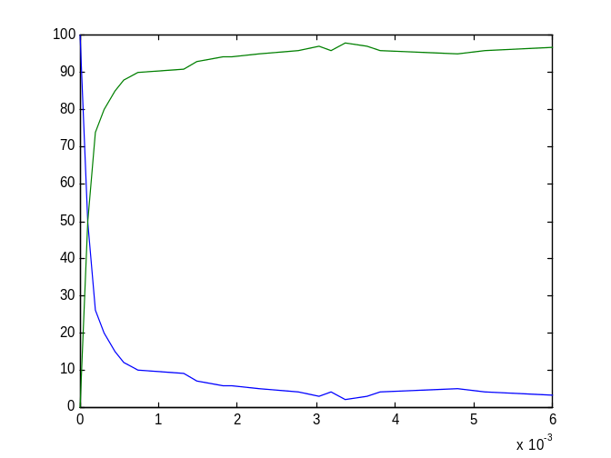
H + Cl → HCl
global(e1(100)).
H+electron(10)::=
e1 ! {electron} , H_plus(electron).
H_plus(e)::= e ? [] , H .
Cl::= e1 ? {electron} , Cl_minus(electron). Cl_minus(e)::= e ! [] , Cl .
Sharing of local channels and creating molecules
hcl_5.cp

Slide 23
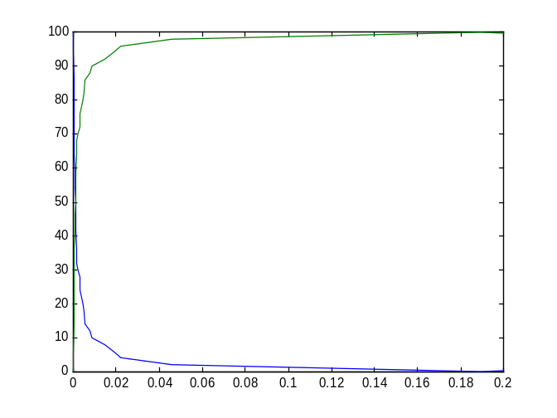
H + H → H₂
global(e(10),e1(10)).
H+electron(0.1)::=
e1 ! {electron} , H_BoundH(electron) ;
e1 ? {e2} , H_BoundH(e2) ;
e ! {electron} , H_Bound(electron) . H_BoundH(el)::= el ? [] , H ;
el ! [] , H.
H_Bound(el)::= el ? [] , H .
Mixed choice on the same channel (homo dimerization)
h2_7.cp

Slide 24
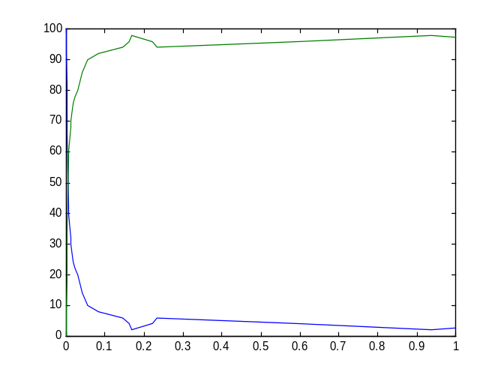
O + O → O₂
global(e(100),ee(20)).
O+electron(0.1)::=
ee ! {electron} ,O_Double_Bound(electron) ;
ee ? {electron} , O_Double_Bound(electron) ;
e ? {electron} , O_Bound1(electron) . O_Double_Bound(el)::=
el ! [] , O ;
el ? [] , O .
O_Bound1(el)::=
el ! [] , O ;
e ? {electron1}, O_Bound2(el,electron1) . O_Bound2(el,electron1)::=
electron1 ! [] , O_Bound1(el) .
Multiple local channels and polyadic messages. Restriction of reaction scope via molecular identity and proximity creates only O2.
o2_9.cp

Slide 25
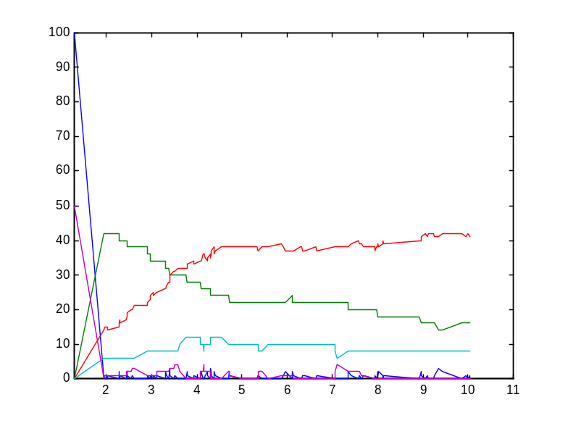
H + O → H₂O + O₂ + H₂
System(N1,N2)::=
<< CREATE_H(N1) | CREATE_O(N2) .
CREATE_H(C)::=
{C =< 0} , true ;
{C > 0} , {C--} | H | self .
CREATE_O(C)::=
{C =< 0} , true ;
{C > 0} , {C--} | O | self
>> .
Composition of separately defined atoms
(arithmetic, scopes, logical guards)
h2o_10.cp

Slide 26
RCOOH + NH2R → RCONHR + H₂O
(condensation and hydrolysis)
global(amine(10),hydrolysis(1)).
R_Amine+eRN::= NH2(eRN) | R(eRN).
R_Carboxyl+eRC::= R(eRC) | COOH(eRC) .
NH2(eRN)::= amine ? {eRC} , Amide(eRN,eRC) | H2O .
Amide(eRN,eRC)::=
hydrolysis ? [] , COOH(eRC) | NH2(eRN) .
R(e)::= e ! [] , self .
COOH(eRC)::= amine ! {eRC} , true .
H2O::= hydrolysis ! [] , true .
Modular representation of organic molecules, functional groups and their interactions
cond_pep_1.cp

Slide 27
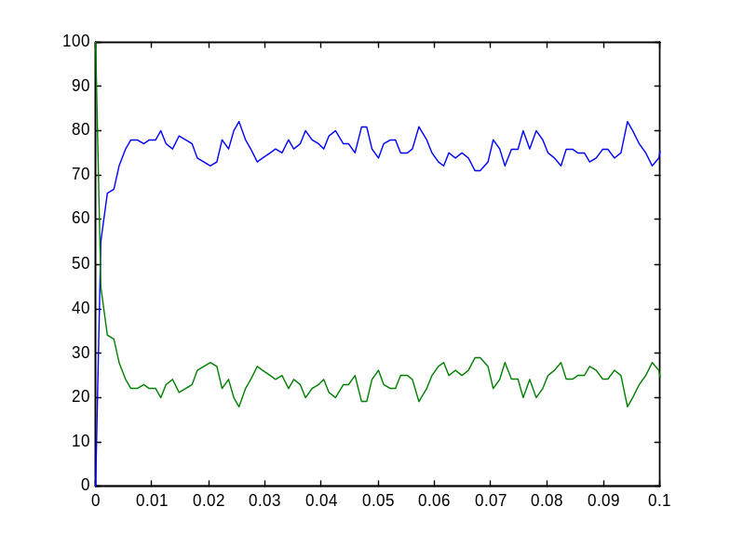
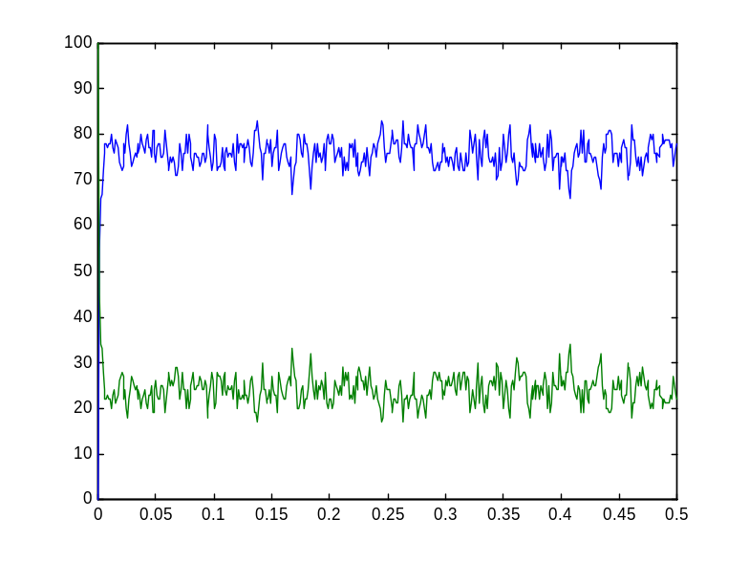
RCOOH + NH2R → RCONHR + H₂O
(condensation and hydrolysis)
cond_pep_1.cp

Slide 28
Osmosis across membranes
global(inside(1),outside(1)).
Membrane::= inside ! {outside} , Membrane ;
outside ! {inside} , Membrane . H_plus(location)::=
location ? {new_location} , H_plus(new_location).
Manual trace
osmosis_1.cp
global(inside(1),outside(1)).
Membrane::= inside ! {outside} , Membrane ;
outside ! {inside} , Membrane . H_plus_GREEN(location)::= location ? {new_location} ,
H_plus_BLUE(new_location) .
H_plus_BLUE(location)::= location ? {new_location} , H_plus_GREEN(new_location) .
Location traced by “color”
osmosis_2.cp
Change of molecule location modeled by global channel mobility.

Slide 29
Osmosis across membranes
@spr
<2> suspended
osmosis_1 # .Membrane.comm(global.inside(1)!, global.outside(1)!)
osmosis_1 # .H_plus.comm(global.outside(1)!)
osmosis_1 # .H_plus.comm(global.outside(1)!)
osmosis_1 # .H_plus.comm(global.outside(1)!)
osmosis_1 # .H_plus.comm(global.outside(1)!)
osmosis_1 # .H_plus.comm(global.outside(1)!)
osmosis_1 # .H_plus.comm(global.outside(1)!)
osmosis_1 # .H_plus.comm(global.outside(1)!)
osmosis_1 # .H_plus.comm(global.outside(1)!)
osmosis_1 # .H_plus.comm(global.outside(1)!)
osmosis_1 # .H_plus.comm(global.outside(1)!)
osmosis_1 # .H_plus.comm(global.outside(1)!)
osmosis_1 # .H_plus.comm(global.outside(1)!)
osmosis_1 # .H_plus.comm(global.outside(1)!)
osmosis_1 # .H_plus.comm(global.outside(1)!)
osmosis_1 # .H_plus.comm(global.outside(1)!)
osmosis_1 # .H_plus.comm(global.outside(1)!)
osmosis_1 # .H_plus.comm(global.inside(1)!)
osmosis_1 # .H_plus.comm(global.inside(1)!)
osmosis_1 # .H_plus.comm(global.inside(1)!)
osmosis_1 # .H_plus.comm(global.inside(1)!)
osmosis_1 # .H_plus.comm(global.inside(1)!)
osmosis_1 # .H_plus.comm(global.inside(1)!)
osmosis_1 # .H_plus.comm(global.inside(1)!)
osmosis_1 # .H_plus.comm(global.inside(1)!)
osmosis_1 # .H_plus.comm(global.inside(1)!)
osmosis_1 # .H_plus.comm(global.inside(1)!)
osmosis_1 # .H_plus.comm(global.inside(1)!)
osmosis_1 # .H_plus.comm(global.inside(1)!)
osmosis_1 # .H_plus.comm(global.inside(1)!)
osmosis_1 # .H_plus.comm(global.inside(1)!)
osmosis_1 # .H_plus.comm(global.inside(1)!)
osmosis_1 # .H_plus.comm(global.inside(1)!)
osmosis_1 # .H_plus.comm(global.inside(1)!)
osmosis_1 # .H_plus.comm(global.inside(1)!)
osmosis_1 # .H_plus.comm(global.inside(1)!)
osmosis_1 # .H_plus.comm(global.inside(1)!)
osmosis_1 # .H_plus.comm(global.inside(1)!)
osmosis_1 # .H_plus.comm(global.inside(1)!)
osmosis_1 # .H_plus.comm(global.outside(1)!)
osmosis_1 # .H_plus.comm(global.outside(1)!)
osmosis_1 # .H_plus.comm(global.outside(1)!)
osmosis_1 # .H_plus.comm(global.outside(1)!)
osmosis_1 # .H_plus.comm(global.outside(1)!)
osmosis_1 # .H_plus.comm(global.outside(1)!)
osmosis_1 # .H_plus.comm(global.outside(1)!)
osmosis_1 # .H_plus.comm(global.outside(1)!)
osmosis_1 # .H_plus.comm(global.outside(1)!)
osmosis_1 # .H_plus.comm(global.outside(1)!)
osmosis_1 # .H_plus.comm(global.outside(1)!)
osmosis_1 # .H_plus.comm(global.outside(1)!)
osmosis_1.cp

Slide 30
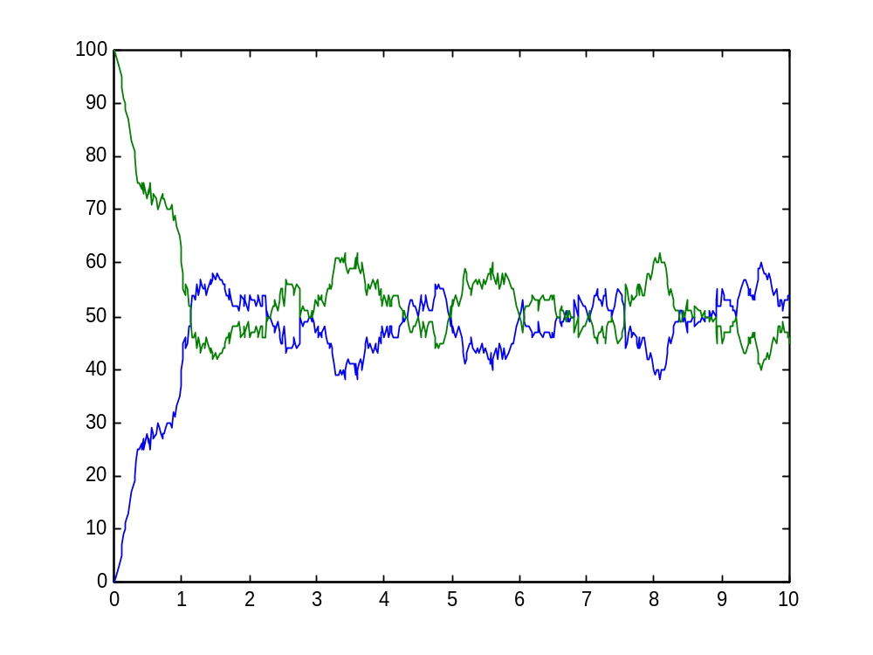
Osmosis across membranes
osmosis_2.cp

Slide 31
Active Transport
global(inside(1),outside(1),pump_inside(10),pump_outside(1)).
Membrane::= inside ! {outside,pump_outside} , Membrane ;
outside ! {inside,pump_inside} , Membrane .
Pump::= pump_inside ! {outside,pump_outside} , Pump ;
pump_outside ! {inside,pump_inside} , Pump .
H_plus_GREEN(location,pump)::=
location ? {new_location,new_pump} ,
H_plus_BLUE(new_location,new_pump) ; pump ? {new_location,new_pump} ,
H_plus_BLUE(new_location,new_pump) .
H_plus_BLUE(location,pump)::=
location ? {new_location,new_pump} ,
H_plus_GREEN(new_location,new_pump) ;
pump ? {new_location,new_pump} ,
H_plus_GREEN(new_location,new_pump) .
Active transport represented by differential interaction rates
pump_3.cp

Slide 32
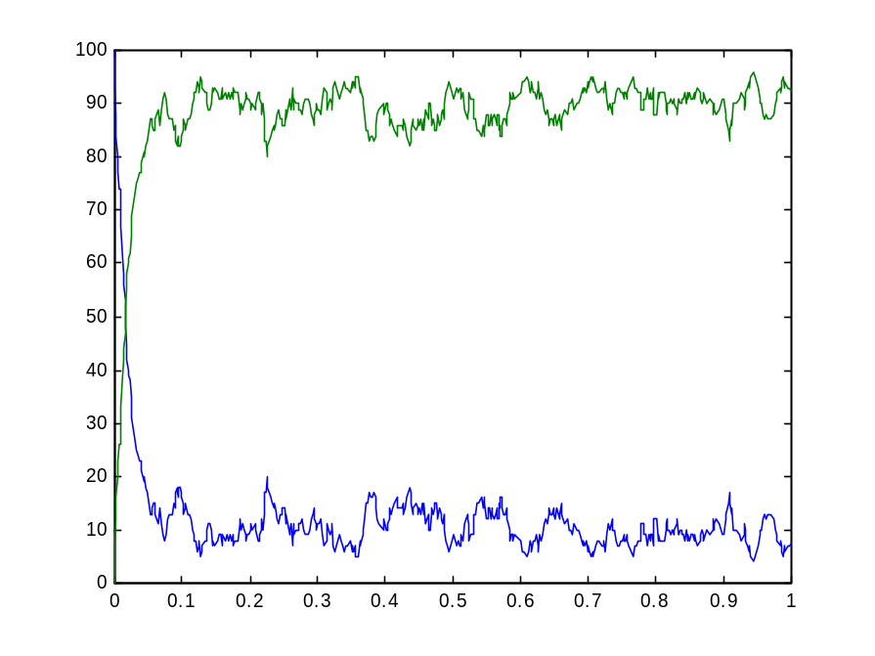
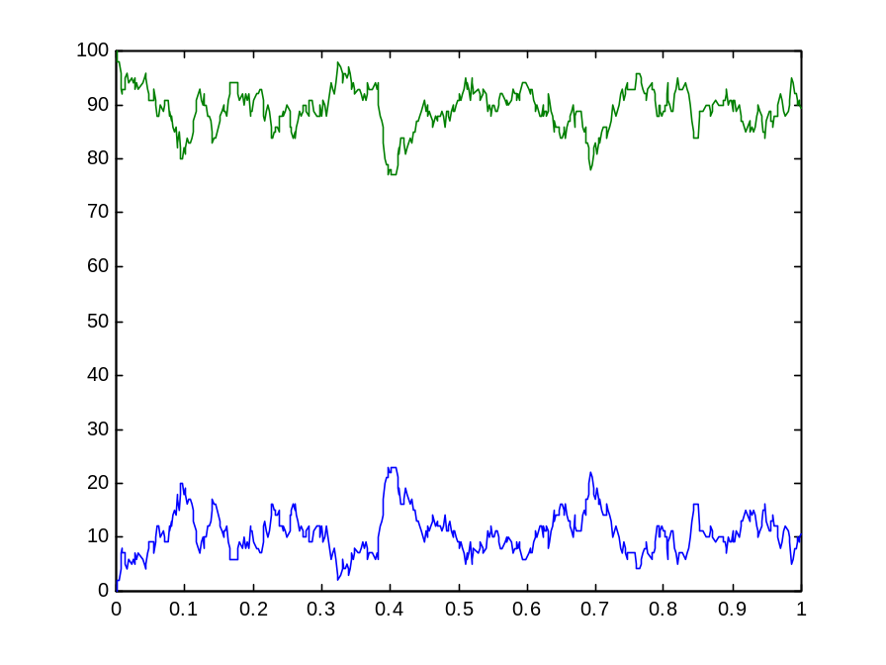
Active transport
All molecules IN at t=0
All molecules OUT at t=0
pump_3.cp

Slide 33
Enzymatic Reaction
global(sucd_suc(10), suc_fadh2,fum_fum).
Succinate_dehydrogenase_FAD+(catalyze_suc(1),release_suc(10))::=
<< sucd_suc ! {release_suc,catalyze_suc} ,
Bound_Succinate_dehydrogenase_FAD ;
Bound_Succinate_dehydrogenase_FAD::=
release_suc ! [] , Succinate_dehydrogenase_FAD ; catalyze_suc ! [] , Succinate_dehydrogenase_FAD >> .
Fumarate::= fum_fum ? [] , true .
Succinate::= sucd_suc ? {rel,cat} ,
<< rel ? [] , Succinate ;
cat ? [] , Fumarate >> .
E-FAD
succinate
fumarate
comp_inhib_2a.cp

Slide 34
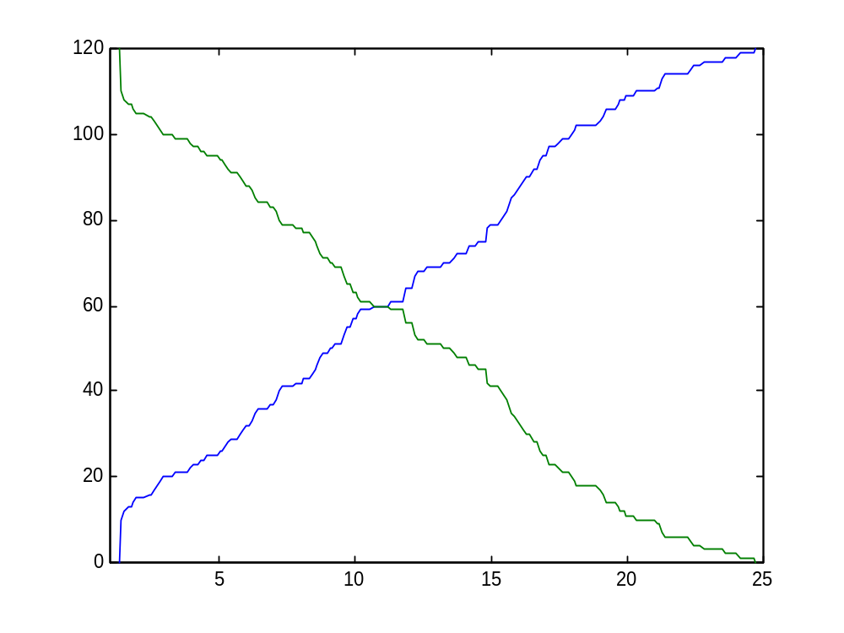
Enzymatic Reaction
comp_inhib_2a.cp

Slide 35
Competitive Inhibition
global(sucd_suc(10), suc_fadh2,fum_fum).
Succinate_dehydrogenase_FAD+(catalyze_suc(1),release_suc(10))::=
<< sucd_suc ! {release_suc,catalyze_suc} ,
Bound_Succinate_dehydrogenase_FAD ;
Bound_Succinate_dehydrogenase_FAD::=
release_suc ! [] , Succinate_dehydrogenase_FAD ; catalyze_suc ! [] , Succinate_dehydrogenase_FAD >> .
Fumarate::= fum_fum ? [] , true .
Succinate::= sucd_suc ? {rel,cat} ,
<< rel ? [] , Succinate ;
cat ? [] , Fumarate >> .
E-FAD
succinate
fumarate
Malonate + E-FAD
E-FAD-Malonate
comp_inhib_2a.cp

Slide 36
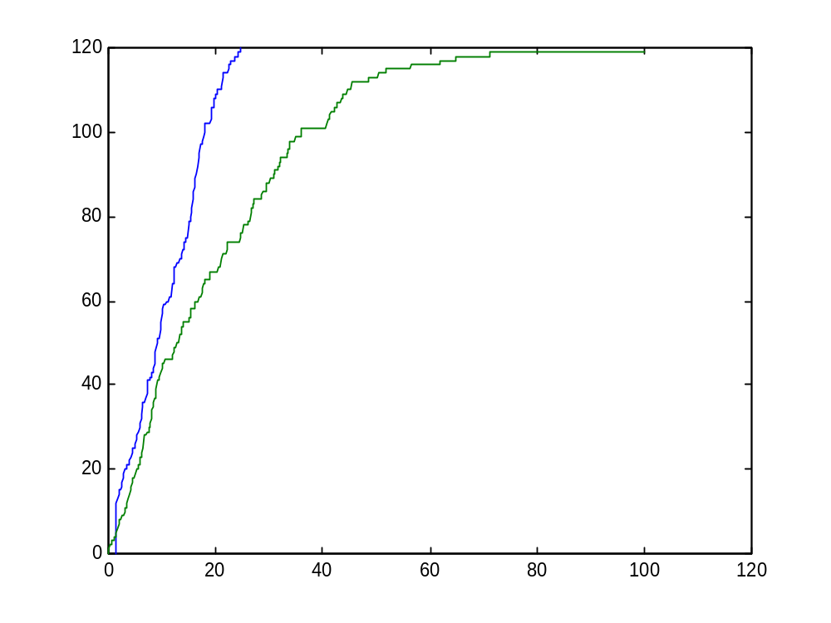
Competitive Inhibition
comp_inhib_2a.cp

Slide 37
Phosphodiester bond
global(hydroxyl_P(1)).
Seed_Nucleotide::=
<< hydroxyl_P ? {pd_ester} , Seed_Bound(pd_ester) .
Seed_Bound(pd_ester)::= pd_ester ! [] , Seed_Nucleotide
>> .
Nucleotide+pde(0.001)::=
<< hydroxyl_P ! {pde} , Nucleotide_5_Bound .
Nucleotide_5_Bound::=
pde ? [] , Nucleotide ; hydroxyl_P ? {pd_ester} , Nucleotide_5_3_Bound(pd_ester) .
Nucleotide_3_Bound(pd_ester)::=
pd_ester ! [] , Nucleotide .
Nucleotide_5_3_Bound(pde,pd_ester)::= pde ? [] , Nucleotide_3_Bound(pd_ester) ; pd_ester ! [] , Nucleotide_5_Bound(pde)
>> .
Directional polymerization of nucleic acids, by creation of
two phosphodiester bonds
phosphodiester_sugar_phosphate_7.cp

Slide 38
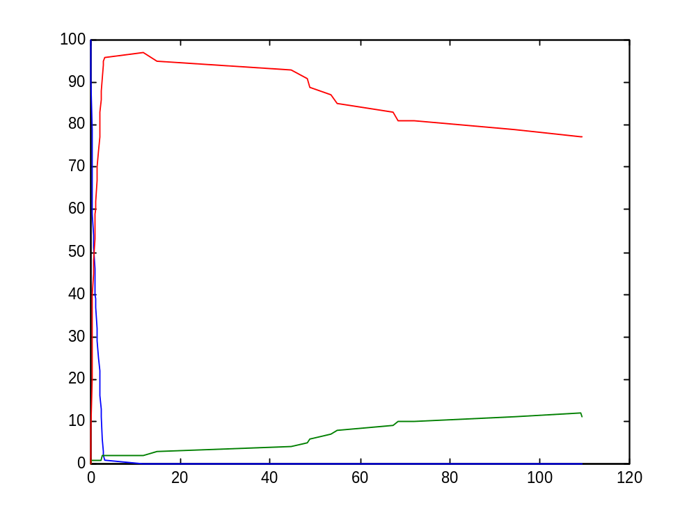
Phosphodiester bond
5’
P
5’
P
3’
3’
5’
P
3’
5’
P
3’
5’
P
3’
5’
P
Growing end
3’
phosphodiester_sugar_phosphate_7.cp

Slide 39
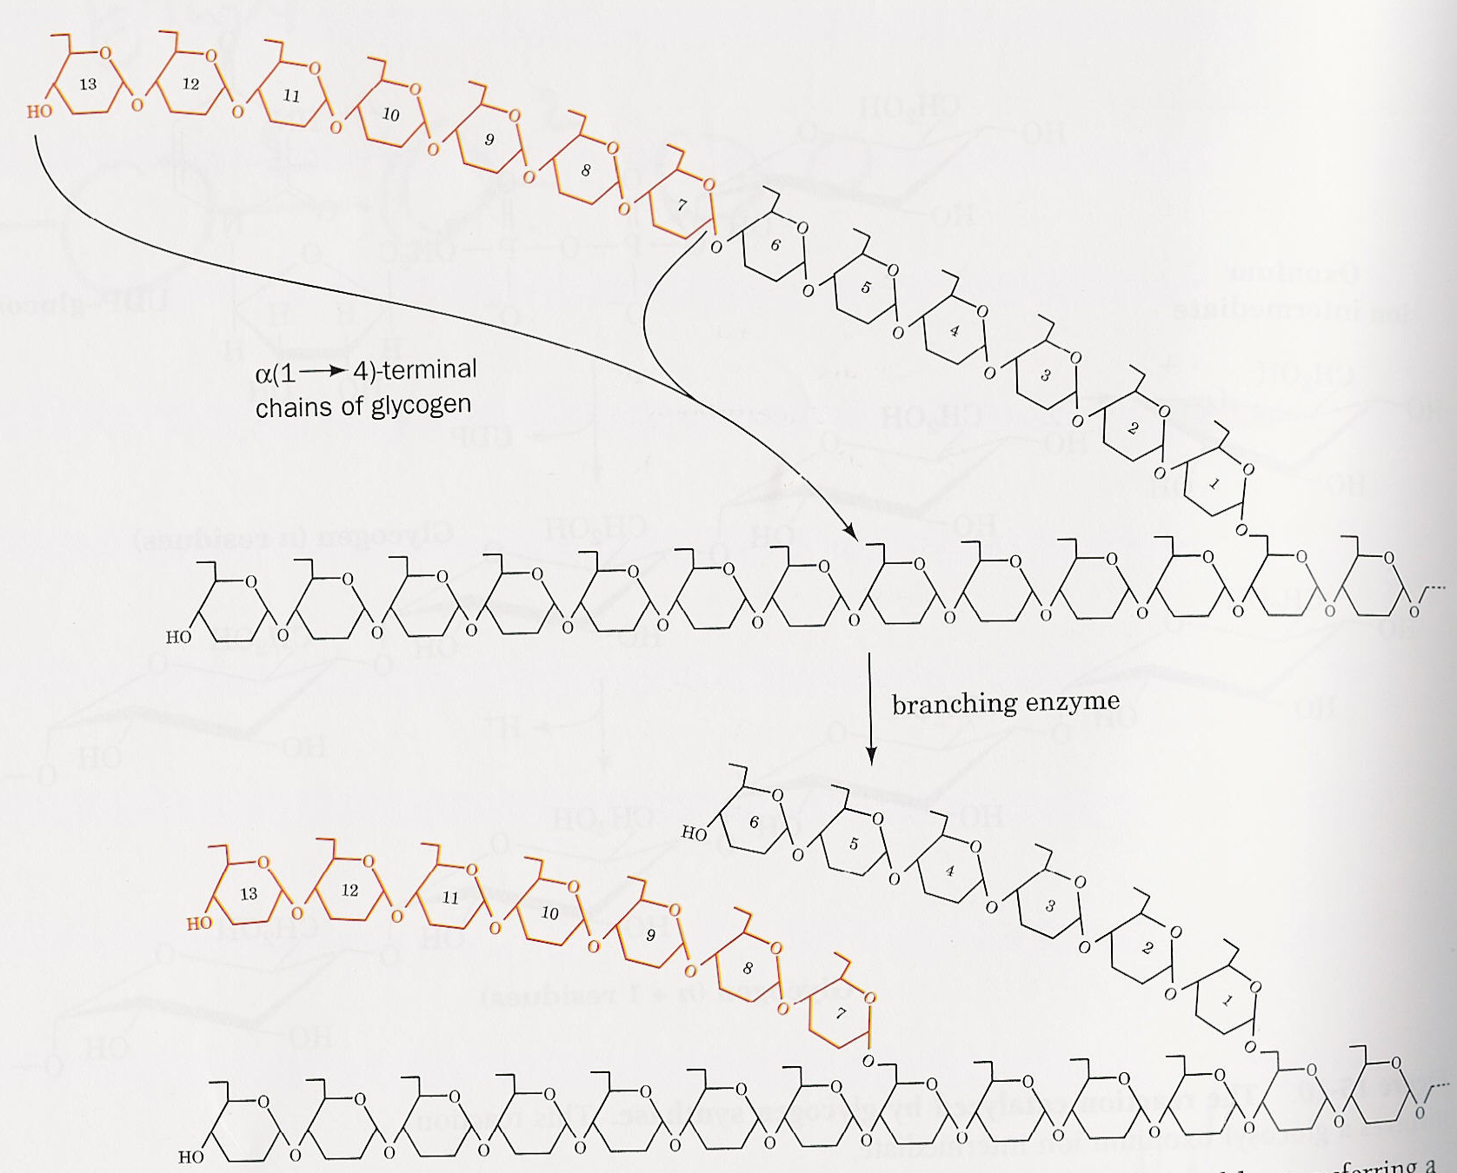
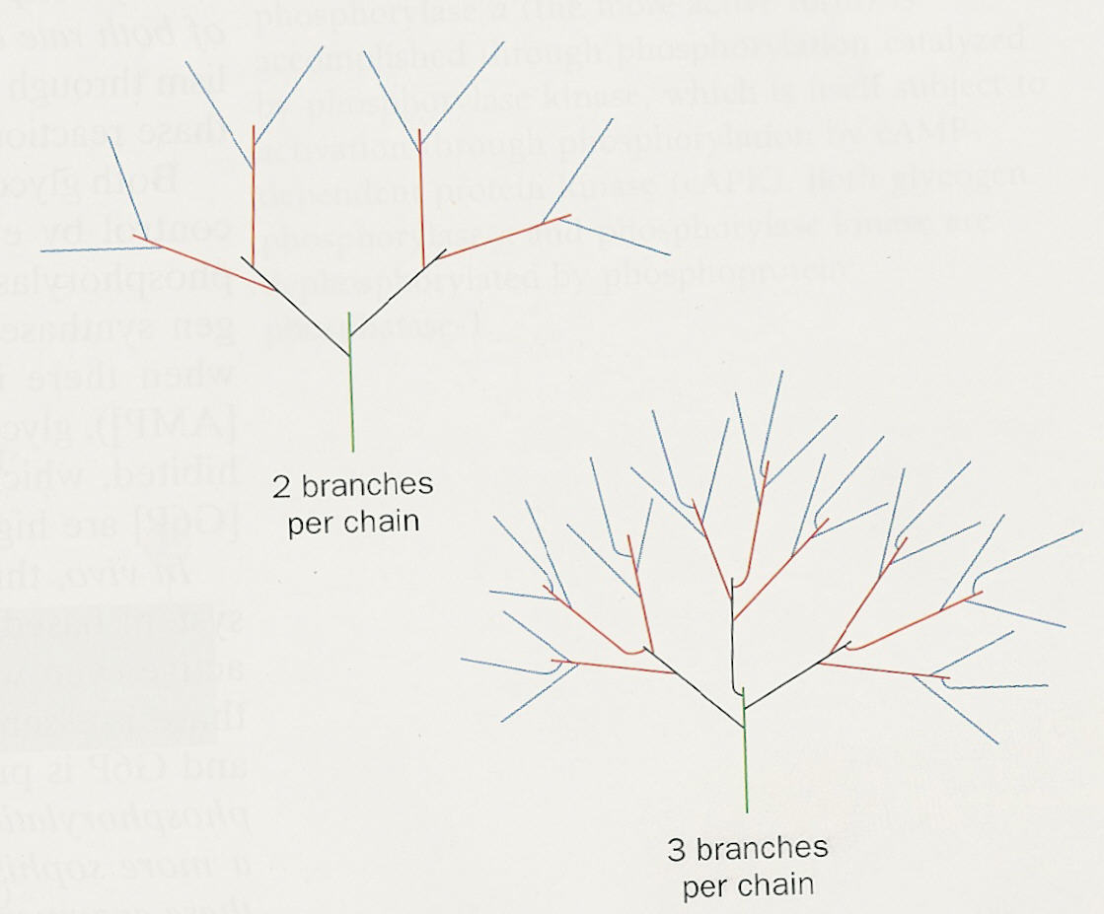
Glycogen: Packaging glucose by polymerization and branching
Glycogen_fixed.cp

Slide 40
Glycogen - I
Glucose(to_root, to_leaf, RC, LC, LBC)::=
{LC>=0}, << {LBC = 0} ,
<< {LC = 0} , Leaf_Glucose ; {LC = 7 , RC >= 4} , BCE_Glucose ;
{LC > 0 , LC =\= 7 , RC >= 4} ,
BNCE_Glucose ; {LC > 0 , RC < 4} , Disabled_Glucose >> ; {LBC > 0} ,
<< {RC >= 4 , LBC >=4} , BNCE_Glucose ;
{RC < 4} , Disabled_Branched_Glucose ; {LBC < 4} , Disabled_Branched_Glucose >> .
Use of variables and arithmetic conditions to determine process state. Infinite rates for internal synchronization.
Glycogen_fixed.cp

Slide 41
Glycogen - II
Seed_Glucose(RC,LC,LBC)::=
Glycogen ? {to_leaf} , to_leaf ! {RC,LBC} , Root_Glucose(to_leaf,RC,LC,LBC) .
Root_Glucose(to_leaf,RC,LC,LBC)::=
to_leaf ? {LC,LBC} , {LC++} , Root_Glucose(to_leaf,RC,LC,LBC) .
UDP_Glucose(LC,LBC)+(to_root,to_leaf)::=
udp_glucose ! {to_root} , to_root ? {RC,LBC} , {RC++} , to_root ! {LC,LBC} , Glucose(to_root,to_leaf,RC,LC,LBC) .
Leaf_Glucose::=
glycogen ? {to_leaf} , to_leaf ! {RC,LBC} , to_leaf ? {LC,LBC} , {LC++} , to_root ! {LC,LBC} , Glucose(to_root,to_leaf,RC,LC,LBC);
to_root ? {RC,_} , << {RC >=0} , {RC++} , Glucose ;
{RC < 0} , Disabled_Leaf_Glucose >> .
Disabled_Leaf_Glucose::= to_root ? {RC,_} , {RC++} , Glucose .
BNCE_Glucose::= to_leaf ? {LC,LBC} , {LC++} ,
<< {LBC = 0} , to_root ! {LC,LBC} , Glucose ;
{LBC > 0} , {LBC++} , to_root ! {LC,LBC} , Glucose >> ;
to_root ? {RC,_} ,
<< {RC >=0} , {RC++} , to_leaf ! {RC,LBC} , Glucose ;
{RC < 0} , to_leaf ! {RC, LBC} , Disabled_Glucose >> ; branch ? {to_branch} , Branch_Synch1(to_branch,RC,LC,LBC) .
Branch_Synch1(to_branch,RC,LC,LBC)+(RC1,LBC1)::=
{RC1=0} | {LBC1=1} | << to_branch ! {RC1,LBC} , to_leaf ! {RC1,LBC} , to_root ! {LC,LBC1} , Branch_Point(to_root,to_branch,to_leaf) >> .
Glycogen_fixed.cp

Slide 42
Glycogen - III
Disabled_Glucose::= to_leaf ? {LC,LBC} , {LC++} ,
<< {LBC = 0} , to_root ! {LC,LBC} , Glucose ;
{LBC > 0} , {LBC++} , to_root ! {LC,LBC} , Glucose >> ; to_root ? {RC,_} , {RC++} , to_leaf ! {RC,LBC} , Glucose .
BCE_Glucose+(new_to_root,RC1,LC1,LBC1)::=
<< to_leaf ? {LC,LBC} , {LC++} , << {LBC = 0} , to_root ! {LC,LBC} , Glucose ;
{LBC > 0} , {LBC++} , to_root ! {LC,LBC} , Glucose >> ;
to_root ? {RC,_} , << {RC >=0} , {RC++} , to_leaf ! {RC,LBC} , Glucose ;
{RC < 0} , to_leaf ! {RC,LBC} , Disabled_Glucose >> ;
branch ? {to_branch} , Branch_Synch(to_branch,RC,LC,LBC) ;
cleave ! {new_to_root} , {LC1 = -1} | {RC1 = -1} | Cleave_Synch(to_leaf) .
Cleave_Synch(to_leaf)::=
to_root ! {LC1,LBC} , to_leaf ! {RC1, LBC} , new_to_root ? {RC,_} , {RC++} ,
to_leaf ! {RC,LBC} , Glucose(new_to_root,to_leaf, RC, LC, LBC) >> .
Branch_Synch(to_branch,RC,LC,LBC)+(RC1,LBC1)::=
{RC1=0} | {LBC1=1} | << to_branch ! {RC1,LBC} , to_leaf ! {RC1,LBC} ,
to_root ! {LC,LBC1} , Branch_Point(to_root,to_branch,to_leaf) >> >> .
Disabled_Branched_Glucose::= to_leaf ? {LC,LBC} , {LC++} ,
<< {LBC = 0} , to_root ! {LC,LBC} , Glucose ;
{LBC > 0} , {LBC++} , to_root ! {LC,LBC} , Glucose >> ;
to_root ? {RC,_} , {RC++} , to_leaf ! {RC,LBC} , Glucose >> .
Branch_Point(to_root,to_branch,to_leaf)::= to_root ? {_,_} , self ; to_branch ? {_,_} , self ; to_leaf ? {_,_} , self .
Glycogen_Synthase::= udp_glucose ? {to_root} , glycogen ! {to_root} , Glycogen_Synthase .
Branching_Enzyme::= cleave ? {to_branch} , branch ! {to_branch} , Branching_Enzyme .
Glycogen_fixed.cp

Slide 43
Glycogen
.Root_Glucose.comm(.UDP_Glucose.to_root!)
Disabled_Branched_Glucose.comm(.UDP_Glucose.to_root!,
.UDP_Glucose.to_root!, 1, 4, 4, global.branch(1)!, global.cleave(1)!,
global.glycogen(1)!)
...
.Branch_Point.comm(.UDP_Glucose.to_root!,
BCE_Glucose.new_to_root!, .UDP_Glucose.to_root!)
Disabled_Glucose.comm(BCE_Glucose.new_to_root!,
.UDP_Glucose.to_root!, 1, 8, 0, global.branch(1)!, global.cleave(1)!,
global.glycogen(1)!)
...
BNCE_Glucose.comm(.UDP_Glucose.to_root!, .UDP_Glucose.to_root
!, 4, 5, 0, global.branch(1)!, global.cleave(1)!, global.glycogen(1)!)
...
Leaf_Glucose.comm(.UDP_Glucose.to_root!, .UDP_Glucose.to_leaf
, 2, 0, 0, global.branch(1)!, global.cleave(1)!, global.glycogen(1)!)
...
.Glycogen_Synthase.comm(global.glycogen(1)!,
global.udp_glucose(1)!)
.Branching_Enzyme.comm(global.branch(1)!, global.cleave(1)!)
Glycogen_fixed.cp

Slide 44
BNCE
9,0,0
Leaf
8,1,0
7,2,0
Disabled
6,3,0
5,4,0
Branch Point
4,5,0
Disabled Branched
3,6,0
2,7,0
Root
1,8,0
1,4,4
2,3,3
3,2,2
1
1,1,0
2,0,0
RC,LC,LBC (LC irrelevant in Disabled_Branched)
Glycogen_fixed.cp

Slide 45
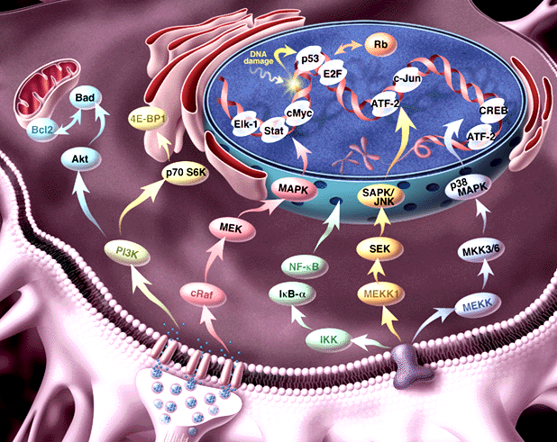
Signal transduction and regulatory pathways
Notes:
<number>##
<footer>*
<header>*
08/11/2607/16/96

Slide 46
From receptors on the cell membrane
RTK
RTK
G protein receptors
Cytokine receptors
DNA damage, stress sensors
G_{β}
G_{α}
SHC
GRB2
G_{γ}
RAB
RhoA
RAC/Cdc42
C-ABL
Multiple connections:
feedback, cross talk
SOS
Ca⁺²
GCK
PAK
HPK
RAS
GAP
PYK2
?
Modular at domain, component and pathway level
PKA
RAF
MOS
TLP2
MEKK1,2,3,4
MAPKKK5
MLK/DLK
ASK1
MAPKKK
MKK1/2
MKK4/7
MKK3/6
MAPKK
PP2A
MAPK
ERK1/2
JNK1/2/3
P38 α/β/γ/δ
Rsk,
MAPKAP’s
TFs, cytoskeletal proteins
Kinases, TFs
Mitosis, Meiosis,
Differentiation, Development
Inflammation, Apoptosis
To intracellular (functional) end-points

Slide 47
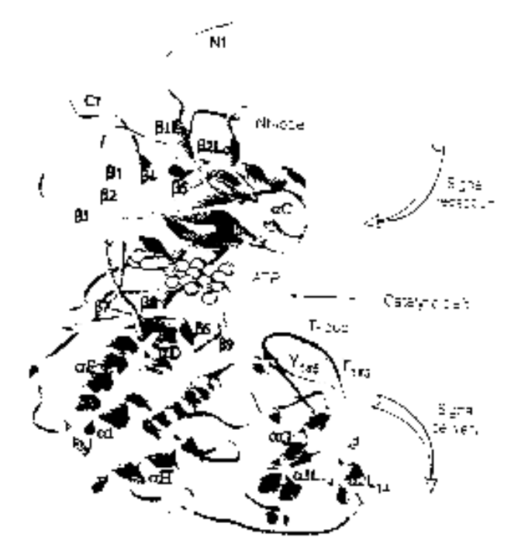
Example: ERK1 Ser/Thr kinase
Structure
Process
NH₂
Binding MP1 molecules
Nt lobe
Regulatory T-loop:
Change conformation
Kinase site:
Phosphorylate Ser/Thr residues
(PXT/SP motifs)
ATP binding site:
Bind ATP, and use it for phsophorylation
p-Y
Catalytic core
p-T
Ct lobe
Binding to substrates
COOH
Notes:
<number>##
<footer>*
<header>*
08/11/2607/16/96

Slide 48
Communication and global mobility
Ready to send p-tyr
on tyr !
Ready to receive on tyr ?
MEK1
ERK1
tyr ! [p-tyr] . KINASE_ACTIVE_SITE + … | … + tyr ? [tyr] . T_LOOP
Y
Actions consumed
alternatives discarded
p-tyr replaces tyr
KINASE_ACTIVE_SITE | T_LOOP {p-tyr / tyr }
pY
Notes:
<number>##
<footer>*
<header>*
08/11/2607/16/96

Slide 49
The circadian clock machinery
(Barkai and Leibler, Nature 2000)
A
R
degradation
A
R
degradation
UTR_{A}
UTR_{R}
translation
translation
A_RNA
R_RNA
transcription
transcription
P_{A}
P_{R}
A_GENE
R_GENE
Differential rates: Very fast, fast and slow
Notes:
<number>##
<footer>*
<header>*
08/11/2607/16/96

Slide 50
The machinery in π-calculus: “A” molecules
A_GENE::= PROMOTED_A + BASAL_A
PROMOTED_A::= pA ? {e}.ACTIVATED_TRANSCRIPTION_A(e)
BASAL_A::= bA ? [].( A_GENE | A_RNA)
ACTIVATED_TRANSCRIPTION_A::=
τ₁ . (ACTIVATED_TRANSCRIPTION_A | A_RNA) +
e ? [] . A_GENE
A_Gene
RNA_A::= TRANSLATION_A + DEGRADATION_mA
TRANSLATION_A::= utrA ? [] . (A_RNA | A_PROTEIN)
DEGRADATION_mA::= degmA ? [] . 0
A_RNA
A_PROTEIN::= (new e1,e2,e3)
PROMOTION_A-R + BINDING_R + DEGRADATION_A
PROMOTION_A-R ::= pA!{e2}.e2![]. A_PROTEIN +
pR!{e3}.e3![]. A_PRTOEIN
BINDING_R ::= rbs ! {e1} . BOUND_A_PRTOEIN
BOUND_A_PROTEIN::= e1 ? [].A_PROTEIN + degpA ? [].e1 ![].0
DEGRADATION_A::= degpA ? [].0
A_protein
Notes:
<number>##
<footer>*
<header>*
08/11/2607/16/96

Slide 51
The machinery in π-calculus: “R” molecules
R_GENE::= PROMOTED_R + BASAL_R
PROMOTED_R::= pR ? {e}.ACTIVATED_TRANSCRIPTION_R(e)
BASAL_R::= bR ? [].( R_GENE | R_RNA)
ACTIVATED_TRANSCRIPTION_R::=
τ₂ . (ACTIVATED_TRANSCRIPTION_R | R_RNA) +
e ? [] . R_GENE
R_Gene
RNA_R::= TRANSLATION_R + DEGRADATION_mR
TRANSLATION_R::= utrR ? [] . (R_RNA | R_PROTEIN)
DEGRADATION_mR::= degmR ? [] . 0
R_RNA
R_PROTEIN::= BINDING_A + DEGRADATION_R
BINDING_R ::= rbs ? {e} . BOUND_R_PRTOEIN
BOUND_R_PROTEIN::= e1 ? [] . A_PROTEIN + degpR ? [].e1 ![].0
DEGRADATION_R::= degpR ? [].0
R_protein
Notes:
<number>##
<footer>*
<header>*
08/11/2607/16/96

Slide 52
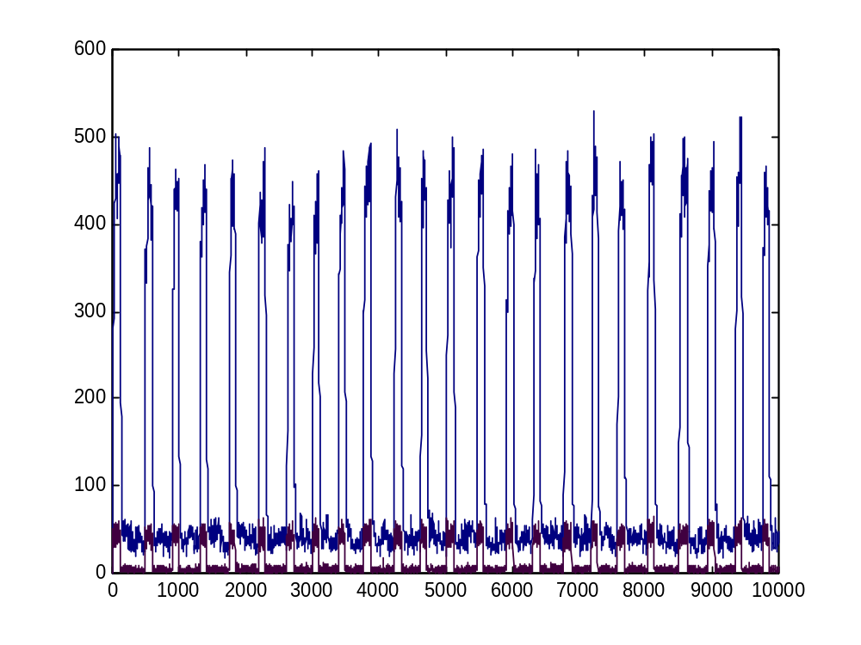
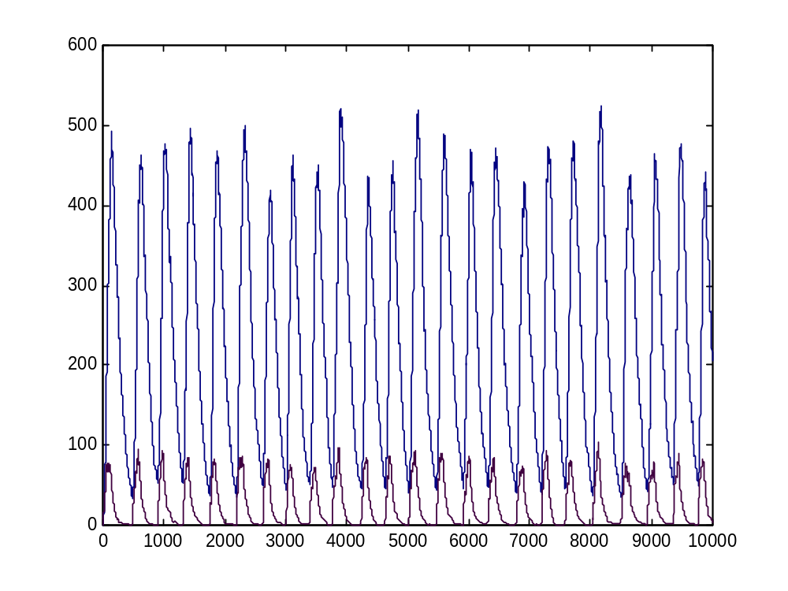
BioPSI simulation
A
R
Robust to a wide range of parameters
Notes:
<number>##
<footer>*
<header>*
08/11/2607/16/96

Slide 53
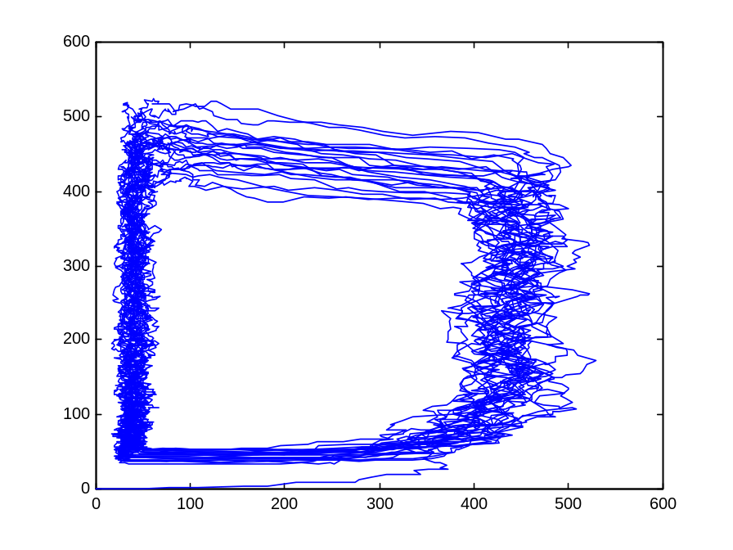
The A hysteresis module
A
ON
A
Fast
Fast
OFF
R
R
The entire population of A molecules (gene, RNA, and protein) behaves as one bi-stable module

Slide 54
Modular cell biology
? How to identify and compare modules and prove their function?
! Semantic concept: Two processes are equivalent if can be exchanged within any context without changing system behavior
Notes:
<number>##
<footer>*
<header>*
08/11/2607/16/96

Slide 55
Modular cell biology
Build two representations in the π-calculus
  Implementation: molecular level
  Specification: functional module level
Show the equivalence of both representations
  by computer simulation
  by formal verification
Notes:
<number>##
<footer>*
<header>*
08/11/2607/16/96

Slide 56
The circadian specification
R
Counter_A
R
degradation
OFF
ON
UTR_{R}
translation
R_RNA
P_{R}
transcription
R_GENE
R (gene, RNA, protein) processes are unchanged (modularity)
Notes:
<number>##
<footer>*
<header>*
08/11/2607/16/96

Slide 57
Hysteresis module
ON_H-MODULE(C_{A})::=
{C_{A}<=T1} . OFF_H-MODULE(C_{A}) +
{C_{A}>T1} .
(rbs ! {e1} . ON_DECREASE +
e1 ! [] . ON_H_MODULE +
pR ! {e2} . (e2 ! [] .0 | ON_H_MODULE) +
τ1 . ON_INCREASE)
ON_INCREASE::= {C_{A}++} . ON_H-MODULE
ON_DECREASE::= {C_{A}--} . ON_H-MODULE
ON
OFF_H-MODULE(C_{A})::=
{C_{A}>T2} . ON_H-MODULE(C_{A}) +
{C_{A}<=T2} .
(rbs ! {e1} . OFF_DECREASE +
e1 ! [] . OFF_H_MODULE +
τ2 . OFF_INCREASE )
OFF_INCREASE::= {C_{A}++} . OFF_H-MODULE
OFF_DECREASE::= {C_{A}--} . OFF_H-MODULE
OFF
Notes:
<number>##
<footer>*
<header>*
08/11/2607/16/96

Slide 58
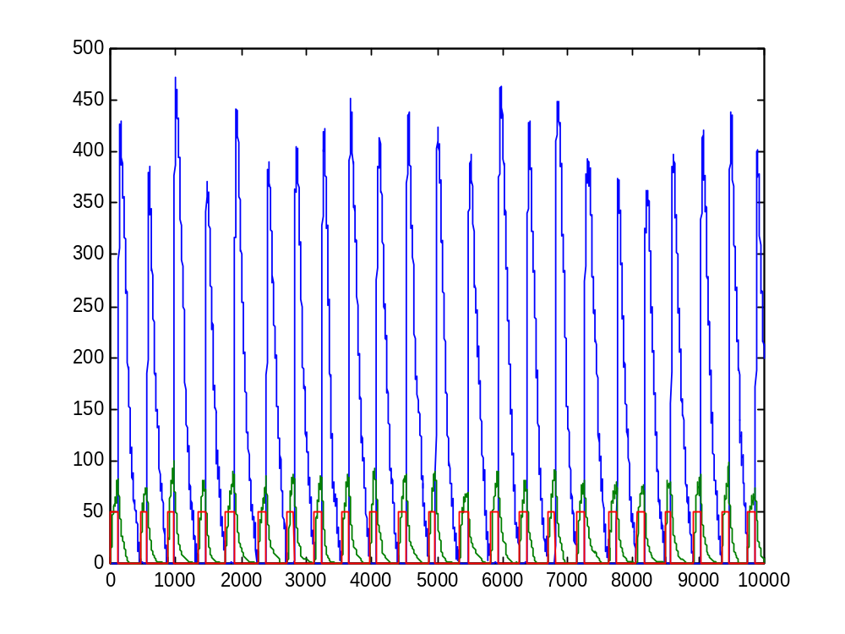
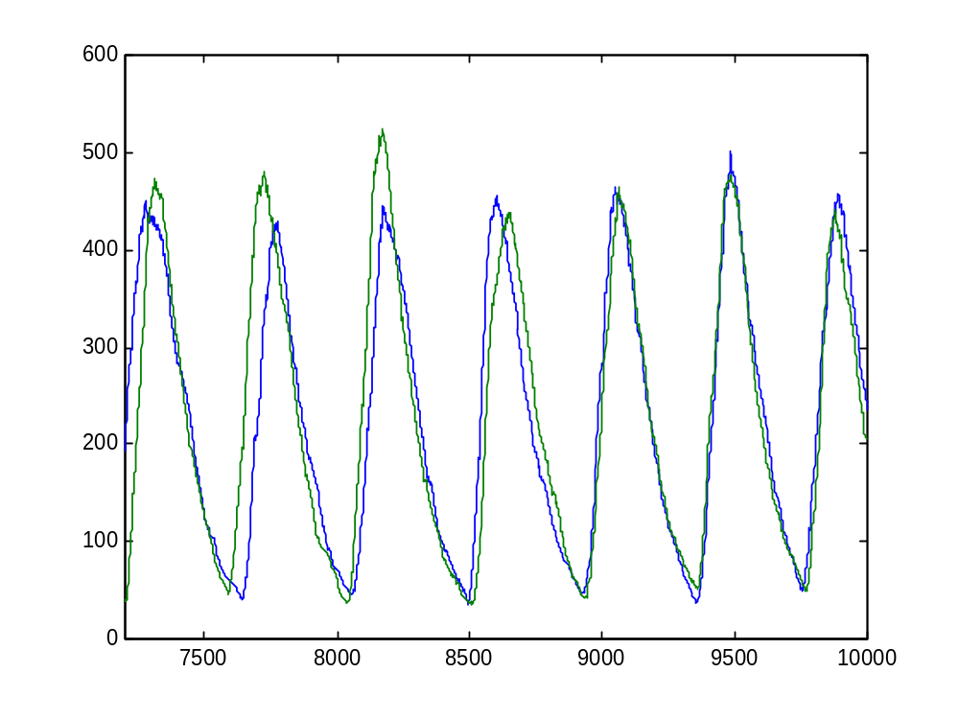
BioPSI simulation
Module, R protein and R RNA
R (module vs. molecules)

Slide 59
The RTK-MAPK pathway
GF
GF
RTK
RTK
16 molecular species
24 domains; 15 sub-domains
Four cellular compartments
Binding, dimerization, phosphorylation,
de-phosphorylation, conformational changes, translocation
~100 literature articles
250 lines of code
SHC
GRB2
SOS
RAS
MKP1
PP2A
GAP
RAF
MKK1
ERK1
IEP
MP1
IEP
J
F
IEG

Slide 60
Why Pi?
Chemical reactions are bimolecular and synchronous
Global channels easily implement global recognition and interaction capabilities
Local channels can implement chemical bonds, identity of molecules and complexes, compartmentalization.
Channel name passing proves useful and sufficient in multiple contexts.
Multiple levels of abstraction can be uniformly represented.
Compositionality allows bottom-up description of molecular systems.

Slide 61
Verification in biology?
Prediction of behaviour of complex systems in health and disease
Comparison of variant systems
Modularization and definition of function

